Slide 1





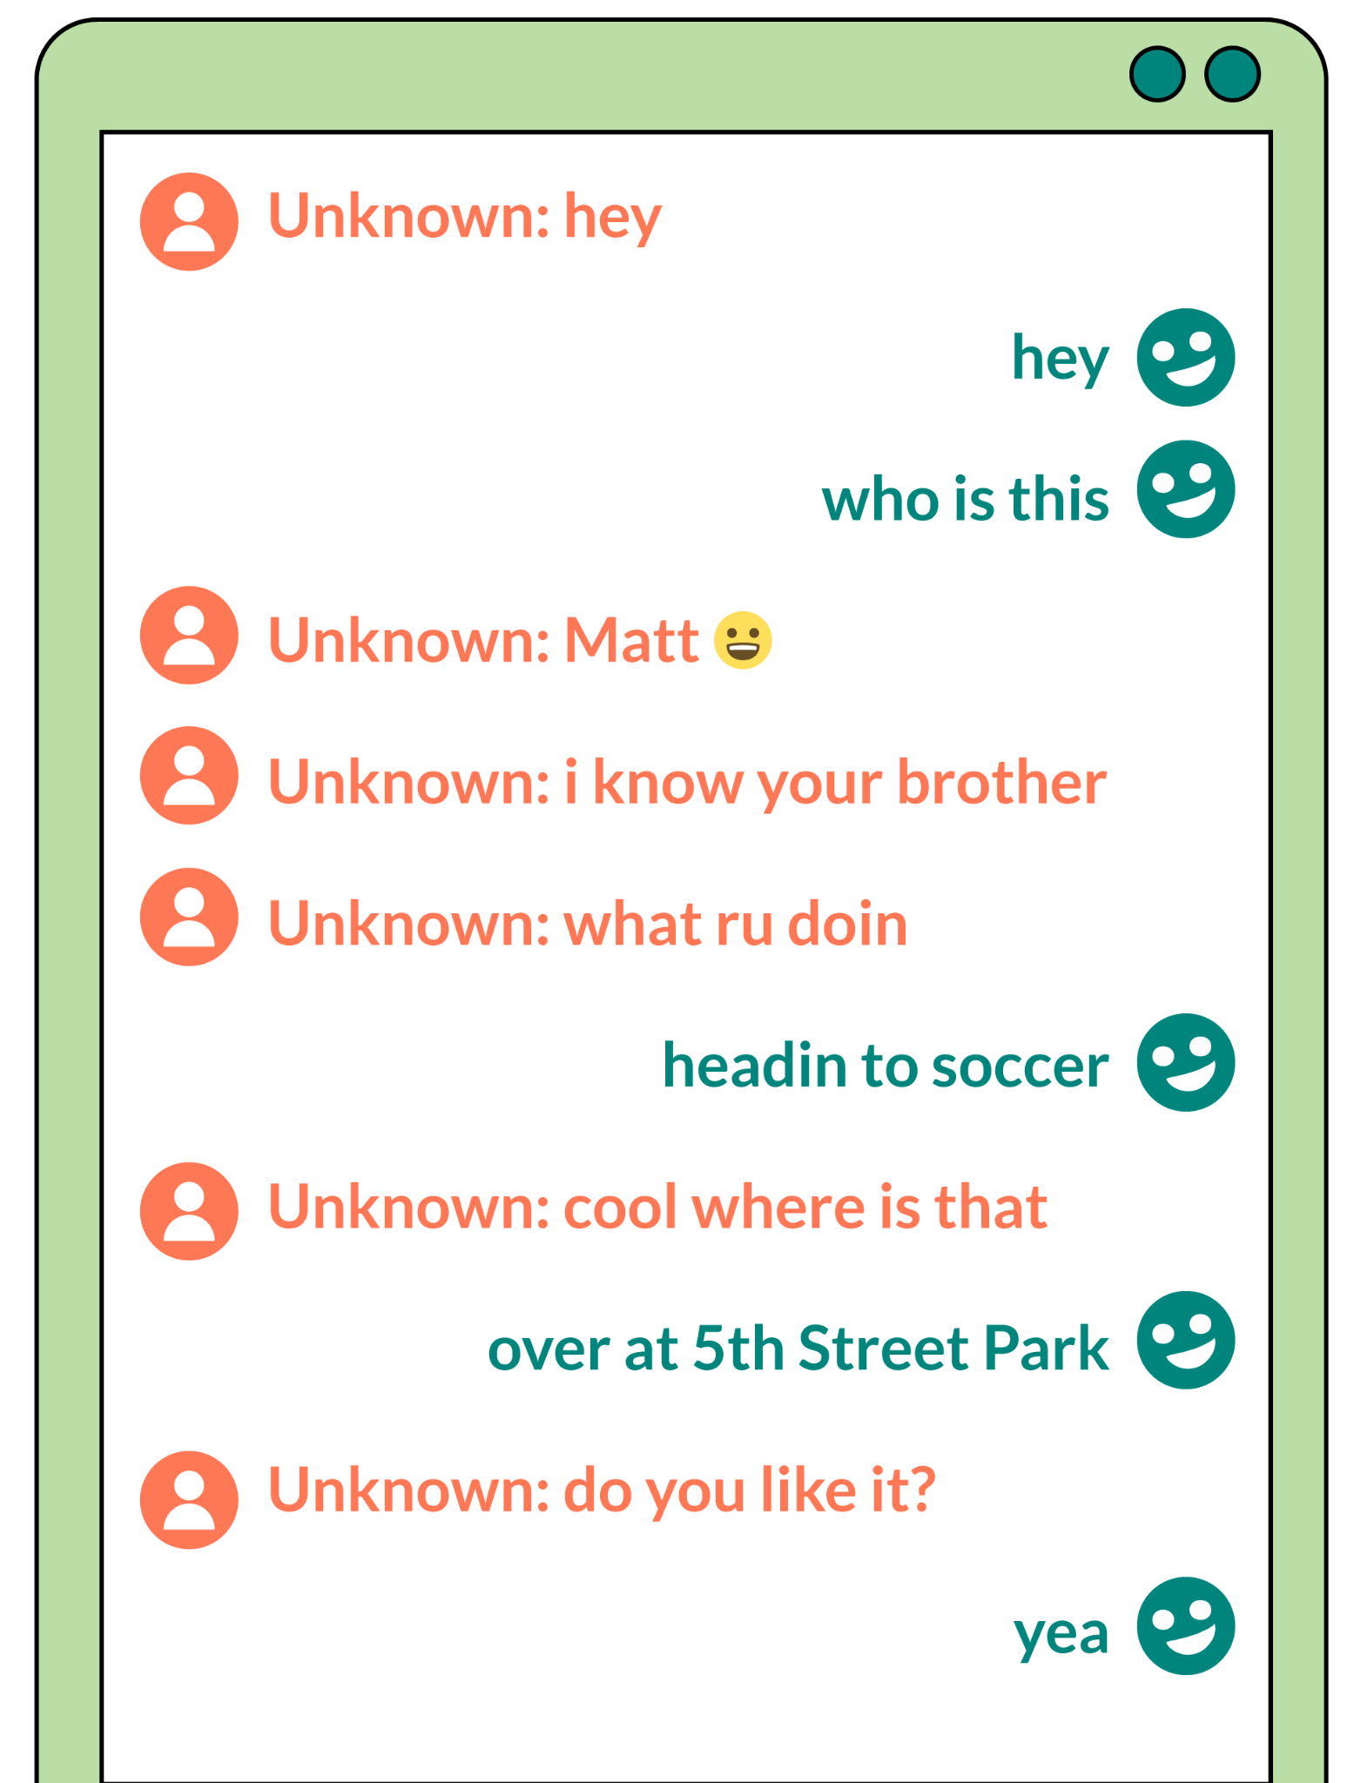

GRADE 4: DIGITAL CITIZENSHIP FAMILY ACTIVITY
Privacy & Security
Digital citizenship: Thinking critically and using technology responsibly to learn, create, and participate
Instructions
It’s important to know what information is OK to share online. What should we keep private and what is OK to share? Get one or more family members together to help. Read the setup before doing the activity together!
Setup
Read aloud: It's in our nature to share and connect with others. But sharing online comes with some risks. It is OK to share personal information. Personal information includes things like what you like to do, your favorite movie, ideas that you have, or even pictures of your pet. It is risky to share private information with someone you don’t know or with everyone online. Private information includes things that identify you, such as your full name, home address, phone number, school, or date of birth.
Activity
Read aloud: Let’s read the chat between Alex and a person they met online, and then talk about who is sharing private information and who is sharing personal information.
Discussion questions: What personal information is shared? What information should be kept private? Does it seem like Alex knows this person? Does that change how we respond to people online? Why is it OK to share personal information but not private information online? What can you say or do when someone asks for private information online?
Learn more about how to protect your privacy online at commonsense.org/family-tips-on-privacy!
commonsense.org/education
Shareable with attribution for noncommercial use. Remixing is permitted.

