Slide 1
Child Study Team Year in Review 2015-2016
Committed to Excellence

Slide 2
Child Study Team Year in Review
Why so many meetings?
New Referrals: 24
Students Found Eligible: 15 (Includes pre-school disabled & speech-only IEPs)
Fifteen of the 24 referred students were determined to meet the eligibility criteria under IDEA. The Child Study Team identified these children as students with a disability who demonstrate a need for specialized instruction.
Re-evaluations: 24
All special education students are re-evaluated or re-assessed every three years to determine continued eligibility for special education and/or related services. For the 2015-2016 school year, eight students were declassified, and no longer met the criteria as a student with a disability.

Slide 3
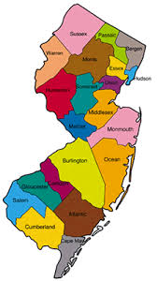
Child Study Team Year in Review
How do we compare?
Statewide Classification Rate 16.5%
South Harrison Classification Rate 19%
Greenwich Township 26.5%
Mantua 20.5%
Swedesboro-Woolwich 20%
East Greenwich 16.8%

Slide 4
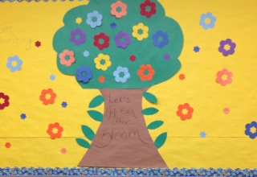
Child Study Team Year in Review
New Intervention Program--Social Skills
Mrs. Alex Moore and Mrs. Lauren McCall
28 students, Grade K-6
Michelle Garcia Winter’s, “The Incredible Flexible You”

Slide 5

Child Study Team Year in Review
South Harrison SEPAC
Topic: Benefits of Inclusion Presented by the ARC of New Jersey Meeting Date: Wednesday, October 19th
Meeting Time: 6:30 PM
Location: SH Media Center SEPAC aims to provide training opportunities and informational forums on learning disabilities and student supports. We promote programs within the community that encourage understanding, acceptance, and inclusion of students with disabilities.

