Slide 1



Swope Middle School Student Voice
Presentation of Projects

Slide 2


Step 1 – Introduction to Team
Introductions
Mission Statement:
“As a group, our mission is to ensure all students within our school have equal opportunities to make their voices heard within the school community to help promote change, as well as to ensure an abundance of opportunities to access mental health resources at our school site.”

Slide 3

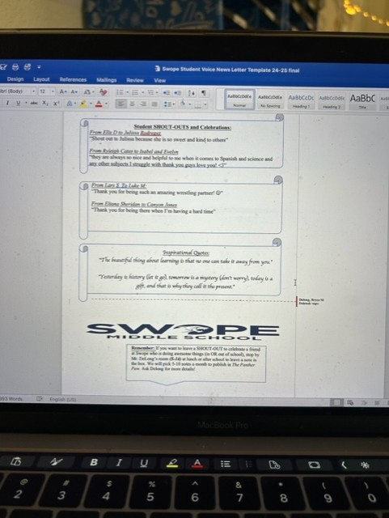
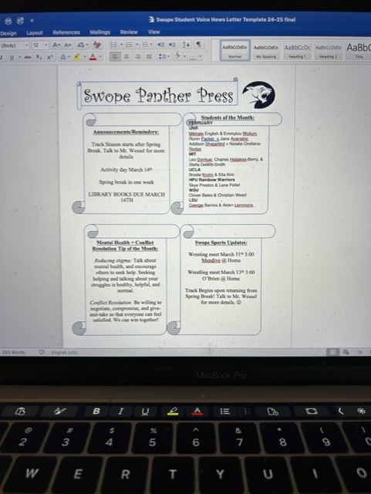
Step 2 – Newsletter Team

Slide 4
Your turn!
Please use the blank newsletter paper to fill in the categories that you would put in your newsletter if you did one for your own school!

Slide 5

Step 3 – Lobbying Team
What is lobbying?
Lobbying means to use conversation, rhetoric, and influence to get those in power (Government officials, school boards, administration, in our case) to recognize and accommodate for the interests and needs of our student body.

Slide 6
Your turn!
You should now have the lobbying big 3 activity in front of you. :)
Please circle the 3 MOST IMPORTANT areas of improvement at your school. This will help you identify your student body’s struggles and needs so that you can more effectively address those issues with your committee.

Slide 7
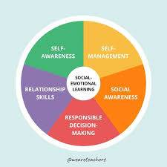
Step 4 – Classroom SEL Team
SEL stands for Social and Emotional Learning, and our goal is to promote a strong culture and understanding of SEL among our teachers and our students to improve positivity in classroom management, teacher-student interactions, and students overall mental health.

Slide 8
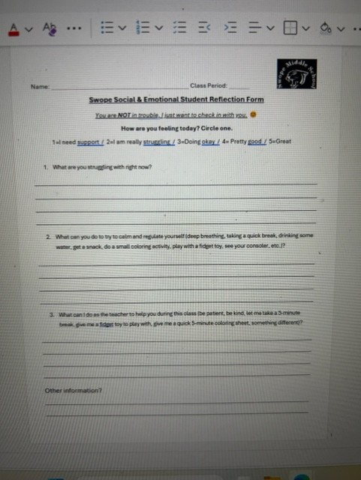
Parts of Mental Health Reflection form:
1. 1-5 check in (how student is feeling)
2. What can you do to try to calm and regulate yourself (deep breathing, taking a quick break, drinking some water, get a snack, do a small coloring activity, play with a fidget toy, see your consoler, etc.)?
3. What can I do as the teacher to help you during this class (be patient, be kind, let me take a 5-minute break, give me a fidget toy to play with, give me a quick 5-minute coloring sheet, something different)?
4. Other/additional information?

Slide 9
Conclusion
Thank you all so much for coming to support our student voice group! We would be greatly appreciative if you could fill out the participant input sheet so we can reflect upon the work we are doing and hear awesome ideas from you all! Thank you :)

