Slide 1
Trauma- Informed PRACTICES
Trauma Affects More People Than You Think

Slide 2
Rationale for the Student Voice Project
More than two-thirds of children in the U.S. reported at least one traumatic event by age 16
One of four 16 –year- old students have experienced at least four traumatic events in their lives
Two of the educational missions at Sparks Middle School are : 1) creating a safe and inclusive environment and 2) building an internal school community
Trauma affects students’ ability to learn and can lead to cognitive impairments

Slide 3
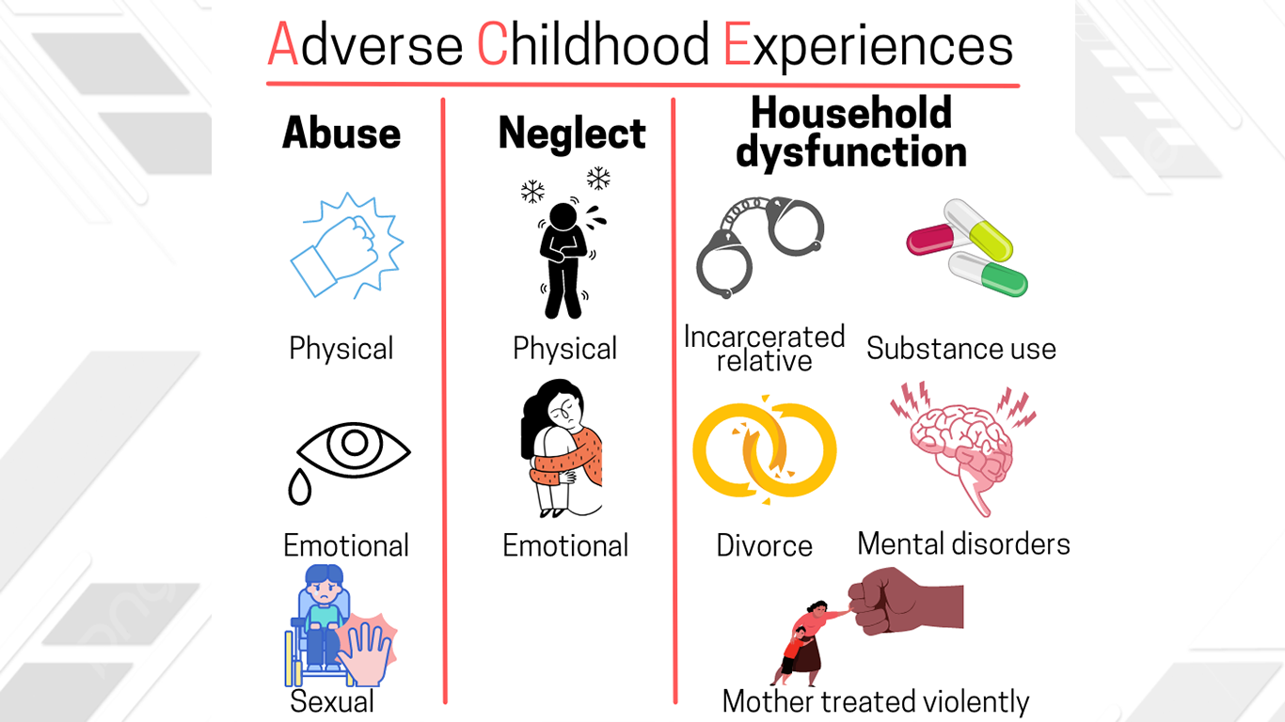
What is considered trauma or adverse childhood experiences ?

Slide 4
Other Forms of Trauma
Community or School Violence
Natural Disasters or Terrorism
Witnessing or Experiencing Domestic Violence
Refugee or War Experiences
Military Family- Related Stressors
Physical Assault
Serious Accidents or Life-Threatening Illness

Slide 5
Strategies to Combat the Long-Term Effects of Trauma in Schools
Creating a safe school environment which ensures the physical and emotional safety of all students. Consistent and predictable expectations also create a sense of safety among students.
Building relationship and rapport through trauma-informed practices which include culturally responsive teaching methods, practices, and educational supports
Creating a sense of community and inclusion

Slide 6
A Three-Step Approach
Our project this year surrounds Trauma-Informed practices through a three-step approach: 1) creating a safe and inclusive school environment; 2) giving back to the internal and external community; and 3) self-care. These approaches support the mission of the School District and Sparks Middle School.

Slide 7
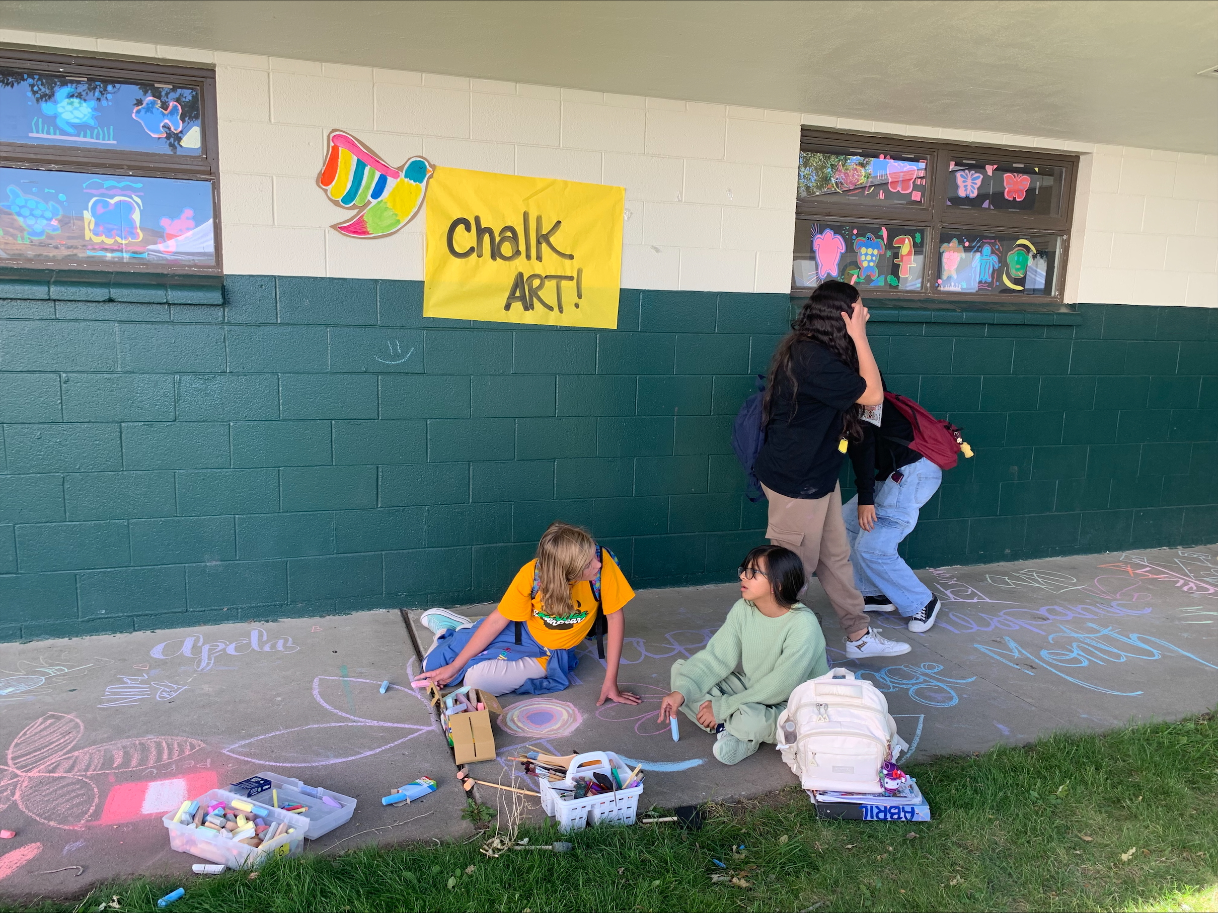
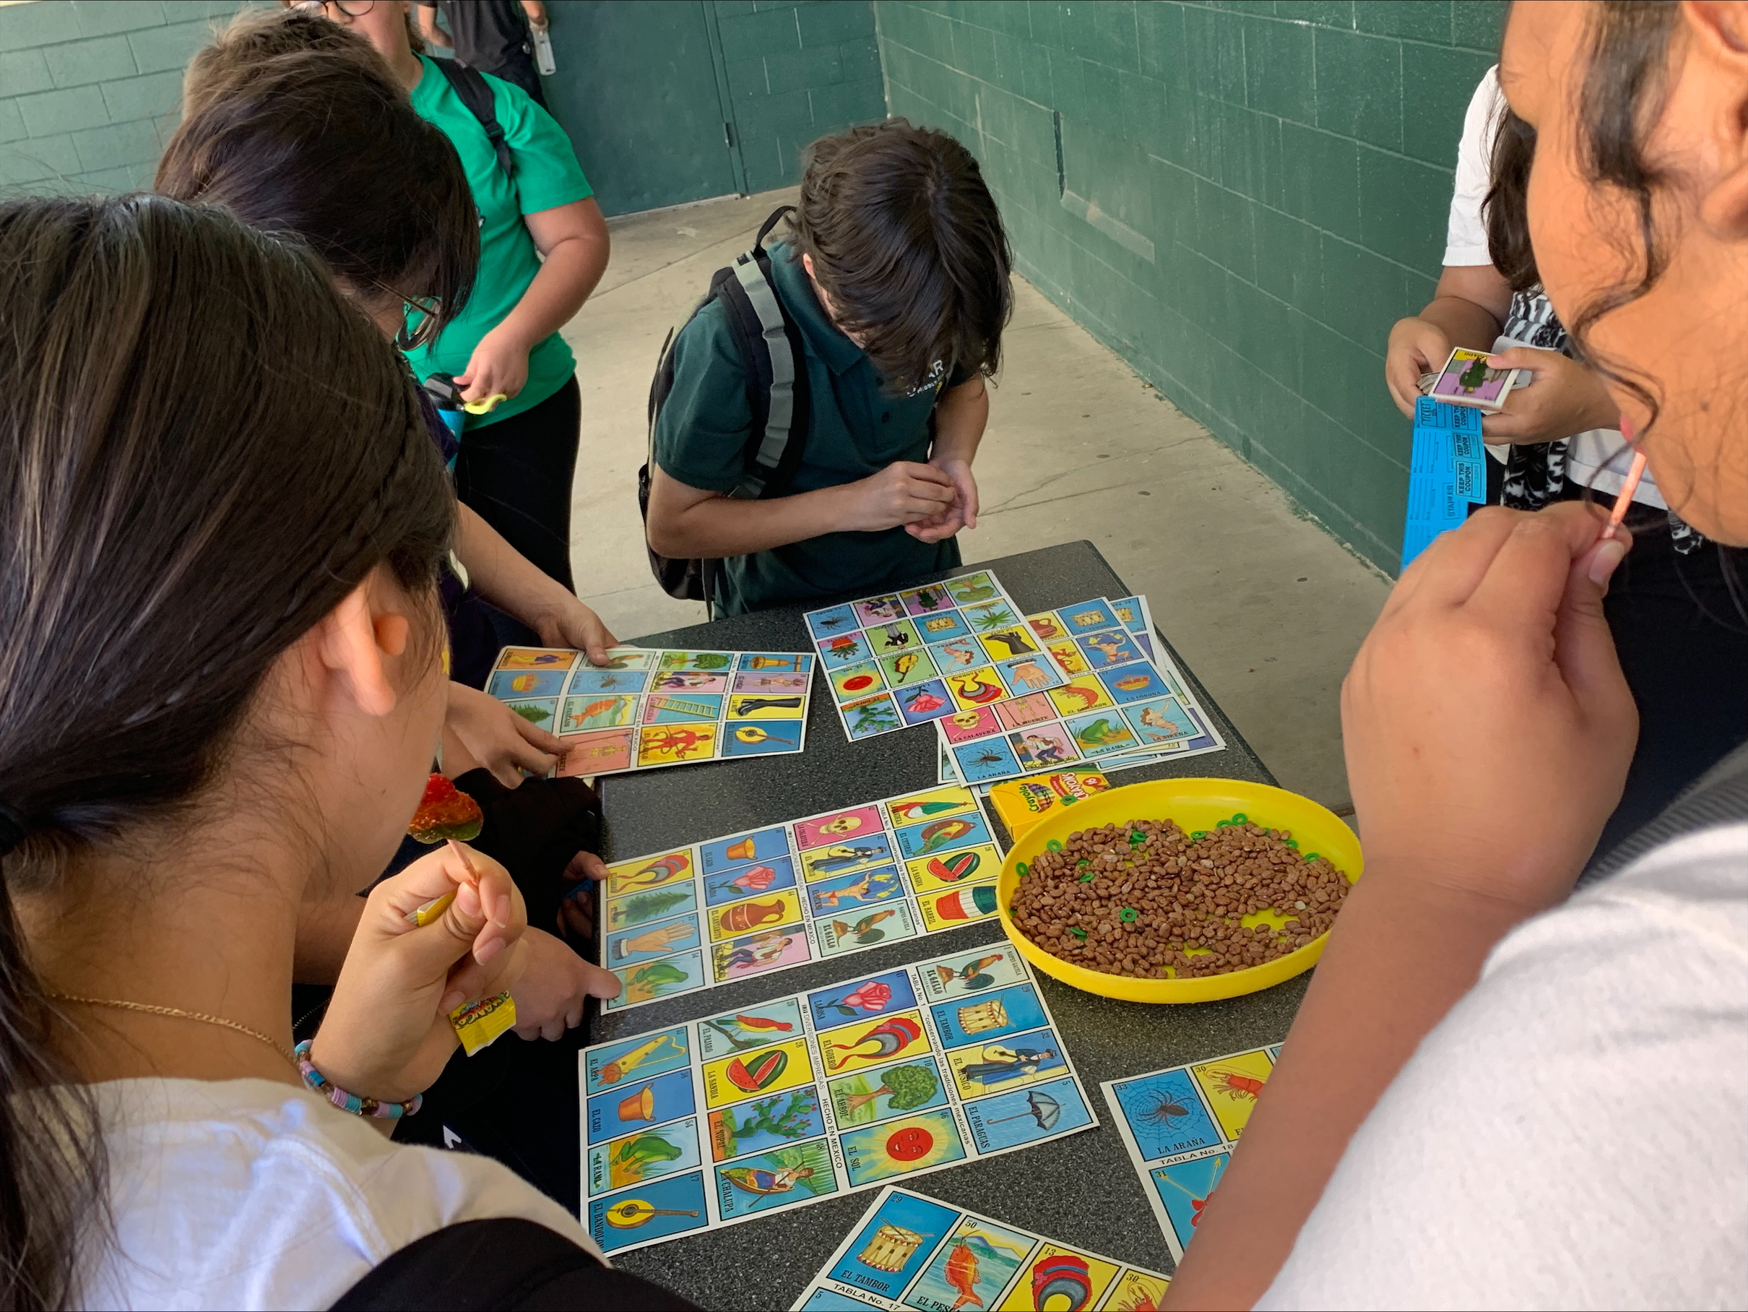
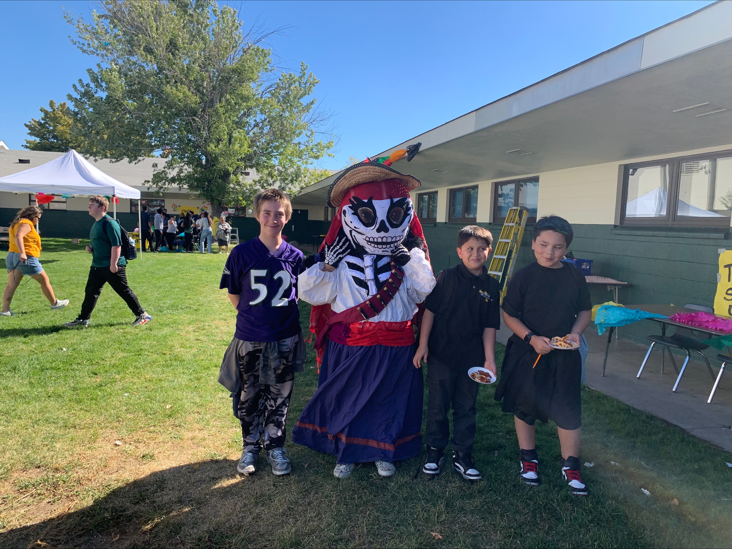
Step 1: Creating a safe and inclusive school environment. At Sparks Middle School, we created an inclusive environment through cultural celebrations.

Slide 8
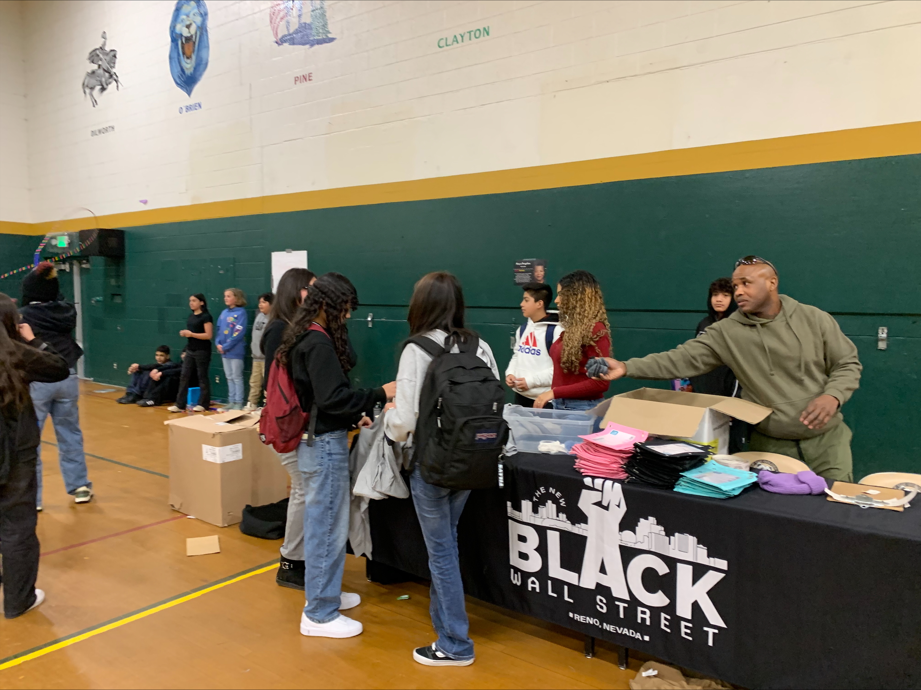
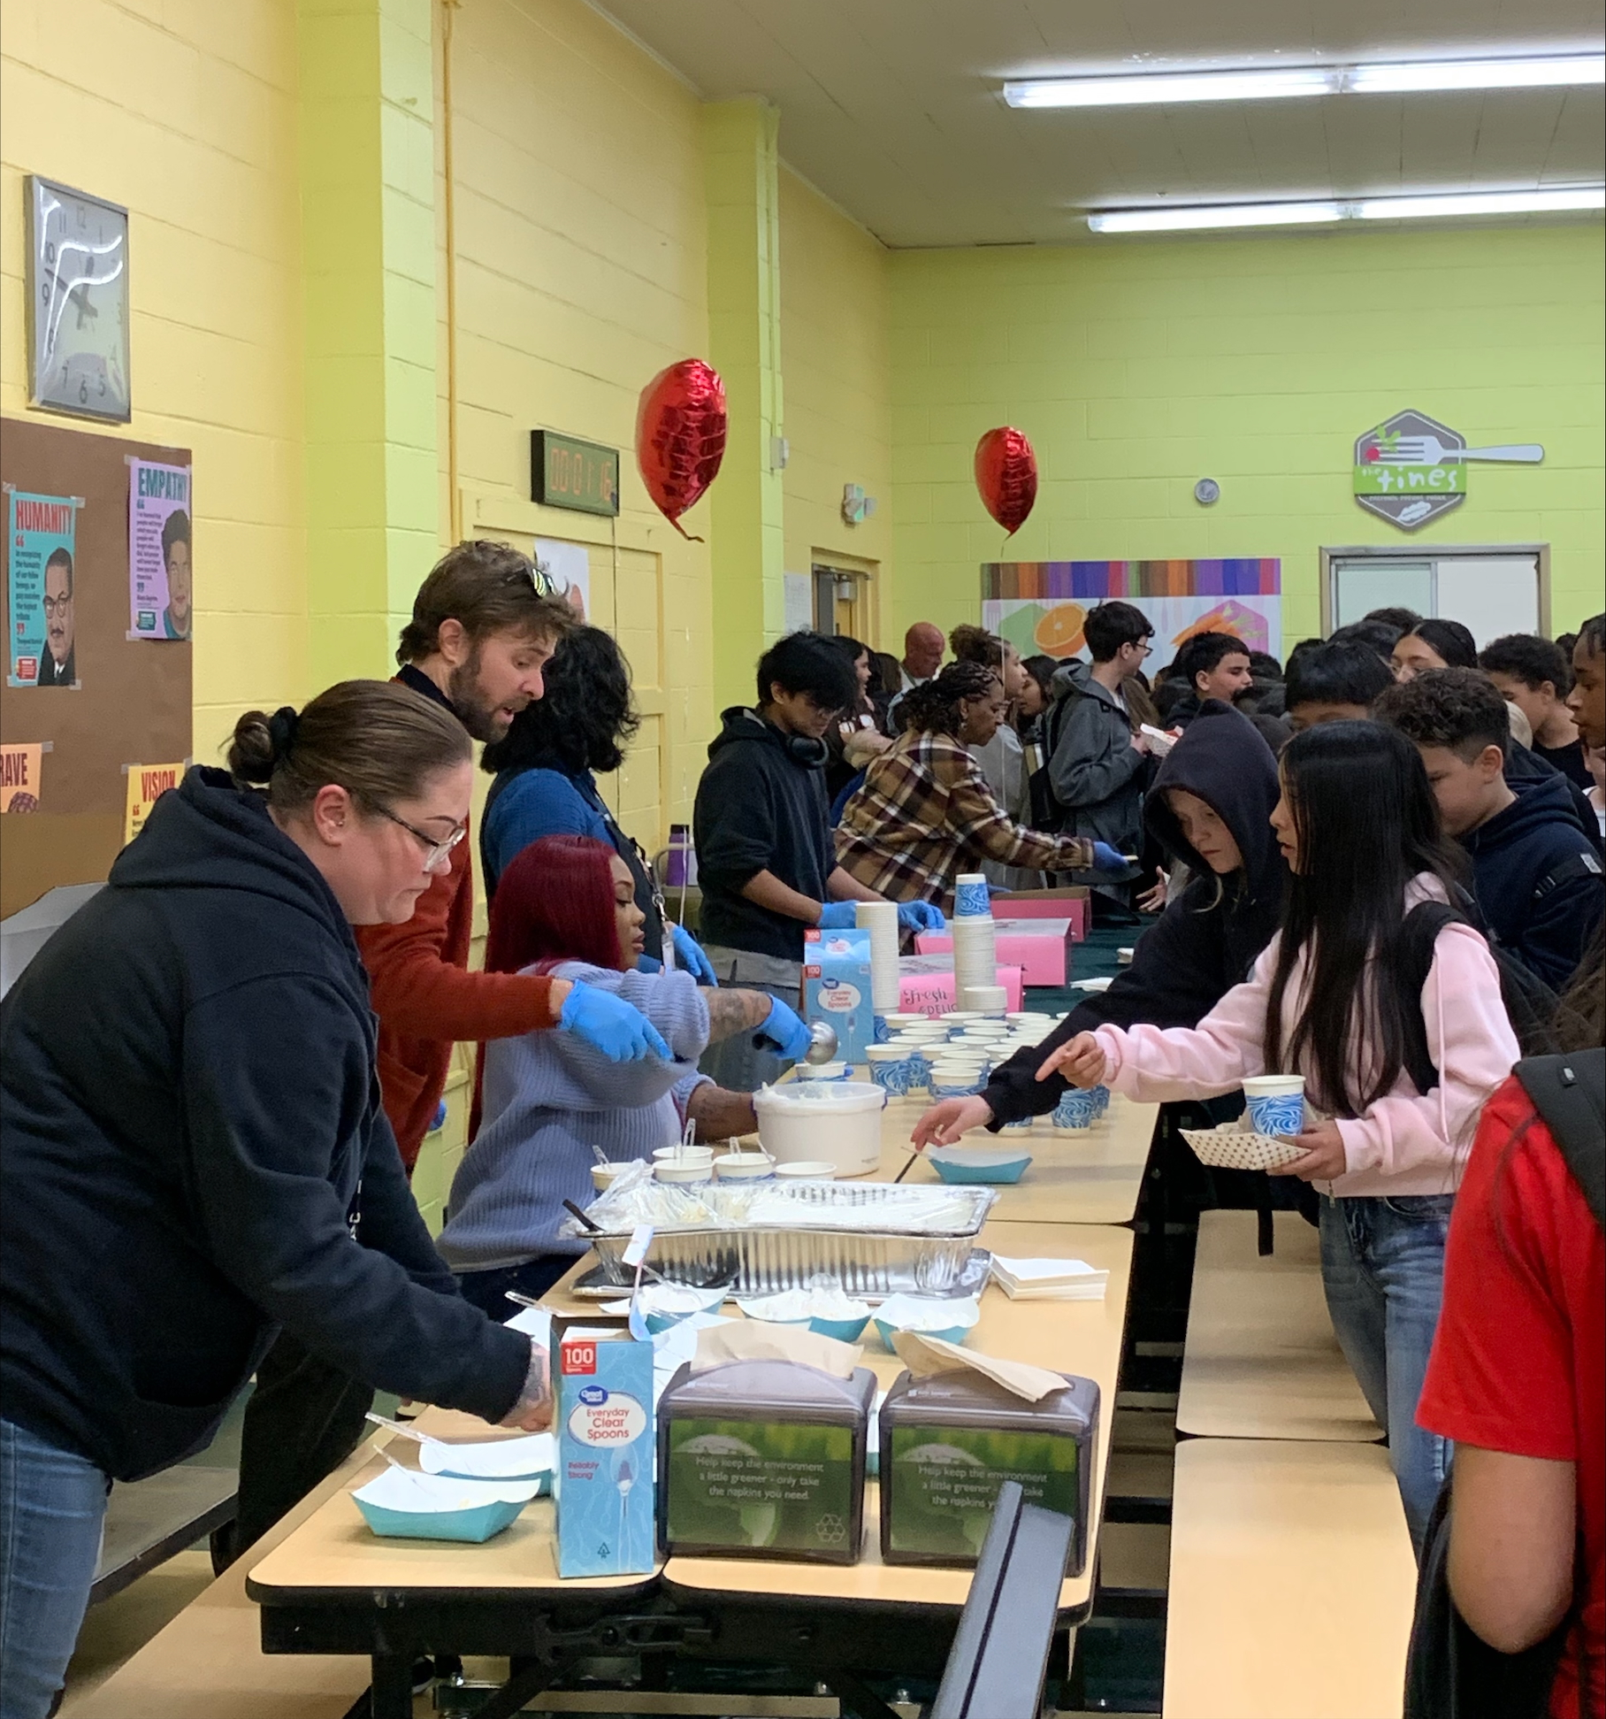

Slide 9

Peer Mentoring Program

Slide 10
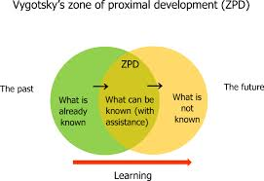
Zone of Proximal Development
At Sparks Middle School, Student Voice started a peer mentoring program. Student Voice members were paired with EL Newcomer students with the goal of helping them learn to speak English and adjust to their new school environment.

Slide 11

Giving Back
Step (2): Giving Back to the internal and external community.
During December, Student Voice participated in a Sock Drive donating socks to Eddy House.
In the month of February, we also donated Valentine gifts to seniors living in convalescent homes. Our next act of service is a Coin Drive where we will donate proceeds to, I Fly Away Bird Rescue, a non-profit agency that rescues and rehabilitates injured birds. We build and give back to our internal community by beautifying our school campus (painting basketball courts).

Slide 12

Schoolwide Mindfulness Activities
Student Voice emphasized the importance of self-care by creating posters about having a growth mindset and developing coping mechanisms. In addition, Student Voice creates mindfulness activities, which are embedded in our SEL curriculum. For our exhibit, we will perform one of our engaging mindfulness mini lessons, which will allow participants to experience a mind shift and focus on the positive as well as the present.
Step (3): Self-Care:

Slide 13

Questions

