Slide 1


North Valleys student voice

Slide 2
Ice Breaker

Slide 3
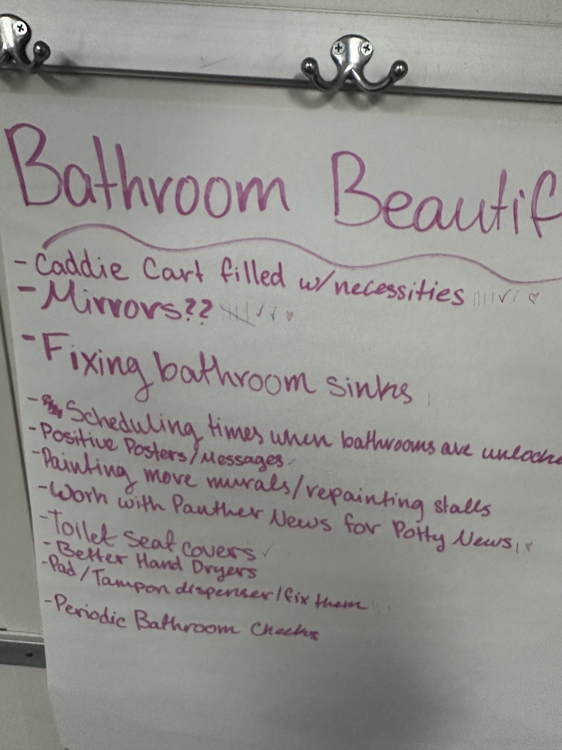
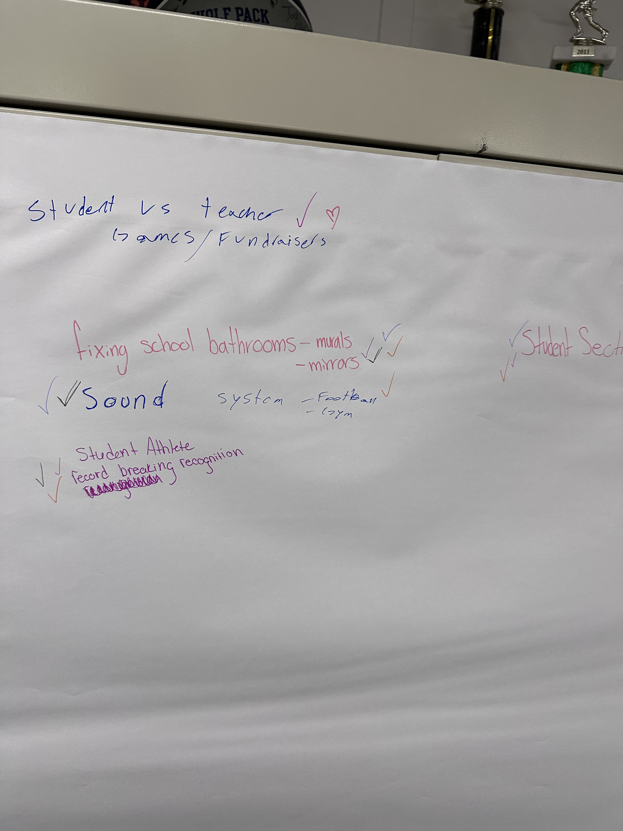
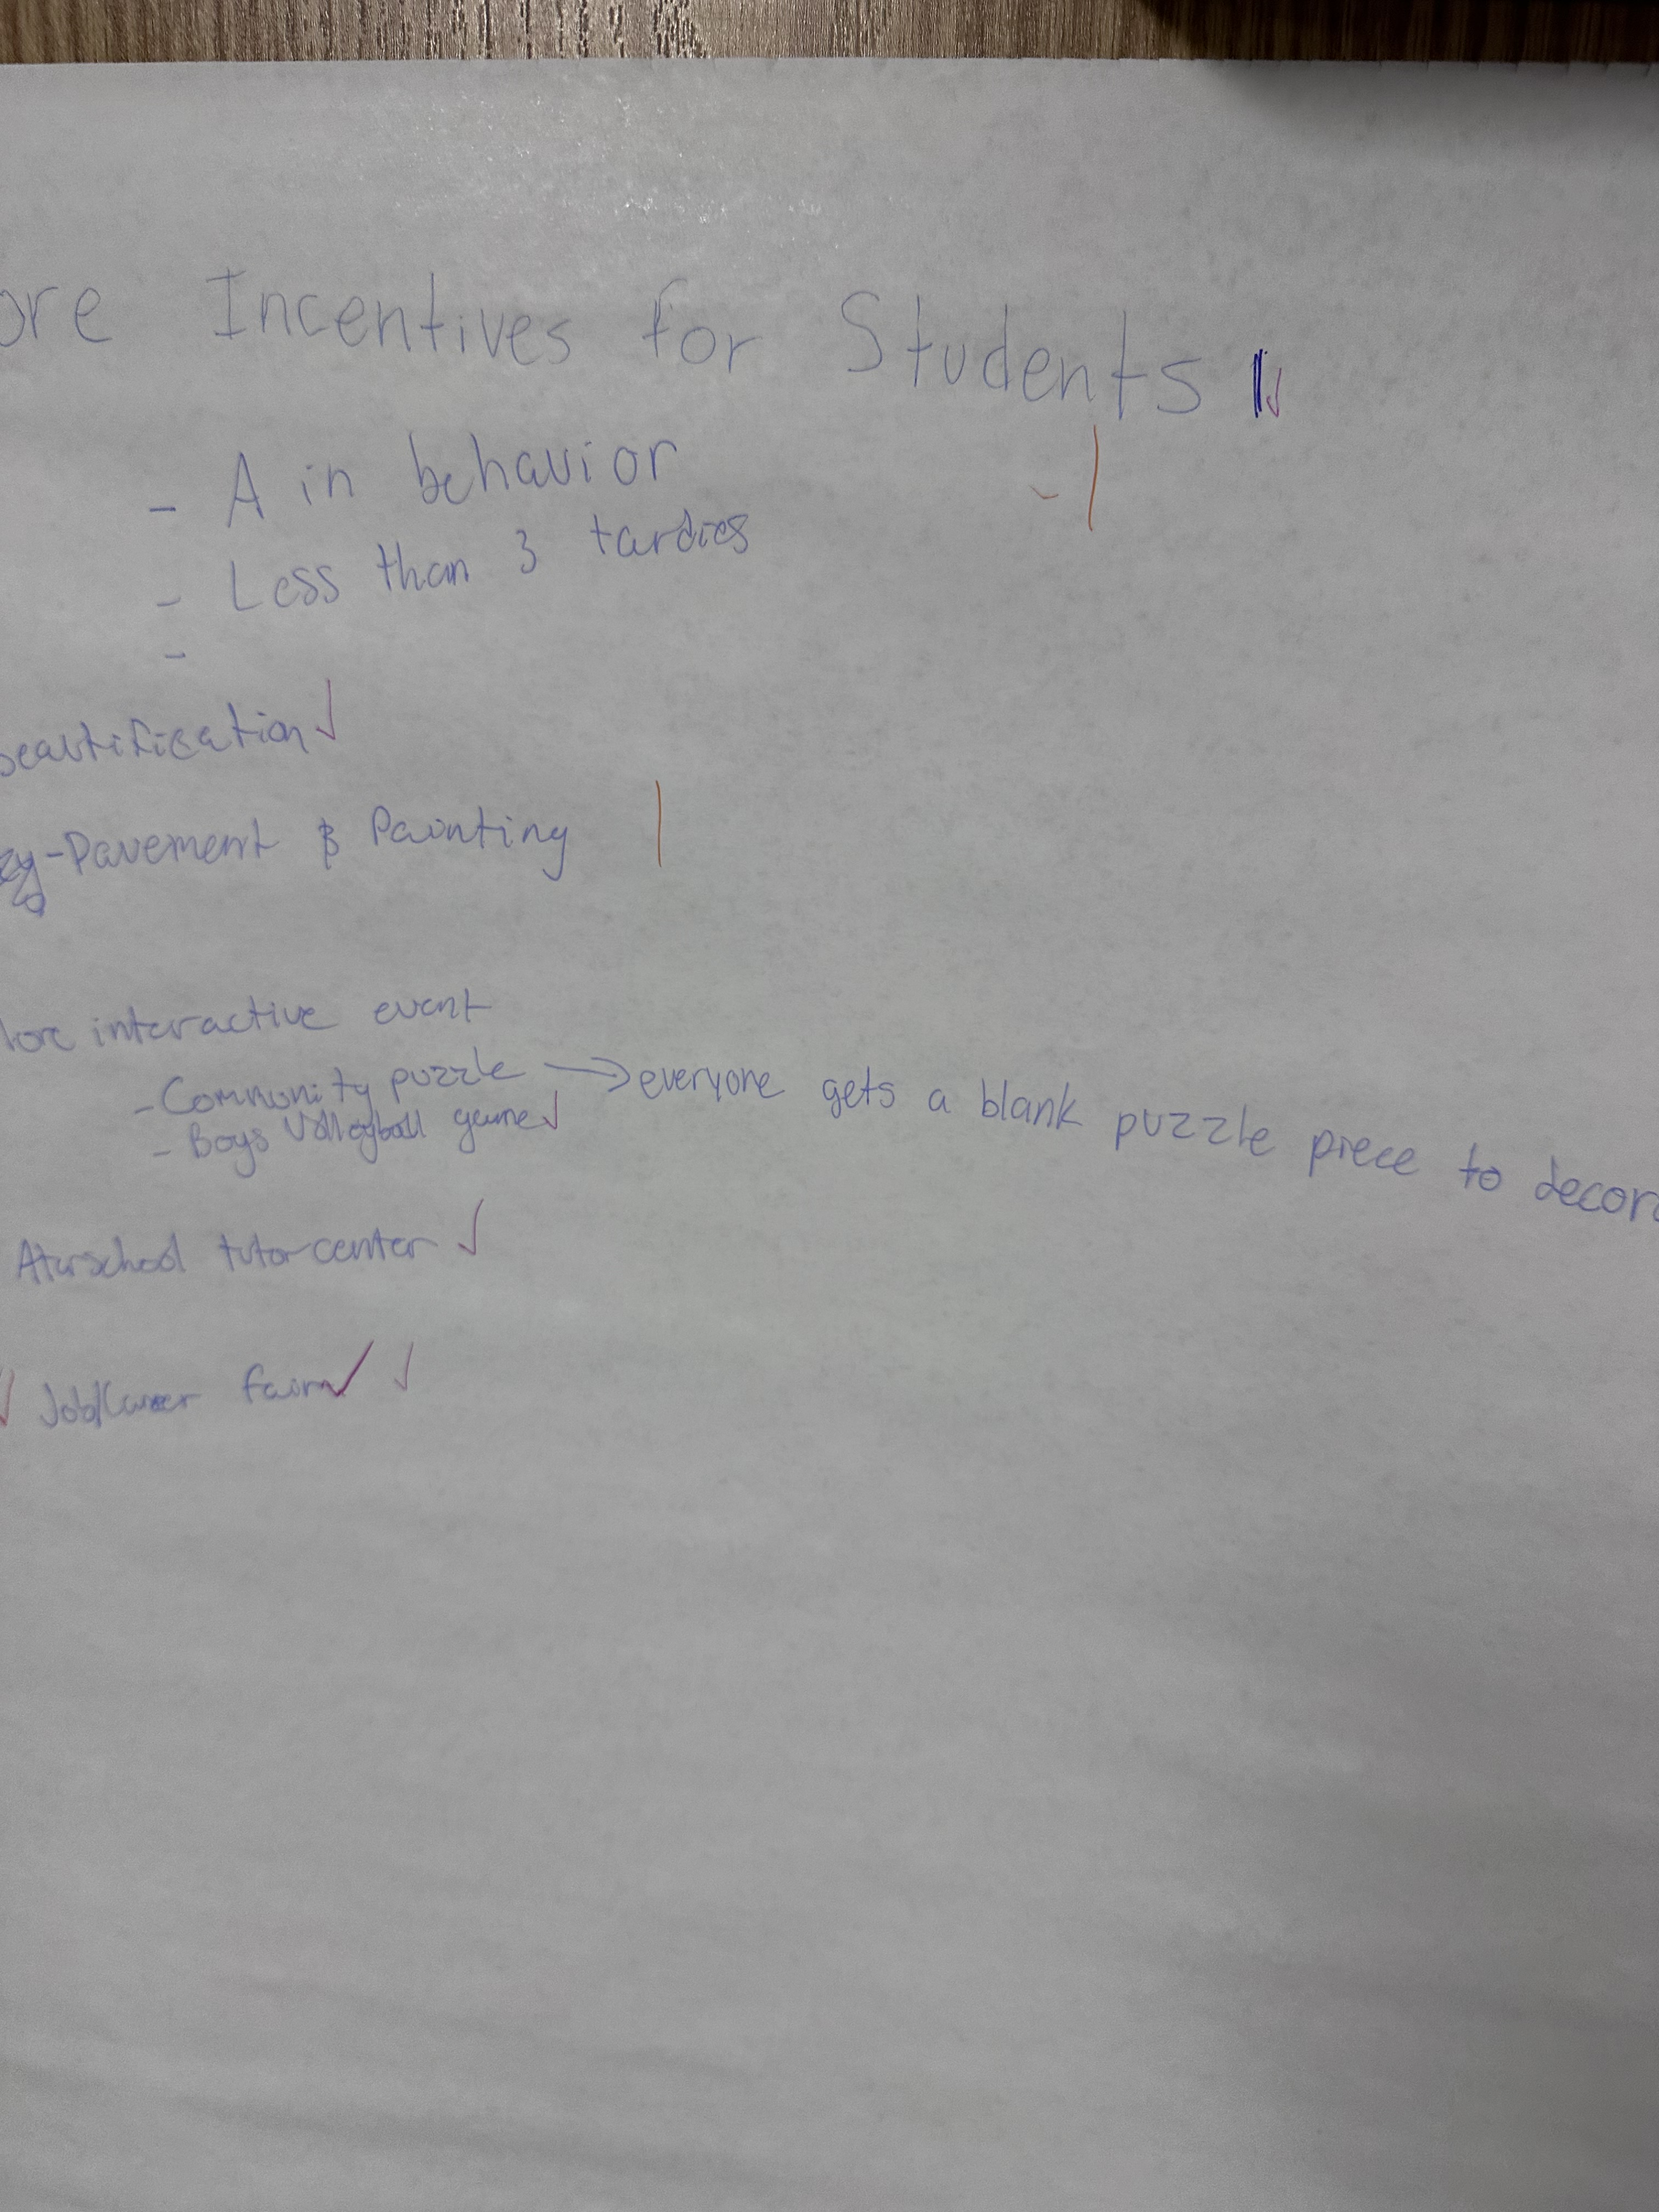
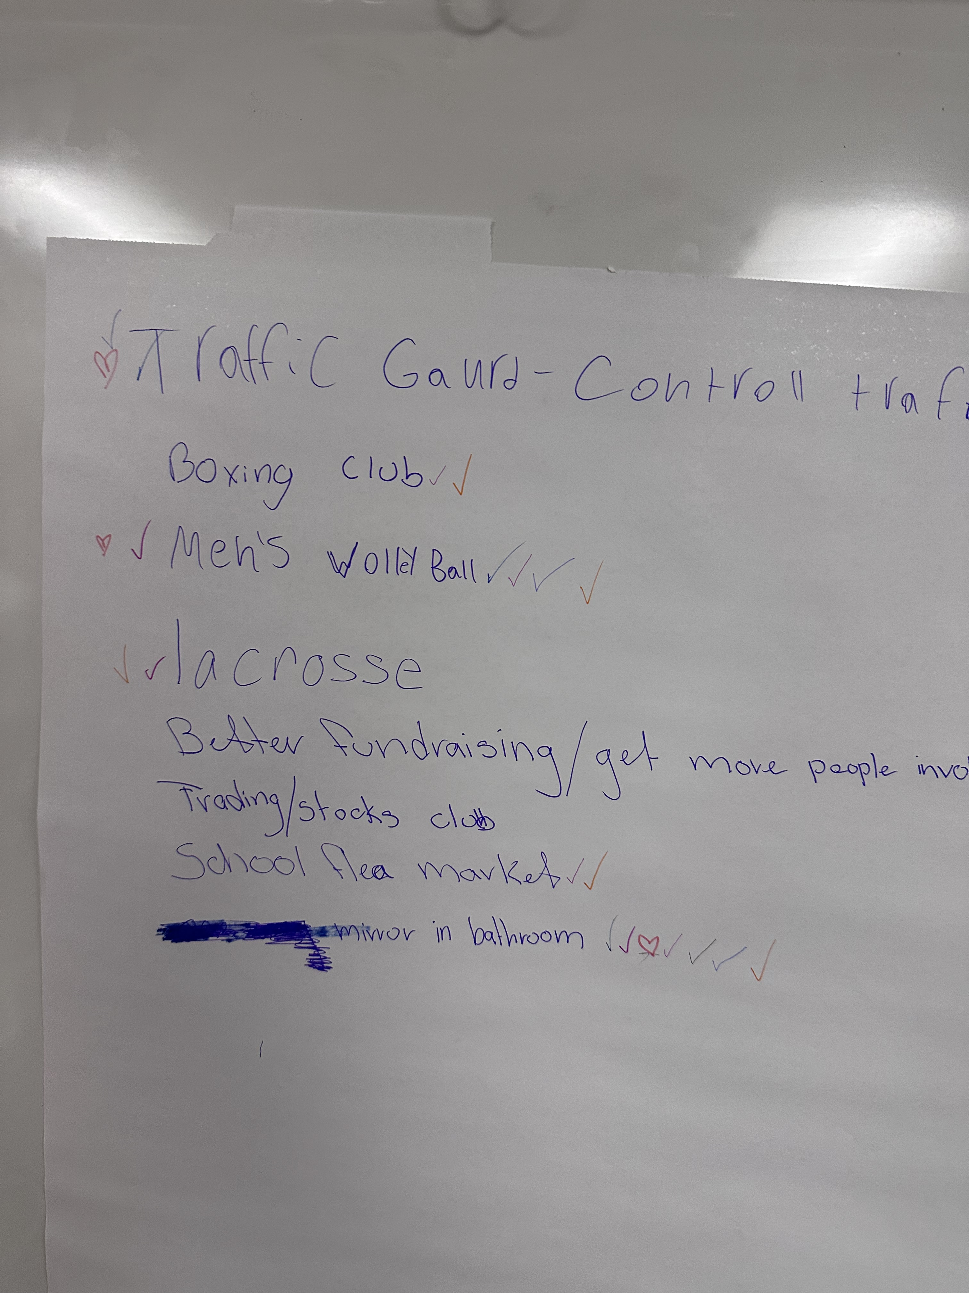
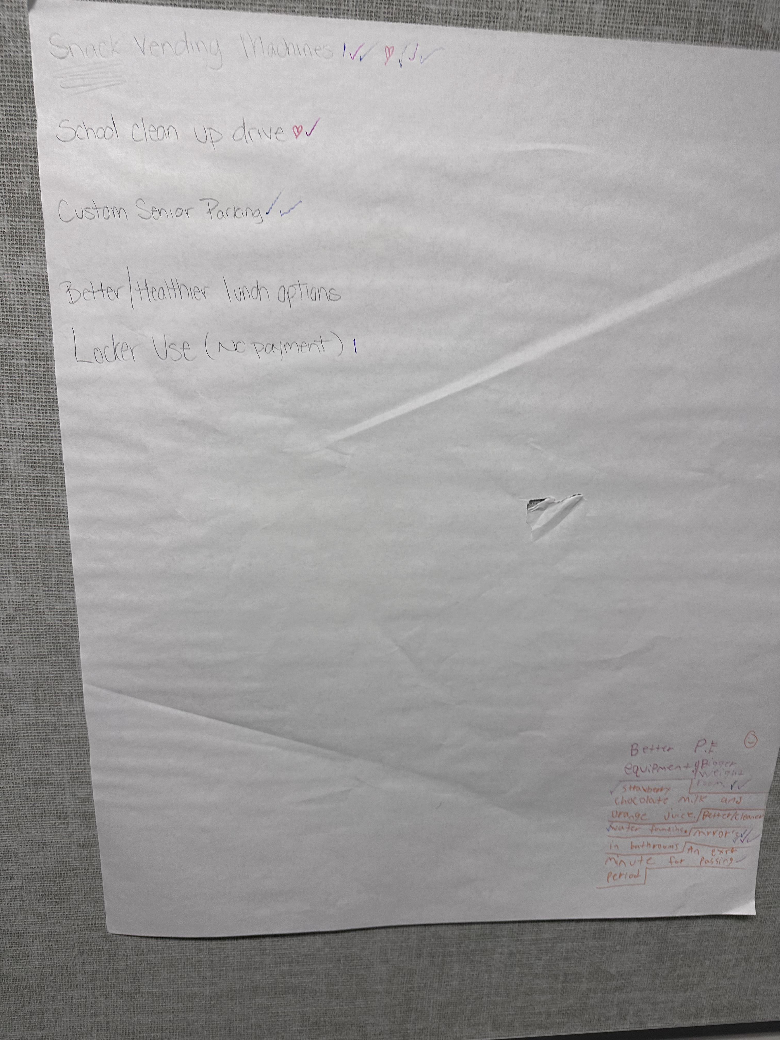
Panther Process
Students attended a student voice meeting and listed their ideas for school improvement. After we created a list students voted on their top ideas.

Slide 4
Our Findings
Students identified several key areas.
Bathroom Beautification (paint the bathrooms, fix counters)
More clubs (lacrosse, volleyball, etc.)
Student section
School record breakers honored in hallway parades
All the things listed above help create a better school culture for students.

Slide 5
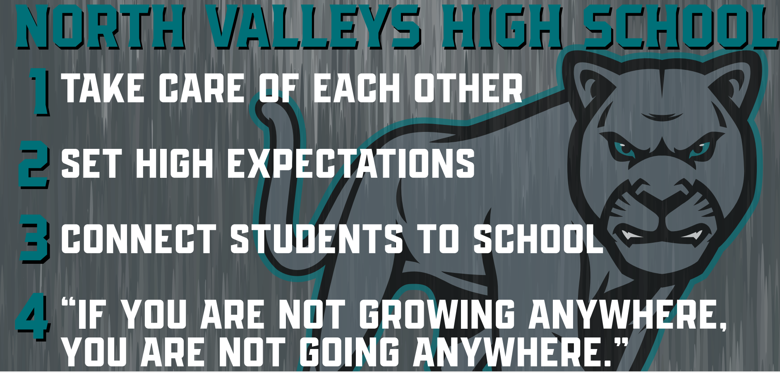

Slide 6
Student voice Outcomes
Student Voice Locker (coming in 4th Quarter)
4 pillars painted and posted in the hallway (in progress)
Creation of Student Section (Havoc Crew)
Art in honors wing
Student Feedback on 25-26 bell schedule
Completion of art in girls' bathrooms (in progress)

Slide 7
Create your own Culture
What do you think your schools “4 pillars” should be?
What can staff do
What principles would be important
How would they support all students
How can students contribute
Design your own “4 pillars”

Slide 8
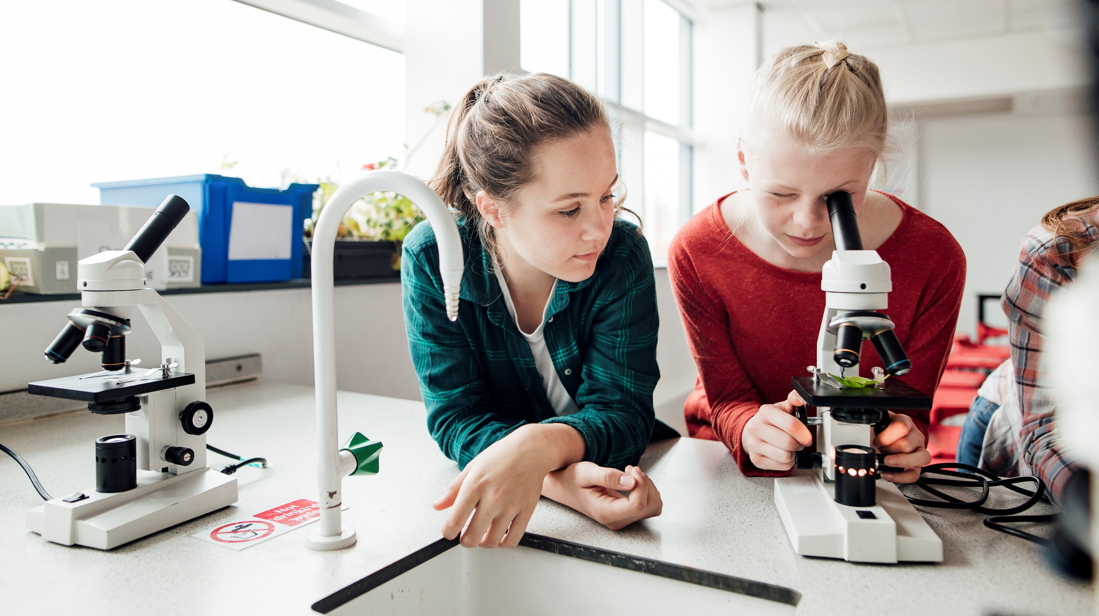
Thank
You
someone@example.com

