Slide 1

Got GRIT?
Learning to Fail Forward & Use Failure to Your Advantage.
Dilworth Middle School​
Student Voice Team

Slide 2

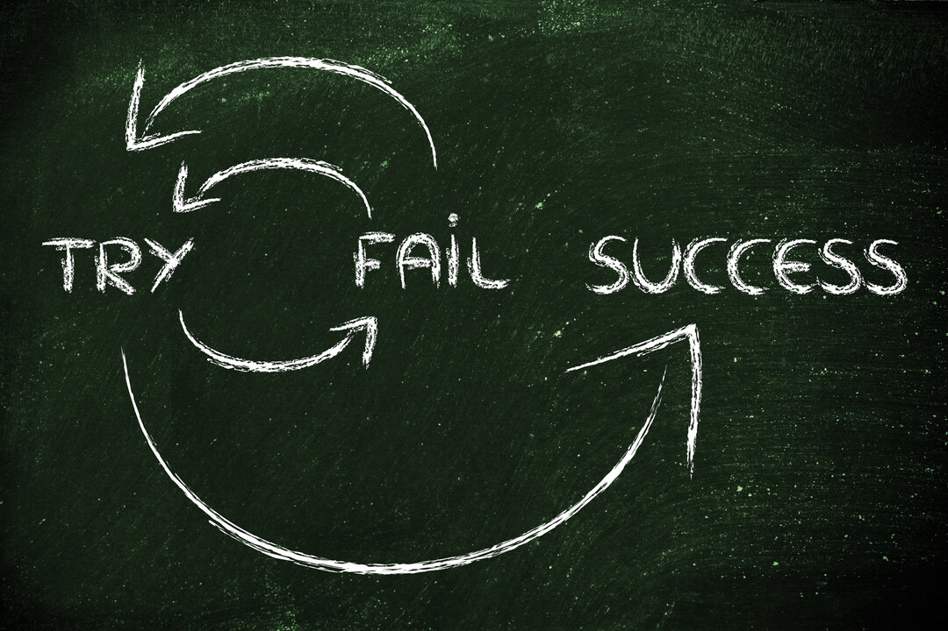
What is Failure?

Slide 3

First Action In Learning

Slide 4

Famous Failures.

Slide 5

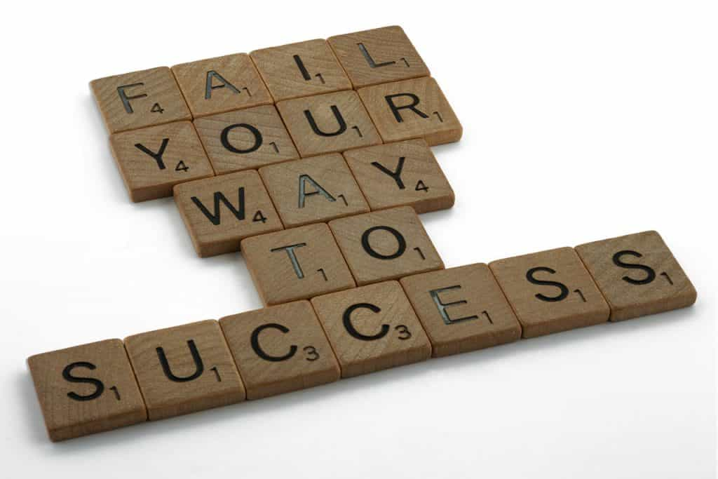
Why is failing important?

Slide 6
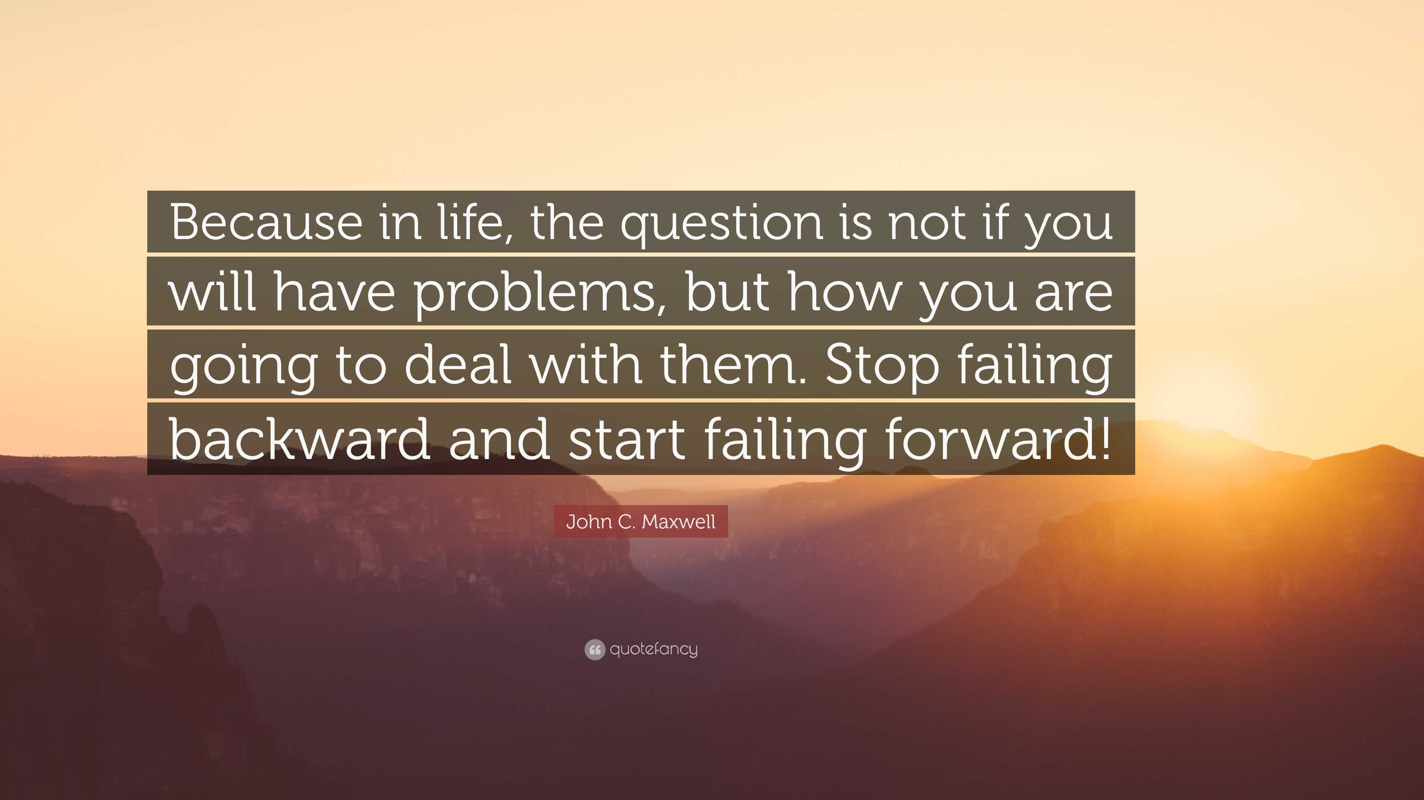
Failing Backward.

Slide 7
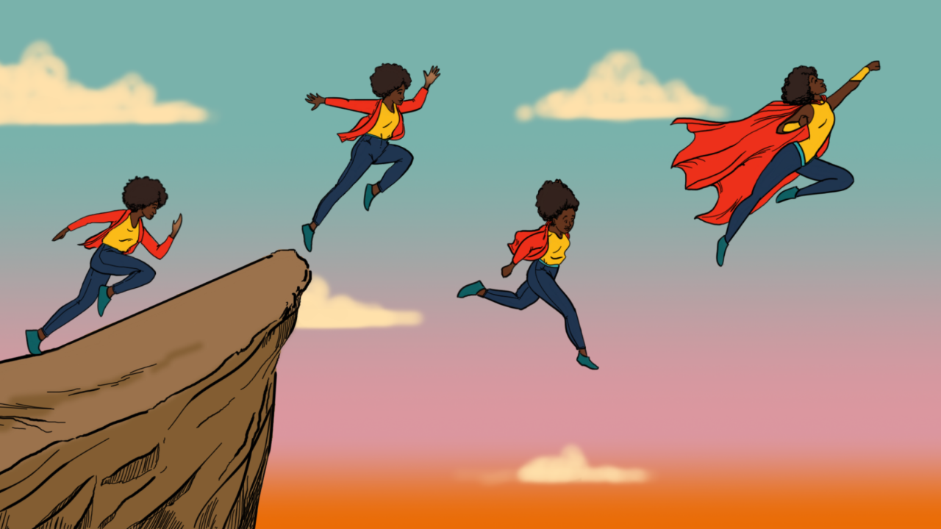
Failing Forward.

Slide 8

Failure & Wisdom Toss

Slide 9
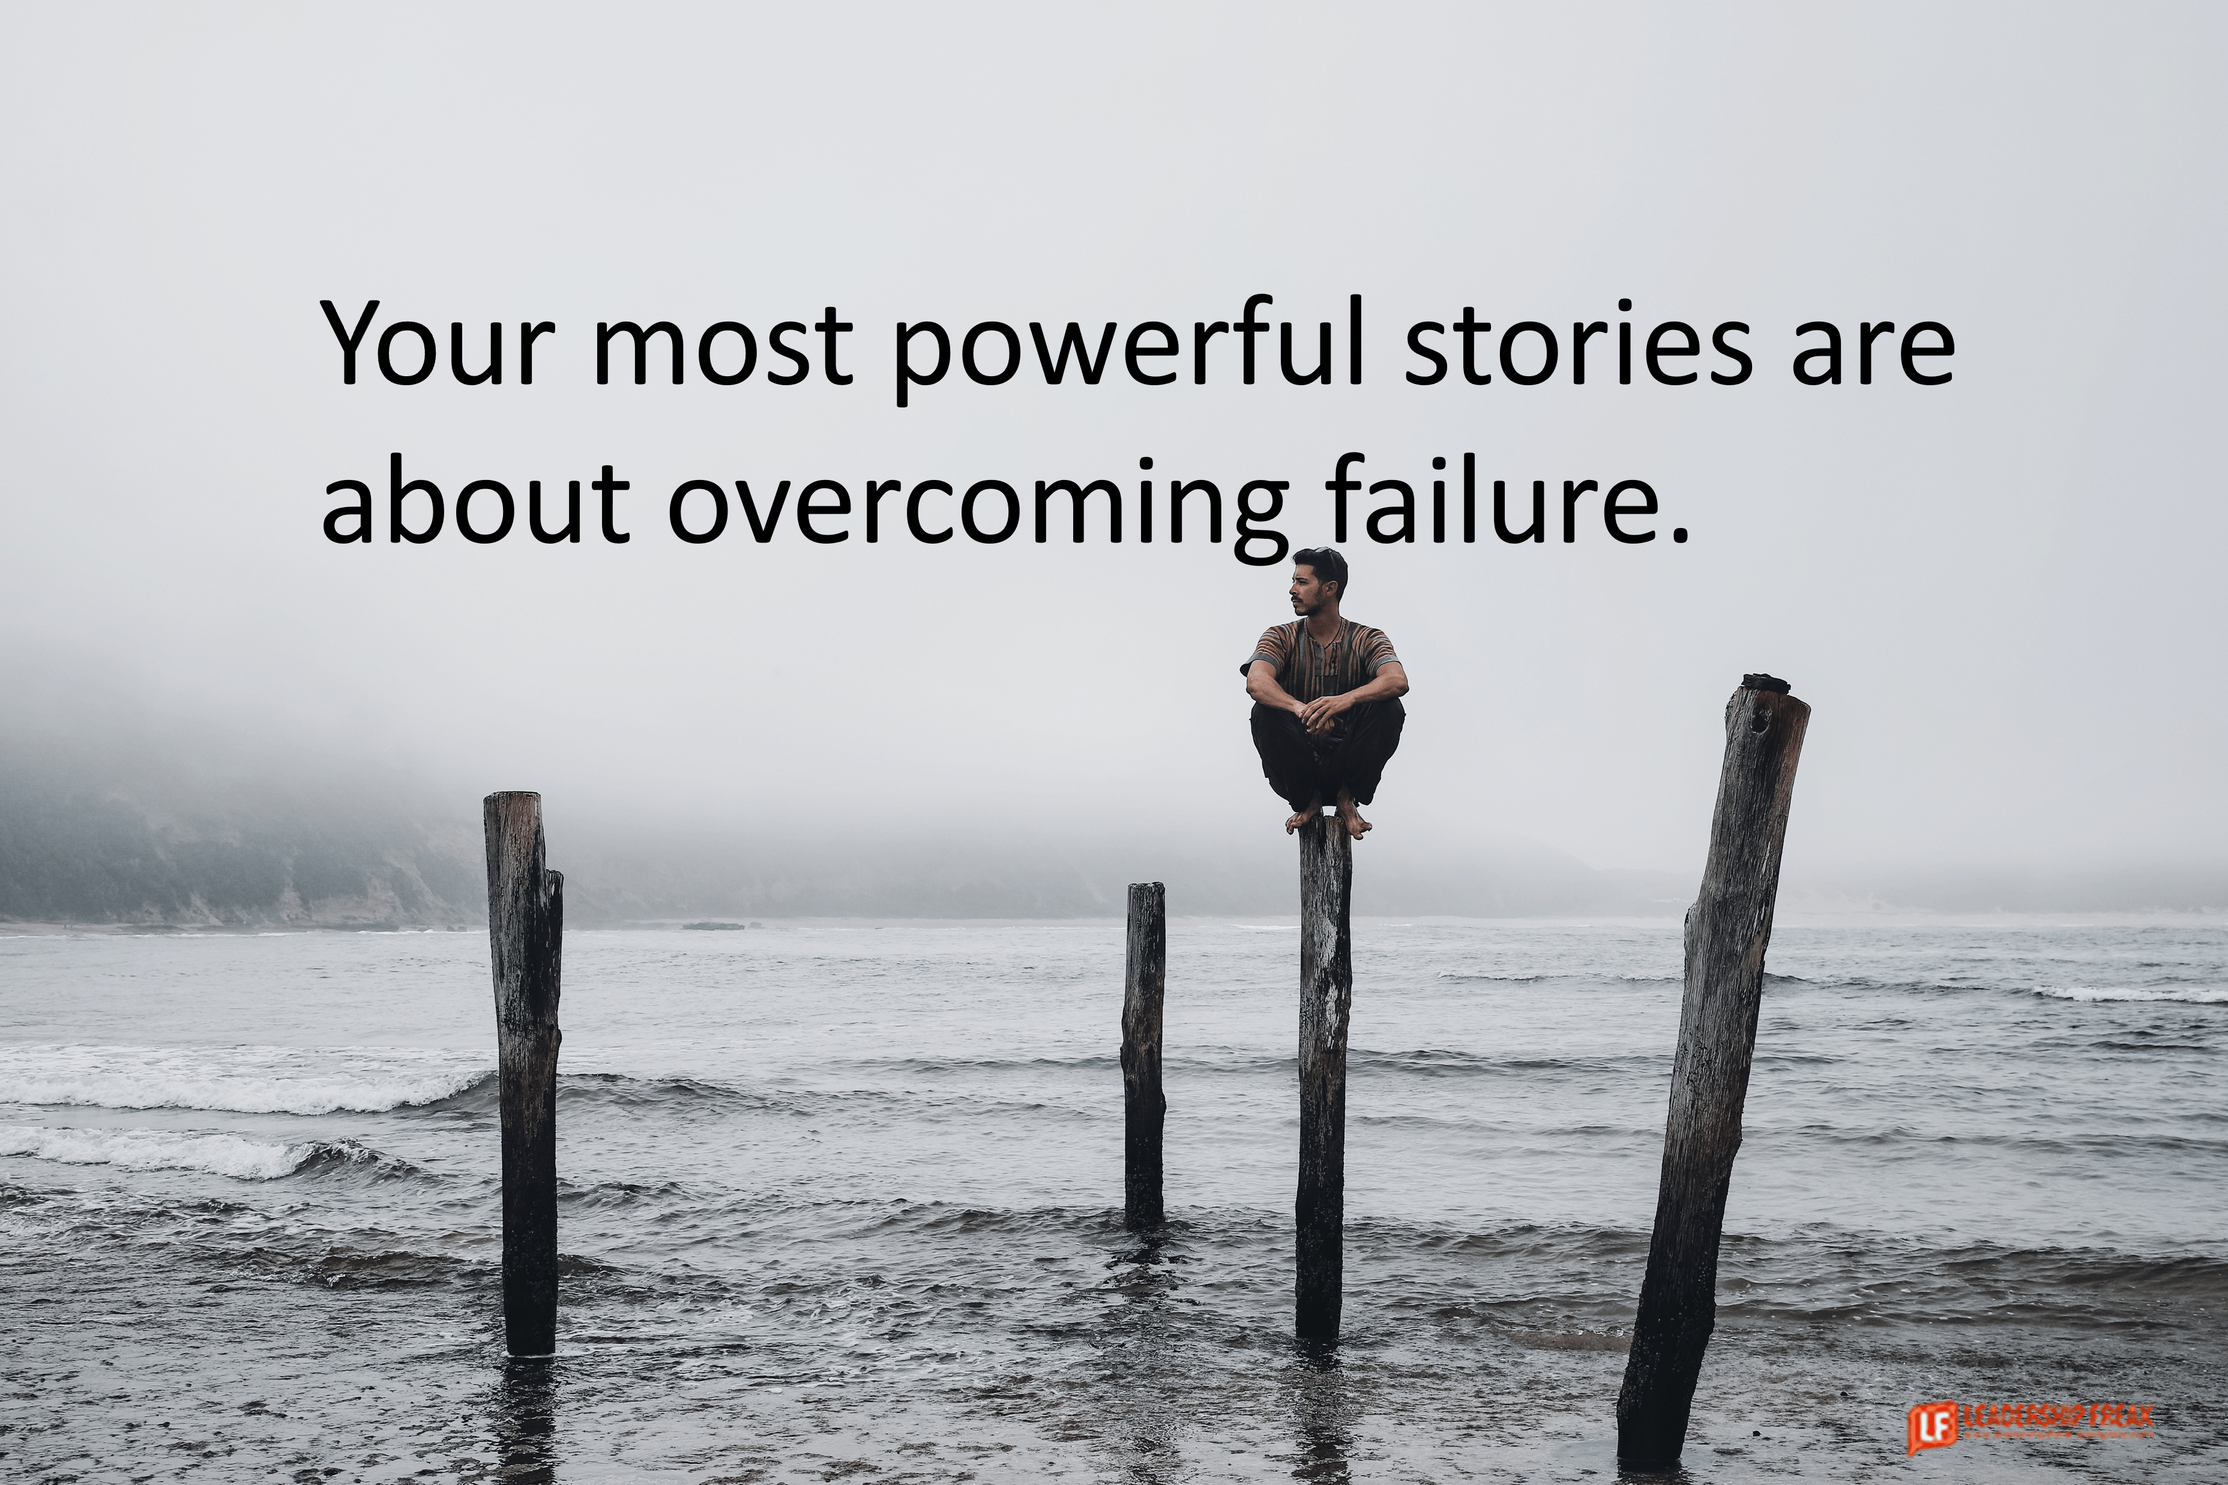
1. Feel your emotions
Overcoming Failure & Disappointment
2. Practice positive self-talk
3. Let failure happen and embrace it
4. Focus on a growth mindset
5. Take risks
Notes:
OVERCOMING FAILURE & DISAPPOINTMENT
Say: For us to reach our potential and meet our goals, we need to push ourselves past our limits. We can't fear failure and we need to use it to help us make other things possible. Embracing failure can help motivate us and will help make us become more successful. There are five steps to overcoming failure and disappointments.
Feel your emotions. You are allowed to feel your emotions! You might feel angry or sad at times, but it is important to let them pass. Embrace them, acknowledge them, and send them on their way.
Practice positive self-talk. Tell yourself that failures are lessons. They are life's way of teaching you something. Failure does not define who you are as a person.
Let failure happen and embrace it. Acknowledge that failures will happen and remind yourself that it's okay to fail, but it's not okay to give up. Embrace your failures and disappointments so that you can learn from them.
Focus on a growth mindset. What can you do to change the outcome the next time you face failure? What did you learn and how will this change you?
Take risks. Don't be afraid of failure. Take risks to learn more and achieve what you want.

Slide 10
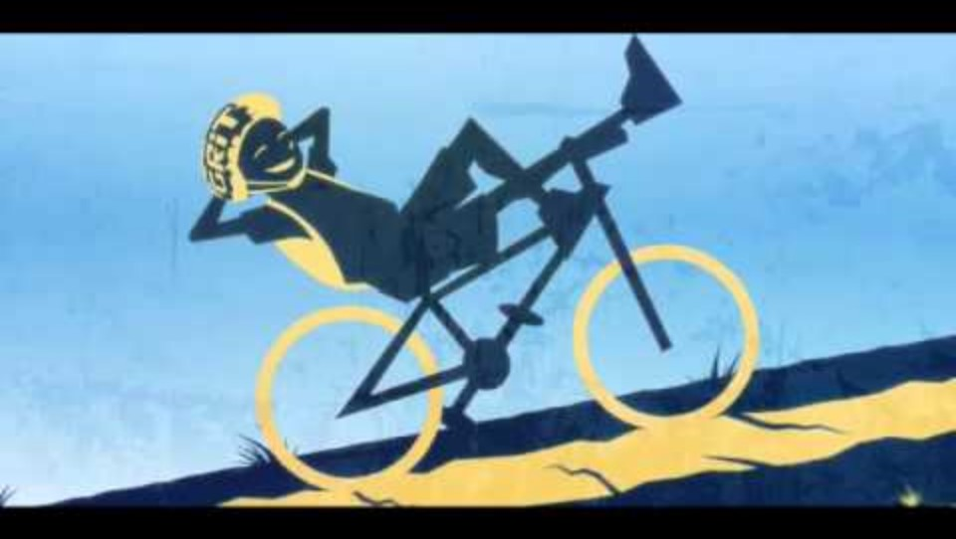
What is Grit and Why is it Important?
Notes:
WHAT IS GRIT & WHY IS IT IMPORTANT?
Do: Watch Grit: The Key to Your Success (2:22).
Ask: According to this video, what is grit? Why is grit important?
Allow Hope Squad members to discuss and respond.
Say: Grit is not a long race. It's short races one after another. When someone with grit encounters a problem, they try to solve it the best way they know how. When they have disappointments and failures, they learn and grow from the situation. Those with grit are positive, hopeful, optimistic, and ready to start a new challenge. It's important to have grit in your life as this will help you achieve any goal.

Slide 11

The Hardest Part of Grit
-Sometimes its hard to see the end in sight.
-you must remind yourself to keep going!
-its okay to lean on people you love & ask for help when you need it!
Notes:
THE HARDEST PART OF GRIT
Ask: Why is it hard to have grit in every situation? What is the hardest part of having grit?
Allow Hope Squad members to discuss and respond.
Say: Sometimes it's hard to have grit in every situation. There will be times when you don't have the motivation to find positive outcomes in a hard situation. No one is able to have grit all the time. We all struggle, but doing our best is key to becoming the person we want to become. You will find the grit to push forward if you work at it one day at a time.

Slide 12
GRIT.
Dilworth Middle School
Student Voice

