Slide 1
Yvonne Shaw Middle School
Student Advisory Council

Slide 2
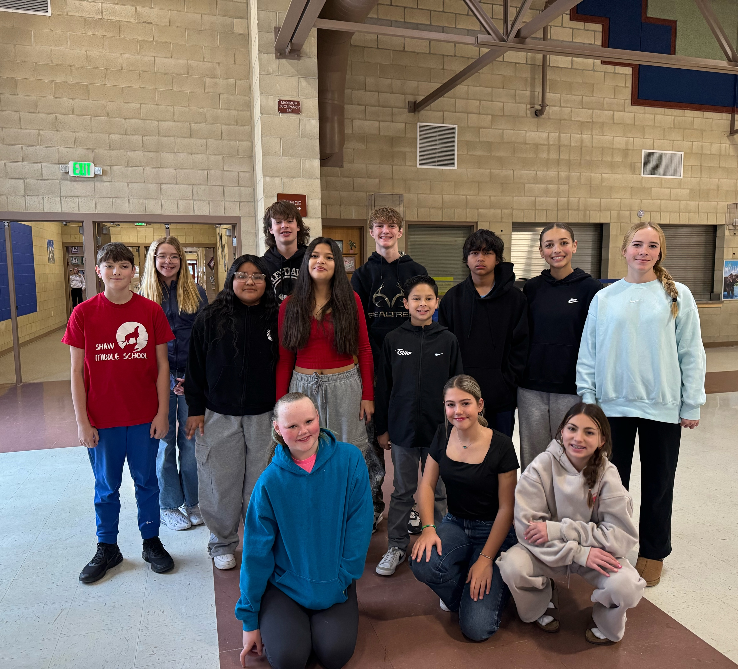
Meet Our Members:
Reese Gipe (6)
Jaida Czech (6)
Taylena George (6)
Sebastian Aguirre (6)
Avery Snow (7)
Fiona Burger (7)
Kolton Andersen (7)
Jacob Andelin (7)
Jacobe Ahdunko (7)
Kennedy Williams (8)
Payton Stutzman (8)
Maci Reddig (8)
Connor Huynh (8)
Julia Whellams (8)

Slide 3

Our Experience
This is the second year we have had Student advisory council at Shaw Middle School.
In our meetings we discuss many things involving school events, assemblies, functions, overall school data, I-ready, and student experience.
Last school year we started a beautification initiative at Shaw that we decided to continue this year by helping make Shaw a better place by including a kindness week.
We have already gotten to work in continuing our kindness project and we plan to do much more.

Slide 4
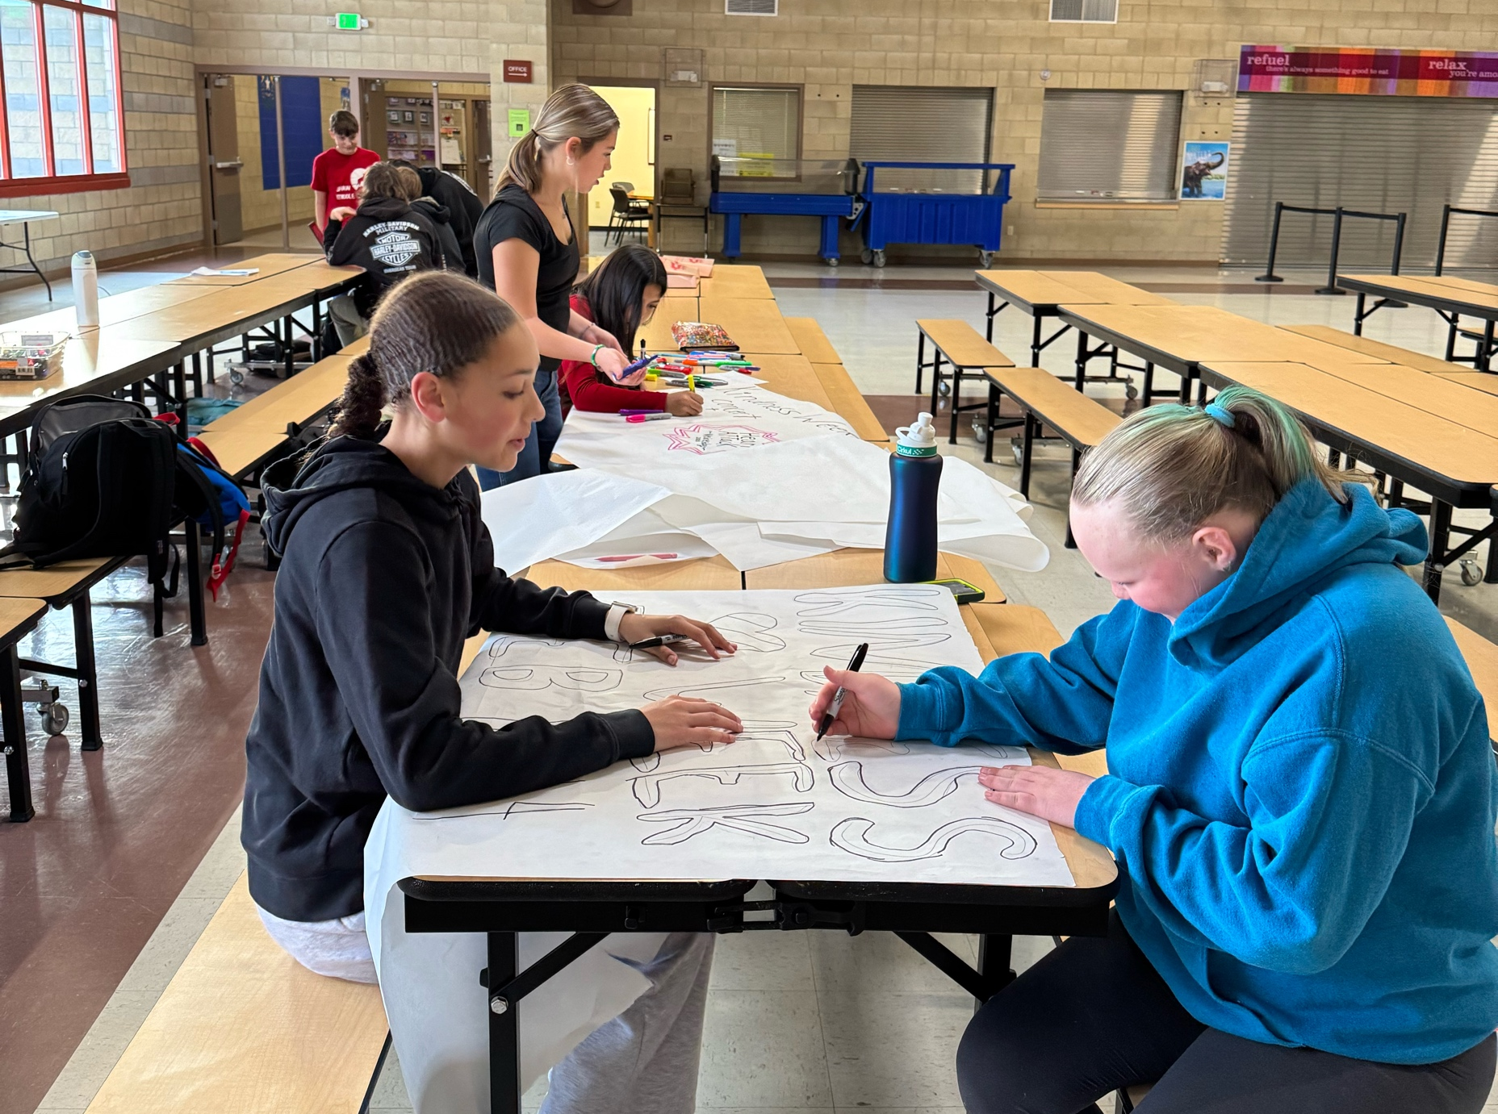
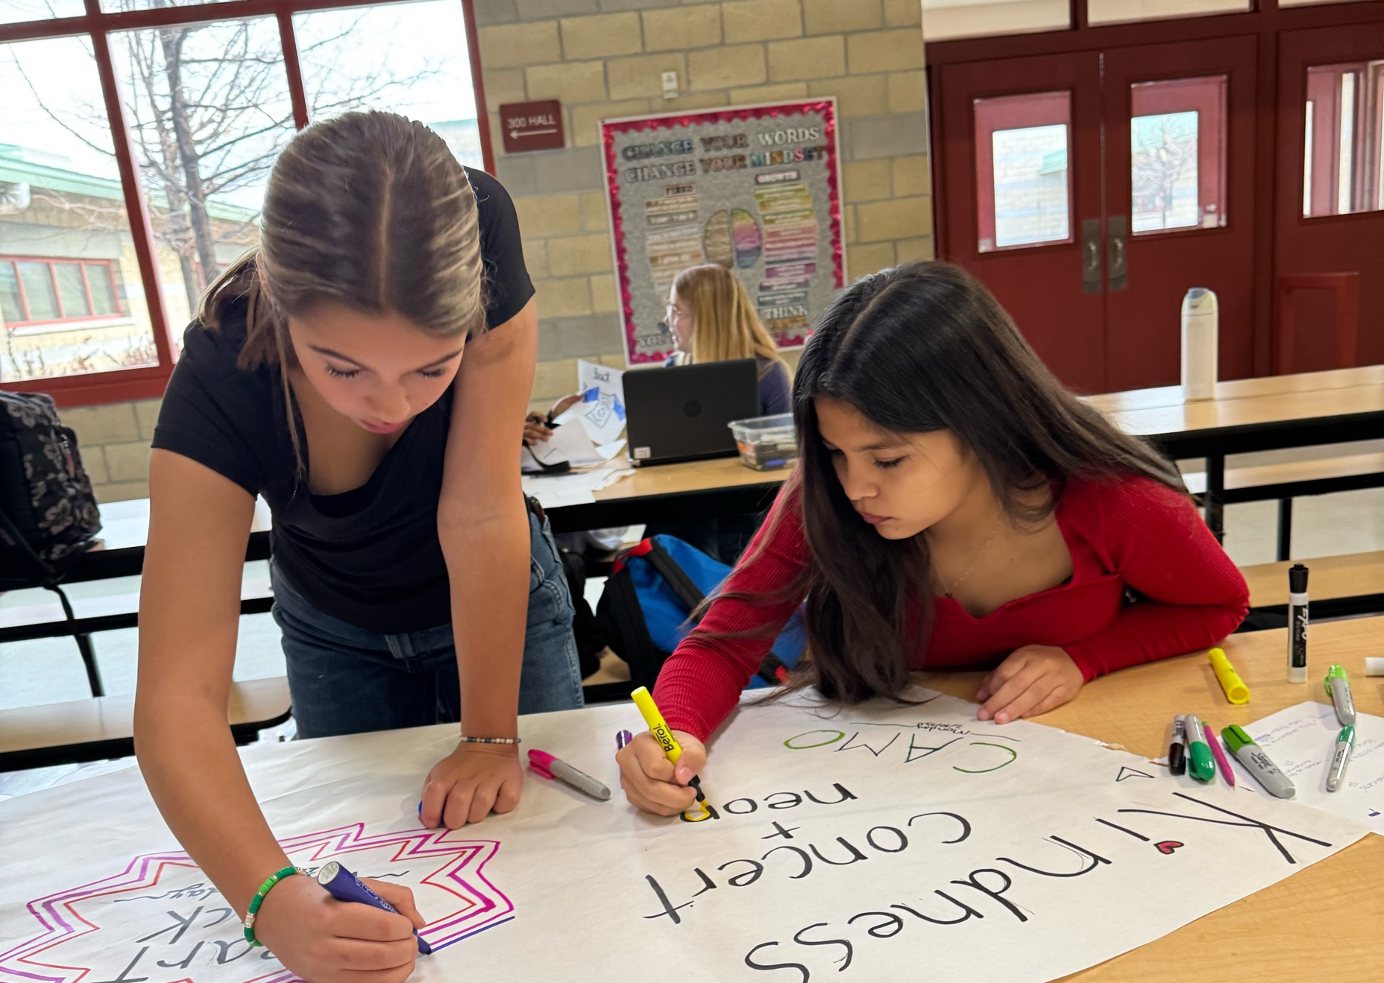
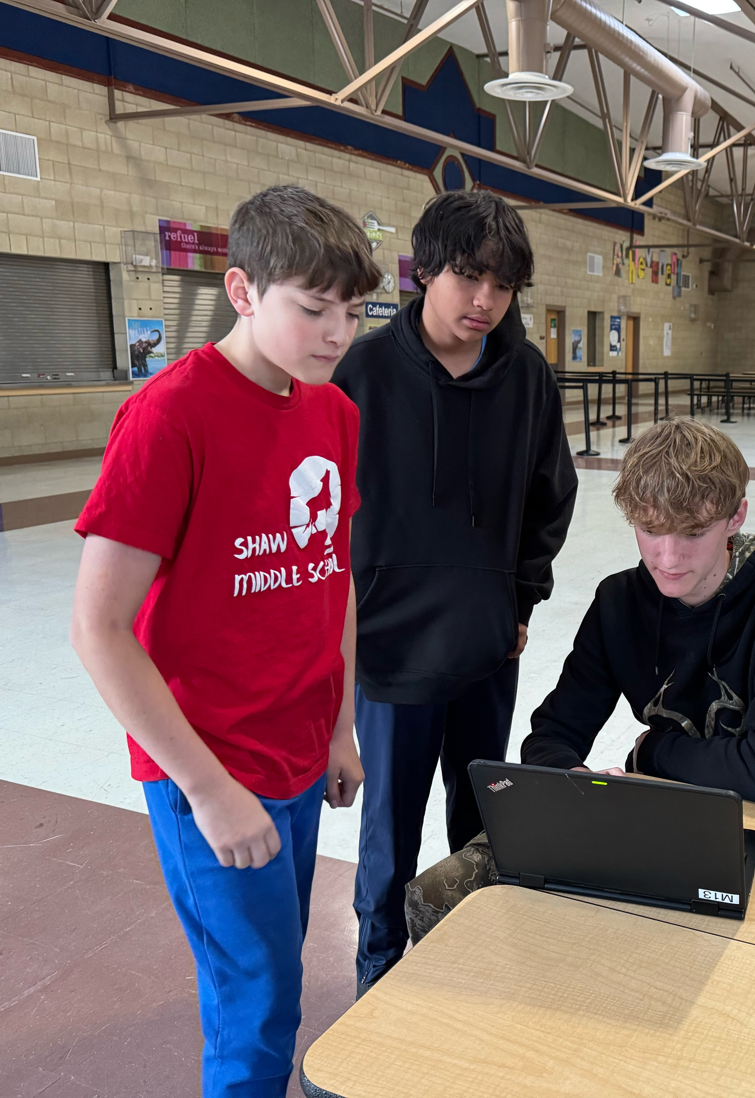
Preparations for Kindness week
-Design and order shirts to wear as well as give out at the concert and as prizes
-Order bracelets to hand out and give as prizes
-Make posters to hang in the halls
-Create kindness task cards

Slide 5
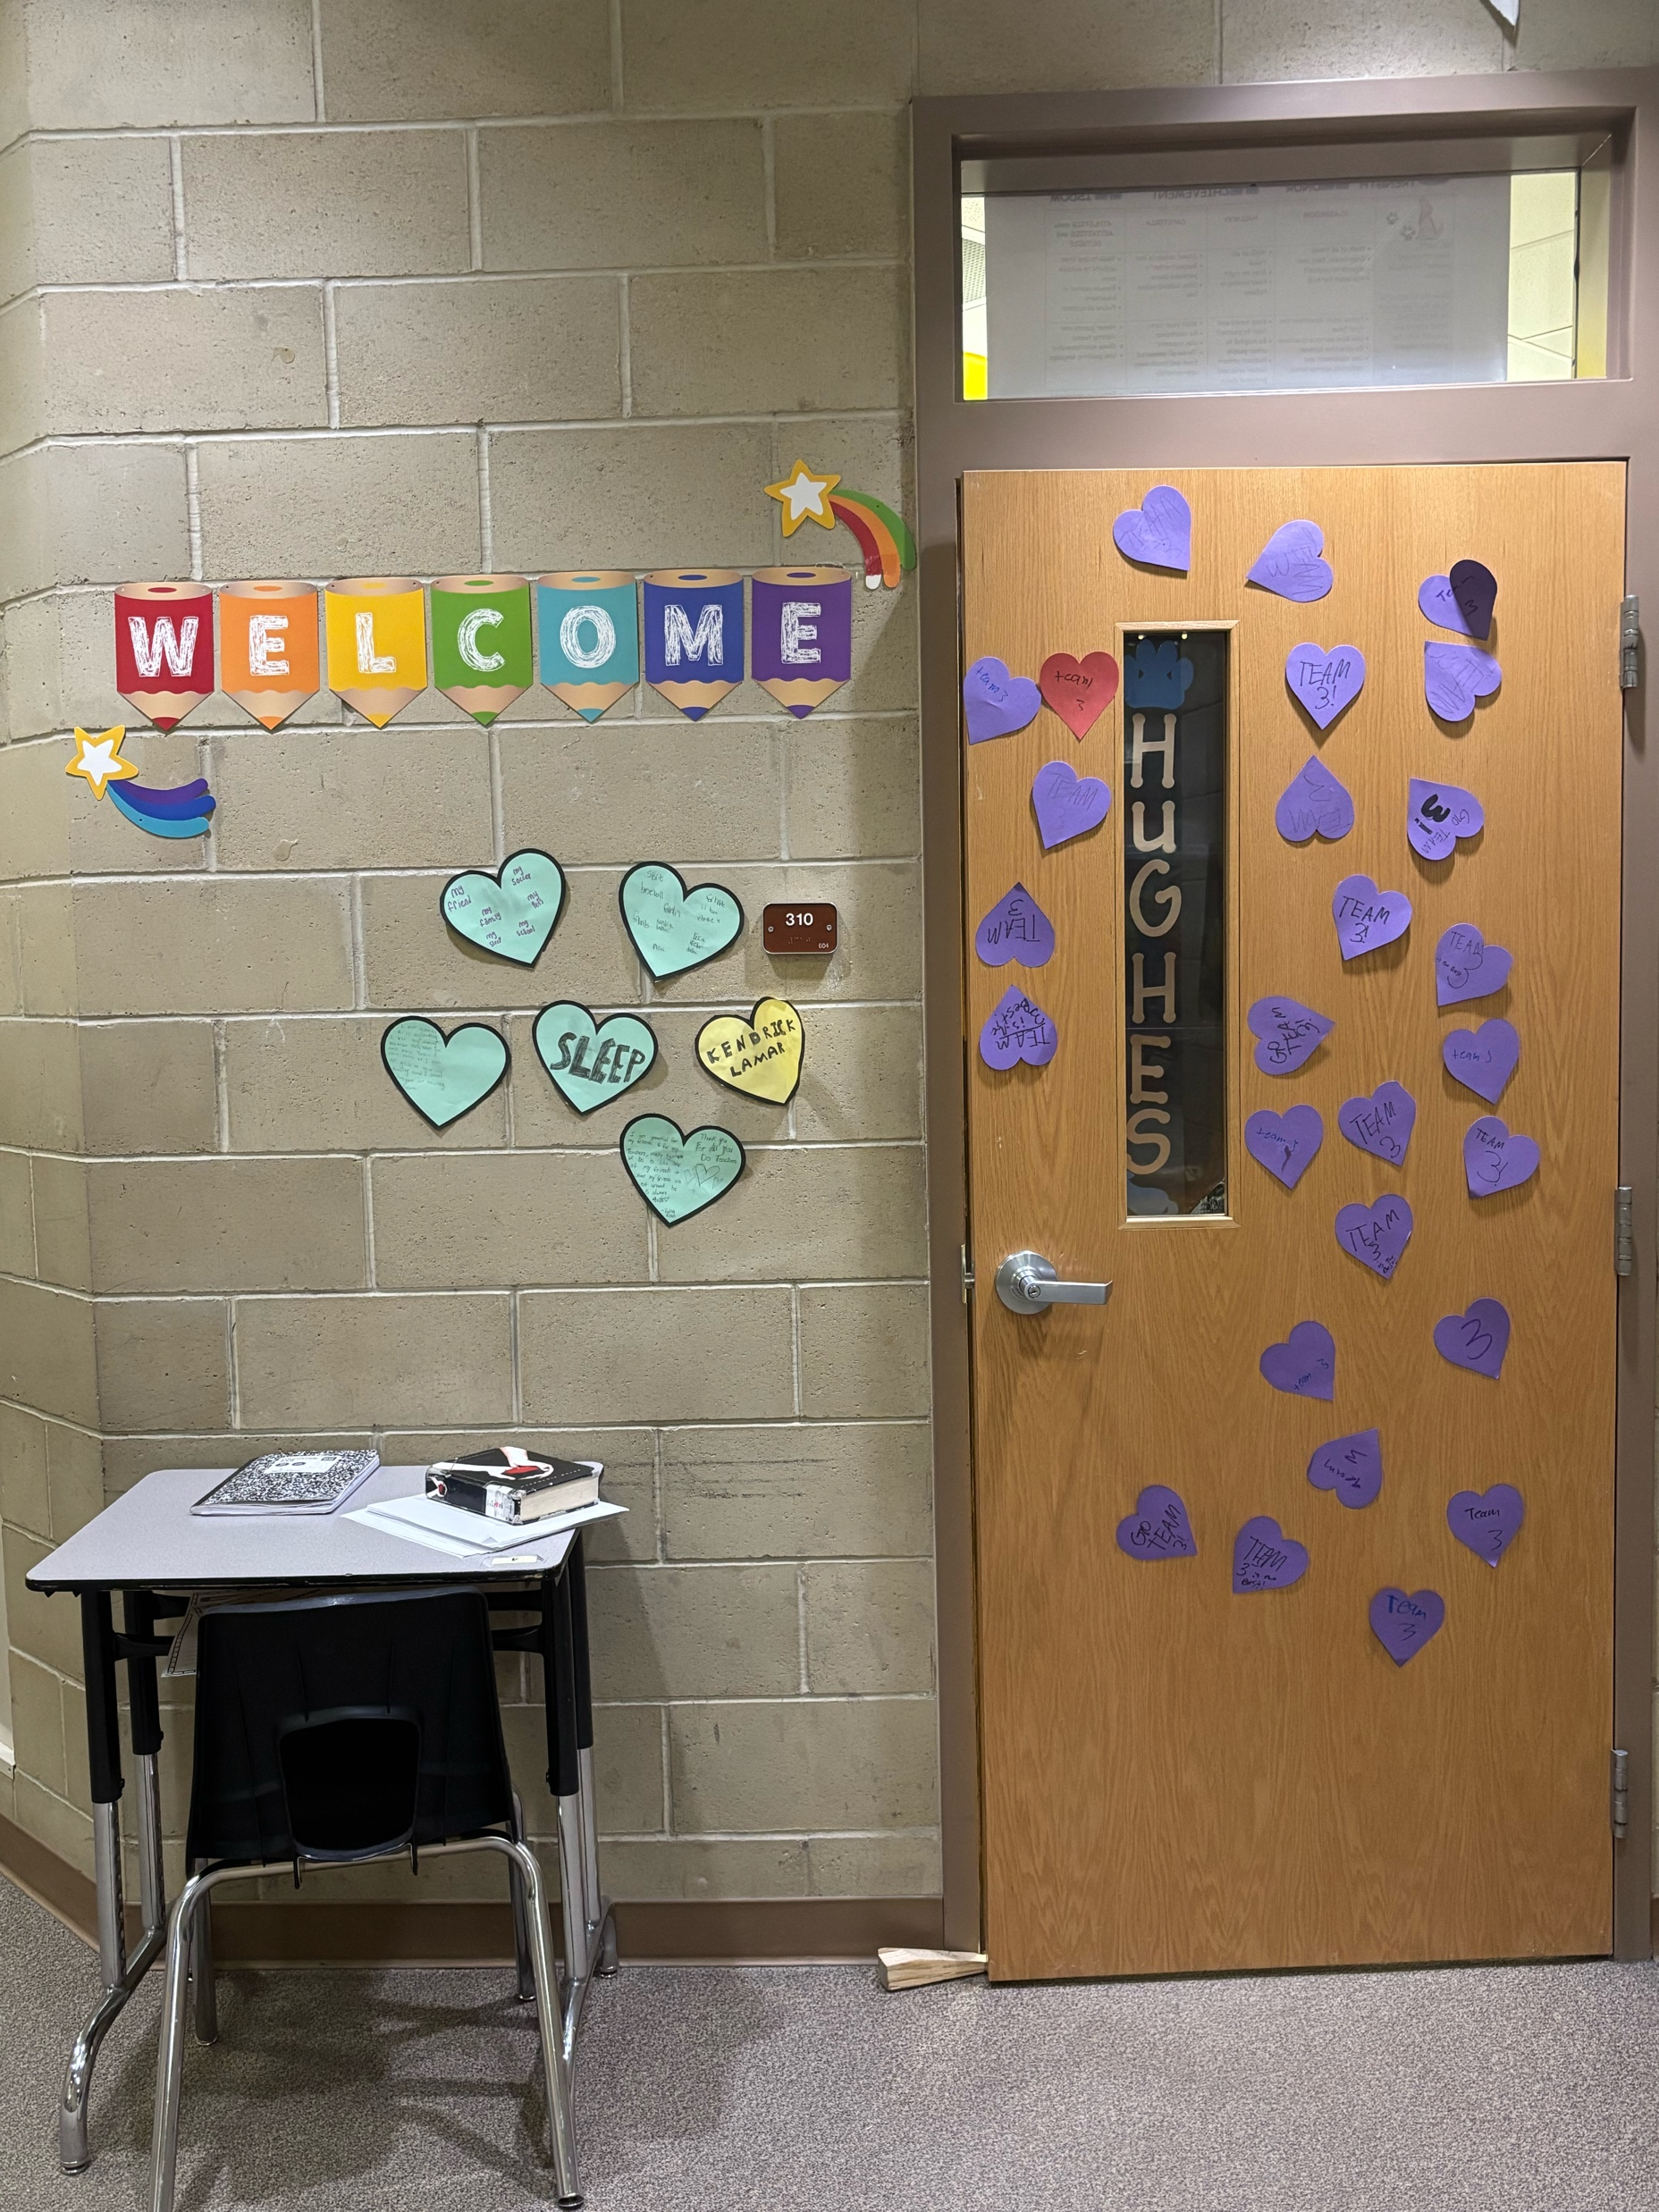
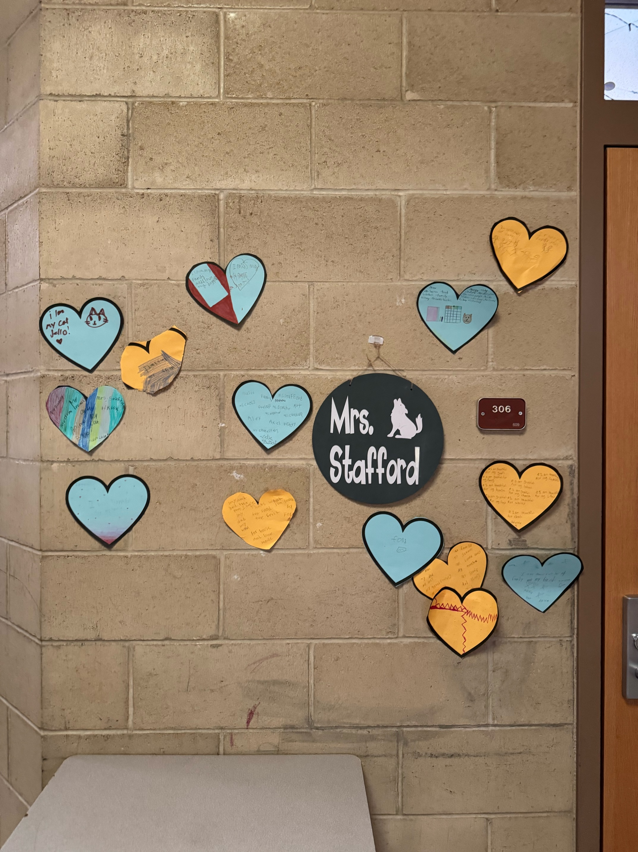
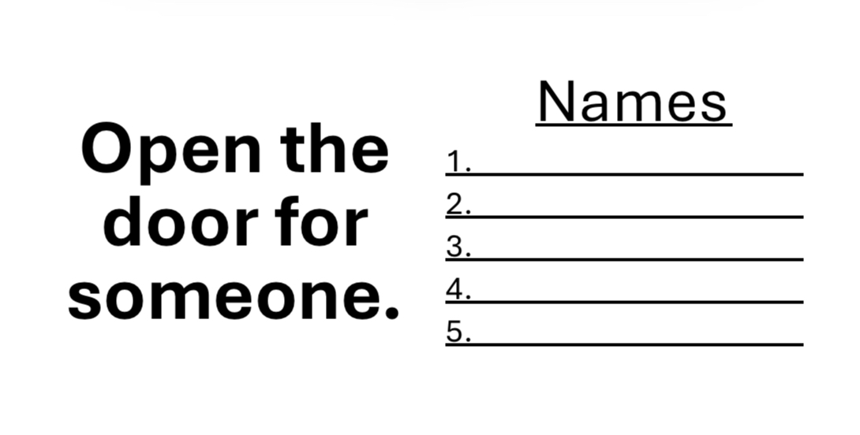
Kindness Week
DRESS UP DAYS :
Pajama Day – Don’t sleep on kindness
Neon Day- Shine Bright for kindness
Camo Day- Don’t hide from kindness
Jersey day – Team up for kindness
Wear Pink and Red to spread love and kindness
Activities
Kindness Task Cards
Prize Drawing
HeartAttacks
Kindness Concert

Slide 6

Kindness Word of the Day!
  Practice- We encouraged the students to practice being kind each day
  Hakuna Matata- It’s a wonderful phrase. It means no worries for the rest of your days. We encouraged students to not worry and have a great day.
  Gratitude- We encouraged students to focus on all the things you are grateful for that day!
  Compassion- We encouraged students when they see someone down in the dumps try to help them.
  Empathy- We encouraged students to try to feel what others are feeling.
ThePhoto by PhotoAuthor is licensed under CCYYSA.

Slide 7

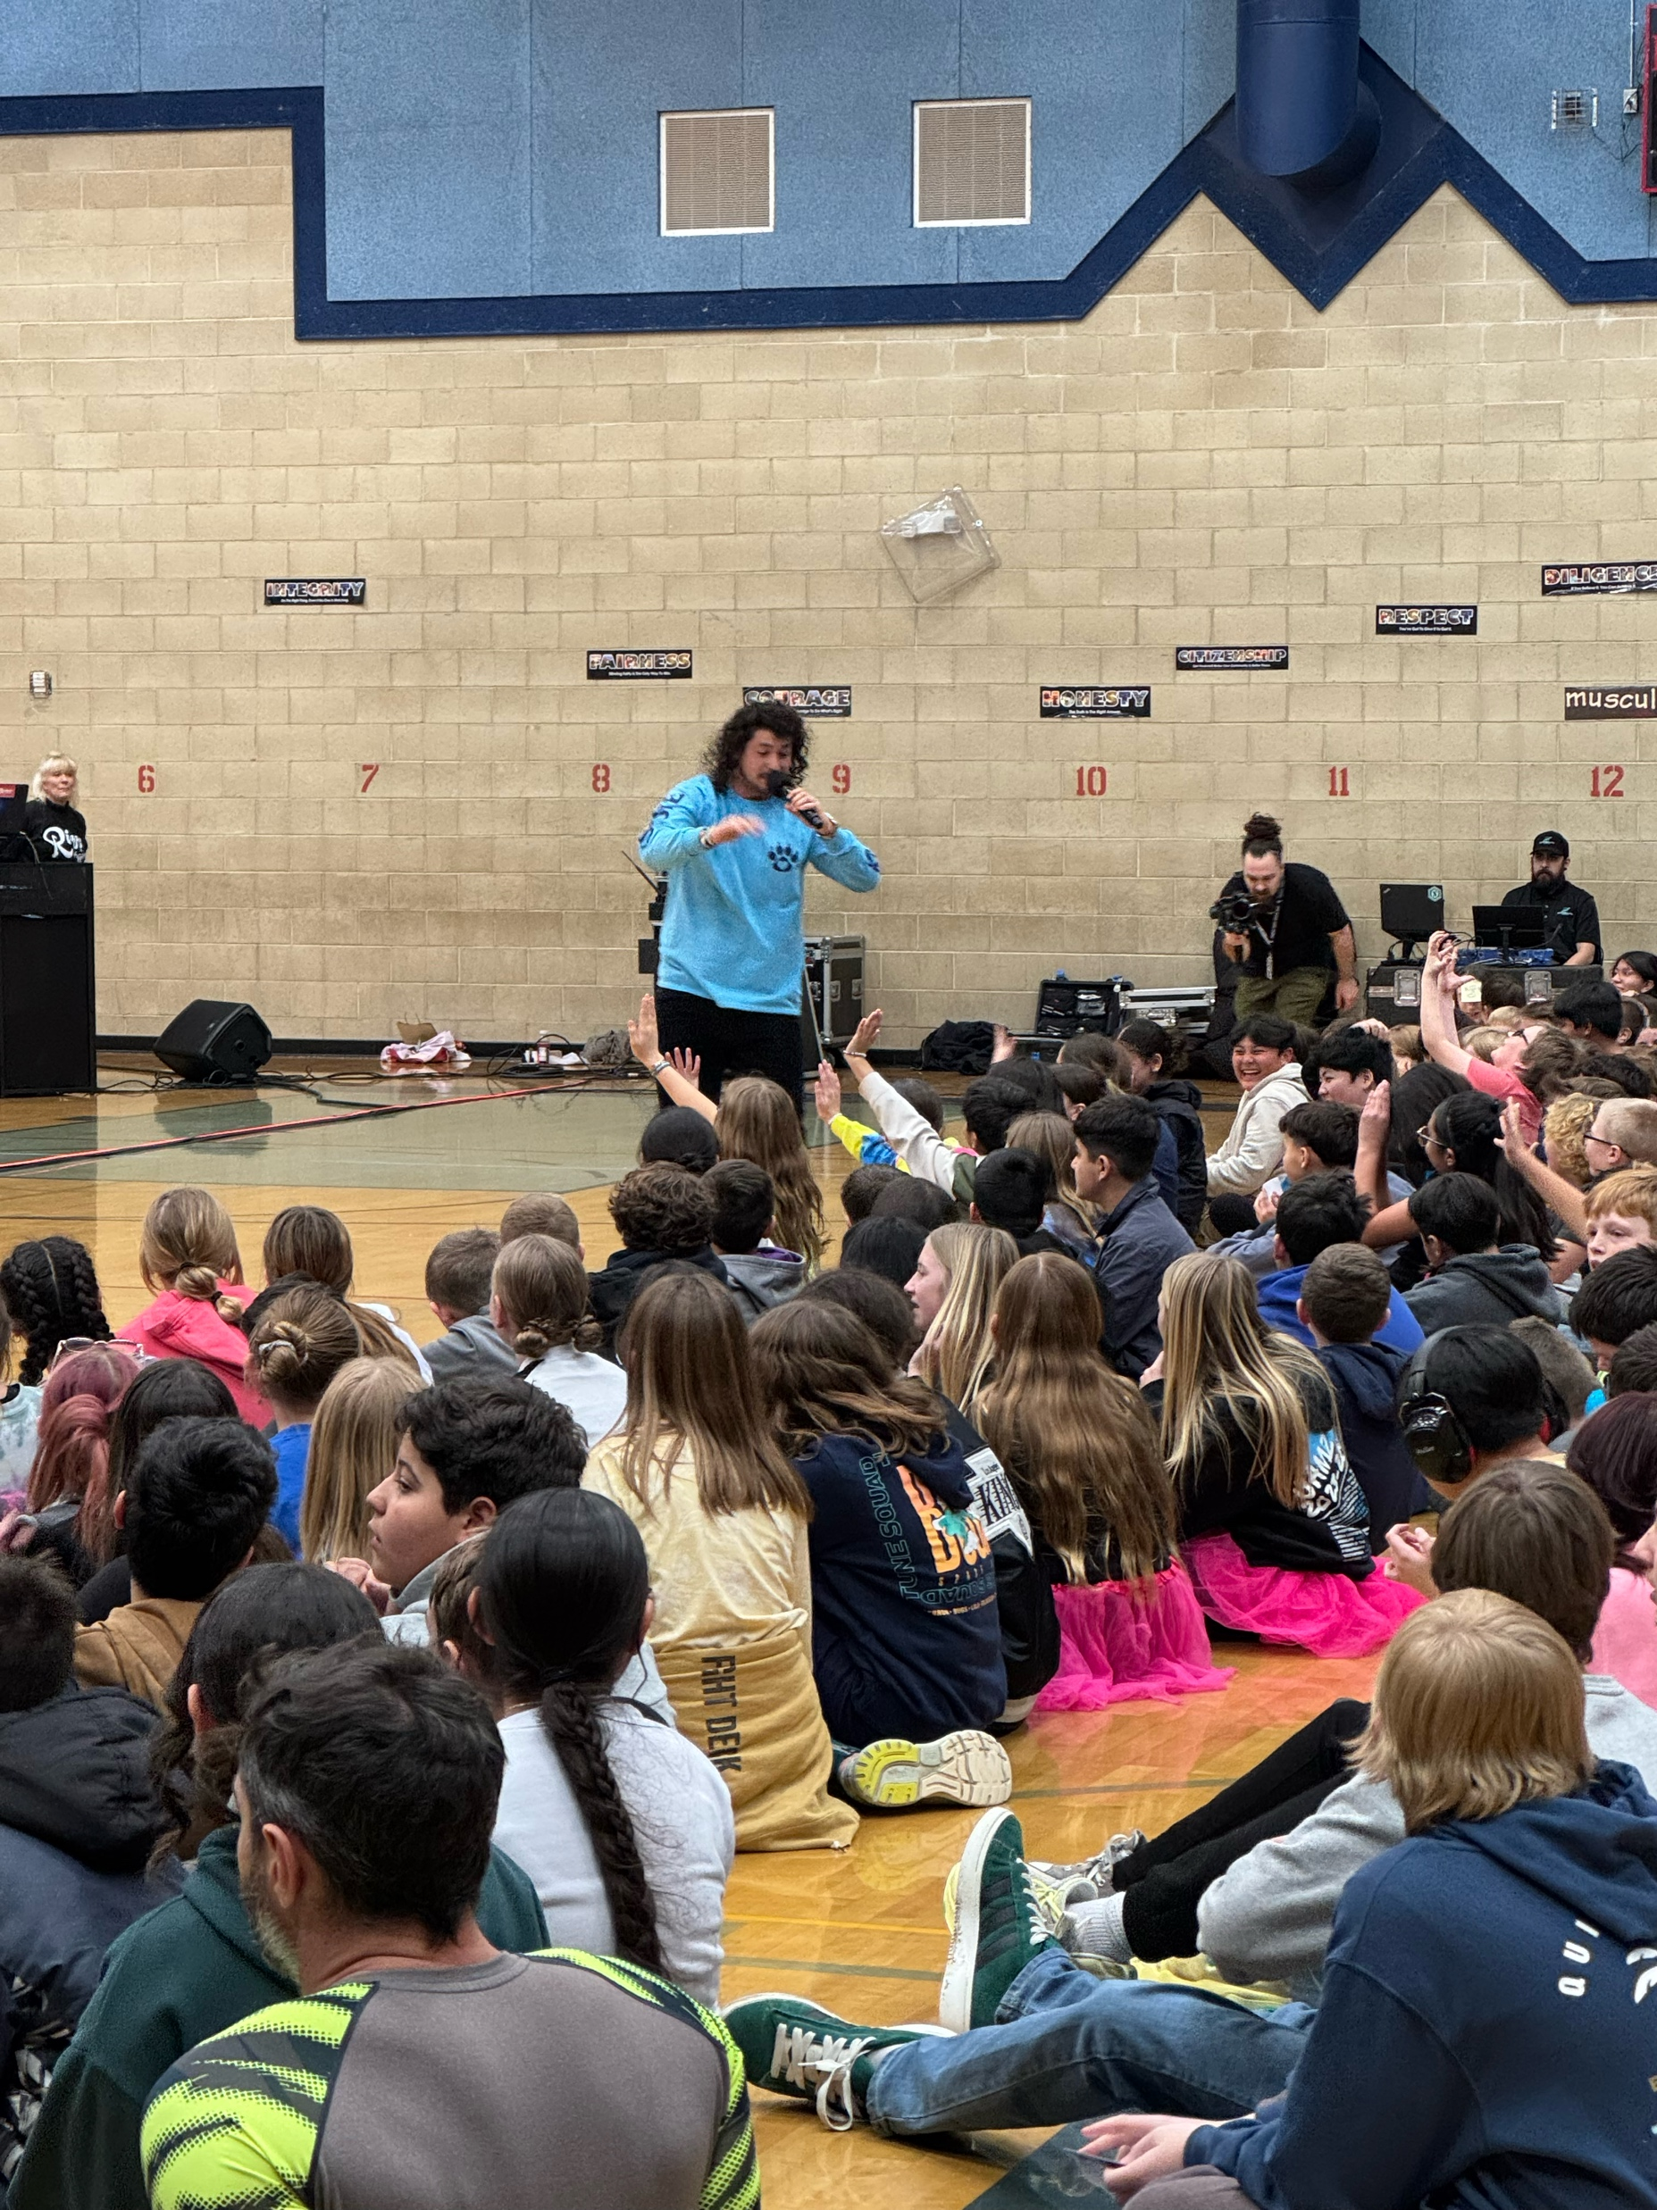
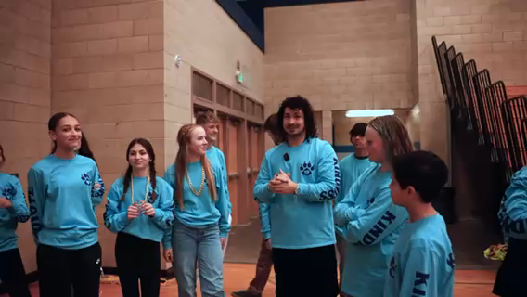
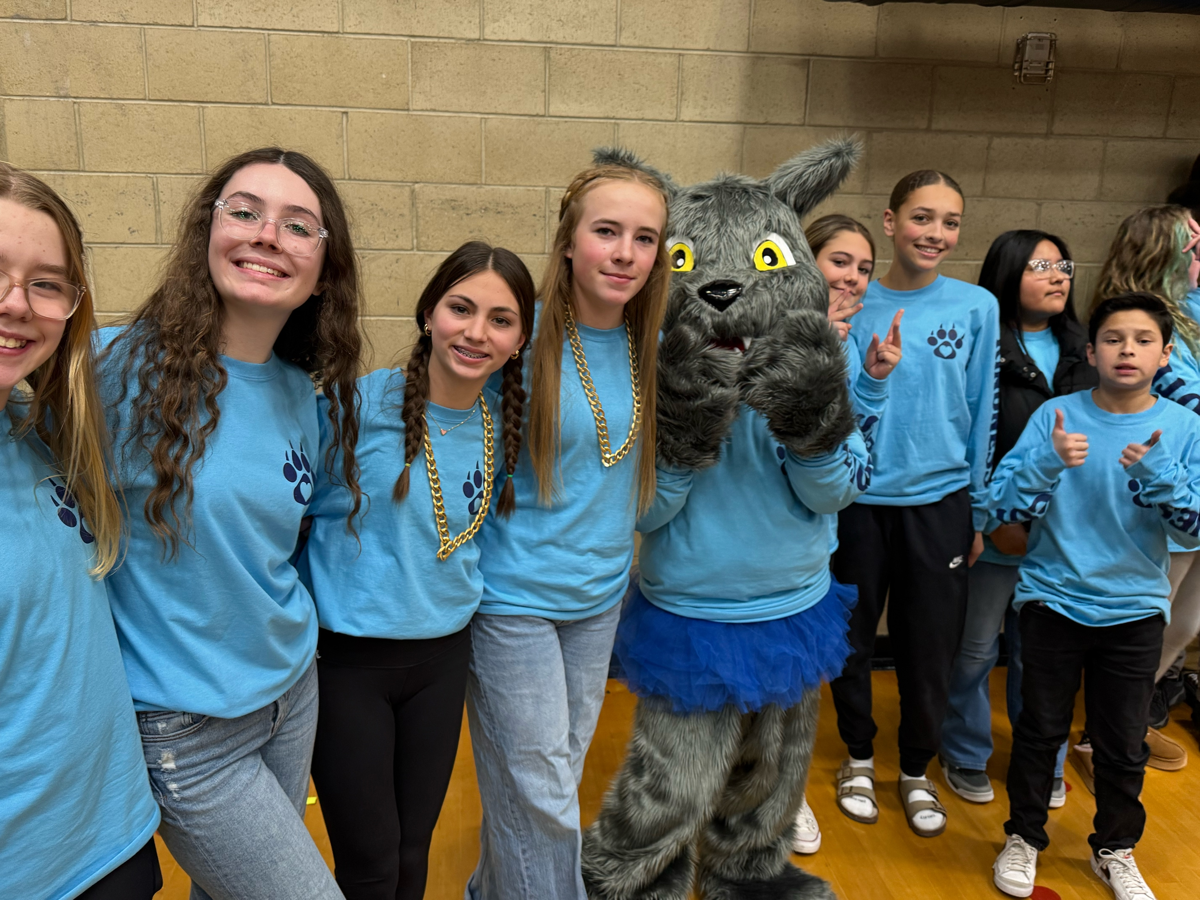
Kindness Concert with RIZZ
Video Link

Slide 8

Our goals for our school to continue to spread kindness
- Kindness Rock pathway
Kindness/ friendship bench
Continue with beautification of Shaw with clean up days

Slide 9

KINDNESS ROCKS

