Slide 1

Setting the Scene

Slide 2

“I wish we could do something different at school…”
“Something I actually want to do…”

Slide 3

“Something I am passionate about…”

Slide 4

“Could I learn to play the guitar in 10 weeks?.”

Slide 5
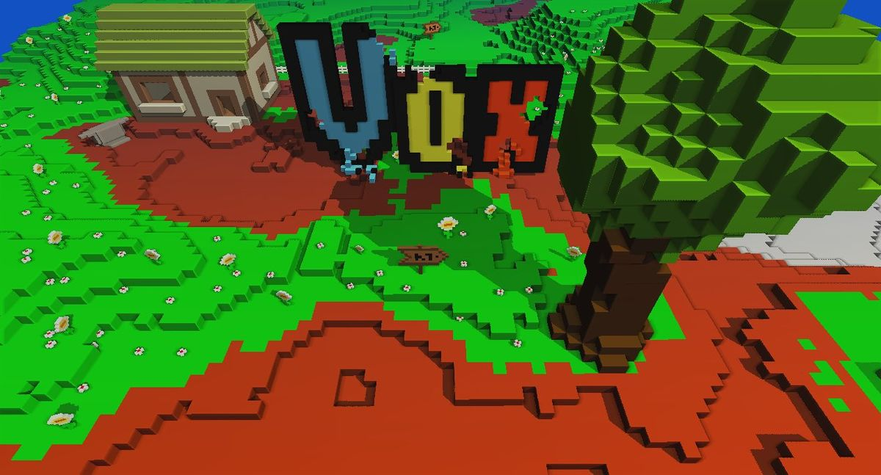
“How would I make my own videogame?

Slide 6

“I’d like to learn how to sew.”

Slide 7
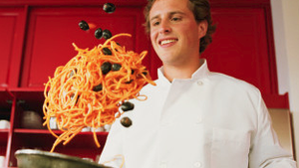
Could I cook a “MasterChef” Quality feast?

Slide 8
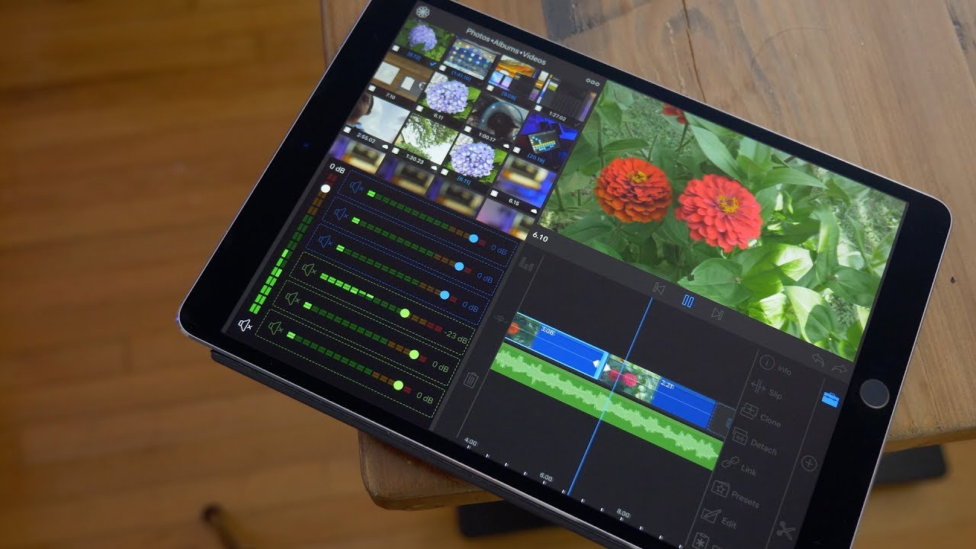
I could make a Hollywood movie scene on my iPad?

Slide 9
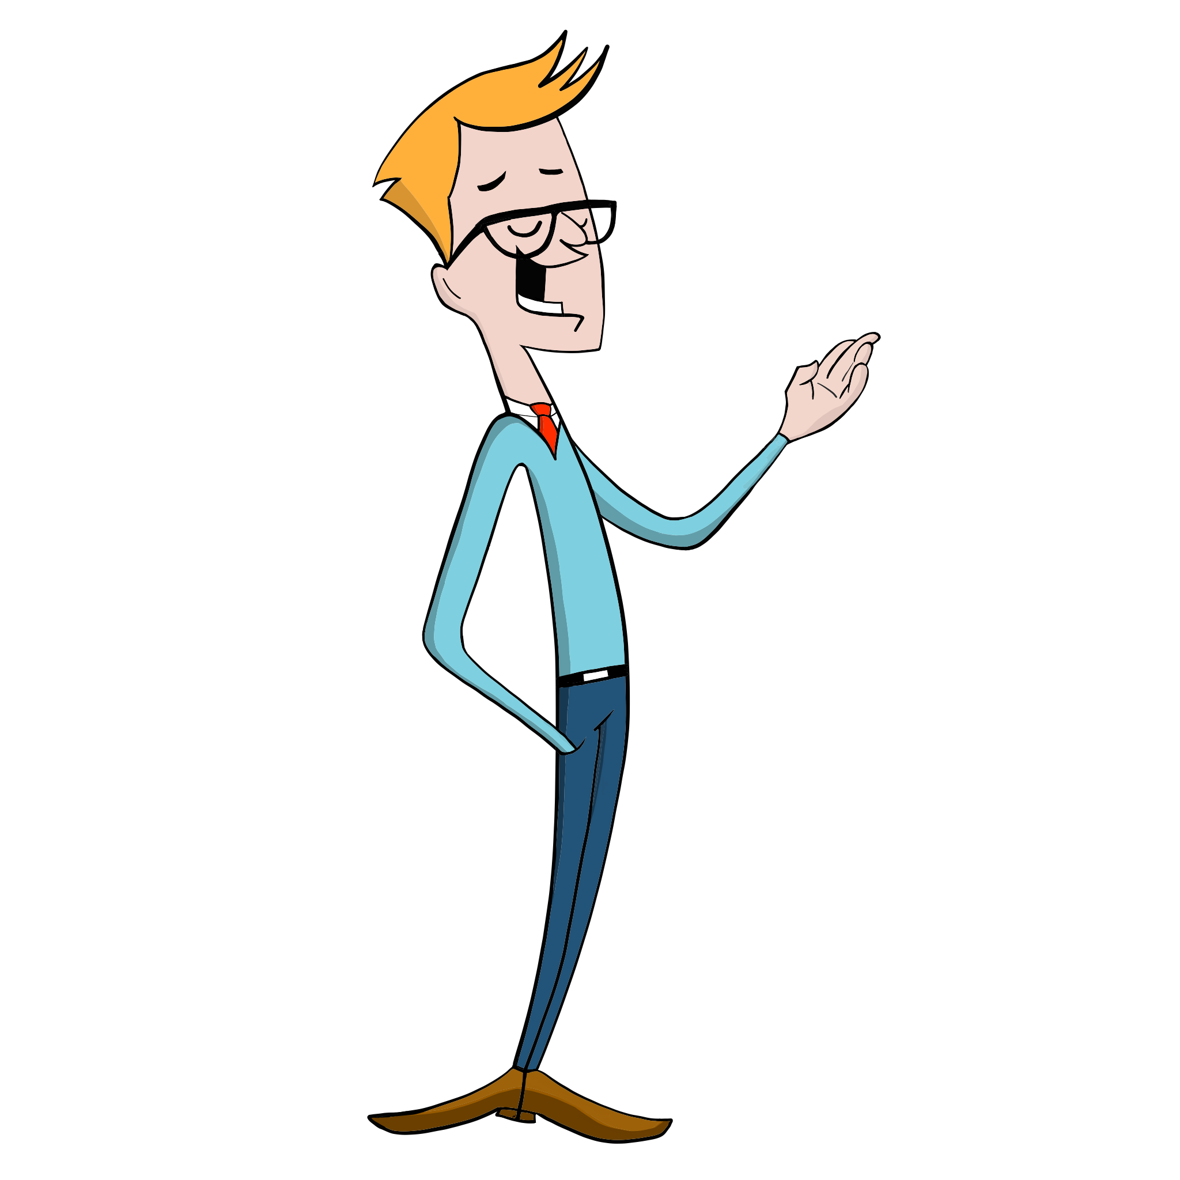
What do you want to learn?
What is your passion?

Slide 10
What is a Passion Project?
A Passion Project is a task in which you explore a ‘passion’ of yours in a meaningful way.
Your passion will be led by a ‘guiding question’ such as “Can I cook a restaurant quality meal for guests?” or “Could I make a dress good enough to sell?”
Throughout this process you will learn a great deal about the processes, materials, and skills required. Developing a deep understanding, and appreciation of your topic.
The success or failure of the task is irrelevant, if you gain wisdom, and share it with others.
In order to achieve all this you will need curiosity, determination, a plan and resilience.

Slide 11
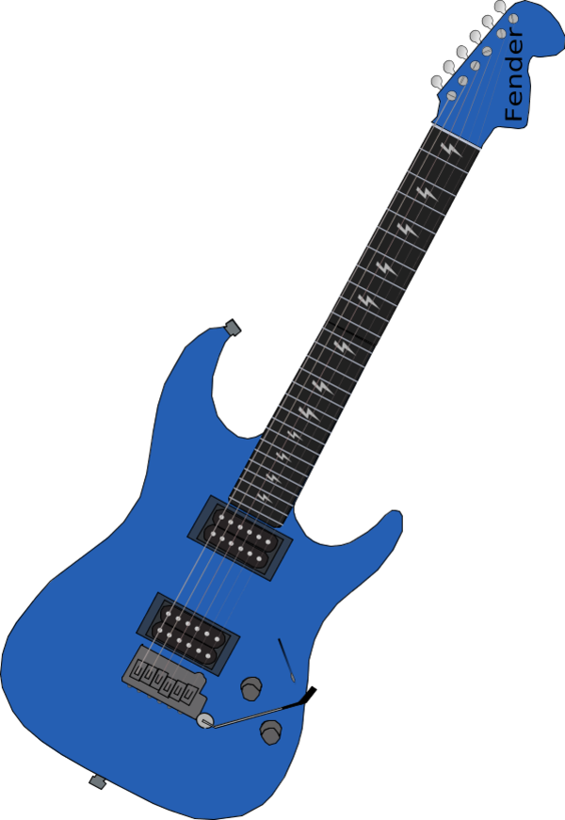
Welcome
The purpose of this project is for you to learn something new; something you have always wanted to do.
Maybe you want to learn how to play the guitar, build a dog kennel, cook a gourmet meal, create a video game, complete a family tree or even make a movie.
There are no limits as long as you are passionate about the subject area and prepared to learn more about it.
Copyright innovativeteachingideas.com

Slide 12
Passion Project Purpose?
Try something new.
Challenge yourself
Learn from the experience
Share the experience

Slide 13
PLEASE…
Prepare to be creative

Slide 14
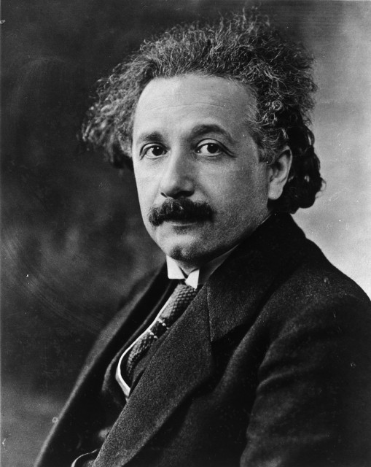
“Creativity is intelligence having fun”
Albert Einstein

Slide 15
PLEASE…
Be Innovative, and try new things

Slide 16

“Innovation is taking things that already exist, and putting them together in new way”
Tom Freston

Slide 17
DON’T FEAR FAILURE…
If you don’t make mistakes, you’ll never learn

Slide 18
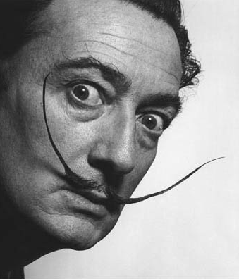
“Have no fear of perfection, you’ll never reach it.”
Salvador Dali

Slide 19
DON’T GIVE UP…
Everything is hard at first

Slide 20

“The greatest thing is when you do put your heart and soul into something over an extended period of time, and it is worth it.”
– Steve Jobs

Slide 21

What will you get out of it?
You will gain new skills, knowledge and understanding about something important to you, whilst demonstrating your capacity to learn and share that knowledge with others.
This project, just like last semester, is a big one, covering the entire quarter.
You have to learn your topic and skills well enough to share your knowledge with your peers, parents and teachers. And they will all be assessing you on this.
DID YOU KNOW…Eustress is a positive kind of stress, the kind that makes you feel excited about what you're doing and about life. Your passions, are one of the greatest ways to access that kind of stress. When you're doing something you love—something you don't have to do for any other reason other than the fact that you love it—you feel a rush of excitement and joy.
Copyright innovativeteachingideas.com

Slide 22

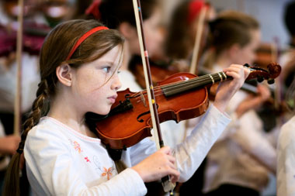

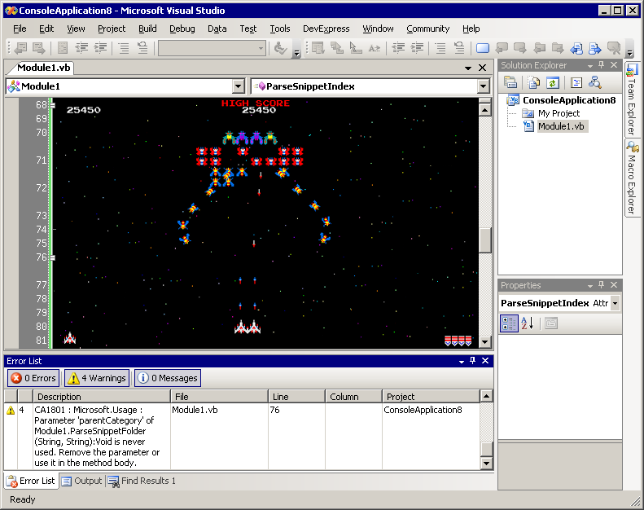



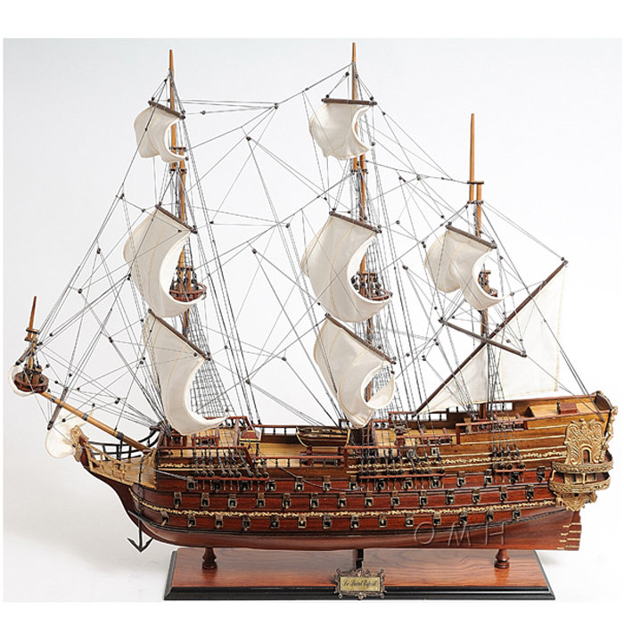

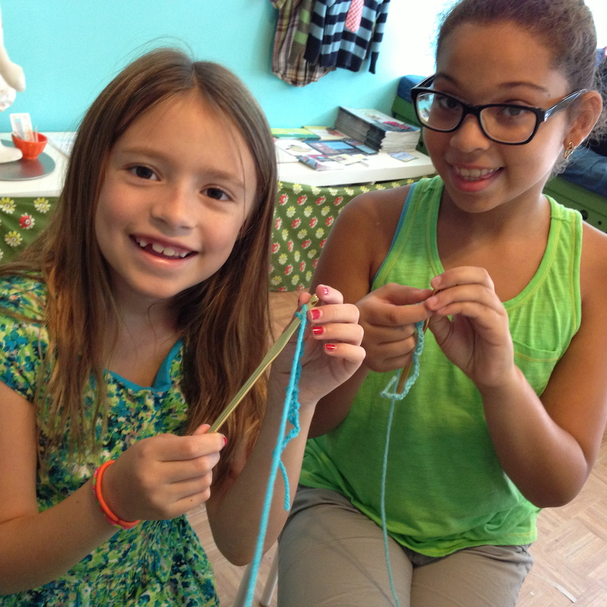
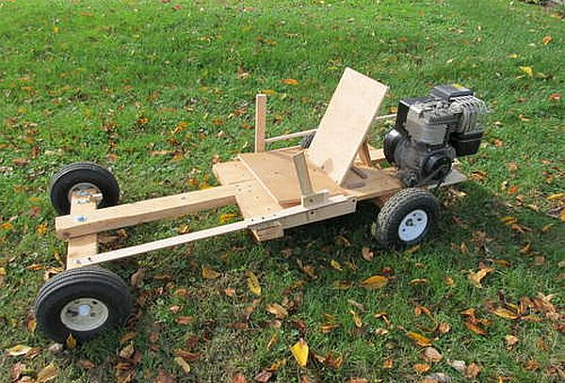

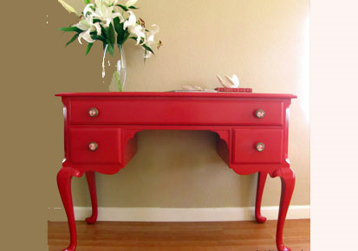
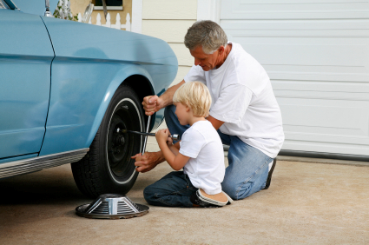

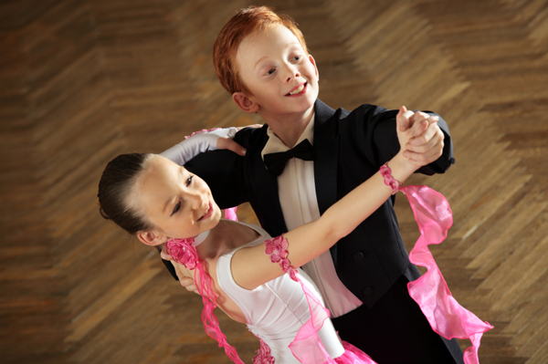
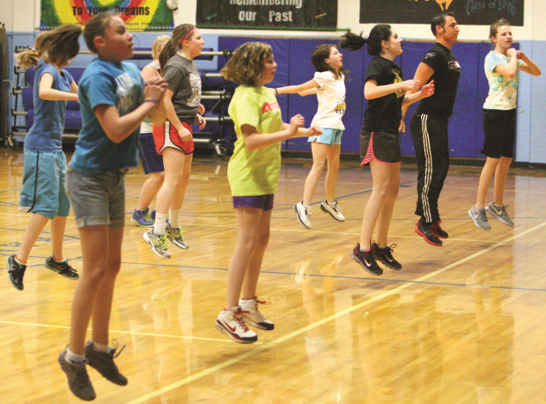
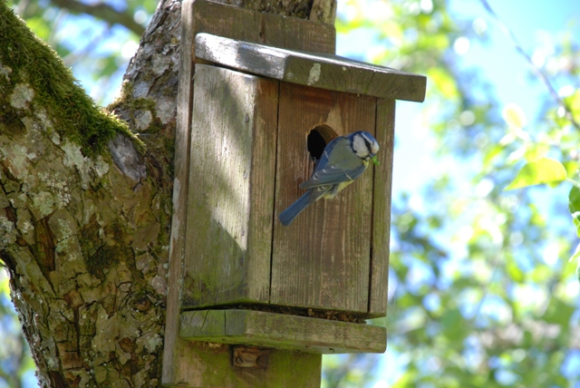
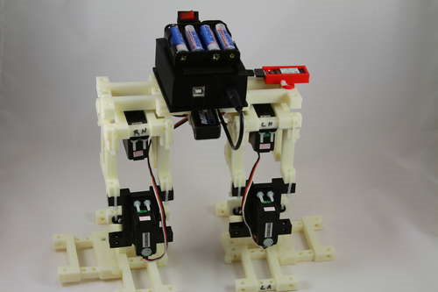
What others have done
Cook a three course meal | Learn an Instrument | Build a dog kennel | Learn to code | Make a movie
Write a song | Paint a proper picture | Build a model | Make a dress | Learn to knit
Build a Go-Kart | Make a video game | Restore an Antique | Fix a car | Landscape a garden
Grow a Veggie Patch | Learn to dance | Improve your fitness | Make a bird house | Make a Robot
Copyright innovativeteachingideas.com

Slide 23

Non-negotiables
You have to research something
You have to create or do something
You have to present something
Remember this project is about learning, not doing something perfectly. Don’t be afraid to challenge yourself…
Copyright innovativeteachingideas.com

Slide 24
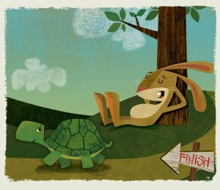
Remember, It’s a marathon, not a sprint.
Although this task is a large one you will have greater success if you approach it as a series of small steps.
You will need to communicate your progress with peers, parents and your teachers through a journal, diary or blog as evidence of your learning.
This Project will culminate in a presentation of your choice no longer than 5 minutes demonstrating the skills, knowledge and journey of your learning process.
We would like you to be creative in putting this presentation together and we will be sharing some examples of how you might like to present your final project.
SLOW & STEADY WINS THE RACE
Copyright innovativeteachingideas.com

