Slide 1


7th Grade Health Screening
Washoe County School District

Slide 2
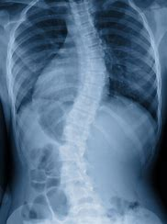
What is scoliosis?
Scoliosis is a sideways curve or rotation of the spine.
Scoliosis affects 3% of the population and generally appears after the last growth spurt before puberty.
Scoliosis is best treated when found early.
Treatment is determined by the extent of scoliosis and may not require any intervention.

Slide 3
What to expect for your screening
Boys and girls will be screened separately by trained nurses.
1
You will be asked to take off your shoes.
2
Once in a private area, the nurse will ask you to take off your shirt with your back facing the nurse.
3
Stand with your feet together and weight equally distributed on both legs.
4
5
Let your arms hang naturally at your side, shoulders relaxed.

Slide 4
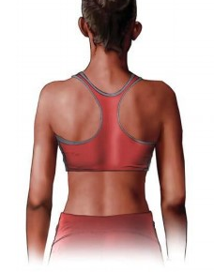
Arms relaxed hanging naturally at your side

Slide 5
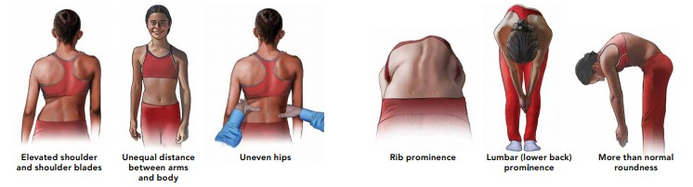
Signs of Scoliosis
Uneven shoulders and shoulder blades
Unequal distance between arms and body
Uneven hips
Rib hump or rib prominence
Lower back hump
More than normal roundness

Slide 6
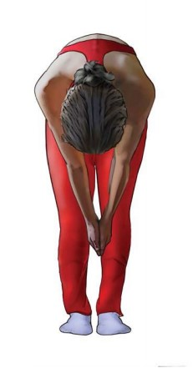
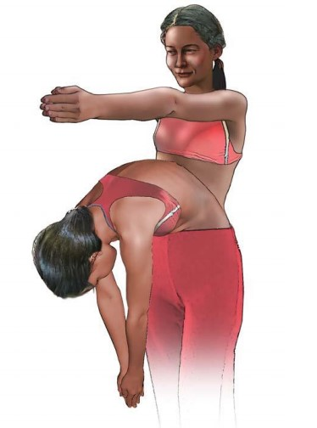
Adam’s Forward Bend Test
Put palms of your hands together, arms out straight.
Put your chin on your chest.
Roll down until hands reach mid-shin.

Slide 7
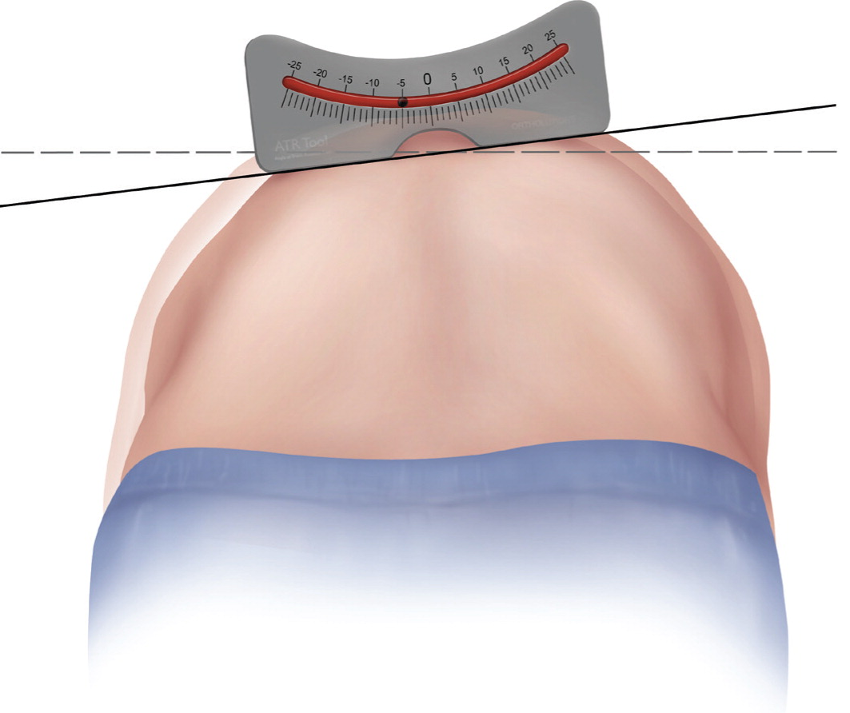
Scoliometer
The nurse may place a scoliometer on your back to determine if there is a curve or rotation of the spine.

Slide 8
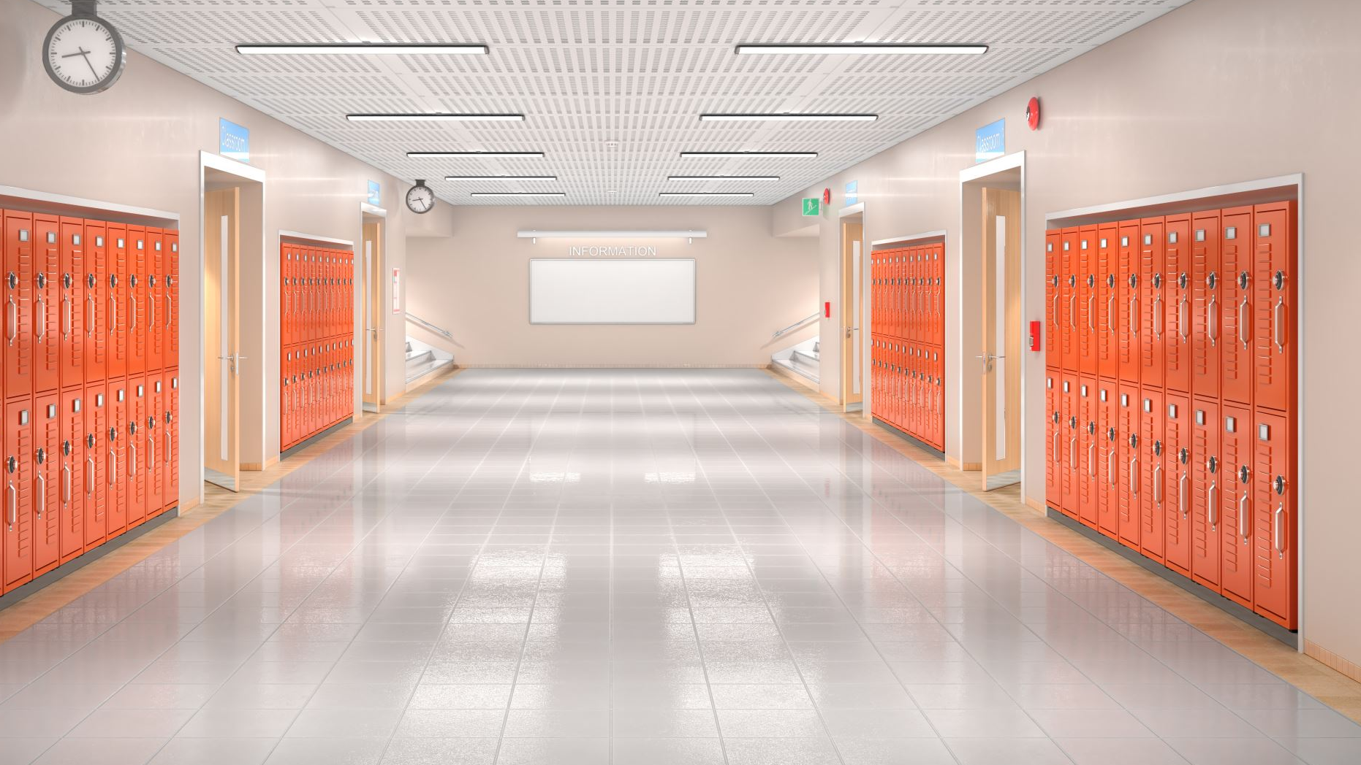
REMINDERS
Your screening will consist of vision, hearing, and scoliosis
Please be quiet walking to the screening location and during the screening to be respectful of surrounding classrooms and your peers.

Slide 9

Thank you!!

