Slide 1
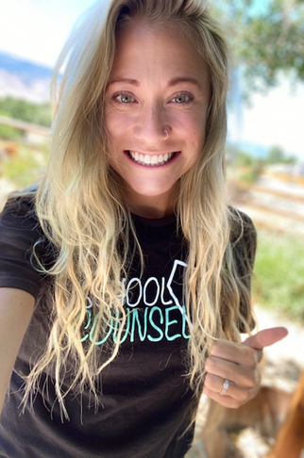
Mrs. Frey School Counselor
Classroom lessons 30 minutes every other week to learn about:
Feelings
Self-regulation
Coping strategies
Problem-solving
Many more! ☺
Small groups are facilitated with consent
Grief and loss
Anxiety
Low self-esteem
Family change
Specific social skills
Individual brief counseling by parent, teacher, or student referral
Challenges at school
Changes at home
Provide referrals for outside counseling and community resources
Contact me!
Email: JCRios@washoeschools.net
Phone: 775-353-5750 ext. 50863

