Slide 1

Administration of
Grade 2-12 Measures
Notes:
NARRATION:
Welcome to the Administration of Grades 2-8 Measures tutorial. This tutorial will cover administration of both the reading and the math measures.

Slide 2
Copyright Notice
All aimsweb™Plus materials and content are protected under the United States copyright law and include, but are not limited to:
Software (including screenshots or images of the software)
PowerPoints, handouts, training guides, software guides, manuals, scripts, and other assorted documentation in the form of print, digital, or other medial format
Videos or other media
For more information, please see the aimsweb License Agreement (http://www.aimsweb.com/license-agreement)
Copyright 2016, Pearson Education, Inc. or its affiliate(s).
All Rights Reserved
Notes:
Please keep in mind that these materials and the content are protected under US copyright law. For more information visit the website listed on this page.

Slide 3
Learning Objectives
Online Measures
Be able to describe the reading and math measures used for Grades 2-12.
Understand how to administer the assessments with fidelity.
Apply what you have learned to practice.
Notes:
NARRATION:
At the close of this tutorial you will:
Be able to describe the aimswebPlus measures used for grades 2-12 in the areas of Reading and Math.
Understand how to administer the measures with fidelity.
Apply what you have learned to practice.

Slide 4

aimswebPlus Measures
Notes:
First, we will help you gain a basic understanding of the aimswebPlus measures across both the reading and math areas for grades 2-12.

Slide 5

Reading
Measure | Purpose | Grades 2-3 | Grades 4-12 | Time to Test
Vocabulary | Screening | ✓ | ✓ | Untimed (4-7 minutes)
Reading Comprehension | Screening | ✓ | ✓ | Untimed (15-25 minutes)
Silent Reading Fluency | Both |  | ✓ | Untimed (about 5 minutes)
Oral Reading Fluency | Both | ✓ | ✓ | ~2 minutes
*Grades 9-12 take 8th grade tests
Notes:
This table shows the recommended grade levels for which each of the Reading measures are given, as well as the approximate time needed for each administration. It also indicates whether the measures are designed for Screening, Monitoring or both.
If you have students in grades 9-12 who are taking these measures, they will take the 8th grade measures and their results will be compared to 8th grade norms.

Slide 6
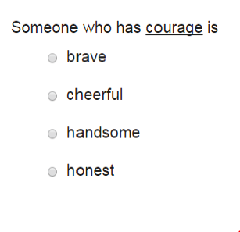
Vocabulary
What the student does:
Identifies the meanings of target words by selecting from multiple-choice options.
Levels:
Grades 2-12 (9-12 take 8th grade measure)
Notes:
Vocabulary assesses a student’s knowledge of grade-appropriate words. Selected to measure a range of student knowledge, the Vocabulary measure helps to inform instruction and provide further understanding of a student’s reading ability. The student chooses the response that best matches the meaning of vocabulary words from the multiple-choice options. This is an untimed test.

Slide 7
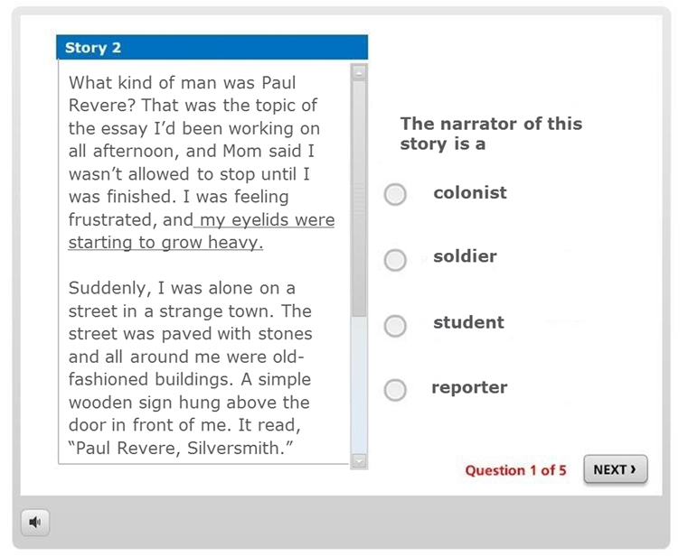
Reading Comprehension (RC)
What the student does:
Reads six passages of text and answers multiple-choice questions about each passage.
Levels:
Grades 2-12 (9-12 take 8th grade measure)
Notes:
Reading Comprehension assesses a student’s ability to answer questions about grade-appropriate informational and literary texts. Addressing the main reading comprehension standards of key ideas/details, craft and structure, and integration of knowledge/ideas, the Reading Comprehension measure helps to inform instruction and provide further understanding of a student’s reading ability. The student reads passages of text and answers multiple-choice questions about each passage. This is an untimed test.

Slide 8
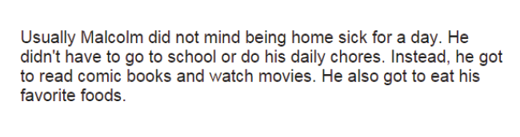
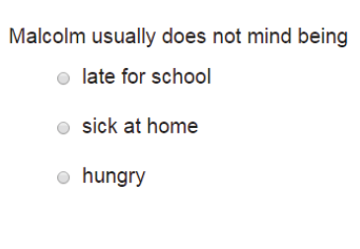
Silent Reading Fluency (SRF)
What the student does:
Reads three stories, each divided into four brief sections, and answers multiple-choice questions about each story.
Levels:
Grades 4-12 (9-12 take 8th grade measure)
Notes:
Silent Reading Fluency assesses a student’s ability to quickly read and answer questions about grade-appropriate story segments. Each form contains three stories broken into four segment/question pairs. This measure helps to inform instruction and provide further understanding of a student’s reading ability. The student reads short story segments and answers multiple-choice questions about each passage. After an answer is selected, the student receives immediate feedback (correct or incorrect) before moving on to the next segment and question. This is an untimed test; however, the time students spend on each screen is captured to determine reading rates for each story. The student must also meet a minimum criterion to receive a valid score.

Slide 9
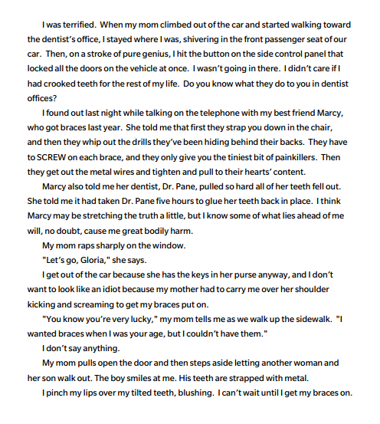

Oral Reading Fluency
(OR)
What the student does:
The student sees two separate one-page stories and reads as much of the story as possible within 1 minute.
Level:
Grade 1-12: Fall, Winter & Spring (9-12 take 8th grade measure)
Notes:
NARRATION:
Oral Reading Fluency (ORF) is included in the tests of Early Literacy for students in 1st grade, and is benchmarked in the Fall, Winter and Spring. Oral Reading Fluency (ORF) is also benchmarked during the Fall, Winter, & Spring of grades 2-12.
During the administration the student sees a one-page story and reads as much of the story as possible within 1 minute. The system will keep track of how many words were correct and how many words were incorrect to compute an accuracy rate. When Benchmarking, the student will read two passages; when Progress Monitoring, only one passage is necessary.

Slide 10
Math
Measure | Purpose | Grades 2-8 | Time to Test
Concepts and Applications | Screening | ✓ | Untimed (up to 25 minutes)
Number Comparison Fluency- Triads | Both | ✓ | 3 min
Mental Computation Fluency | Both | ✓ | 4 min
Number Sense Fluency (NCF-T + MCF) | Both | ✓ | 7 min
*Grades 9-12 take 8th grade tests
Notes:
This table shows the recommended grade levels for which each of the online measures of Math are given, as well as the approximate time needed for each administration. It also indicates whether the measures are designed for Screening, Monitoring or both.
As with Reading, the measures are delivered to students with web-based testing. The student logs in, takes the test, and the scores are automatically generated. Scores are then synced over to the aimswebPlus account. Make note that when students in grades 9-12 are tested, they are given 8th grade measures.
Total testing time for screening is less than 30 minutes per student.

Slide 11
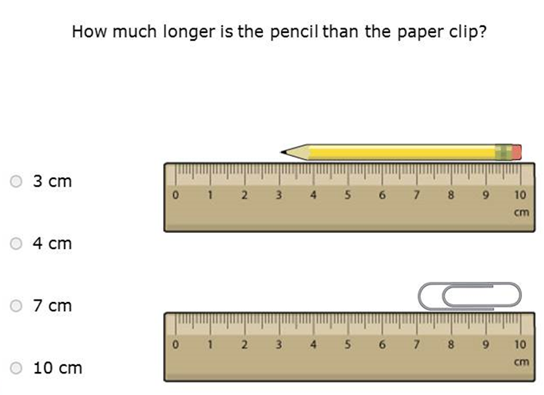
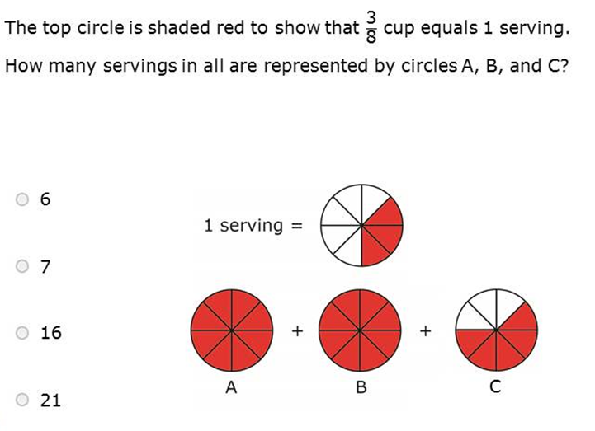
Concepts and Applications (CA)
What the student does:
Solves multiple-choice math word problems.
Levels:
Grades 2 -12 (9-12 take 8th grade measure)
Notes:
Concepts & Applications assesses a student’s ability to solve one- and two-step word problems as well as his/her knowledge of essential math concepts in the areas of algebra, base ten numbers, measurement and data, geometry, fractions, statistics and probability, expressions and equations, and functions. Content reflects math expectations appropriate to each grade level. The student answers multiple-choice math problems, each addressing an aspect of the content areas listed above. This measure has no time limit and the student attempts all items. Students are allowed to use scratch paper and pencils to solve test items, and audio is available for students who prefer to have the items read to them.

Slide 12
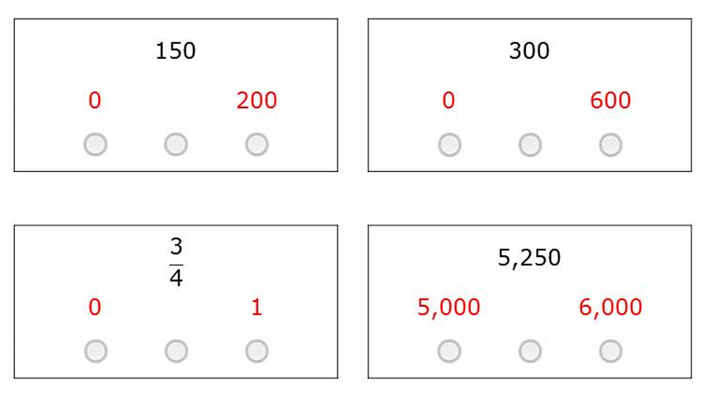
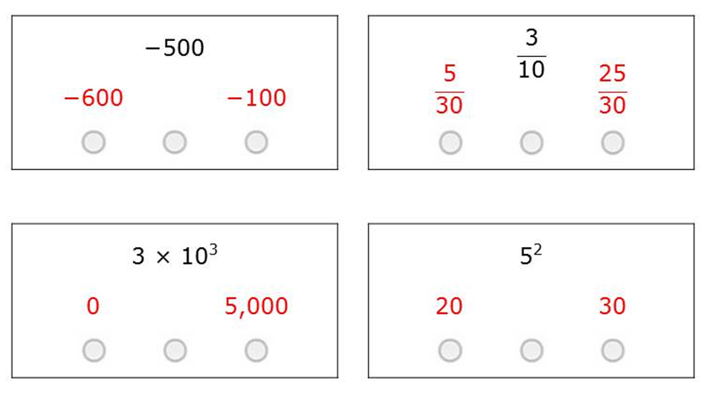
Number Comparison Fluency- Triads (NCF-T)
What the student does:
Mentally solves multiple-choice math problems, each requiring the student to assess magnitude while comparing a set of three numbers.
Levels:
Grades 2 -12 (9-12 take 8th grade measure)
Notes:
Number Comparison Fluency–Triads assesses a student’s ability to assess magnitude and compare numbers within and across number systems. Content reflects math expectations appropriate to each grade level. Because it is a timed measure, NCF–T can also measure the level of automaticity of these skills.
The student answers multiple-choice math items, each requiring a comparison of a set of three numbers. Each item is presented as a triad of numbers, with the student determining whether the top number in the triad is closer in value to the bottom left number, the bottom right number, or exactly in between the two numbers. The student answers as many items as possible in 3 minutes.
The NCF-T measure is combined with the next measure (MCF) to create a Number Sense Fluency score.
When progress monitoring, both NCF–T and MCF must be administered. Together, these two measures combine into the Number Sense Fluency (NSF) score, which is the basis for making progress monitoring decisions.

Slide 13
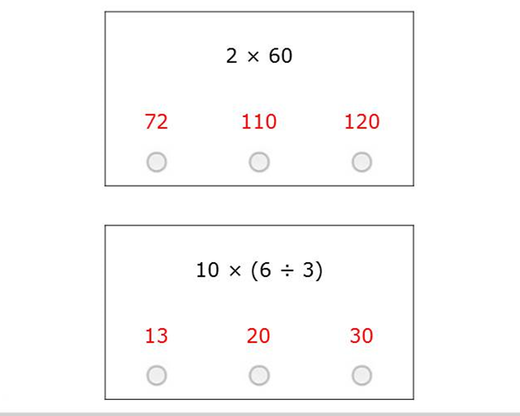
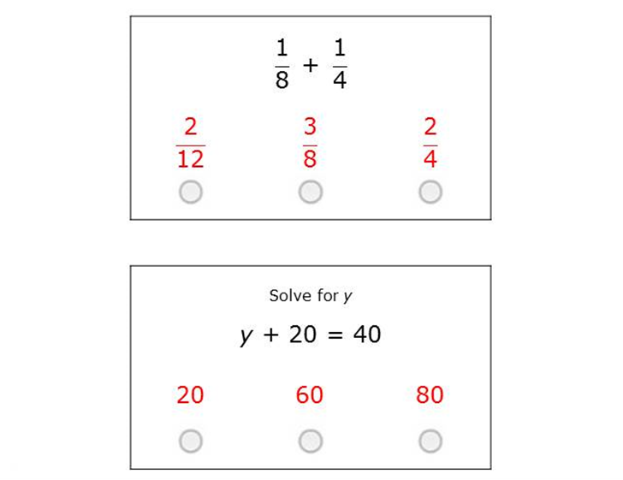
Mental Computation Fluency (MCF)
What the student does:
Mentally solves multiple-choice math computation problems.
Levels:
Grades 2 -12 (9-12 take 8th grade measure)
Notes:
Mental Computation Fluency assesses a student’s ability to mentally solve computation problems. Content reflects math expectations appropriate to each grade level. Because it is a timed measure, MCF can also measure the level of automaticity of these skills.
The student answers multiple-choice math items, each requiring mental computation of a math expression. The student answers as many items as possible in 4 minutes. Each MCF form contains 42 items, presented two per screen.
When progress monitoring, both NCF–T and MCF must be administered. Together, these two measures combine into the Number Sense Fluency (NSF) score, which is the basis for making progress monitoring decisions.

Slide 14

Number Sense Fluency (NSF)
This is a summary of performance from the Number Comparison Fluency-Triads and Mental Computation Fluency tests for students in Grades 2 and up.
Notes:
Number Sense Fluency is not a specific test that a student takes, but is a summary of their performance across both the Number Comparison Fluency-Triads test and the Mental Computation Fluency test. The combination of these measures and total scores can be used for benchmark screening and progress monitoring of students in Grades 2 and up.

Slide 15


Before Completing Online Assessments
Notes:
First, let’s cover information you need to know about administering the online measures for grades 2 and up. This includes setting up the ideal testing environment as well as planning and preparation. These topics are vital to make sure that you receive reliable and valid results.
Take note that we will cover the one measure not completed online, Oral Reading Fluency, later in this video.

Slide 16
Assessment Environment
Online Measures
Quiet space
that is
free from distractions.
Schedule when students are rested and able to pay attention.
Come prepared with test assignment information.
Computer lab with technology ready.
Notes:
NARRATION:
Testing should take place in a computer lab or classroom that is quiet and free from distractions. Keep in mind what is happening just outside of the lab or classroom. Try to make sure that each student is far enough away from other students so as to limit eavesdropping. Make sure that your technology is ready to use so there are limited disruptions to the administration of the tests. This includes readying the computers or devices with TestNav. Teachers should make sure to have test assignment information available so that students can log in. Be sure to schedule your testing when students are rested and able to pay attention. Keep in mind student activities that are occurring prior and just after your test session.

Slide 17


Planning and Preparation
Test Materials:
Computer
(meets TestNav requirements)
Mouse
Headphones
TestNav Requirements:
https://support.assessment.pearson.com/display/TN/
Notes:
NARRATION:
Each student will need his/her own computer station that meets minimum system requirements to properly view and interact with the test content. (Please visit TestNav’s online support website at https://support.assessment.pearson.com/display/TN/ to view the most current system requirements and to find answers to other TestNav-related questions.) In addition, each student’s computer station needs a mouse and headphones, pretested with the volume set to a reasonable level.

Slide 18
During Online Assessments
Notes:
Now we will cover some To-Do’s, Not-To-Do’s, and information about accommodation use during testing.

Slide 19
To Do’s
aimswebPlus assessments are standardized.
Be an active proctor. Make sure that students are on task.
Walk around. Answer questions individually.
Encourage students to answer based on what they think each item is asking.
Re-administer after several days if testing is spoiled.
Be sure the students complete all sections assigned to them.
Notes:
NARRATION:
All of the aimswebPlus assessments are standardized. Adhering to the standardized administration will help ensure that the data you collect is reliable and valid. While standardization is built right into the online assessments, it is also helpful to create a predictable testing situation for students from a variety of backgrounds. Examiners should present and then supervise test sessions, ensuring that students are on task and that any questions are answered. While examiners themselves do not present the test items to students, they must familiarize themselves with the administration and scoring procedures and understand each measure’s content and purpose prior to administering the online measures to students. After testing is complete, if you feel that for some reason your test session is spoiled, the student can retake the test. It is suggested to wait a few days before students retake any test forms to minimize the potential for practice effects. Always be sure that students complete all sections that are assigned to them.

Slide 20
Not To Do’s
aimswebPlus assessments are standardized.
Do not teach the student during the test.
Do not provide hints or corrective feedback.
No calculators are allowed for any math measure.
Do not allow students to talk during the tests.
Avoid bathroom and water breaks during the session. Minimize movement and traffic within
the room.
Notes:
NARRATION:
To avoid violations in standardization do not teach or correct the student during the assessment. During universal screening, no calculators are permitted on math measures. These types of things were not used in the standardization of the measures and thus are not permitted. Students should not be allowed to talk during the tests as this will distract others. Encourage your students to use the bathroom and take a drink of water before the testing session as this will not be allowed during testing. This will help to reduce distracting movements during the test.

Slide 21
Screening Accommodations
With Online Measures
Not Allowed
Hints and corrective feedback.
Extending time limits.
Allowed
Scratch paper- only for CA.
Modifying the environment (e.g. special lighting, adaptive furniture).
Accommodations documented in a student’s IEP or 504 plan. Some are built into TestNav.
Notes:
NARRATION:
Occasionally you might need to consider accommodating for a student with specific needs. These guidelines will help you to determine what are and are not appropriate accommodations during the screening process.
Accommodations that are not allowed include providing hints and corrective feedback and extending time limits on timed tests. It is virtually impossible to extend time limits on online assessments either way.
The following accommodations are allowed for screening: scratch paper on the Concepts and Applications test and modifying the environment with special lighting or adaptive furniture. You may also provide accommodations documented specifically within a student’s IEP or 504 plan. For the reading measures there is accommodative technology such as contrast, magnification, answer blocking and hidden lines built into the TestNav software. Text-to-speech is available for both reading and math measures. Be aware that while these accommodations are available for all students to use in the software, that you only want students with documented needs to use accommodations to actually use them. Always keep these accommodations in mind when interpreting data.

Slide 22
Monitoring Accommodations
In addition to the screening accommodations allowed, other appropriate accommodations may be made during progress monitoring as long as:
  The accommodations are applied consistently during progress monitoring.
  Any accommodations are documented.
Notes:
NARRATION:
During progress monitoring, other appropriate accommodations may be made as long as they are applied consistently each time and are well documented. It is important to know that a comparison of any student’s progress monitoring score to the national norms may not be appropriate due to these accommodations.

Slide 23
Recommended
Interruptions to internet connection is possible and can be unpredictable at times!
Be Proactive!
Install ProctorCache and precache test items. Students can resume testing and results will be available once the internet connection resumes.
Notes:
NARRATION:
As you are aware, interruptions to internet connection is possible and can be unpredictable at times. {Click} We highly recommend that you be proactive by installing ProctorCache and precaching test items. This not only helps your testing run more efficiently throughout the process, but also allows students to continue testing should the internet go down. You must always have connectively to initiate the assessment through TestNav, but should internet be interrupted, the students can continue taking their tests. Their results will move over to aimswebPlus once internet connection is resumed.
More information on this can be found in the Help file or on the TestNav webpages. This option must be completed by an Account Manager.

Slide 24
Benchmarking Quick Steps:
Online Assessment Administration (demo)

Slide 25

Administration of the Online Assessments
Notes:
NARRATION:
Let’s take a look at the introductory scripts to use for the math and reading online measures.

Slide 26
Math Measures
State verbatim:
“Today you’ll be taking a math test on the computer. You’ll need to wear your headphones to hear the test directions. When there are words that can be read to you, you’ll see a play button on the right side of the screen. Just click on the play button if you want to hear the words.
There are several parts to today’s math test—make sure to keep working until the test is complete. Follow all the test directions, answer every question, and do your own work.
If you have any questions during the test, please stay seated and raise your hand—I will come over to you. Remember: Do your best! Put on your headphones now and we’ll begin.”
Notes:
These oral directions should be given just prior to the students beginning their tests. This script may be found in the Math Administration and Scoring Guide for Grades 2-12.
State verbatim:
“Today you’ll be taking a math test on the computer. You’ll need to wear your headphones to hear the test directions. When there are words that can be read to you, you’ll see a play button on the right side of the screen. Just click on the play button if you want to hear the words.
There are several parts to today’s math test—make sure to keep working until the test is complete. Follow all the test directions, answer every question, and do your own work.
If you have any questions during the test, please stay seated and raise your hand—I will come over to you. Remember: Do your best! Put on your headphones now and we’ll begin.”

Slide 27
Reading Measures
State verbatim:
“Today you’ll be taking a reading test on the computer. You’ll need to wear your headphones to hear the test directions. When there are words that can be read to you, you’ll see a play button on the right side of the screen. Just click on the play button if you want to hear the words.
There are several parts to today’s reading test—make sure to keep working until the test is complete. Follow all the test directions, answer every question, and do your own work.
If you have any questions during the test, please stay seated and raise your hand—I will come over to you. Remember: Do your best! Put on your headphones now and we’ll begin.”
Notes:
These oral directions should be given just prior to the students beginning their reading tests. This script may be found in the Reading Administration and Scoring Guide for Grades 2-12.
State verbatim:
“Today you’ll be taking a reading test on the computer. You’ll need to wear your headphones to hear the test directions. When there are words that can be read to you, you’ll see a play button on the right side of the screen. Just click on the play button if you want to hear the words.
There are several parts to today’s reading test—make sure to keep working until the test is complete. Follow all the test directions, answer every question, and do your own work.
If you have any questions during the test, please stay seated and raise your hand—I will come over to you. Remember: Do your best! Put on your headphones now and we’ll begin.”

Slide 28

Oral Reading Fluency
Notes:
NARRATION:
Now we will move on to the only measure for Grades 2-12 that is administered one-on-one with Digital Record Forms.

Slide 29
Oral Reading Fluency
(ORF)
What the student does:
The student sees two separate one-page stories and reads as much of the story as possible within 1 minute.
Level:
Grade 1 and up- Fall, Winter & Spring (9-12 take 8th grade measures)
Notes:
NARRATION:
Oral Reading Fluency (ORF) is benchmark screened in the Fall, Winter and Spring beginning at grade 1. Oral Reading Fluency requires students to read aloud a fictional text for 1 minute. The examiner marks errors on a digital record form. The score is reported as words read correctly and the number of errors made. This allows for accuracy percentages. When screening you will give two one-minute passage and the system will report the average of these two scores.

Slide 30
Oral Reading Fluency
Has dedicated item sets exclusively for universal screening.
Are graded to be of similar difficulty within each grade level set.
Are all individually administered.
Multiple alternate forms per grade level for frequent progress monitoring.
Notes:
NARRATION:
Let’s start with some general information about the aimswebPlus ORF measures.
aimswebPlus provides dedicated item sets exclusively for universal screening.
The assessments are all graded to be of similar difficulty within each grade level set.
All of the measures are individually administered.
There are multiple alternate forms per grade level for frequent progress monitoring – up to 23 different test forms for screening and progress monitoring. The number of forms varies by measure, depending on the seasons administered and the corresponding PM periods available.

Slide 31
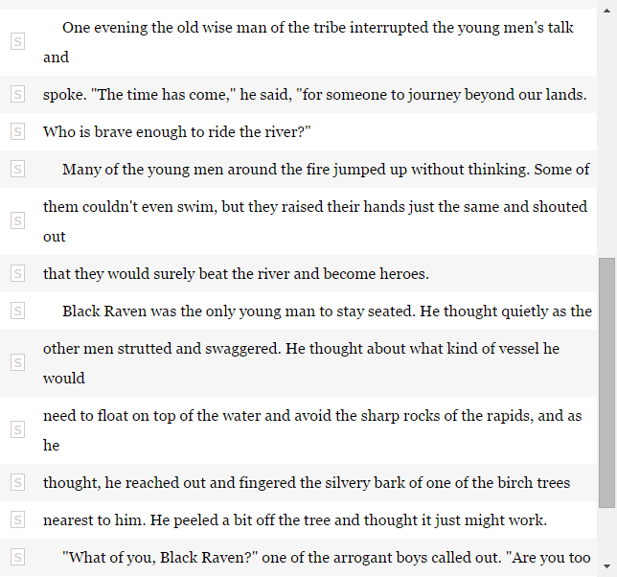


Materials Needed
Oral Reading Fluency (ORF)
Student
Digital Record Form
Notes:
NARRATION:
To administer Oral Reading Fluency you will need the ORF printed test forms for the student and the administrator will need the Digital Record Form which can be accessed on a computer or tablet that is connected to the internet.

Slide 32
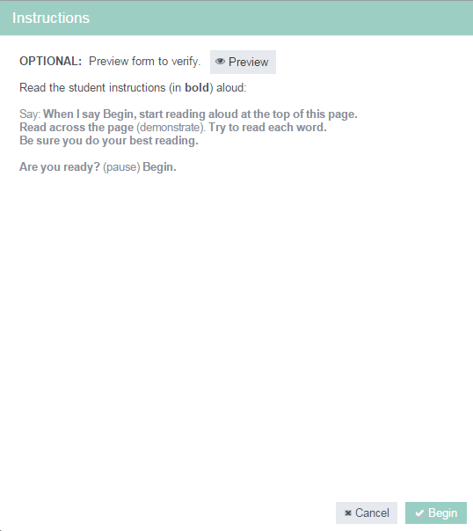
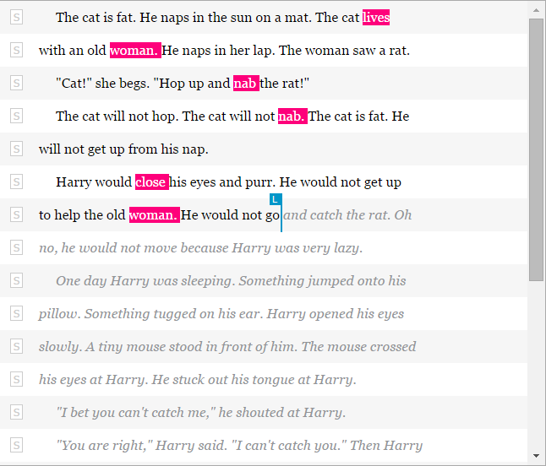
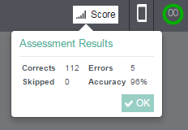
Digital Record Forms
(ORF)
Notes:
NARRATION:
The Digital Record Form (DRF) will contain the standardized directions. A timer will be present in the upper right-hand corner of the measure and errors can be marked by simply clicking on any incorrectly pronounced word. When the timer expires you will be prompted to pick the last word the student said. During benchmark testing sessions you will click the Next button to advance to the next story. After administering and scoring the second story the results will appear on screen and auto-populate to the reports.

Slide 33
Assessment Environment
One-on-One Measures
Quiet space
that is
free from distractions.
Same examiner for each student across the year.
Assess away from others to prevent eavesdropping.
Sit across from student or use the corner of a table.
Notes:
NARRATION:
While assessment environments are flexible, keep these points in mind. Testing should take place in an area that is quiet and free from distractions. A set-aside place in the classroom or stations in the media center, cafeteria, gym, or empty classrooms are approaches that have been used by others before. Try to have the same examiner test the students at each administration during the year. Younger children tend to perform better with a familiar examiner. Eliminate eavesdropping and practice effects by testing students away from other students. It’s also important to test the student at a small table or at the corner of a large table so that their attention is on what they are supposed to be doing and not on what you are doing on the computer.

Slide 34

Planning and Preparation
Student test materials must be downloaded from the aimswebPlus system and printed.
Each student’s performance is recorded on a digital record form (DRF) using a computer or tablet.
Notes:
NARRATION:
Student test materials are required for all measures. Test pages must be downloaded from the aimswebPlus help file and printed.. Once a test form is printed, it may be used as a master that can be photocopied as needed. Please be sure to keep masters and all copies in a secure place before and after use.
Each student’s performance is recorded on a digital record form (DRF) using a computer or electronic tablet. The digital record forms include all the instructions you’ll need for administering the measures to students - including what to say to the student and correct/incorrect response information. The DRF will guide examiners through the appropriate screens via computer. Scores are automatically generated when the student responses are submitted to aimswebPlus. Aside from the printed stimulus pages for the student, examiners will not need any printed materials or a stopwatch to administer and record a test session.

Slide 35

To Do’s
aimswebPlus assessments are standardized.
Administer the measures the same way each time.
Adhere to the exact standardized directions.
Adhere to the exact scoring rules.
Notes:
NARRATION:
All of the aimswebPlus assessments are standardized. Adhering to the standardized administration and scoring rules will help ensure the data you collect is reliable and valid. Therefore, it is crucial that you administer the measures the same way each time. This includes reading the exact standardized directions and adhering to the exact scoring rules for each student during each administration.

Slide 36
Not To Do’s
aimswebPlus assessments are standardized.
Do not teach or correct the student.
Avoid Practice Effects.
No rulers, guides, or other manipulatives are to be used during universal screening.
Notes:
NARRATION:
To avoid violations in standardization do not teach or correct the student. Remember this is about assessing students. It is important that students are not able to view the measures before they are assessed with them. Therefore, the measures shouldn’t be used for practice or homework, and should not be sent home. Try to make sure the testing environment is far enough away from other students so as to limit eavesdropping. During universal screening, no rulers, guides, or other manipulatives are permitted. These types of things were not used in the standardization of the measures and thus are not permitted. If a test session is spoiled (for example, the testing is interrupted during the administration of any of the timed fluency measures) examiners may re-administer the same test form to the student. It is suggested that examiners wait a few days before re-administering a form to minimize the potential for practice effects.
The next slides will discuss accommodations further.

Slide 37
Screening Accommodations
With Timed Measures
Allowed
Enlarging the test format.
Modifying the environment (e.g. special lighting, seating, furniture).
Not Allowed
Extending the administration time.
Providing feedback during administration beyond what is specified.
Providing practice administrations.
Students previewing or pre-reading the measures.
Notes:
NARRATION:
Speed plays an important role in the timed fluency measures, thus certain typical accommodations cannot be used without invalidating the norms.
The following accommodations are allowed for screening: enlarging the test format, and modifying the environment. This could include special lighting, seating, and furniture).
Those accommodations that are not allowed include extending the administration time, providing feedback during administration beyond what is specified, providing practice administrations, and having students preview or pre-read the measures.

Slide 38
Monitoring Accommodations
In addition to the screening accommodations allowed, other appropriate accommodations may be made during progress monitoring as long as:
  The accommodations are applied consistently during progress monitoring.
  Any accommodations are documented.
Notes:
NARRATION:
During progress monitoring, other appropriate accommodations may be made as long as they are applied consistently each time a test is administered and are they are well documented. It is important to know that a comparison of any student’s progress monitoring score to the national norms may not be appropriate due to these accommodations.

Slide 39
During Administration
Notes:
NARRATION:
Let’s take a closer look at how the DRF will function during administration.

Slide 40
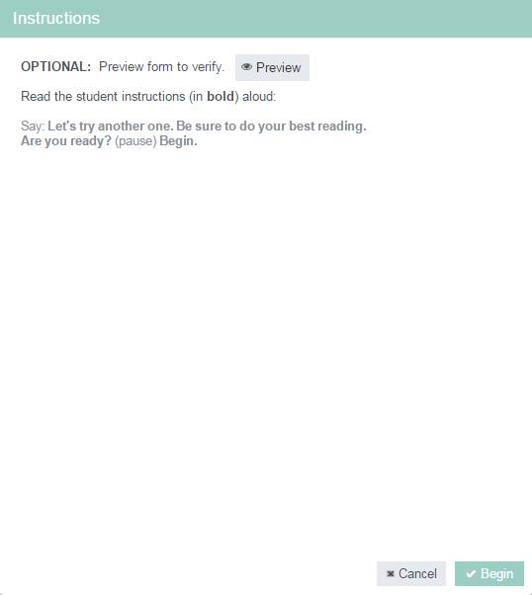
During Testing
Oral Reading Fluency (ORF)
Notes:
NARRATION:
Place the student test page in front of the student. You can ensure that your page in the DRF will match the student’s page by clicking the “Preview” button.
Say: When I say Begin, start reading aloud at the top of this page. Read across the page (demonstrate by moving finger across the page). Try to read each word. Be sure to do your best reading.
Are you ready? (pause) Begin.
Click Begin on the DRF when the student says or begins to sound out the first word.
Record student responses by clicking on any incorrectly read word.
At 1 minute say: Stop. Click the last item attempted and then click the Score button in the upper right hand corner
You will be prompted to select the last word the student read. When conducting benchmark test sessions, click the Next button in the upper right hand corner to advance to the second story.
Have the student turn to the second story page and say: Let’s try another one. Be sure to do your best reading. Are you ready? (pause) Begin.
Click Begin on the DRF when the student says or begins to sound out the first word.
Record student responses by clicking on any incorrectly read word.
At 1 minute say: Stop. Click the last word attempted and then click the Score button in the upper right hand corner.

Slide 41

Scoring Rules
Notes:
NARRATION:
Let’s take a look at the specific scoring rules for Oral Reading Fluency.

Slide 42
Scoring Rules
Oral Reading Fluency (ORF)
Correct:
A correctly read word.
Self-corrections made within 3 seconds.
Repeated words.
Inserted words.
Regional dialects.
Articulation problems.
Do Not Penalize For:
Notes:
NARRATION:
Students receive 1 point for each correctly read word.
Do not penalize for the following things:
Self-corrections made within 3 seconds
Repeated words
Inserted words
Regional dialects, or
Articulation problems

Slide 43
Scoring Rules
Oral Reading Fluency (ORF)
Errors:
A word is skipped.
Any sound in a word is mispronounced.
A different word is substituted.
A word is not read in its proper sequence.
Notes:
NARRATION:
Words are considered incorrect if:
A word is skipped.
Any sound in a word is mispronounced.
A different word is substituted.
A word is not read in its proper sequence.

Slide 44
Scoring Rules
Oral Reading Fluency (ORF)
Errors:
An abbreviation is read rather than the full word it represents.
The student self-corrects after 3 seconds have elapsed.
No attempt is made within 3 seconds.
Notes:
NARRATION:
Other ways that words can be considered incorrect are if:
An abbreviation is read rather than the full word it represents
The student self-corrects after 3 seconds have elapsed, or
No attempt is made within 3 seconds

Slide 45

During Testing Keep In Mind
Allow only about 3 seconds for student to respond before saying the word and marking it incorrect.
Allow about 10 seconds for the student to sound out or to subvocalize before saying the word and marking it incorrect.
Notes:
NARRATION:
When administering Oral Reading Fluency, there are things you’ll need to keep in mind:
Allow only about 3 seconds for student to respond before saying the word and marking it incorrect. You may give this corrective feedback as often as needed. No other feedback is permitted.
Allow about 10 seconds for the student to sound out or to subvocalize before saying the word and marking it incorrect.

Slide 46
During Testing Keep In Mind
If a student skips a line, do not redirect or give any corrective feedback.
If a student reads 10 or fewer words on the first story, do not administer the second story.
If a student self-corrects an incorrectly pronounced word within 3 seconds, record the response as correct.
Students receive 1 point for each correctly read word.
Notes:
NARRATION:
Additional things to keep in mind when administering Oral Reading Fluency are:
If a student skips a line, do not redirect or give any corrective feedback.
If a student reads 10 or fewer words on the first story, do not administer the second story. Click the pause icon in the upper right corner and select Discontinue Form from the pop-up menu. The student’s score will reflect only the words read correctly on the first story.
If a student self-corrects an incorrectly pronounced word within 3 seconds, record the response as correct.
Students receive 1 point for each correctly read word.

Slide 47



Software demonstration
Notes:
Now that you know all of the finer details let’s go into the software for a quick demonstration of how to access and launch DRFs for benchmarking.
Trainer- When in the software describe the following steps:
1. Click onto the Students tab and then choose Benchmark Comparison from the pull down menu.
2. Filter to your class or group of students.
3. Find the student that you want to assess and click onto the icon in the assess column. This will launch your first assessment. If the measure is optional, you will have the option to skip it if you want.

