Slide 1
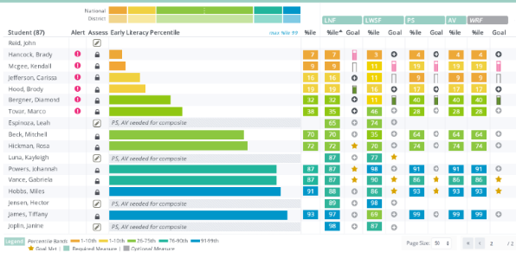
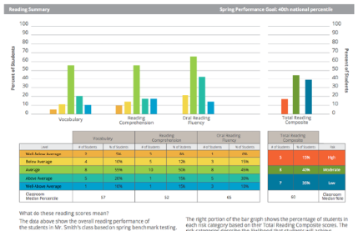

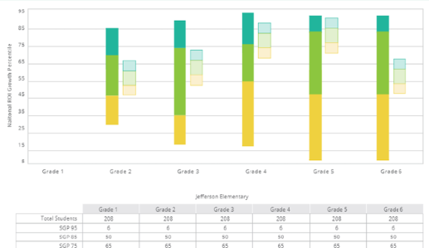
What is aimswebPlus?
Notes:
So, what exactly is aimswebPlus? We would like to give you a brief introduction in case you are not already acquainted with the aimswebPlus system of assessment. This will help you to see the value of using this system within your schools.

Slide 2

What is aimswebPlus?
Has a new suite of assessments for early literacy, early numeracy, reading, and math.
Results link well to instructional planning.
Standards-based assessments.
Essential component of an RTI or MTSS model.
Notes:
aimswebPlus has a whole new suite of assessments, while retaining assessments from classic aimsweb that have been found to be especially useful. The measures are standards-based and now provide more diagnostic types of information. Not only can you get a quick view of how your students compare to others in your account or to another norm-base, but you can glean even more individual skills-based information for your instructional and intervention planning. There are a variety of reporting options available within the early literacy, early numeracy, reading, and math domains. aimswebPlus reports provide more in-depth standards-based options for users who relate their assessment results to the Common Core State Standards. Assessment practices used within aimswebPlus continue to be essential components within a Response-to-Intervention (RTI) or Multi-Tiered Support System (MTSS) model.

Slide 3

Online Assessments
For Grades 2-12
Administer to groups of students
Automatically scored
Reports are available immediately
Notes:
All remaining measures for grades 2 and up are administered online. Once tests have been assigned to students within the aimswebPlus system, they can log in and take their series of assessments in TestNav. This online feature allows teachers to administer the assessments for a group of students at the same time. Once a student has completed their assessments the results are populated to aimswebPlus from TestNav within a short period of time.
It is recommended that examiners review and/or watch our Administration and Scoring video related to online assessments. There are specific considerations to make prior to completing online assessments. This will ensure that you obtain the most valid results possible.
Note that aimswebPlus online measures are fixed and not adaptive. This means that the items do not change depending upon student response. This will allow for uniform assessment across students and time within a school year. This is a key feature of a formative assessment system.

Slide 4

A Quick Glimpse
Early Literacy (K-1)
Print Concepts*
Initial Sounds
Letter Naming Fluency
Phoneme Segmentation
Word Reading Fluency
Letter Word Sounds
Auditory Vocabulary*
Oral Reading Fluency
Early Numeracy (K-1)
Number Naming Fluency
Quantity Total Fluency
Quantity Difference Fluency
Concepts and Applications*
Number Comparison Fluency- Pairs
Math Facts Fluency- One Digit
Math Facts Fluency- Tens
Reading (Gr 2-12*)
Oral Reading Fluency
Vocabulary*
Reading Comprehension*
Silent Reading Fluency
Math (Gr 2-12*)
Concepts and Applications*
Number Sense Fluency
Mental Computation Fluency
Number Comparison Fluency- Triads
*Benchmark only
*Gr 9-12 take 8th grade measures
Notes:
Here is a quick glimpse of the measures that aimswebPlus provides. We will be covering these in more detail in a bit, but here you can see the wide variety of measures that are available across the various academic domains and grade levels. All of these can be used for benchmark screening and many have multiple forms and can be also used for progress monitoring.

Slide 5
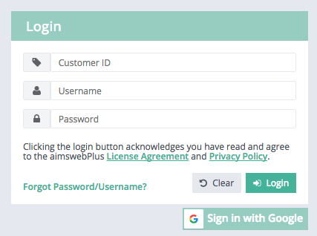
Basic Navigation
1
4
5
2
3
6
Log in with Customer ID, Username, and Password.
View messages, task notification, or printed reports.
Update profile settings and password. View user roles.
Log out.
Gray Action Bar organizes primary actions into Students, Groups, and Manager modules (dependent on user role).
Dropdown options for the selected module.
Notes:
Animated: Click for each number
Now on to the aimswebPlus software! First, you should understand that aimswebPlus data and account management is held within a secure online platform system. Your student data is completely confidential.
This slide gives you the basic layout of the key locations within the account that you need to understand to get your job done efficiently.
Here is the aimswebPlus log in page. Enter your account Customer ID number, Username, and Password that you have been assigned and have received via email. If you are expecting your access information and have not seen it be sure to check your spam folder. The first time that you log in you will need to accept the user responsibility statement and reset your password.
The black menu bar is displayed across the top of the page. Within this black bar is a “notification (bell) icon”. This is where you can view messages and access and print reports that you have requested.
The My Settings area is where you can update your profile settings and password. You can also view your user roles here.
Click on the “log out” button to log out. We recommend that you log out anytime that you leave your computer to protect student data privacy. If you do not log out and 20 minutes of inactivity have elapsed, you will be automatically signed out. There will be a warning pop-up after the first 15 minutes to inform you that you will be logged out.
Moving down and over to the left is the grey action bar. This is where you can access reports for individuals or groups of students, assess students, and manage your account.
Within the Students tab you can find student specific details and reports.
Within the Groups tab you will access reports that aggregate student performance in your classes and groups.
Within the Manage tab you can manage your classes and groups.
When you click onto the Students, Groups, or Manage buttons you will notice that the options within the dropdown box below will adjust for the types of tasks that can be completed in that area. Options that are available within the dropdown box depend on your user role and account settings.

Slide 6

Online Assessments via TestNav
Notes:
Here we will cover information about administering online assessments for students in Grades 2-12. Online assessments are delivered to students through the application called TestNav.

Slide 7
Online Assessment Process
Obtain TestNav credentials (same all year)
Proctor unlocks the test
Student logs into TestNav and takes the assessment
Results are synced to aimswebPlus
Notes:
There are basically four steps to completing online assessments. First, you must obtain the student credentials for their test and unlock the tests within your aimswebPlus account. Then, the student can log into TestNav with those credentials and take their test. Finally, the scores will sync from TestNav over to aimswebPlus where you can view the results.
There are a number of considerations to make before and during the online assessment administration. We will walk through each of these from the beginning.

Slide 8
Tips: Before Testing
Make sure that each computer has TestNav properly installed on each computer.
Retrieve login credentials from the Test Assignment List.
Know how to access TestNav on the student computers.
Unlock the tests within your aimswebPlus account.
Place dividers between each student. (optional)
Make sure that “APS” shows above the sign in box.
Notes:
Here are some tips to make sure that the administration and completion of online tests through TestNav works as efficiently and as valid as possible. These should all be considered prior to the student taking the tests. Some of these will need to be completed by a manager and/or a technology coordinator.
Be sure that TestNav has been properly installed on each computer that students use for tests.
Make sure that you know where to access TestNav on the student computers.
For privacy and to prevent students from copying from others beside them, place dividers between students who are seated close to each other. This is optional, but proven to be quite helpful.
Retrieve the student login credentials from the Test Assignment List. Be sure that each student is given their own passcode information so that data is linked to the student who is being assessed. This will prevent errors in the scores assigned to the students. Do not sign students in ahead of time or this will create problems with functionality.
Unlock the online tests prior to going to the testing session.
Make sure that “APS” appears above the Sign In box. If it states something different, you must “Choose a different customer” (select aimswebPlus) from the dropdown at the top of the screen. This will be shown on the next screen.

Slide 9
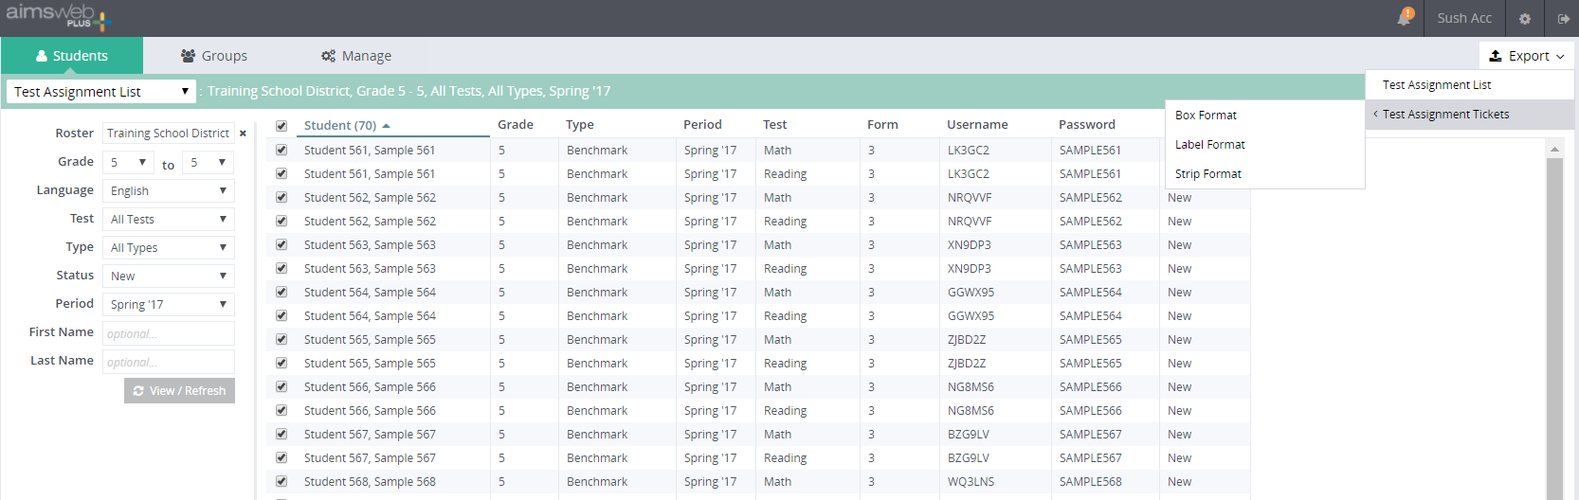
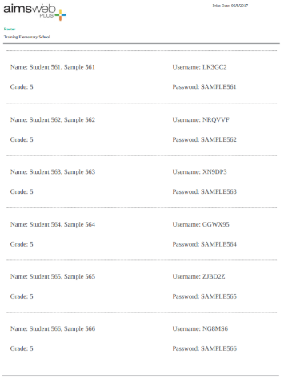
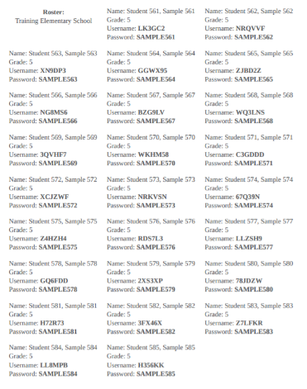
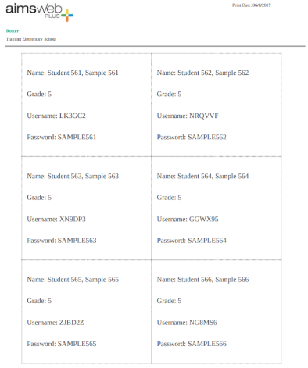
Online Test Assignment List
6
1
2
5
4
3
Click Students
Select Test Assignment List
Filter to the list and click onto View/Refresh
Select the students
Click Export and select list or type of tickets
Find and download your list from the notifications area
Notes:
Animated: Click for each step
Test Assignment will generate a Username and Password which the student will enter at the TestNav log in screen. To navigate to your test assignment list follow these steps:
Click onto the Students tab on the grey action bar.
Select Test Assignment List from the dropdown menu.
Filter to the list and click onto View/Refresh.
Select the student or students you would like to retrieve test assignments for.
Click onto the Export button and select Test Assignment List or Tickets. You can choose from three types of tickets (box, label, or strip).
To access the list, find it and download it from the notifications area.

Slide 10
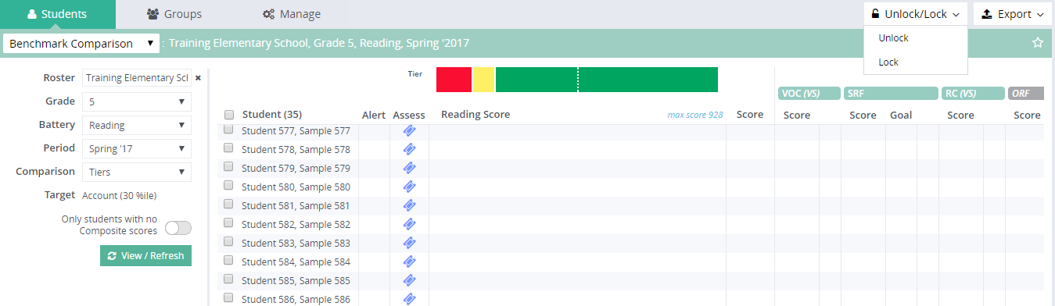
Unlock Online Assessments
1
3
2
Click Students tab and select Benchmark Comparison. Filter to the group, battery, and period
Select the students to unlock tests
Click the Unlock/Lock button and select Unlock
Notes:
Animated: Click for each step
Because students will use the same login to TestNav throughout the school year the proctor will need to unlock the assessments that they want the student to take prior to them attempting to log in. This occurs right within the aimswebPlus account. For benchmark assessments you will go to the Benchmark Comparison screen to do this. Notice that locked tests have blue colored tickets. To unlock the tests follow these steps:
1. Click onto the Students tab and select Benchmark Comparison from the dropdown menu. Filter to the roster, battery, and period and click View/Refresh.
2. Select the students by clicking on the boxes next to their name. You can select the entire group by clicking onto the box at the top of the column.
3. Click onto the Unlock/Lock button at the top-right and select Unlock. The tickets will turn to a green color, which indicates that they are unlocked.

Slide 11
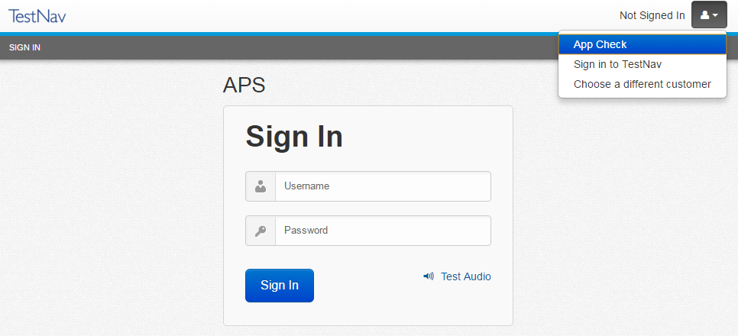
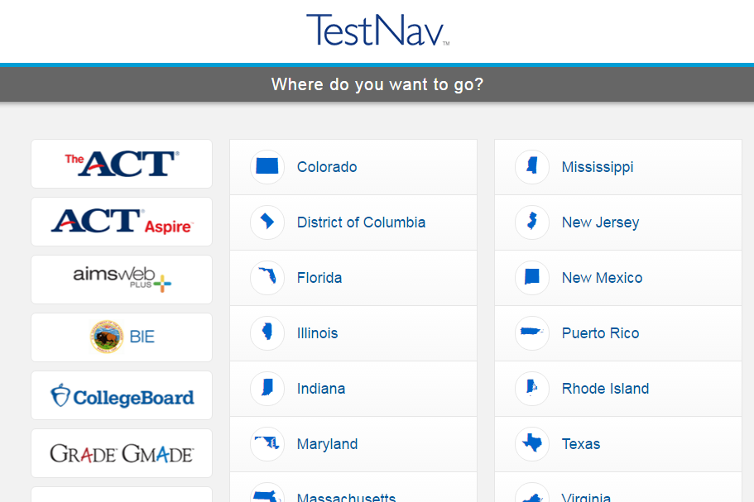
Before the Student Logs In
1
2
Notes:
Animated: Click for each step
Before the student attempts to log in make sure that you have the correct TestNav login screen. In the top screenshot you can see the Sign In screen for TestNav. Notice how APS is displayed to the top-left of the Sign In area. If this does not show, you will go to the top of the screen and select “Choose a different customer” from the dropdown menu. Then, select aimswebPlus from the list.

Slide 12

TestNav Tips: Before Testing
Each student will need headphones. Have a few extra sets ready.
Know how to adjust volume for headphones during testing.
Test that audio is working on each computer with the headsets.
Notes:
Here are some tips to make sure that audio works properly during testing. All tests will have orally presented directions. Some tests (CA and VOC) allow for answer choices to be read to the student.
Each student will need headphones. Make sure to have an extra set or two just in case they are needed.
Be sure to test that audio is working on each computer and that the headsets are working properly before initiating any test session. This should be done prior to the students sitting at the computers.
Make sure the proctor knows how to adjust volume on headsets during testing. Some students prefer different volumes.

Slide 13
TestNav Tips: Before Testing
Introduce the test session with the scripted introduction.
This includes:
Information about headphones/audio
Test segments
Test taking practices
Provide additional direction as needed:
These could include:
Behavior expectations
Listen to or read directions
What to do if items auto pass
What to do when complete
Not using accommodations features unless allowed
Notes:
You will want to introduce the reading and math online assessments by reading the introductory script to the students. This is found in the Administration and Scoring Guides for each subject area. These instructions include details to provide to the students about using headphones, playing audio, the test segments, how to take the tests, and how to ask questions. Use this introduction at the minimum.
You may also include more specifics about behavioral expectations, paying to directions, what to do if items auto pass (click onto the back button), what to do when they finish, or other details relevant to your setting. You can also tell the students not to play with the testing accommodations dropdown menu at the top of the screen. The proctor should assist students who have IEP or 504 accommodations for those options.

Slide 14
TestNav Tips: During Testing
Hand out paper before testing starts. Provide the pencils when CA begins.
Scratch paper
Proctors
Younger students will need more supervision and assistance.
Group size
Consider noise level, space between students, and individual characteristics.
Notes:
Here are some additional tips to consider for during testing.
Scratch paper: The only online assessment that allows for scratch paper is math Concepts and Applications. This test is given third (after both NCF-T and MCF) in the math battery. It is suggested that you can pass out scratch paper before the students start and then instruct them to raise their hand when they get to the Concepts and Applications measure. Have the pencils ready to disperse when the students get to this point. This measure is the last in the battery.
Proctors: You will want to consider the student to proctor ratio. Whoever is in the room assisting the students should know what they can or cannot do (i.e. not answering questions about test items) in regards to responding to student questions. They should also give active supervision throughout the test.
Group size: Many users will administer the online assessments to larger groups of students. The group size should be considered along with factors such as noise levels in the room, spacing allowed between students, and individual student characteristics. Younger students, as well as students who can get easily distracted, are better off testing within smaller groups.

Slide 15
TestNav Tips: During Testing
IEP or 504 Plans only (Reading Measures only)
Contrast
Magnifier
Show/hide lines
Answer masking
For all students:
Text-to-Speech
(directions and answers)
Vocabulary
Concepts and Applications
Text to Speech
(directions only)
All other measures
Notes:
TestNav has accommodative technology tools built within. Here is what is available once the student is logged in. Accommodations are selected from the dropdown menu at the top of the student screen. On the reading measures students can adjust contrast, magnify, show/hide lines, and mask answers. These options should only be used if the accommodations are documented in an IEP or 504 plan. Accommodations are not built into the math measures; however, Concepts and Applications always allows for directions and answers to be read to the student.
The text-to-speech is an option for all measures; however, notice the differences between measures. For Vocabulary and Concepts and Applications the student can have the directions and answers read aloud to them. All other measures allow text-to-speech for the directions only.

Slide 16
TestNav Tips: During Testing
Automatic Item Pass
Measure | May go back? | Item passes | Answer screen passes
RC | Yes | 300 sec | 60 sec
VOC | Yes | 60 sec (40 sec warning)
CA | Yes | Never (TestNav closes after 2 hours)
SRF | No | 60 sec (40 sec warning) | 30 sec (20 sec warning)
NSF | No | Never | Never
Notes:
Be aware that TestNav has automatic item pass on most of the online measures. Untimed tests allow for students to go back and review test items and change/add responses. Timed tests do not allow students to go back. The reason that auto pass is enabled is to make sure that students progress efficiently through the measures. Proctors should be watching students to make sure that they are attending to the test and progressing at a typical rate to prevent unnecessary needs to go back to previous items.
These details are provided for your information so that you can know what to expect when students are taking the online tests.

Slide 17

Reading
Measure | Purpose | Grades 2-3 | Grades 4-12 | Time to Test
Vocabulary | Screening | ✓ | ✓ | Untimed (4-7 minutes)
Reading Comprehension | Screening | ✓ | ✓ | Untimed (15-25 minutes)
Silent Reading Fluency | Both |  | ✓ | Untimed (about 5 minutes)
Oral Reading Fluency | Both | ✓ | ✓ | ~2 minutes
*Grades 9-12 take 8th grade tests
Notes:
This table shows the recommended grade levels for which each of the Reading measures are given, as well as the approximate time needed for each administration. It also indicates whether the measures are designed for Screening, Monitoring or both.
If you have students in grades 9-12 who are taking these measures, they will take the 8th grade measures and their results will be compared to 8th grade norms.

Slide 18
Reading Measures
State verbatim:
“Today you’ll be taking a reading test on the computer. You’ll need to wear your headphones to hear the test directions. When there are words that can be read to you, you’ll see a play button on the right side of the screen. Just click on the play button if you want to hear the words.
There are several parts to today’s reading test—make sure to keep working until the test is complete. Follow all the test directions, answer every question, and do your own work.
If you have any questions during the test, please stay seated and raise your hand—I will come over to you. Remember: Do your best! Put on your headphones now and we’ll begin.”
Notes:
These oral directions should be given just prior to the students beginning their reading tests. This script may be found in the Reading Administration and Scoring Guide for Grades 2-12.
State verbatim:
“Today you’ll be taking a reading test on the computer. You’ll need to wear your headphones to hear the test directions. When there are words that can be read to you, you’ll see a play button on the right side of the screen. Just click on the play button if you want to hear the words.
There are several parts to today’s reading test—make sure to keep working until the test is complete. Follow all the test directions, answer every question, and do your own work.
If you have any questions during the test, please stay seated and raise your hand—I will come over to you. Remember: Do your best! Put on your headphones now and we’ll begin.”

Slide 19
Math
Measure | Purpose | Grades 2-8 | Time to Test
Concepts and Applications | Screening | ✓ | Untimed (up to 25 minutes)
Number Comparison Fluency- Triads | Both | ✓ | 3 min
Mental Computation Fluency | Both | ✓ | 4 min
Number Sense Fluency (NCF-T + MCF) | Both | ✓ | 7 min
*Grades 9-12 take 8th grade tests
Notes:
This table shows the recommended grade levels for which each of the online measures of Math are given, as well as the approximate time needed for each administration. It also indicates whether the measures are designed for Screening, Monitoring or both.
As with Reading, the measures are delivered to students with web-based testing. The student logs in, takes the test, and the scores are automatically generated. Scores are then synced over to the aimswebPlus account. Make note that when students in grades 9-12 are tested, they are given 8th grade measures.
Total testing time for screening is less than 30 minutes per student.

Slide 20
Math Measures
State verbatim:
“Today you’ll be taking a math test on the computer. You’ll need to wear your headphones to hear the test directions. When there are words that can be read to you, you’ll see a play button on the right side of the screen. Just click on the play button if you want to hear the words.
There are several parts to today’s math test—make sure to keep working until the test is complete. Follow all the test directions, answer every question, and do your own work.
If you have any questions during the test, please stay seated and raise your hand—I will come over to you. Remember: Do your best! Put on your headphones now and we’ll begin.”
Notes:
These oral directions should be given just prior to the students beginning their tests. This script may be found in the Math Administration and Scoring Guide for Grades 2-12.
State verbatim:
“Today you’ll be taking a math test on the computer. You’ll need to wear your headphones to hear the test directions. When there are words that can be read to you, you’ll see a play button on the right side of the screen. Just click on the play button if you want to hear the words.
There are several parts to today’s math test—make sure to keep working until the test is complete. Follow all the test directions, answer every question, and do your own work.
If you have any questions during the test, please stay seated and raise your hand—I will come over to you. Remember: Do your best! Put on your headphones now and we’ll begin.”

Slide 21
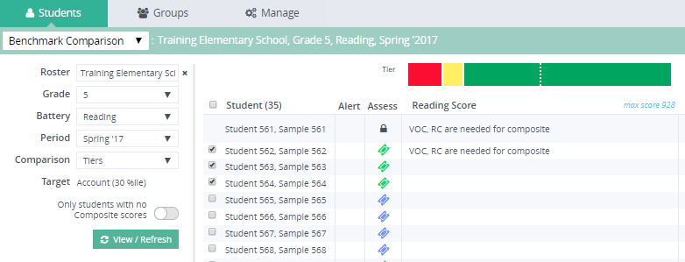
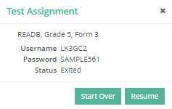
Resume/Restart Tests
1
2
3
Click Students tab and select Benchmark Comparison. Filter to the group, battery, and period and click View/Refresh
Click onto the lock icon the Assess column
Select Start Over or Resume
Notes:
Animated: Click for each step
Occasionally, you may need to stop a test that a student has not completed. This can be done within tests that are untimed by making the selection at the top-right in TestNav. Once the test has been exited the test needs to be Resumed/Restarted from within aimswebPlus. Here are the steps for pausing and then resuming a test. Once a test is resumed the student will be able to log in once again and continue where they left off.
Click onto the Students tab and select Benchmark Comparison from the dropdown menu. Filter to the roster, battery, and period. Click onto View/Refresh.
In aimswebPlus on the Benchmark Comparison screen, click onto the lock icon. A popup box will appear.
Select Start Over or Resume. This step must be completed to enable the student to log in again.

Slide 22

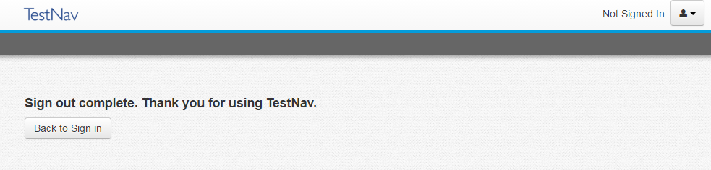
TestNav: After Testing
Make sure that each student completes the entire battery/test.
Notes:
Once the student has completed all measures and items, they should see this screen. At this point, TestNav will compute all scores and sync the results to the aimswebPlus account where results can be viewed by the teacher. You will want to make sure that the students arrive at this screen.

