Slide 1
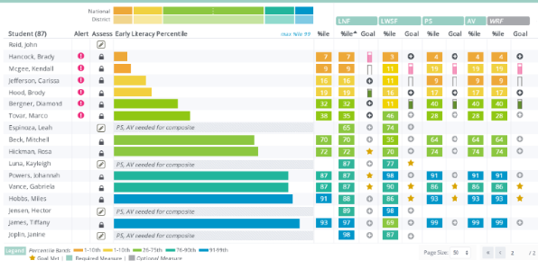
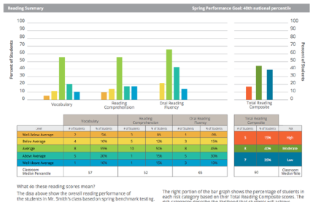

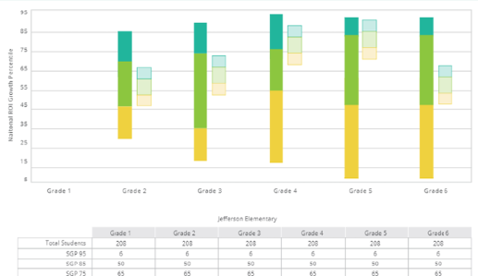
What is aimswebPlus?
Notes:
So, what exactly is aimswebPlus? We would like to give you a brief introduction in case you are not already acquainted with the aimswebPlus system of assessment. This will help you to see the value of using this system within your schools.

Slide 2

What is aimswebPlus?
Has a new suite of assessments for early literacy, early numeracy, reading, and math.
Results link well to instructional planning.
Standards-based assessments.
Essential component of an RTI or MTSS model.
Notes:
aimswebPlus has a whole new suite of assessments, while retaining assessments from classic aimsweb that have been found to be especially useful. The measures are standards-based and now provide more diagnostic types of information. Not only can you get a quick view of how your students compare to others in your account or to another norm-base, but you can glean even more individual skills-based information for your instructional and intervention planning. There are a variety of reporting options available within the early literacy, early numeracy, reading, and math domains. aimswebPlus reports provide more in-depth standards-based options for users who relate their assessment results to the Common Core State Standards. Assessment practices used within aimswebPlus continue to be essential components within a Response-to-Intervention (RTI) or Multi-Tiered Support System (MTSS) model.

Slide 3

Online Assessments
For Grades 2-12
Administer to groups of students
Automatically scored
Reports are available immediately
Notes:
All remaining measures for grades 2 and up are administered online. Once tests have been assigned to students within the aimswebPlus system, they can log in and take their series of assessments in TestNav. This online feature allows teachers to administer the assessments for a group of students at the same time. Once a student has completed their assessments the results are populated to aimswebPlus from TestNav within a short period of time.
It is recommended that examiners review and/or watch our Administration and Scoring video related to online assessments. There are specific considerations to make prior to completing online assessments. This will ensure that you obtain the most valid results possible.
Note that aimswebPlus online measures are fixed and not adaptive. This means that the items do not change depending upon student response. This will allow for uniform assessment across students and time within a school year. This is a key feature of a formative assessment system.

Slide 4

A Quick Glimpse
Early Literacy (K-1)
Print Concepts*
Initial Sounds
Letter Naming Fluency
Phoneme Segmentation
Word Reading Fluency
Letter Word Sounds
Auditory Vocabulary*
Oral Reading Fluency
Early Numeracy (K-1)
Number Naming Fluency
Quantity Total Fluency
Quantity Difference Fluency
Concepts and Applications*
Number Comparison Fluency- Pairs
Math Facts Fluency- One Digit
Math Facts Fluency- Tens
Reading (Gr 2-12*)
Oral Reading Fluency
Vocabulary*
Reading Comprehension*
Silent Reading Fluency
Math (Gr 2-12*)
Concepts and Applications*
Number Sense Fluency
Mental Computation Fluency
Number Comparison Fluency- Triads
*Benchmark only
*Gr 9-12 take 8th grade measures
Notes:
Here is a quick glimpse of the measures that aimswebPlus provides. We will be covering these in more detail in a bit, but here you can see the wide variety of measures that are available across the various academic domains and grade levels. All of these can be used for benchmark screening and many have multiple forms and can be also used for progress monitoring.

Slide 5
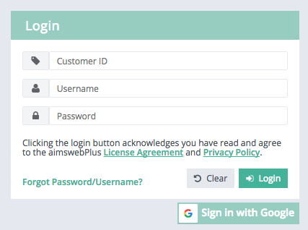
Basic Navigation
1
4
5
2
3
6
Log in with Customer ID, Username, and Password.
View messages, task notification, or printed reports.
Update profile settings and password. View user roles.
Log out.
Gray Action Bar organizes primary actions into Students, Groups, and Manager modules (dependent on user role).
Dropdown options for the selected module.
Notes:
Animated: Click for each number
Now on to the aimswebPlus software! First, you should understand that aimswebPlus data and account management is held within a secure online platform system. Your student data is completely confidential.
This slide gives you the basic layout of the key locations within the account that you need to understand to get your job done efficiently.
Here is the aimswebPlus log in page. Enter your account Customer ID number, Username, and Password that you have been assigned and have received via email. If you are expecting your access information and have not seen it be sure to check your spam folder. The first time that you log in you will need to accept the user responsibility statement and reset your password.
The black menu bar is displayed across the top of the page. Within this black bar is a “notification (bell) icon”. This is where you can view messages and access and print reports that you have requested.
The My Settings area is where you can update your profile settings and password. You can also view your user roles here.
Click on the “log out” button to log out. We recommend that you log out anytime that you leave your computer to protect student data privacy. If you do not log out and 20 minutes of inactivity have elapsed, you will be automatically signed out. There will be a warning pop-up after the first 15 minutes to inform you that you will be logged out.
Moving down and over to the left is the grey action bar. This is where you can access reports for individuals or groups of students, assess students, and manage your account.
Within the Students tab you can find student specific details and reports.
Within the Groups tab you will access reports that aggregate student performance in your classes and groups.
Within the Manage tab you can manage your classes and groups.
When you click onto the Students, Groups, or Manage buttons you will notice that the options within the dropdown box below will adjust for the types of tasks that can be completed in that area. Options that are available within the dropdown box depend on your user role and account settings.

Slide 6
Account Information Emailed
Make sure you are able to access your account.
Check access level- Gear Icon (upper right)
https://uat-app.aimswebplus.com/#/login
Open Training Account
Customer ID: 6293
smanager1, smanager2, smanager9
Password2

Slide 7
Help Feature
Green Help Button- Lower Right Hand Corner
Enable Pop-Ups
Access Stimulus and Administration Materials

Slide 8

Online Assessments via TestNav
Notes:
Here we will cover information about administering online assessments for students in Grades 2-12. Online assessments are delivered to students through the application called TestNav.

Slide 9
Online Assessment Process
Obtain TestNav credentials (same all year)
Proctor unlocks the test
Student logs into TestNav and takes the assessment
Results are synced to aimswebPlus
Notes:
There are basically four steps to completing online assessments. First, you must obtain the student credentials for their test and unlock the tests within your aimswebPlus account. Then, the student can log into TestNav with those credentials and take their test. Finally, the scores will sync from TestNav over to aimswebPlus where you can view the results.
There are a number of considerations to make before and during the online assessment administration. We will walk through each of these from the beginning.

Slide 10
TestNav Tips: During Testing
IEP or 504 Plans only (Reading Measures only)
Contrast
Magnifier
Show/hide lines
Answer masking
For all students:
Text-to-Speech
(directions and answers)
Vocabulary
Concepts and Applications
Text to Speech
(directions only)
All other measures
Notes:
TestNav has accommodative technology tools built within. Here is what is available once the student is logged in. Accommodations are selected from the dropdown menu at the top of the student screen. On the reading measures students can adjust contrast, magnify, show/hide lines, and mask answers. These options should only be used if the accommodations are documented in an IEP or 504 plan. Accommodations are not built into the math measures; however, Concepts and Applications always allows for directions and answers to be read to the student.
The text-to-speech is an option for all measures; however, notice the differences between measures. For Vocabulary and Concepts and Applications the student can have the directions and answers read aloud to them. All other measures allow text-to-speech for the directions only.

Slide 11
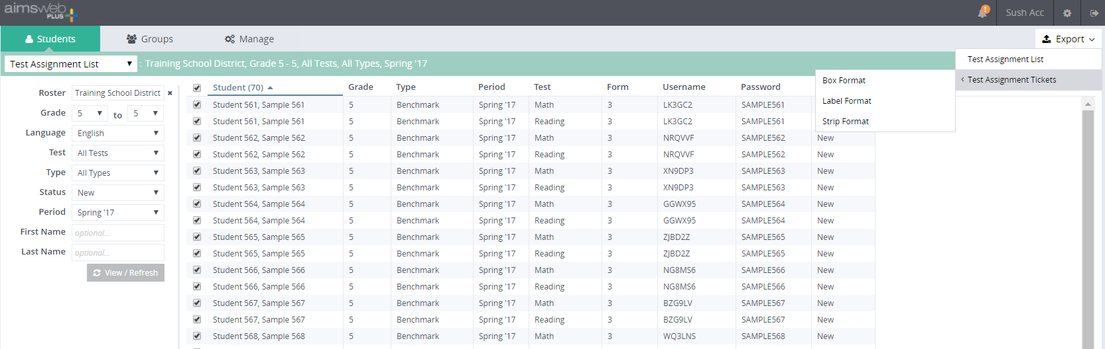
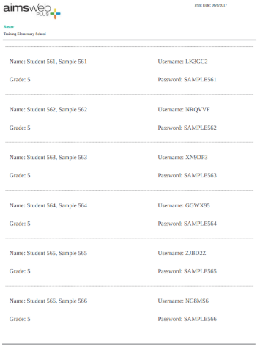
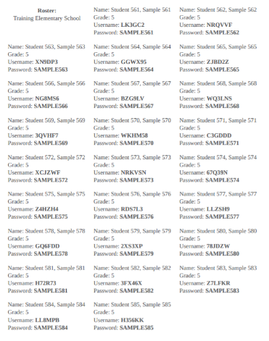
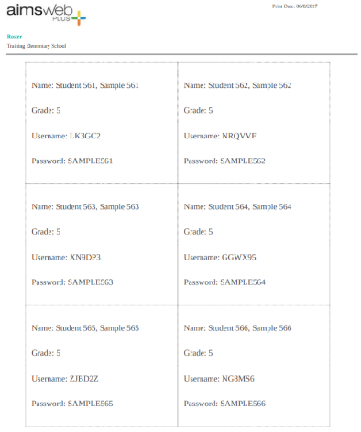
Online Test Assignment List
6
1
2
5
4
3
Click Students
Select Test Assignment List
Filter to the list and click onto View/Refresh
Select the students
Click Export and select list or type of tickets
Find and download your list from the notifications area
Notes:
Animated: Click for each step
Test Assignment will generate a Username and Password which the student will enter at the TestNav log in screen. To navigate to your test assignment list follow these steps:
Click onto the Students tab on the grey action bar.
Select Test Assignment List from the dropdown menu.
Filter to the list and click onto View/Refresh.
Select the student or students you would like to retrieve test assignments for.
Click onto the Export button and select Test Assignment List or Tickets. You can choose from three types of tickets (box, label, or strip).
To access the list, find it and download it from the notifications area.

Slide 12
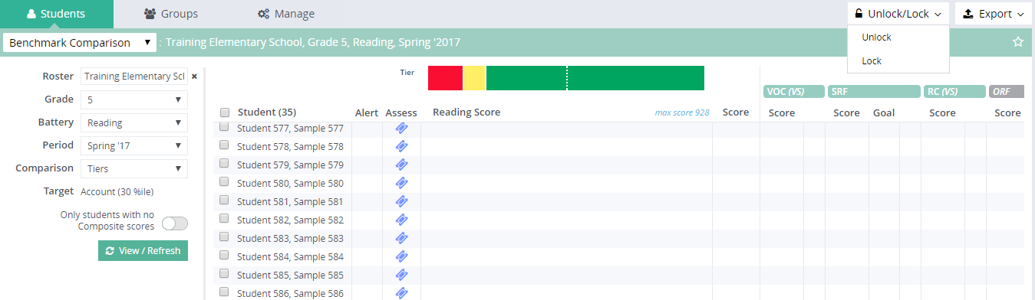
Unlock Online Assessments
1
3
2
Click Students tab and select Benchmark Comparison. Filter to the group, battery, and period
Select the students to unlock tests
Click the Unlock/Lock button and select Unlock
Notes:
Animated: Click for each step
Because students will use the same login to TestNav throughout the school year the proctor will need to unlock the assessments that they want the student to take prior to them attempting to log in. This occurs right within the aimswebPlus account. For benchmark assessments you will go to the Benchmark Comparison screen to do this. Notice that locked tests have blue colored tickets. To unlock the tests follow these steps:
1. Click onto the Students tab and select Benchmark Comparison from the dropdown menu. Filter to the roster, battery, and period and click View/Refresh.
2. Select the students by clicking on the boxes next to their name. You can select the entire group by clicking onto the box at the top of the column.
3. Click onto the Unlock/Lock button at the top-right and select Unlock. The tickets will turn to a green color, which indicates that they are unlocked.

Slide 13
TestNav Tips: During Testing
Automatic Item Pass
Measure | May go back? | Item passes | Answer screen passes
RC | Yes | 300 sec | 60 sec
VOC | Yes | 60 sec (40 sec warning)
CA | Yes | Never (TestNav closes after 2 hours)
SRF | No | 60 sec (40 sec warning) | 30 sec (20 sec warning)
NSF | No | Never | Never
Notes:
Be aware that TestNav has automatic item pass on most of the online measures. Untimed tests allow for students to go back and review test items and change/add responses. Timed tests do not allow students to go back. The reason that auto pass is enabled is to make sure that students progress efficiently through the measures. Proctors should be watching students to make sure that they are attending to the test and progressing at a typical rate to prevent unnecessary needs to go back to previous items.
These details are provided for your information so that you can know what to expect when students are taking the online tests.

Slide 14

Reading
Measure | Purpose | Grades 2-3 | Grades 4-12 | Time to Test
Vocabulary | Screening | ✓ | ✓ | Untimed (4-7 minutes)
Reading Comprehension | Screening | ✓ | ✓ | Untimed (15-25 minutes)
Silent Reading Fluency | Both |  | ✓ | Untimed (about 5 minutes)
Oral Reading Fluency | Both | ✓ | ✓ | ~2 minutes
*Grades 9-12 take 8th grade tests
Notes:
This table shows the recommended grade levels for which each of the Reading measures are given, as well as the approximate time needed for each administration. It also indicates whether the measures are designed for Screening, Monitoring or both.
If you have students in grades 9-12 who are taking these measures, they will take the 8th grade measures and their results will be compared to 8th grade norms.

Slide 15
Math
Measure | Purpose | Grades 2-8 | Time to Test
Concepts and Applications | Screening | ✓ | Untimed (up to 25 minutes)
Number Comparison Fluency- Triads | Both | ✓ | 3 min
Mental Computation Fluency | Both | ✓ | 4 min
Number Sense Fluency (NCF-T + MCF) | Both | ✓ | 7 min
*Grades 9-12 take 8th grade tests
Notes:
This table shows the recommended grade levels for which each of the online measures of Math are given, as well as the approximate time needed for each administration. It also indicates whether the measures are designed for Screening, Monitoring or both.
As with Reading, the measures are delivered to students with web-based testing. The student logs in, takes the test, and the scores are automatically generated. Scores are then synced over to the aimswebPlus account. Make note that when students in grades 9-12 are tested, they are given 8th grade measures.
Total testing time for screening is less than 30 minutes per student.

Slide 16
Measure Definitions & Acronyms
Review the Measure Definitions and Acronym Handout
This handout describes what students are doing during each assessment for Early Literacy, Early Numeracy, Reading, and Math.

Slide 17
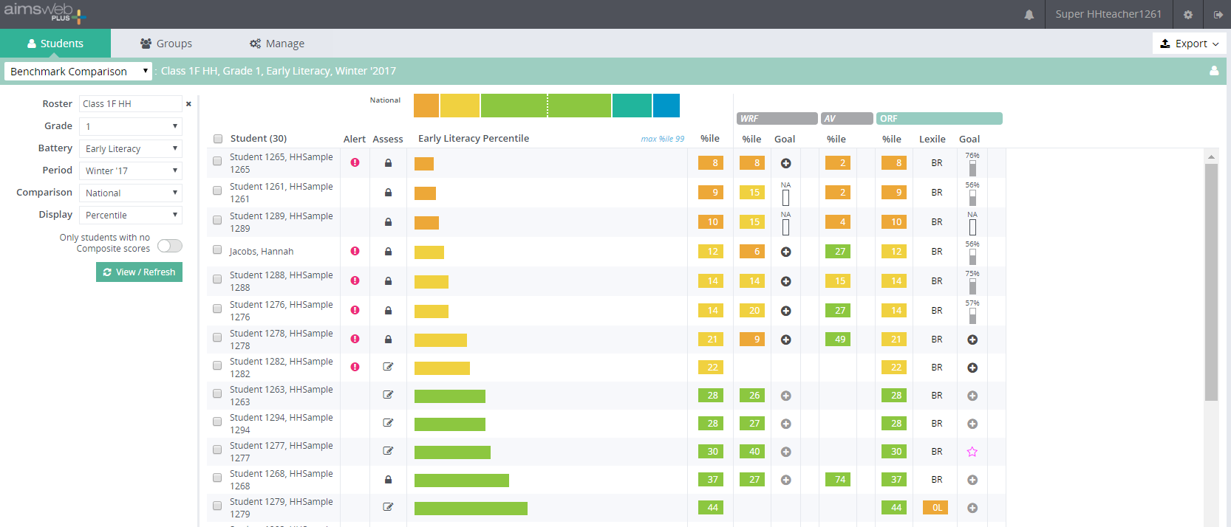
Benchmark Comparison Screen
Notes:
Animated- click to show interactive areas.
The Benchmark Comparison report displays benchmark scores for a specified group of students on the selected battery and each of the individual measures. This screen is mainly used by teachers to view class or group progress. This is also a launch point for DRF assessments, adding goals, and viewing individual reports and test assignments. Examples of the interactive areas are circled here. {Click}

Slide 18
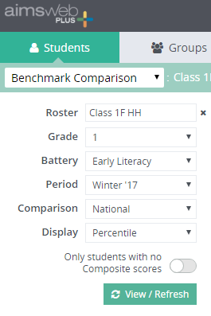
Navigation to the Benchmark Comparison Screen
Grade
You can choose one grade level.
Battery
Select the academic area. Early Literacy and Numeracy will show for K-1. Reading and Math will show for Grades 2-8
Roster
Custom choice with predictive text. Begin typing and then pick your roster from a dropdown menu.
Period
Choose the period and year from which to view data.
Comparison
Choose between National %ile,
National & District %ile, National & School %ile, or Tiers.
Display
Choose between Percentile and Score. This will affect the numerical values for all of the results on screen.
Toggle to on if you wish to only view students who have no Composite scores.
Notes:
Animated- click for each filter option
To navigate to the Benchmark Comparison screen you will click onto the Students tab and then select Benchmark Comparison from the dropdown menu.
{Click} First, filter to the roster of students you wish to see results for. This can be based on district, school, or even class or custom group rosters. This field is custom and uses predictive text. Once you fill in the first three letters or digits in a roster name you can select your choice from a menu.
{Click} Next, choose the grade level you want on the report.
{Click} In the area of Battery you will choose between Early Literacy or Early Numeracy for K-1 students or Reading or Math for students in Grades 2-8.
{Click} Choose the benchmark period and year from which to view the data.
{Click} In the area of Comparison you will choose between National norms, National and District norms, National and School norms, or Tiers. You will need at least 30 students in a comparison group before local comparisons can be generated.
{Click} Next, choose Percentile or Score from the Display dropdown menu. Your choice here will affect how all of the numerical values are reported for your results.
{Click} Finally, if you wish to only view students with no composite scores you can toggle this switch on. This would be most useful when you are benchmarking students and only want to see students who need to complete assessments.
{Click} Once you have made your selections click onto the View/Refresh button. Note that your selections will be reported in the green bar at the top. You can also queue this report for printing or saving as a PDF by clicking onto Export.

Slide 19
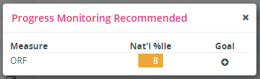
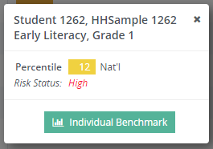
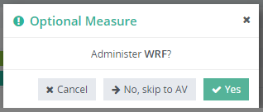
Benchmark Comparison Screen Components
Interpret SRF with caution
Notes:
Animated- Click for each component.
Here we will go through the various pieces of data and interactive components of the Benchmark Comparison screen.
{Click} The colored bands at the top of the screen are based on national and local percentile ranges of scores or tier levels. When viewing by percentiles, you will only see one bar if you did not select local comparisons in the filter options. If you selected to view a Tier comparison you will see the color band broken into three pieces.
{Click} The legend at the bottom of the Benchmark Comparison screen will indicate what each of the colors mean based on norms or tiers. Additional information about required/optional measures and Lexiles is also provided.
{Click} Initially, before students complete any assessment, student names will be listed alphabetically. After scores are entered they will be listed in order from lowest to highest composite score as you move to the bottom of the screen. Students with no scores will be listed at the top. You can reorder students from highest score to lowest by clicking onto the Student header. Notice that the total number of students within the roster you have selected will show in the header.
{Click} The Alert column will have pink icons if a student’s composite score prompts the need for possible progress monitoring. These are interactive icons. Once the icon is clicked a pop-up will appear and indicate the measure or measures for which monitoring is recommended. Monitoring is recommended for scores below the 25th percentile if you have selected the percentile comparison report. If you are looking at a tier comparison report recommendations are made for tier 2 and 3 students. From this pop-up you can click on the “add goal icon” and begin setting a monitoring schedule. Once a schedule is added for one or more measures during the current period the pink alert icon will disappear.
{Click} The Assess column will contain one of three symbols. The pencil icon indicates that a DRF is the next assessment in line. The ticket icon will appear for grades 2-8 once online tests have been assigned. A lock icon will indicate that all measures have been completed or are in progress (online measures). These icons are all interactive. If you click onto the pencil icon you will be able to launch the next DRF assessment. You will have the option to skip optional measures (K-1) or to skip between online measures and ORF (Gr 2-8).
{Click} Within the center portion of the screen you will see colored bands that represent composite scores. If no required measures have been administered, this area will be blank. If one, but not all required measures, have been administered there will be an indication of which assessments need to be completed to develop a composite score. The actual score/percentile is listed to the right of the colored bands. You can click on top of any of the scores/percentiles to see more information about the score/percentile (and comparison group if selected) as well as the students risk status. School or District norm comparison are only possible if there are 30 or more students entered during the period. You are able to directly access Individual Benchmark reports from the popup as well.
{Click} The remainder of the data on this screen relates to scores or percentiles for each individual measure within the skill area. Notice that the measure headers are mint colored if they are required or grey if they are optional. If you are viewing a norm comparison report you will see the scores/percentiles color coded by range. Next to each individual score/percentile you will see either a “plus icon” or a “goal indicator”. Dark colored plus icons indicate that the results from that measure suggest monitoring because the measure score is in the below average range or Tier 2/3 range. You can set up a monitor schedule for that measure type from any of these access points. If there is a goal indicator icon, meaning there is already a schedule in place, you can click onto it to see immediate goal feedback and also access a full view of the monitoring report.
{Click} A caution symbol will be added next to Silent Reading Fluency scores (grades 2-8) if the score is 39 percentile points higher than the median of the other measure scores in the reading battery. If this appears, you may wish to retest the student using a different SRF form with survey level assessment. Analysis has found that many times unusually high SRF scores are the result retesting and previous exposure to the items.

Slide 20
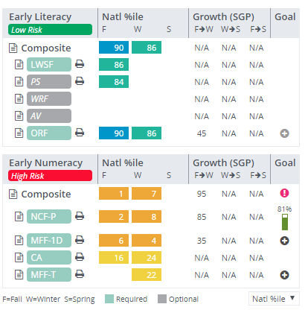
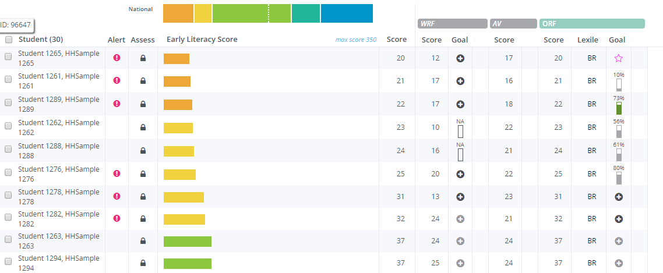
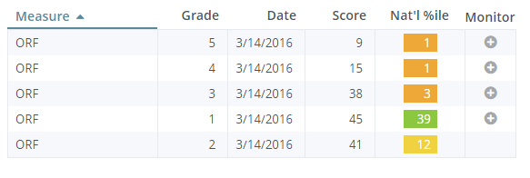
Begin Monitoring Schedule Set Up
Benchmark Comparison
Student Profile
Survey Level Assessment
Notes:
Animated: shows where to start a schedule on each screen
You can begin a progress monitor schedule from the Student Profile, Benchmark Comparison, and Survey Level Assessment screens. Alongside the measures and scores you may see black or grey plus icons. This indicates that there is not a current schedule for that particular measure. Simply click onto the icon {Click} and you will be automatically taken to the progress monitor Goal Details screen.
Remember, some of the plus icons are light grey in color, while others are darker. The darker icons indicate that aimswebPlus is recommending that the student monitored in the particular area due to the score being below average.

Slide 21
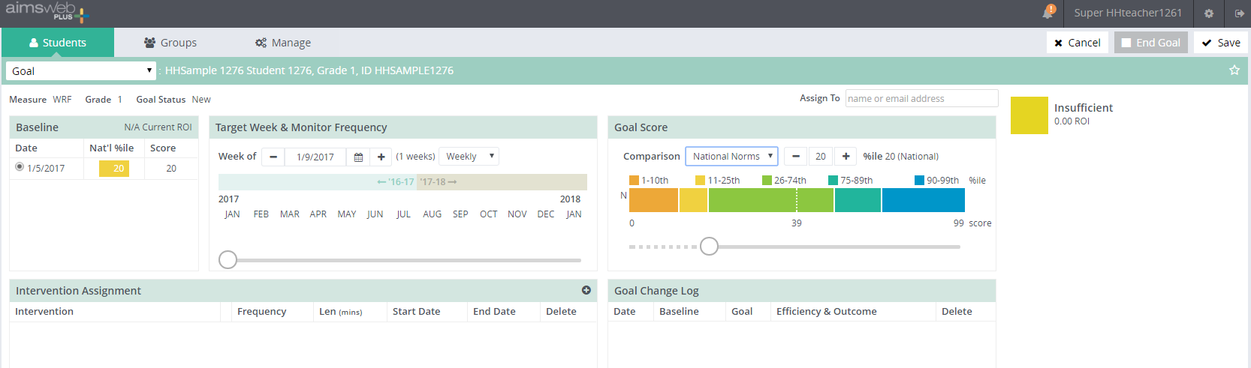

Goal Details Screen
Notes:
Once you have clicked the “plus icon” you will be taken to the Goal Details screen. This is a quick view of what it looks like to begin.

Slide 22
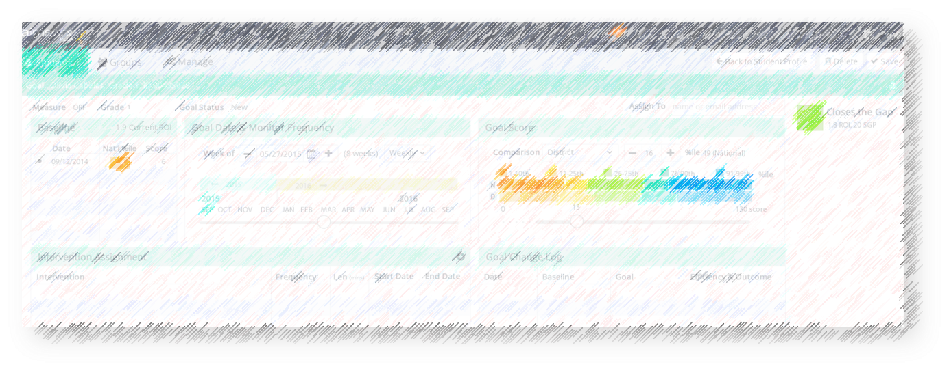

Steps within the software
Determine Baseline
Goal Date & Monitor Frequency
Set Goal Score
Intervention Assignment
Notes:
Animated- Click to introduce each step
The Goal Details screen has four sections that need consideration. {Click} First you need to set your baseline score. {Click} Next you will set your goal ending date and the frequency of data collection. {Click} Then, you will set your goal score. {Click} Finally, you can assign your initial intervention. We will go through each of these steps on the Goal Details screen next.

Slide 23
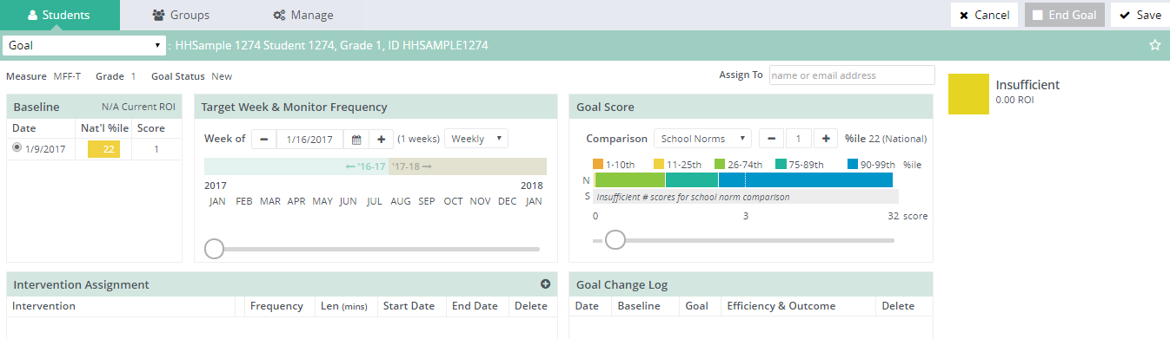

Determine the Baseline
Notes:
Our first area of focus is the baseline. Your baseline score will be automatically entered from the previous screen. You will need to do nothing further. Due to the digital nature of the measures, this score cannot be edited and the date cannot be changed. If there are other scores with the same measure type and grade level (likely from benchmarking) they will show up here. You can select one of the other previous scores, but most likely you will chose the most recent score.
Trainer: You can have two concurrent schedules in the same measure as long as the grade levels are not the same. Also note that as any score is added to the system (benchmark or progress monitor) within the same level and measure that those will be possible baseline scores.

Slide 24

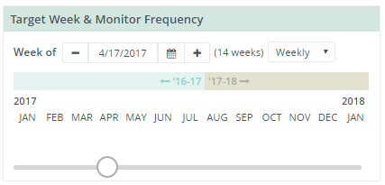
Goal Date & Monitor Frequency
Notes:
Now that you know what the baseline score is, you will move over to the Goal Date and Monitor Frequency area. Within this area you are able to set the ending date by manually typing in the date, using the calendar icon, or the slider bar. You can set the goal date anytime between the current week and one year from the current date. When setting the goal date make sure that you set it out far enough that the you have sufficient time for the intervention to take effect and for feedback to occur.
You also want to be careful not to set the goal too far out if you are working off grade level. You will learn that as you select your goal score that the expected rate of improvement will be provided. You will want to choose an end date that assures that the student is making a good amount of progress per week and will allow them to move as quickly as possible to the next grade level material.
Within this area you will also set the frequency of your data collection. You can select weekly or monthly. If you wish to monitor semimonthly you would most likely choose monthly and then monitor on your schedule. This way, the system would not give you an alert that the assessment is overdue every other week.

Slide 25
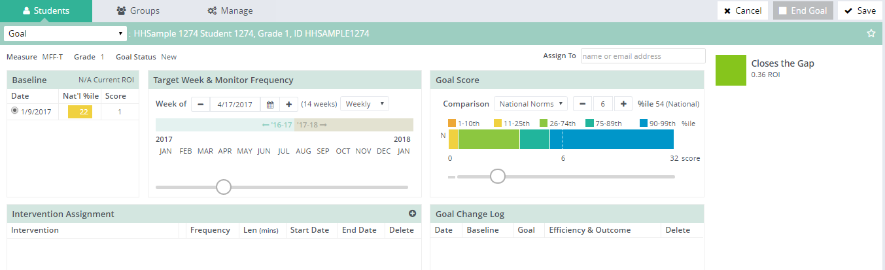
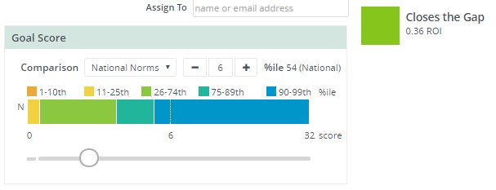
Set the Goal Score
Notes:
Once you have set your goal ending date you can determine the goal score. You will use this section to set your goal score. You can manually enter the goal score, use the +/- buttons, or the slider bar. As you make changes, you will notice the system will reflect whether the goal is insufficient, closes the gap, or ambitious based on student growth percentiles at the top right corner. Within this area you are able to see where the student’s goal score will fall in comparison to national, district, or school norms (whichever you have chosen) at the goal end date. If the goal ending date is outside of the current benchmark period, district/school norms will be selected from the previous year’s data if available.

Slide 26
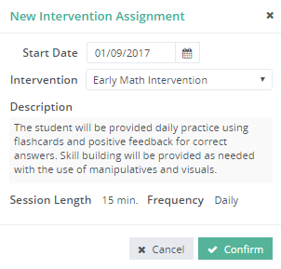
Intervention Assignment
3
1
2
Notes:
Animated click on steps
If you have interventions in your account (discussed earlier) you can add intervention detail upon initial schedule set up. This detail carries forward into the interactive screens and reports.
1. Click onto the plus icon. A pop-up box will appear.
2. Select the intervention and click onto Confirm.
3. Once you have completed all of these and the previous steps, you should click onto Save at the top right corner to save the schedule.

Slide 27
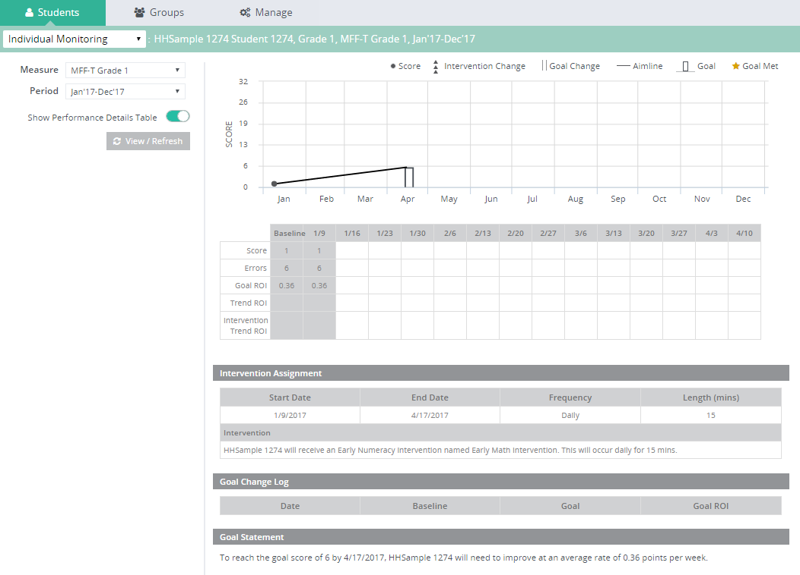
Initial Individual Monitor Report
Notes:
Here is a view of the schedule that was set on the previous series of slides. This is accessed through the Benchmark Comparison, Monitor, or Student Profile screens by clicking onto the goal indicator bar.
Trainer: Take note that if a student is assigned to more than one teacher that both teachers will have access to view this report. You may also have two monitoring schedules existing at the same time in the same measure if they are at different grade levels.

Slide 28
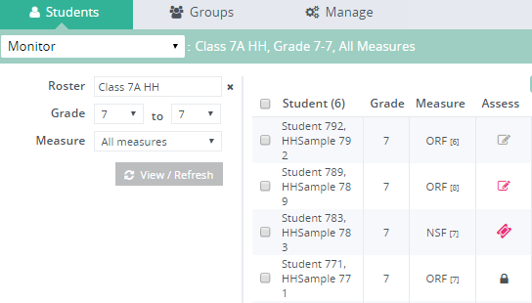
Data Collection
DRF Measures
Online Measures
Review: Can you find the DRF progress monitoring stimulus materials in the Help File?
Notes:
Course Participant note: in the course videos, this slide is replaced by a demonstration within the software.
The links to DRF measures will be found from the Monitor screen. From this same screen, you can access and assign tests for online assessments. Simply navigate to the Monitor screen, find your student, and click the links under the Assess column.
{Click} You can click onto the “pencil icons” to obtain access to DRF scoring. You will find that the pencil icons are color coded:
Pink indicates that the assessment is past due according to the monitor schedule.
Light gray indicates that the assessment has been completed for the week. You will not be able to complete another monitoring measure until the next Monday.
Dark gray indicates that the assessment is due.
{Click} For online tests you must first assign the test by clicking onto the “gear icon” to assign a test. {Click} Click onto Assign within the popup and the icon will then turn into a “ticket icon”. Once a test assignment has been made, you can click onto the “ticket icon” to view the test username and passcode. {Click} Click onto OK to close this window.
Once test assignments are made, you can also go to the Test Assignment list and pull lists for groups.
{Click} As a quick review, go into your training account, find the Help File, and see if you can find the stimulus materials for DRFs.
Trainer: Be ready to demo where to find the materials if needed.

Slide 29
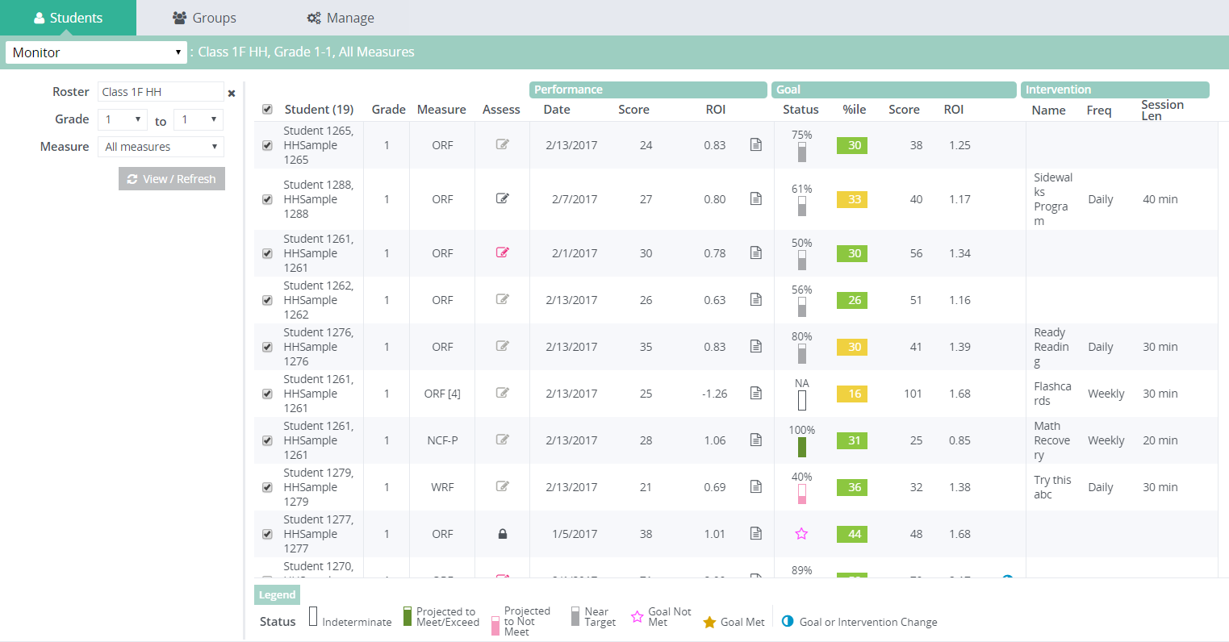
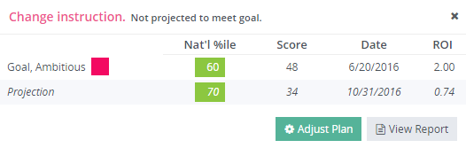
Access to Intervention and Goal Changes
1
Benchmark Comparison
1
2
Monitor
Click onto a Goal Status bar
Click onto Adjust Plan button
1
Student Profile
Notes:
Animated: Click for steps
Should you decide than an intervention needs to be changed or adjusted you can access the ability to adjust a student’s intervention or goal from any of the goal status bars. These are found on the Benchmark Comparison, Student Profile, and Monitor screens.
Click onto the goal status bar and a pop-up box will appear.
Then click onto “Adjust Plan”. This will take you to the screen where you can make changes. This will bring you to the Goal screen (next slide).

Slide 30
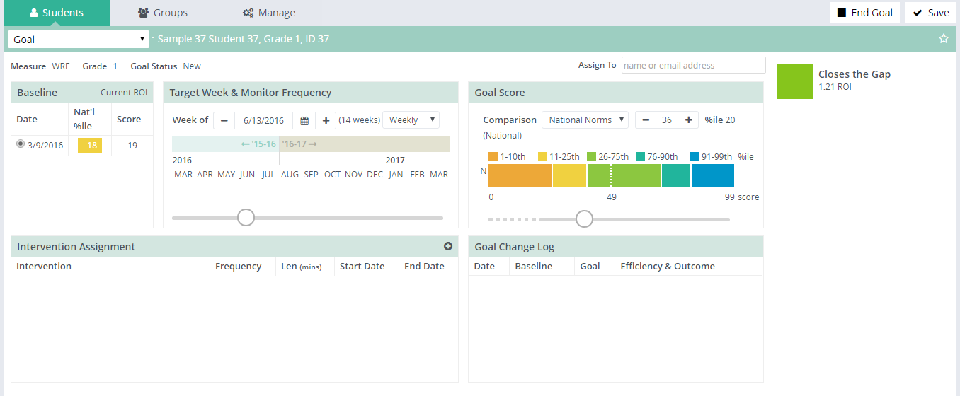
Change a Goal
2
1
Change the goal within the Goal Score area
Click Save
Notes:
Animated: Click for each step.
Based on feedback that you are given, you might decide to change a goal score. Here are the steps to change a goal:
Change the goal within the Goal Score area by typing in the score or using the slider bar.
Click onto Save at the top-right of the screen.
If you start to make changes and then decide not to proceed, do not click Save. Navigate off of this screen so that any adjustment you have made will not activate.

Slide 31
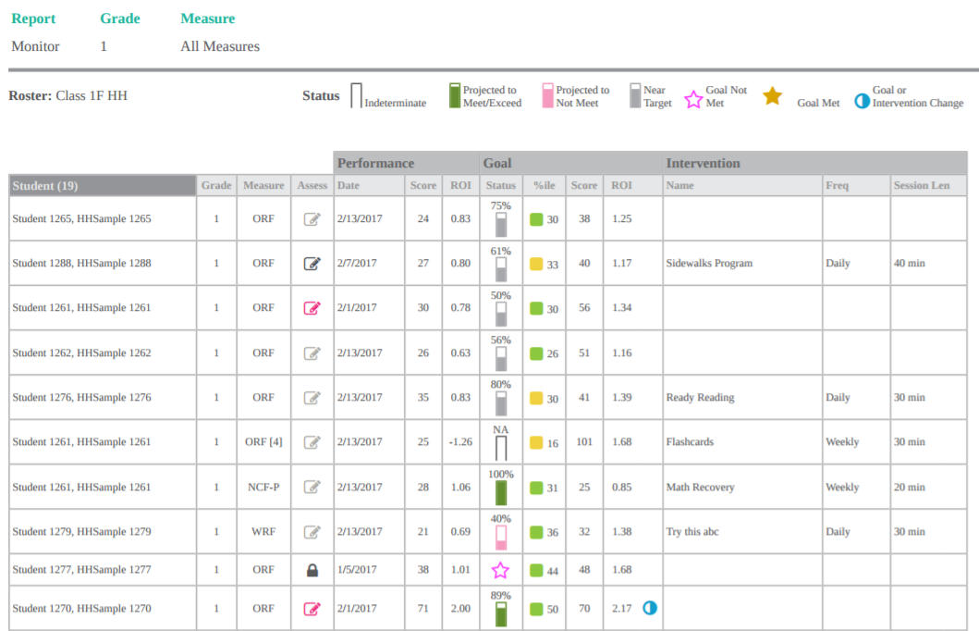
Group Monitoring Report
Notes:
Once you have set up progress monitor schedules you will be able to group your monitor data into summary reports. If you are assigned as a manager you will have access to all students at your levels of access. If you are a teacher or reporter you will have access to students assigned to you.

Slide 32
Group Monitor Screen
1
2
3
Click Students tab
Select Monitor
Filter to your group and click View/Refresh
Notes:
Animated: Click for each step.
Follow these simple steps to access the group monitor screen:
Click onto the Students tab
Select Monitor from the dropdown menu.
Use the filter to select your group of students and click onto View/Refresh. Your results will populate on the screen.
If you would like to print this report you can click onto the Export button. Retrieve your report (as seen on the previous slide) from the Notifications area when it is ready.
This screen provides both data and access to different details and reports. We will now take a closer look at what you can do at this screen.

Slide 33

Monitor Screen Functions
Begin a DRF
View an intervention change and effect
View a goal change and effect
Access to online test assignments will also show up in this column
View a report
View specific goal feedback, adjust plan, view report
Notes:
Animated: Click to move across columns left to right.
{Click} The Assess column contains your access points to assessments, whether they be DRF or online assessments.
{Click} The column with the “paper icons” contains direct access to each student’s individual monitoring report.
{Click} The “goal status icons” are links to the students current goal feedback. This is also an area where you can adjust the plan or view a report.
{Click} The “blue circle icons” shown under the Goal area give a signal that a goal has been changed. You can click onto this to see more specific details.
{Click} The “blue circle icons” shown under the Intervention area signals that an intervention has been changed. You can click onto this icon as well to see more details.

Slide 34
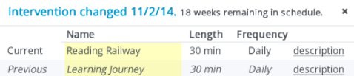
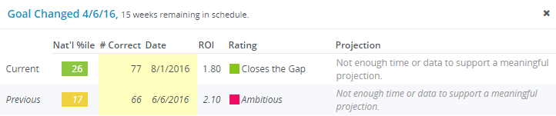

Monitor Screen Components
Notes:
Animated: Click for each component.
Here we will go through the various pieces of data and interactive components of the Monitor screen.
{Click} Student names will be listed along the left side. The total student count in the group you have filtered will show in the header. If you have selected more students than the screen allows there is a scroll bar on the right.
{Click} The next column to the right shows the grade level of the student. This may or may not be the grade level of the monitoring measure.
{Click} The measure column shows the measure type that the student is being monitored with. If they have an off level measure it will be added in parenthesis next to the measure name.
{Click} The Assess column contains interactive DRF access points or test assignment tickets for the monitoring measures. DRFs are signified by a “pencil icon”, while online assessments use a “ticket icon”. A “lock icon” will indicate that an online measure is underway or that the goal period has ended.
{Click} The Performance group, as highlighted here, contains the date of the most recent assessment, that raw score, and current actual weekly ROI. There is also an access point to the individual monitoring reports. If the ROI cannot yet be calculated, no ROI value will be shown.
{Click} The Goal group of columns contains the current goal status, the ending national percentile within the norm season that the goal date lands, the raw goal score, and the necessary ROI to meet the goal based on the baseline score or most recent score since an intervention change. You are able to click onto the goal indictor icons to see feedback about current progress. We will cover this feedback in more depth later.
You will see little blue “goal change icons” in this section if an goal has ever been adjusted. You can click onto this icon to see: the date the goal changed, the number of weeks remaining in the schedule, and information about the current and previous goals. This includes the National percentile at the end date for the goal (based on the relevant norm period/grade level), the raw goal score, the ending date, the necessary ROI to meet the goal, the rating of ambitiousness based on student growth percentiles, and a current projection based on the data.
{Click} The Intervention group of columns contains the name of the most recent intervention as well as the frequency and session length for that intervention. You will see little blue “intervention change icons” in this section if an intervention has ever been changed. You can click onto this icon to see: the date the intervention changed, the number of weeks remaining in the schedule, and the name/length/frequency of both the current and the latest intervention. There are also access points to view the descriptive details about each intervention.
{Click} The bold column labels that are highlighted here are interactive as well. By clicking once or twice onto any one of them, you can reorder students in the group by ascending or descending values or letters.
A PDF version of this report may be downloaded for printing or saving by clicking onto the Export button.

Slide 35
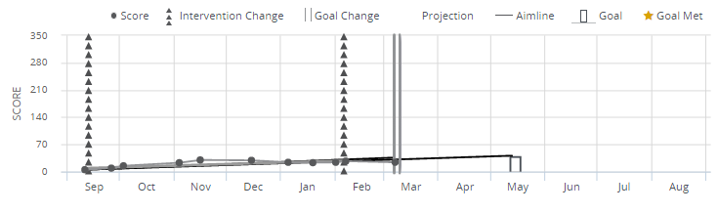
Individual Monitoring Screen
Access:
Student profile screen*
Benchmark Comparison screen*
Monitor screen
Student Search>Student tab>Individual Monitoring
*Baseline must a benchmark score
Notes:
Animated
The Individual Monitoring screen can be accessed from a number of points in the software including the Student Profile screen, Benchmark Comparison screen, Monitor Screen, or through Student Search and selection of Individual Monitoring. *Note that you can only access this report via the Student Profile or Benchmark Comparison screens if the original baseline score is from benchmark results.
{Click} There is a legend at the top of the report to help you interpret the components displayed. Information available for the student seen here includes data points that correspond to the score and date, an intervention line, an aimline that shows the connection between the baseline and goal, and the goal score. Feedback is provided within this goal bar in regards to how well the student is doing once enough data has been collected.
Raw scores, goal and trend ROIs, intervention details, and a goal statement are provided under the graph.
We will look at the PDF version of this report next.
Trainer: These are more specifics of the various ways to locate this screen.
Select a student and go to Individual Monitoring in the student pulldown menu.
From the Monitor screen click onto the Goal Status bar and then select View Report.
From the Student Profile screen click onto the “paper icons” next to the monitoring scores or click onto the “goal status icons”.
From the Benchmark Comparison screen click onto the Goal Status bar and then select View Report.

Slide 36
Goal Feedback
Indeterminate
Near Target
Projected to Meet or Exceed
Projected to Not Meet
Goal Not Met
Goal Met- not expired
Goal Met- expired
Notes:
When you click onto the goal status bars on the Monitor screen, the system will give you more specific feedback in regards to current rate of improvement, projected percentiles, and whether the student is projected to meet their goal or if they have met their goal. There are seven different types of goal feedback. Many of them are based on confidence intervals surrounding the projected score. We will show more on confidence intervals and specifics about each status next and then go through each goal feedback.

Slide 37
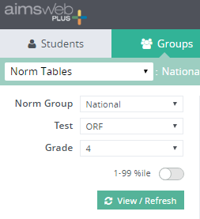
Navigation to National Norms
Norm Group
To view national norms choose National.
Grade
Choose the grade level. Only grade levels that have available norms will show.
Percentile
Click the
1-99 %ile toggle to view norms at all percentiles.
Test
Choose any measure or composite.
Notes:
Animated- click for each filter option
To navigate to the Norms Tables report, select the Groups tab and then Norms Tables from the dropdown menu. The filter options will vary depending on your Norm Group selection. We are going to look at the filter options separately for national norms here. The next slide will cover local norm filter options.
{Click} First, you will filter to the National norms.
{Click} Next, choose any measure or battery you would like to view norms for.
{Click} Then choose the grade level you want on the report. Depending on the measure or battery you have chosen, only grade levels with norms will show.
{Click} Finally, if you wish to view all percentiles broken down 1-99 then click on the toggle. You will not have access to ROI norms if you do this.
{Click} Once you have made your selections click onto the View/Refresh button. Note that your selections will be reported in the green bar at the top. You can queue this report for printing or saving as a PDF by clicking onto Export.

Slide 38
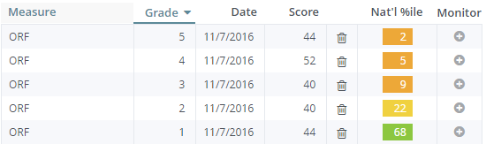
Survey Level Assessment Report
Provides documentation of data collected using Survey Level Assessment. Determine a student’s present level and optimal monitoring level.
Notes:
Survey Level Assessments are used to determine a student’s present level of performance (PLOP) and can also be used to determine the appropriate level at which to progress monitor students. Determining a PLOP is attained by drop back testing until the score is in the average range. Optimal progress monitoring is often performed within the grade level at which the student scores within the 11-25th percentiles. Previously, users had to do SLA by hand outside of the system. With aimswebPlus this can now be completed within the system and scoring is all digital. After completing SLAs the system will keep a historical record of results. Scores are compared to the closest benchmark period at the time of data collection. Scores may be used as baseline scores for a monitoring schedule.

Slide 39
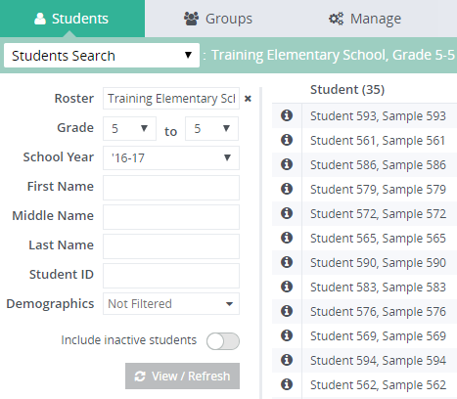
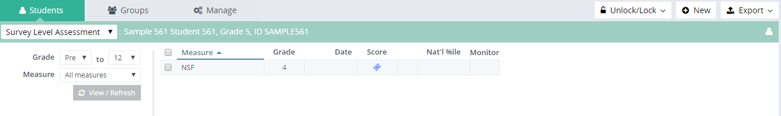
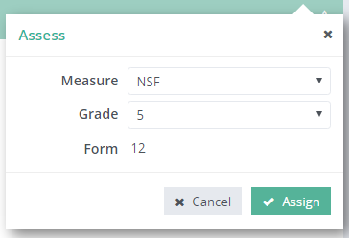
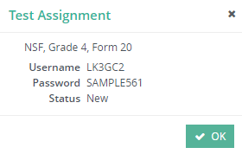
Survey Level Assessment
(online measures)
Click the Students tab and then Student Search
Select the student and choose Survey Level Assessment
Click onto New and choose the online measure and level
Click onto Assign
Retrieve the test credentials.
Unlock the test
1
6
3
2
5
4
Notes:
Animated: Click for the steps of completing a SLA in the software.
Remember that you will use Survey Level Assessment to set your baseline in these two instances. One, you are testing back to determine what level to monitor the student and then use the appropriate score for a baseline. Or two, it is beyond two weeks from your benchmark data collection and you need a new baseline score.
To complete an SLA you will follow these steps:
Locate your student through the Student Search dropdown menu on the Students tab.
Once you have selected the student you will again use the dropdown menu from the Students tab and you will select Survey Level Assessment.
From this screen you can click onto New (in the upper right) and then choose the online measure and grade level. A popup will appear.
Click onto Assign and wait for the test to be assigned.
You will then be able to access the credentials by clicking onto the test ticket or visiting the Test Assignment List screen.
Unlock the test.
Once the assessments are completed you will see scores and percentiles on the SLA screen.
Once the assessments are completed you will see scores and percentiles on the SLA screen. You can click onto the plus icon and begin a monitor schedule using the SLA score as a baseline.

