Slide 1

Multi-Tiered Systems of Support (MTSS)
Deanna Rugzie
MTSS Facilitator

Slide 2
What is MTSS?
MTSS = Multi-Tiered System of Support
MTSS is a systemic, continuous- improvement framework that uses evidence-based practices, focusing on data-based problem-solving at multiple levels to support “need-driven” decision making to accelerate performance for all students. (Gibbons, K., Bollman, K. (Directors) (2015, June 23). Response to Intervention Summer Institute. 10th Annual Response to Intervention (RtI) Summer Institute. Lecture conducted from Crowne Plaza, Bloomington).
It is based on the assumption that ALL students can learn and achieve when provided with effective teaching, research-based instruction and access to standards-based curriculum.
Main Goal:
  To problem-solve why students are struggling with grade level content and provide assistance to those identified students within all tiers to ‘close the gap’ of student achievement
Originally referred to as Response to Intervention (RtI)
  Difference from RtI:
    problem-solving and support for students’ social/emotional/and behavior needs
    provides a framework for focusing on overall school improvement
    emphasizes prevention
  (Hurst, S. (2014, January 6). What is the Difference Between RtI and MTSS? Retrieved July 27, 2015.)

Slide 3
MTSS vs. RtI/PBIS?
RtI – Referral based process to determine if a student is responding to the prescribed intervention; used for SLD referral
MTSS
MTSS – ALL students can learn and achieve; Problem solve on how to ‘close the gap’ and accelerate learning for all children
RtI
PBIS
PBIS - is an application of a behaviorally-based systems approach

Slide 4
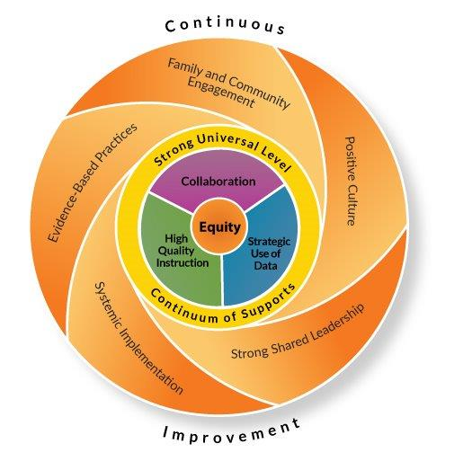
What is MTSS?
Notes:
Explain graphic
MTSS is made of up of collaboration, assessment, instruction, and culturally responsive practices - it is not just is a student making progress
It is a whole child approach done in a variety of different settings

Slide 5
Why MTSS?
Use of evidence-based practices is required by law
  NCLB Act of 2001 requires the use of instruction based on scientific research (Stanovich, P., & Stanovich, K. (2006). What is Scientifically Based Research? A Guide for Teachers. Retrieved July 27, 2015, from http://lincs.ed.gov/publications/pdf/science_research.pdf).
  Reauthorization of (IDEA) in 2004 required the use of a process based on the child’s response to scientific, researched-based intervention
    Specific to Learning Disabilities: IDEA requires that (1) states could no longer require the use of significant discrepancy between intellectual ability and achievement as a part of learning disability determinations, (2) states must permit the use of a process based on the student’s response to scientific-research/evidence-based interventions (Topic: Identification of Specific Learning Disabilities. (2006, October 4). Retrieved July 27, 2015, from http://sped.dpi.wi.gov/sites/default/files/imce/sped/pdf/sld-guide.pdf).
  2013, Wisconsin state law stated that IEP teams could no longer use significant discrepancy as learning disability criterion and must use progress monitoring data collected during intensive, scientific research-based/evidence-based interventions
    WI state law requires that a student (if suspected as having a disability) must receive TWO intensive interventions within the area of concern before IEP teams can make the learning disability eligibility determination
    The intervention must be implemented within the general education setting by appropriately licensed general education staff (2006, October 4). Retrieved July 27, 2015, from http://sped.dpi.wi.gov/sites/default/files/imce/sped/pdf/sld-guide.pdf).

Slide 6
WHY MTSS?
The School District of Marshfield’s vision for the implementation of a MTSS framework, embedded in best practice, is to ensure that ALL students in the district are provided with high quality instruction that is evidence based within a supportive environment, ensuring that students’ academic and behavior needs are not only met, but promote growth within the learning environment.

Slide 7
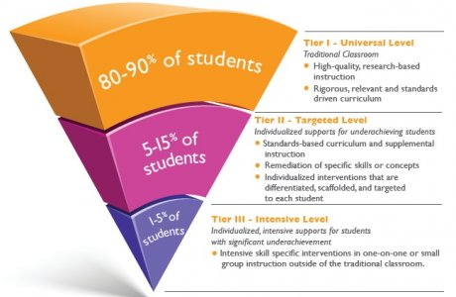
Marshfield MTSS Model
Three tier model
Following components are implemented in
each tier:
  Instruction
  Assessment
  Problem-solving

Slide 8
MTSS Framework: Tier 1
Tier 1 – high-quality, research-based instruction made up of a standards driven curriculum. It is made up of the following:
  High Quality Instruction – engaging, standards-based, data-driven, and research-based instruction which are grounded in culturally responsive practices
  Culturally Responsive Practices – account for and adapt to the broad diversity of race, language and culture in Wisconsin schools and prepare all students for a multicultural world
  Curriculum – is what is taught, including scope, sequence, pacing, materials, rigor, format, relevance (provide examples, such as, Imagine It! of our curriculums)
Assessment
  Universal screening– AIMSweb; PALS (4k-2nd);Lexiles (2nd – 6th)
    Screening – testing to determine if a student is sufficiently different (discrepant) such that more intensive intervention may be required
    Universal Screening – Testing of ALL students to identify at-risk
    Benchmark Assessment – combines screening and progress monitoring (it is both)
  State assessments – Forward (3rd – 10th)
  Classroom performance (formative and summative)
  Record reviews

Slide 9
MTSS Framework: Tier 1
Problem-Solving
  Grade Level Teams (PLC)
  utilize and review grade/content level data to determine how students are progressing toward standards
  Data drives instruction!
    Constant review of formative assessments
    Helps determine differentiation and flexible groups
  MTSS building teams should review school wide data trends to help determine supports needed
Teams | Data Reviewed
PLC Team | Use screening data to triage students to tiered interventions; review of data
MTSS Building Team | Review school level achievement & behavior support data to determine effects and needs
*Adapted from “Supporting High Quality Implementation of MTSS: Nobody Said It would be “Easy” presentation by Mark Shinn, Ph.D. on February 15, 2016

Slide 10
MTSS Framework: Tier 2
Instruction (10-15% of students)
  instruction is provided in unison with the core curriculum
    Supplemental or strategic support
    Supplemental Intervention – curriculum and instruction practices that are provided to SOME students IN ADDITION to the routine
    Meant for students who are deemed at-risk for failure, low-performing or needing enrichment
    Implies a small group of three to five students for 20-40 minutes, at least three to five days a week.
    Intervention – a systematic use of a technique, practice, or program designed and shown to improve learning in specific areas of student need. An intervention teaches skills to help students overcome specific deficits or maladaptive response patterns. Interventions require a targeted assessment, planning, and data to be effective; consideration is given to the nature of the problem (skill deficit vs. performance deficit).

Slide 11
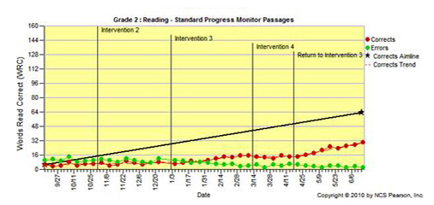
MTSS Framework: Tier 2
Assessment
  Progress Monitoring - is used to assess students’ academic performance to quantify a student rate of improvement or responsiveness to instruction, and evaluation the effectiveness of instruction
    Example: AIMSweb
    Done on bi-weekly or
    weekly basis
    *For an SLD referral: must be
    weekly
    Fidelity – is the degree to which an intervention or instruction is delivered as planned with accuracy and consistency
      Fidelity Logs & Checks

Slide 12
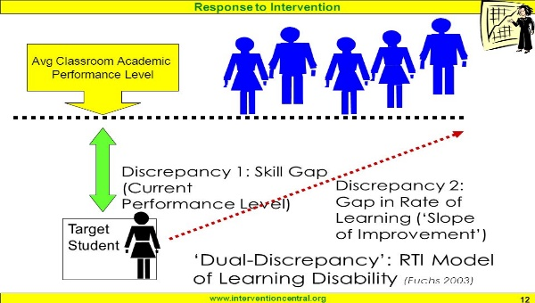
MTSS Framework: Tier 2
Vocabulary:
Performance Discrepancy – how a student’s level of achievement compares to the expected level of achievement, norm-based. (see graphic).
Progress Discrepancy – how a student’s rate of improvement (ROI) compares to the expected level of ROI of achievement with norm-based criteria
Rate of Improvement - is a numerical index that reflects how rapidly raw scores on a measure increase during a given school year

Slide 13
MTSS Framework: Tier 2
Problem-Solving
  Grade Level Teams (PLC)
  utilize and review grade/content level data to determine how students are progressing toward standards
  Data drives instruction!
    Constant review of formative assessments
    Helps determine differentiation and flexible groups
  Problem Solving Team might be utilized to determine effective interventions for students
Teams | Data Reviewed
PLC Team | Use screening data to triage students to tiered interventions; review of data
Problem Solving Team | Review achievement behavior support data to determine effects and needs for students

Slide 14
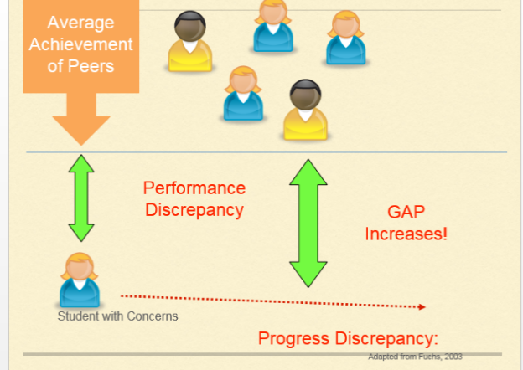
MTSS Framework: Tier 3
Instruction (1-5% of students)
Tier 3 – individualized, intensive instruction for students with significant underachievement; intensive, skill specific interventions in one-on-one or small group instruction that is either supplemental or supplanted.
This implies smaller instructional group sizes, longer daily sessions and intervention over a longer term*
Example: Replacement curriculum in special education
Intensive Intervention – a systematic use of a technique, program, or
practice designed to improve learning or performance in a specific area
of need
Assessment
Progress monitoring on a weekly basis
*(Shinn, M. R., PhD, & Walker, H. M., PhD (Eds.). (2010). Interventions for Achievement and Behavior Problems in a Three-Tier Model Including RtI. Bethesda, MD: National Association of School Psychologists. )

Slide 15
MTSS Framework: Tier 3
Problem-Solving
  Problem Solving Team utilized to determine effective interventions for students
  Special Education Referral
Teams | Data Reviewed
Problem Solving Team | Review achievement behavior support data to determine effects and needs for students
Special Education Referral | Review achievement behavior support data to determine effects and needs for students and if they meet criteria for a disability

Slide 16
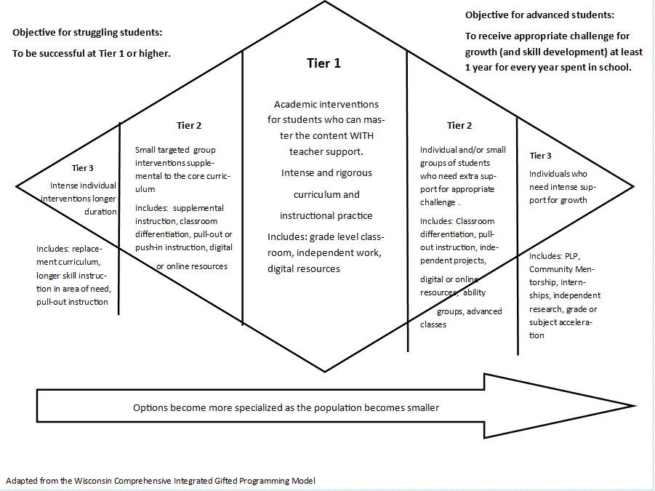

Slide 17
Note about Fidelity
Fidelity is the degree to which an intervention/instruction is delivered as planned with accuracy and consistency. It measures the difference between what is expected in the curriculum/intervention design and what is actually executed in the class and/or intervention session (Deni, J., Dimick. D., Foster, K., (Speakers) (2012, November 14). Instructional Integrity: From Research to Practice. 42nd Conference on Exceptional Children. Lecture conducted from North Carolina Department of Public Instruction, Greensboro.)
Crucial component within all Tiers
Instruction/Interventions to be implemented with fidelity
It cannot be assumed that interventions are conducted with fidelity, as fidelity data is required to demonstrate that interventions are implemented correctly.
Aim for 80% or higher with fidelity of interventions/instruction
Collecting fidelity data will be incorporated into the MTSS data gathering process
Lack of fidelity with curriculum/interventions
Misleading data
Misinformed decisions affecting student outcomes

Slide 18
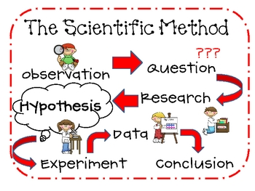
Problem Solving Process
Problem Identification (What’s the problem?)
Problem Analysis (Develop hypotheses, why is it happening?)
Plan Development
  Intervention determined
  What assessment will be used?
  What is the intended goal?
Plan Implementation
Plan Evaluation (Did it work?)
Notes:
Only going to focus on steps 1-4
Think in terms of a science project. When we teach our students about what is needed to be included in their science project we require steps from the scientific method.
In the scientific method our students are required to observe and question (this would be when we look at student data and question why a student is not performing where we expect them to be (performance deficit). Our research is the problem identification stage – we are trying to figure out the possible problem. Our problem analysis is our hypothesis phase. We are developing a possible reason for why the there is a performance deficit. From there we determine our plan (or equivalent would be experiment). We collect our data (progress monitoring) and then after the end of our experiment we come back and determine if it worked.

Slide 19

Problem Identification
Problem Identification is used to review multiple sources of data to prioritize the main concern and guide the problem analysis phase
Progression of conversation:
Instruction
Curriculum
What sequence do objectives follow?
Environment
Motivational level?
How is material presented?
How does student engage during instructional conversations?
Difficulty of curriculum for all students compared to target?
Learner
What are the expectations of the student?
How is peer environment impacting student?
History of instruction?
Notes:
As you move through each section you need to determine if there is anything in any of these areas that need to be adjusted/changed for the student before considering talking about the issues that may line within the child. If something in the area of instruction, curriculum and environment needs to be changed, this should be addressed. Again, only focus on things that are educationally relevant and we are able to control.
No right or wrong way to have this conversation. Whole goal is to pinpoint the cause for the student learning gap.
This flow of conversation might feel uncomfortable at first and some questions might put people on “defense” but remember back to the beginning when we reflected on why we wanted to be become educators. To make a difference in children’s lives. This means that sometimes we have to have the “hard” conversations and be subjective. “remove emotion”.

Slide 20

Problem Analysis
Reviewing possible reasons for skill deficit
Generate a hypothesis to determine why the problem is occurring based on data reviewed
  Why do we create a hypothesis?
  Hypothesis - a proposed explanation for a phenomenon. For a hypothesis to be a scientific hypothesis, the scientific method requires that one can test it.
Notes:
Hypothesis are created to help guide the plan to intervene with the student. As the definition says, it is a proposed explanation. The plan we create for the child is to test out that hypothesis. For example, after going through the problem identification phase a team may determine that Billy does not have basic phonic skills. Through the problem identification phase it was not determined that there were problems with the current instruction or the curriculum but within the area of environment it was noted that Billy has been to five different schools and he is only in 3rd grade. He has also consistently missed 15+ days per school year. What would be the logical hypothesis why Billy does not have any phonics skills? He has not had the specific and consistent instruction in this area. Thus, the plan would be to provide Billy with some specific instruction within the area of phonics.
Again, there is no right or wrong hypothesis. Remember it is a team decision and what the team determines based on extensive data review that the child needs at that time. If the team is really questioning the hypothesis or even the plan that is created, as this question “Is what we are determining going to be detrimental to the child?”

Slide 21
Plan Development
Who: will implement intervention
What: intervention will be used; progress monitoring tool will be used
When: intervention will be conducted; progress monitoring will be done
Where: intervention will be implemented
How: intervention will be implemented
Needs to address the hypothesis question
Develop a goal statement
Notes:
Since the RIOT/ICEL form has been eliminated a new Problem Solving form was created. This form includes now the target areas of concern at the top. It also has a checkbox for teams who determine no new plan was needed. Now the identified problem and hypothesis are combined into one box. All else remains the same.
Remember it is important for teams to discuss who will be collecting fidelity. Suggestion would be to schedule fidelity observations at that meeting. Also, be sure to document the outcome of the meeting on the problem solving log along with a follow up date. I know it is hard to schedule meetings, so getting things on the calendar as soon as possible is very helpful.

Slide 22
Goal Statement
Goal statement will address the hypothesis question
The goal(s) should be specific, including baseline data, what the desired outcome should be and within what timeframe it will be completed
Goal statements should be written using the following formula: “By _____ (date), Sally will have increased within the area of reading fluency from 28 words per minute (the problem) to __________.”
Notes:
The purpose of the goal is to measure if the plan is working. In the frame of mind of the scientific method, this step is the “experiment”. Our progress monitoring is the data that we are collecting and tells us if the hypothesis was correct or not. We need an accurate goal statement to ensure the data we collect accurately answers our hypothesis or not.

Slide 23
Plan Implementation
Intervention will be administered as prescribed, which was developed during the plan development phase
Ensure fidelity at this phase
Be sure to be progress monitoring (collecting data)

Slide 24
Plan Evaluation
Upon completion of the intervention cycle, the team reviews progress monitoring and fidelity data to determine if the prescribed plan was effective in achieving student progress
Consider the following:
  If the student has made adequate progress toward their goal and no longer requires intervention, fading out the intervention
  Student has made adequate progress but continues to need support
  Student has made insufficient and requires a change in the current plan
  Student has made insufficient progress, after multiple interventions, and requires a referral for an evaluation
Notes:
Some teams might be near the point they need to evaluate the plan. We will get into more detail within the next year, but in the mean time you will want to determine if the student is making the gains that were expected (reaching the goal that was set). If not, the team is again going to want to go through the PS process with this new information to determine if the right problem was identified or if it was the correct hypothesis and a new plan is needed. Or it might just be the that the current plan needs to be tweaked to better suit the students needs.

Slide 25
MTSS Teams
District Team
Building Team
Reviewing district data to assess needs of the district
Develop protocols to assist buildings with implementation
Provide training to building teams
Create intervention guide and protocols for implementation
Review school-wide data to determine needs of the school
Review individual student data with teacher to engage in problem solving and develop an intervention plan
Assist staff members with MTSS implementation, including collecting data, documenting interventions and intervention implementation to ensure fidelity

Slide 26
MTSS Teams
District Team
Building Team
Made up of representatives throughout the district
  Principal/Assistant Principals
  School Psychologists
  Director of Curriculum and Instruction
  Director of Student Services
  Literacy Coaches
  Behavior Specialist
Will include
  Administrator
  Data coach
  School Psychologist
  General Education Representative
  Special Education Representative

Slide 27
Reference Guides
MTSS Website
  MTSS manual
  Alpine guides
  Problem Solving Forms
MTSS Intervention Webpage

Slide 28
Questions?
Contact Information:
  Deanna Rugzie
  School Psychologist (Madison Elementary)
  MTSS Facilitator
  rugzie@marshfieldschools.org

