Slide 1
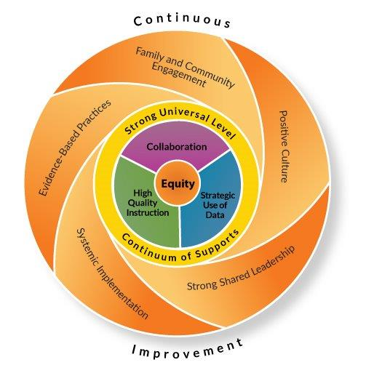
What does “Equitable Multi-Level Systems of Support” actually mean?
And how does it relate to me and our students?

Slide 2
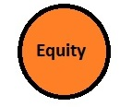
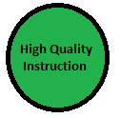
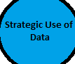
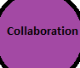
Think: trauma-informed classrooms, professional development, personalized learning experiences for students, academic and career planning, tiered academic and behavioral supports, culturally responsive practices.
Think: personalized learning experiences for students, tiered academic and behavioral supports, use of technology resources, curriculum resources, professional development, curriculum standards, curriculum assessments, assessments driving instruction (formative and summative), culturally responsive practices, curriculum review process, educator effectiveness, data management systems (Alpine/Skyward), mentoring new staff.
Think: data management systems (Alpine/Skyward), PLC, Problem-Solving Meetings, academic and behavior data to drive instruction/intervention, use of assessments to drive instruction, educator effectiveness, building leadership teams (MTSS, PBIS), professional development.
Think: trauma-informed practices, PBIS, use of technology resources, parent communication, PLC, building leadership teams (MTSS, PBIS, BLT), academic and career planning, technology resources for communication, mentoring of staff, professional development.
Notes:
Equity – Educational equity means that every student has access to the resources and educational rigor they need at the right moment in their education, across race, gender, ethnicity, language, disability, sexual orientation, family background, and/or family income.
High Quality Instruction – Curriculum, teaching practices and learning environments are standards-based, evidenced-based, engaging, differentiated, culturally responsive, and data-driven.
Strategic Use of Data – Ongoing, reflective and collaborative analysis of implementation and outcomes data in a problem-solving process to inform improvement and achieve equity.
Collaboration - A systemic process of learners, families, educators, and the community working together to ensure the academic, behavioral, social and emotional success of every learner.

Slide 3
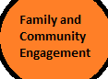
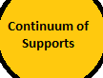
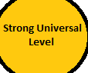
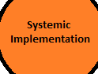
Think: use of technology resources, parent communication, open houses, and conferences.
Think: PLC, data management systems (Alpine/Skyward), assessments driving instruction (formative and summative), PBIS, personalized learning, tired academic and behavioral supports, Problem-Solving Meetings, staff mentoring, professional development, culturally responsive practices, trauma-informed practices, and curriculum review process.
Think: personalized learning, use of technology resources, PLC, assessment driving instruction (formative and summative), building teams (PBIS, MTSS, BLT), PBIS, data management systems (Alpine/Skyward), curriculum review, professional development, staff mentoring, educator effectiveness, culturally responsive practices, trauma-informed practices.
Think: professional development, trauma-informed practices, tiered academic and behavioral supports, PBIS, personalized learning, use of technology resources, PLC, Problem-Solving meetings, building leadership teams (MTSS, PBIS), use of data management systems (Alpine/Skyward), staff mentoring, curriculum review, culturally responsive practices, and educator effectiveness.
Notes:
Family and Community Engagement – Families and communities are active partners and key collaborators in achieving the goal of success for every learner.
Continuum of Supports – High quality instruction, collaboration, and strategic use of data of varying intensity to equitably address the needs of every learner.
Strong Universal Level – Instruction, assessment and collaborative systems and practices are accessible, effective and reflective of every learner.
Systemic Implementation - Programs, practices, roles and expertise aligned and coordinated into an interdependent whole to ensure every learner benefits equitably from access, opportunity, and support across the school and district.

Slide 4
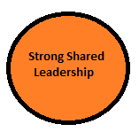
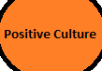
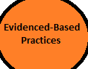
Think: teacher leadership opportunities, PLC, professional development, building and district teams (MTSS, BLT, PBIS, curriculum review teams, Personalized Learning), and staff mentoring.
Think: trauma-informed practices, PBIS, tiered academic and behavioral supports, PLC, culturally responsive practices, and building teams (PBIS, MTSS, BLT).
Think: PLC, curriculum resources, use of technology resources, personalized learning, PBIS, building and district teams (MTSS, PBIS, BLT), data management systems (Alpine/Skyward), academic and career planning, curriculum review, and assessment driving instruction (formative and summative), parent communication, tiered academic and behavior supports, professional development, trauma-informed practices, and culturally responsive practices.
Notes:
Strong Shared Leadership – Representative teams with responsibility to lead and oversee implementation of an equitable multi-level system of supports at the school and district level.
Positive Culture – A collective sense of purpose and commitment to ensure the well-being, sense of belonging, safety and success of every learner.
Evidenced-Based Practices - Use of programs, practices and procedures with the best available evidence balanced with the fit to the schools’ and district’s population and values.

Slide 5
Multi-Tiered Systems of Support
From Theory to Application

Slide 6

Who is Sara?
6th Grade Student
Grades:
  ELA – B
  Math – N
  Social Studies – B
  Science – C
  Art – 1
  Music – 1
  PE – 2
6th Grade Fall & Winter AIMSweb Scores:
  RCBM: 140; 163 (average)
  MAZE: 20, 21 (average)
  MCOMP: 10, 10 (well below average)
  MCAP: 6, 10 (well below average)
Lexile Scores:
  Fall: 800
  Winter: 891
State assessments: Proficient in ELA, Basic in Math
Intervention in math computation
  Progress monitoring = no growth
*Not real student*
Has a history of difficulty in math
Sara enjoys art, music and reading
Sara wants to be an author when she grows up
She prefers to provide written responses to work instead of being called on or engaging in oral presentations
She enjoys reading to younger students and attention from school staff

Slide 7
Student to Teacher Connection
Sara’s Needs
Classroom Application
Review of data from Alpine, AIMSweb, formative/summative assessments
Work within PLC to first support Sara in math; after no success with Tier 1 supports; Problem-Solving Meeting to determine intervention; interventions documented in Alpine
Intervention implemented and progress tracked in AIMSweb
Use of digital resources to assist with skill & drill practice
Communication with parent/guardian regarding implementation of math intervention
Continuation of math curriculum standards and resources during regular math instruction; making lesson plans and grading work
Options given to Sara for varied ways to complete homework
Support with math, including intervention
MTSS Areas Addressed:
Equity
High Quality Instruction
Strategic Use of Data
Collaboration
Family Engagement
Continuum of Supports
Strong Universal Level of Support
Systemic Implementation
Evidenced-Based Practices

Slide 8
Student to Teacher Connection
Sara’s Needs
Classroom Application
Review of data from Alpine, AIMSweb, formative/summative assessments
Problem-Solving Meeting to determine if referral needed based on progress monitoring data; if yes, referral is made
Continued implementation of intervention implemented and progress tracked in AIMSweb as evaluation is completed
Evaluation information gathered (assessments, observations, parent/teacher input)
Continued used of digital resources to assist with skill & drill practice
Communication with parent/guardian regarding evaluation and services
Continuation of math curriculum standards and resources during regular math instruction
Evaluation meeting held to review evaluation data, existing data, determine eligibility
Continued options given to Sara for varied ways to complete homework
Intensive math intervention provided through special education daily, progress monitoring occurs
Support with math, including intervention
Special Education referral made
  Qualifies for Special Education Services
MTSS Areas Addressed:
Equity
High Quality Instruction
Strategic Use of Data
Collaboration
Family Engagement
Continuum of Supports
Strong Universal Level of Support
Systemic Implementation
Evidenced-Based Practices

Slide 9
Student to Teacher Connection
Sara’s Needs
Classroom Application
Review of data from Alpine, AIMSweb, formative/summative assessments
Use of curriculum standards and resources; making lessons plans and grading work
Work within PLC to ensure students are achieving in a systematic way
Use of digital resources to help with engagement
Varied ways to complete projects based on learning styles, such as providing written responses
Grades and progress shared with parents at parent/teacher conferences and progress reports
Reading/ELA, Social Studies and Science instruction at grade level
MTSS Areas Addressed:
Equity
High Quality Instruction
Strategic Use of Data
Collaboration
Family Engagement
Continuum of Supports
Strong Universal Level of Support
Systemic Implementation
Evidenced-Based Practices
Strong Shared Leadership
Positive Culture

Slide 10
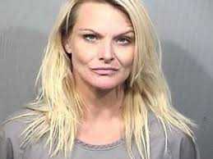
More about Sara
*Not real student*
Absences this school year: 15; in past years, Sara has averaged 25 absences per year
Has been seeing school counselor for social/emotional concerns; has been in groups in the past
Difficulty focusing, cries easily, will become verbally aggressive toward adults and peers at times
Discipline referrals: 20 minors; 7 majors
Currently lives with grandmother and grandfather and younger sister
Was removed from mother’s home due to neglect and drug/alcohol abuse
She feels remorse after she has become explosive towards adults and peers
Sara often states she is worried about her mother

Slide 11
Student to Teacher Connection
Sara’s Needs
Classroom Application
Review of absent history from Skyward
Guardian and teacher communication to increase attendance
Teacher/School Counselor/Principal/Social Worker collaborate to reduce barriers causing absences; work with County Case Worker
When needed, truancy citations administered
Outside support provided to family to support attendance
Absenteeism
MTSS Areas Addressed:
Equity
Strategic Use of Data
Collaboration
Family and Community Engagement
Continuum of Supports
Systemic Implementation
Strong Shared Leadership
Positive Culture

Slide 12
Student to Teacher Connection
Sara’s Needs
Classroom Application
Teacher continues with relationship building
Review of data from Alpine/ Skyward
Work within PLC to first support Sara behaviorally; after no success with Tier 1 PBIS supports; Problem-Solving Meeting to determine need for intervention; interventions documented in Alpine
Continued exposure to classroom guidance lessons
Teacher/School Counselor collaboration; School Counselor referral made
School Counseling support provided weekly
Behavioral intervention put in place with rewards focusing on her interests and preference; data collected daily
Communication with guardians, including outside agency referrals made; work with County Case Worker
Collaboration with Teacher/School Counselor/Psychologist/Social Worker/Principal to support Sara in and out of school setting
Staff learns more about how trauma affects students learning through professional development
Social/Emotional and Behavioral Difficulties
MTSS Areas Addressed:
Equity
High Quality Instruction
Strategic Use of Data
Collaboration
Family and Community Engagement
Continuum of Supports
Strong Universal Level of Support
Systemic Implementation
Evidenced-Based Practices
Strong Shared Leadership
Positive Culture

Slide 13
Other Staff Duties/Activities to support Sara’s (and all students) academic and behavioral success
Professional Development in a variety of areas to keep up with current trends in education
Sitting on various committees to assist with implementation of building and district activities that support students, including staff meetings
Learning and implementing technology/electronic resources to support all learning
Lesson planning and grading
Supporting extra curricular activities focusing on student interest
Collaboration with various staff and parents to support needs of students
Mentoring new staff
MTSS Areas Addressed:
Equity
High Quality Instruction
Strategic Use of Data
Collaboration
Family and Community Engagement
Continuum of Supports
Strong Universal Level of Support
Systemic Implementation
Strong Shared Leadership
Positive Culture
Evidence-Based Practices

Slide 14
Notes:
There a lot of moving parts to make this Framework successful for each child. At times, it has seemed like a challenge to learn and implement these changes. Yet, with all of these challenges, we have made enormous positive changes. Understand that what you do every day in your classrooms to meet the needs of all our students, you are effectively implementing MTSS.

