Slide 1

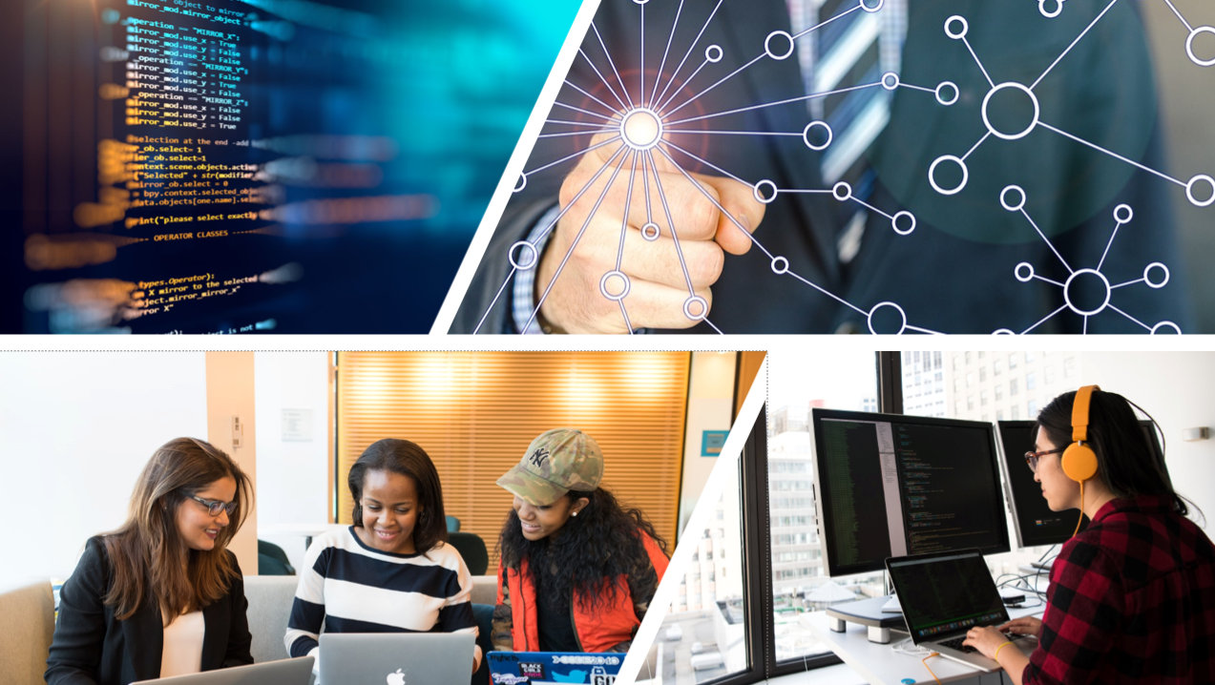




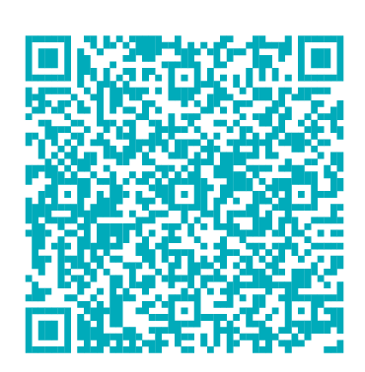
Statewide Program of Study: Programming and Software Development — Page 1
Revised–Oct 2024
Information Technology Career Cluster
The Information Technology (IT) career cluster focuses on the design, development, support, and management of hardware, software, multimedia, and systems integration services. This career cluster includes occupations ranging from Software Developer and Programmer to Cybersecurity Specialists and Network Analysts.
Statewide Program of Study: Programming and Software Development
The Programming and Software Development program of study focuses on occupational and educational opportunities associated with researching, designing, developing, testing, and operating systems-level software, compilers, and network distribution software for medical, industrial, military, communications, aerospace, business, scientific, and general computer applications. This program of study includes creating, modifying, and testing the codes, forms, and script that allow computer applications to run.
Secondary Courses for High School Credit
Level 1 | Principles of Information Technology
Level 2 | Computer Science I
Level 3 | Computer Science II
Level 4 | AP Computer Science A
Example Postsecondary Opportunities
Apprenticeships
Computer Programmer Apprenticeship
Associate Degrees
Computer Programming
Web Page, Digital/Multimedia and Information Resources Design
Bachelor’s Degrees
Data Science
Computer Engineering
Master’s, Doctoral, and Professional Degrees
Management Science
Computer Software Engineering
Additional Stackable IBCs/License
AWS Certified Developer Associate
Aligned Advanced Academic Courses
AP or IB | AP Calculus AB AP Statistics IB Mathematics Applications and Interpretation SL
Dual Credit | Dual credit offerings will vary by local education agency.
Example Aligned Occupations
Students should be advised to consider these course opportunities to enrich their preparation. AP or IB courses not listed under the Secondary Courses for High School Credit section of this framework document do not count towards concentrator/completer status for this program of study.
Computer User Support Specialists
Work-Based Learning and Expanded Learning Opportunities
Median Wage: $51,411
Annual Openings: 5,757
10-Year Growth: 21%
Work-Based Learning Activities | Intern at a local IT company to develop skills in programming and coding Shadow a software developer to learn how they create and improve software to support efficient processes at their company
Expanded Learning Opportunities | Program and create a game Participate in SkillsUSA or TSA
Software Developers
Median Wage: $111,705
Annual Openings: 15,324
10-Year Growth: 36%
Programming and Software Development
Aligned Industry-Based Certifications
Computer Programmers
Certified Entry-Level Python Programmer (PCEP)
Median Wage: $87,997
Annual Openings: 1,176
10-Year Growth: 4%
Data Source: TexasWages, Texas Workforce Commission. Retrieved 3/8/2024.
Successful completion of the Programming and Software Development program of study will fulfill requirements of the STEM endorsement if the math and science requirements are met or the Business and Industry endorsement.
For more information visit: https://tea.texas.gov/academics/college-career-and-military-prep/career-and-technical-education/programs-of-study-additional-resources

Slide 2



Statewide Program of Study: Programming and Software Development — Page 2
Information Technology Career Cluster
Statewide Program of Study: Programming and Software Development
Course Information
Course |  | Prerequisites | Corequisites | Career Clusters
Principles of Information Technology* 13027200 (1 credit) |  | Prerequisites: None Corequisites: None Recommended Prerequisites: None Recommended Corequisites: None
Level 1
Course |  | Prerequisites | Corequisites | Career Clusters
Computer Science I* 03580200 (1 credit) |  | Prerequisites: Algebra I Corequisites: None Recommended Prerequisites: None Recommended Corequisites: None | 1. Information Technology
Level 2
Course |  | Prerequisites | Corequisites | Career Clusters
Computer Science II 03580300 (1 credit) |  | Prerequisites: Algebra I and either Computer Science I or Fundamentals of Computer Science Corequisites: None Recommended Prerequisites: None Recommended Corequisites: None | 1. Information Technology
Level 3
Course |  | Prerequisites | Corequisites | Career Clusters
AP Computer Science A* A3580110 (1 math credit) A3580120 (1 LOTE credit) |  | Prerequisites: None Corequisites: None Recommended Prerequisites: Algebra I or a student should be comfortable with functions and the concepts found in the uses of functional notation such as f(x) = x + 2 and f(x) = g(h(x)) Recommended Corequisites: None
Programming and Software Development
* Indicates course is included in more than one program of study.
For additional information on the Information Technology career cluster,
contact cte@tea.texas.gov or visit https://tea.texas.gov/cte
[LEA name] does not discriminate on the basis of race, color, national origin, sex, or disability in its programs or activities and provides equal access to the Boy Scouts and other designated youth groups. The following person has been designated to handle inquiries regarding the nondiscrimination policies: [title], [address], [telephone number], [email]. Further nondiscrimination information can be found at Notification of Nondiscrimination in Career and Technical Education Programs.

