Slide 1


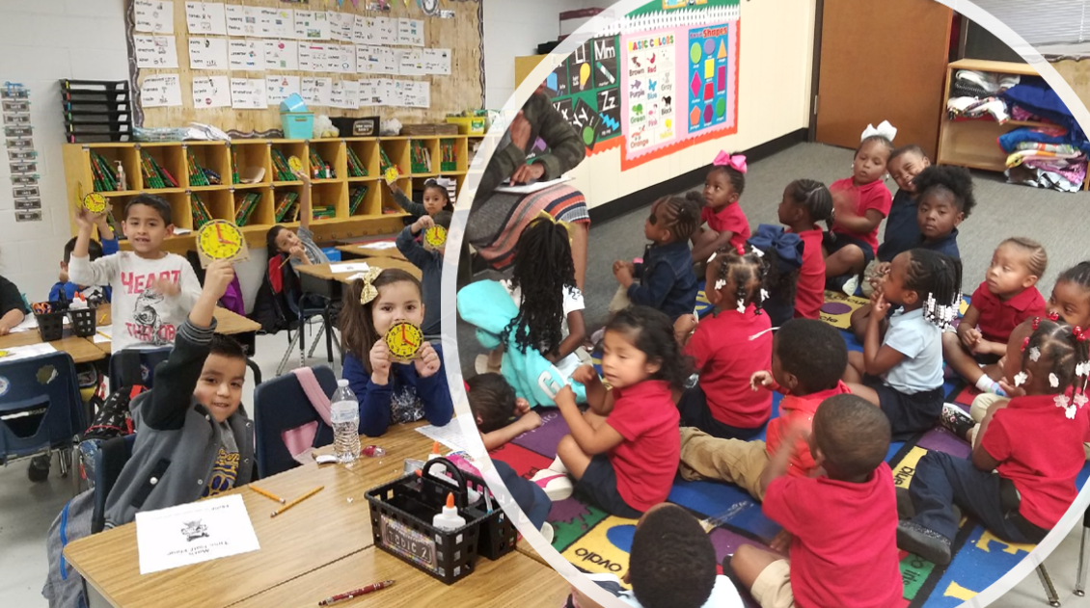



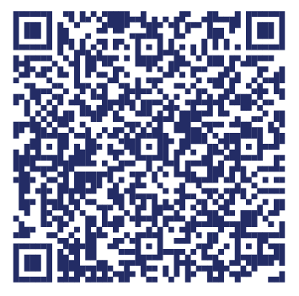
Statewide Program of Study: Teaching and Training — Page 1
Revised–Oct 2024
Education and Training Career Cluster
The Education and Training career cluster focuses on planning, managing, and providing education and training services and related learning support services. All parts of courses are designed to introduce learners to the various careers available within the Education and Training career cluster. This career cluster includes a diverse spectrum of occupations, ranging from teaching assistant, classroom teacher, to school administrator.
Statewide Program of Study: Teaching and Training
The Teaching and Training program of study focuses on occupational and educational opportunities associated with careers related to teaching, instructing, and creating instructional and enrichment materials. The program of study includes recognizing a variety of student groups and their corresponding needs, identifying processes for developing curriculum and coordinating educational content, and coaching groups and individuals.
Secondary Courses for High School Credit
Level 1 | Principles of Human Services
Level 2 | Human Growth and Development
Level 3 | Instructional Practices *DC Tarleton
Level 4 | Practicum in Education and Training *DC Tarleton
Example Postsecondary Opportunities
Apprenticeships
Teacher Apprentice
Associate Degrees
Adult and Continuing Education and Teaching
Educational/Instructional Technology
Bachelor’s Degrees
Elementary Education and Teaching
Secondary Education and Teaching
Master’s, Doctoral, and Professional Degrees
Educational Leadership and Administration, General
Curriculum and Instruction
Additional Stackable IBCs/License
Generalist, Grades EC-4
Aligned Advanced Academic Courses
Dual Credit | Dual credit offerings will vary by local educational agency.
Students should be advised to consider these course opportunities to enrich their preparation. AP or IB courses not listed under the Secondary Courses for High School Credit section of this framework document do not count towards concentrator/completer status for this program of study.
Example Aligned Occupations
Teaching Assistants, Except Postsecondary
Work-Based Learning and Expanded Learning Opportunities
Median Wage: $28,066
Annual Openings: 10,000
10-Year Growth: 15%
Work-Based Learning Activities | Serve as a camp counselor to learn mentoring, facilitation, and lesson planning skills Volunteer in a tutoring center to learn lesson planning and skills assessment
Expanded Learning Opportunities | Participate in FCCLA Participate in TAFE
Secondary School Teachers, Except Special Education and CTE
Median Wage: $61,035
Annual Openings: 8,288
10-Year Growth: 14%
Aligned Industry-Based Certifications
Teaching and Training
Educational Aide I
Education Administrators, Kindergarten through Secondary
Median Wage: $81,976
Annual Openings: 2,676
10-Year Growth: 14%
Data Source: TexasWages, Texas Workforce Commission. Retrieved 3/8/2024.
Successful completion of the Teaching and Training program of study will fulfill requirements of the Public Service endorsement.
For more information visit: https://tea.texas.gov/academics/college-career-and-military-prep/career-and-technical-education/programs-of-study-additional-resources

Slide 2

Statewide Program of Study: Teaching and Training — Page 2
Education and Training Career Cluster
Statewide Program of Study: Teaching and Training
Course Information
Course |  | Prerequisites | Corequisites | Career Clusters
Principles of Human Services* 13024200 (1 credit) |  | Prerequisites: None Corequisites: None Recommended Prerequisites: None Recommended Corequisites: None
Level 1
Course |  | Prerequisites | Corequisites | Career Clusters
Human Growth and Development 13014300 (1 credit) |  | Prerequisites: None Corequisites: None Recommended Prerequisites: Principles of Education and Training Recommended Corequisites: None
Level 2
Course |  | Prerequisites | Corequisites
Instructional Practices 13014400 (2 credits) |  | Prerequisites: One credit from Education and Training career cluster Corequisites: None Recommended Prerequisites: Principles of Education and Training, Human Growth and Development, or Child Development Recommended Corequisites: None
Level 3
Course |  | Prerequisites | Corequisites | Career Clusters
Practicum in Education and Training First Time Taken: 13014500 (2 credits) Second Time Taken: 13014510 (2 credits) |  | Prerequisites: Instructional Practices Corequisites: None Recommended Prerequisites: Principles of Education and Training, Human Growth and Development, and Child Development Recommended Corequisites: None
Level 4
Teaching and Training
* Indicates course is included in more than one program of study.
For additional information on the Education and Training career cluster,
contact cte@tea.texas.gov or visit https://tea.texas.gov/cte
[LEA name] does not discriminate on the basis of race, color, national origin, sex, or disability in its programs or activities and provides equal access to the Boy Scouts and other designated youth groups. The following person has been designated to handle inquiries regarding the nondiscrimination policies: [title], [address], [telephone number], [email]. Further nondiscrimination information can be found at Notification of Nondiscrimination in Career and Technical Education Programs.

