Slide 1


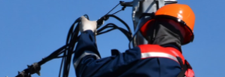
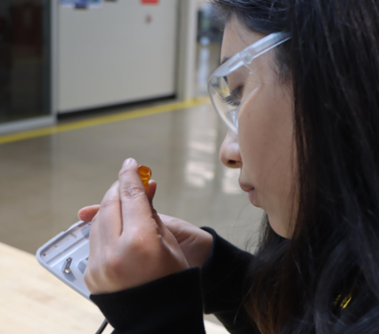




Statewide Program of Study: Electrical — Page 1
Revised–May 2024
Architecture and Construction Career Cluster
The Architecture and Construction career cluster focuses on designing, planning, managing, building, and maintaining the built environment. This career cluster includes occupations ranging from architect, carpenter, and construction manager to electrician, plumber and heating, air conditioning and refrigeration technician.
Statewide Program of Study: Electrical
The Electrical program of study focuses on occupational and educational opportunities associated with installing, maintaining, and repairing electrical wiring, equipment, and fixtures. The program of study also addresses installing and repairing telecommunications cable including fiber optics.
Secondary Courses for High School Credit
Level 1 | Principles of Construction
Level 2 | Electrical Technology I DC (TSTC)
Level 3 | Electrical Technology II DC (TSTC)
Level 4 | Practicum in Construction Technology DC (TSTC)
Example Postsecondary Opportunities
Apprenticeships
Electrician
Associate Degrees
Electrical and Power Transmission Installation
Electrical Power and Controls
Electromechanical Technology
Bachelor’s Degrees
Construction Engineering
Electrical, Electronic, and Communications
Engineering Electrical Engineering
Master’s, Doctoral, and Professional Degrees
Construction Engineering
Construction Management
Additional Stackable IBCs/License
Journeyman Electrician
Master Electrician
Aligned Advanced Academic Courses
Dual Credit | Dual credit offerings will vary by local education agency.
Students should be advised to consider these course opportunities to enrich their preparation. AP or IB courses not listed under the Secondary Courses for High School Credit section of this framework document do not count towards concentrator/completer status for this program of study.
Work-Based Learning and Expanded Learning Opportunities
Work-Based Learning Activities | Participate in an internship with an electrical company to develop installation skills Join a pre-apprenticeship program that involves determining if electrical wiring is up to code Interview an electrician about their training and education
Expanded Learning Opportunities | Participate in SkillsUSA Participate in trade competitions
Example Aligned Occupations
Electricians Helpers
Median Wage: $38,140
Annual Openings: 1,632
10-Year Growth: 20%
Electricians
Aligned Industry-Based Certifications
Median Wage: $54,769
Annual Openings: 9,221
10-Year Growth: 27%
NCCER Construction Technology Certification Level I
NCCER Core
NCCER Electrical Level I
NCCER Electronic System Technician Level I
NCCER Electronic System Technician Level II
Electrical
Construction Managers
Median Wage: $95,072
Annual Openings: 6,325
10-Year Growth: 24%
Data Source: TexasWages, Texas Workforce Commission. Retrieved 3/8/2024
Successful completion of the Electrical program of study will fulfill requirements of the Business and Industry endorsement.
For more information visit: https://tea.texas.gov/academics/college-career-and-military-prep/career-and-technical-education/programs-of-study-additional-resources

Slide 2












Statewide Program of Study: Electrical — Page 2
Architecture and Construction Career Cluster
Statewide Program of Study: Electrical
Course Information
Course |  | Prerequisites | Corequisites | Career Clusters
Principles of Construction* 13004220 (1 credit) |  | Prerequisites: None Corequisites: None Recommended Prerequisites: None Recommended Corequisites: None | 1. Architecture and Construction
Level 1
Course |  | Prerequisites | Corequisites | Career Clusters
Electrical Technology I 13005600 (1 credit) |  | Prerequisites: None Corequisites: None Recommended Prerequisites: Principles of Architecture or Principles of Construction Recommended Corequisites: None | 1. Architecture and Construction 2. Energy 3. Manufacturing
Level 2
Course |  | Prerequisites | Corequisites | Career Clusters
Electrical Technology II 13005700 (2 credits) |  | Prerequisites: Electrical Technology l Corequisites: None Recommended Prerequisites: Principles of Architecture or Principles of Construction Recommended Corequisites: None | 1. Architecture and Construction 2. Energy
Level 3
Course |  | Prerequisites | Corequisites | Career Clusters
Practicum in Construction Technology* First Time Taken: 13005250 (2 credits) Second Time Taken: 13005260 (2 credits) |  | Prerequisites: Construction Technology ll; Building Maintenance Technology II; Electrical Technology II; Heating, Ventilation, and Air Conditioning (HVAC) and Refrigeration Technology II; Plumbing Technology I; or Mill and Cabinetmaking Technology Corequisites: None Recommended Prerequisites: None Recommended Corequisites: None | 1. Architecture and Construction
Level 4
Electrical
* Indicates course is included in more than one program of study.
For additional information on the Architecture and Construction career cluster,
contact cte@tea.texas.gov or visit https://tea.texas.gov/cte
[LEA name] does not discriminate on the basis of race, color, national origin, sex, or disability in its programs or activities and provides equal access to the Boy Scouts and other designated youth groups. The following person has been designated to handle inquiries regarding the nondiscrimination policies: [title], [address], [telephone number], [email]. Further nondiscrimination information can be found at Notification of Nondiscrimination in Career and Technical Education Programs.

