Slide 1


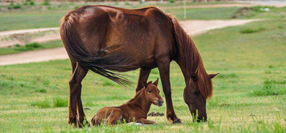
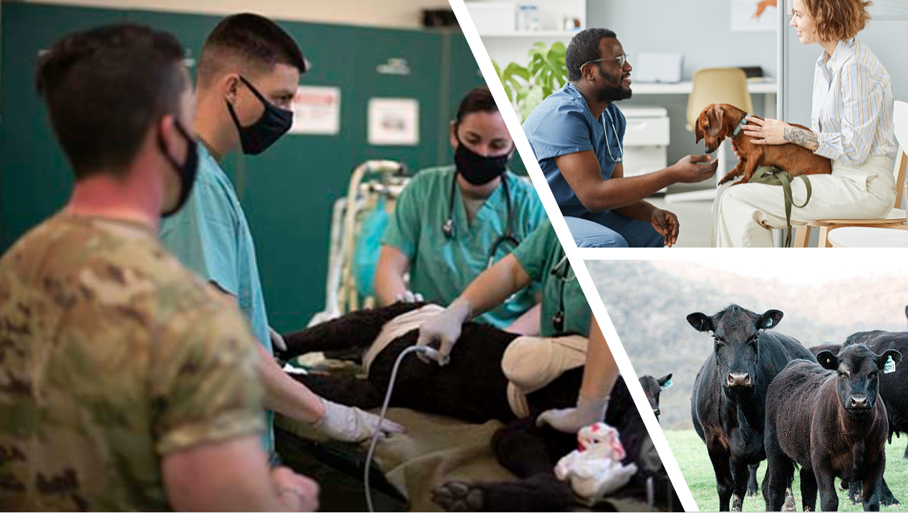



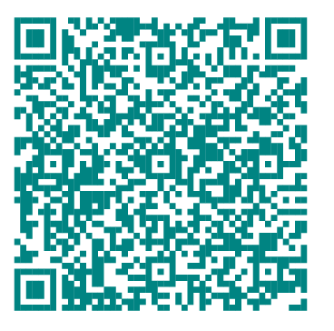
Statewide Program of Study: Animal Science — Page 1
Revised–May 2024
Agriculture, Food, and Natural Resources Career Cluster
The Agriculture, Food, and Natural Resources (AFNR) career cluster focuses on the essential elements of life, food, water, land, and air. This career cluster includes occupations ranging from farmer, rancher, and veterinarian to geologist, land conservationist, and florist.
Statewide Program of Study: Animal Science
The Animal Science program of study focuses on occupational and educational opportunities associated with the science, research, and business of animals and other living organisms. This program of study includes applying biology and life science to real-world life processes of animals and wildlife, either in laboratories or in the field, which could include a veterinary office, a farm or ranch, or any outdoor area harboring animal life. Students will research and analyze the growth and destruction of species and research or diagnose diseases and injuries of animals.
Secondary Courses for High School Credit
Level 1 | Principles of Agriculture, Food, and Natural Resources
Level 2 | Small Animal Management
Level 3 | Livestock Production
Level 4 | Veterinary Medical Applications Practicum in Agriculture, Food, and Natural Resources
Example Postsecondary Opportunities
Apprenticeships
Reproduction Technician
Associate Degrees
Biological and Physical Sciences
Entomology
Bachelor’s Degrees
Animal Science
Zoology/Animal Biology
Master’s, Doctoral, and Professional Degrees
Marine Sciences
Biotechnology
Additional Stackable IBCs/License
Veterinarian
Certified Veterinary Technician
Aligned Advanced Academic Courses
Example Aligned Occupations
AP or IB | AP Biology IB Biology SL IB Biology HL
Dual Credit | Dual credit offerings will vary by local education agency.
Veterinary Assistants and Laboratory Animal Caretakers
Students should be advised to consider these course opportunities to enrich their preparation. AP or IB courses not listed under the Secondary Courses for High School Credit section of this framework document do not count towards concentrator/completer status for this program of study.
Median Wage: $29,906
Annual Openings: 1,348
10-Year Growth: 24%
Work-Based Learning and Expanded Learning Opportunities
Work-Based Learning Activities | Shadow an animal scientist in a biology lab to learn about applying science to understand animals and wildlife Intern in a veterinary clinic, caring for animals and wildlife being treated in the clinic
Expanded Learning Opportunities | Participate in an FFA career, leadership, and speaking contest like an agriscience fair Attend an agricultural industry seminar
Veterinary Technologists and Technicians
Median Wage: $33,679
Annual Openings: 1,217
10-Year Growth: 24%
Animal Science
Aligned Industry-Based Certifications
Veterinarian
Agricultural Biotechnology
AgriLife Veterinary Assistant Certificate
Certified Veterinary Assistant, Level I
Elanco Fundamentals of Animal Science Certification
Elanco Veterinary Medical Applications Certification
Equine Management and Evaluation Certification
Feedyard Technician in Cattle Care and Handling
Licensed Veterinary Technician
Production Agriculture - Job Ready
Small Animal Science and Technology
Median Wage: $103,160
Annual Openings: 347
10-Year Growth: 26%
Data Source: TexasWages, Texas Workforce Commission. Retrieved 3/8/2024
Successful completion of the Animal Science program of study will fulfill requirements of a Business and Industry endorsement.
For more information visit: https://tea.texas.gov/academics/college-career-and-military-prep/career-and-technical-education/programs-of-study-additional-resources

Slide 2

Statewide Program of Study: Animal Science — Page 2
Agriculture, Food, and Natural Resources Career Cluster
Statewide Program of Study: Animal Science
Course Information
Course |  | Prerequisites | Corequisites | Career Clusters
Principles of Agriculture, Food, and Natural Resources* 13000200 (1 credit) |  | Prerequisites: None Corequisites: None Recommended Prerequisites: None Recommended Corequisites: None | 1. Agriculture, Food and Natural Resources
Level 1
Course |  | Prerequisites | Corequisites | Career Clusters
Small Animal Management 13000400 (0.5 credit) |  | Prerequisites: None Corequisites: None Recommended Prerequisites: None Recommended Corequisites: None | 1. Agriculture, Food and Natural Resources
Level 2
Course |  | Prerequisites | Corequisites | Career Clusters
Livestock Production 13000300 (1 credit) |  | Prerequisites: None Corequisites: None Recommended Prerequisites: None Recommended Corequisites: None | 1. Agriculture, Food and Natural Resources
Level 3
Course |  | Prerequisites | Corequisites | Career Clusters
Advanced Animal Science 13000700 (1 credit) |  | Prerequisites: Biology and Chemistry or Integrated Physics and Chemistry (IPC); Algebra l and Geometry; and either Small Animal Management, Equine Science, or Livestock Production Corequisites: None Recommended Prerequisites: Veterinary Medical Applications Recommended Corequisites: None | 1. Agriculture, Food and Natural Resources
Veterinary Medical Applications 13000600 (1 credit) |  | Prerequisites: Equine Science, Small Animal Management, or Livestock Production Corequisites: None Recommended Prerequisites: None Recommended Corequisites: None
Level 4
Animal Science
* Indicates course is included in more than one program of study.
For additional information on the Agriculture, Food, and Natural Resources career cluster,
contact cte@tea.texas.gov or visit https://tea.texas.gov/cte
[LEA name] does not discriminate on the basis of race, color, national origin, sex, or disability in its programs or activities and provides equal access to the Boy Scouts and other designated youth groups. The following person has been designated to handle inquiries regarding the nondiscrimination policies: [title], [address], [telephone number], [email]. Further nondiscrimination information can be found at Notification of Nondiscrimination in Career and Technical Education Programs.

