Slide 1


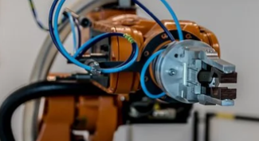




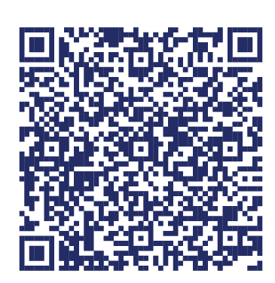
Statewide Program of Study: Robotics and Automation Technology — Page 1
Revised–Oct 2024
Manufacturing Career Cluster
The Manufacturing career cluster focuses on planning, managing, and performing the processing of materials into intermediate or final products and related professional and technical support activities such as production planning and control, maintenance, and process engineering. This career cluster includes occupations ranging from welder and machinist to industrial engineering technician and semi-conductor processing technician.
Statewide Program of Study: Robotics and Automation Technology
The Robotics and Automation Technology program of study focuses on occupational and educational opportunities associated with the assembly, operation, maintenance, and repair of electromechanical equipment or devices. This program of study includes exploration of a variety of mechanical fields, including robotics, refinery and pipeline systems, deep ocean exploration, and hazardous waste removal.
Secondary Courses for High School Credit
Level 1 | Principles of Applied Engineering
Level 2 | Robotics I
Level 3 | Robotics II
Level 4 | Engineering Design and Presentation I
Example Postsecondary Opportunities
Associate Degrees
Instrumentation Technology
Industrial Technology
Robotics Technology
Automation Engineer Technology
Bachelor’s Degrees
Mechanical Engineering
Electrical Electronics Engineering
Electrical, Electronic, and Communications Engineering Technology
Electromechanical Engineering Technology
Master’s, Doctoral, and Professional Degrees
Mechanical Engineering
Engineering/Industrial Management
Industrial Engineering
Electrical and Electronics Engineering
Aligned Advanced Academic Courses
Dual Credit | Dual credit offerings will vary by local education agency.
Students should be advised to consider these course opportunities to enrich their preparation. AP or IB courses not listed under the Secondary Courses for High School Credit section of this framework document do not count towards concentrator/completer status for this program of study.
Work-Based Learning and Expanded Learning Opportunities
Example Aligned Occupations
Work-Based Learning Activities | Intern with a robotics technician working at a manufacturing plant Shadow a PLC programmer
Expanded Learning Opportunities | Tour a manufacturing facility Participate in SkillsUSA or TSA Build a robot and participate in a robotics competition
Computer Numerically Controlled Tool Operators
Median Wage: $46,353
Annual Openings: 1,146
10-Year Growth: 10%
Aligned Industry-Based Certifications
Semiconductor Processing Technicians
C-101 Certified Industry 4.0 Associate - Basic Operations
C-103 Certified Industry 4.0 Associate - Robot System Operations
C-200 Certified Industry 4.0 Automation System Specialist I - 216 Robotic System Integration 1
C-200 Certified Industry 4.0 Automation Systems Specialist I - 208 Programmable Controller Troubleshooting I
C-200 Certified Industry 4.0 Automation Systems Specialist I - 215 Robotic Operations I
Certified Manufacturing Associate
Certified SOLIDWORKS Professional (CSWP) - Additive Manufacturing
Certified SOLIDWORKS Professional (CSWP) – CAM
CNC Lathe Operations
CNC Lathe Set Up and Operations
FANUC Robot Operator I
FESTO Certified Industry 4.0 Associate Fundamentals
Industrial Technology Maintenance (ITM) - Process Control Systems
Machining CNC Mill Operations Level I
Machining CNC Mill Programming Setup and Operations Level I
Machining CNC Milling Skills Level II
Machining CNC Turning Level II
Certified Logistics Technician (CLT)
Certified Production Technician (CPT) 4.0
Lean Six Sigma Green Belt Certification
Certified Technician-Supply Chain Automation (CT-SCA)
Machining Milling Level I
Machining Drill Press Level I
Machining Grinding Level I
Median Wage: $36,902
Annual Openings: 621
10-Year Growth: 9%
Robotics and Automation Technology
Industrial Engineers
Median Wage: $100,000
Annual Openings: 1,898
10-Year Growth: 26%
Data Source: TexasWages, Texas Workforce Commission. Retrieved 3/8/2024.
Successful completion of the Robotics and Automation Technology program of study will fulfill requirements the STEM endorsement if the math and science requirements are met or of the Business and Industry endorsement.
For more information visit: https://tea.texas.gov/academics/college-career-and-military-prep/career-and-technical-education/programs-of-study-additional-resources

Slide 2






Statewide Program of Study: Robotics and Automation Technology — Page 2
Manufacturing Career Cluster
Statewide Program of Study: Robotics and Automation Technology
Course Information
Course |  | Prerequisites | Corequisites | Career Clusters
Principles of Manufacturing* 13032200 (1 credit) |  | Prerequisites: None Corequisites: None Recommended Prerequisites: Algebra I or Geometry Recommended Corequisites: None
Level 1
Course |  | Prerequisites | Corequisites | Career Clusters
Robotics I 13037000 (1 credit) |  | Prerequisites: None Corequisites: None Recommended Prerequisites: Principles of Applied Engineering Recommended Corequisites: None
Level 2
Course |  | Prerequisites | Corequisites | Career Clusters
Robotics II 13037050 (1 credit) |  | Prerequisites: Robotics l Corequisites: None Recommended Prerequisites: None Recommended Corequisites: None
Level 3
Course |  | Prerequisites | Corequisites | Career Clusters
Engineering Design and Presentation I 13036500 (1 credit) |  | Prerequisites: Algebra l Corequisites: None Recommended Prerequisites: Principles of Applied Engineering Recommended Corequisites: None
Robotics and Automation Technology
* Indicates course is included in more than one program of study.
For additional information on the Manufacturing career cluster,
contact cte@tea.texas.gov or visit https://tea.texas.gov/cte
[LEA name] does not discriminate on the basis of race, color, national origin, sex, or disability in its programs or activities and provides equal access to the Boy Scouts and other designated youth groups. The following person has been designated to handle inquiries regarding the nondiscrimination policies: [title], [address], [telephone number], [email]. Further nondiscrimination information can be found at Notification of Nondiscrimination in Career and Technical Education Programs.

