Slide 1


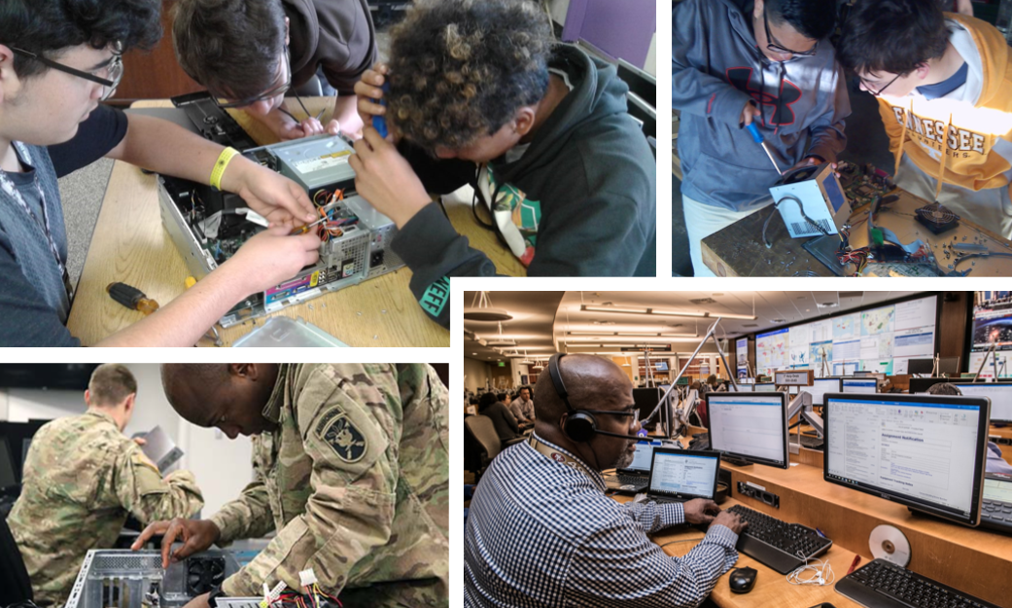



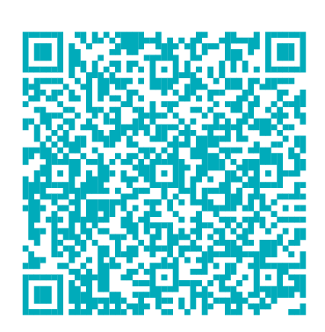
Statewide Program of Study: Information Technology Support and Services — Page 1
Revised–June 2024
Information Technology Career Cluster
The Information Technology (IT) career cluster focuses on the design, development, support, and management of hardware, software, multimedia, and systems integration services. This career cluster includes occupations ranging from Software Developer and Programmer to Cybersecurity Specialists and Network Analysts.
Statewide Program of Study: Information Technology Support and Services
The Information Technology Support and Services program of study focuses on occupational and educational opportunities associated with administering, testing, and implementing computer databases and applying knowledge of database management systems. This program of study includes analyzing user requirements, automating or improving existing systems, and reviewing computer system capabilities. It also includes research, design, and testing of computer or computer-related equipment for commercial, industrial, military, or scientific use.
Secondary Courses for High School Credit
Level 1 | Principles of Information Technology
Level 2 | Computer Maintenance + Computer Maintenance Lab
Level 3 | Computer Technician Practicum
Level 4 | Practicum in Information Technology
Example Postsecondary Opportunities
Apprenticeships
Coding Apprenticeship
Associate Degrees
Computer Science
Network and System Administration
Bachelor’s Degrees
Computer and Information Systems Security/Auditing/Information Assurance
Computer Engineering
Master’s, Doctoral, and Professional Degrees
Information Science/Studies
Electrical and Electronics Engineering
Aligned Advanced Academic Courses
AP or IB | AP Computer Science A AP Computer Science Principles IB Computer Science SL IB Computer Science HL
Dual Credit | Dual credit offerings will vary by local education agency.
Example Aligned Occupations
Students should be advised to consider these course opportunities to enrich their preparation. AP or IB courses not listed under the Secondary Courses for High School Credit section of this framework document do not count towards concentrator/completer status for this program of study.
Computer User Support Specialists
Work-Based Learning and Expanded Learning Opportunities
Median Wage: $51,411
Annual Openings: 5,757
10-Year Growth: 21%
Work-Based Learning Activities | Intern at a local IT company to develop skills in computer system maintenance and setting up computer equipment Shadow a database administrator or computer software or hardware engineer to learn about their day-to-day responsibilities
Expanded Learning Opportunities | Participate in SkillsUSA or TSA Subscribe to industry journals
Computer Network Support Specialists
Median Wage: $65,646
Annual Openings: 1,634
10-Year Growth: 19%
Information Technology Support and Services
Aligned Industry-Based Certifications
Computer Hardware Engineers
Computer Repair Technology - Job Ready
Median Wage: $119,662
Annual Openings: 377
10-Year Growth: 14%
Data Source: TexasWages, Texas Workforce Commission. Retrieved 3/8/2024.
Successful completion of the Information Technology Support and Services program of study will fulfill requirements of the Business and Industry endorsement.
For more information visit: https://tea.texas.gov/academics/college-career-and-military-prep/career-and-technical-education/programs-of-study-additional-resources

Slide 2





Statewide Program of Study: Information Technology Support and Services — Page 2
Information Technology Career Cluster
Statewide Program of Study: Information Technology Support and Services
Course Information
Course |  | Prerequisites | Corequisites | Career Clusters
Principles of Information Technology* 13027200 (1 credit) |  | Prerequisites: None Corequisites: None Recommended Prerequisites: None Recommended Corequisites: None
Level 1
Course |  | Prerequisites | Corequisites | Career Clusters
Computer Maintenance* 13027300 (1 credit) |  | Prerequisites: None Corequisites: None Recommended Prerequisites: Principles of Information Technology Recommended Corequisites: None | 1. Information Technology
Level 2
Course |  | Prerequisites | Corequisites | Career Clusters
Computer Technician Practicum First Time Taken: 13027500 (2 credits) Second Time Taken: 13027510 (2 credits) |  | Prerequisites: None Corequisites: None Recommended Prerequisites: Principles of Information Technology, Computer Maintenance, Computer Maintenance Lab, Networking, and Networking Lab Recommended Corequisites: None | 1. Information Technology
Practicum in Information Technology* First Time Taken: 13028000 (2 credits) Second Time Taken: 13028010 (2 credits) |  | Prerequisites: A minimum of two high school information technology (IT) courses Corequisites: None Recommended Prerequisites: None Recommended Corequisites: None | 1. Information Technology
Information Technology Support and Services
* Indicates course is included in more than one program of study.
For additional information on the Information Technology career cluster,
contact cte@tea.texas.gov or visit https://tea.texas.gov/cte
[LEA name] does not discriminate on the basis of race, color, national origin, sex, or disability in its programs or activities and provides equal access to the Boy Scouts and other designated youth groups. The following person has been designated to handle inquiries regarding the nondiscrimination policies: [title], [address], [telephone number], [email]. Further nondiscrimination information can be found at Notification of Nondiscrimination in Career and Technical Education Programs.

