Slide 1

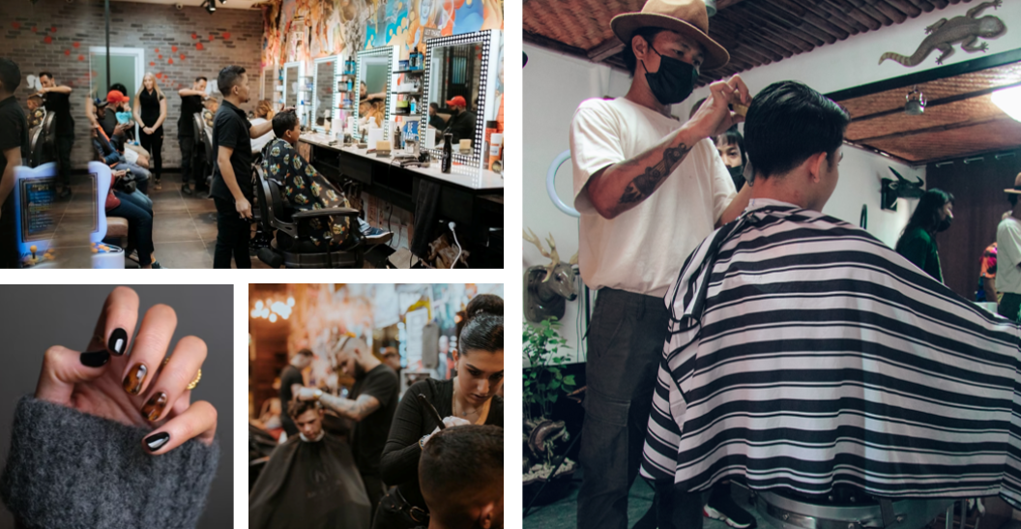




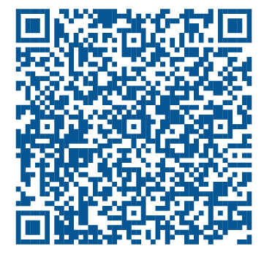
Statewide Program of Study: Cosmetology and Personal Care Services — Page 1
Revised–June 2024
Human Services Career Cluster
The Human Services career cluster focuses on preparing individuals for employment in career pathways that relate to families and human needs, such as counseling and mental health services, family and community services, personal care services, and consumer services. This career cluster includes occupations ranging from community health workers to cosmetologists and nutritionists.
Regional Program of Study: Cosmetology and Personal Care Services
Approved in ESC Regions 1, 2, 3, 4, 5, 6, 7, 8, 9, 10, 11, 12, 13, 14, 16, 17, 18, 19, & 20
*The list of approved ESC regions is updated every school year. Be sure to check the CTE regional program of study website for updates.
The Cosmetology and Personal Care Services regional program of study focuses on occupational and educational opportunities associated with providing beauty and personal care services. This program of study includes managing personal care facilities and coordinating or supervising personal service workers.
Secondary Courses for High School Credit
Level 1 | Principles of Cosmetology Design and Color Theory Microbiology and Safety for Cosmetology Careers
Level 2 | Introduction to Cosmetology Entrepreneurship I
Level 3 | Cosmetology I Cosmetology I + Cosmetology I Lab
Level 4 | Cosmetology II Cosmetology II + Cosmetology II Lab
Example Postsecondary Opportunities
Apprenticeships
Apprentice Stylist
Associate Degrees
Cosmetology Operator
Esthetics and Skin Care
Additional Stackable IBCs/License
Class A Barber
Eyelash Extension Specialist
Hair Weaving Specialist
Aligned Advanced Academic Courses
Example Aligned Occupations
Dual Credit | Dual credit offerings will vary by local educational agency.
Hairdressers, Hairstylists,
and Cosmetologists
Students should be advised to consider these course opportunities to enrich their preparation. AP or IB courses not listed under the Secondary Courses for High School Credit section of this framework document do not count towards concentrator/completer status for this program of study.
Median Wage: $27,286
Annual Openings: 8,014
10-Year Growth: 25%
Work-Based Learning and Expanded Learning Opportunities
Work-Based Learning Activities | Work part-time in a salon, spa, or barbershop Participate in an apprenticeship at a salon to become an apprentice stylist
Expanded Learning Opportunities | Tour a salon, spa, or barbershop Participate in SkillsUSA
Skincare Specialists
Median Wage: $35,112
Annual Openings: 778
10-Year Growth: 38%
Cosmetology and Personal Care Services
Aligned Industry-Based Certifications
First-Line Supervisors of Personal Service Workers
Cosmetology Operator License
Median Wage: $36,795
Annual Openings: 2,253
10-Year Growth: 29%
Data Source: TexasWages, Texas Workforce Commission. Retrieved 3/8/2024.
Successful completion of the Cosmetology and Personal Care Services regional program of study will fulfill requirements of the Public Service endorsement.
For more information visit: https://tea.texas.gov/academics/college-career-and-military-prep/career-and-technical-education/programs-of-study-additional-resources

Slide 2




Statewide Program of Study: Cosmetology and Personal Care Services — Page 2
Human Services Career Cluster
Regional Program of Study: Cosmetology and Personal Care Services
Course Information
Course |  | Prerequisites | Corequisites | Career Clusters
Principles of Cosmetology Design and Color Theory 13025050 (1 credit) |  | Prerequisites: None Corequisites: None Recommended Prerequisites: Principles of Human Services Recommended Corequisites: None | 1. Human Services
Microbiology and Safety for Cosmetology Careers N1302540 (1 credit) |  | Prerequisites: None Corequisites: None Recommended Prerequisites: None Recommended Corequisites: None | 1. Human Services
Level 1
Course |  | Prerequisites | Corequisites | Career Clusters
Introduction to Cosmetology 13025100 (1 credit) |  | Prerequisites: None Corequisites: None Recommended Prerequisites: None Recommended Corequisites: None | 1. Human Services
Level 2
Course |  | Prerequisites | Corequisites | Career Clusters
Cosmetology I + Cosmetology I Lab 13025210 (3 credits) |  | Prerequisites: None Corequisites: None Recommended Prerequisites: Introduction to Cosmetology Recommended Corequisites: None | 1. Human Services
Level 3
Course |  | Prerequisites | Corequisites | Career Clusters
Cosmetology II + Cosmetology II Lab 13025310 (3 credits) |  | Prerequisites: Cosmetology I Corequisites: None Recommended Prerequisites: None Recommended Corequisites: None | 1. Human Services
Cosmetology and Personal Care Services
* Indicates course is included in more than one program of study.
For additional information on the Human Services career cluster,
contact cte@tea.texas.gov or visit https://tea.texas.gov/cte
[LEA name] does not discriminate on the basis of race, color, national origin, sex, or disability in its programs or activities and provides equal access to the Boy Scouts and other designated youth groups. The following person has been designated to handle inquiries regarding the nondiscrimination policies: [title], [address], [telephone number], [email]. Further nondiscrimination information can be found at Notification of Nondiscrimination in Career and Technical Education Programs.

