Slide 1


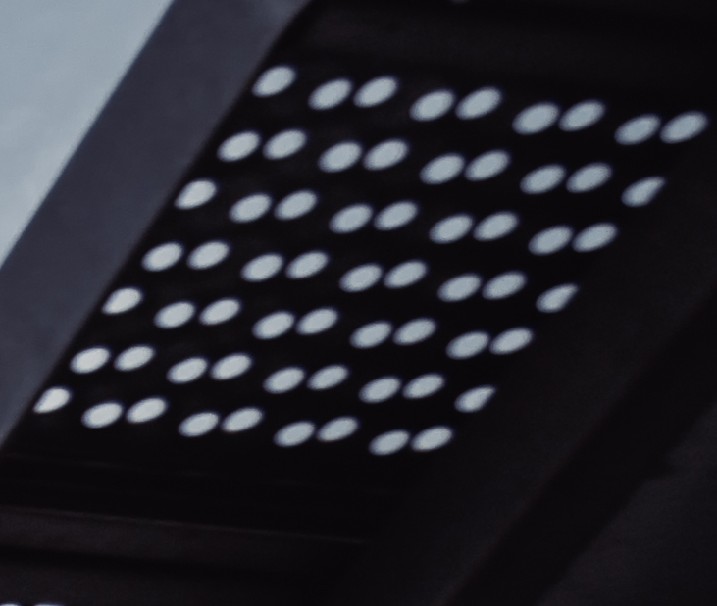




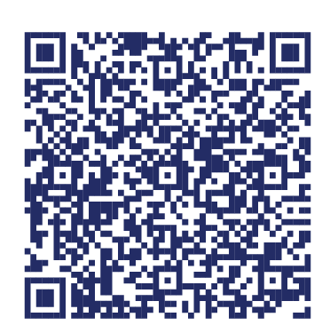
Statewide Program of Study: Mechanical and Aerospace Engineering — Page 1
Revised–Oct 2024
Engineering Career Cluster
The Engineering career cluster focuses on planning, designing, testing, building, and maintaining of machines, structures, materials, systems, and processes using empirical evidence and science, technology, and math principles. This career cluster includes occupations ranging from mechanical engineer and drafter to electrical engineer and to mapping technician.
Statewide Program of Study: Mechanical and Aerospace Engineering
The Mechanical and Aerospace Engineering program of study focuses on occupational and educational opportunities associated with the design, development, maintenance, and testing of engines, machines, and structures related to aircraft and spacecraft. Students will design, test, and evaluate projects related to aerodynamics, structural, and mechanical design. This program of study includes applying scientific, mathematical, and empirical evidence to solve problems related to navigation, mechanics, robotics, propulsion, and combustion.
Secondary Courses for High School Credit
Level 1 | Introduction to Engineering Design (PLTW)
Level 2 | Engineering Science
Level 3 | Aerospace Engineering (PLTW))
Level 4 | Engineering Design and Development (PLTW)
Example Postsecondary Opportunities
Apprenticeships
Mechanical Engineering Technician Apprenticeship
Associate Degrees
Mechanical Engineering
Aeronautics/Aviation/Aerospace Science and Technology, General
Bachelor’s Degrees
Aeronautical/Aerospace Engineering Technology/Technician
Aeronautics/Aviation/Aerospace Science and Technology, General
Master’s, Doctoral, and Professional Degrees
Electrical and Electronics Engineering
Aerospace, Aeronautical, and Astronautical/Space Engineering, General
Additional Stackable IBCs/License
Professional Engineer (PE License)
Aerospace Engineering Certification
Aligned Advanced Academic Courses
AP or IB | AP Calculus AB AP Calculus BC AP Physics 1 | AP Physics 2 AP Statistics | IB Physics SL IB Physics HL
Dual Credit | Dual credit offerings will vary by local education agency.
Example Aligned Occupations
Students should be advised to consider these course opportunities to enrich their preparation. AP or IB courses not listed under the Secondary Courses for High School Credit section of this framework document do not count towards concentrator/completer status for this program of study.
Work-Based Learning and Expanded Learning Opportunities
Aerospace Engineering and Operations Technologists
and Technicians
Work-Based Learning Activities | Intern at an aviation or aerospace company Shadow a mechanical engineer to understand design and testing processes Complete a project to test and evaluate a new product design for a local company
Expanded Learning Opportunities | Tour an aerospace facility Participate in SkillsUSA or TSA
Median Wage: $48,204
Annual Openings: 192
10-Year Growth: 21%
Mechanical Engineers
Aligned Industry-Based Certifications
Median Wage: $99,937
Annual Openings: 1,755
10-Year Growth: 18%
Engineering Technology Foundations
Pre-Engineering/Engineering Technology - Job Ready
Autodesk Certified Professional Fusion 360
Mechanical and Aerospace Engineering
Aerospace Engineers
Median Wage: $115,694
Annual Openings: 483
10-Year Growth: 18%
Data Source: TexasWages, Texas Workforce Commission. Retrieved 3/8/2024.
Successful completion of the Mechanical and Aerospace Engineering program of study will fulfill requirements of STEM endorsement if the math and science requirements are met or the Business and Industry endorsement.
For more information visit: https://tea.texas.gov/academics/college-career-and-military-prep/career-and-technical-education/programs-of-study-additional-resources

Slide 2








Statewide Program of Study: Mechanical and Aerospace Engineering — Page 2
Engineering Career Cluster
Statewide Program of Study: Mechanical and Aerospace Engineering
Course Information
Course |  | Prerequisites | Corequisites | Career Clusters
Introduction to Engineering Design (PLTW)* N1303742 (1 credit) |  | Prerequisites: None Corequisites: None Recommended Prerequisites: None Recommended Corequisites: None
Level 1
Course |  | Prerequisites | Corequisites | Career Clusters
Level 2
Engineering Science* 13037500 (1 credit) |  | Prerequisites: Algebra l, one credit in Biology, and at least one credit in a course from the STEM career cluster Corequisites: None Recommended Prerequisites: None Recommended Corequisites: None | 1. Engineering 2. Transportation, Distribution and Logistics
Course |  | Prerequisites | Corequisites | Career Clusters
Aerospace Engineering (PLTW)* N1303745 (1 credit) |  | Prerequisites: None Corequisites: None Recommended Prerequisites: At least one credit in a Level 2 or higher course in the Engineering career cluster Recommended Corequisites: None
Course |  | Prerequisites | Corequisites | Career Clusters
Engineering Design and Development (PLTW)* N1303749 (1 credit) |  | Prerequisites: None Corequisites: None Recommended Prerequisites: At least two courses in engineering with at least one being a Level 2 or higher course Recommended Corequisites: None
* Indicates course is included in more than one program of study.
Mechanical and Aerospace Engineering
For additional information on the Engineering career cluster,
contact cte@tea.texas.gov or visit https://tea.texas.gov/cte
[LEA name] does not discriminate on the basis of race, color, national origin, sex, or disability in its programs or activities and provides equal access to the Boy Scouts and other designated youth groups. The following person has been designated to handle inquiries regarding the nondiscrimination policies: [title], [address], [telephone number], [email]. Further nondiscrimination information can be found at Notification of Nondiscrimination in Career and Technical Education Programs.

