Slide 1


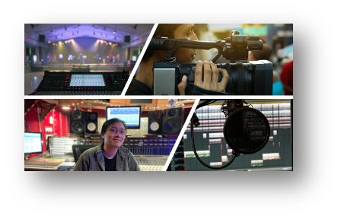



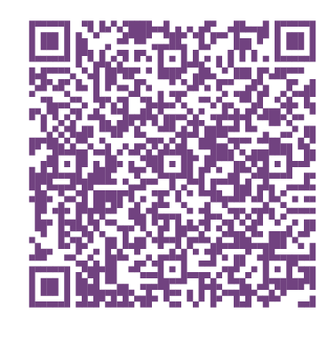
Statewide Program of Study: Digital Communications — Page 1
Revised–Oct 2024
Arts, Audio Visual Technology, and Communication Career Cluster
The Arts, Audio Visual Technology, and Communication (AAVTC) career cluster focuses on designing, producing, exhibiting, performing, writing, and publishing multimedia content requiring creative aptitude, fluency in computer and technology applications, and proficiency in oral and written communication. This career cluster includes occupations ranging from camera operator, audio and video technician, director, and producer to graphic designer and web and digital interface designer.
Statewide Program of Study: Digital Communications
The Digital Communications program of study focuses on occupational and educational opportunities associated with the production of audio and visual media formats for various purposes, such as TV broadcasts, advertising, video production, or motion pictures. The program of study includes operating machines and equipment such as microphones, sound speakers, video screens, projectors, video monitors, sound and mixing boards, and related electronic equipment to record sound and images.
Secondary Courses for High School Credit
Level 1 | Principles of Arts, Audio/Video Technology, and Communications
Level 2 | Audio/Video Production I
Level 3 | Audio/Video Production I + Audio/Video Production I Lab Audio/Video Production II
Level 4 | Practicum in Audio/Video Production
Example Postsecondary Opportunities
Apprenticeships
Light Technician
Associate Degrees
Commercial and Advertising Art
Animation, Interactive Technology, Video Graphics, and Special Effects
Bachelor’s Degrees
Cinematography and Film/Video Production
Recording Arts Technology
Master’s, Doctoral, and Professional Degrees
Animation, Interactive Technology, Video Graphics, and Special Effects
Communications Technology
Additional Stackable IBCs/License
CompTIA Digital Media and Entertainment Professional Certification (DMEP)
Aligned Advanced Academic Courses
AP or IB | IB Film SL IB Film HL
Dual Credit | Dual credit offerings will vary by local education agency.
Example Aligned Occupations
Students should be advised to consider these course opportunities to enrich their preparation. AP or IB courses not listed under the Secondary Courses for High School Credit section of this framework document do not count towards concentrator/completer status for this program of study.
Camera Operators, Television, Video, and Film
Work-Based Learning and Expanded Learning Opportunities
Median Wage: $48,422
Annual Openings: 155
10-Year Growth: 20%
Work-Based Learning Activities | Shadow a sound designer to learn how sound and foley are created for movies or podcasts Intern with a technical director at a sports team, recording studio, or radio station Shadow a technician on a live news broadcast, concert, or other event
Expanded Learning Opportunities | Participate in SkillsUSA or TSA Participate in Student Television Network Capture and edit film and audio for a podcast with a local community organization
Audio and Video Technicians
Median Wage: $46,319
Annual Openings: 626
10-Year Growth: 30%
Digital Communications
Aligned Industry-Based Certifications
Producers and Directors
Adobe Certified Professional in Digital Video Using Adobe Premiere Pro
Adobe Certified Professional in Visual Design Using Adobe Photoshop
Audio-Visual Communications - Job Ready
Median Wage: $65,029
Annual Openings: 522
10-Year Growth: 12%
Data Source: TexasWages, Texas Workforce Commission. Retrieved 3/8/2024.
Successful completion of the Digital Communications program of study will fulfill requirements of the Business and Industry endorsement.
For more information visit: https://tea.texas.gov/academics/college-career-and-military-prep/career-and-technical-education/programs-of-study-additional-resources

Slide 2

Statewide Program of Study: Digital Communications — Page 2
Arts, Audio Visual Technology, and Communication Career Cluster
Statewide Program of Study: Digital Communications
Course Information
Course |  | Prerequisites | Corequisites | Career Clusters
Principles of Arts, Audio/Video Technology, and Communications* 13008200 (1 credit) |  | Prerequisites: None Corequisites: None Recommended Prerequisites: None Recommended Corequisites: None
Level 1
Course |  | Prerequisites | Corequisites | Career Clusters
Audio/Video Production I 13008500 (1 credit) |  | Prerequisites: None Corequisites: None Recommended Prerequisites: Principles of AAVTC Recommended Corequisites: None
Audio/Video Production I + Audio/Video Production I Lab 13008510 (2 credits) |  | Prerequisites: None Corequisites: None Recommended Prerequisites: Principles of AAVTC or Digital Media Recommended Corequisites: None
Level 2
Course |  | Prerequisites | Corequisites | Career Clusters
Audio/Video Production II 13008600 (1 credit) |  | Prerequisites: Audio/Video Production I Corequisites: None Recommended Prerequisites: None Recommended Corequisites: None
Level 3
Course |  | Prerequisites | Corequisites | Career Clusters
Practicum in Audio/Video Production First Time Taken: 13008700 (2 credits) Second Time Taken: 13008710 (2 credits) |  | Prerequisites: Audio/Video Production II and Audio/Video Production II Lab Corequisites: None Recommended Prerequisites: None Recommended Corequisites: None
Level 4
Digital Communications
* Indicates course is included in more than one program of study.
For additional information on the Arts, Audio Visual Technology and Communication career cluster,
contact cte@tea.texas.gov or visit https://tea.texas.gov/cte
[LEA name] does not discriminate on the basis of race, color, national origin, sex, or disability in its programs or activities and provides equal access to the Boy Scouts and other designated youth groups. The following person has been designated to handle inquiries regarding the nondiscrimination policies: [title], [address], [telephone number], [email]. Further nondiscrimination information can be found at Notification of Nondiscrimination in Career and Technical Education Programs.

