Slide 1


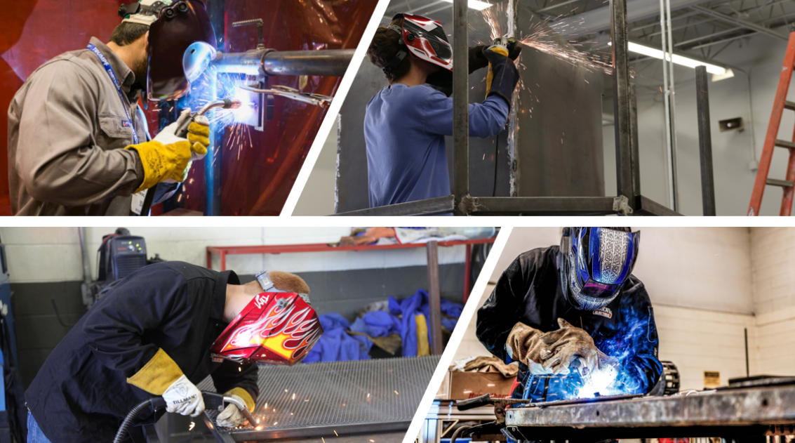
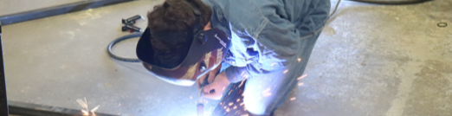




Statewide Program of Study: Agricultural Technology and Mechanical Systems — Page 1
Revised–May 2024
Agriculture, Food, and Natural Resources Career Cluster
The Agriculture, Food, and Natural Resources (AFNR) career cluster focuses on the essential elements of life, food, water, land, and air. This career cluster includes occupations ranging from farmer, rancher, and veterinarian to geologist, land conservationist, and florist.
Statewide Program of Study: Agricultural Technology and Mechanical Systems
The Agricultural Technology and Mechanical Systems program of study focuses on occupational and educational opportunities associated with applying engineering technology and biological science to agricultural problems related to power and machinery, electrification, structures, soil and water use, and processing agricultural products. This program of study includes diagnosing, repairing, or overhauling farm machinery and vehicles, such as tractors, harvesters, dairy equipment, and irrigation systems.
Secondary Courses for High School Credit
Level 1 | Principles of Agriculture, Food, and Natural Resources
Level 2 | Agricultural Mechanics and Metal Technologies
Level 3 | Agricultural Structures Design and Fabrication
Level 4 | Agricultural Equipment Design and Fabrication + Agricultural Laboratory and Field Experience
Example Postsecondary Opportunities
Apprenticeships
Farm Equipment Mechanic I
Associate Degrees
Diesel Mechanics Technology
Industrial Mechanics and Maintenance Technology
Bachelor’s Degrees
Agricultural Engineering
Agricultural Systems Management
Master’s, Doctoral, and Professional Degrees
Agricultural Engineering
Industrial Technology
Additional Stackable IBCs/License
Diesel Equipment Technology-Off Highway Specialization CER1
Accredited Farm Manager
Aligned Advanced Academic Courses
Example Aligned Occupations
Dual Credit | Dual credit offerings will vary by local education agency.
Farm Equipment Mechanics and Service Technicians
Students should be advised to consider these course opportunities to enrich their preparation. AP or IB courses not listed under the Secondary Courses for High School Credit section of this framework document do not count towards concentrator/completer status for this program of study.
Work-Based Learning and Expanded Learning Opportunities
Median Wage: $46,582
Annual Openings: 326
10-Year Growth: 23%
Work-Based Learning Activities | Participate in a farm mechanic apprenticeship at an equipment production company Intern at an equipment manufacturing facility working with agricultural engineers
Expanded Learning Opportunities | Participate in an FFA career, leadership, and speaking contest like an agriscience fair Participate in an agriculture robotics event
Mobile Heavy Equipment Mechanics
Median Wage: $57,943
Annual Openings: 2,637
10-Year Growth: 31%
Aligned Industry-Based Certifications
Agricultural Technology
and Mechanical Systems
AWS D1.1 Structural Steel
AWS D9.1 Sheet Metal Welding
AWS SENSE Level I: Entry Welder
Machining Measurement, Material, and Safety Level I
NCCER Core
NCCER Welding Level I
Welding - Job Ready
Farmers, Ranchers, and Other Agricultural Managers
Median Wage: $65,490
Annual Openings: 28,020
10-Year Growth: 4%
Data Source: TexasWages, Texas Workforce Commission. Retrieved 3/8/2024.
Successful completion of the Agricultural Technology and Mechanical Systems program of study will fulfill requirements of the Business and Industry endorsement.
For more information visit: https://tea.texas.gov/academics/college-career-and-military-prep/career-and-technical-education/programs-of-study-additional-resources

Slide 2


Statewide Program of Study: Agricultural Technology and Mechanical Systems — Page 2
Agriculture, Food, and Natural Resources Career Cluster
Statewide Program of Study: Agricultural Technology
and Mechanical Systems
Course Information
Course |  | Prerequisites | Corequisites | Career Clusters
Principles of Agriculture, Food, and Natural Resources* 13000200 (1 credit) |  | Prerequisites: None Corequisites: None Recommended Prerequisites: None Recommended Corequisites: None | 1. Agriculture, Food and Natural Resources
Level 1
Course |  | Prerequisites | Corequisites | Career Clusters
Agricultural Mechanics and Metal Technologies 13002200 (1 credit) |  | Prerequisites: None Corequisites: None Recommended Prerequisites: Principles of AFNR Recommended Corequisites: None | 1. Agriculture, Food and Natural Resources
Level 2
Course |  | Prerequisites | Corequisites | Career Clusters
Agricultural Structures Design and Fabrication 13002300 (1 credit) |  | Prerequisites: None Corequisites: None Recommended Prerequisites: Agricultural Mechanics and Metal Technologies Recommended Corequisites: None
Level 3
Course |  | Prerequisites | Corequisites | Career Clusters
Agricultural Equipment Design and Fabrication + Agricultural Laboratory and Field Experience 13002360 (2 credits) |  | Prerequisites: None Corequisites: None Recommended Prerequisites: Agricultural Mechanics and Metal Technologies Recommended Corequisites: None | 1. Agriculture, Food and Natural Resources
Level 4
Agricultural Technology
and Mechanical Systems
* Indicates course is included in more than one program of study.
For additional information on the Agriculture, Food, and Natural Resources career cluster,
contact cte@tea.texas.gov or visit https://tea.texas.gov/cte
[LEA name] does not discriminate on the basis of race, color, national origin, sex, or disability in its programs or activities and provides equal access to the Boy Scouts and other designated youth groups. The following person has been designated to handle inquiries regarding the nondiscrimination policies: [title], [address], [telephone number], [email]. Further nondiscrimination information can be found at Notification of Nondiscrimination in Career and Technical Education Programs.

