Slide 1
Rogers Public Schools
Finance Department Orientation

Slide 2
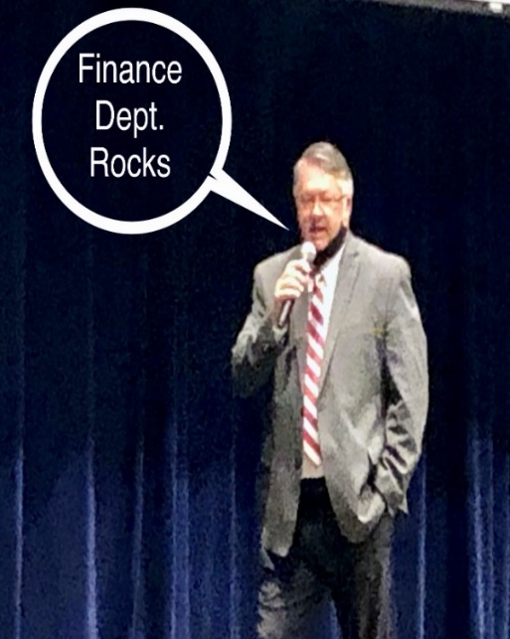
Finance Department
Aly Caldwell Thomason – Accounts Payable
Ashley Phillips – Payroll/Benefits
Blanca Guerra – Teacher Retirement
Jake Haak – CFO
Marisol Serafin – Benefits Coordinator
Miriah Grosshart – Receipts/Coding
Nancy Price – Payroll/Contracts
Tanya Schein - Credit Cards/Attendance
Finance Intern

Slide 3
Equalized Salary Payments
Most employees get 1st check in September and 3 checks in June
All contracted employees have equalized payments
Pay day on the 20th of each month
Direct deposit – may have up to 2 bank accounts
Let us know if you change your bank account
Check will be mailed to address on file if not signed up for direct deposit. Send an email to address@rpsar.net to update your address.
School year/ Contract year:
July 1st – June 30th

Slide 4
Sick Leave
1 paid sick day per month worked
Unlimited accumulation of sick leave
(most districts limit this to 90 days)
If you previously worked in another Arkansas Public School, you are eligible to transfer up to 90 days into our district.

Slide 5
Catastrophic Sick Leave Bank (optional)
Donate 1 sick day
May be granted up to 30 days per school year for a catastrophic illness

Slide 6
Workers Compensation
Report it to your supervisor
You are covered
Conservative Care Occupational Health
1615 W. Persimmon St., Ste B. Rogers, AR 72756

Slide 7
Teacher Retirement
As an employee of Rogers Public Schools, you are automatically a member of ARTRS (Arkansas Teacher Retirement).
Rogers School District matches 15% of salary
Contracted employees w/185 days or more contribute 7%
Contracted employees w/184 days or less have the option to be contributory (extra form required)
Full retirement at 28 years
Vested in 5 years
Retirement based on highest 5 years salary
Also eligible for Social Security benefits
Accumulated sick leave is paid at retirement @ ½ your daily rate not to exceed the Sub II rate of pay.

Slide 8
Additional Retirement
Webb & Associates
Annuities 403B and 457 are available
Contact Jeremy Webb at 1-800-366-9322

Slide 9
Legislative Requirements
Asbestos
Some of our buildings contain asbestos that is encapsulated either in concrete or under the floor, such as the glue that holds a floor tile in place. For further information email
Dan Caley dan.caley@rpsar.net
or
School principal

Slide 10
Health Insurance

Slide 11
Colonial Life Insurance
Offered through the state to all contracted employees working 30 or more hours per week and contracted bus drivers.
You will automatically be enrolled in a $10,000 policy for $2.30 per month, if you are eligible. (30 hours or more)
You have the option to decline
Extra coverage is available
You will receive an enrollment email from Marisol Serafin when you have access to enroll
Enrollment is through Colonial Life portal.
If coming from another Arkansas public school, your current coverage will transfer.
As a transfer, you have the option to decline or enroll in additional coverage.

Slide 12
Health Insurance
Offered to contracted employees working 30 or more hours per week and contracted bus drivers.
District pays $234.50 per month for employee
Current Plans Available
Premium – Health Advantage
Classic – Health Advantage (HSA available-Data Path)
Basic – Health Advantage (HSA available-Data Path)
If spouse is offered health care coverage from their employer, they may not enroll on your plan.
You will receive an enrollment email from Marisol Serafin when you have access to enroll
Enrollment is through the ARBenefits portal.
Documentation needed to enroll:
Dependents: Birth Certificate
Spouse: Marriage License and Spousal Affidavit Form

Slide 13
Health Insurance Monthly Premiums
Premium
Employee only $201.96
Employee & Spouse $706.92
Employee & Child(ren) $457.28
Employee & Family $779.68
Classic
Employee only $88.38
Employee & Spouse $347.76
Employee & Child(ren) $209.30
Employee & Family $391.88
Basic
Employee only $43.24
Employee & Spouse $241.58
Employee & Child(ren) $140.02
Employee & Family $262.12
Rates effective 2025

Slide 14
Premium Plan
Deductible
$750 individual
$1,500 family
RX card
$15 generic
$40 preferred
$80 non-preferred
$100 (Tier 4)
Co pays (in-network)
$25 primary doctor
$50 specialist
$250 emergency
$100 urgent care
Coinsurance (in-network)
20% - Up to $2500 individual
$5000 family
Max out of pocket (in-network)
$3250 medical + $3100 RX individual
$6500 medical + $6200 RX family

Slide 15
Classic Plan
Deductible
$1750 individual
$3500 family
No RX card
You pay what insurance company would pay
Counts towards deductible
Coinsurance
20% after deductible
up to $4700 individual
$6475 family
Max out of pocket
(in-network)
$6450 individual
$9675 family
HSA available - Data Path

Slide 16
Basic Plan
Deductible
$4000 individual
$8000 family
No RX card
You pay what insurance company would pay
Counts towards deductible
Coinsurance
20% after deductible
up to $2450 individual
$4900 family
Max out of pocket
$6450 individual
$12900 family
NO out-of-network coverage
HSA available – Data Path

Slide 17
Other Perks
Activity Pass
Discounts For Staff
Go to: Rogers Public Schools Website » Departments » Human Resources » Discounts for Staff

Slide 18
Section 125 Cafeteria Plan
Offered to contracted employees working 20 or more hours per week.
Plans offered: Dental, Vision, Short Term Disability, etc.
You will receive an enrollment email from Marisol Serafin when you have access to enroll
Enrollment is through USAble portal.

Slide 19
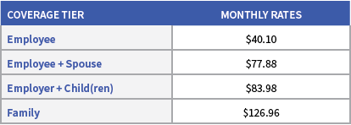
Dental
Delta Dental
Deductible – $50 per person
Annual Benefit – $1,500 per person
Right Start 4 Kids – In network providers at 100% coinsurance up to age 13
Preventative Services
In-Network 100% coverage
Basic Services
In-Network 80% coverage after deductible
Major Services
In-Network 50% coverage after deductible
You will receive a dental card in the mail.

Slide 20
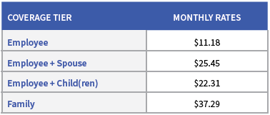
Vision
Delta Vision Eye Med
Exam Co-Pay is $10.00
Materials Co-Pay is $10.00
Allowance of $200.00 (glasses/contacts) + 15% off remainder on frames (at participating providers)
Benefit Period is once every 12 months since your last date of service.
You will receive a vision card in the mail.

Slide 21
Long Term Disability
District pays for Long-term disability
LTD pays up to 60% of salary after 90 days

Slide 22
Short Term Disability
Pre-existing condition applies and is a 3/12 exclusion.
Example: ANY condition 3 months prior to effective date will NOT be covered for the first 12 months.
Up to $1,250 per week

Slide 23
Supplemental Plans
Hospital Indemnity - US Able Life
Age based at issue age
12/12 pre-existing condition, any condition 12 months prior to effective date will not be covered for first 12 months
Wellness benefit $30 per person per calendar year
Cancer – TransAmerica
Annual wellness benefit $100 per person per calendar year

Slide 24
Supplemental Plans Continued
Critical Illness – Aflac
Age based at issue age
No pre-existing or waiting period
Annual wellness benefit $100 employee and spouse only
Accident – Aflac
Wellness benefit $100 per person per calendar year

Slide 25
Life Insurance
Voluntary Term Life Insurance – USAble Life
Age Based
Guarantee issue up to $200,000
Dependent Life
Spouse $5,000 up to $150,000
Child(ren) 6 months an up $5,000 or $10,000
Live births to – 6 months $1,000
Dependent coverage is available only when purchasing a policy on yourself.

Slide 26
MetLaw
MetLife
$21 per month
A voluntary benefit with access to counsel for your personal legal needs.
Will/Trust preparation along with other legal services.

Slide 27
Universal Life
Transamerica– permanent life insurance protection with a premium that never increases due to age
Fully portable
Coverage continues to age 100 as long as premiums are paid
Accelerated Death Benefit for terminal illness
Builds cash value and accrues interest

Slide 28
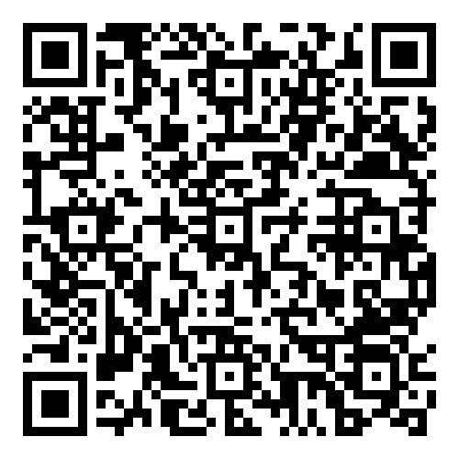
RPEF Donation
Would you like to donate?
Scan the QR code to sign up.

Slide 29
Powerschool TalentEd
Have you completed all onboarding tasks?
All tasks must be complete to be set up in payroll and to have access to enroll in benefits.

Slide 30
Questions?
Benefits Coordinator
Marisol Serafin
marisol.serafin@rpsar.net
(479) 636-3910
Finance Department
(479) 636-3910
Assistant Superintendent for Human Resources
Dr. Roger Hill
roger.hill@rpsar.net
(479) 636-3910

