Slide 1
Recommended Master Plan
Executive Summary
March 31, 2025

Slide 2
Agenda
Recap of Key Findings Enrollment Projections, Capacity, Utilization & Facility Condition Assessments.
Recommendations
Elementary Schools
High Schools
Funding Opportunities

Slide 3
What is a Master Plan?
The Master Plan is a guidance document that establishes a long-term planning framework or “road map” to help guide capital investments, promote efficient operations, and help the district achieve its desired educational vision over the next decade and beyond.
Discovery Phase
Assess current and future needs. Identify challenges and opportunities
10-Year Enrollment Projections
Capacity & Utilization Study
Facility Conditions Assessments (FCAs)
Master Planning Phase
Develop short- and long-term planning options
Iterative process looking at multiple options. Preferred option may include the following:
Program needs & expansion
Facility Realignment & Consolidation
Capital Investment Strategy
School Construction Program & Site Selection

Slide 4
Recap of Key Findings/Takeaways

Slide 5
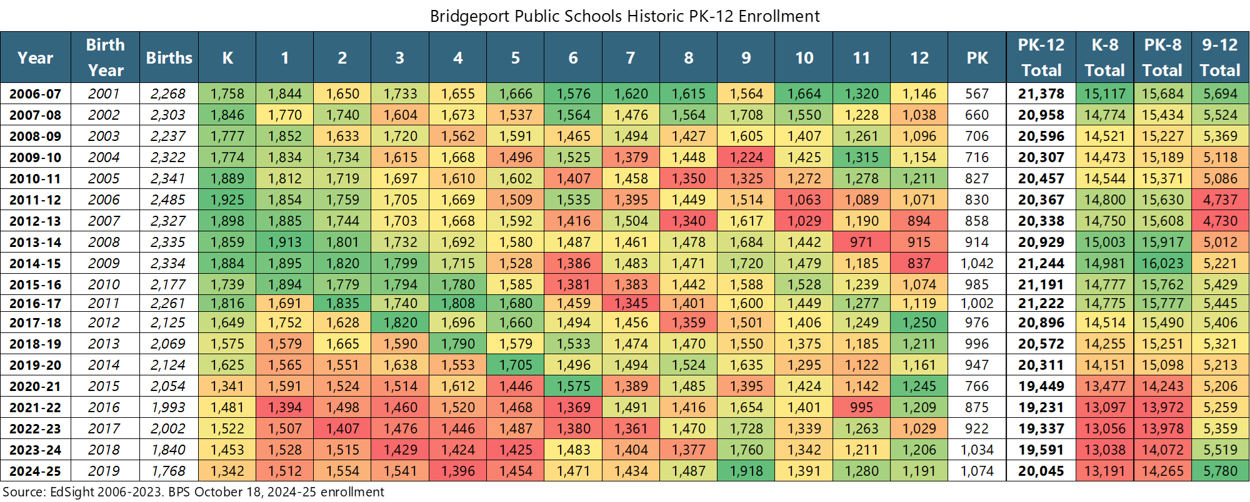
Historic Enrollment
Over the last 10-years, PK-12 enrollment declined by 1,150 students.
PK-8 enrollment declined by 1,500 students
9-12 enrollment increased by 350 students

Slide 6
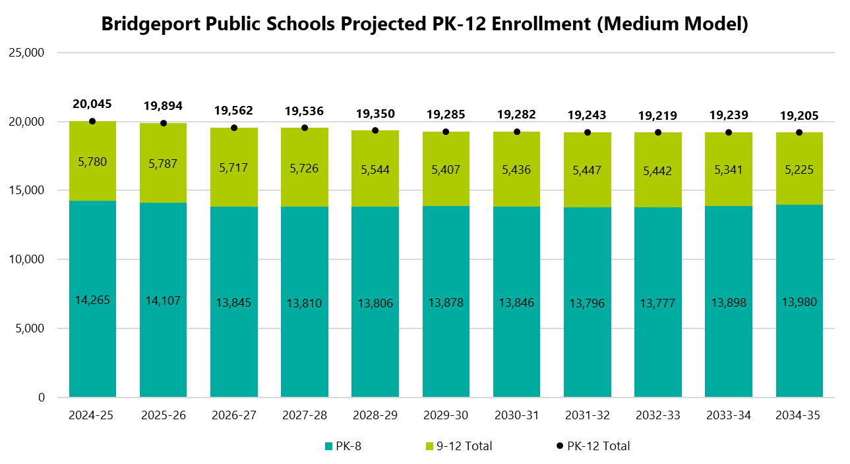
Districtwide Projections
Over the next 5-Years
PK-8 enrollment averages ~13,890
9th-12th enrollment averages ~ 5,640
Over the next decade
PK-8 enrollment averages ~13,875 students.
9th-12th enrollment averages ~5,500

Slide 7
Existing Elementary Utilization
Overall utilization ~80%. Grouped schools based on current utilization into four categories
Well Utilized (7 schools)
Efficiently used. Limited headroom in existing classrooms
Moderately Well Utilized (6 schools)
Some headroom in existing classrooms
Underutilized (10 schools)
Some headroom in existing classrooms and/or a few flex classrooms available
Very Underutilized (7 schools)
Significant headroom in existing classrooms and/or several flex classrooms available

Slide 8
Projected Elementary Utilization
Grouped schools based on average utilization over the next five years using the following four categories
Well Utilized (6 schools)
Efficiently used. Limited headroom in existing classrooms
Moderately Well Utilized (7 schools)
Some headroom in existing classrooms
Underutilized (7 schools)
Some headroom in existing classrooms and/or a few flex classrooms available
Very Underutilized (10 schools)
Significant headroom in existing classrooms and/or several flex classrooms available
Bryant, Barnum, and Tisdale added to this category.
-1
+1
-3
+3

Slide 9
High School Projected Utilization
Greater than 100% Utilization :
Potential for some operational impacts (could result in larger class sizes, less resilience to “bubbles,” more intensive scheduling, prep periods outside of classrooms, etc.)
With the opening of the New Bassick and relocation of BMA (approx. 250 students) into Bassick for 2025-26, the district will lose about 900 seats of planning capacity at the high school level.
High School utilization is projected to peak between 2025-26 and 2027-28 at about 95% systemwide (seat surplus of about 135 seats). As high school enrollment decreases, seat surplus is projected to grow to around 500 over the last 5-years.
Assuming recent suburban student enrollment trends continue, utilization at Fairchild Wheeler is projected to remain low, averaging below 62% utilization over the next decade.
Increasing suburban enrollment Fairchild Wheeler would open up additional seats to Bridgeport resident students and could help alleviate projected enrollment pressures at the remaining comprehensive high schools.

Slide 10
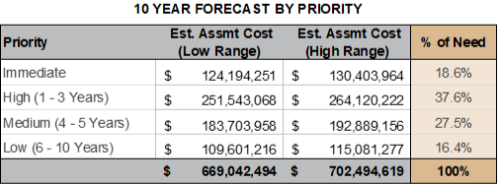
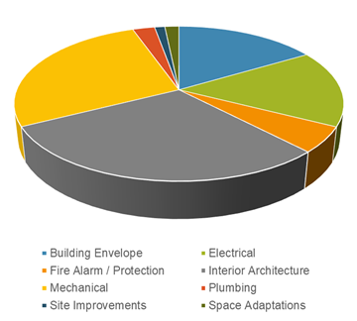
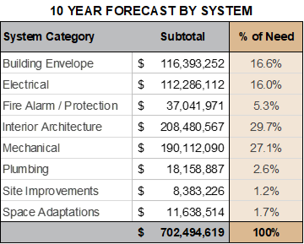
Summary of Findings: Project Wide
$702.5M
Assessment Parameters:
37 Buildings
3,469,505 Square Feet
Capital Renewal &
Improvement needed over the next 10 years with
56% in first 3 years and
84% in 5 years
30%
Interior Architecture
Greatest total forecasted need with Mechanical systems at 27% and Building Envelope at 17%
56%
Primary justification of projects is “Useful Life” with “Environmental Improvements” at 18% and “Damaged /Inoperable” at 11%

Slide 11
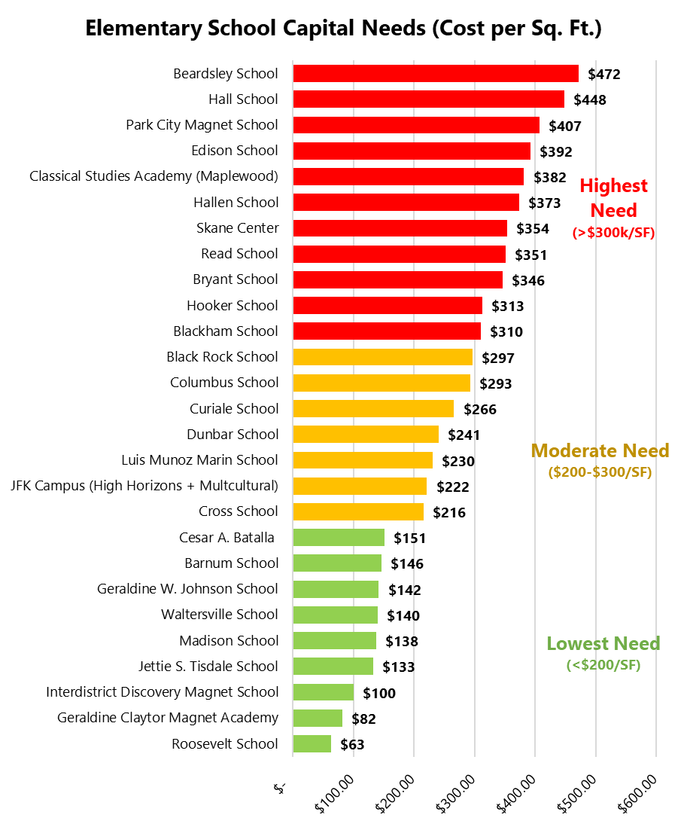
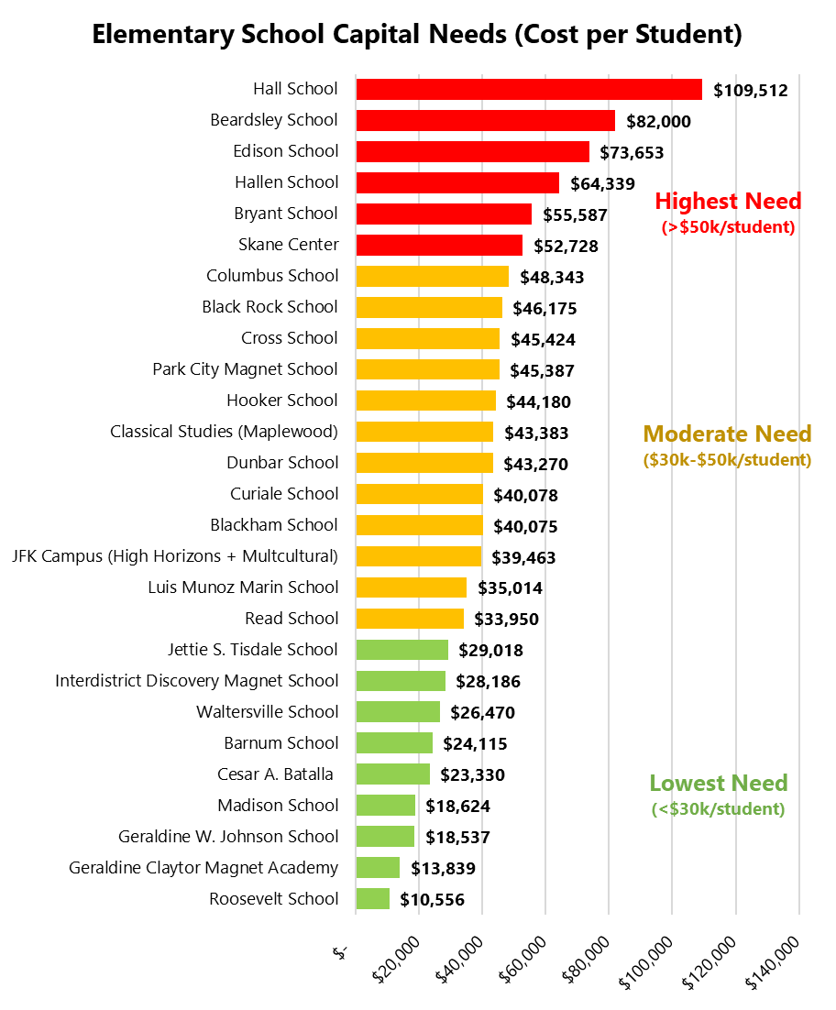
Elementary School Comparison
Includes all building components and priority 1-4 items.
All values shown are un-escalated 2024 Q4 dollars.
Note that the old Winthrop and leased space at Classical Studies Annex were not assessed
Only includes building elements (excludes site).
Values rounded to the nearest dollar
Includes both building and site elements
Normalized to enrollment as of 10/1/2024

Slide 12
Condition & Utilization ES Matrix
Highest Capital Needs (>$300/SF)
Moderate Capital Needs ($200-$300/SF)
Lowest Capital Needs (<$200/SF)
Well Utilized or Moderately Well Utilized
> 80% Utilization
Blackham
Park City Magnet
Read
Skane Center
Batalla
Geraldine Johnson
Discovery Magnet
Madison
Roosevelt
High Horizons Magnet
Multicultural Magnet
Beardsley
Bryant
Classical Studies (Maplewood)
Edison
Hall
Hallen
Hooker
Black Rock
Columbus
Cross
Curiale
Dunbar
Luis Munoz Marin
Underutilized or
Very Underutilized
<80% Utilization
Barnum
Geraldine Claytor
Tisdale
Waltersville

Slide 13
Recommendations

Slide 14
BPS Master Plan Guiding Criteria
Short Term
Identify funding strategies to develop a targeted capital renewal plan, utilizing State and Federal dollars to the greatest extent possible.
Develop a Facilities Master Plan that will act as a comprehensive roadmap moving the District forward in identifying renovations, repairs, maintenance and new construction needs.
Seek opportunities to consolidate facilities where possible. If determined that reducing the number of facilities is necessary, efforts should be made to reduce disproportionate impact upon any one community.
Create a plan that improves current facility conditions that maintain health and safety standards, utilizing State and Federal grant funding where possible, minimizing the fiscal impact on the District.
Alignment of school facilities with Bridgeport’s current demographics, educational and programming needs to ensure we are best serving our students and community.
Include community stakeholders in the process when plausible and possible.
Long Term
Create a long-term budget plan for maintenance and upgrades seeking diverse and sustainable funding.
Continue to Implement and update the Facilities Master Plan, guaranteeing that the District moves forward with identified needs for renovations, repairs, maintenance and new construction.
Develop and implement a Capital Investment Plan to establish adequate planning of funding for the Facilities Master Plan.
Plan for and implement facilities in the District that can provide inclusivity for all special education students and that will allow them to remain in-district, in the least restrictive environment.
Continue to include community stakeholders in the process when plausible and possible.

Slide 15
Master Plan Recommendations
The Master Planning Process was a data-driven, collaborative effort with BPS, both quantitative and qualitative information on enrollment, facilities, space need and the community were compiled, analyzed and validated to guide the recommendations presented in this Plan.
This Plan is intended to provide the framework to support the educational vision, necessary improvements and investments needed to maintain BPS facilities for the years to come. The recommendations in this plan are not rigid, but rather a malleable framework that is responsive and flexible to changes in enrollment, funding, timing and educational needs and mandates.
Planning is a continuous process, and this Master Plan should be referenced, reviewed and updated as needed to ensure that it is aligning with the ever-changing needs and landscape of education in Bridgeport.
Through targeted investments and structural and organizational changes, the Master Plan aims to address facility needs in a holistic, thoughtful and deliberate manner with recommendations for each facility intended to improve educational environments and operational efficiency, while limiting overall disruption, where possible.
The recommendations also take into consideration Bridgeport's financial obligations and ability to bond the improvements, while providing guidance on available state funding.
The recommendations are intended to guide structural changes and facility investments in City school buildings over the next decade and beyond. Near-term decision making should be in alignment with the recommendations of this plan.

Slide 16
Recommended Long Term Plan
Elementary Schools

Slide 17
Future Construction Projects
Future construction projects where feasible should include planning and spaces for districtwide self-contained programs and Pre-K based on district needs. Location in the city relative to student populations should be considered in the decision-making process.
Planning for new schools should take a proactive approach to future district needs rather than replacement of existing programs.
Educational planning and specifications should be a collaborative effort with BPS educators, administrators and the City of Bridgeport to ensure early agreement that spaces are sufficient and appropriate for the programs and populations that will be accommodated.

Slide 18
Construction Phasing Plan: Elementary
Ongoing Projects
New Winthrop (Includes Skane PK)
Neighborhood PK-8 School at 3 sections per grade with Pre-K center. Students will swing into South End School in 2026-27 for 2 years. Anticipated 2028-29 opening.
Design in Progress
Phase 1 Projects
New special program school built on the old Skane School site. Will house outplaced BPS special education students and programs currently at BLC.
June 2025 or June 2026 Grant Applications
New East Side School
Neighborhood PK-8 School built on old Harding HS site at 750 students. Facilitates closure of older facilities and redistricting in the City’s SE quadrant.
New Special Program School
Phase 2 Projects
New Park City Magnet School and Classical Studies Magnet Schools built on existing Park City site at about 500 students each. Park City students swing to South End School for 2028-29 and 2029-30 school years. Opportunity for shared core spaces (JFK Campus Model). Existing Classical Studies buildings close upon completion.
June 2026 or June 2027 Grant Applications
New Park City & Classical Studies Magnet Schools
Renovate-as-new occurring in two phases. Half of students vacate the building at a time to facilitate comprehensive renovation. Students swing to South End School beginning in 2030-31.
Blackham
Phase 3 Projects
Renovate-as-new or new construction depending on site availability. Remain as neighborhood PK-8 school at 3 or 4 sections per grade. Swing space at South End needed if renovate-as-new is pursued. Project timeline could be accelerated if new site is identified and acquired.
High Horizons & Multicultural Magnets
Renovate-as-new occurring in two phases. May fall outside of 10-year Master Plan window due to need for Swing Space.
June 2028 Grant Applications and Beyond
Read
Construction Key
New Construction
Renovate-as- New

Slide 19
Summary of ES Facility Action Plan
BPS should leverage a consolidated elementary school for adult education and terminate the Saint Michael’s lease.

Slide 20
Proposed Elementary Schools
Neighborhood Schools
Intradistrict Magnet Schools
Interdistrict Magnet Schools
PK-8/K-8
K-6/PK-6
Barnum
Luis Munoz Marin
Madison
Geraldine Claytor
Discovery Magnet
Black Rock
Hallen
Roosevelt
New Park City Magnet
Cesar Batalla
Special Schools
Waltersville
Closed Schools*
Columbus
Beardsley
BLC at Sheriden
Classical Studies – Maplewood
Classical Studies – Annex
Dunbar – (TBD) reuse potential
Edison
Hall
Skane Center – site reused
New Classical Studies Acad.
Blackham (Renovate-as-New)
Cross
New Special Program School
High Horizons (Renovate-as-New)
Curiale
Read (New/Renovate-as-New)
South End (Swing Space)
Geraldine Johnson
Multi-Cultural (Renovate-as-New)
New Winthrop (Includes Skane PK)
Hooker
* BPS should leverage a consolidated elementary school for adult education and terminate the Saint Michael’s lease.
New East Side School
Jettie S. Tisdale
Capital renewal and capital improvement items at remaining buildings should be addressed as part of Capital Improvement Plan

Slide 21
Recommended Long Term Plan
High Schools

Slide 22
Ongoing Projects
New Bassick High School
Anticipated opening in 2025-26
Design capacity of 1,250 students
BMA consolidates into New Bassick
Enrollment target of 250 BMA students to align with Design Enrollment

Slide 23
Priority 1 Projects
Leverage Available Space at Fairfield Wheeler **
** Note that any changes at Fairchild Wheeler are dependent on State BOE and/or legislative action.
Option 1: Seek relief and/or modifications to state mandated suburban student percentages in order to maximize opportunities for BPS students. (e.g. maintain state mandated percentages of suburban students).
Option 2: Grow suburban enrollment. Consider modifications to magnet programs to make them more attractive. Work with state to consider other policy changes that could increase suburban students.
Option 3: Leverage available space to house BPS special programs, such as BMA.
Option 4: Convert Fairchild Wheeler to an intradistrict magnet school and sunset suburban student enrollment.

Slide 24
Priority 2 Projects
Consider Expansion of Aquaculture into a Full-Time High School
Conduct a detailed architectural evaluation. Will require expansion of facility to provide additional educational spaces (gym, electives, additional classroom space, kitchen/cafeteria, etc.)
Need to determine if it is feasible to expand site given location, or if existing footprint can be repurposed to incorporate these elements
Increase BPS high school participation in existing programs. Current program primarily caters to suburban students.
Expand opportunities for elementary programming (e.g. Geraldine Claytor Magnet programs)
Move BMA to a Standalone Facility:
BMA Needs to remain at New Bassick until state audit is completed. May require legislative action if moved prior to audit.
Could open up 250+ seats at New Bassick while also providing opportunity for BMA program expansion.

Slide 25
High School “Bubble” Diagram
Intra/Interdistrict Magnet Schools
Interdistrict Magnet Schools
Special Schools
City High Schools
New Bassick HS (Includes BMA)
BMA (relocated to New Bassick – South End School becomes swing space)
Fairchild Wheeler
Aquaculture
BLC (moves to new Special Program School
Central HS
New Special Program School
Harding HS
Old Bassick (closed)

Slide 26
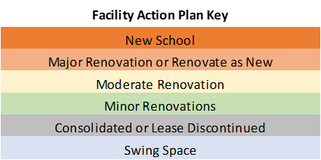
Summary of HS Facility Action Plan

Slide 27
Funding Opportunities

Slide 28
Funding Opportunities
BPS should work with delegation to seek special legislation for elevated reimbursement for a 20-year period to address capital renewal needs, capital improvements and construction projects in the master plan.
Similar approach to Stamford and Norwalk where elevated reimbursement would be in place for a period of time (e.g. 20 years).
Elevated reimbursement for 20 years will quell concerns on future funding availability and show a commitment to the Bridgeport Community. This will also provide the necessary time for the complexities (phasing, swing space, consolidations, construction) of the construction program.
Bridgeport should seek to also capitalize on bonuses where applicable and additional funding streams at the state and federal level to further manage the cost to city and taxpayers.
BPS in partnership with the City should build capacity to pursue grants (staffing, resources, etc.)
Stay current on proposed and newly passed legislation for school funding that can be leveraged for projects contained in this master plan.
At this time, there are various proposals circulating through legislation for increased reimbursement for PreK and Special Education school construction.

Slide 29
State Reimbursement Rates
Bridgeport Public Schools Existing Reimbursement Rates for School Construction: FY2025
Type | State Share | Local Share
New Construction | 68.57% | 31.45%
Renovation | 78.57% | 21.43%
Source: Office of Grants Administration (OGA)
Reimbursement rates are only for eligible expenses.
The “standard” rates set by OGA annually, additional reimbursement is available for districts that qualify for “bonuses”.
Note that state funding is limited for many of the capital renewal items in the FCA’s and addressing capital needs may be achieved most cost-effectively through consolidation and new construction.

Slide 30
Funding Opportunities
Leverage State Grants for:
Priority List Grants (new construction, additions, renovate-as-new)
Non-Priority List Grants (health, safety, & code violation; roofs; security; etc.)
Alliance District General Improvements Grant (covers capital renewal items not covered by other grants) – subject to funding availability.
Indoor Air Quality Grant – note current program has sunset, but legislature is exploring ways of funding this in future years.
Regional Special Education Facilities: These projects are reimbursed at an 80% rate (CGS§ 10-286(a)(4)).
Regional Agriscience Centers: These projects are reimbursed at an 80% rate (CGS § 10- 286(a)(4)).
Utility Rebates
Leverage utility rebates for energy efficiency upgrades (lighting, HVAC, boilers, etc.)
Local funding for CIP
Continue local capital improvement program to complement other funding strategies.

Slide 31
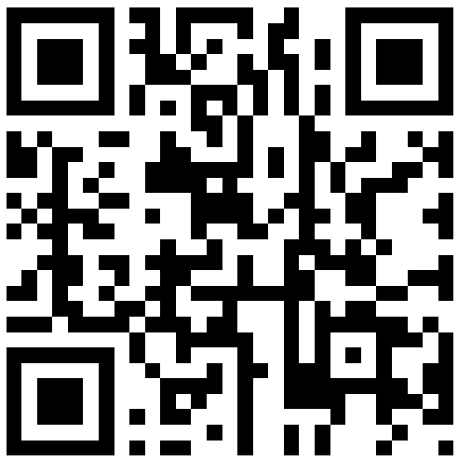
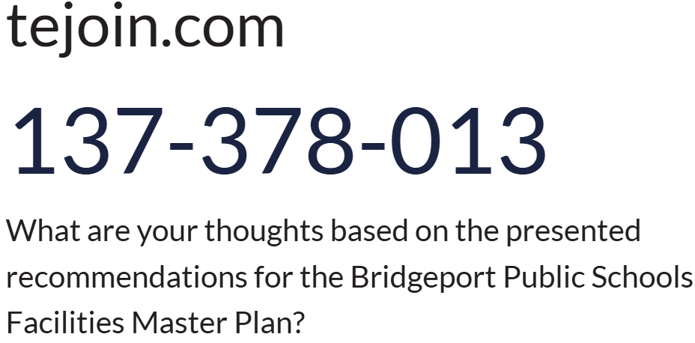
Next Steps…
Community Informational Meetings
March 31, 2025 at Harding HS
April 2, 2025 at Central HS
April 3, 2025 at Bassick HS
Thought Exchange

Slide 32
Additional Information
For Q&A if needed

Slide 33
Ongoing Projects
New Winthrop
Under Design with anticipated opening date of fall 2028
Preliminary Design shows 29 K-8 classrooms, 2 RISE classrooms, 7 shared PK and 3 special education PK classrooms (Skane program).
Currently only 607 PK-8 students in Winthrop – evaluate enrollment in 2027-28 and consider enlarging attendance zone if warranted.
Winthrop will swing to South End School during construction for 2026-27 and 2027-28.
Skane program will move to New Winthrop – demolish existing Skane building and leverage site for future school construction program.

Slide 34
Priority 1 Construction Projects
New East Side School (Old Harding Site)
Target Capacity of 750 K-8 + Pre-K
Recommend incorporating additional space for districtwide special programs (RISE, SOAR, etc.).
Facilitates consolidation 3 to 4 older facilities in the SE quadrant (Hall, Edison, Beardsley, and Dunbar)
New Special Program School (Skane Site)
Demolish existing Skane building and re-use site
Allow out-placed students who receive special education to return to BPS
Specialized Services (Autism, etc.)
Potentially draws in regional students (tuition program)
Incorporate programs at BLC – close facility

Slide 35
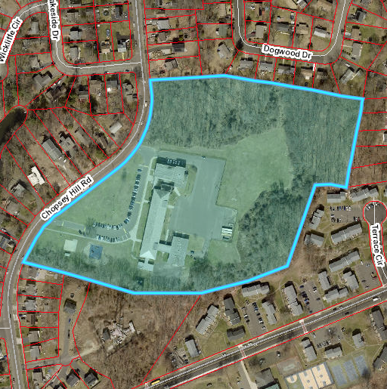
Priority 2A Construction Projects
New Park City Magnet + Classical Studies Academy (JFK Model)
Leverage existing Park City Magnet site. Large site (16 acres)
Construct two ~500-student PK-8 schools co-located on site (Barnum/Waltersville or JFK Campus model)
Shared core spaces should be evaluated as part of architectural feasibility
Potential for shared transportation
Move Park City to South End Swing Space after Winthrop project completed.
Project timeline could be accelerated if construction occurs while existing building is occupied.

Slide 36
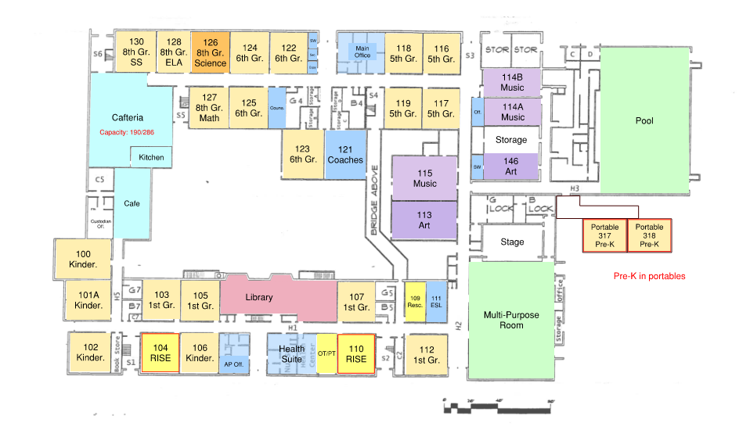
Priority 2B Construction Projects
Blackham Renovate-as-New/Reconstruction –
Phased approach – renovate one wing of the building at a time
Partial swing (students move out of renovated area) to South End
Potential to condense schedule if second swing space is identified
Swing Phase 1: Grades 5-8
Swing Phase 2: Grades K-4

Slide 37
Priority 3A Construction Projects
Read School Renovate-as-New or Reconstruction
Explore potential off-site opportunities (acquire land if available in close proximity to existing school).
Would require swing space
Building a larger 4-section per grade school could help facilitate conversion of Madison to a PK-8.

Slide 38
Priority 3B Construction Projects
High Horizons & Multi-Cultural Magnet Renovate-as-New or Reconstruction
Swing Space required – two phases
Multi-Cultural swings to South End during Phase 1 renovation
High Horizons swings to South End during Phase 2 renovation
Likely beyond 10-year plan based on current schedule
Priorities beyond the ten-year plan, should be verified as part of Plan update.
Schedule be accelerated if a second swing space is identified.

Slide 39
Swing Space Phasing
Winthrop – Two years of swing space needed.
Park City/Classical Studies – Swing space needs to be determined. If yes, then two years of swing space needed.
Blackham – Swing space needed for two phased renovation. Likely 3 to 4 year swing space needed unless multiple swing spaces are used.
Read – Swing space needed if renovate-as-new or reconstruction is proposed. Two years of swing space needed.
High Horizons/Multi-Cultural – Two phase renovate-as-new. Likely 3 to 4 years of swing space needed.
Dunbar – Should Dunbar no longer serve as an elementary school and not be needed for alternative programs, it could be used as an additional swing space to accelerate construction schedule.

Slide 40
Potential Capital Cost Avoidance
Significant cost avoidance can be achieved through the consolidation of facilities that have high capital needs, obsolete, and/or under utilized.
Ongoing projects at the New Bassick HS and Winthrop will result in $92 million in capital cost avoidance.
Phase I calls for the closure of Hall, Edison and Beardsley, & BLC which could account for roughly $75 million in capital cost avoidance.
Phase II calls for an additional $37 million in cost avoidance to school owned facilities plus additional savings through the termination of leased space at the Classical Studies Annex.
Note: Old Winthrop was not included in the FCA study.

