Slide 1
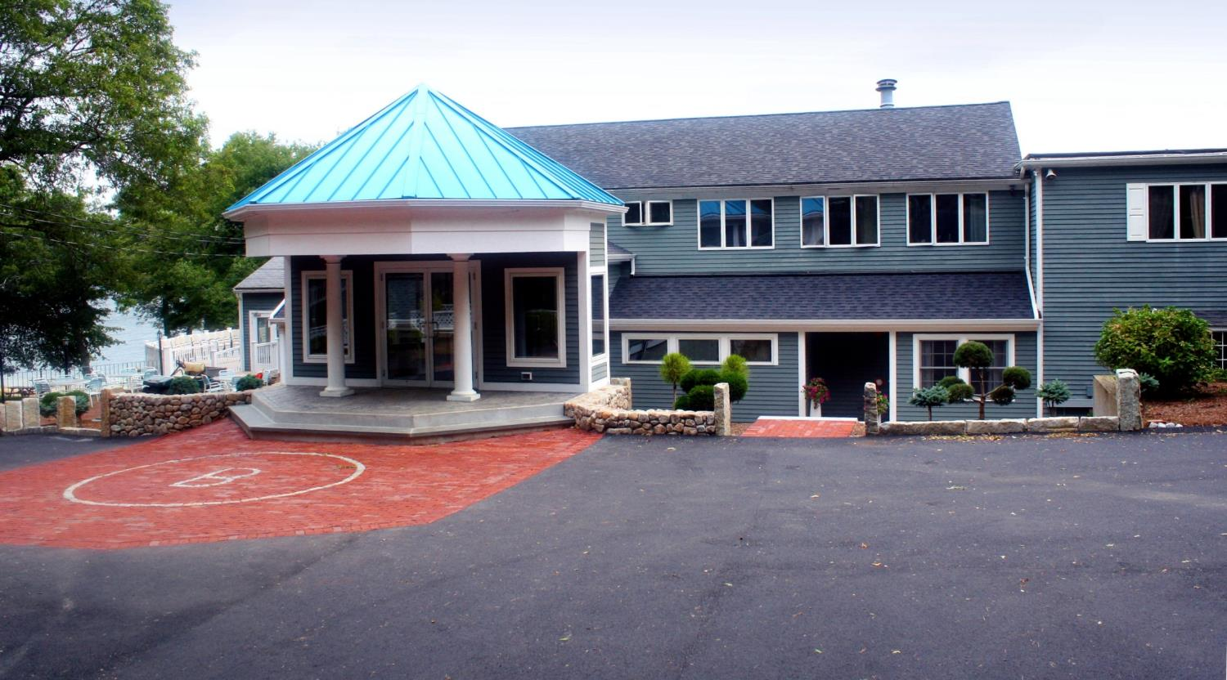

Welcome to Camp Bournedale

Slide 2
Schools Participating In
Camp Bournedale Programming
Amesbury
Bourne
Carver
Braintree
Lincoln, RI
Marblehead
Millbury
Nantucket
Norfolk
Pembroke
Plymouth
Scituate
South Hadley
Tyngsborough
Wakefield
Wrentham

Slide 3
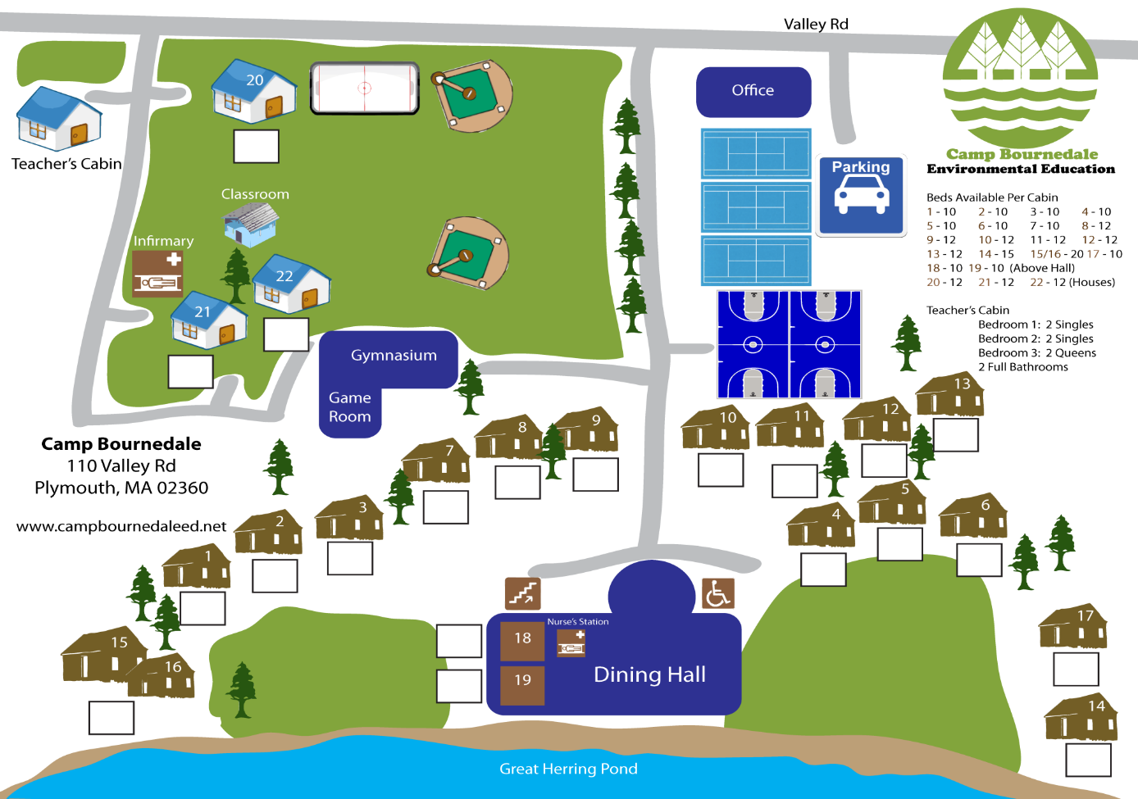


Slide 4
9:00-9:30: Arrival and orientation
9:30-12:00 CLASS
12:00-12: 50 LUNCH
1:00-1:45: Presentation
2:00-4:30: CLASS
4:30-5:00: Recreation
5:00: Depart Monday and Wednesday
Tuesday and Thursday
5:00-5:45: Dinner
6:00-6:30: Recreation
6:30 Depart Tuesday
Thursday
6:30-7:00: Recreation
7:00-8:15: Evening activity
8:30 Depart

Slide 5
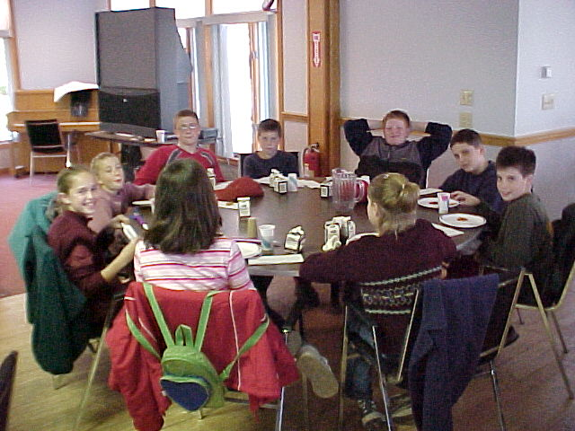
FOOD SERVICE
Family style/buffet
Lunch & dinner
Social atmosphere
Food allergies & dietary restrictions

Slide 6
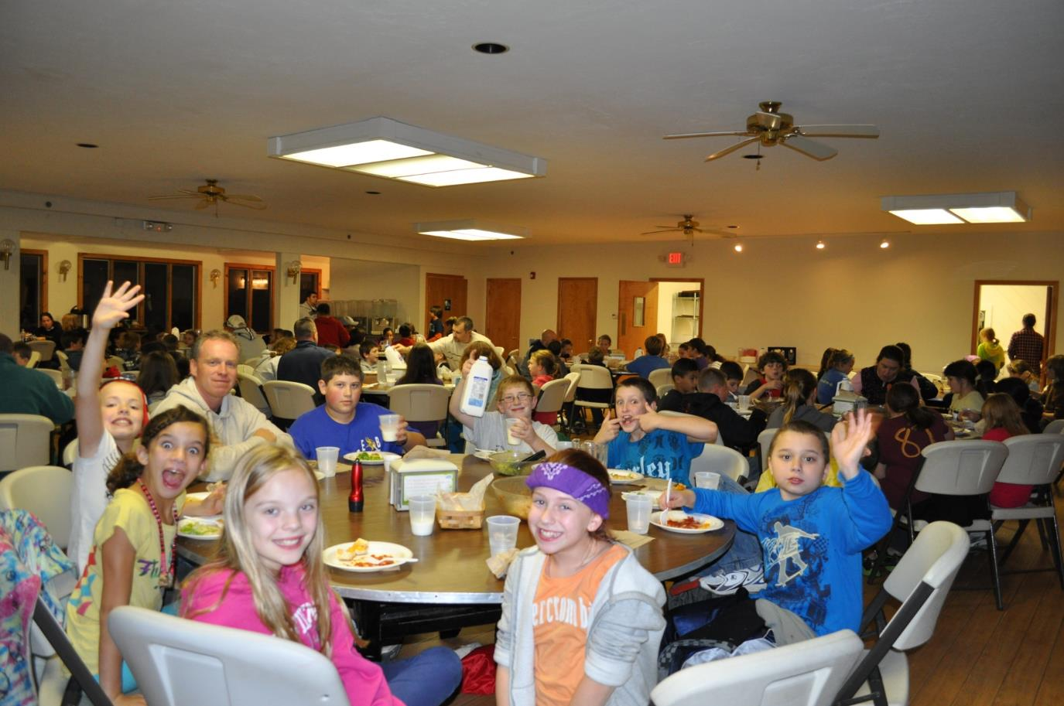

Slide 7

Health Services
Nurse on duty 9:00am-9:00pm.
On site
All medications must be checked-in and logged by camp nurse, including over-the-counter meds.
Health forms should be completed and given to the school nurse at least a week prior to camp visit.

Slide 8
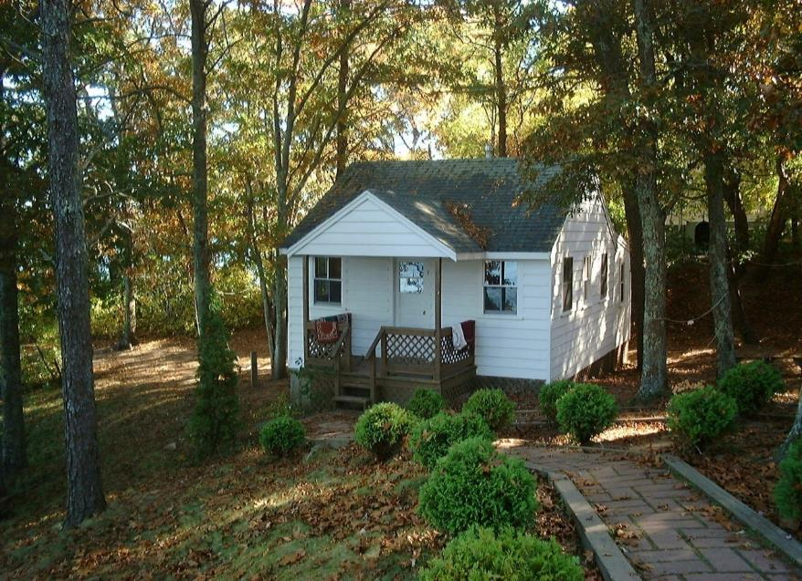
Cabins
10-14 students
Adult chaperone
Heat
Shower
Bathroom

Slide 9
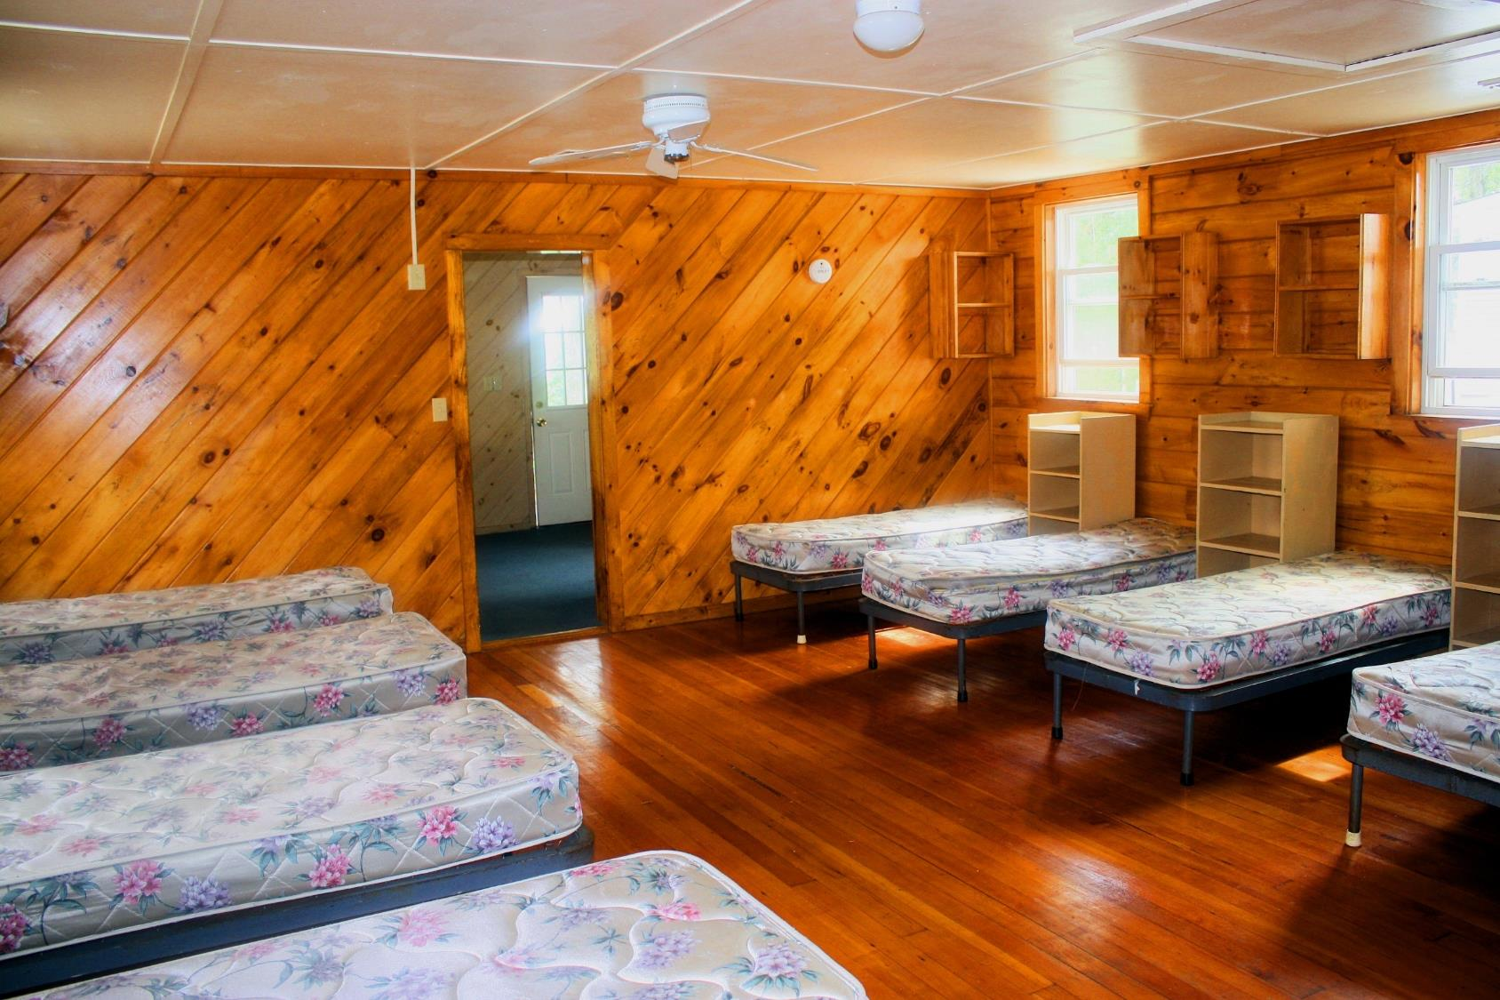

Slide 10
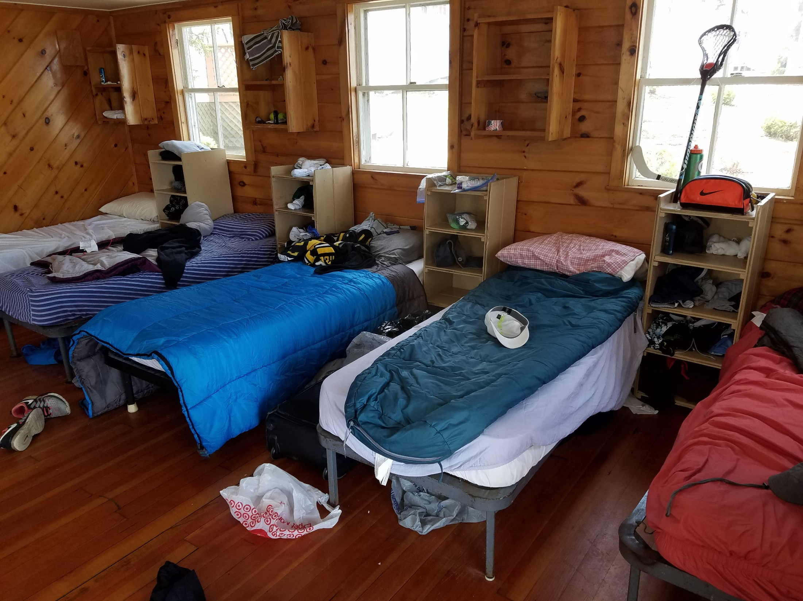

Slide 11
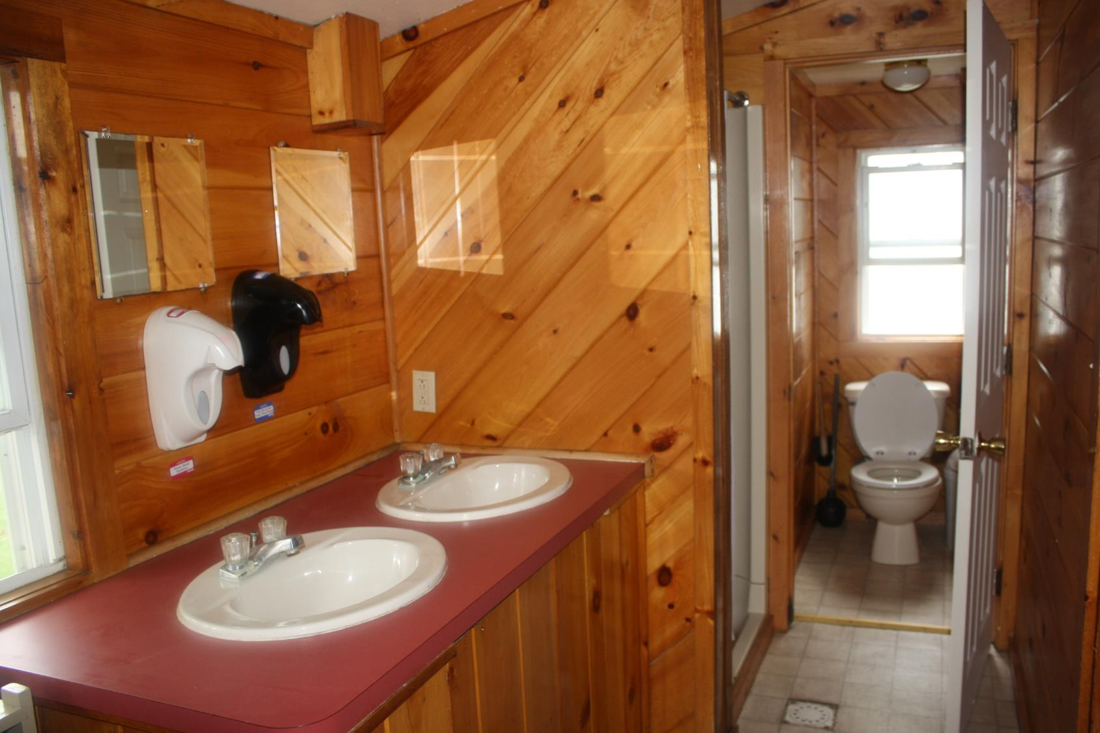

Slide 12
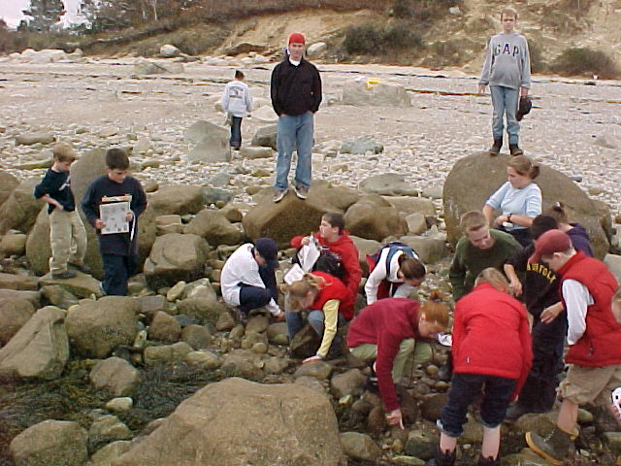
Coastal Ecology
Hands on
Explore
Discover
Observe
Environments

Slide 13
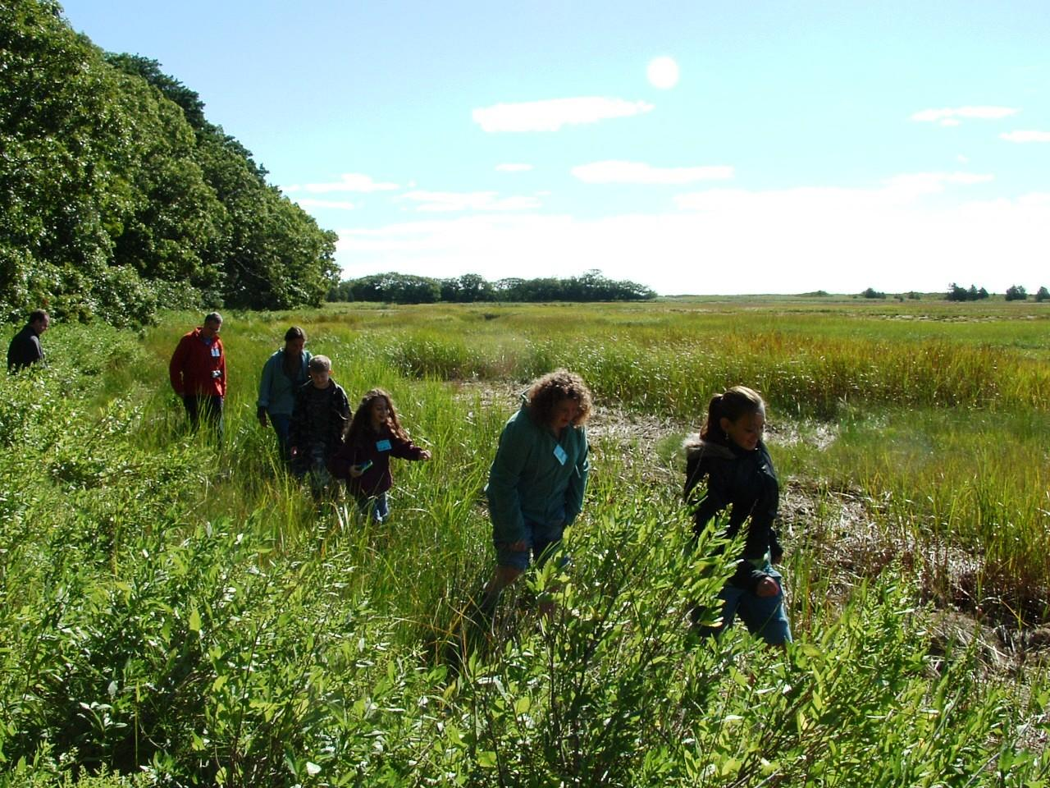

Slide 14
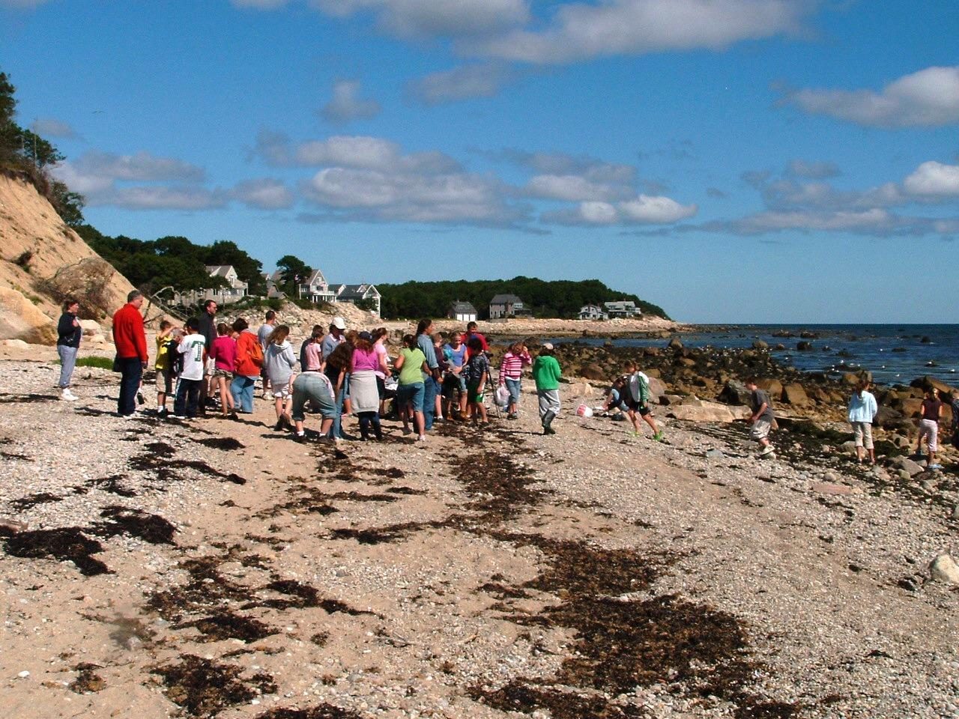

Slide 15
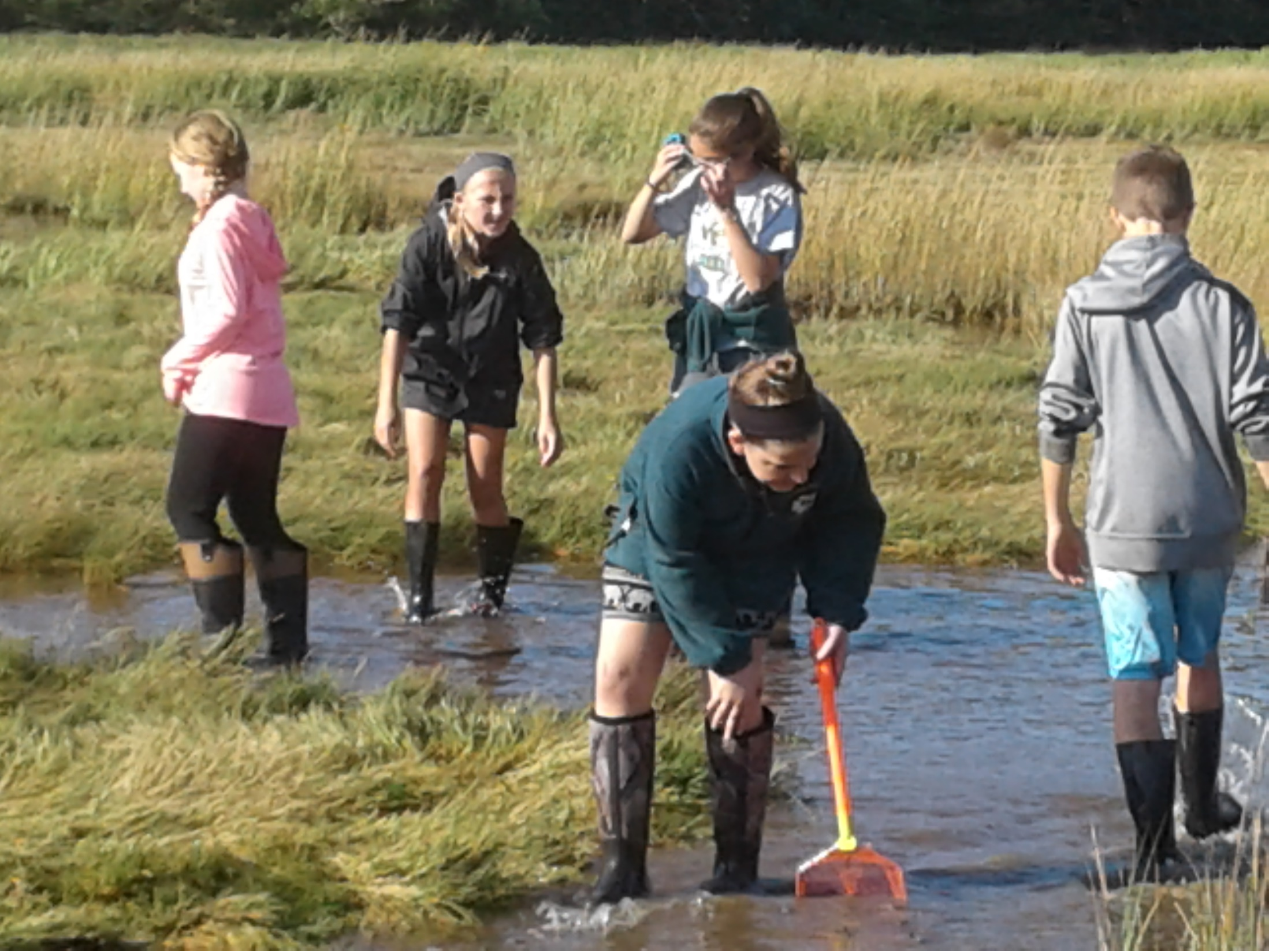
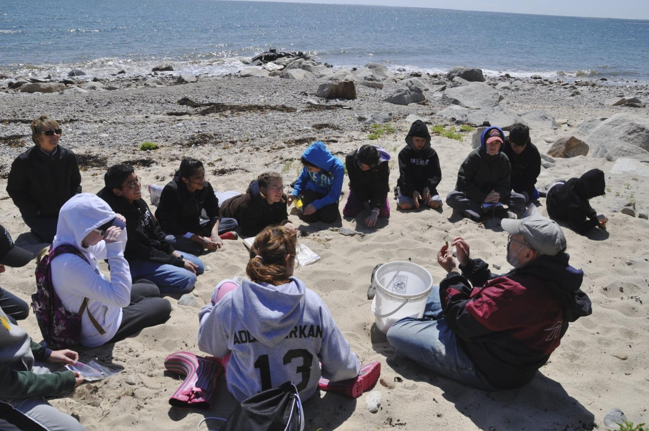

Slide 16
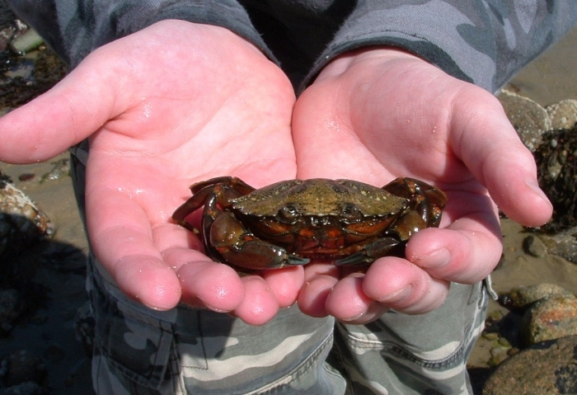

Slide 17
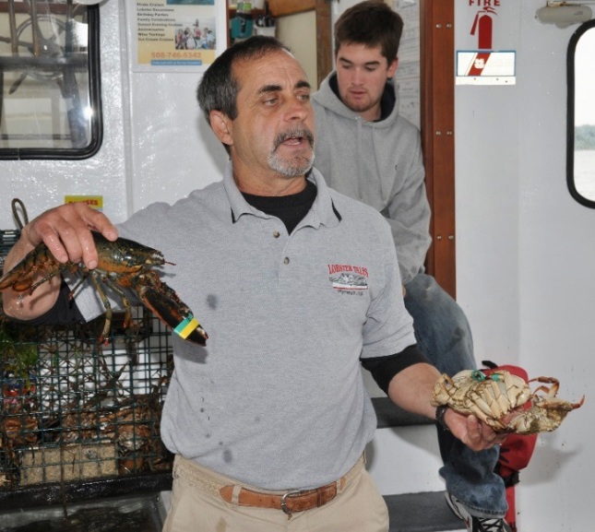
LOBSTER TALES
CAPT. PAUL QUINTAL
TOUR AND HISTORY OF PLYMOUTH HARBOR
NEW ENGLAND COMMERCIAL FISHING INDUSTRY
HAULING OF LOBSTER TRAPS
INVESTIGATING THE CATCH
COAST GUARD INSPECTED AND CERTIFIED

Slide 18
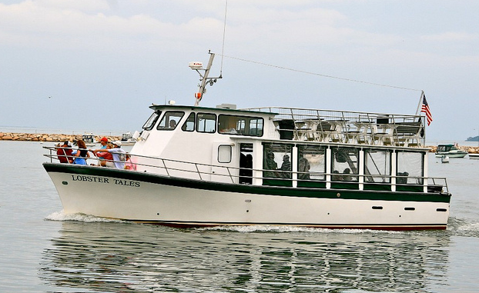

Slide 19
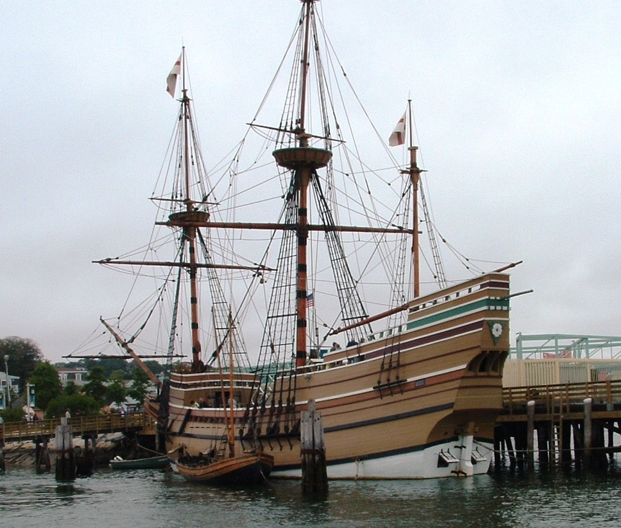

Slide 20
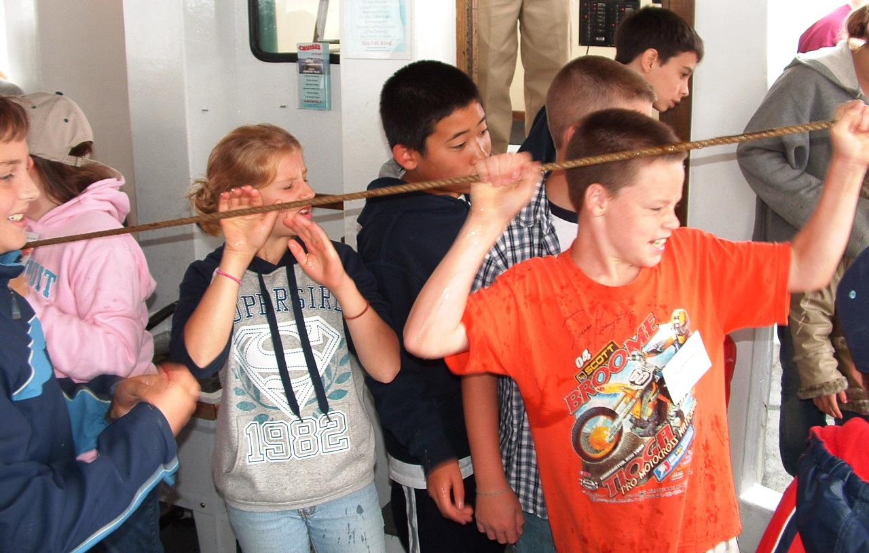

Slide 21
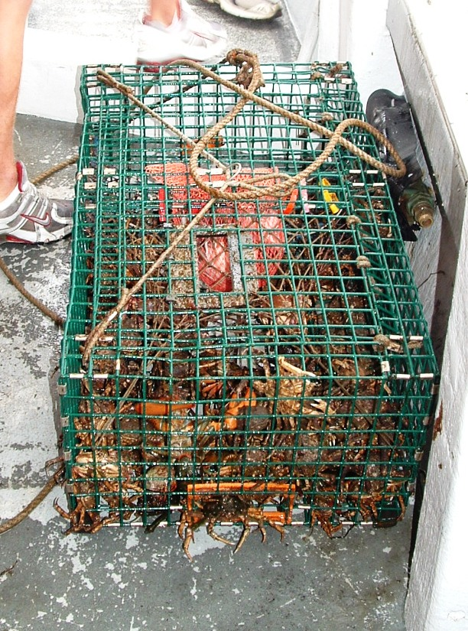

Slide 22
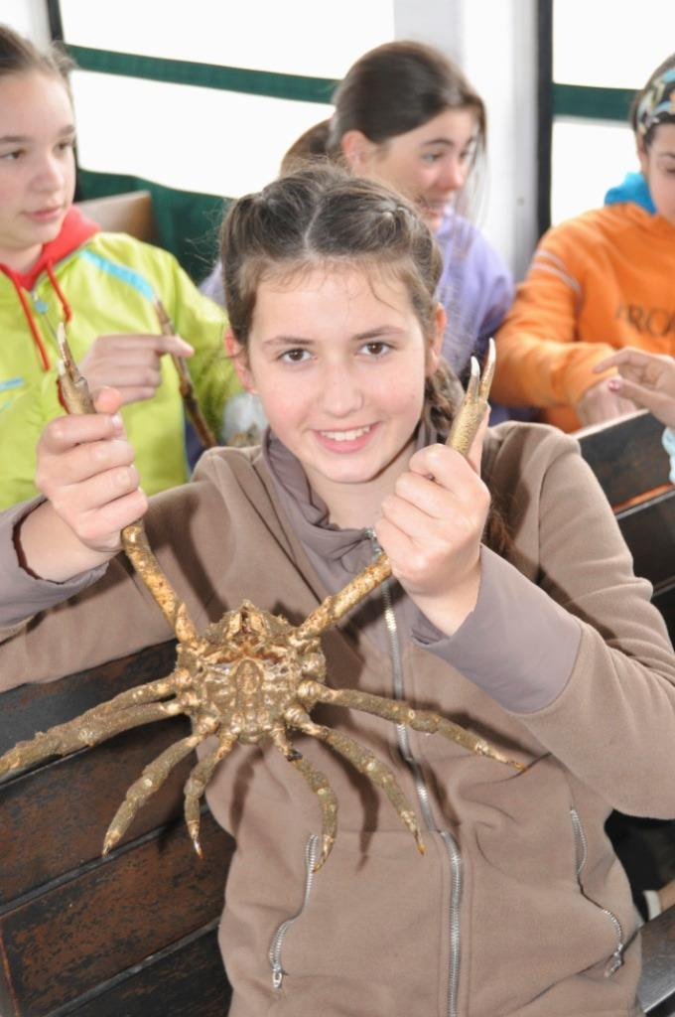

Slide 23
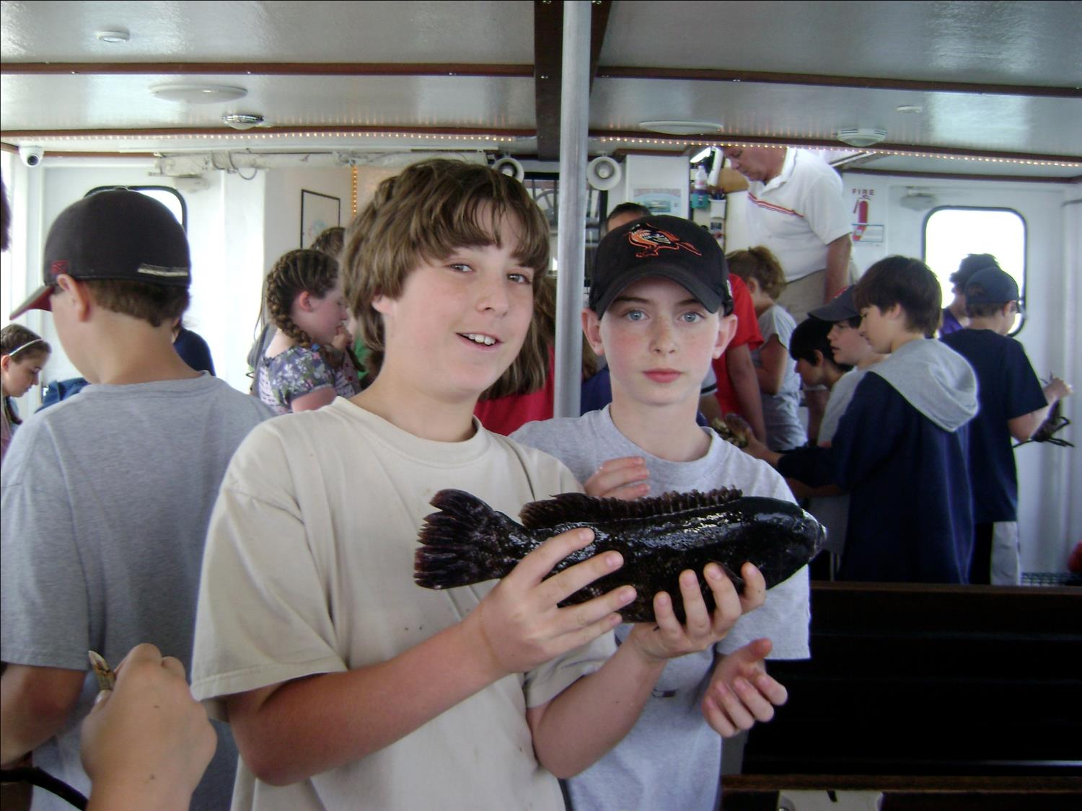

Slide 24
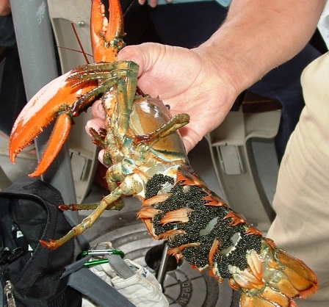

Slide 25
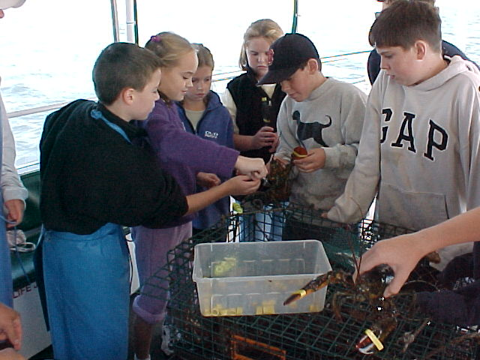

Slide 26
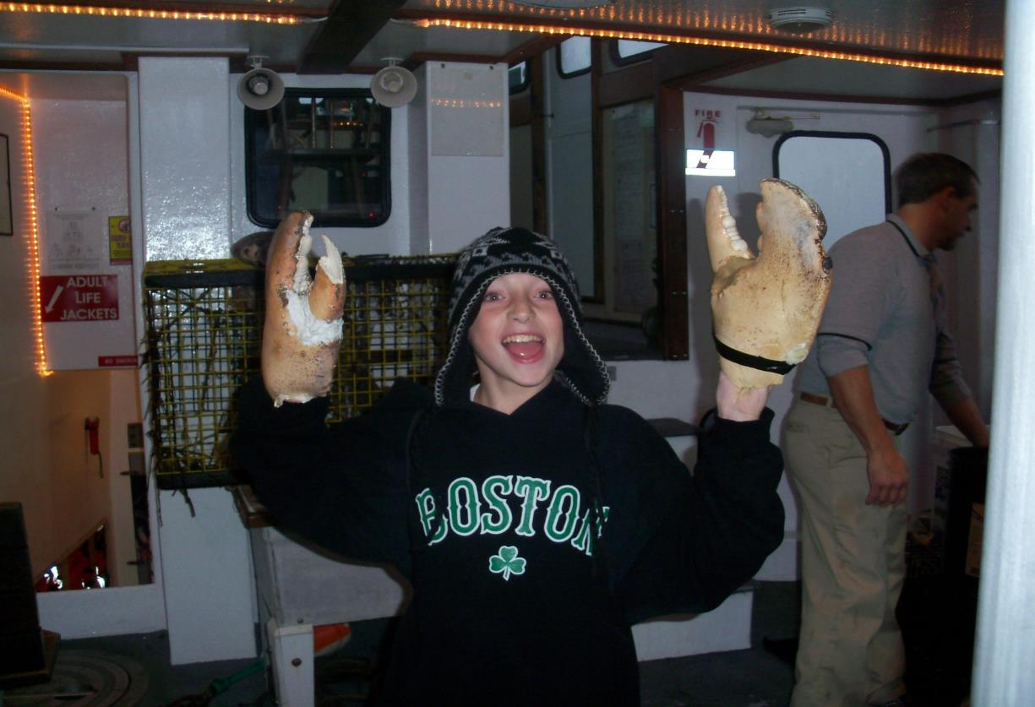

Slide 27
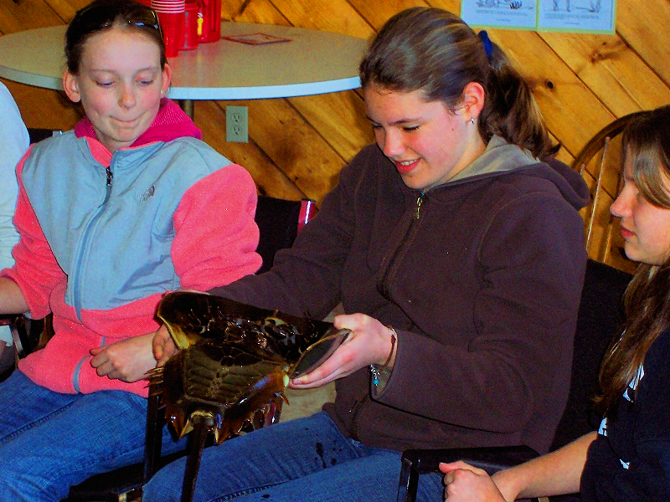
Marine Lab
Touch tanks
Aquariums
Shells
Sharks
Dissection

Slide 28
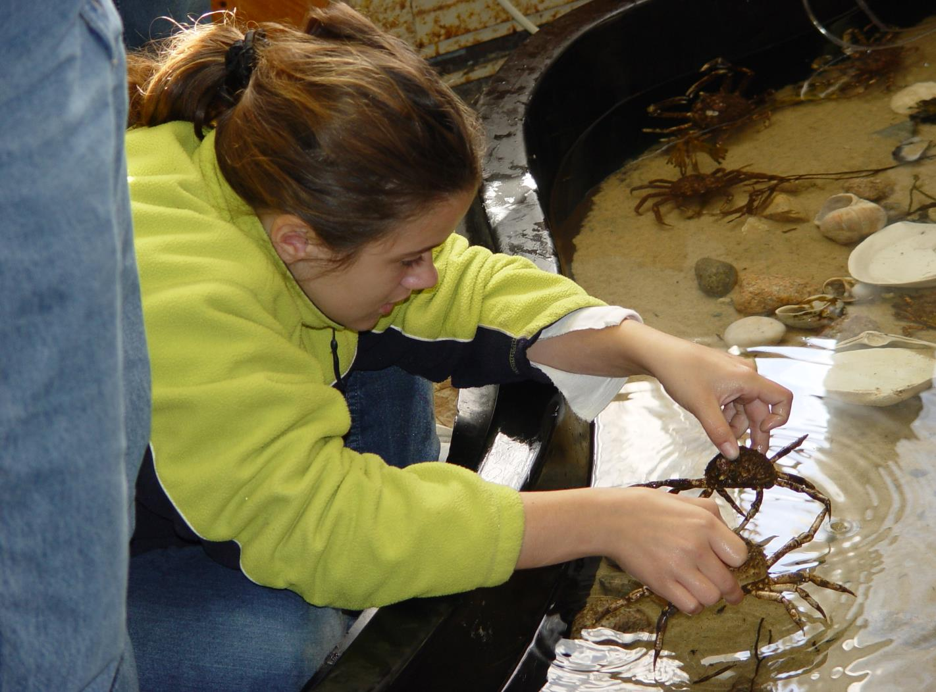

Slide 29
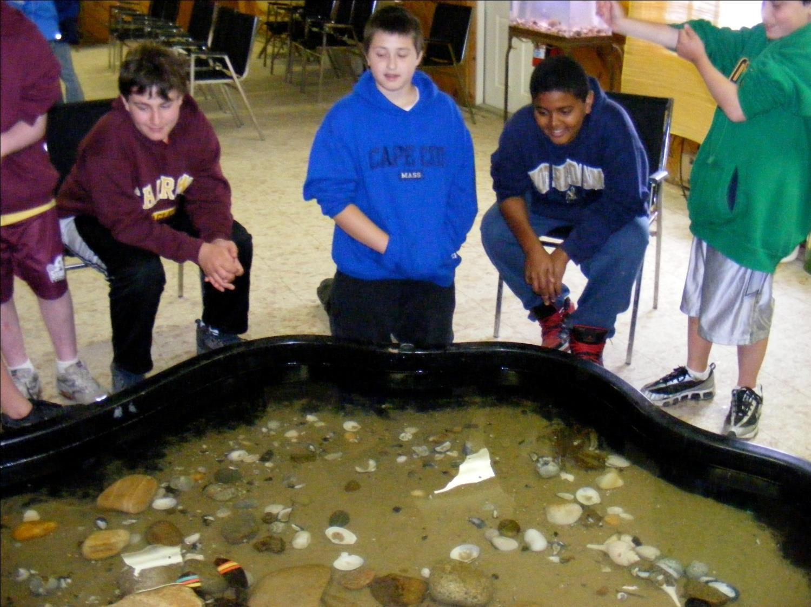

Slide 30
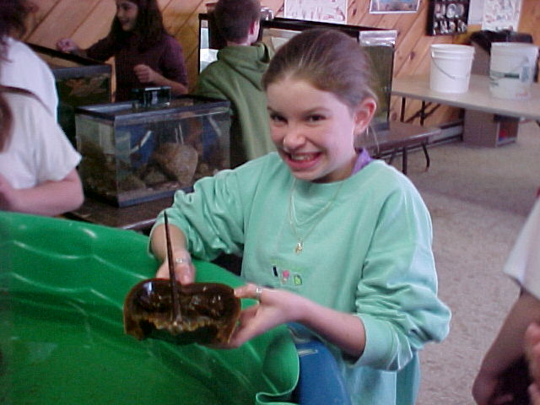

Slide 31
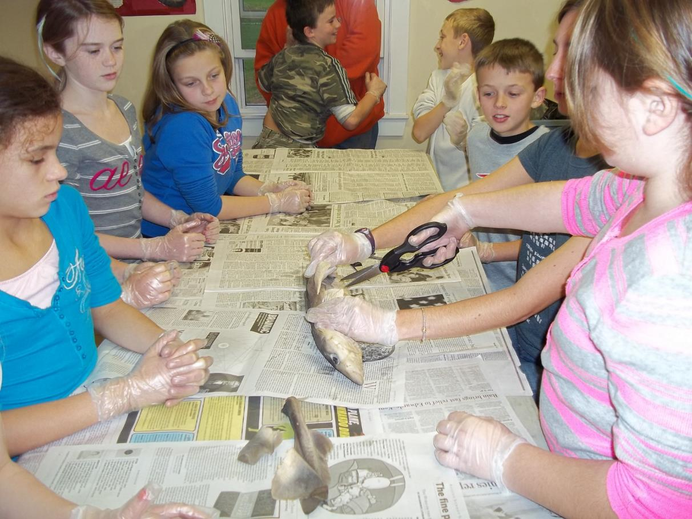

Slide 32
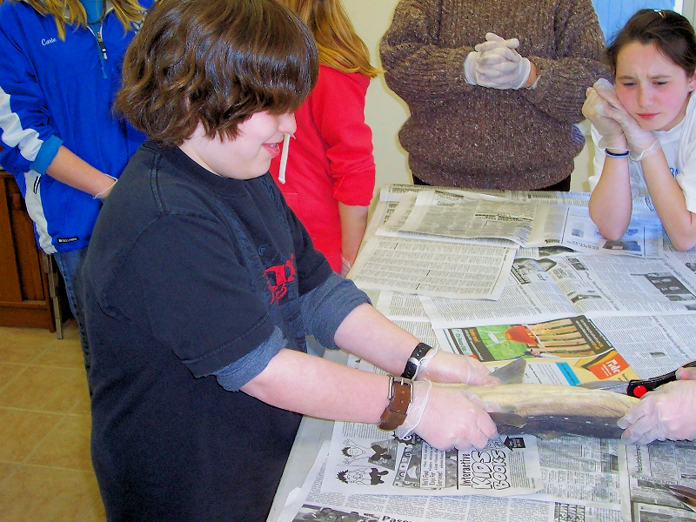

Slide 33
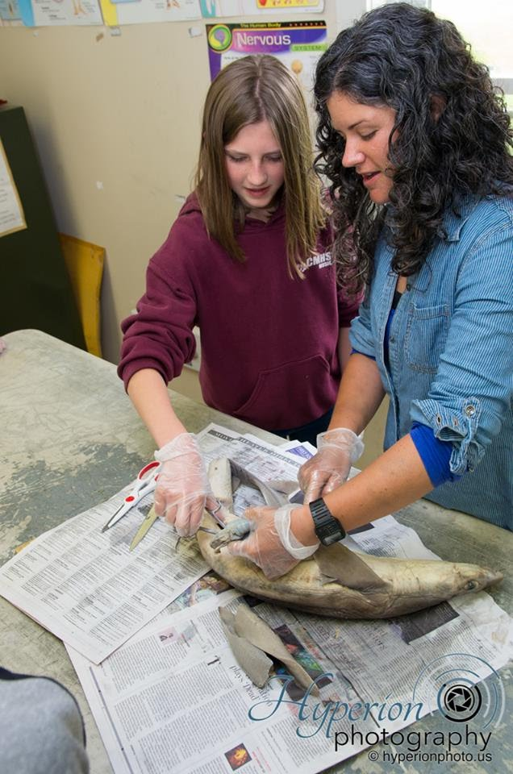

Slide 34
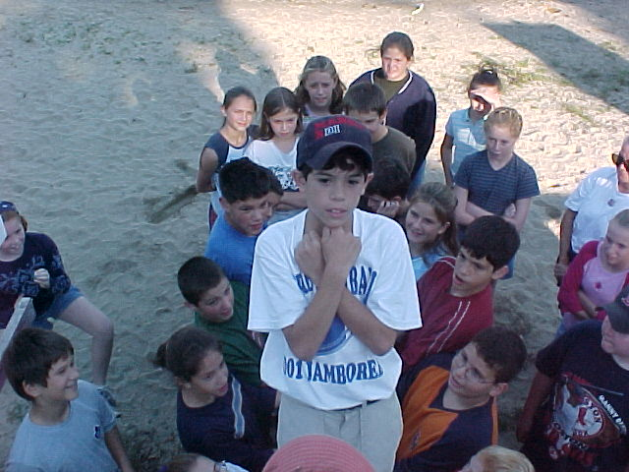
ADVENTURE
PROBLEM SOLVING
TEAMWORK
COOPERATIVE LEARNING
CHALLENGING

Slide 35
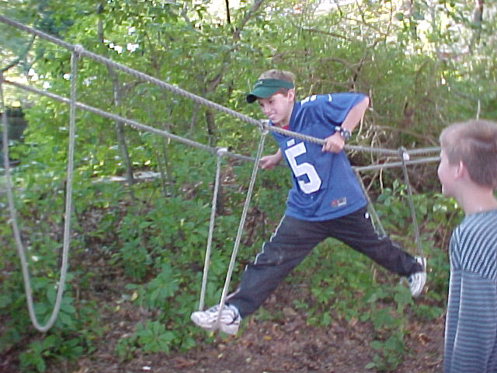

Slide 36
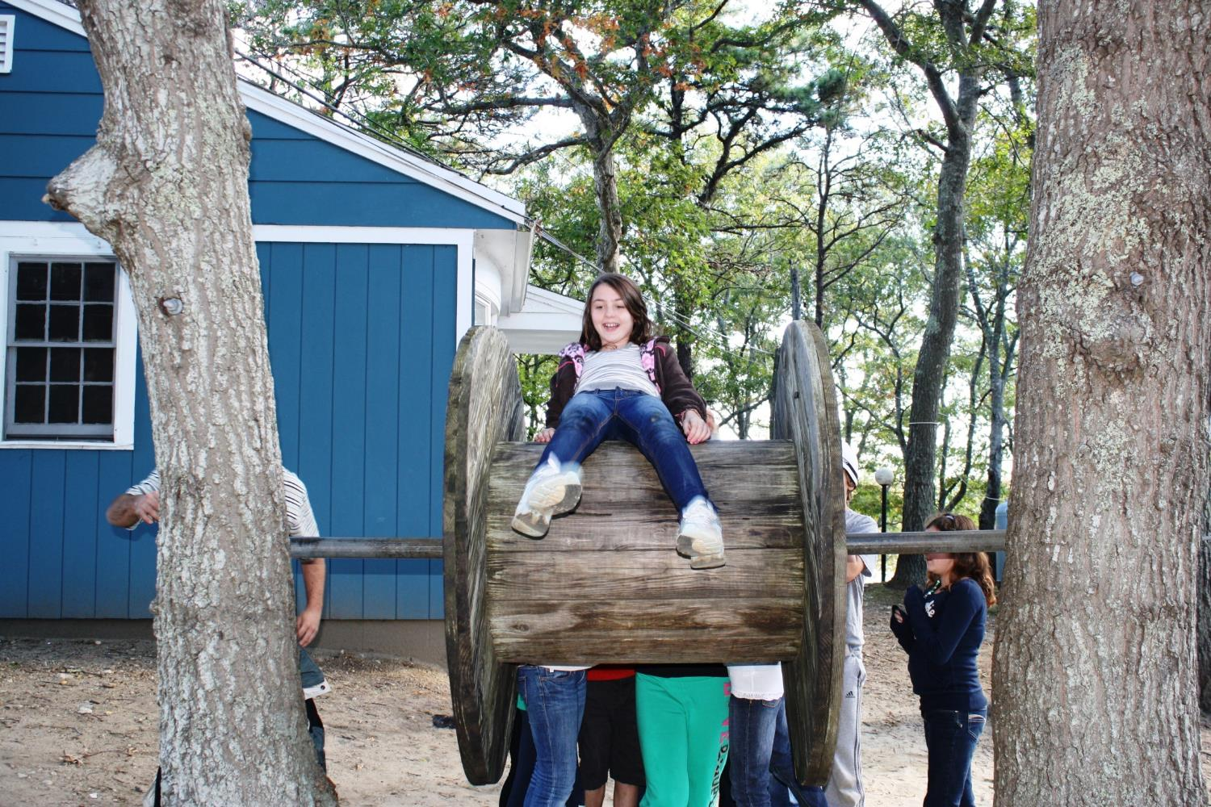

Slide 37
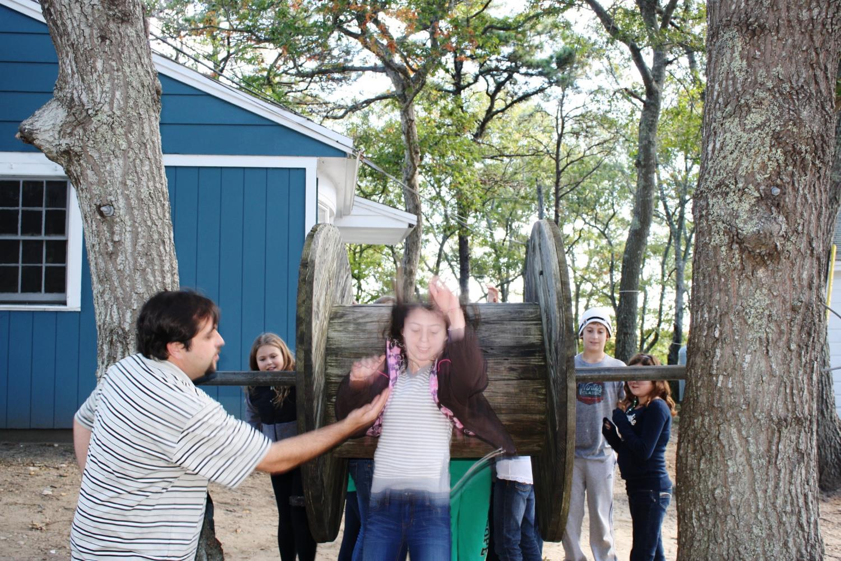

Slide 38
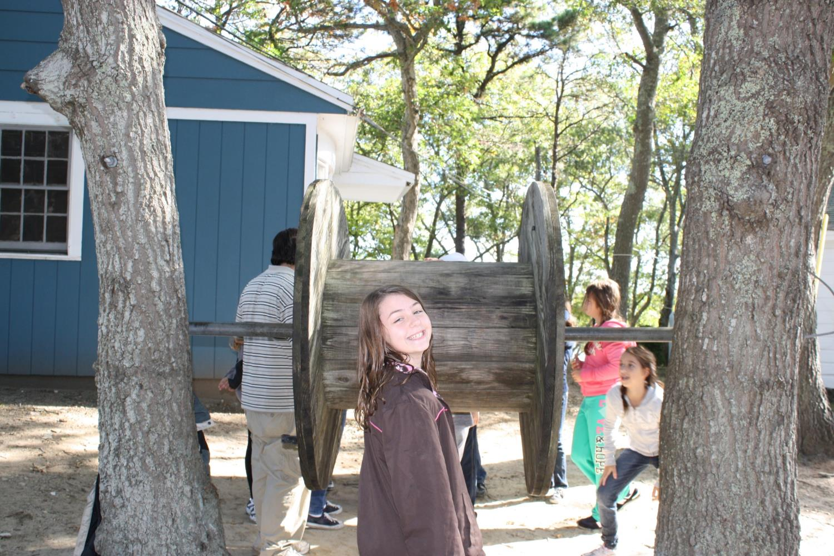

Slide 39
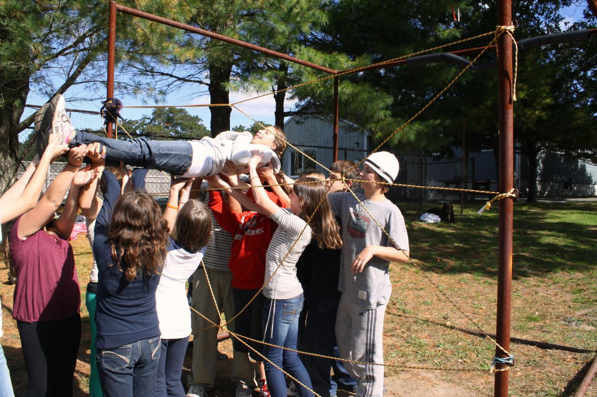

Slide 40
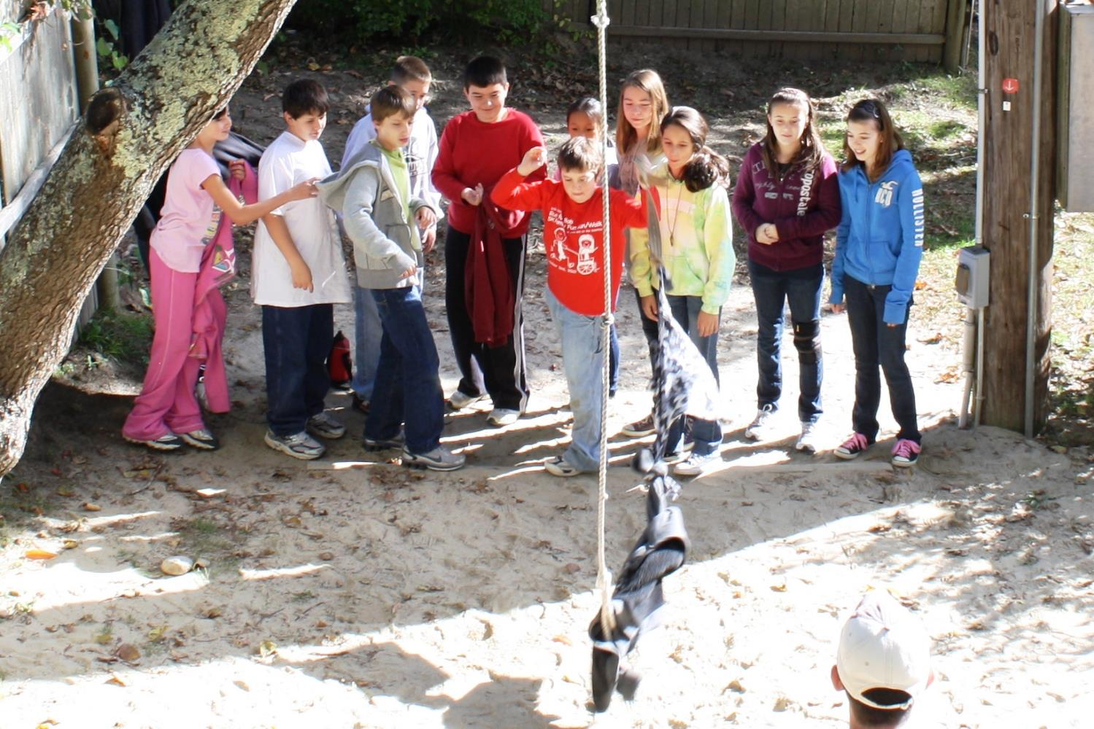

Slide 41
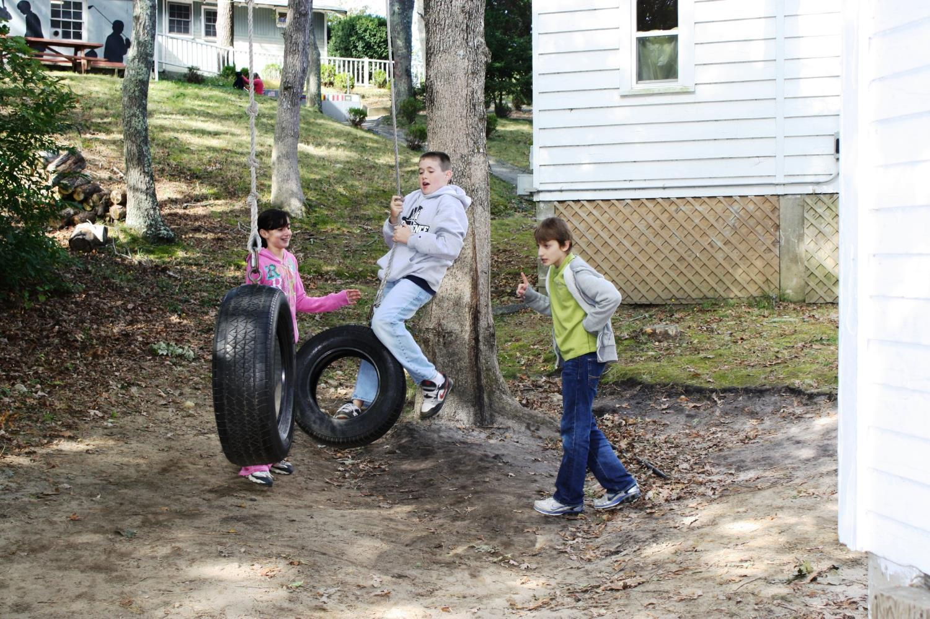

Slide 42
PRESENTATIONS & ACTIVITIES
Afternoon presentations are academic in nature and supplement the classes offered: reptiles, amphibians.science fair experiments
Evening programs are often social and entertaining: campfires & s’mores, karaoke, line-dancing, trivia contests, magic show.

Slide 43
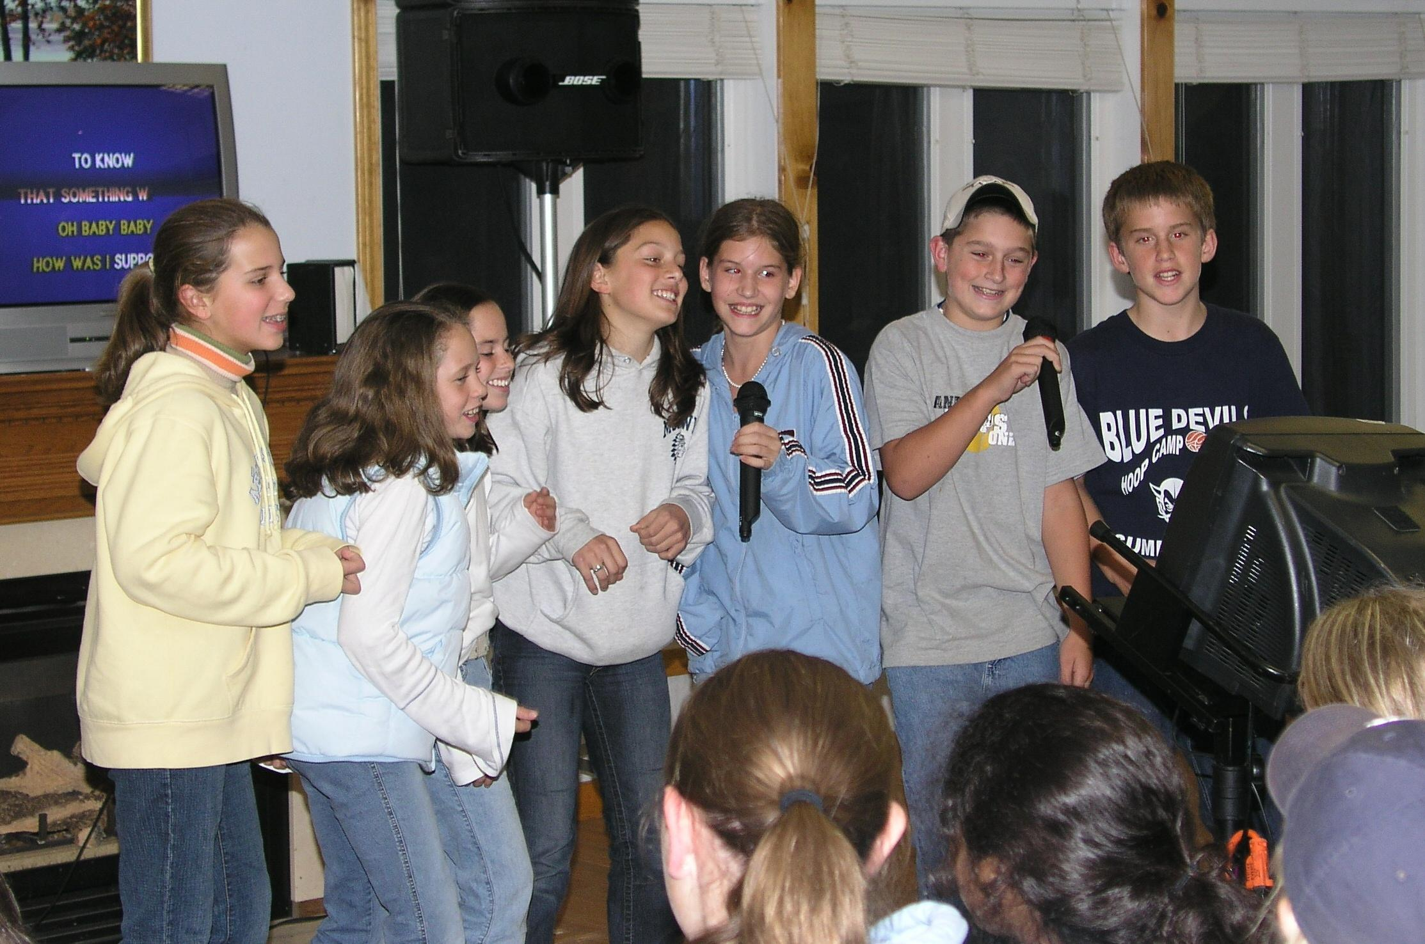

Slide 44
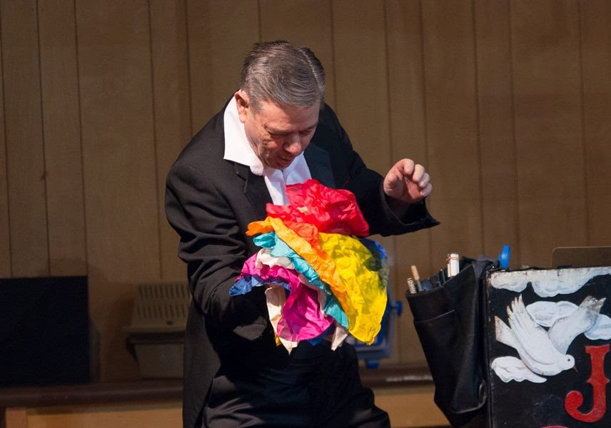

Slide 45
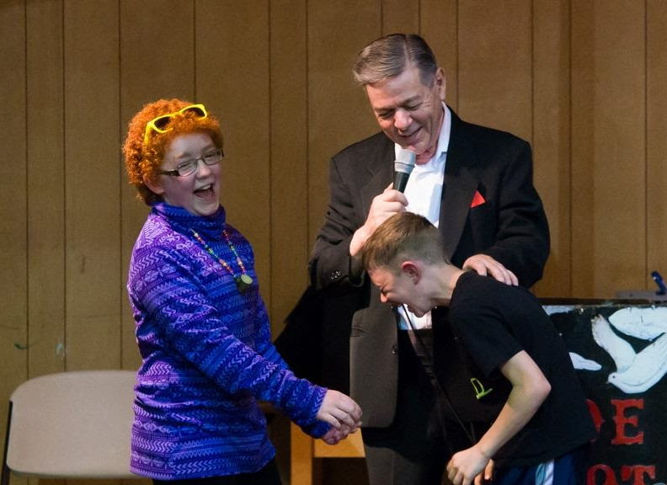

Slide 46
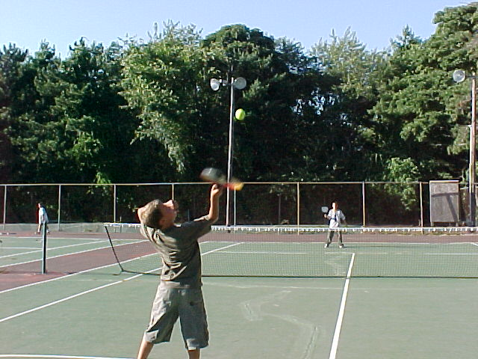
RECREATION
Tennis
Soccer
Street hockey
Basketball
Indoor gym
Game room
Board games and reading
GaGa pits

Slide 47
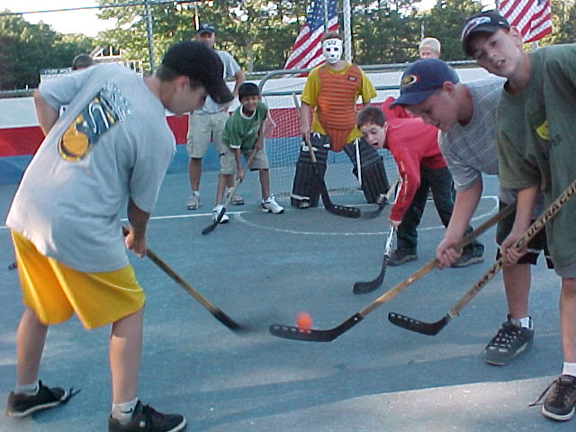

Slide 48
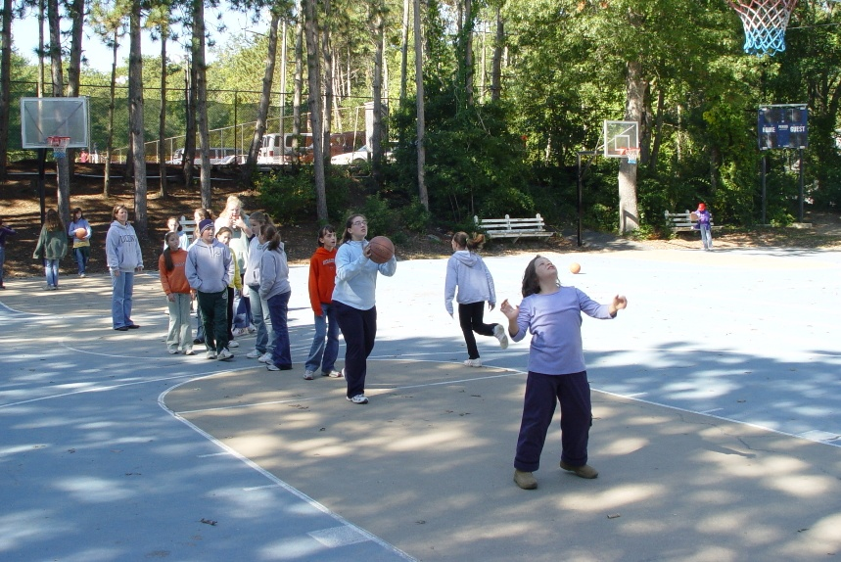

Slide 49
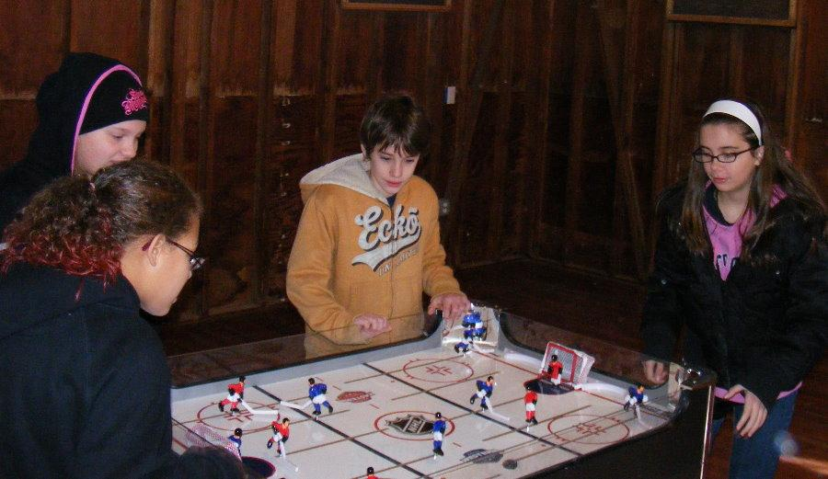

Slide 50
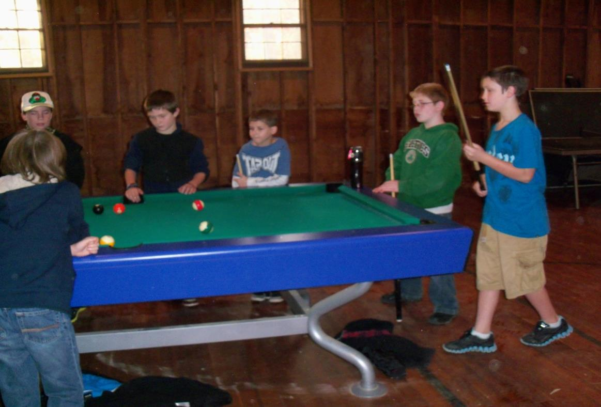

Slide 51
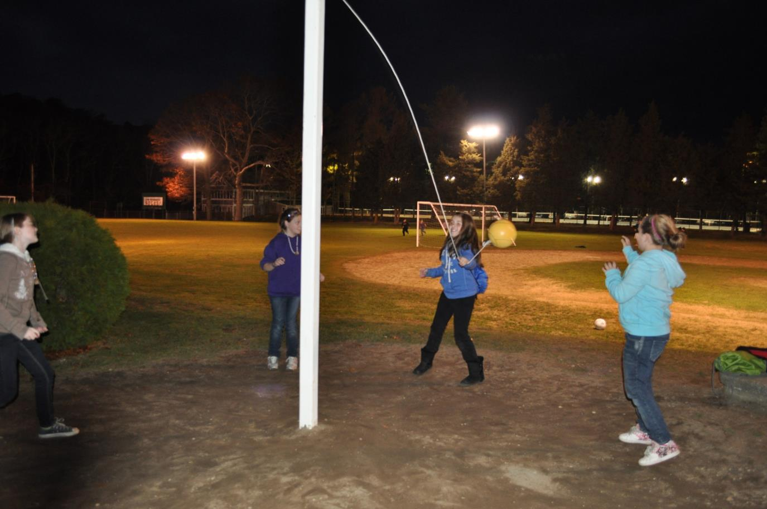

Slide 52
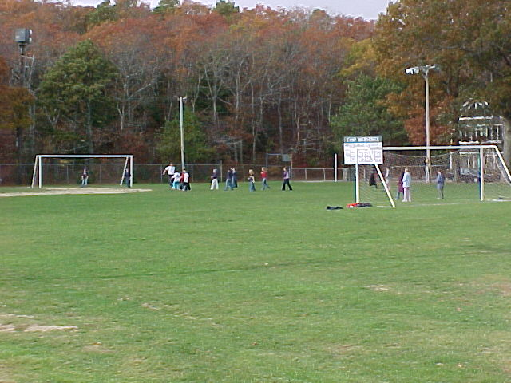

Slide 53
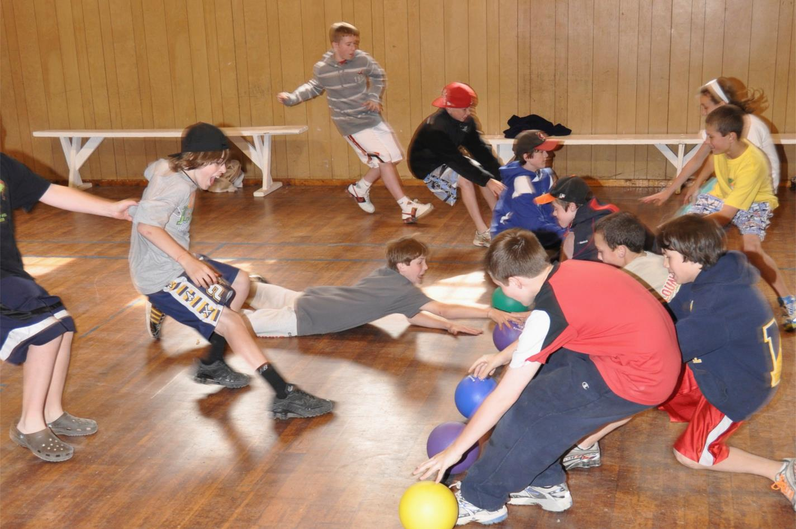

Slide 54

110 VALLEY ROAD
PLYMOUTH, MA 02360
508-888-2634
campbournedale.net

