Slide 1
Measure BB Bond
21st Century Classroom Improvements
February 27, 2025

Slide 2
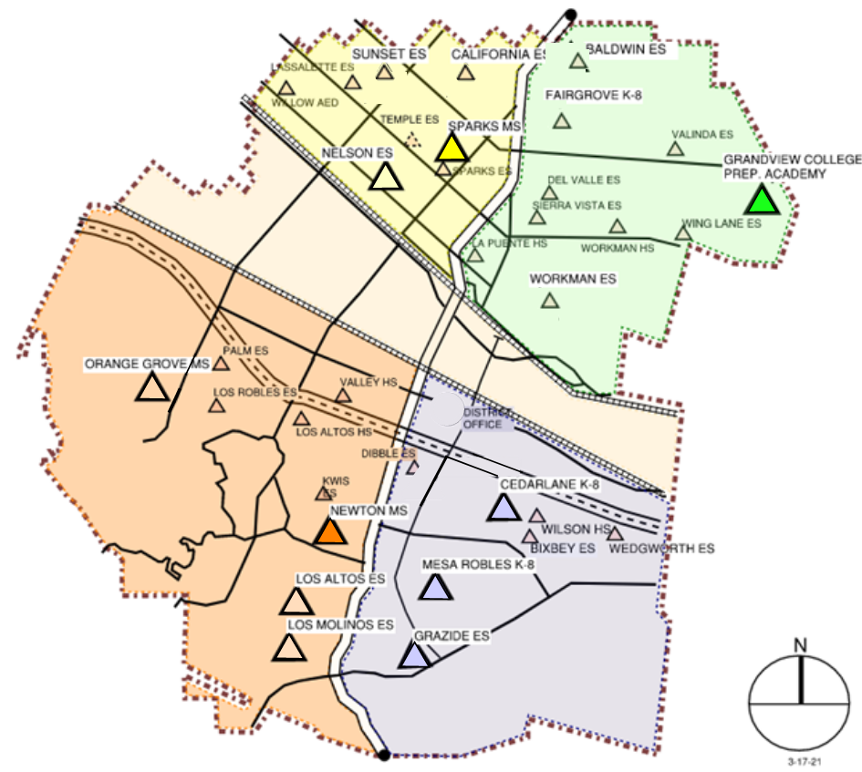
HLPUSD MEASURE BB - SUMMARY SCHOOLS IN PROGRESS
IN PROGRESS
CONSTRUCTION
California ES
Baldwin ES
Los Molinos ES
Grazide ES (Pending)
OUT TO BID 2-11-2025
Kwis ES
Fairgrove K-8
Lassalette ES
Sierra Vista MS
AT DSA FOR REVIEW
Palm ES
Valinda ES
Sparks ES
Wing Lane ES
Valley Alternative
IN DESIGN
Orange Grove MS
COMPLETED
Nelson ES
Los Altos ES
Workman ES
Mesa Robles K-8
Cedarlane K-8
Sparks MS
Grandview MS
Newton MS
Stimson EC
Workman HS
La Puente HS
Wilson HS
Los Altos HS
STIMSON

Slide 3
PHASE B PROGRESS
 | Project Starts | Construction Documents To DSA | DSA Plan Reviews Completed | Projects Bid | Construction Starts (COMPLETED*)
La Puente HS Refresh | l | NA | NA | l | l*
Los Altos HS Refresh | l | NA | NA | l | l*
Wilson HS Refresh | l | NA | NA | l | l*
Workman HS Refresh | l | NA | NA | l | l*
Stimson LC Refresh | l | NA | NA | l | l*
Baldwin ES | l | l | l | l | l
California ES | l | l | l | l | l
Grazide ES | l | l | l | l
Los Molinos | l | l | l | l | l
Kwis ES | l | l | l | l
Lassalette ES | l | l | l | l
Fairgrove Academy | l | l | l | l
Sierra Vista MS | l | l | l | l
Sparks ES | l | l
Palm ES | l | l | l
Valinda ES | l | l | l
Wing Lane ES | l | l
Valley Alternative School | l | l
Orange Grove | l

Slide 4
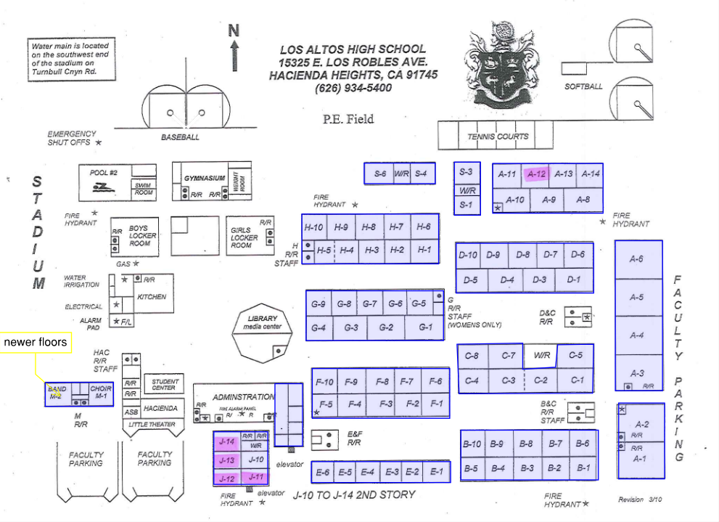
HIGH SCHOOL REFRESH GROUP 2
LOS ALTOS HIGH SCHOOL
69 CLASSROOMS
SCHOOL | START DATE | ANTICIPATED COMPLETION DATE
WILSON HS | 3/4/2024 | Completed 48 days Ahead of Schedule
LOS ALTOS HS | 3/4/2024 | Completed 65 Days Ahead of Schedule

Slide 5
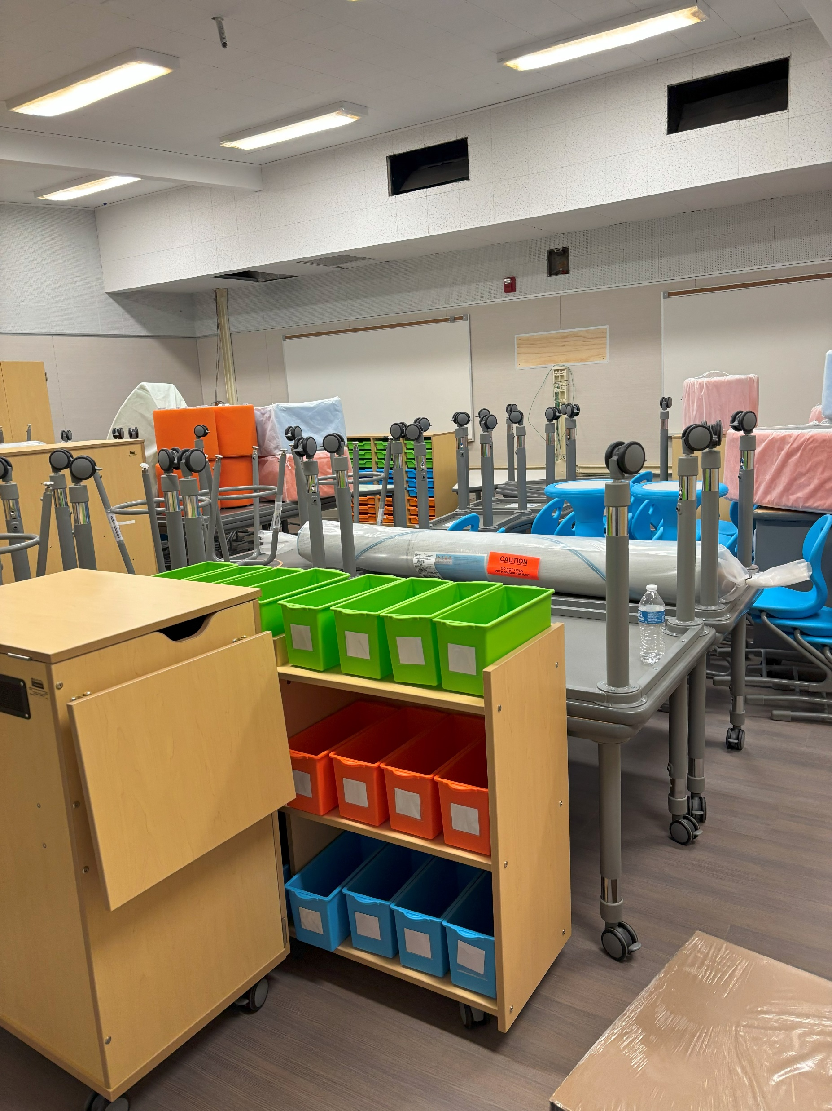
Measure BB 21st Century Classroom Improvements
Baldwin Academy Phase 1
FURNITURE DELIVERY
COMPLETE

Slide 6
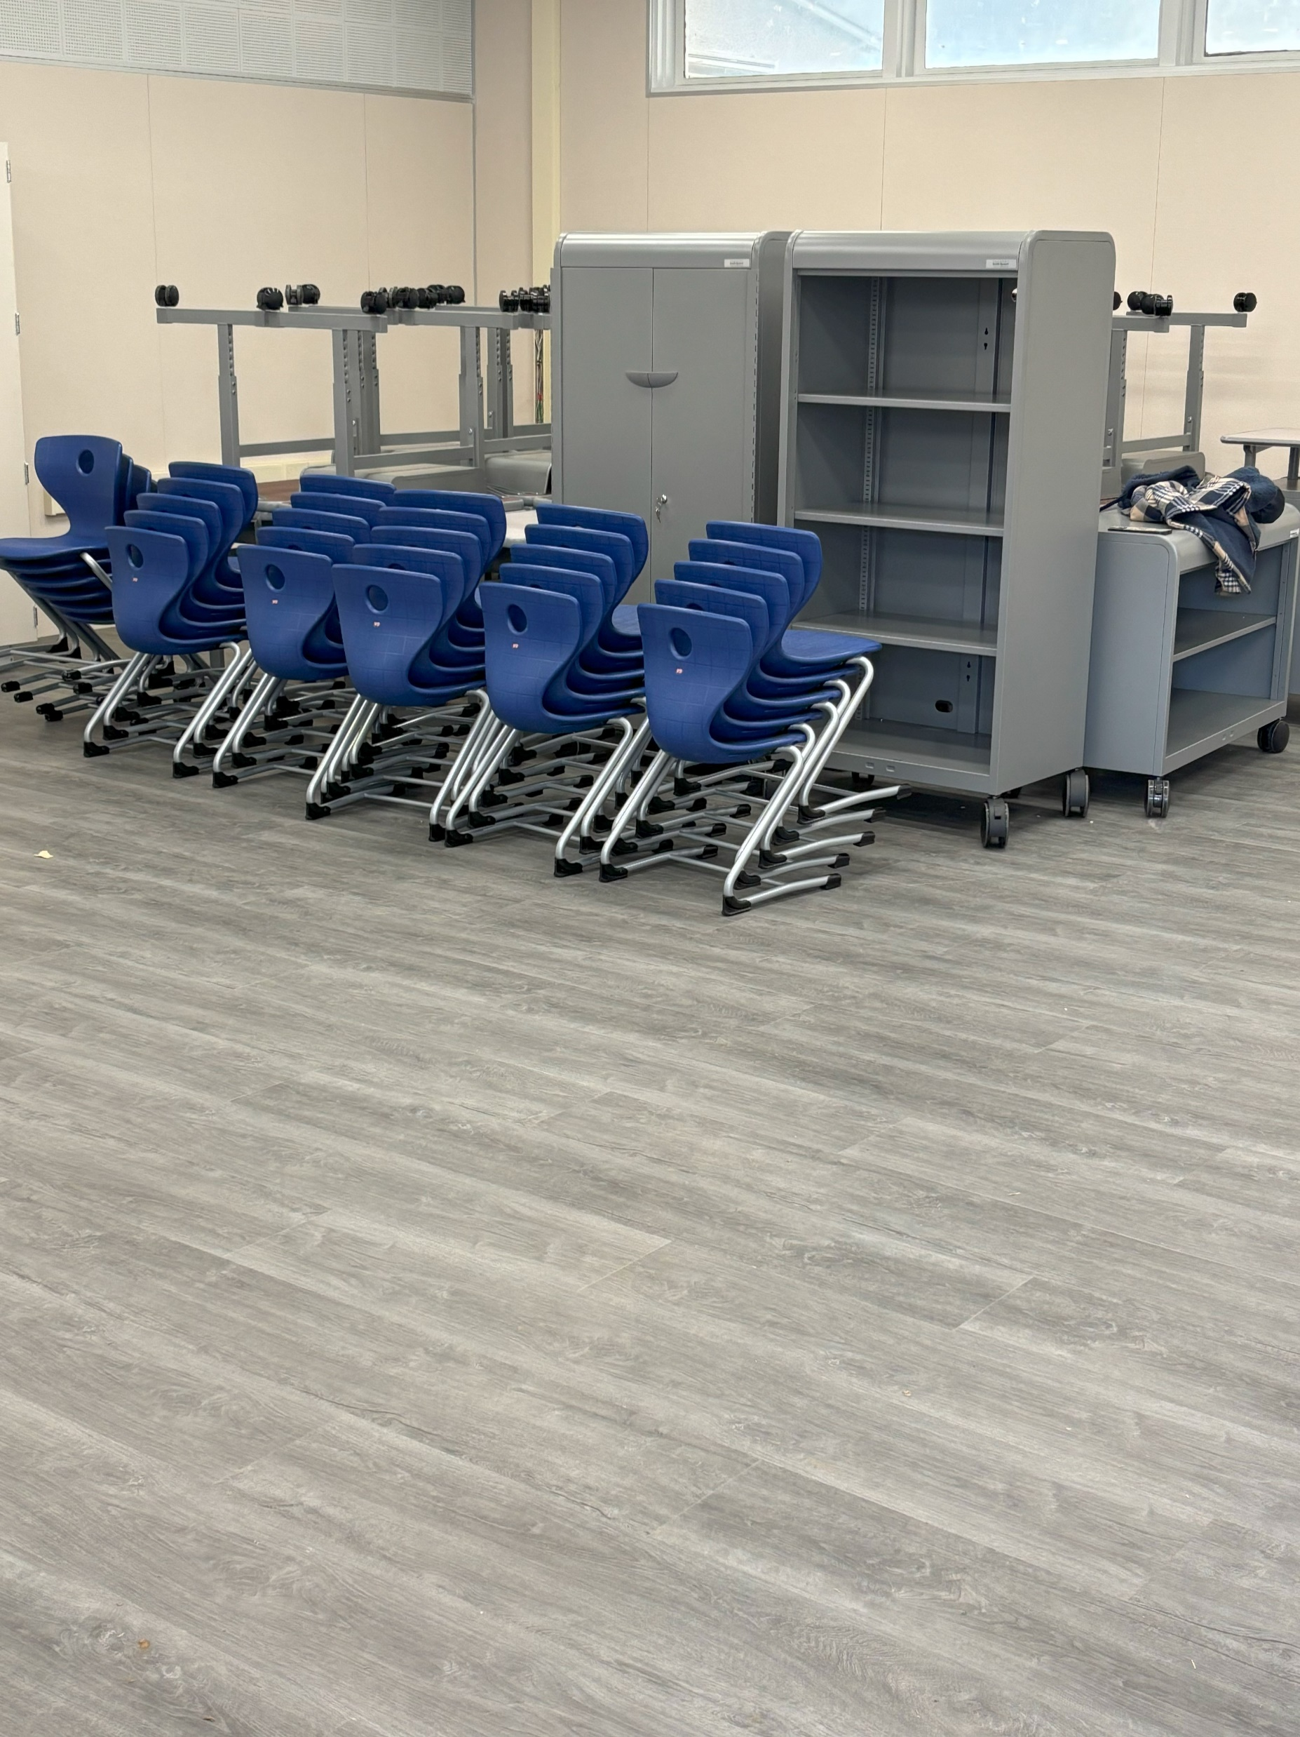
Measure BB 21st Century Classroom Improvements
California Elementary School Phase 1
Bee
FURNITURE DELIVERY
COMPLETE

Slide 7
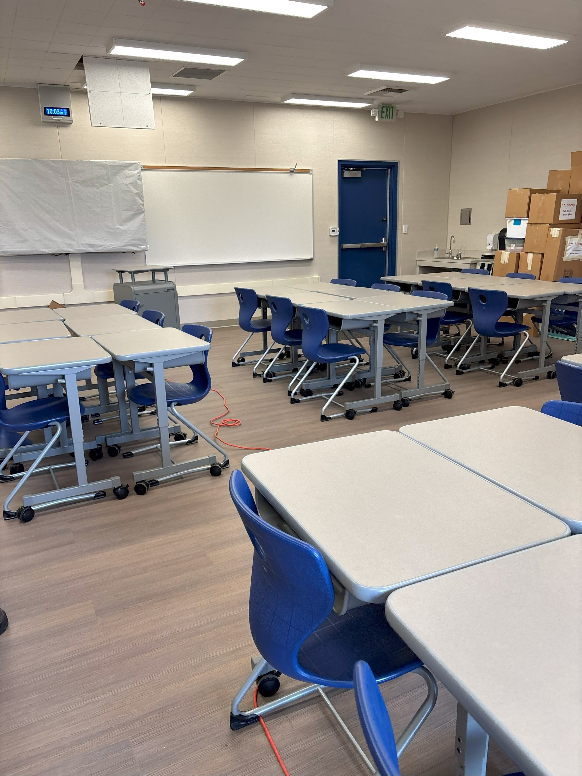
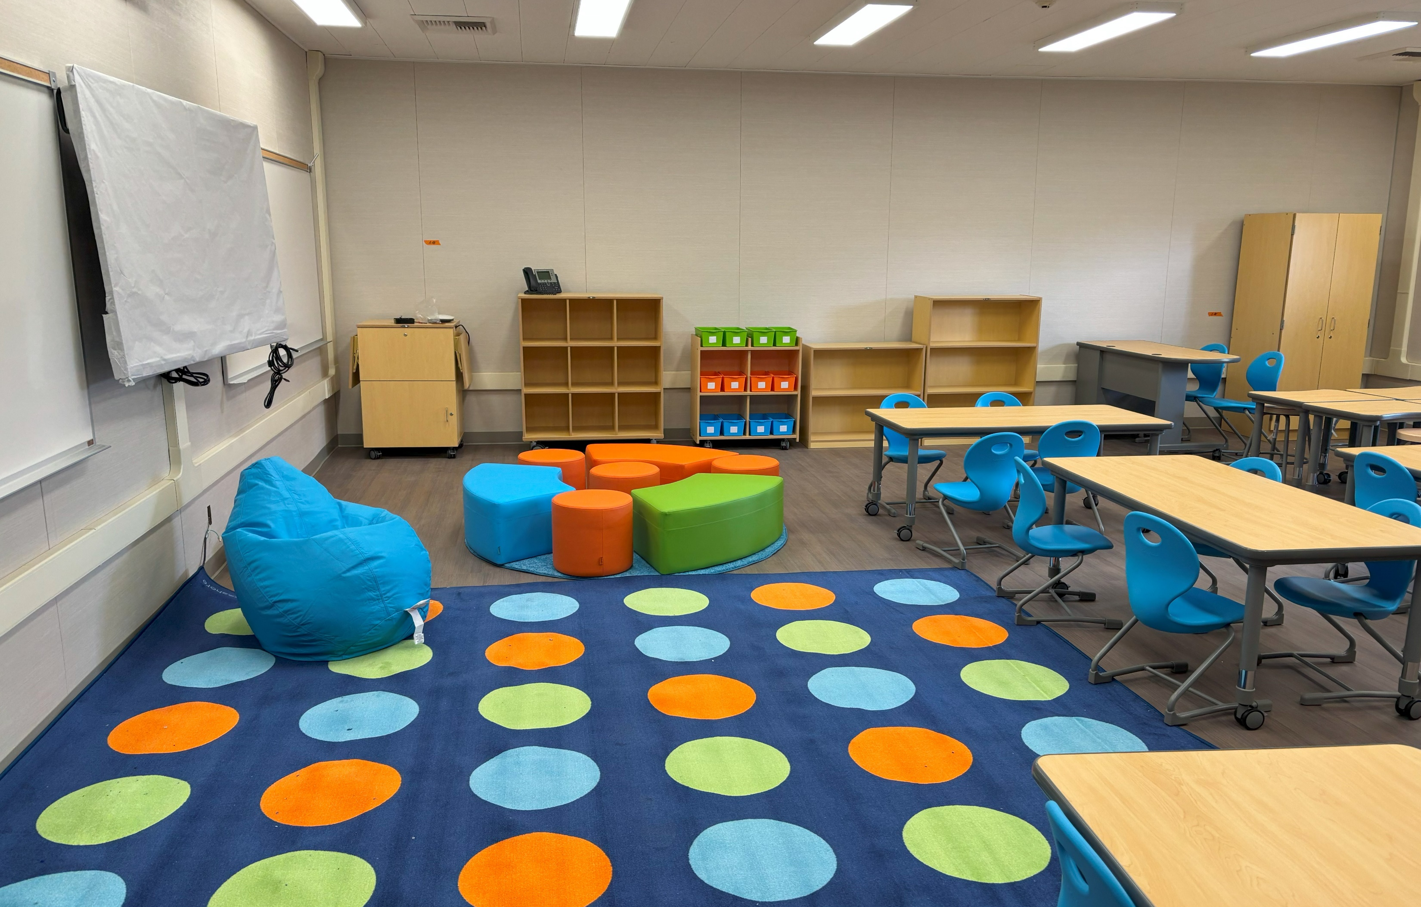
Measure BB 21st Century Classroom Improvements
Los Molinos Elementary Phase1
COMPLETE
COMPLETE

Slide 8
QUESTIONS

