Slide 1
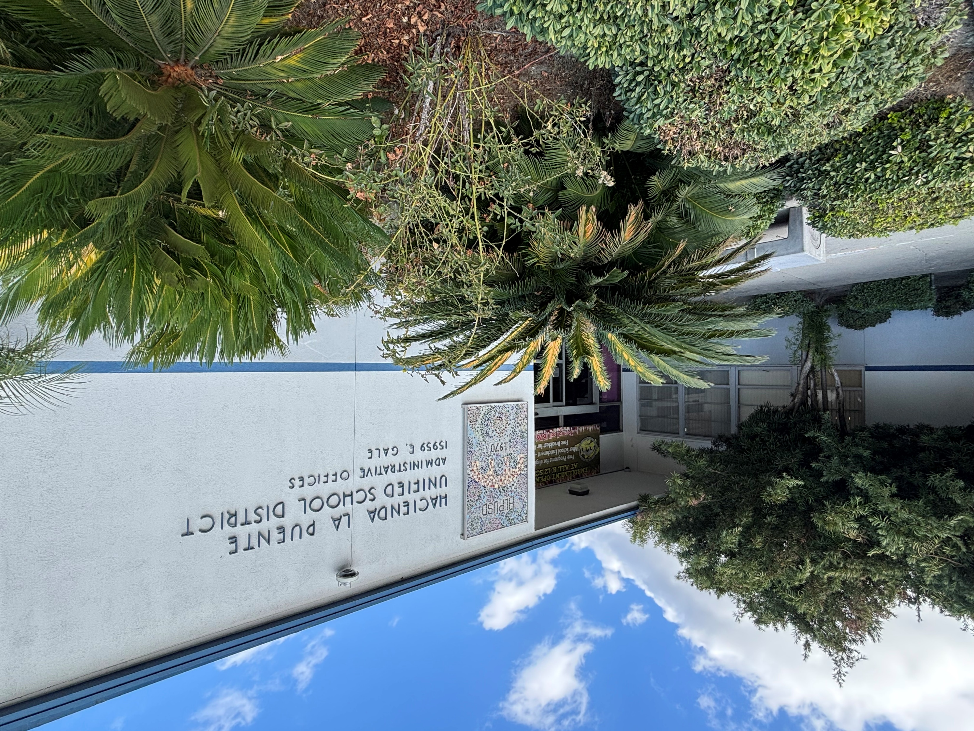

Measure BB Bond
21st Century Classroom Improvements
January 23, 2025

Slide 2
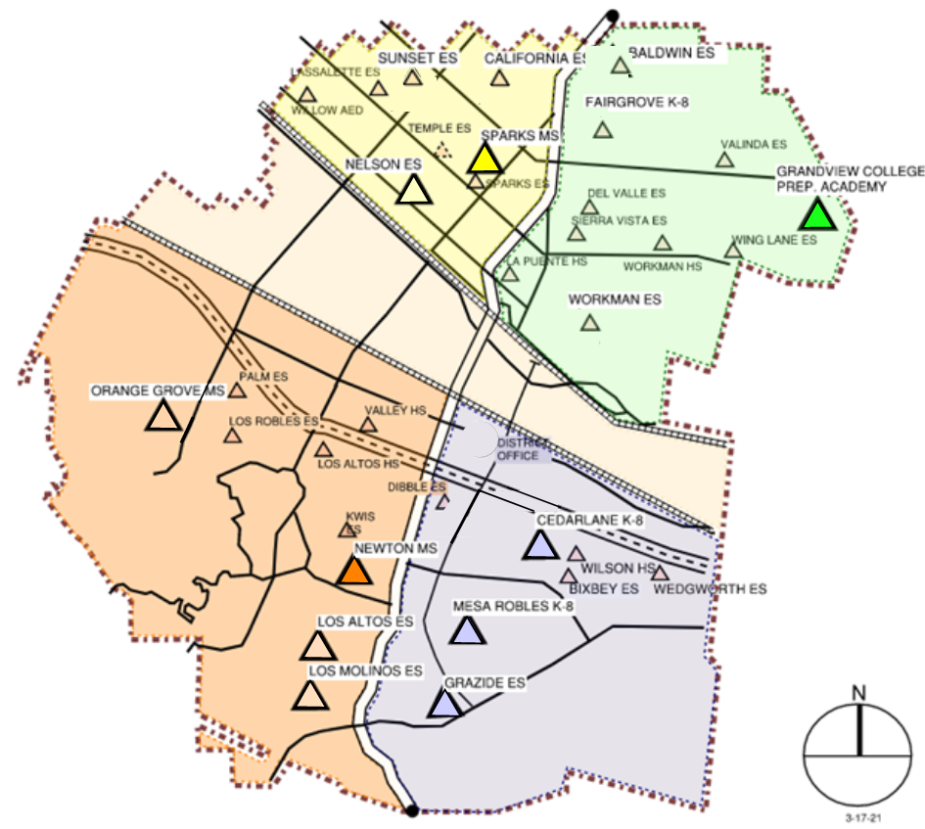

HLPUSD MEASURE BB - SUMMARY SCHOOLS IN PROGRESS
IN PROGRESS
CONSTRUCTION
Los Altos HS
California ES
Baldwin ES
Los Molinos ES
Grazide ES (Pending)
READY TO BID 2-10-2025
Kwis ES
Fairgrove K-8
Lassalette ES
AT DSA FOR REVIEW
Sierra Vista MS
Palm ES
Valinda ES
Sparks ES
Wing Lane ES
Valley Alternative
IN DESIGN
Orange Grove MS
COMPLETED
Nelson ES
Los Altos ES
Workman ES
Mesa Robles K-8
Cedarlane K-8
Sparks MS
Grandview MS
Newton MS
Stimson EC
Workman HS
La Puente HS
Wilson HS
STIMSON

Slide 3
PHASE B PROGRESS
2024
 | Project Starts | Construction Documents To DSA | DSA Plan Reviews Completed | Projects Bid | ConstrUction Starts (COMPLETED*)
La Puente HS Refresh | l | NA | NA | l | l*
Los Altos HS Refresh | l | NA | NA | l | l
Wilson HS Refresh | l | NA | NA | l | l*
Workman HS Refresh | l | NA | NA | l | l*
Stimson LC Refresh | l | NA | NA | l | l*
Baldwin ES | l | l | l | l | l
California ES | l | l | l | l | l
Grazide ES | l | l | l | l
Los Molinos | l | l | l | l | l
Kwis ES | l | l | l
Lassalette ES | l | l | l
Fairgrove Academy | l | l | l
Sierra Vista MS | l | l
Sparks ES | l | l
Palm ES | l | l
Valinda ES | l | l
Wing Lane ES | l | l
Valley Alternative School | l | l
Orange Grove | l
Estimated Completion: December 2026
Estimated Budget: $148 million (Measure BB Bond Authorization)

Slide 4
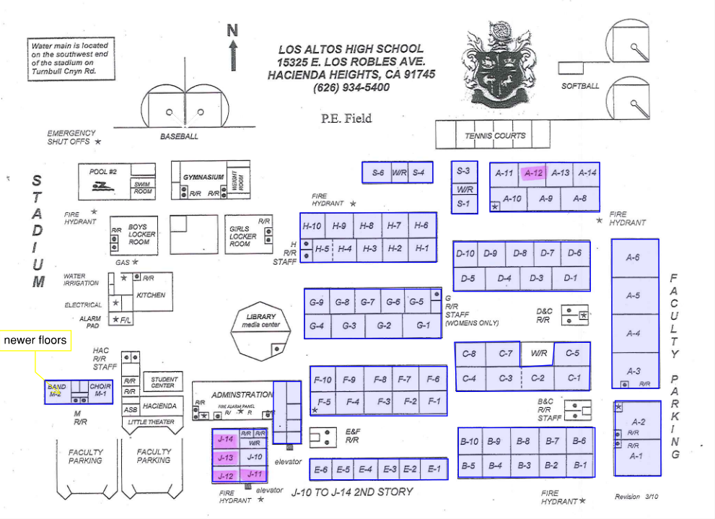
HIGH SCHOOL REFRESH GROUP 2
LOS ALTOS HIGH SCHOOL
69 CLASSROOMS
SCHOOL | START DATE | ANTICIPATED COMPLETION DATE
WILSON HS | 3/4/2024 | Completed 48 days Ahead of Schedule
LOS ALTOS HS | 3/4/2024 | Phase 7: 4/18/2025 (Currently 68 Days Ahead of Schedule)

Slide 5
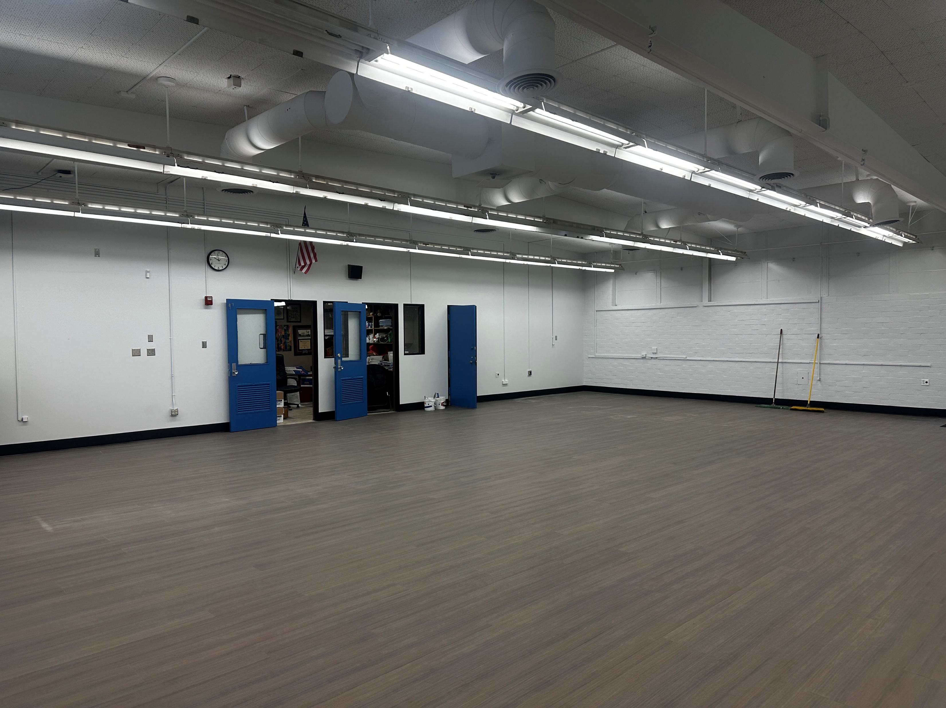
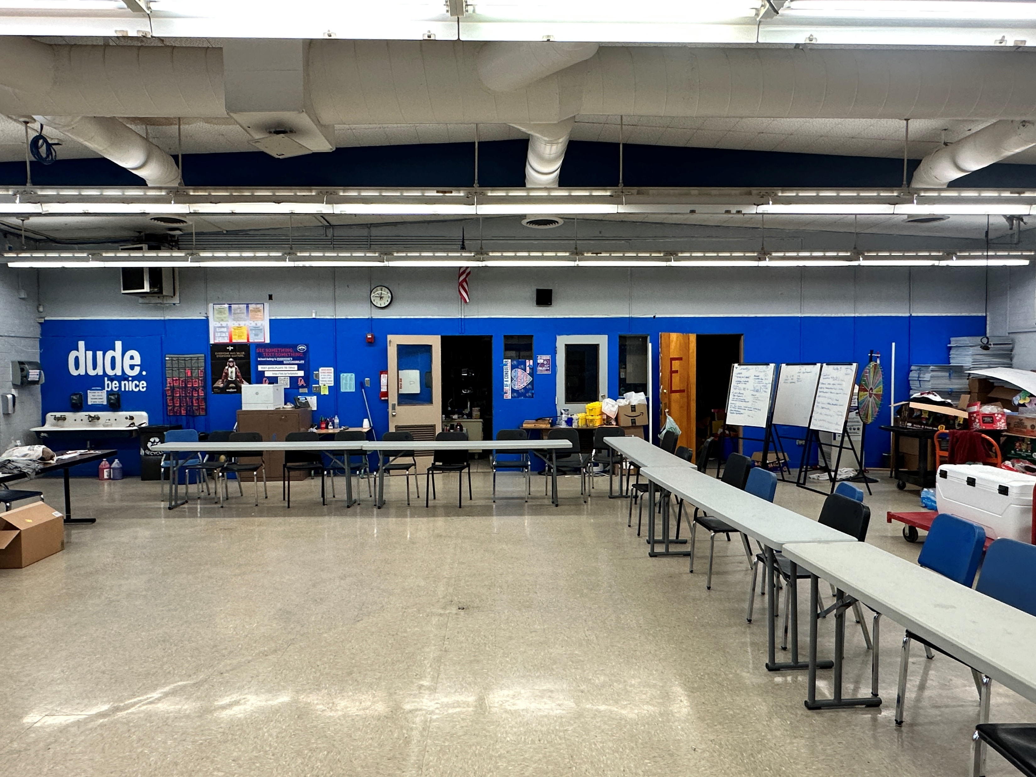
HIGH SCHOOL REFRESH
IN PROGRESS
Los Altos High School
After
Before

Slide 6
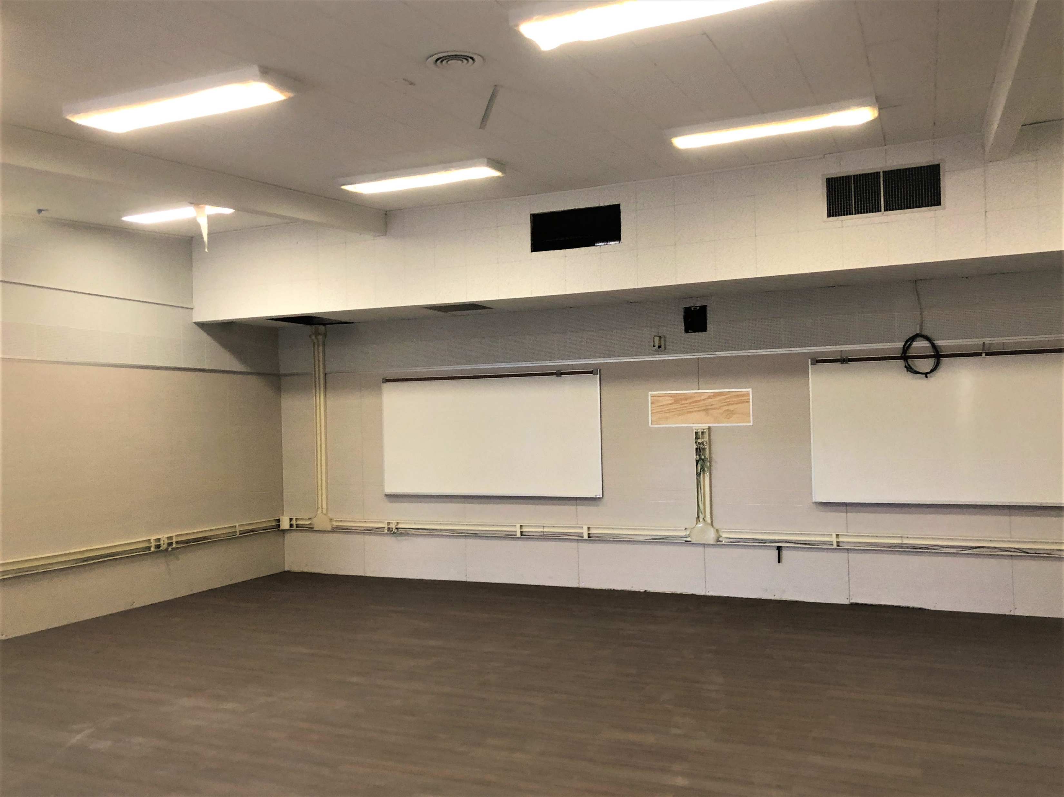
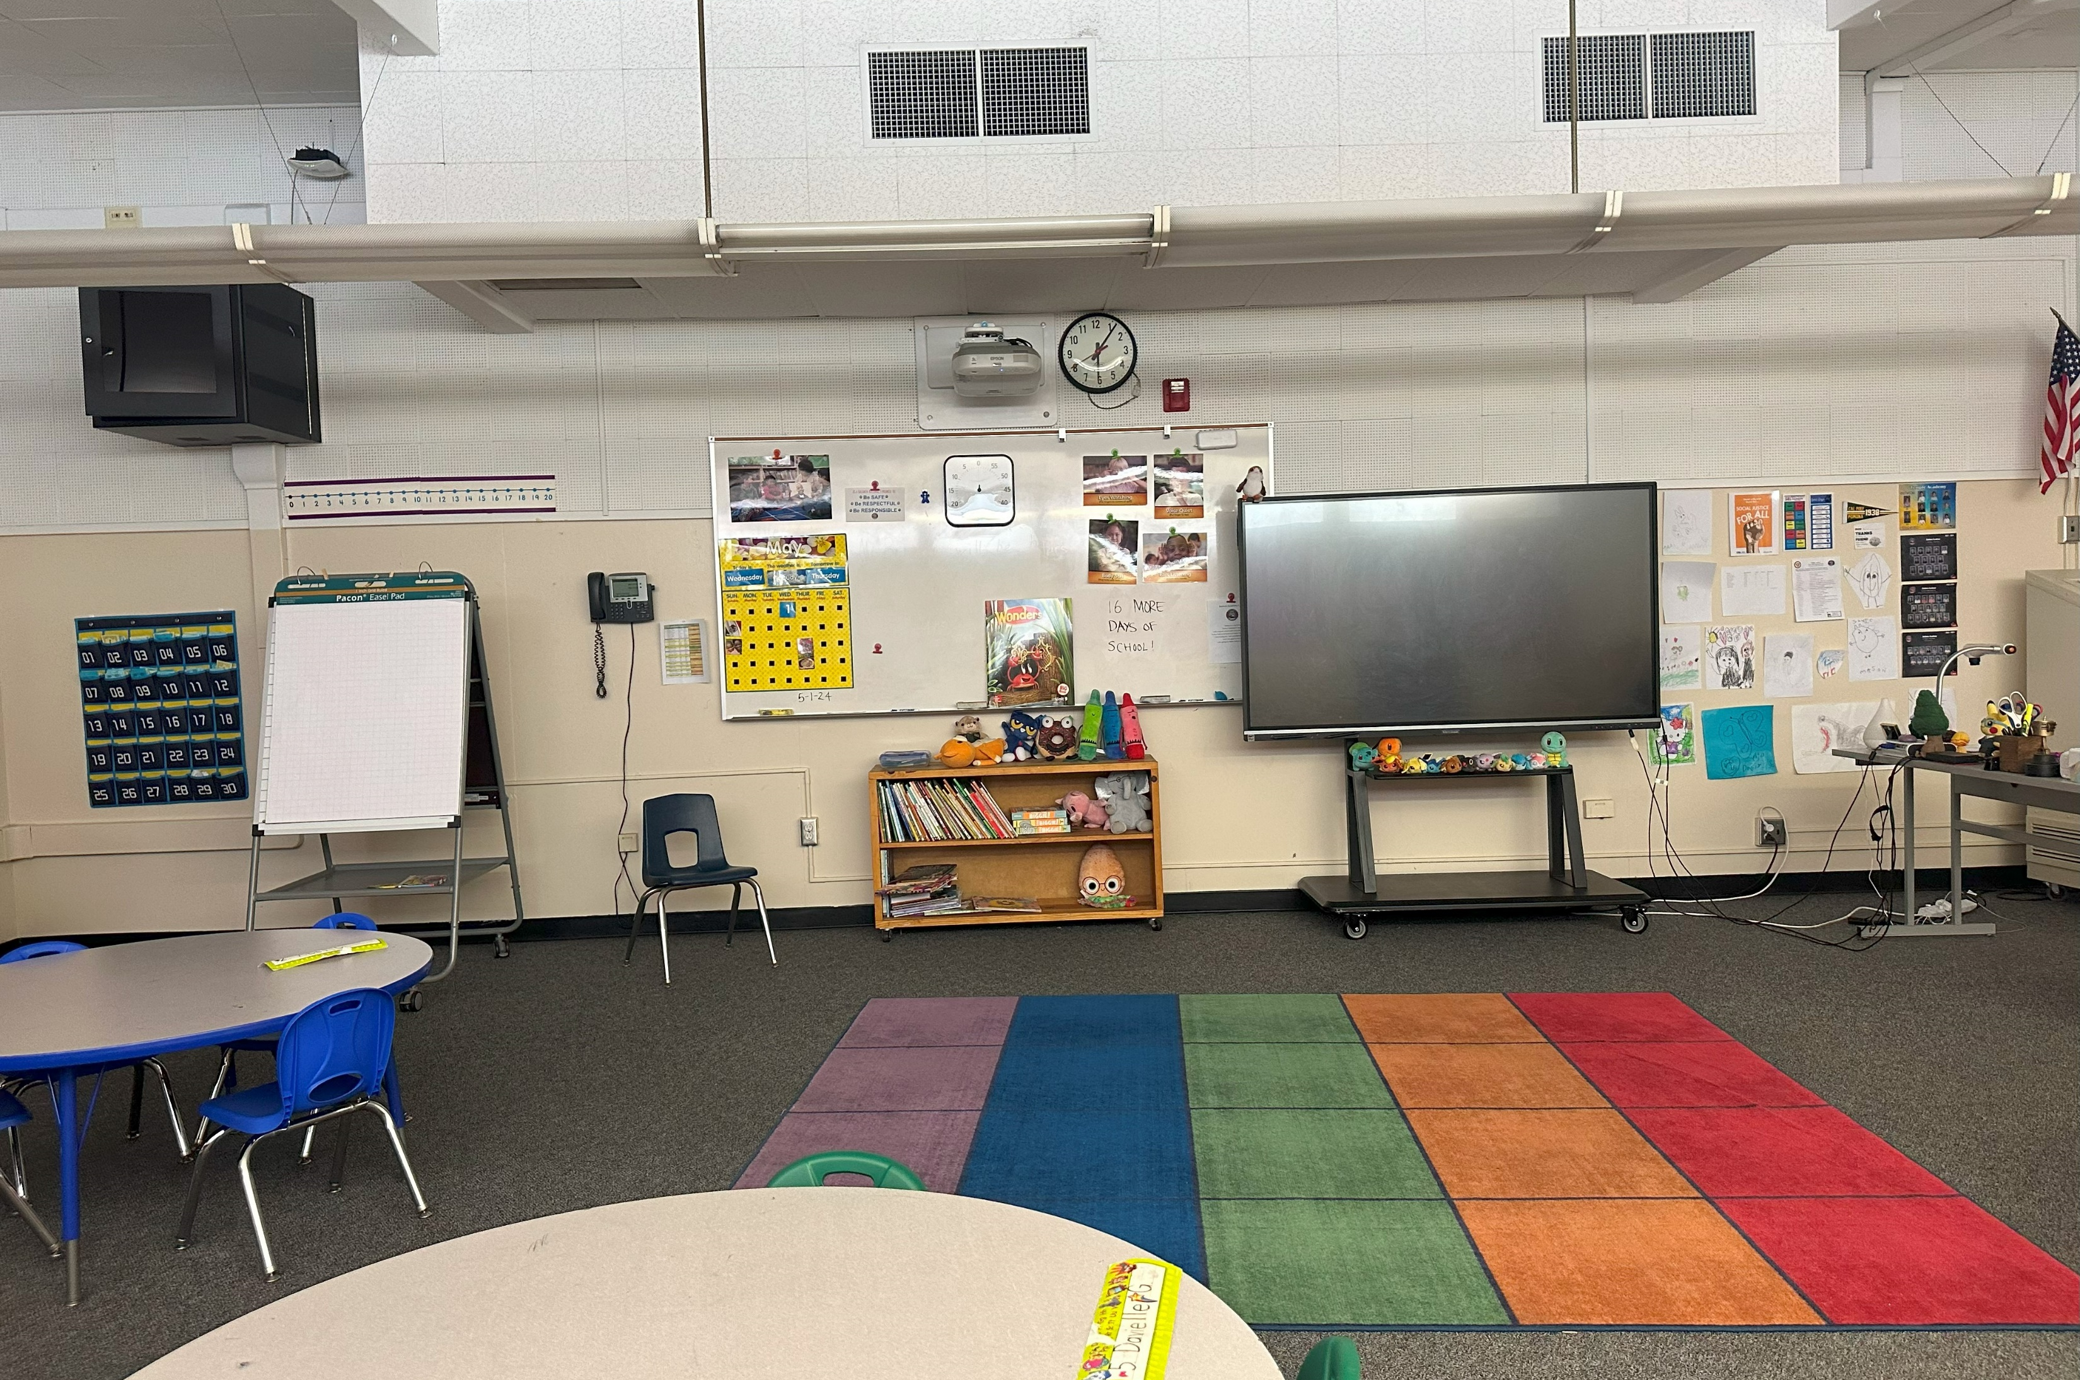
Measure BB 21st Century
Classroom Improvements
Baldwin Academy
Baldwin Academy
IN PROGRESS
Start Date November 12, 2024
Estimated Completion Date July 25, 2025
Before

Slide 7
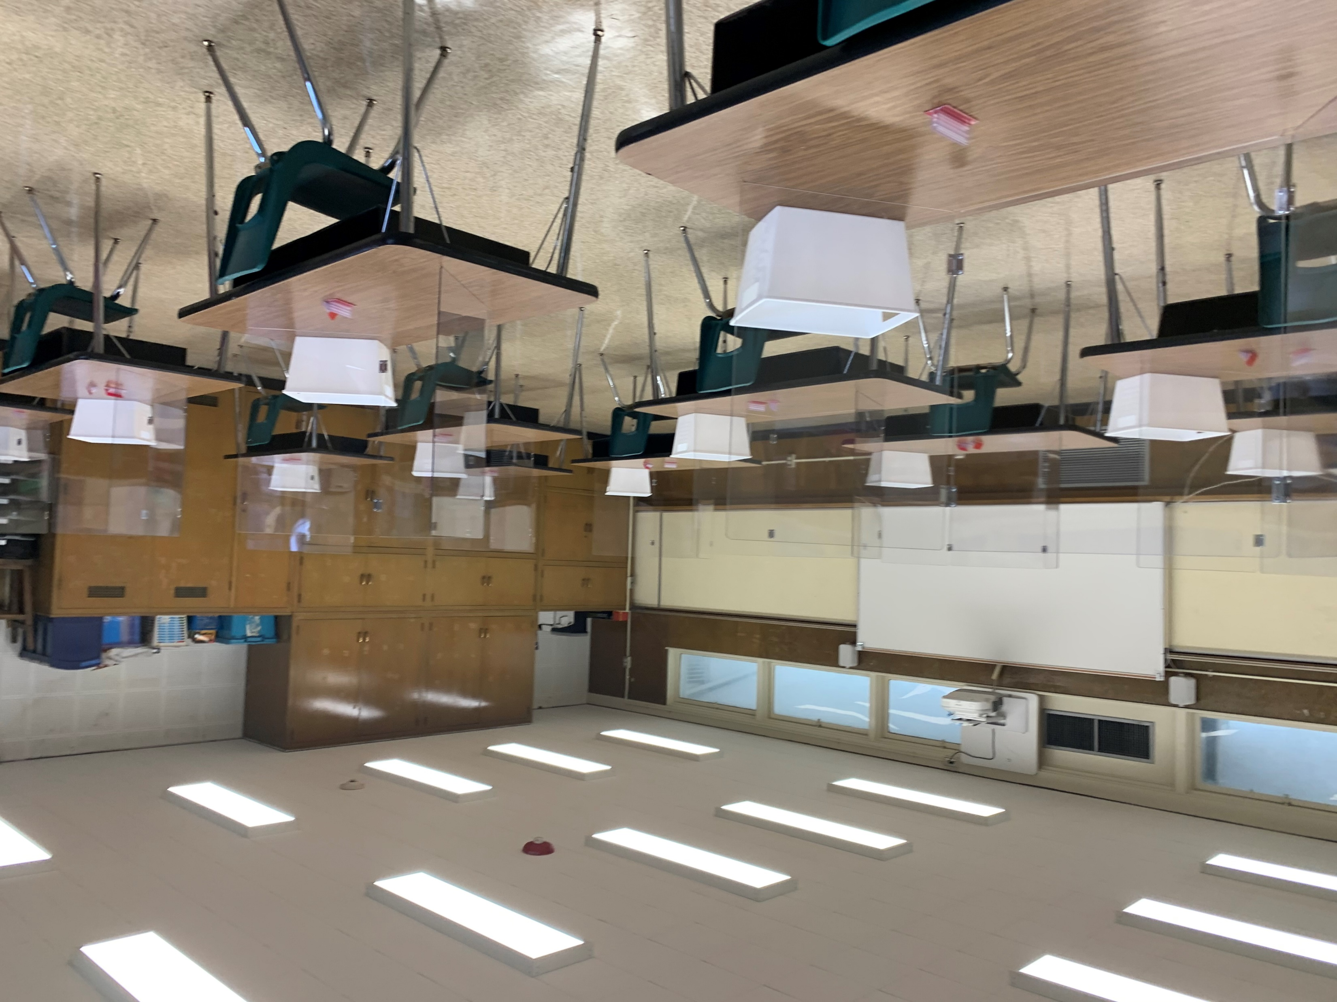
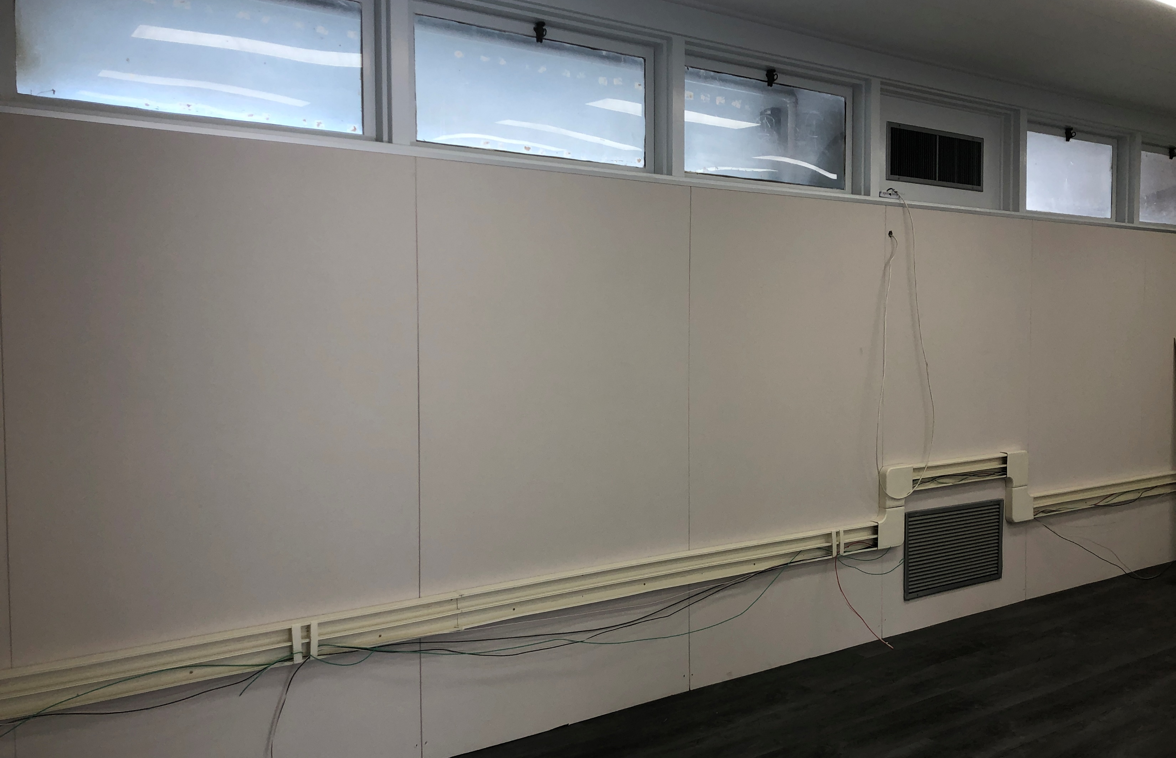
Measure BB 21st Century
Classroom Improvements
California Elementary School
Bee
Before
Start Date November 12, 2024
Estimated Completion Date August 25, 2025
IN PROGRESS

Slide 8
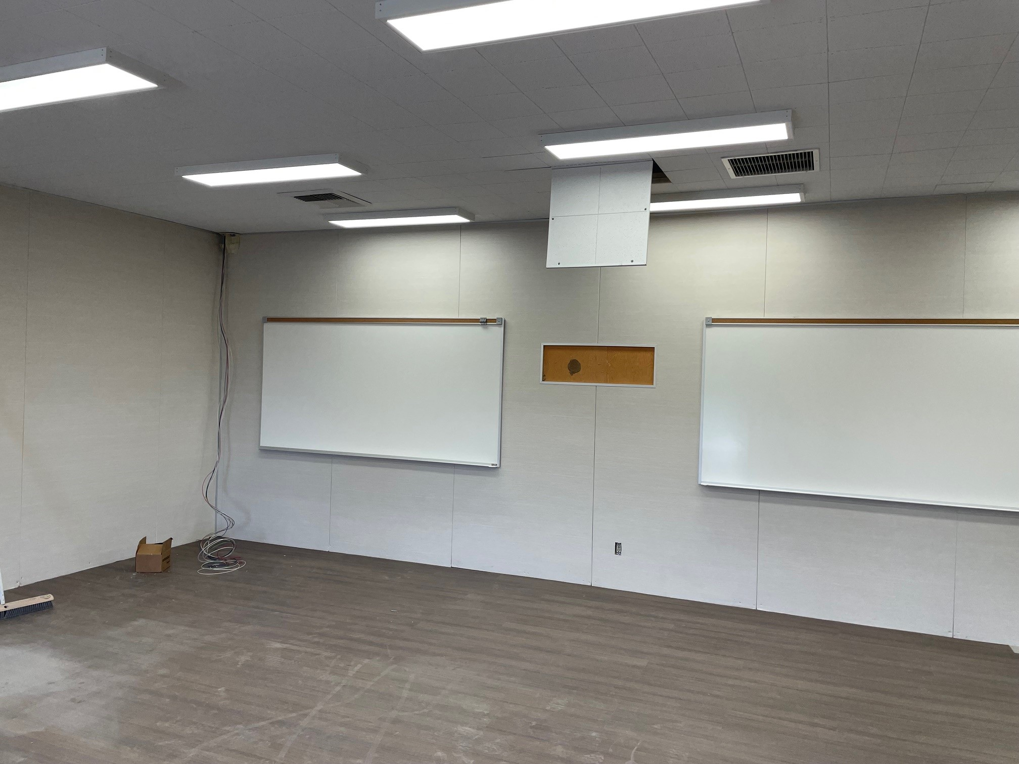
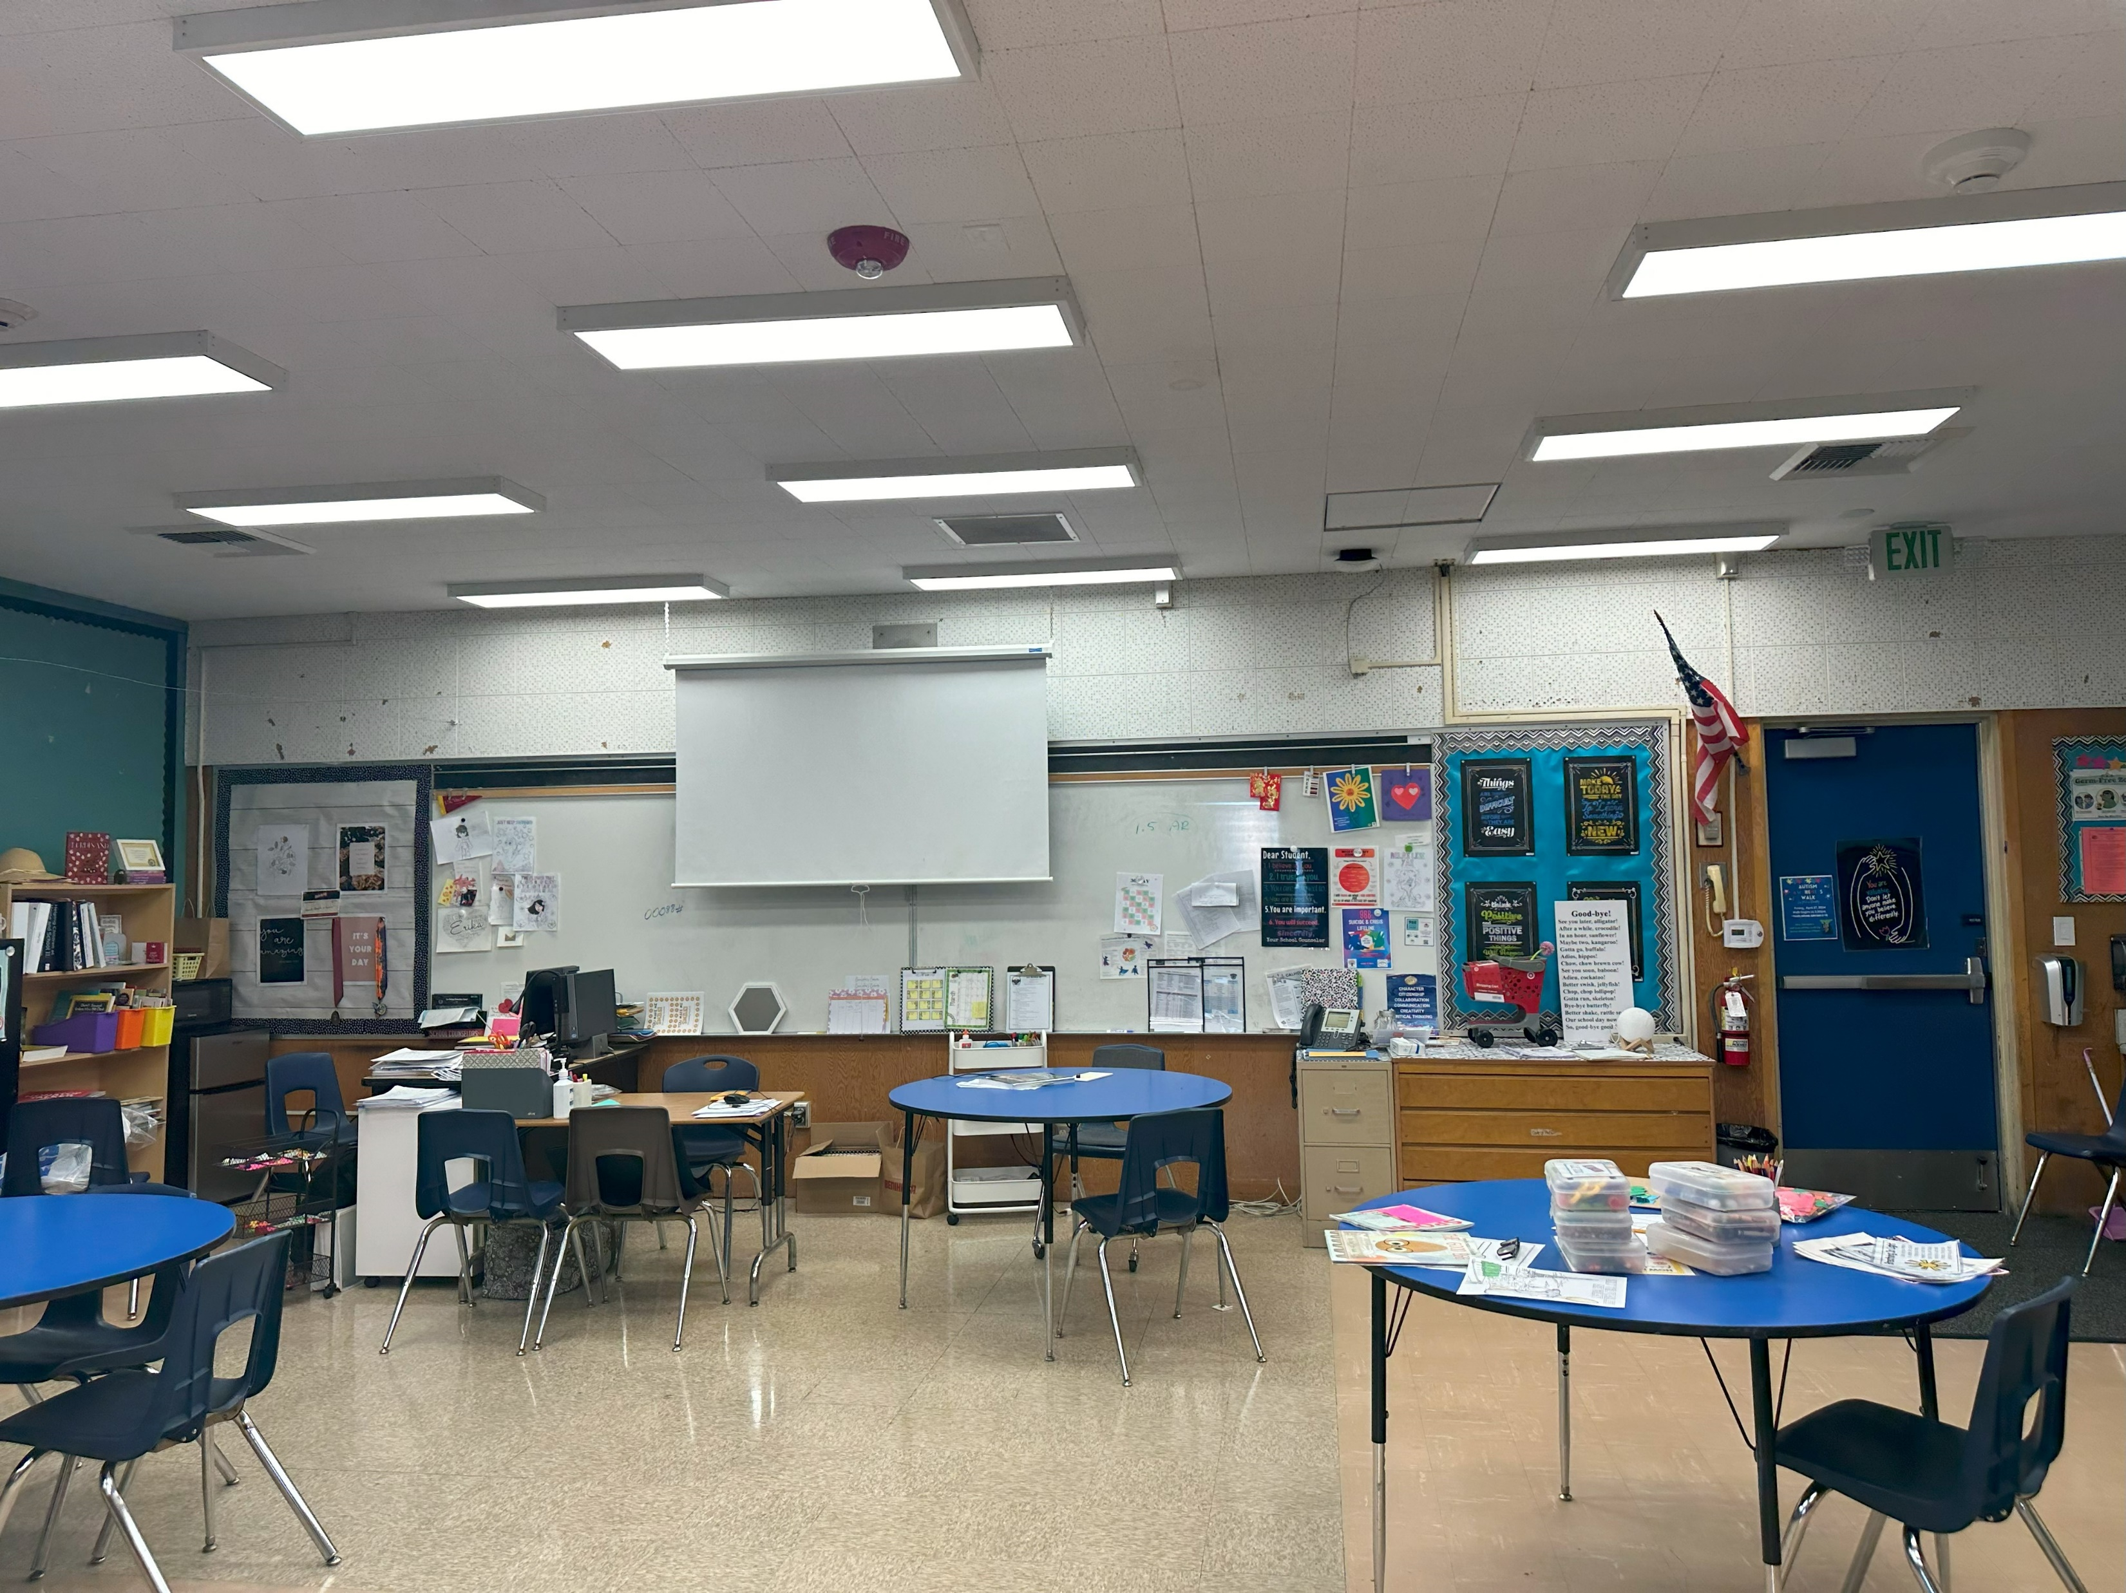
Measure BB 21st Century
Classroom Improvements
Los Molinos Elementary
IN PROGRESS
Before
Start Date November 12, 2024
Estimated Completion Date August 25, 2025

Slide 9

QUESTIONS

