Slide 1
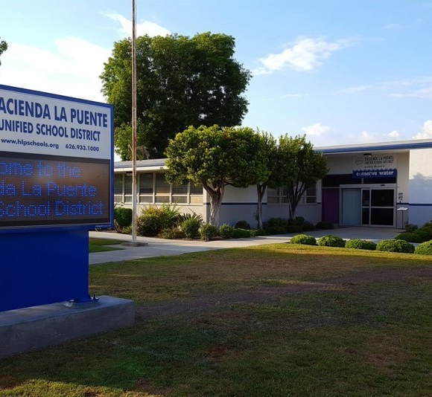

Measure BB Bond
21st Century Classroom Improvements
August 22, 2024

Slide 2
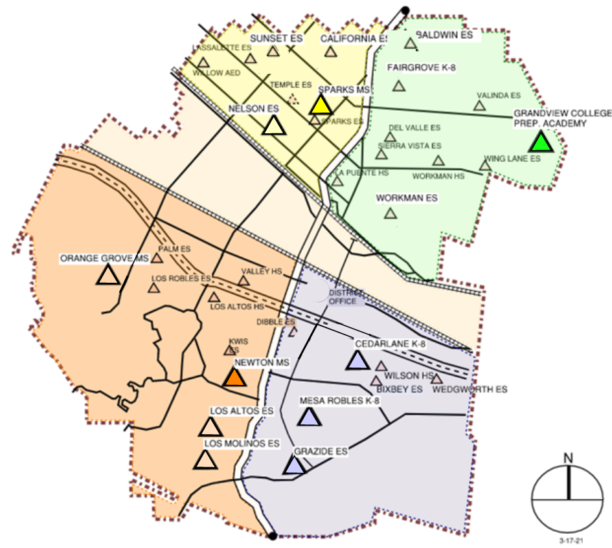
HLPUSD MEASURE BB - SUMMARY SCHOOLS IN PROGRESS
IN PROGRESS
CONSTRUCTION
La Puente HS
Workman HS
Los Altos HS
Wilson HS
Stimson EC
PREP FOR BID
California ES
Baldwin ES
Los Molinos ES
Grazide ES
AT DSA FOR REVIEW
Kwis ES
Lassalette ES
Fairgrove K-8
IN DESIGN
Orange Grove MS
Sierra Vista MS
Palm ES
Valinda ES
Sparks ES
Wing Lane ES
Valley Alternative
COMPLETED
Nelson ES
Los Altos ES
Workman ES
Mesa Robles K-8
Cedarlane K-8
Sparks MS
Newton MS
Grandview K-8
STIMSON

Slide 3
PHASE B PROGRESS
1. Baldwin ES Construction Documents First Bid advertisement 8/14/2024 Open Sept 17, 2024
2. California ES Construction Documents First Bid advertisement 8/14/2024 Open Sept 17, 2024
Anticipated Construction Start Fall of 2024
3. Los Molinos ES Construction Documents First Bid advertisement 8/14/2024 Open Sept 17, 2024
Interim Housing Los Robles (Tentative)
4. Grazide ES Construction Documents First Bid advertisement 8/14/2024 Open Sept 17, 2024
Interim Housing Bixby (Tentative)
Anticipated Construction Start Winter of 2024
5. Kwis ES Construction Documents At DSA for Plan Review Submitted 8/9/2024
6. Lassalette ES Construction Documents At DSA for Plan Review Submitted 8/9/2024
Anticipated Construction Start New Year of 2025
7. Palm ES Construction Documents 50% Const. Docs. District Review 8/16/2024
Interim Housing Los Robles (Tentative)
8. Valinda ES Construction Documents 50% Const. Docs. District Review 8/16/2024
Anticipated Construction Start Spring of 2025
9. Fairgrove K-8 Construction Documents At DSA for Plan Review Submitted 8/12/2024
Interim Housing Del Valle (Tentative)
10. Orange Grove MS Construction Documents Schematic Design
Anticipated Construction Start Summer of 2025
11. Sierra Vista Construction Documents Design Development District Reviewed 8/2/2024
12. Sparks ES Construction Documents Design Development District Reviewed 8/2/2024
Interim Housing Sunset (Tentative)
Anticipated Construction Start Summer -Fall of 2025
13. Wing Lane ES Construction Documents Design Development District Reviewed 9/17/2024
14. Valley Alternative Construction Documents Design Development District Reviewed 9/17/2024
Anticipated Construction Start Fall of 2025

Slide 4
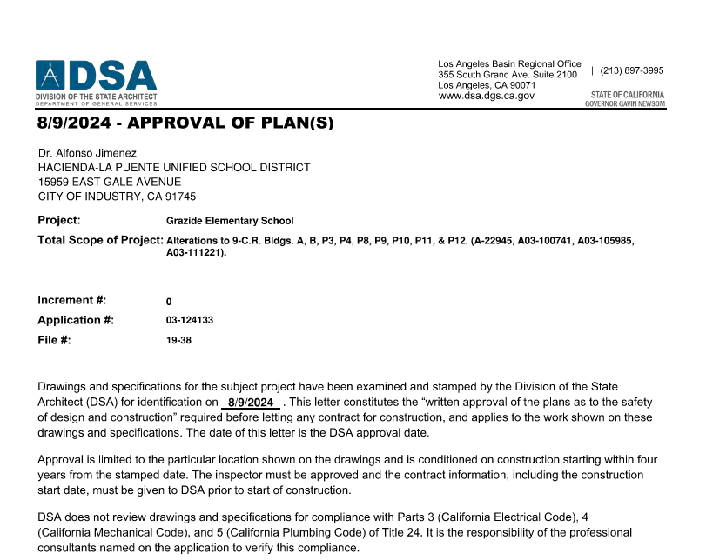
DSA PLAN APPROVAL GRAZIDE ELEMENTARY
“Drawings and specifications for the subject project have been examined and stamped by the Division of the State Architect (DSA) 8/9/2024.”

Slide 5
HIGH SCHOOL
REFRESH
PROJECTS

Slide 6
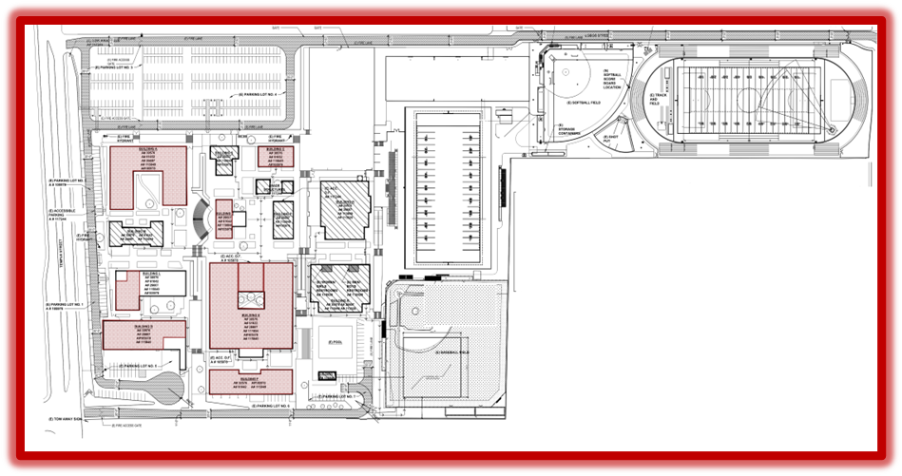
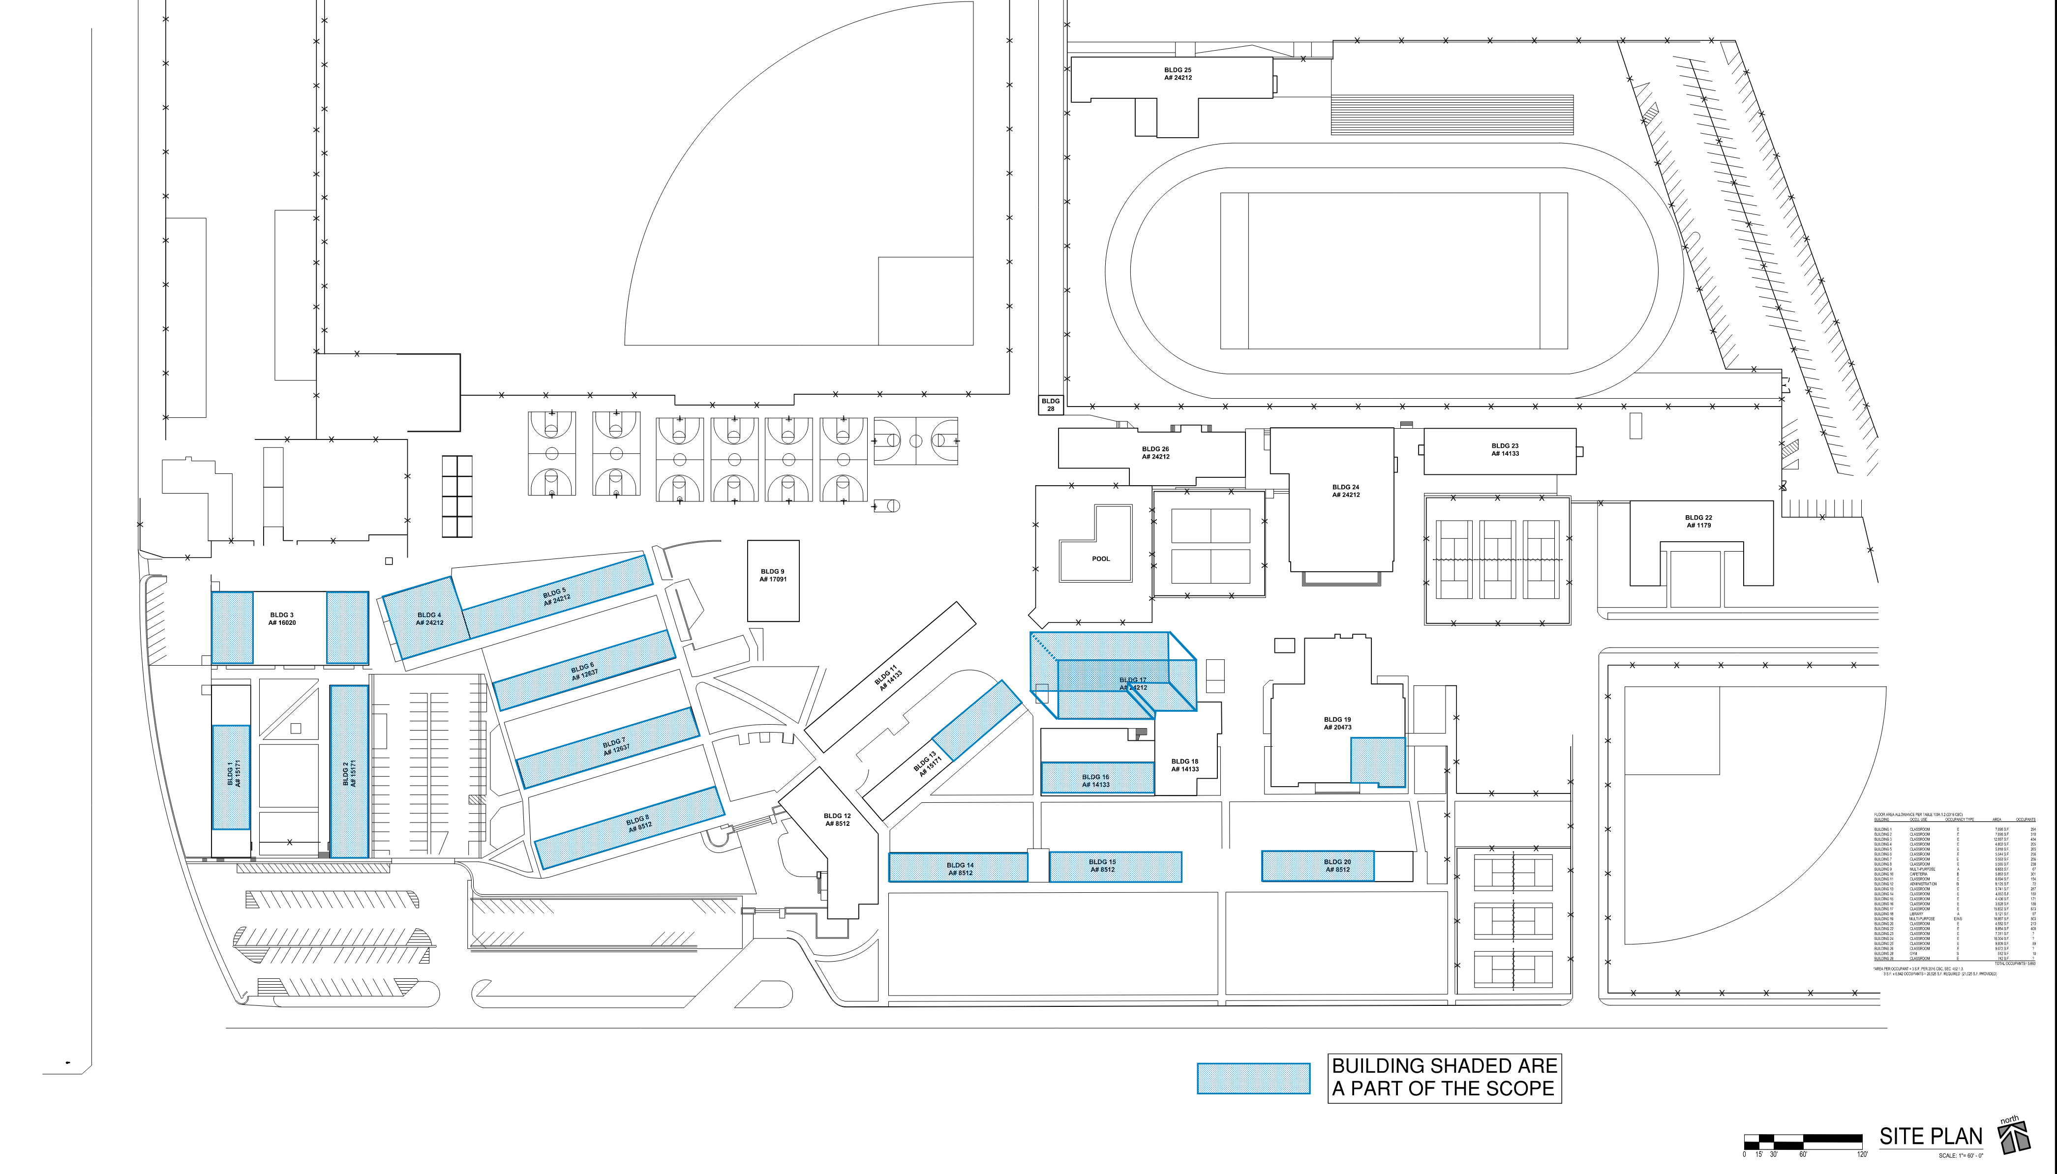
HIGH SCHOOL REFRESH GROUP 1
WORKMAN HIGH SCHOOL
43 CLASSROOMS
LA PUENTE HIGH SCHOOL
55 CLASSROOMS
SCHOOL | `START DATE | ANTICIPATED COMPLETION DATE
WORKMAN HS | 1/16/2024 | 9/13/2024* 50 Days ahead of Schedule
LA PUENTE HS | 1/16/2024 | 11/1/2024

Slide 7
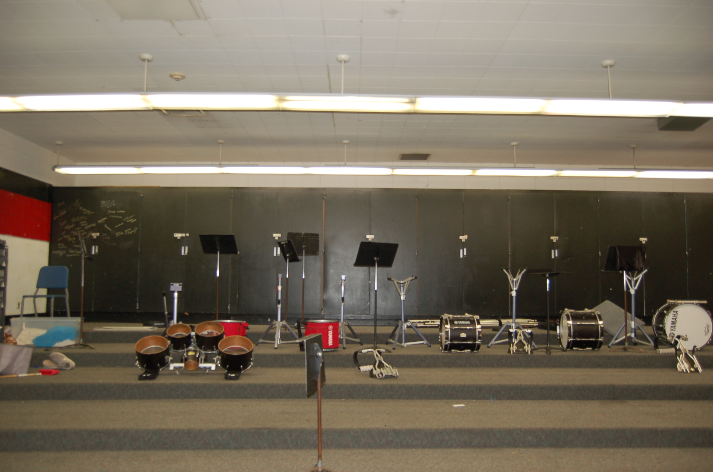
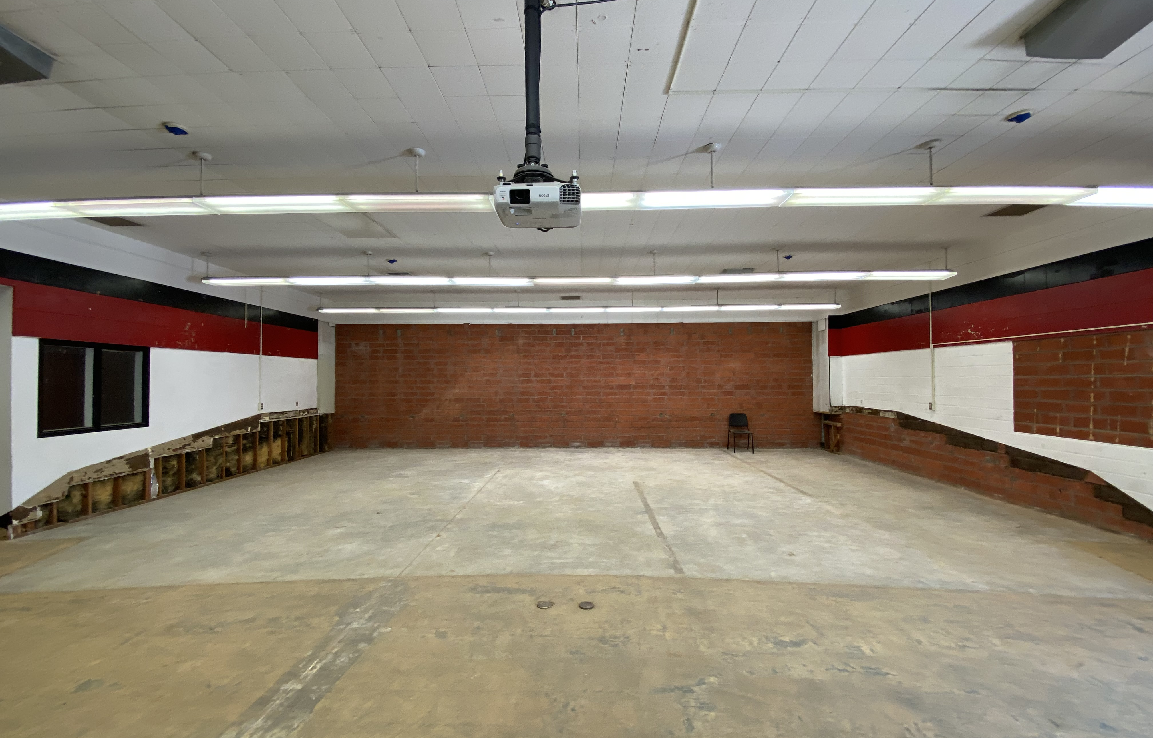
REFRESH GROUP 1
Workman HS Phase 4: Classroom C-2
After

Slide 8
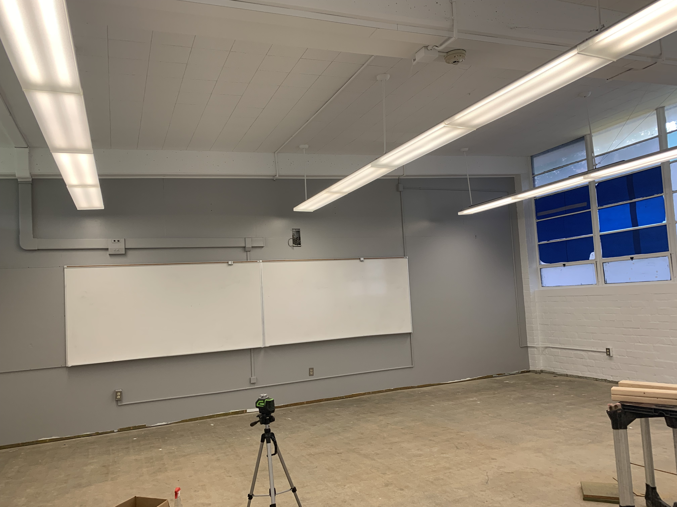
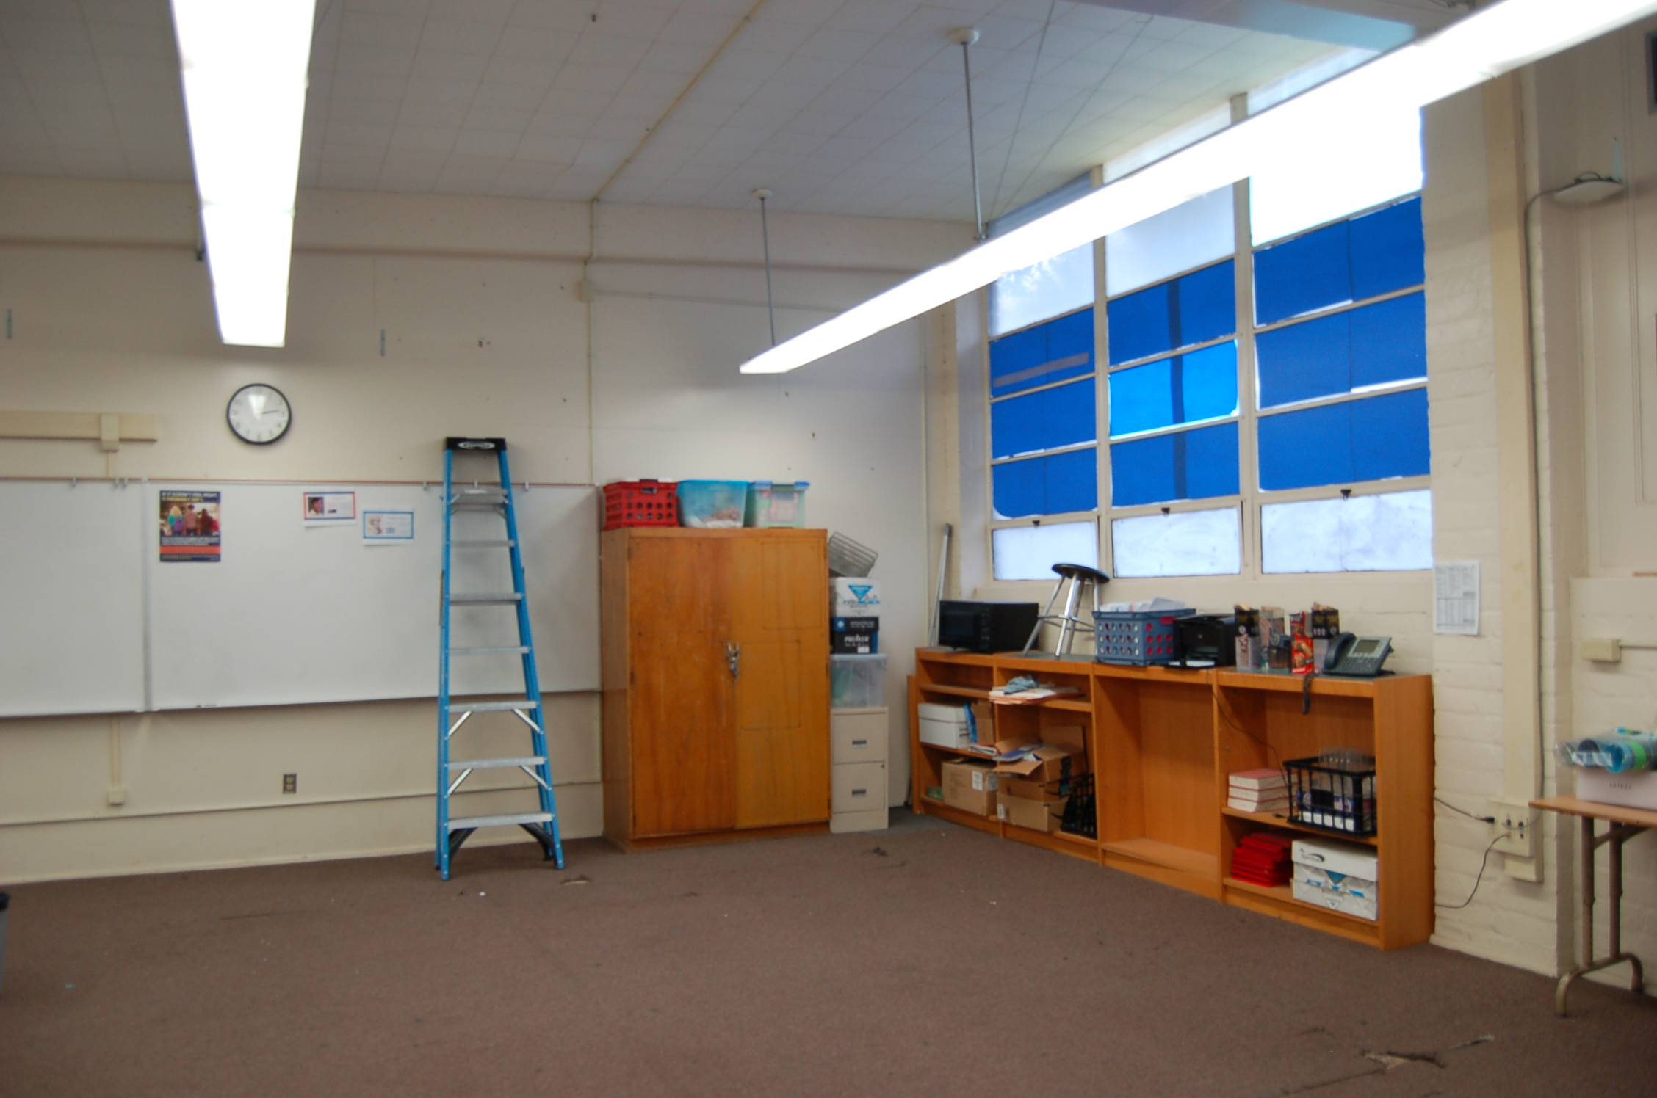
REFRESH GROUP 1
La Puente HS Phase 4:
Classroom 106 Before and Progress
Bee
In Progress
Before

Slide 9
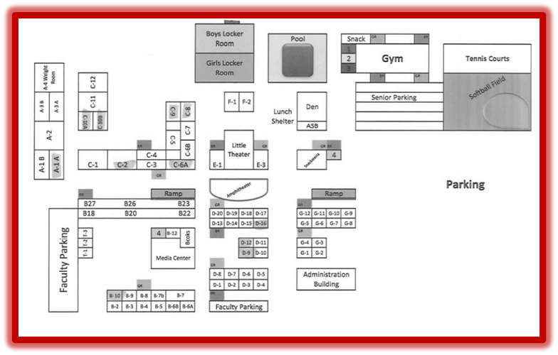
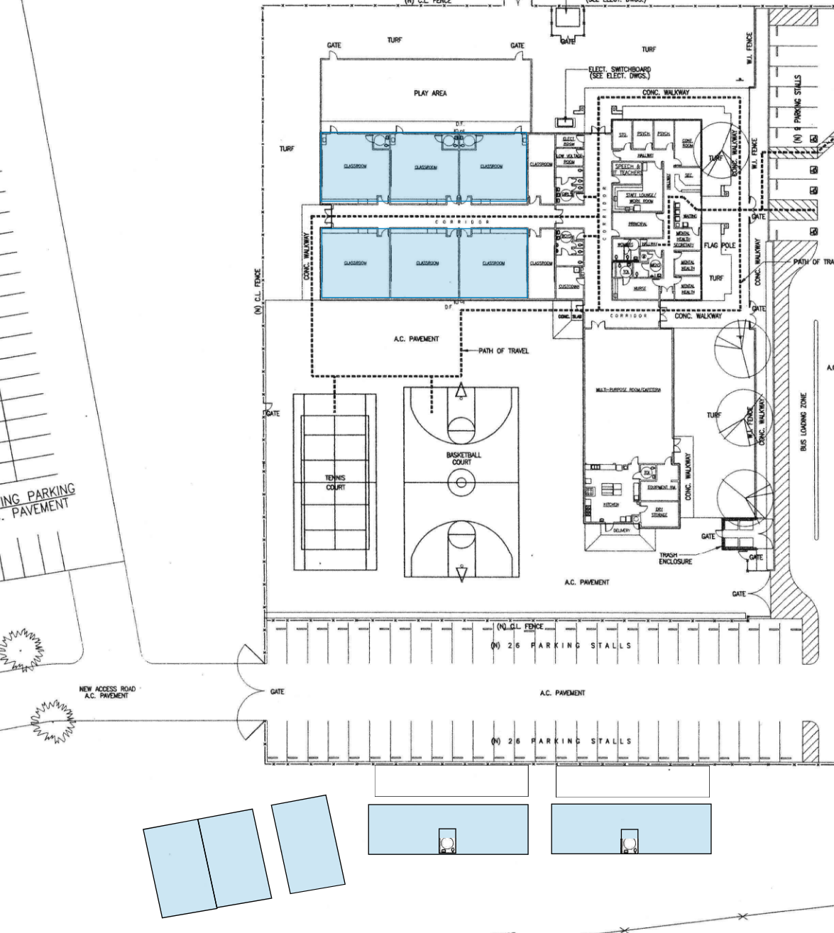
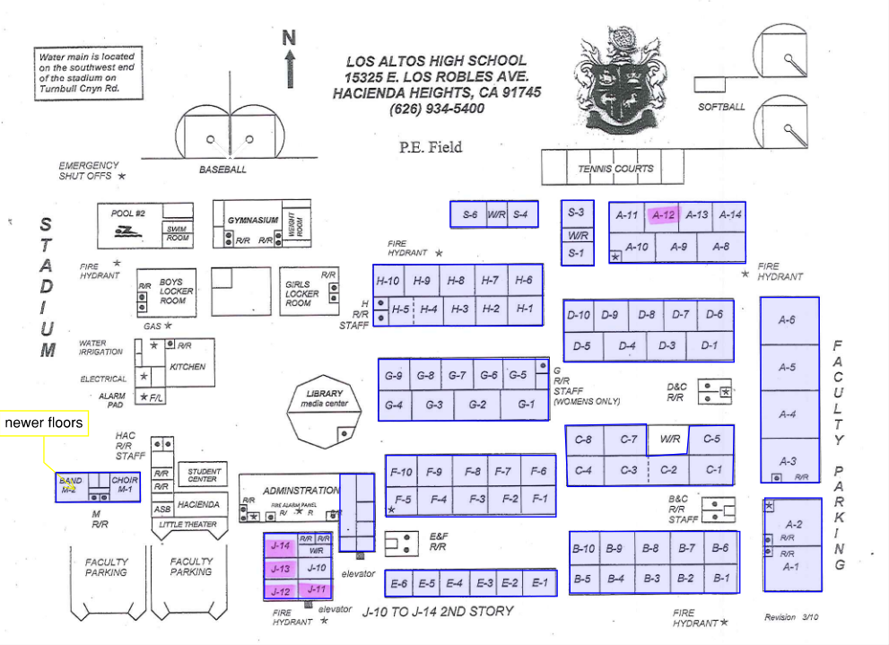
HIGH SCHOOL REFRESH GROUP 2
WILSON HIGH SCHOOL
59 CLASSROOMS
STIMSON LEARNING CENTER
10 CLASSROOMS
LOS ALTOS HIGH SCHOOL
69 CLASSROOMS
SCHOOL | START DATE | ANTICIPATED COMPLETION DATE
WILSON HS | 3/4/2024 | 2/21/2025
LOS ALTOS HS | 3/4/2024 | 4/18/2025
STIMSON EC | 7/1/2024 | 7/31/24 Completed

Slide 10
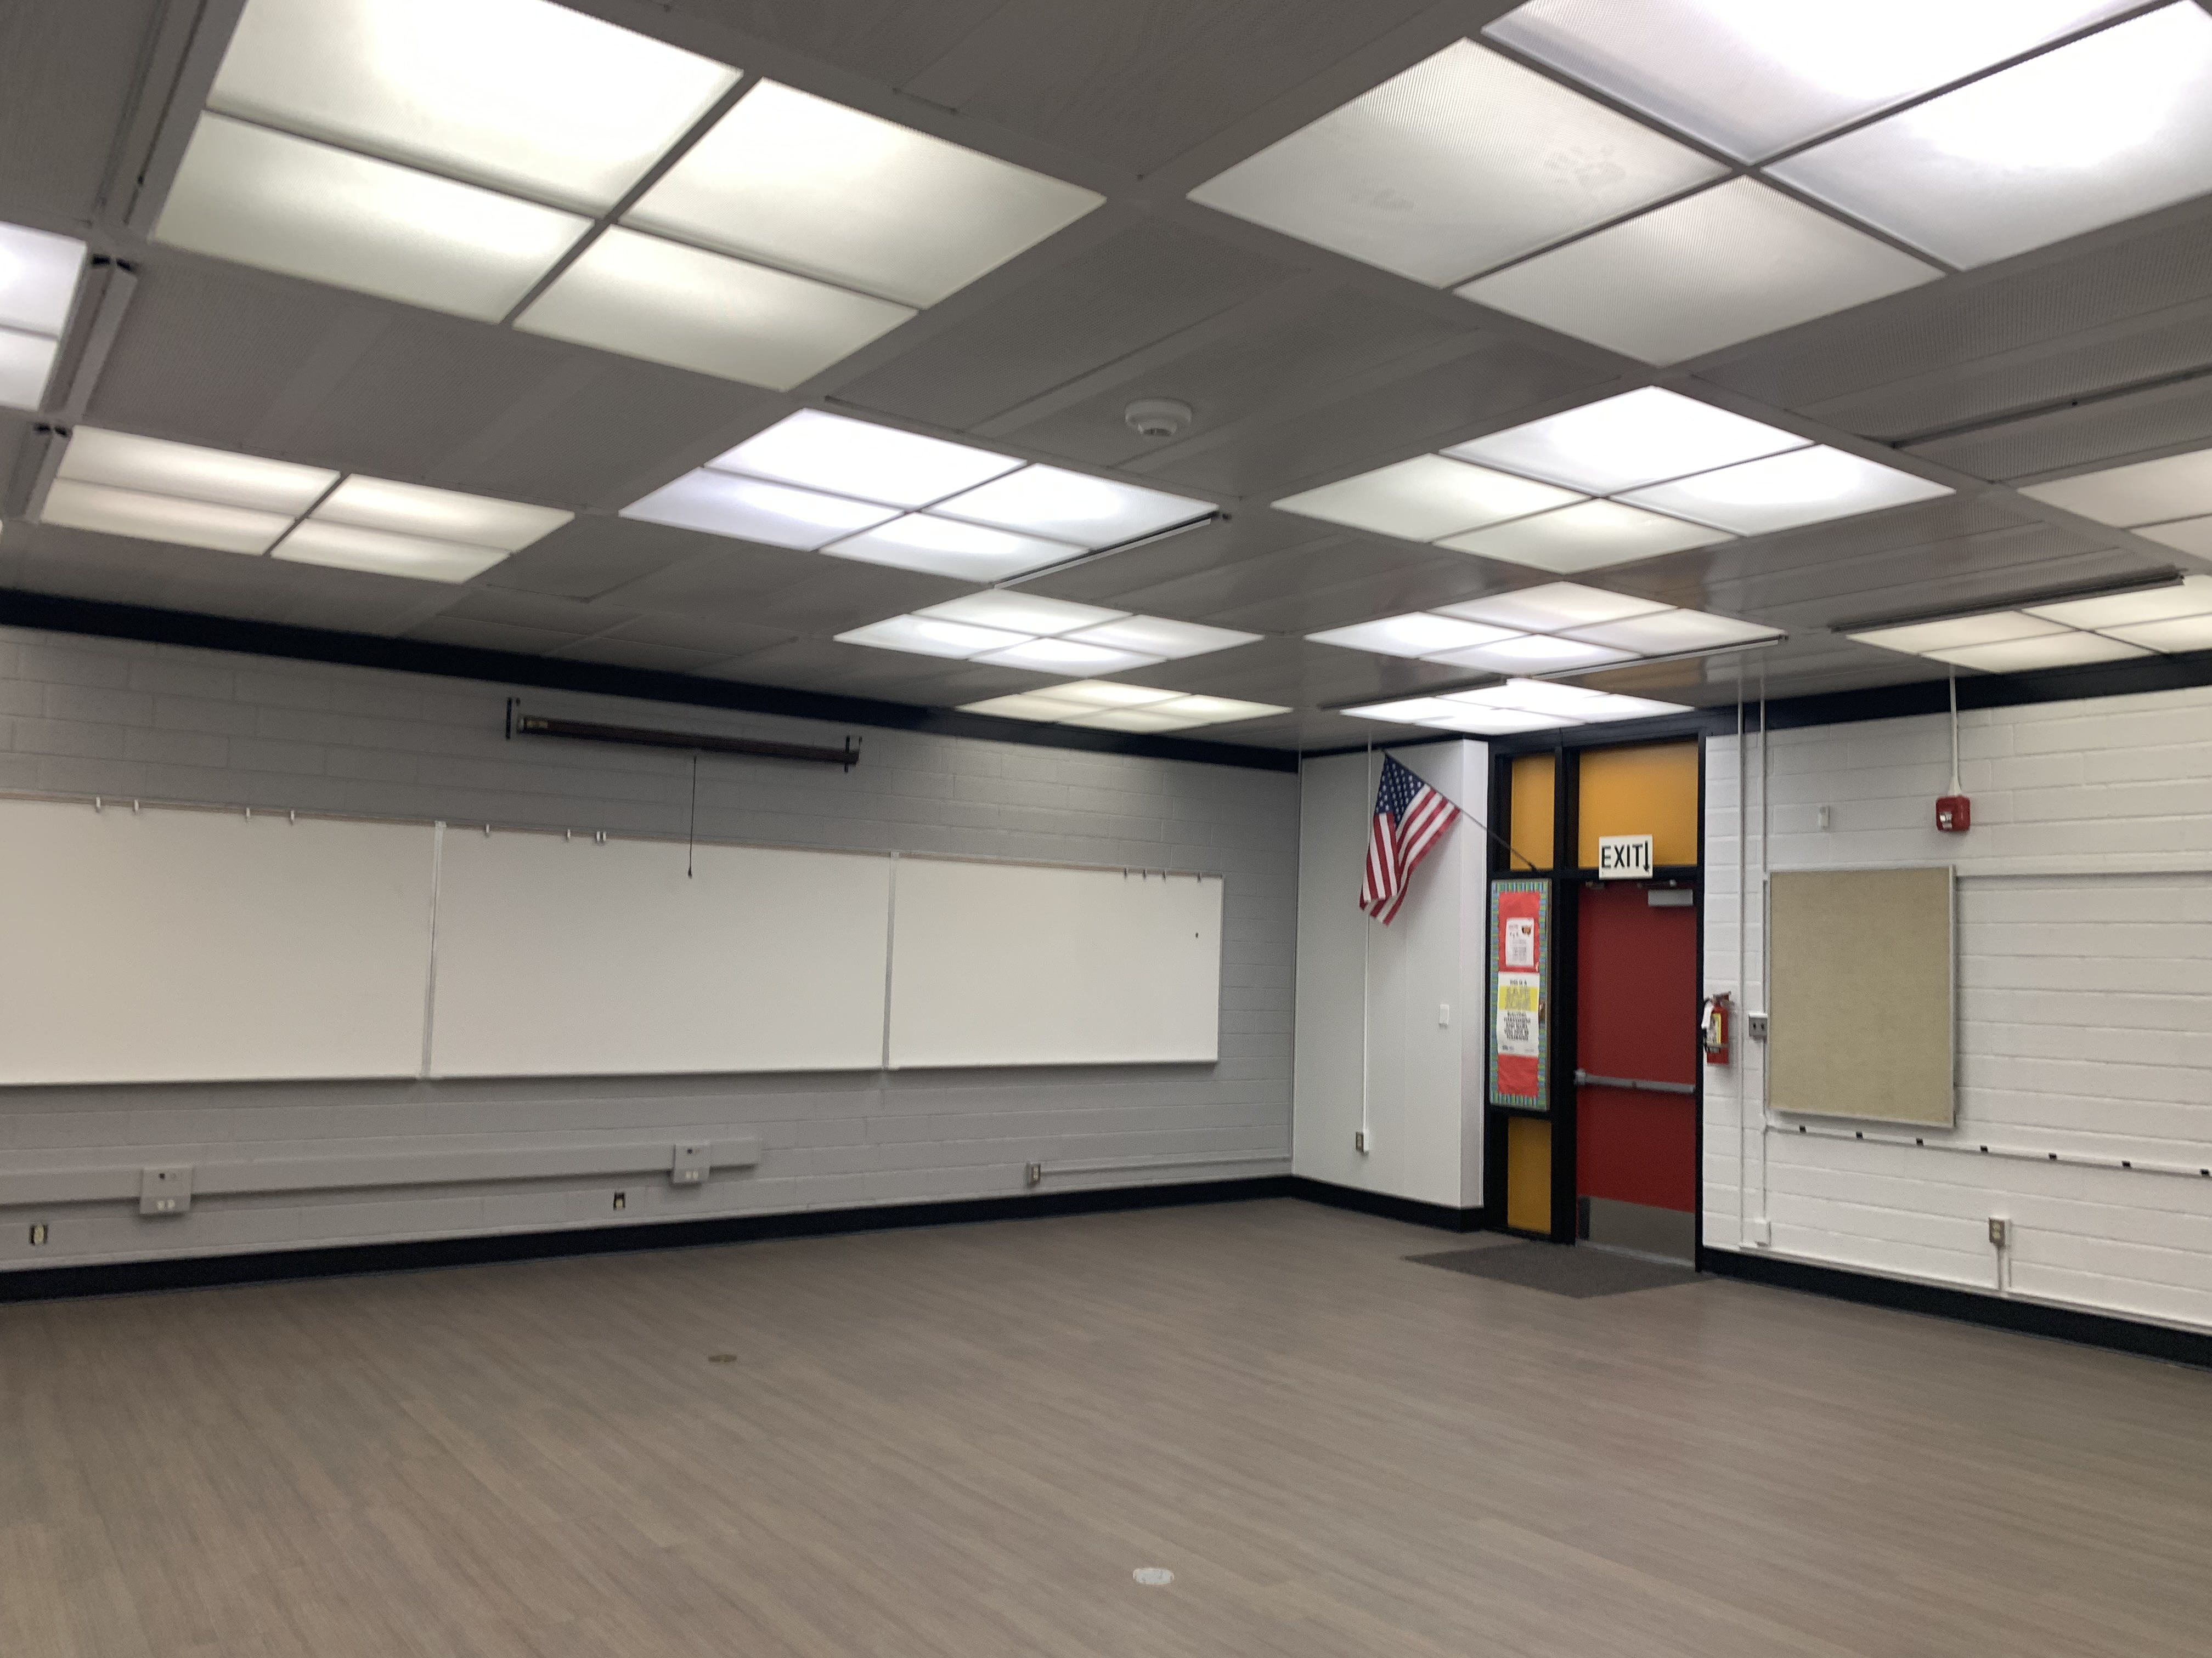
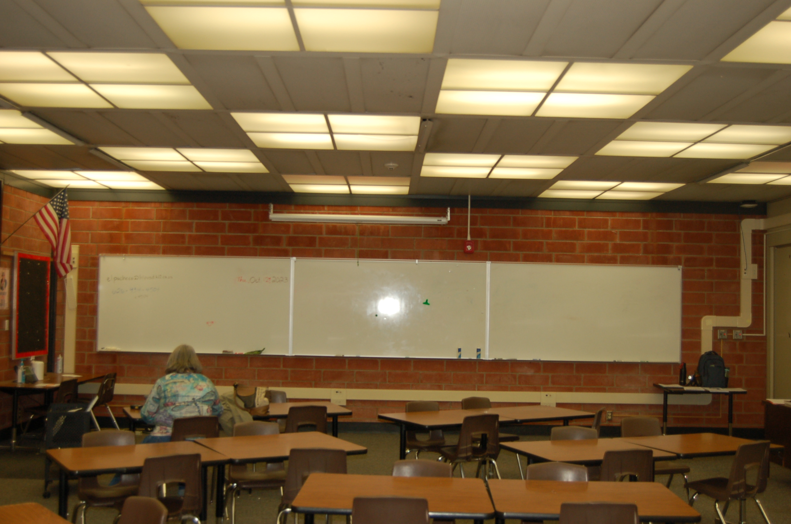
REFRESH GROUP 2
Wilson HS Phase 2
Classroom B-7 Before
and After
After
Before

Slide 11
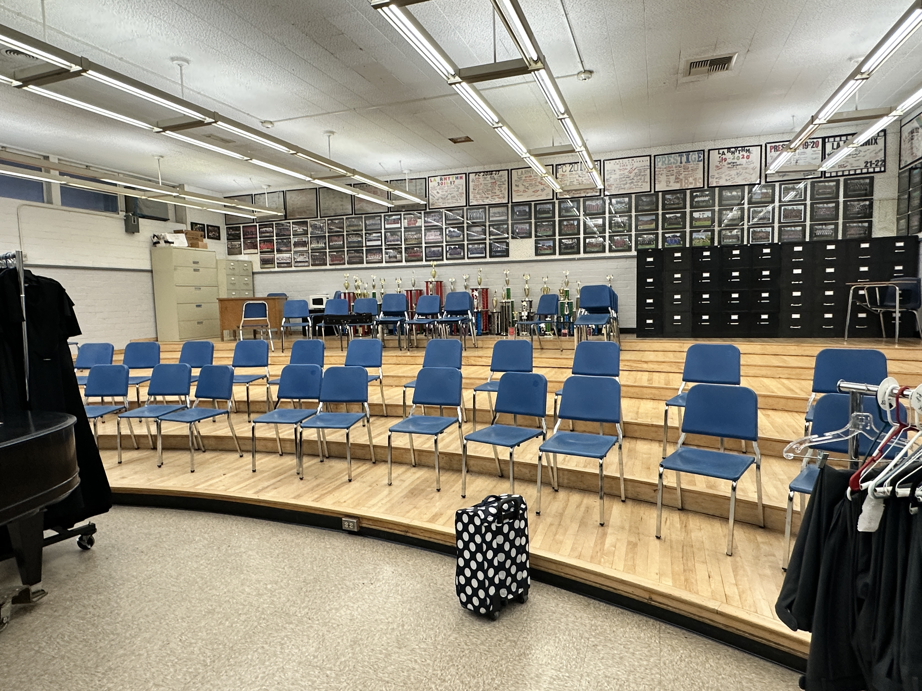
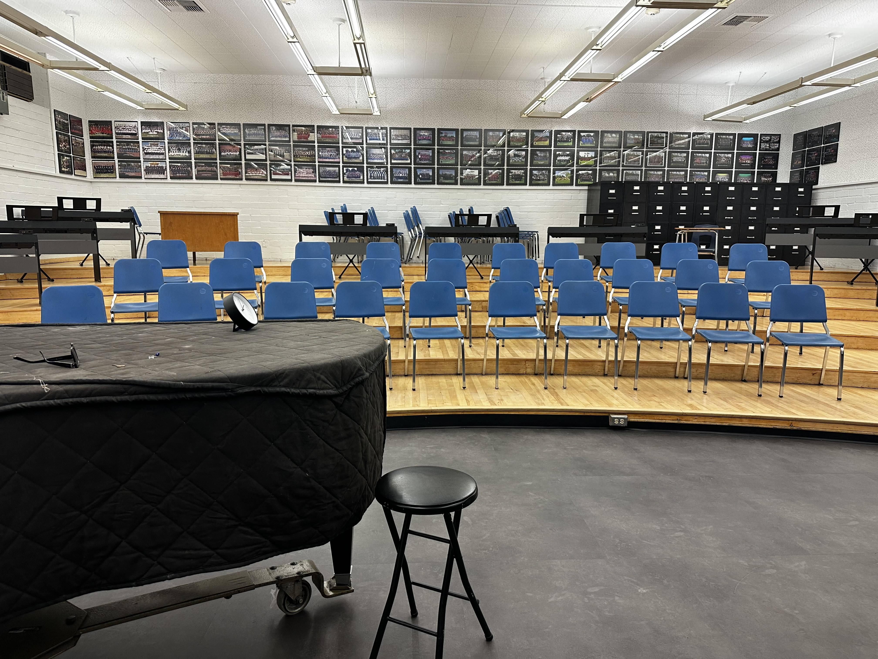
REFRESH GROUP 2
Los Altos HS Phase 2 Classroom M-1.

Slide 12
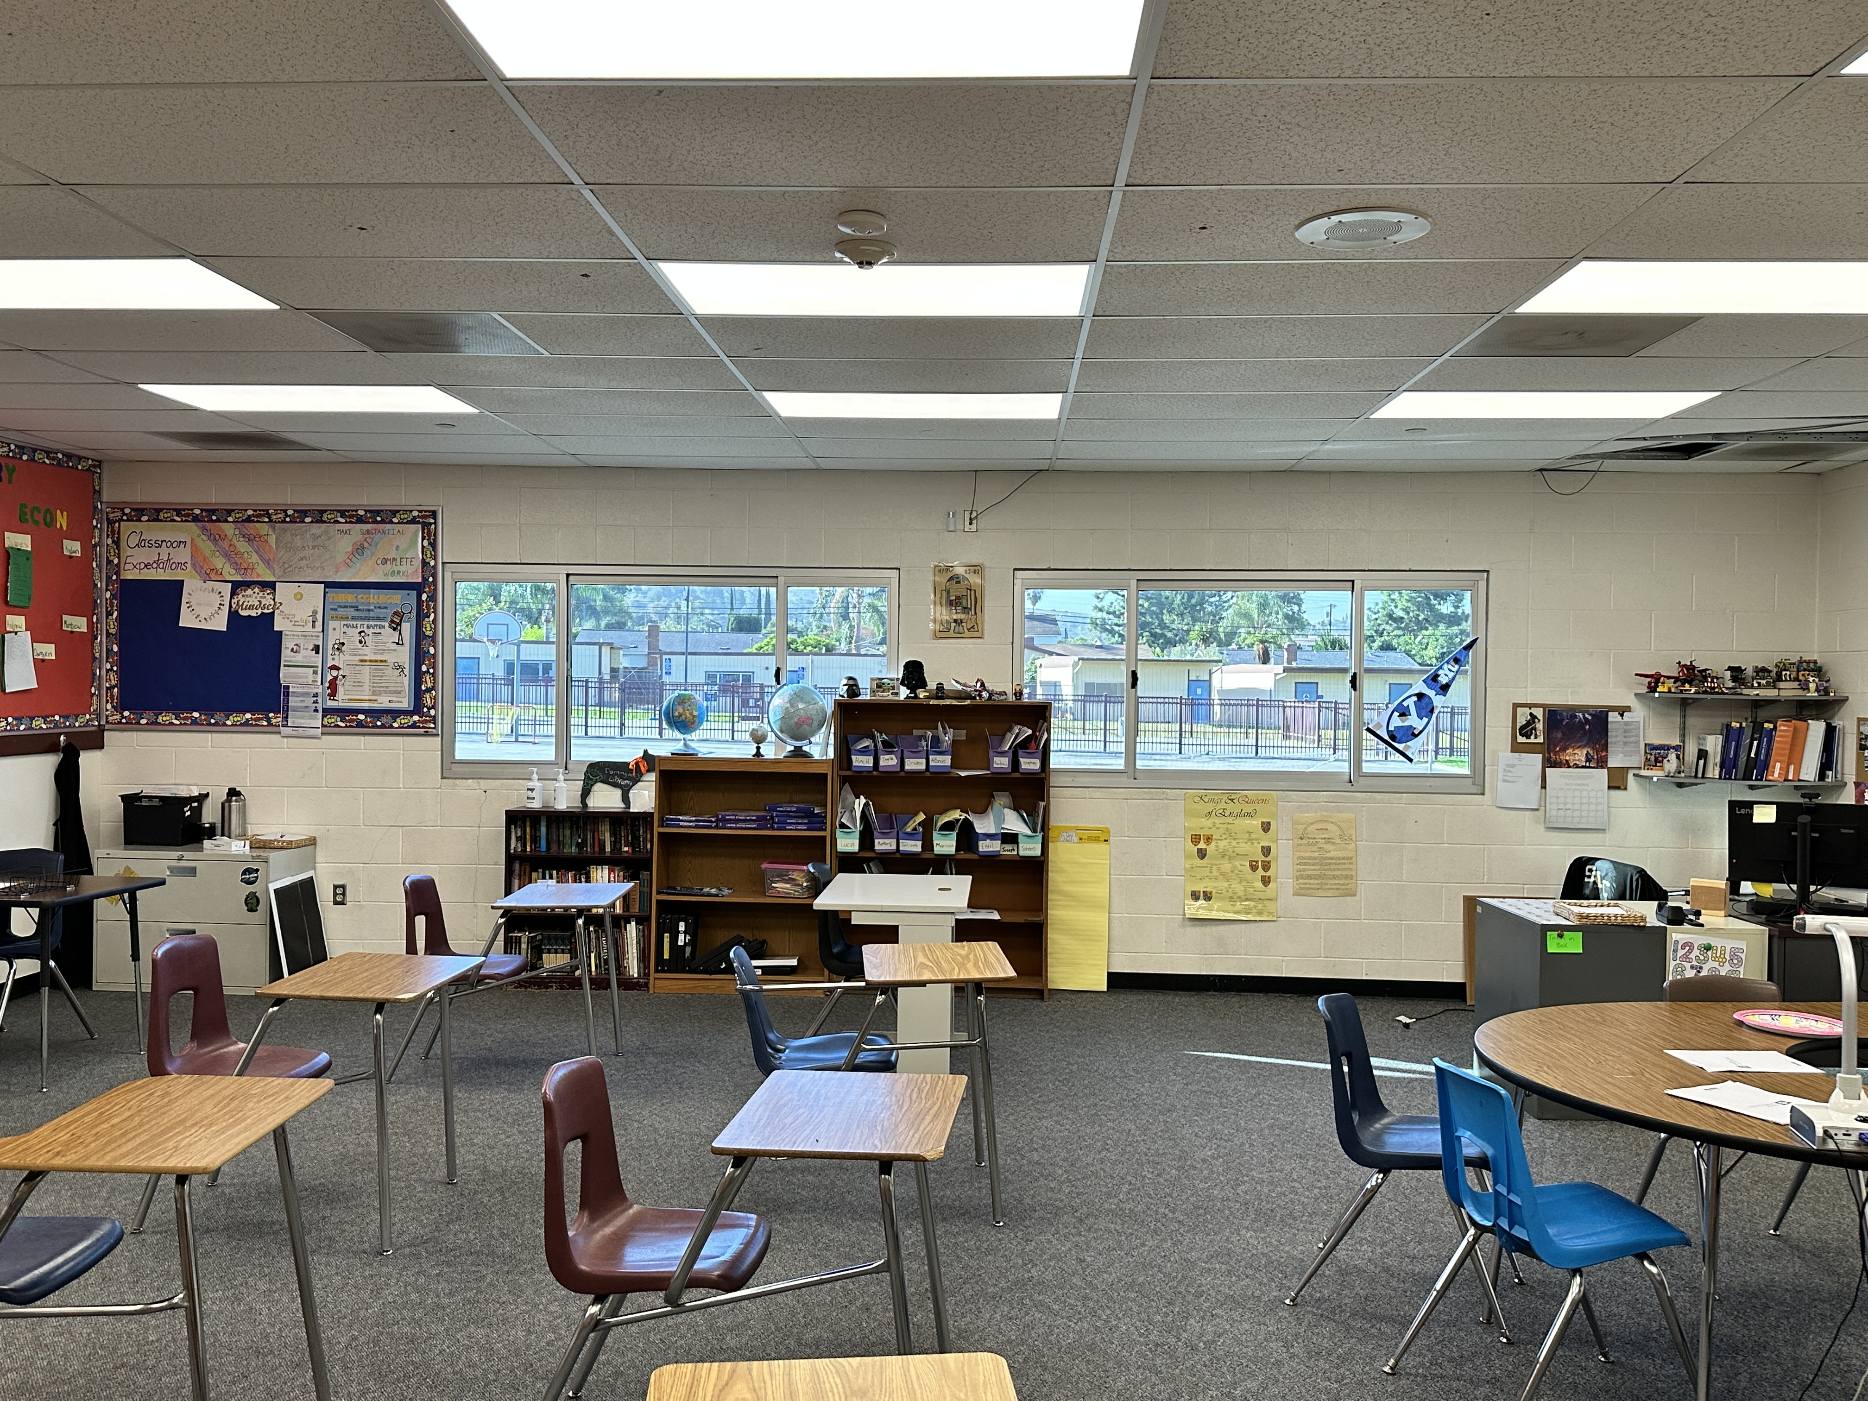
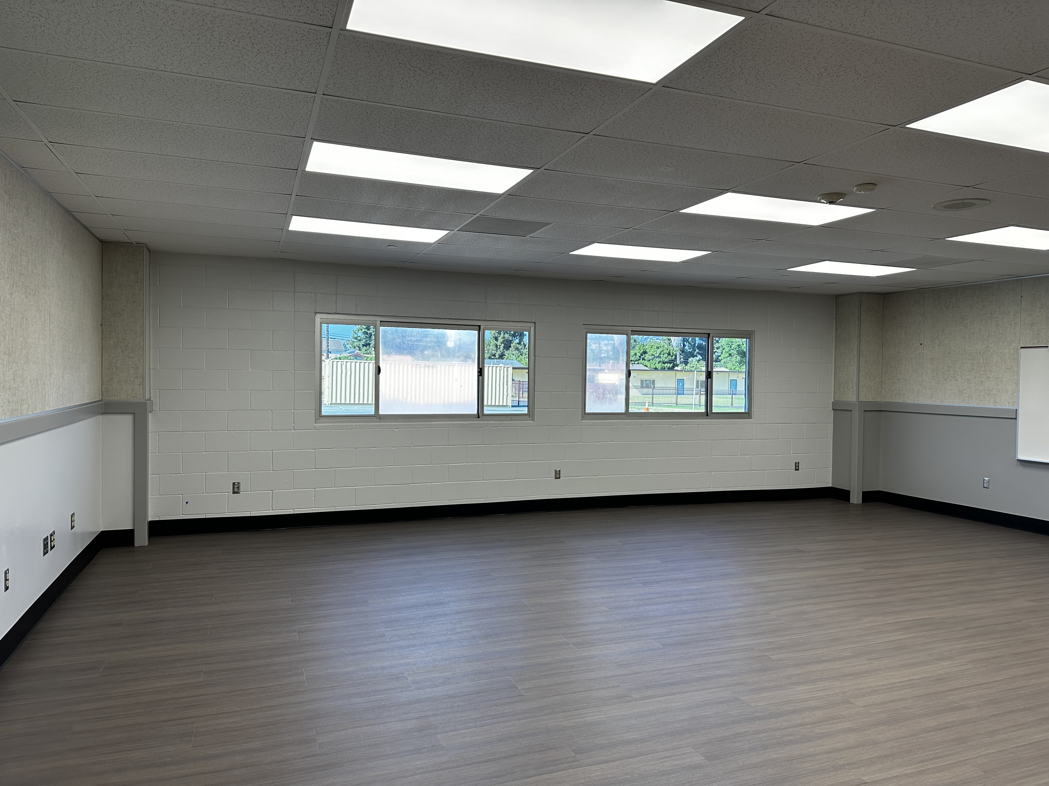
REFRESH GROUP 2
Stimson Learning Center
Classroom Before and After

Slide 13

QUESTIONS

