Slide 1
HACIENDA LA PUENTE UNIFIED SCHOOL DISTRICT
School Site Improvement Projects
Regular Board Meeting September 26, 2024
Business Services
Notes:
Good evening Ma’dam President, Ms. Christine Salazar, Distinguish Board Members; Superintendent, Dr. Jimenez, Executive Cabinet, Colleagues, and community members.
A special greetings to our Principals, Administrators, staff member who are joining us via the virtual platform.

Slide 2
PROJECT COMPLETE LIST
2024/2025
Site | Item Description | Funding Source | Completed Date
Grandview College Prepatory Academy | Iron Fence Painting | Facilities | 09/2024
Nelson Elementary School | New HVAC Unit Replacement | Facilities | 09/2024
Palm Elementary School | New HVAC Unit Replacement | Facilities | 09/2024
Sparks Middle School | Front Office Security Barrier | Facilities | 09/2024
Wing Lane Elementary School | HVAC Repair | Facilities | 09/2024
Workman High School | Pool Fencing | Facilities | 09/2024
Baldwin Academy Dibble Adult School Grazide Elementary School Kwis Elementary School La Puente High School Los Molinos Elementary School Wilson High School | Phase II of re-roofing | Facilities | 09/2024
California | Bottle Filling Station | Facilities | 08/2024
Cedarlane | Playground Asphalt | Facilities | 08/2024
Cedarlane | Portable Installation | Facilities | 08/2024
Grandview | Parking Lot Restriping | Facilities | 08/2024
Changes And Progress Since Last Report - Blue

Slide 3
PROJECT COMPLETE LIST
2024/2025
Site | Item Description | Funding Source | Completed Date
Los Molinos | Bottle Filling Station | Facilities | 08/2024
Mesa Robles | Classroom Flooring | Facilities | 08/2024
Wing Lane | Playground Restriping | Facilities | 08/2024
Wing Lane | Portable Installation | Facilities | 08/2024
District Office | Portables/Restroom | Facilities | 07/2024
Districtwide | Banners | Facilities | 07/2024
Wilson High School | Little Theatre Improvement | CTE Grant | 07/2024
Changes And Progress Since Last Report - Blue

Slide 4
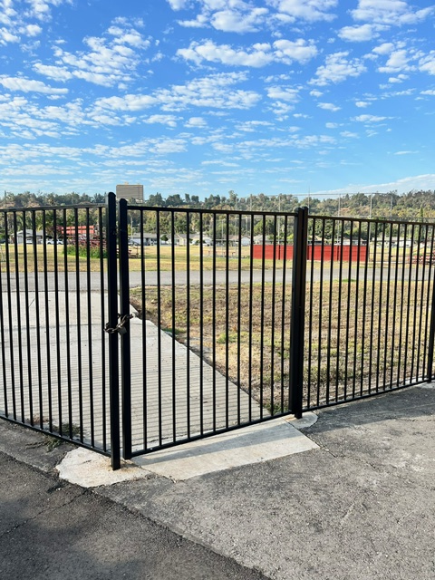
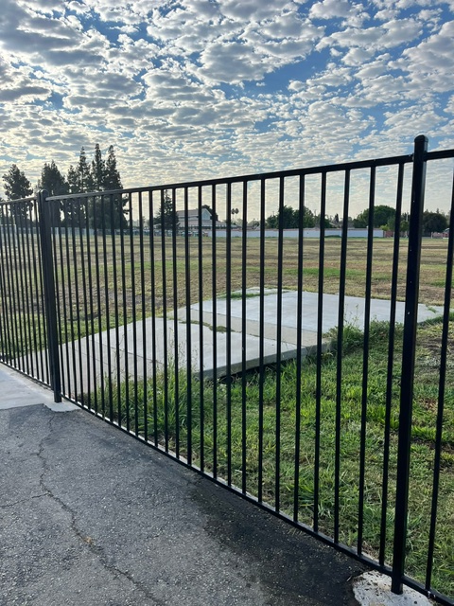
Projects Completed as of September 26, 2024 Grandview College Prep Academy – Iron Fence Painting
BEORE
AFTER

Slide 5
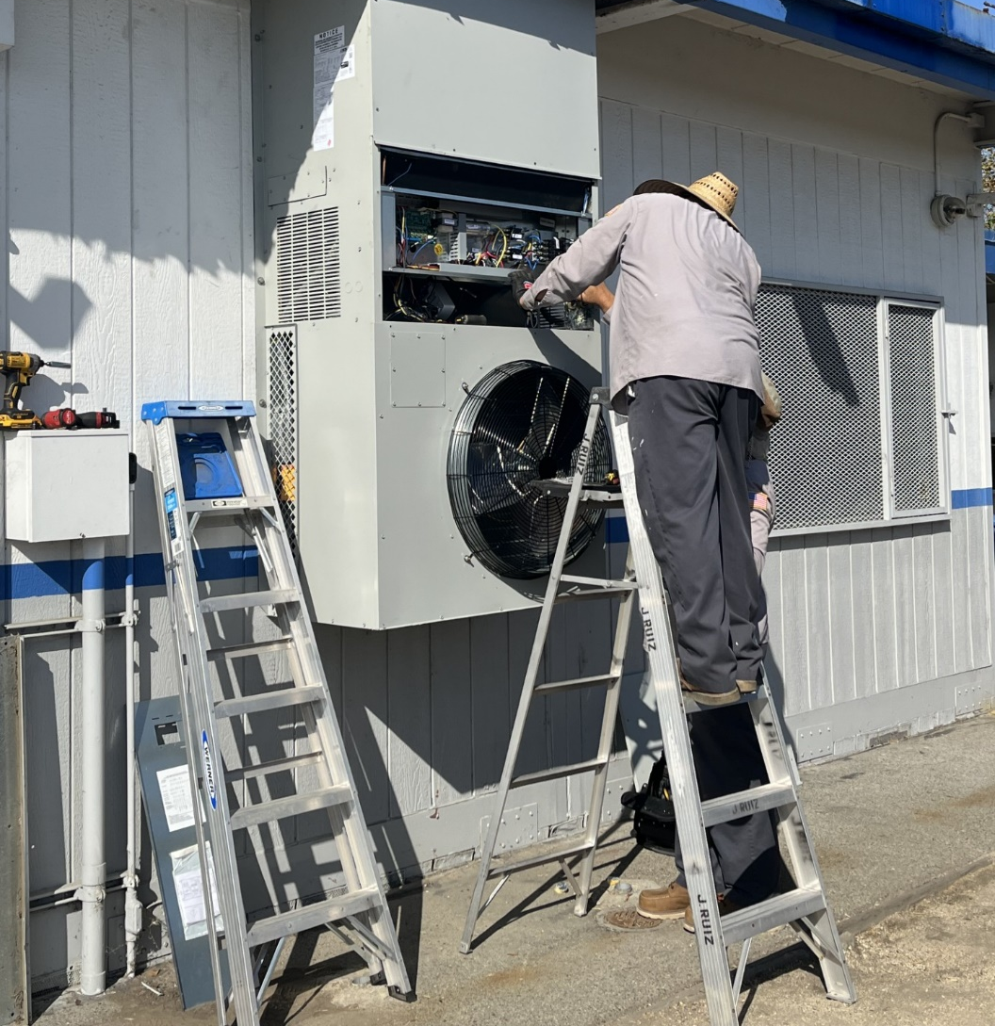
Projects Completed as of September 26, 2024 Nelson Elementary School, E-1 – AC Unit Replacement
AFTER

Slide 6
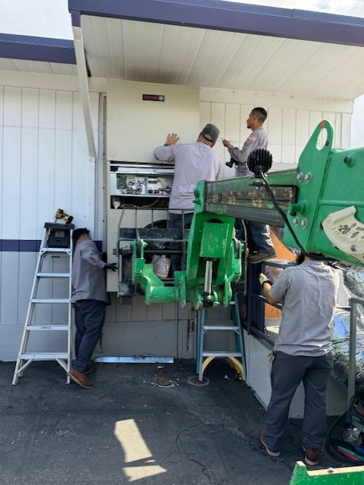
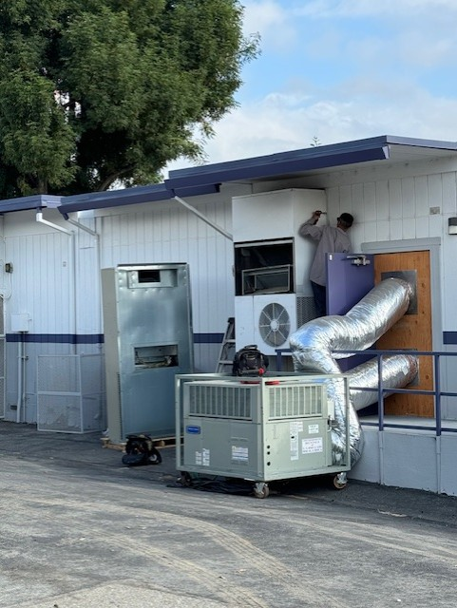
Projects Completed as of September 26, 2024 Palm Elementary School, P3– AC Unit Replacement
BEORE
AFTER

Slide 7
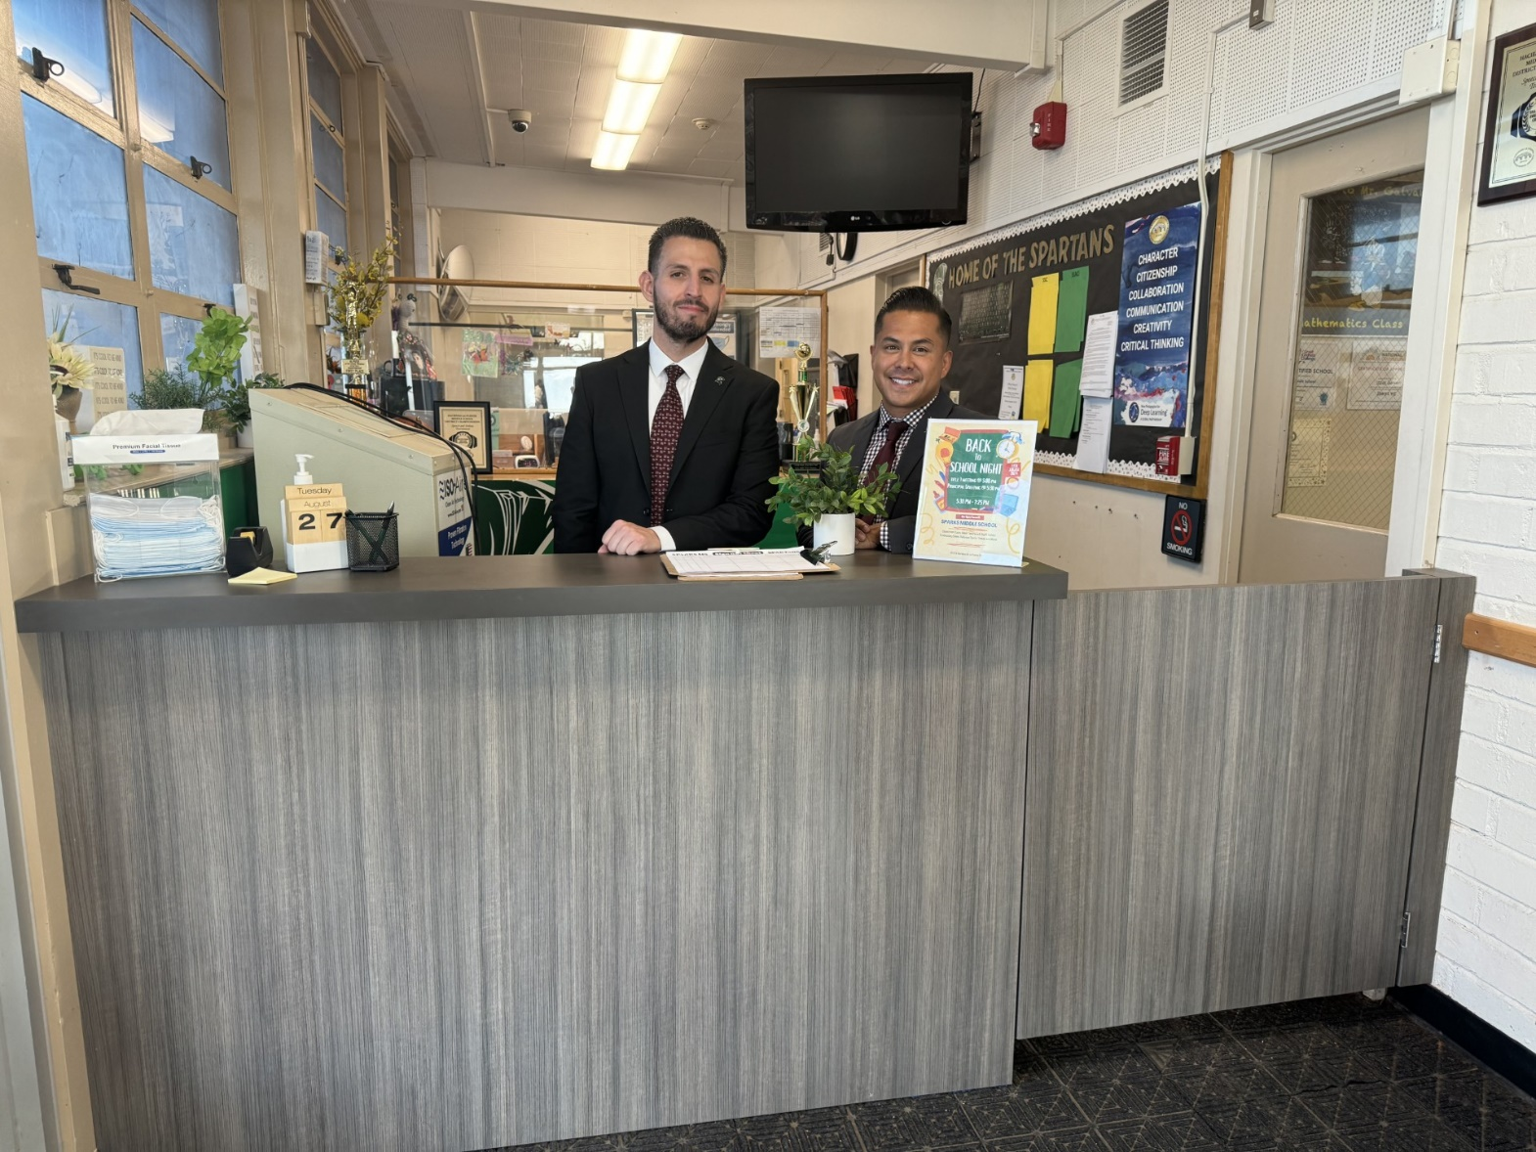
Projects Completed as of September 26, 2024 Sparks Middle School – Front Office Counter

Slide 8
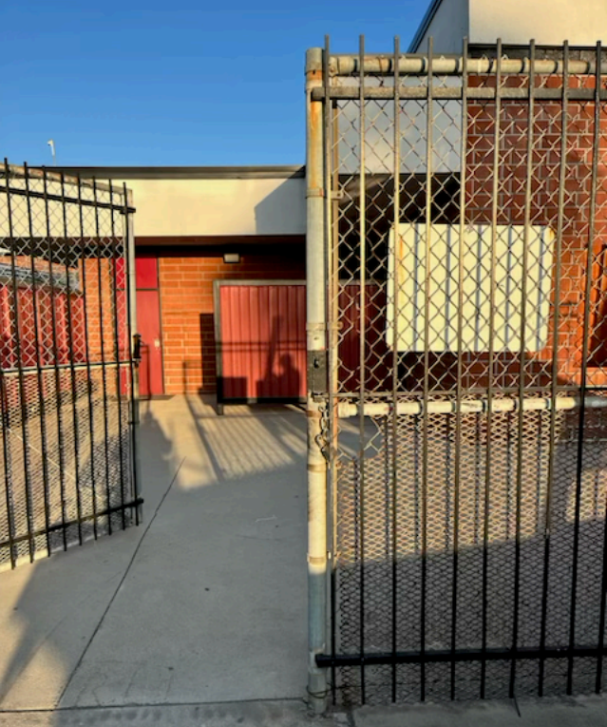
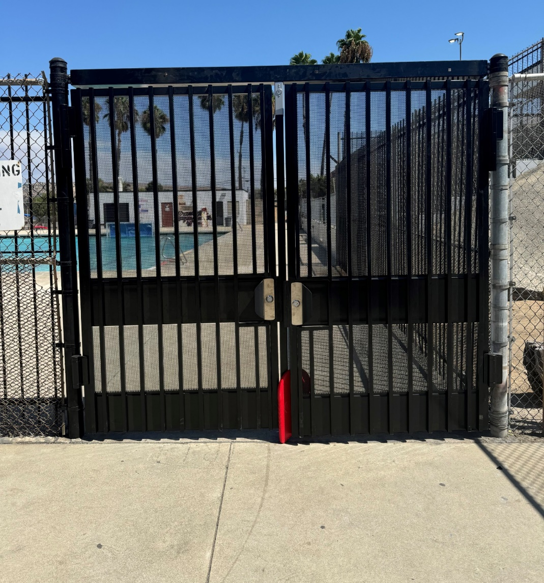
Projects Completed as of September 26, 2024 Workman High School – Pool Fence Compliance
BEFORE
AFTER
BEORE
AFTER

Slide 9
Projects In Progress 2024-2025

Slide 10
Projects in Progress as of September 26, 2024
Facilities
Site | Item Description | Architect Plans | DSA Approval | Procurement | Construct | Funding Source | Target Completion Date
District Office | Data Center Move | Complete | N/A | Complete | Pending | ESSR/General | TBD
Districtwide | HVAC System Replacement | Pending | TBD | TBD | TBD | Facilities | TBD
Kwis Elementary School | Baseball Fields | Complete | Approved | Pending | TBD | Facilities | TBD
La Puente High School | Custom Shade Structure | Complete | Approved | Pending | Pending | Facilities | TBD
Los Altos High School | Gym & Locker Room HVAC (65 tons of temporary HVAC units have been installed) | Complete | Approved | Complete | In Progress | Facilities | 11/2024
Los Altos High School | Stadium Press Box & Bleachers | Complete | Pending | Pending | Pending | Facilities | TBD
Sierra Vista Middle School | HVAC Repair MPR Room | N/A | N/A | Complete | In Progress | Facilities | 09/2024
Stimson Learning Center | Phase II of re-roofing | Complete | Complete | Complete | In Progress | Facilities | 10/2024
Wedgeworth Elementary School | K-5 Permanent School | Complete | Approved | Complete | In Progress | COPS | 06/2025
Wilson High School | Media Center | Pending | Pending | Pending | Pending | Grant | 06/2025
Wilson High School | Stadium Press Box & Bleachers | Complete | Pending | Pending | Pending | Facilities | TBD
Notes:
Los Altos High School, expected to begin in July

Slide 11
Projects in Progress as of September 26, 2024
Facilities
Site | Item Description | Architect Plans | DSA Approval | Procurement | Construct | Funding Source | Target Completion Date
Workman High School | Phase II Stadium and Baseball Field (Phase I Track & Field and Softball Field Complete) OPTION B | Complete | Approved | Approved | In Progress | Facilities | TBD
Workman High School | Shade Structure, Wall, & Lighting | Complete | Pending | Pending | Pending | Facilities | TBD
Changes And Progress Since Last Report - Blue

Slide 12
Projects in Progress as of September 26, 2024
Child Development
Site | Item Description | Architect Plans | DSA Approval | Procurement | Construct | Funding Source | Target Completion Date
Amar Center | Entry Security Project | Complete | Approved | Pending | Pending | Child Development | TBD
Amar Center | Phase II of Re-Roofing | Complete | N/A | Pending | Pending | Child Development | TBD
Fairgrove Academy Head Start | Playground & Shade Structure | Complete | Approved | Complete | In Progress | Child Development | 09/2024
Nelson Elementary School Head Start | Playground, Shade Structure, & Accessibility Path of Travel | Complete | Approved | Complete | In Progress | Child Development | 09/2024
Workman Elementary School Head Start | Playground & Accessibility Path of Travel | Pending | Pending | Pending | Pending | Child Development | TBD
Changes And Progress Since Last Report - Blue

Slide 13
Projects in Progress as of September 26, 2024
Special Ed
Site | Item Description | Architect Plans | DSA Approval | Procurement | Construct | Funding Source | Target Completion Date
Lassalette Elementary School | Inclusive Playground | NA | NA | Complete | In Progress | Facilities | 09/2024
Adult Ed
Site | Item Description | Architect Plans | DSA Approval | Procurement | Construct | Funding Source | Target Completion Date
Center for the Performing Arts | Construction of NEW Performing Arts Center @ Temple Academy | Complete | Complete | Pending | TBD | Adult Ed | 12/2026
Dibble Adult Ed | Admin Upgrade | In Progress | NA | Pending | Pending | Adult Ed | TBD
Dibble Adult Ed | Phase II of Re-Roofing | N/A | N/A | Complete | In Progress | Adult Ed | 10/2024
Willow Adult Ed | Marquee | Complete | NA | Pending | Pending | Adult Ed | TBD
Changes And Progress Since Last Report - Blue

Slide 14
Projects in Progress as of September 26, 2024
Nutrition Services
Site | Item Description | Architect Plans | DSA Approval | Procurement | Construct | Funding Source | Target Completion Date
Baldwin Elementary School | Kitchen Renovation - Three Compartment Sink Installation | Complete | NA | Pending | TBD | Food Services | TBD
District Office | Warehouse Freezer | Complete | NA | Pending | TBD | Food Services | TBD
Mesa Robles Middle School | Kitchen Renovation | Complete | Approved | Pending | TBD | Food Services | TBD
Wilson High School | Kitchen Modernization | Pending | Pending | Pending | TBD | Food Services | TBD
Changes And Progress Since Last Report - Blue
Notes:
Kwis Baseball – Will be Re-Bid, uncertified entry was added to scope of work into the project.
Cedarlane Portable – In design phase with PBK architecture. Soils samples being conducted.
Willow Adult School = Two Story Building continues to be under construction. It coming along very well.

Slide 15
Next Report – October 24, 2024

