Slide 1






HACIENDA LA PUENTE UNIFIED SCHOOL DISTRICT
School Site Improvement Projects
Regular Board Meeting October 24, 2024
Business Services
Notes:
Good evening Ma’dam President, Ms. Christine Salazar, Distinguish Board Members; Superintendent, Dr. Jimenez, Executive Cabinet, Colleagues, and community members.
A special greetings to our Principals, Administrators, staff member who are joining us via the virtual platform.

Slide 2

PROJECT COMPLETE LIST
2024/2025
Site | Item Description | Funding Source | Completed Date
Fairgrove Academy | Playground & Shade Structure | Child Development | 09/2024
Lassalette Elementary School | Inclusive Playground | Facilities | 09/2024
Nelson Elementary School | Playground, Shade Structure, & Accessibility Path of Travel | Child Development | 09/2024
Sierra Vista Middle School | HVAC Repair MPR Room | Facilities | 09/2024
Dibble Adult Education | Phase II of Re-Roofing | Adult Ed | 10/2024
Districtwide | Trip Hazard Repair/ Ramp Repair | Facilities | 10/2024
Lassalette Elementary | Playground Restriping | Facilities | 10/2024
Los Altos High School, Buildings 60s, 70s | Gym & Locker Room HVAC (65 tons of temporary HVAC units have been installed) | Facilities | 10/2024
Wing Lane Elementary School | HVAC Repair | Facilities | 10/2024
Changes And Progress Since Last Report - Blue

Slide 3

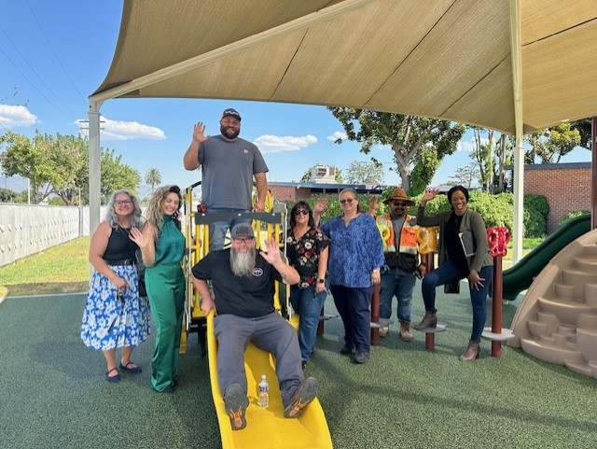
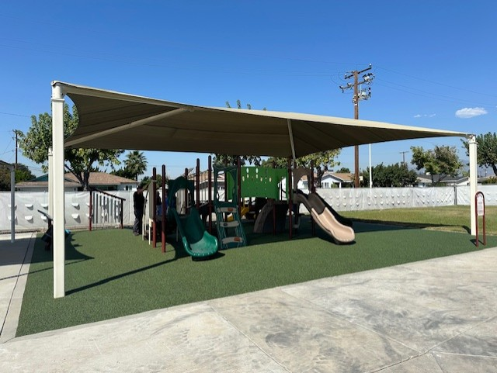
Projects Completed as of October 24, 2024
Fairgrove Academy – Playground & Shade Structure
BEORE
AFTER

Slide 4
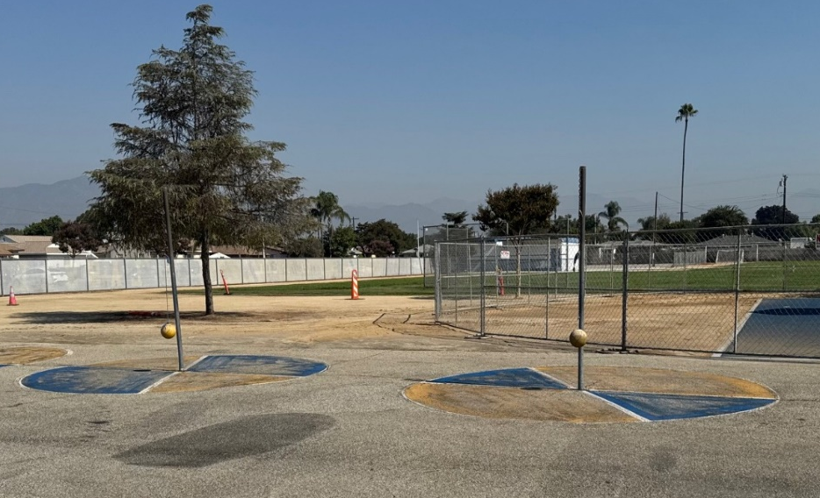
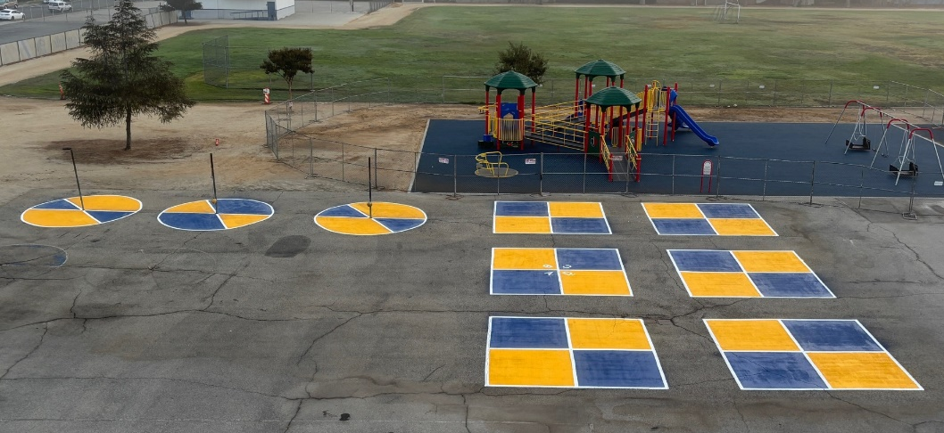
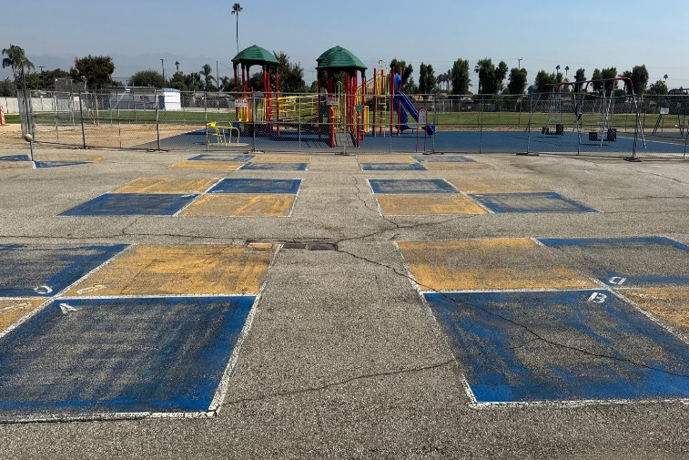
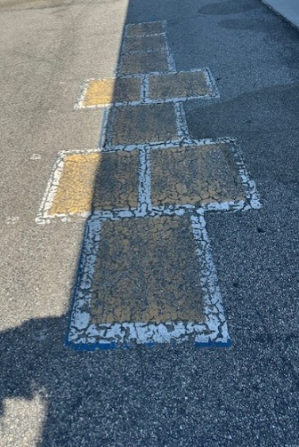
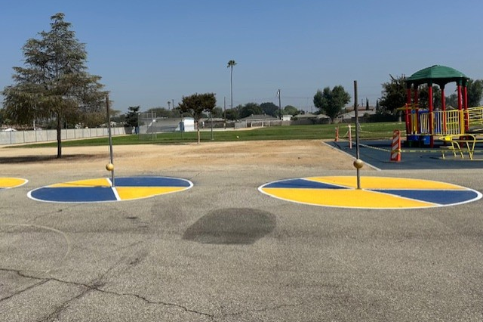
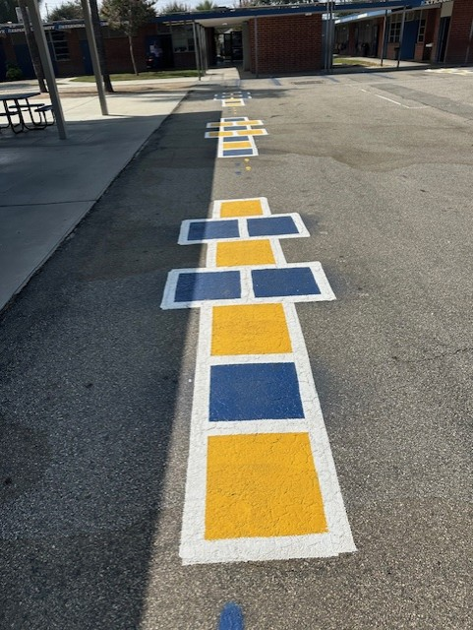
Projects Completed as of October 24, 2024
Lassalette Elementary School – Playground Restriping
BEFORE
AFTER
BEORE
AFTER

Slide 5
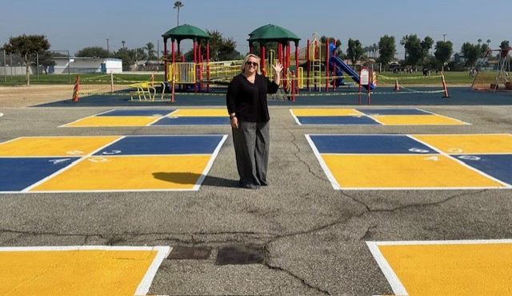
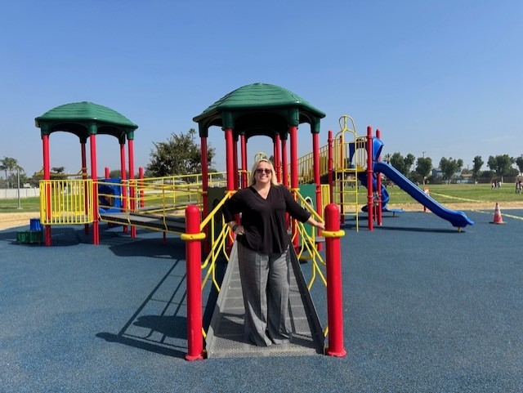
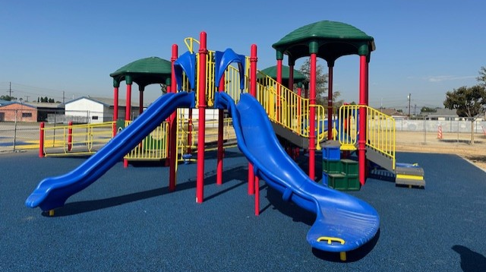

Projects Completed as of October 24, 2024
Lassalette Elementary School – Inclusive Playground
AFTER

Slide 6
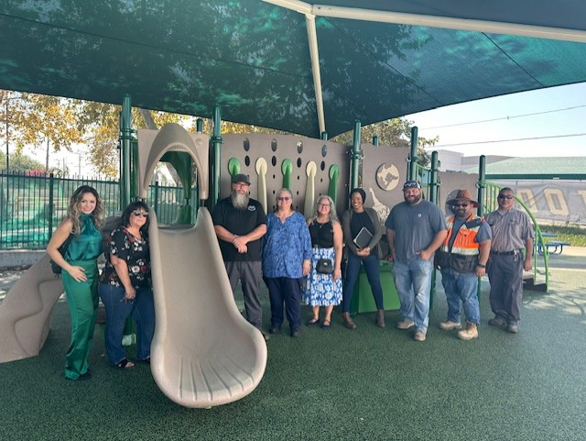
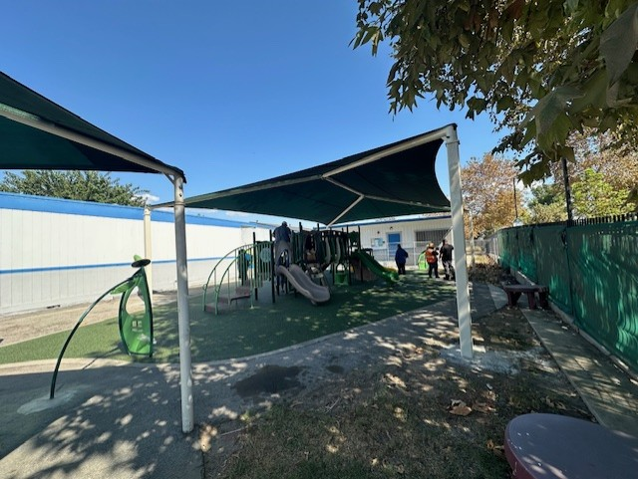
Projects Completed as of October 24, 2024
Nelson Elementary School – Playground & Shade Structure

Slide 7
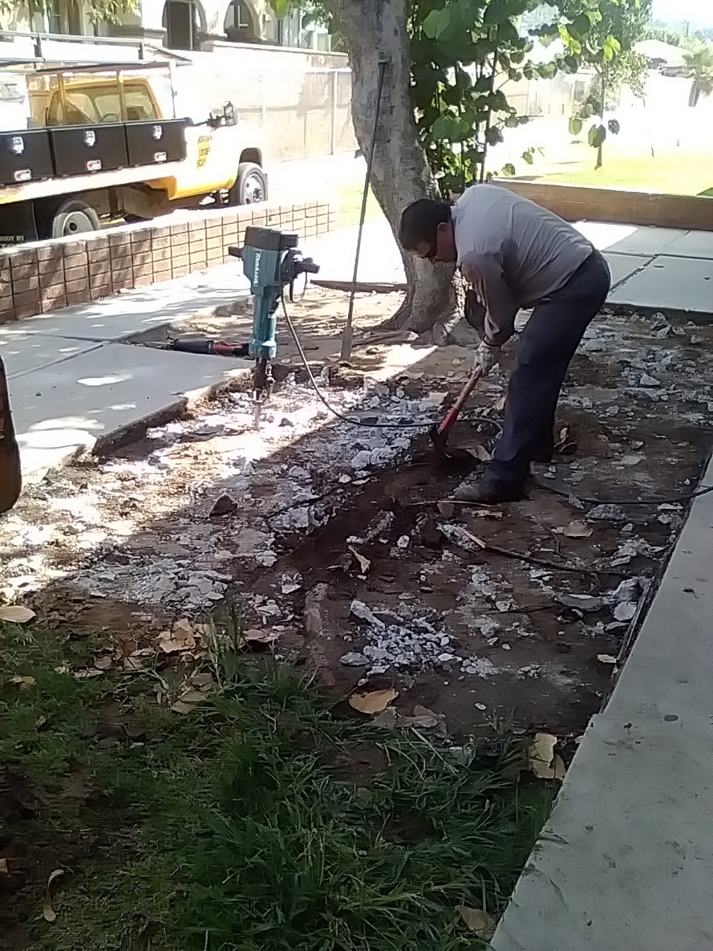
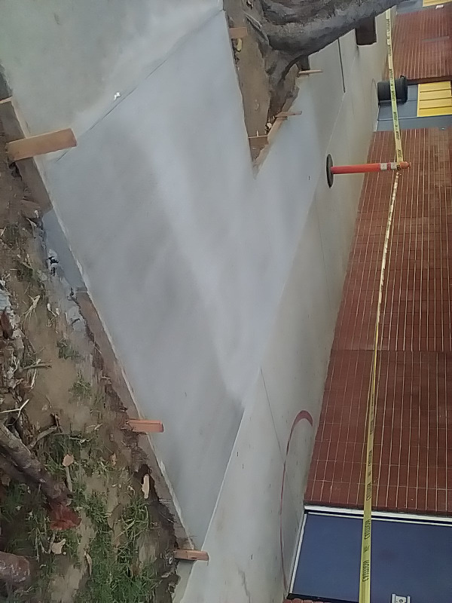
Projects Completed as of October 24, 2024
Districtwide – Trip Hazard Repair (Sierra Vista Middle School)
BEORE
AFTER

Slide 8
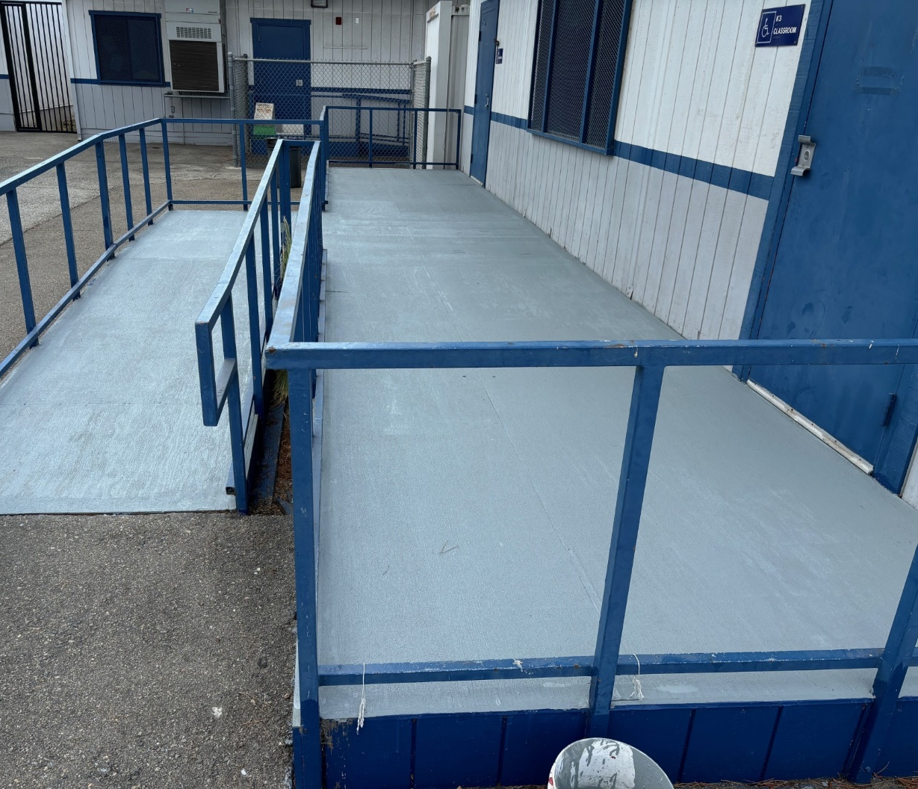
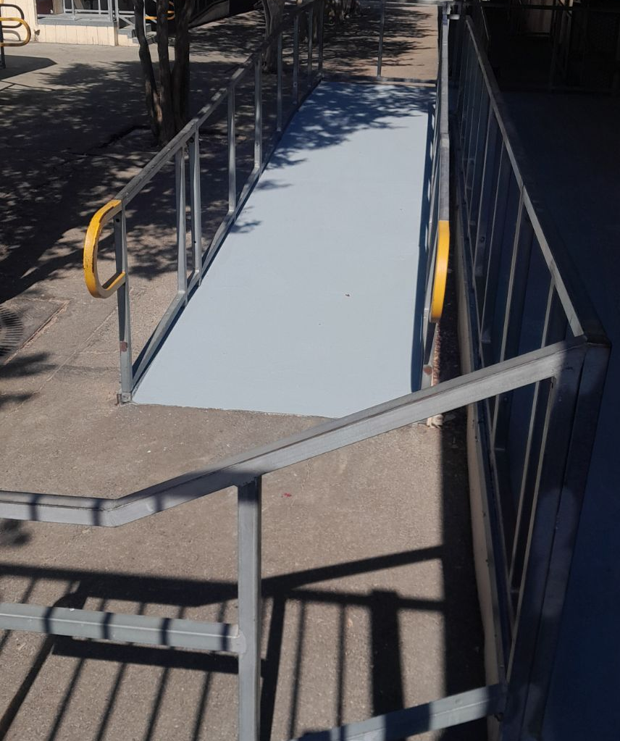
Projects Completed as of October 24, 2024
Districtwide – Ramp Repair
BEORE
AFTER

Slide 9
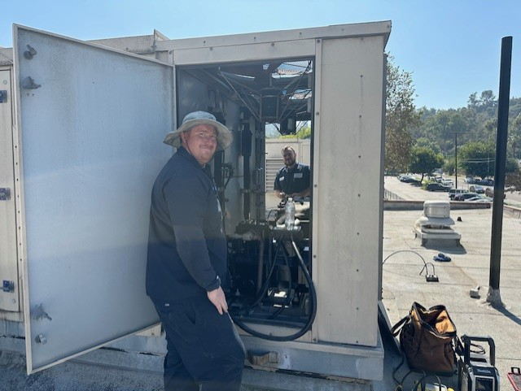
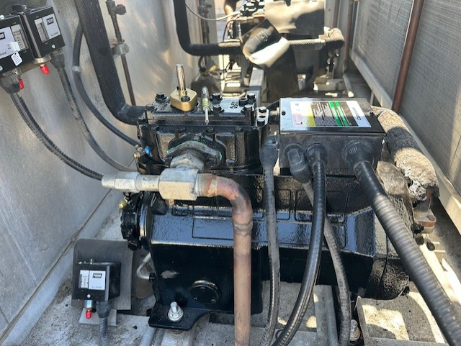
Projects Completed as of October 24, 2024
Wing Lane Elementary School, Building 60 – HVAC Repair
BEORE
AFTER

Slide 10

Projects In Progress 2024-2025

Slide 11
Projects in Progress as of October 24, 2024
Facilities
Site | Item Description | Architect Plans | DSA Approval | Procurement | Construct | Funding Source | Target Completion Date
District Office | Data Center Move | Complete | N/A | Complete | Pending | ESSR/General | TBD
Districtwide | HVAC System Replacement | Pending | TBD | TBD | TBD | Facilities | TBD
Grazide Elementary School | Portable 7 | N/A | N/A | Pending | Pending | Facilities | TBD
Kwis Elementary School | Baseball Fields | Complete | Approved | In Progress | TBD | Grant | TBD
La Puente High School | Custom Shade Structure | Complete | Approved | Pending | Pending | Facilities | TBD
Los Altos High School | Stadium Press Box & Bleachers | Complete | Pending | Pending | Pending | Facilities | TBD
Stimson Learning Center | Phase II of re-roofing | Complete | Complete | Complete | In Progress | Facilities | 12/2024
Wedgeworth Elementary School | K-5 Permanent School | Complete | Approved | Complete | In Progress | COPS | 06/2025
Wilson High School | Media Center | Pending | TBD | TBD | TBD | Grant | 06/2025
Wilson High School | Stadium Press Box & Bleachers | Complete | Pending | Pending | Pending | Facilities | TBD
Workman High School | Phase II Stadium and Baseball Field | Complete | Approved | Approved | In Progress | Facilities | TBD
Workman High School | Shade Structure, Wall, & Track Lighting | Complete | Pending | Pending | Pending | Facilities | TBD
Notes:
Los Altos High School, expected to begin in July

Slide 12
Projects in Progress as of October 24, 2024
Child Development
Site | Item Description | Architect Plans | DSA Approval | Procurement | Construct | Funding Source | Target Completion Date
Amar Center | Entry Security Project | Complete | Approved | Pending | Pending | Child Development | TBD
Amar Center | Phase II of Re-Roofing | N/A | N/A | Pending | Pending | Child Development | TBD
Workman Elementary School Head Start | Playground & Accessibility Path of Travel | Pending | TBD | TBD | TBD | Child Development | TBD
Changes And Progress Since Last Report - Blue

Slide 13
Projects in Progress as of October 24, 2024
Adult Ed
Site | Item Description | Architect Plans | DSA Approval | Procurement | Construct | Funding Source | Target Completion Date
Center for the Performing Arts | Center for the Performing Arts | In Redesign | Complete | Pending | TBD | Adult Ed | TBD
Dibble Adult Ed | Admin Upgrade | In Progress | NA | TBD | TBD | Adult Ed | TBD
Willow Adult Ed | Marquee | Complete | NA | Pending | TBD | Adult Ed | TBD
Changes And Progress Since Last Report - Blue

Slide 14
Projects in Progress as of October 24, 2024
Nutrition Services
Site | Item Description | Architect Plans | DSA Approval | Procurement | Construct | Funding Source | Target Completion Date
Baldwin Academy | Kitchen Renovation - Three Compartment Sink Installation | Complete | NA | Pending | TBD | Food Services | TBD
District Office | Warehouse Freezer | Complete | NA | Pending | TBD | Food Services | TBD
Mesa Robles Middle School | Kitchen Renovation | Complete | Approved | Pending | TBD | Food Services | TBD
Wilson High School | Kitchen Modernization | Pending | Pending | Pending | TBD | Food Services | TBD
Changes And Progress Since Last Report - Blue
Notes:
Kwis Baseball – Will be Re-Bid, uncertified entry was added to scope of work into the project.
Cedarlane Portable – In design phase with PBK architecture. Soils samples being conducted.
Willow Adult School = Two Story Building continues to be under construction. It coming along very well.

Slide 15
Next Report – December 17, 2024

