Slide 1
HACIENDA LA PUENTE UNIFIED SCHOOL DISTRICT
School Site Improvement Projects
Regular Board Meeting January 23, 2025
Business Services
Notes:
Good evening Ma’dam President, Ms. Christine Salazar, Distinguish Board Members; Superintendent, Dr. Jimenez, Executive Cabinet, Colleagues, and community members.
A special greetings to our Principals, Administrators, staff member who are joining us via the virtual platform.

Slide 2
PROJECT COMPLETE LIST
2024/2025
Site | Item Description | Funding Source | Completed Date
Cedarlane Academy | Gas Leak Repair | Facilities | 1/2025
La Puente High School | Outside Lighting | Facilities | 12/2024
La Puente High School | Gym Paint Refresh | Facilities | 12/2024
Orange Grove Middle School | Landscape Clean-up | Facilities | 12/2024
Sparks Middle School | Office Paint Refresh | Facilities | 12/2024
Stimson Learning Center | Phase II of Re-roofing | Facilities | 12/2024
Wilson High School | Gas Leak Repair | Facilities | 12/2024
Dibble Adult Education | Trip Hazard Repair | Facilities | 11/2024
District Office | Trip Hazard Repair | Facilities | 11/2024
Grazide Elementary School | Portable 7 Refurbishment | Facilities | 11/2024
Los Altos Elementary School | Portable Deep Clean | Facilities | 11/2024
Wilson High School | Hazard Repair | Facilities | 11/2024
Newton Middle School | Temporary Fencing | Facilities | 10/2024
Changes And Progress Since Last Report - Blue

Slide 3
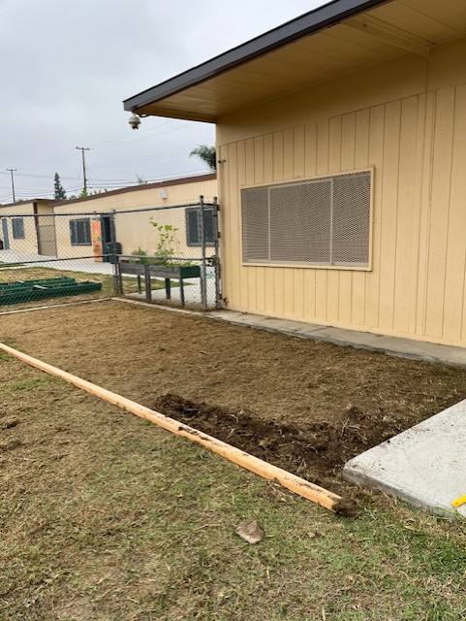
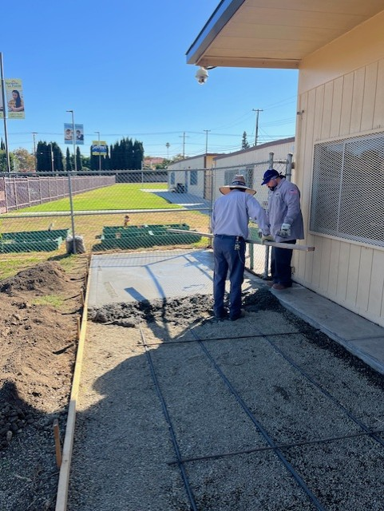
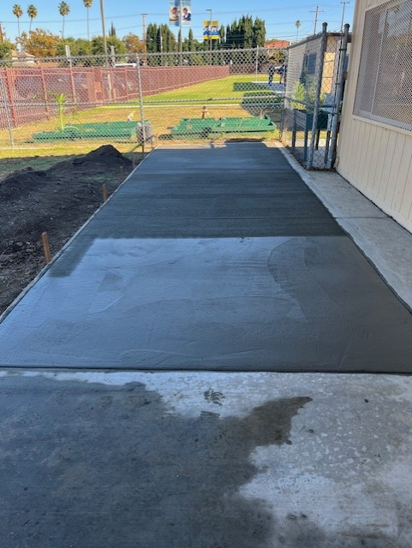
Projects Completed as of January 23, 2025 Dibble Adult School – Trip Hazard Repair
BEORE
AFTER

Slide 4
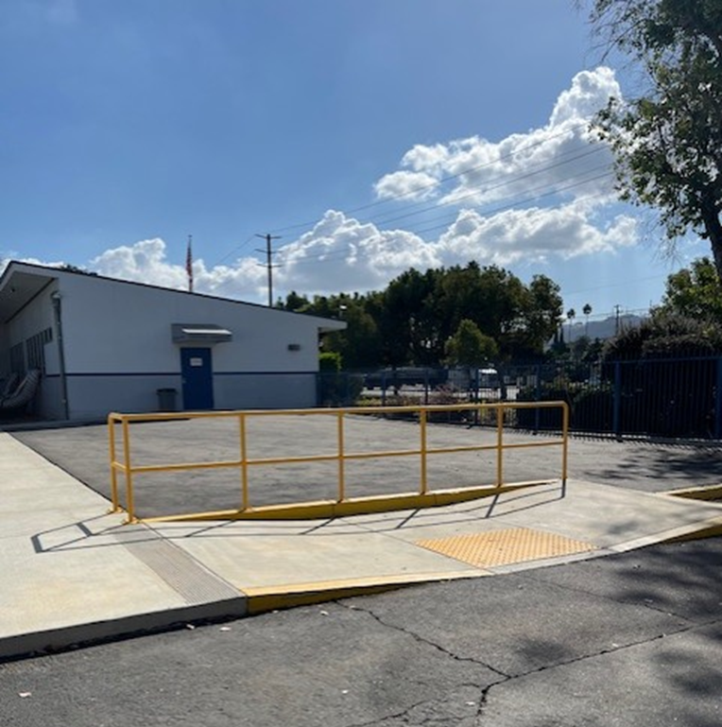
Projects Completed as of January 23, 2025 District Office – Trip Hazard Repair
BEORE
AFTER

Slide 5
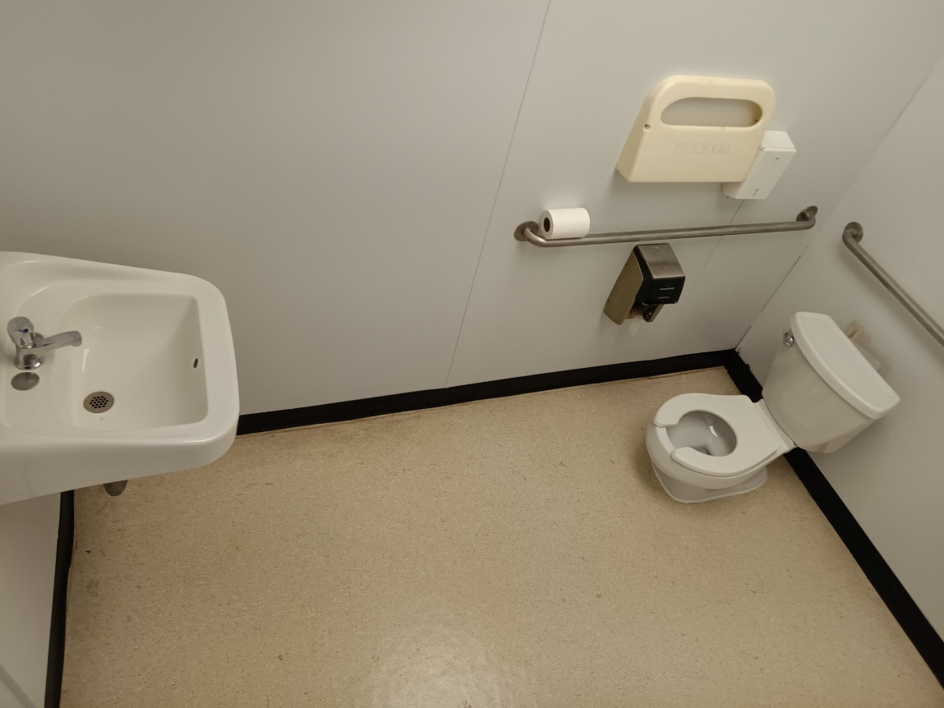
Projects Completed as of January 23, 2025 Grazide Elementary School – Portable Refurbishment
AFTER

Slide 6
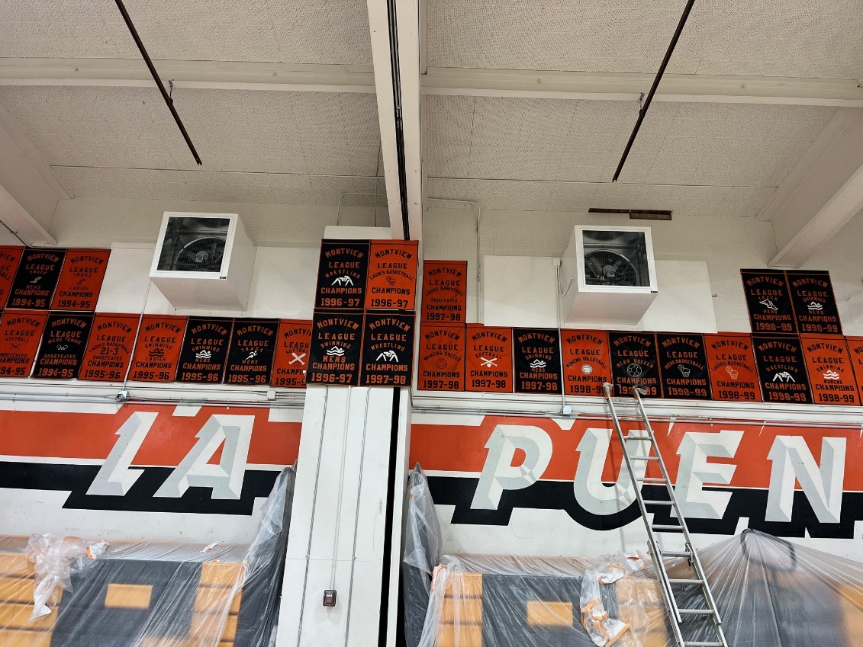
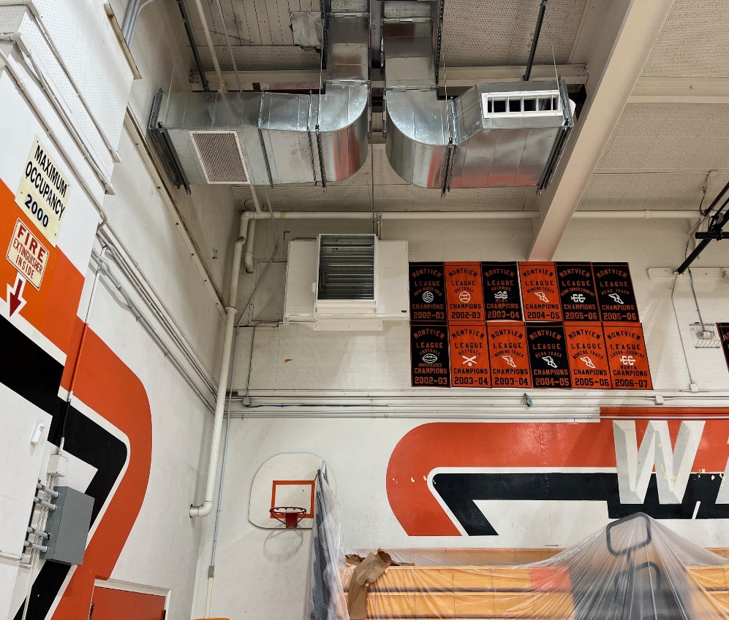
Projects Completed as of January 23, 2025 La Puente High School – Gym Paint Refresh

Slide 7
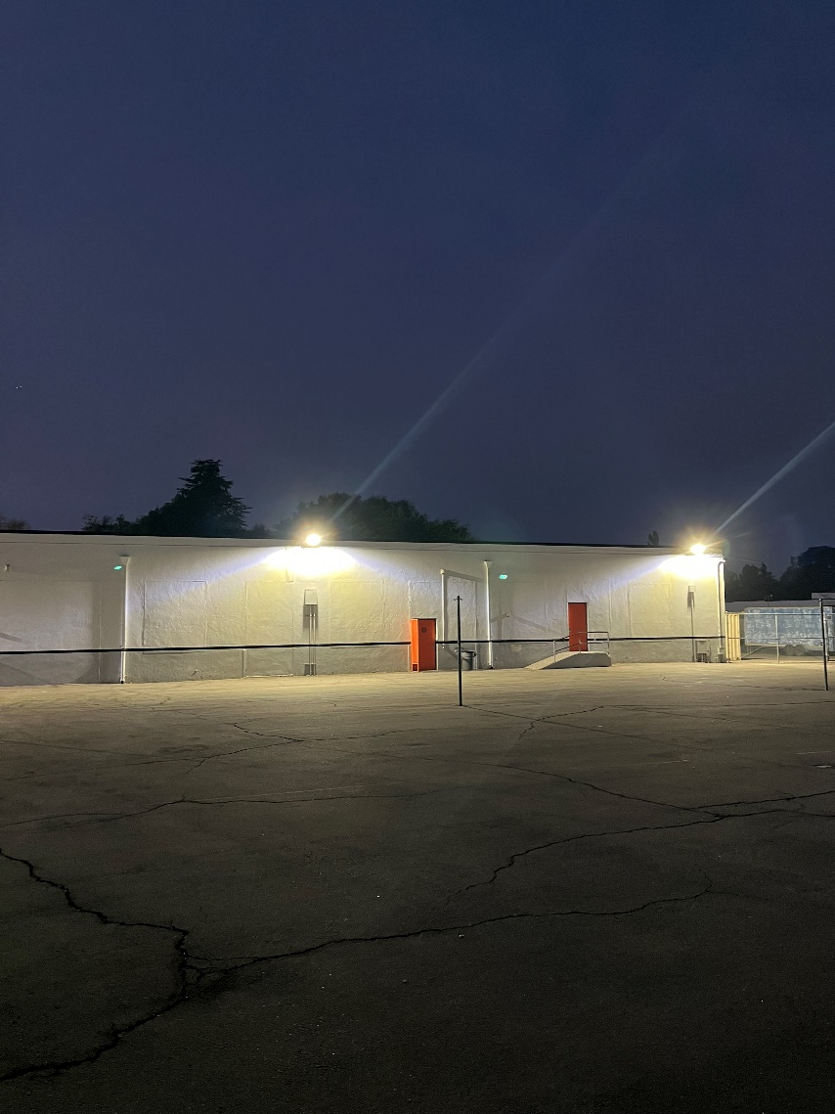
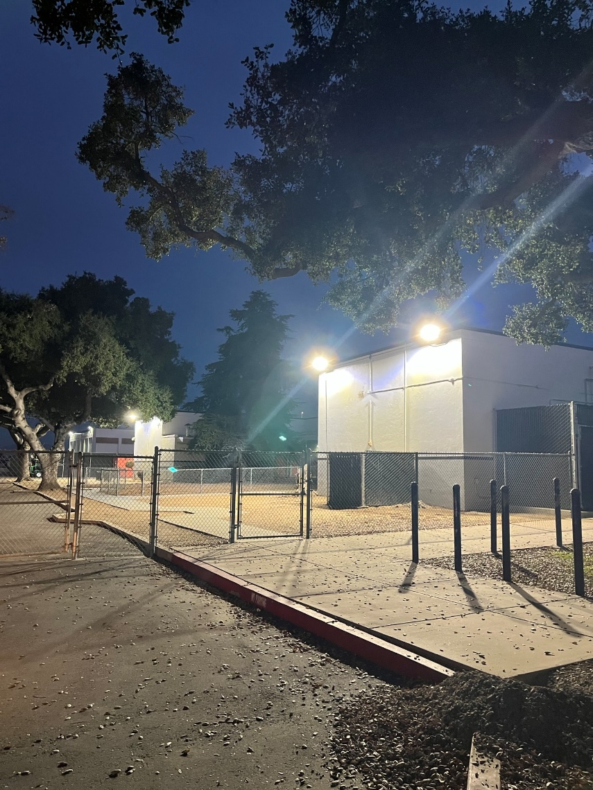
Projects Completed as of January 23, 2025 La Puente High School – Lighting

Slide 8
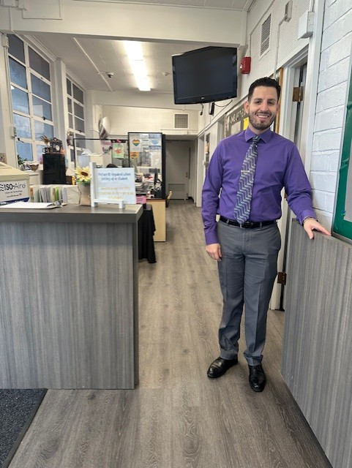
Projects Completed as of January 23, 2025 Sparks Middle School – Office Paint Refresh
BEORE
AFTER

Slide 9
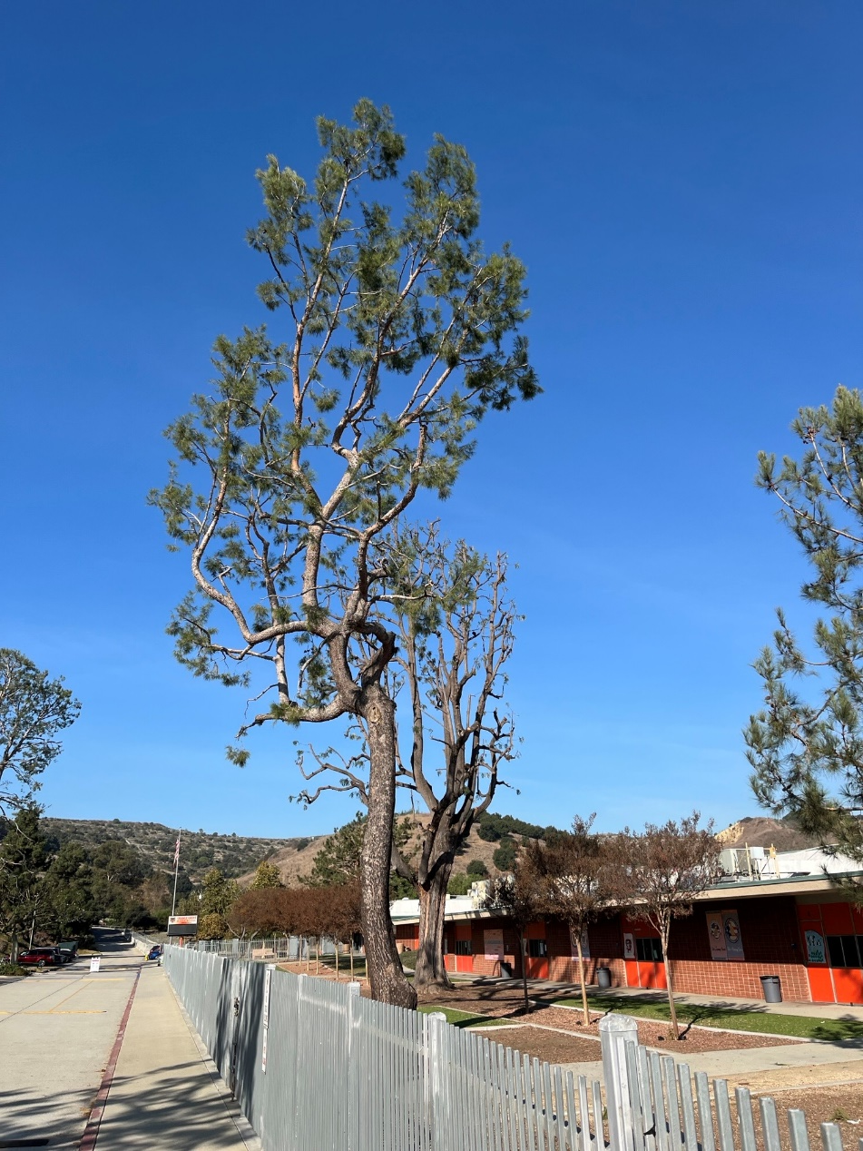
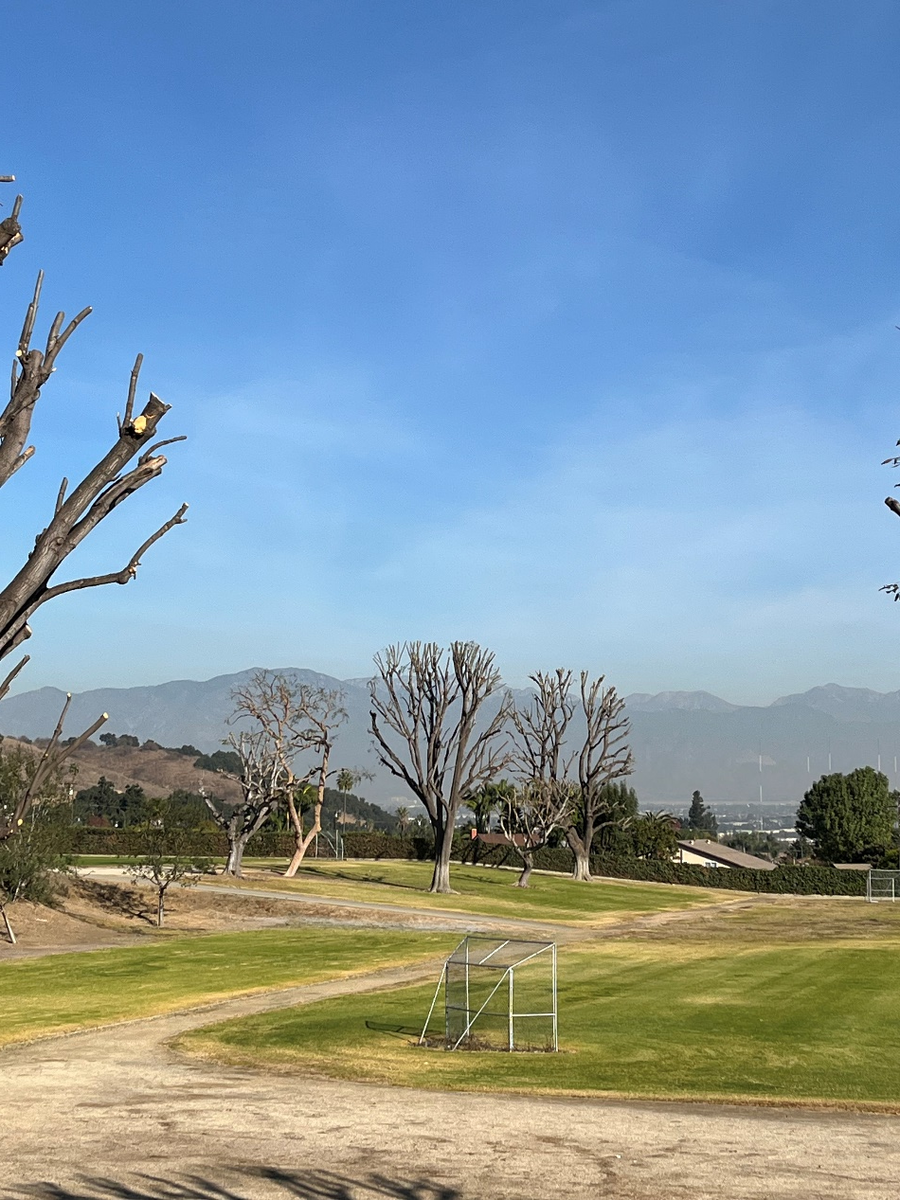
Projects Completed as of January 23, 2025 Orange Grove Middle School – Landscape Clean-Up
BEORE
AFTER

Slide 10
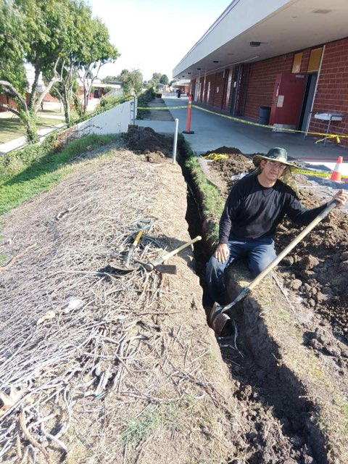
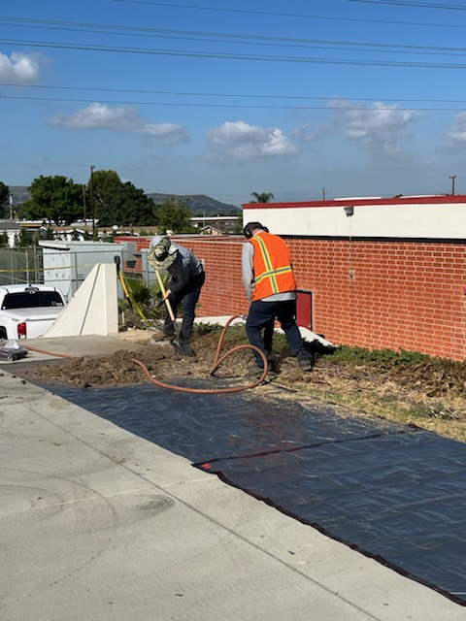
Projects Completed as of January 23, 2025 Wilson High School – Gas Leak Repair
BEORE
AFTER

Slide 11
Projects In Progress 2024-2025

Slide 12
Projects in Progress as of January 23, 2025
Facilities
Site | Item Description | Architect Plans | DSA Approval | Procurement | Construct | Funding Source | Target Completion Date
District Office | Data Center Move | Complete | N/A | Complete | In Progress | ESSR/General | 04/2025
Districtwide | HVAC System Replacement | Pending | TBD | TBD | TBD | TBD | TBD
Districtwide | Network Upgrade Project | N/A | N/A | TBD | TBD | TBD | TBD
Kwis Elementary School | Baseball Fields | Complete | Approved | In Progress | TBD | Grant | TBD
La Puente High School | Custom Shade Structure | Complete | Approved | Pending | Pending | Facilities | 12/2025
Los Altos High School | Stadium Press Box & Bleachers | Complete | Pending | Pending | Pending | Facilities | TBD
Newton Middle School | Fence | N/A | N/A | TBD | TBD | TBD | TBD
Wedgeworth Elementary School | K-5 Permanent School | Complete | Approved | Complete | In Progress | COPS | 06/2025 (Potential Partial Soft Opening 4/2025)
Wilson High School | Classroom Sound Abatement | N/A | N/A | Pending | Pending | Facilities | TBD
Wilson High School | Media Center | Pending | TBD | TBD | TBD | Grant | 06/2026
Wilson High School | Stadium Press Box & Bleachers | Complete | Pending | Pending | Pending | Facilities | TBD
Workman High School | Phase II Stadium and Baseball Field | Complete | Approved | Approved | In Progress | Facilities | 12/2025
Workman High School | Shade Structure, Wall, & Track Lighting | Complete | Pending | Pending | Pending | Facilities | TBD
Notes:
Los Altos High School, expected to begin in July

Slide 13
Projects in Progress as of January 23, 2025 Wilson High School – Media Center Renderings

Slide 14
Projects in Progress as of January 23, 2025 Wilson High School – Media Center Renderings

Slide 15
Projects in Progress as of January 23, 2025
Child Development
Site | Item Description | Architect Plans | DSA Approval | Procurement | Construct | Funding Source | Target Completion Date
Amar Center | Entry Security Project | Complete | Approved | Pending | Pending | Child Development | TBD
Amar Center | Phase II of Re-Roofing | N/A | N/A | Pending | Pending | Child Development | TBD
Workman Elementary School Head Start | Playground & Accessibility Path of Travel | Pending | TBD | TBD | TBD | Child Development | TBD
Changes And Progress Since Last Report - Blue

Slide 16
Projects in Progress as of January 23, 2025
Adult Ed
Site | Item Description | Architect Plans | DSA Approval | Procurement | Construct | Funding Source | Target Completion Date
Center for the Performing Arts | Center for the Performing Arts | In Progress | Complete | Pending | TBD | Adult Ed | TBD
Dibble Adult Ed | Admin Upgrade | In Progress | NA | TBD | TBD | Adult Ed | TBD
Willow Adult Ed | Dental Office | NA | NA | In Progress | TBD | Adult Ed | TBD
Willow Adult Ed | Marquee | Complete | NA | In Progress | TBD | Adult Ed | TBD
Changes And Progress Since Last Report - Blue

Slide 17
Projects in Progress as of January 23, 2025
Nutrition Services
Site | Item Description | Architect Plans | DSA Approval | Procurement | Construct | Funding Source | Target Completion Date
Baldwin Elementary School | Kitchen Renovation - Three Compartment Sink Installation | Complete | NA | In Progress | TBD | Food Services | TBD
District Office | Warehouse Freezer | Complete | NA | In Progress | TBD | Food Services | TBD
Mesa Robles Middle School | Kitchen Renovation | Complete | Approved | In Progress | TBD | Food Services | TBD
Wilson High School | Kitchen Modernization | Pending | Pending | In Progress | TBD | Food Services | TBD
Changes And Progress Since Last Report - Blue
Notes:
Kwis Baseball – Will be Re-Bid, uncertified entry was added to scope of work into the project.
Cedarlane Portable – In design phase with PBK architecture. Soils samples being conducted.
Willow Adult School = Two Story Building continues to be under construction. It coming along very well.

Slide 18
Next Report – February 27, 2025

