Slide 1
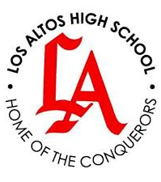
HACIENDA LA PUENTE UNIFIED SCHOOL DISTRICT
School Site Improvement Projects
Regular Board Meeting February 27, 2025
Business Services
Notes:
Good evening Ma’dam President, Ms. Christine Salazar, Distinguish Board Members; Superintendent, Dr. Jimenez, Executive Cabinet, Colleagues, and community members.
A special greetings to our Principals, Administrators, staff member who are joining us via the virtual platform.

Slide 2
PROJECT COMPLETE LIST
2024/2025
Site | Item Description | Funding Source | Completed Date
Baldwin Academy | Restriping | Facilities | 2/2024
Newton Middle School | Fence Installation | Facilities | 2/2024
Los Altos High School | Paint Refresh | Facilities | 2/2024
Valley High School | Paint Refresh | Facilities | 2/2024
Wilson High School | Classroom Sound Abatement | Facilities | 2/2024
Baldwin Academy | Trip Hazard Repair | Facilities | 1/2024
Cedarlane Academy | Gas Leak Repair | Facilities | 1/2024
La Puente High School | Outside Lighting | Facilities | 12/2024
La Puente High School | Gym Paint Refresh | Facilities | 12/2024
Orange Grove Middle School | Landscape Clean-up | Facilities | 12/2024
Sparks Middle School | Office Paint Refresh | Facilities | 12/2024
Stimson Learning Center | Phase II of Re-roofing | Facilities | 12/2024
Wilson High School | Gas Leak Repair | Facilities | 12/2024
Dibble Adult Education | Trip Hazard Repair | Facilities | 11/2024
District Office | Trip Hazard Repair | Facilities | 11/2024
Changes And Progress Since Last Report - Blue

Slide 3
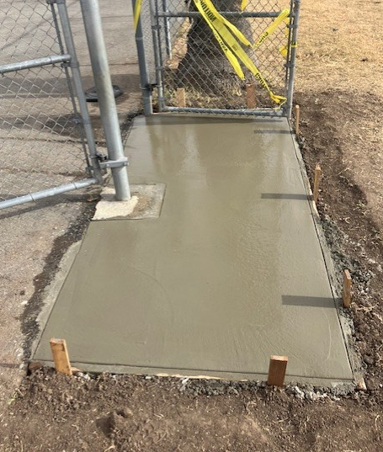
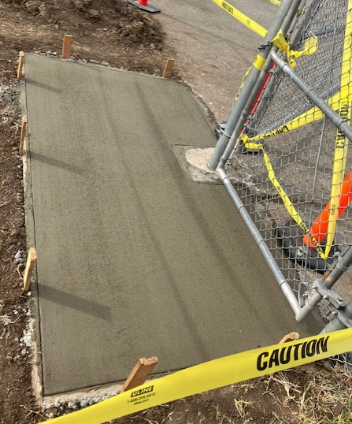
Projects Completed as of February 27, 2025 Baldwin Academy – Trip Hazard Repair
BEORE
AFTER

Slide 4
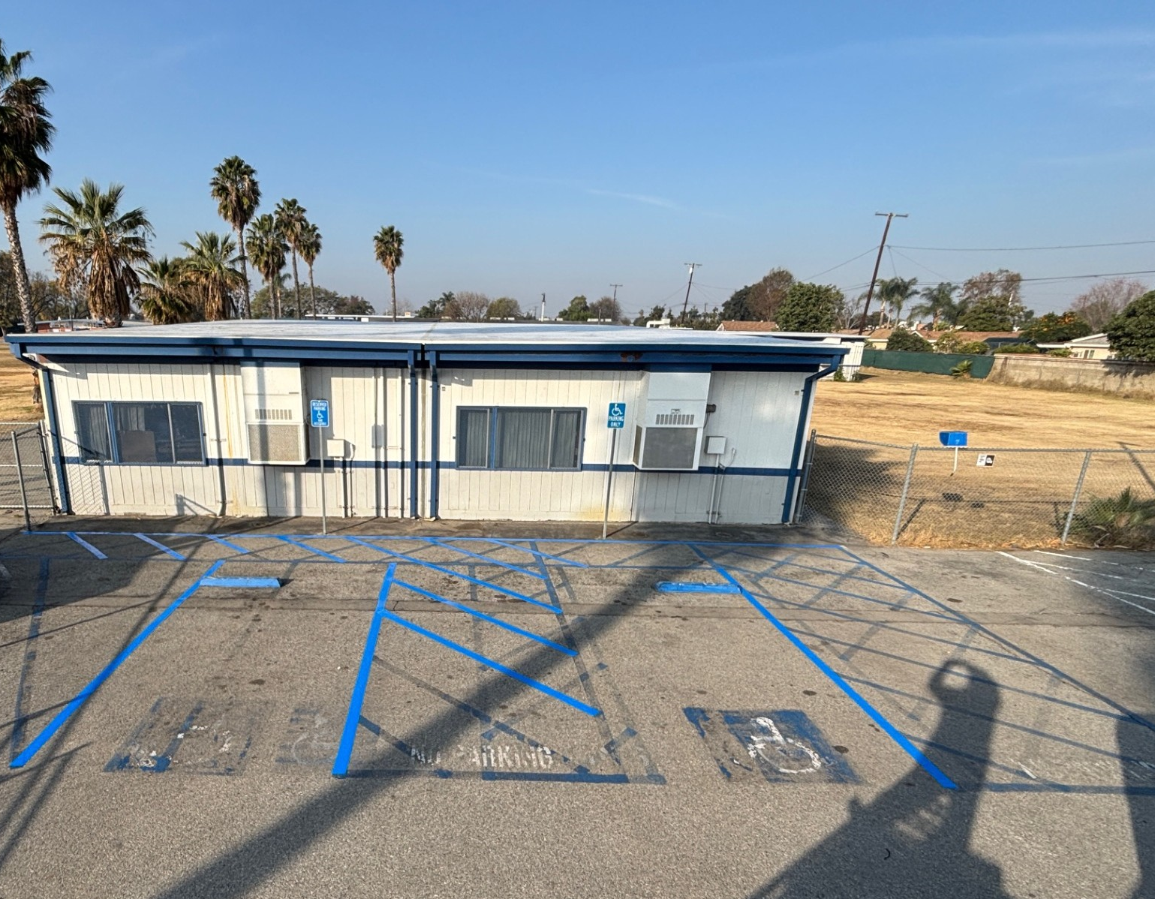
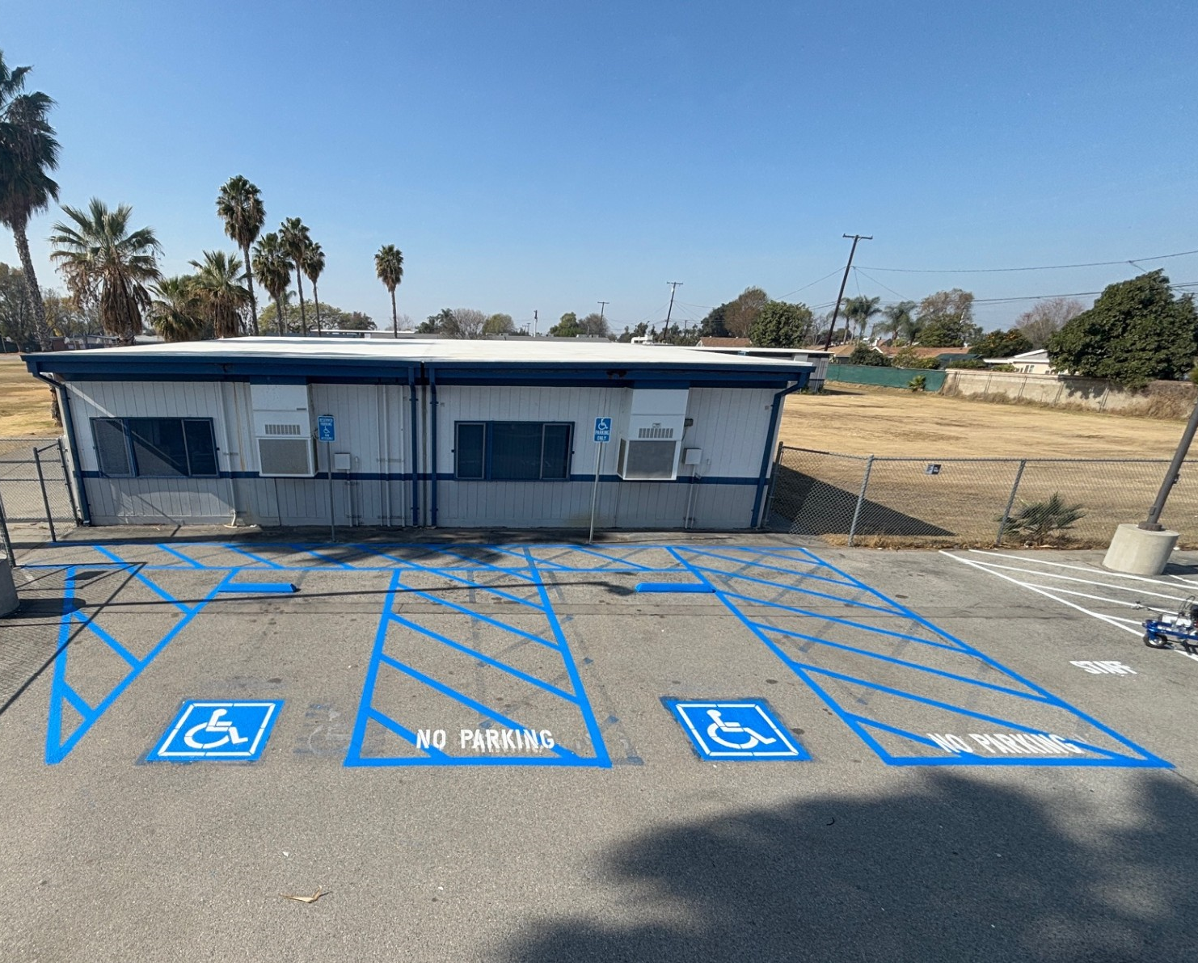
Projects Completed as of February 27, 2025 Baldwin Academy– Restriping
BEFORE
AFTER

Slide 5
Projects Completed as of February 27, 2025 Newton Middle School – Fence Installation

Slide 6
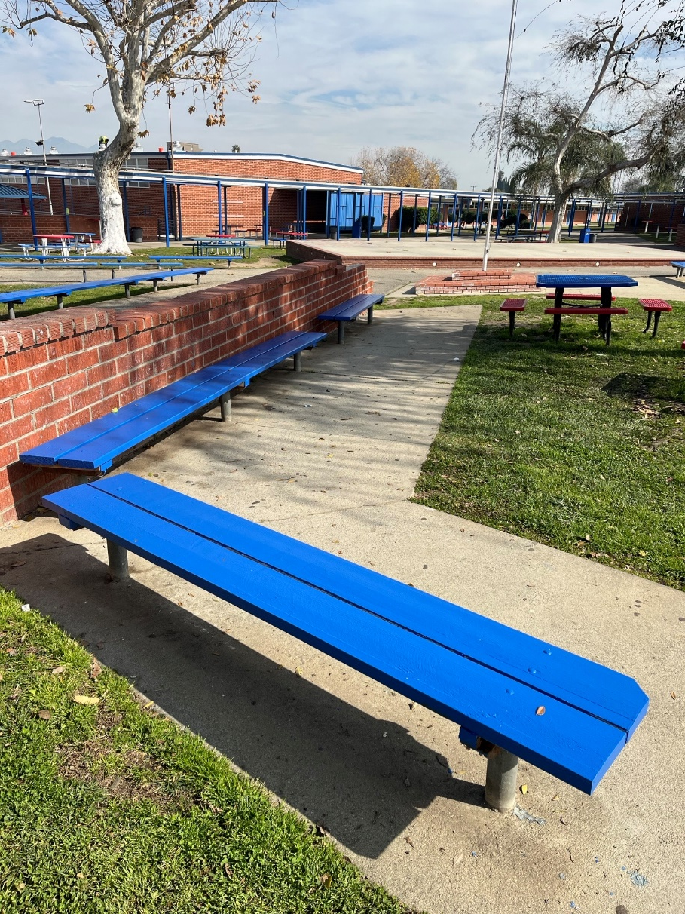
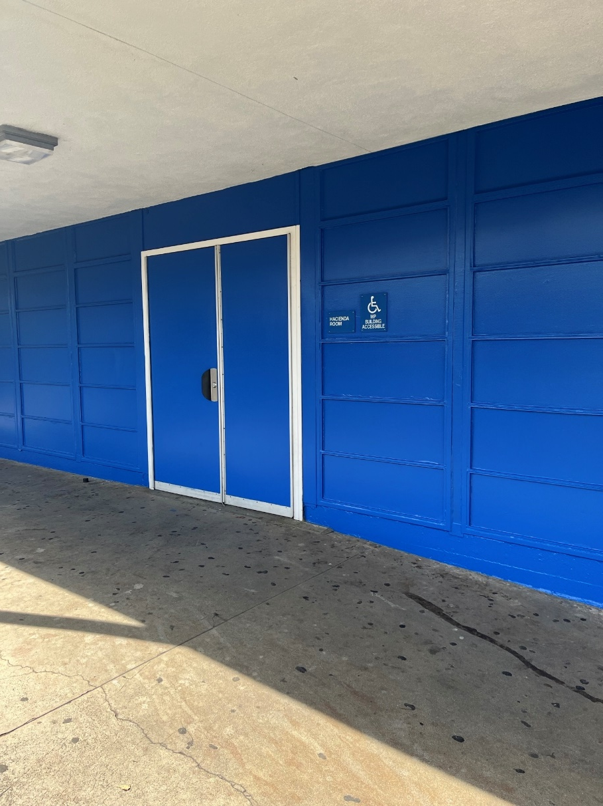
Projects Completed as of February 27, 2025 Los Altos High School – Paint Refresh

Slide 7
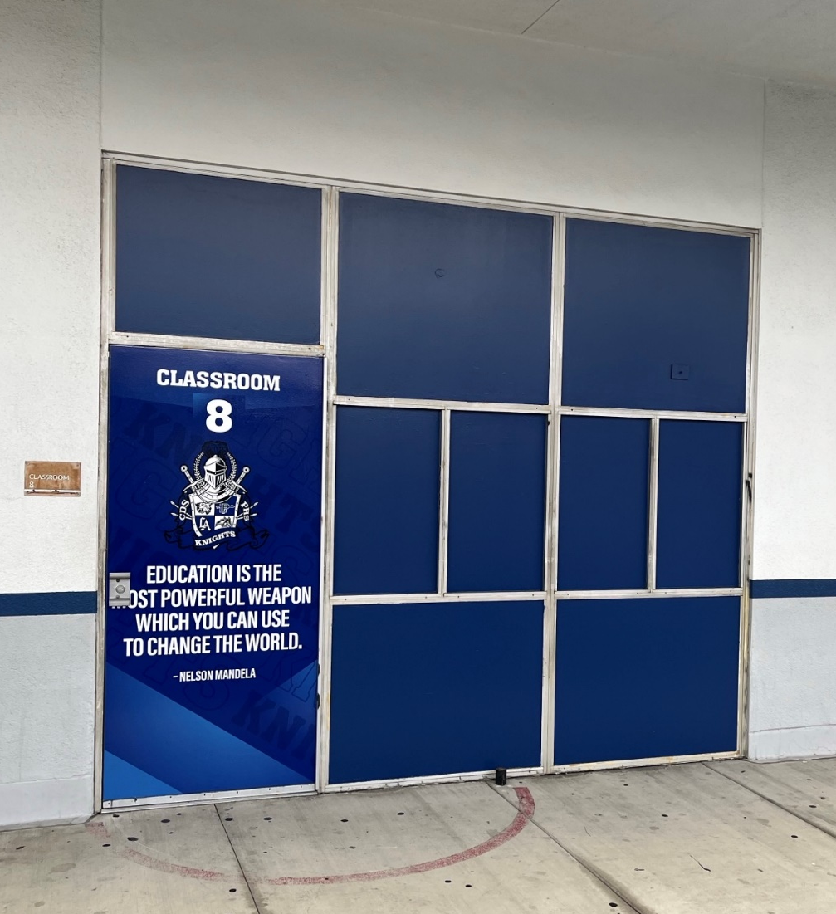
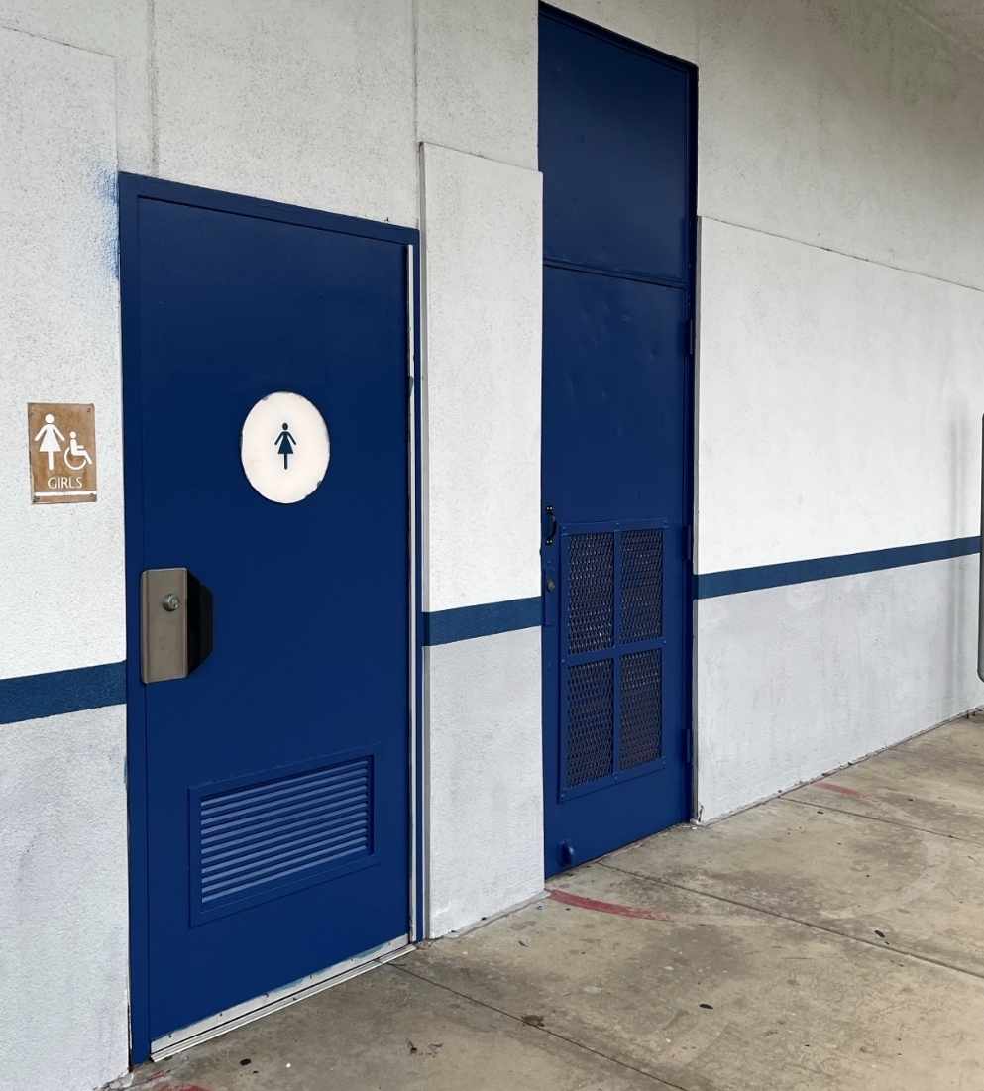
Projects Completed as of February 27, 2025 Valley High School – Paint Refresh

Slide 8
Projects In Progress 2024-2025

Slide 9
Projects in Progress as of February 27, 2025 Los Molinos Elementary Interim Housing Phase II

Slide 10
Projects in Progress as of February 27, 2025
Facilities
Site | Item Description | Architect Plans | DSA Approval | Procurement | Construct | Funding Source | Target Completion Date
District Office | Data Center Move | Complete | N/A | Complete | In Progress | ESSR/General | 04/2025
Districtwide | HVAC System Replacement | Pending | TBD | TBD | TBD | TBD | TBD
Districtwide | Network Upgrade Project | N/A | N/A | Complete | In Progress | ESSR | 12/2026
La Puente High School | Custom Shade Structure | Complete | Approved | Complete | Pending | Surplus Property Sales | 12/2025
Los Altos High School | Stadium Press Box & Bleachers | Complete | Pending | Pending | Pending | General Fund/ Surplus Property Sales | TBD
Sparks Middle School | Irrigation Project/ Tree Planting | N/A | N/A | Approved | In Progress | Grant
Wedgeworth Elementary School | K-5 Permanent School | Complete | Approved | Complete | In Progress | COPS | 06/2025
Wilson High School | Media Center | Pending | N/A | TBD | TBD | Grant | 06/2026
Wilson High School | Stadium Press Box & Bleachers | Complete | Complete | Pending | Pending | General Fund | TBD
Workman High School | Phase II Stadium and Baseball Field | Complete | Approved | Approved | In Progress | General Fund/ Surplus Property Sales | 12/2025
Workman High School | Shade Structure, Wall, & Track Lighting | Complete | Pending | Pending | Pending | General Fund/ Surplus Property Sales | TBD
Changes And Progress Since Last Report - Blue
Notes:
Los Altos High School, expected to begin in July

Slide 11
Projects in Progress as of February 27, 2025 Sparks Middle School – Irrigation Project / Tree Planting

Slide 12
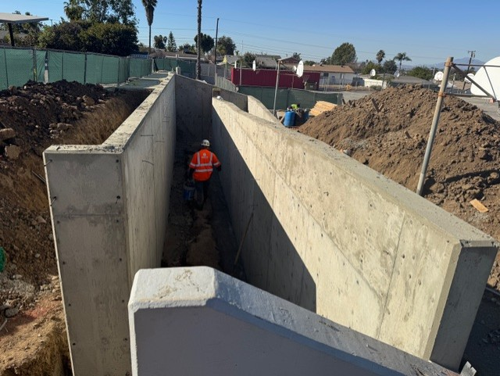
Projects in Progress as of February 27, 2025 Workman High School– ADA Ramp at Basketball Courts

Slide 13
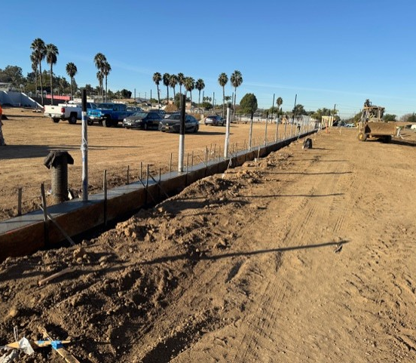
Projects in Progress as of February 27, 2025 Workman High School – Football Field

Slide 14
Projects in Progress as of February 27, 2025
Child Development
Site | Item Description | Architect Plans | DSA Approval | Procurement | Construct | Funding Source | Target Completion Date
Amar Center | Entry Security Project | Complete | Approved | Complete | Pending | Child Development | TBD
Amar Center | Phase II of Re-Roofing | N/A | N/A | Complete | In Progress | Child Development | TBD
Workman Elementary School Head Start | Playground & Accessibility Path of Travel | Complete | Pending | TBD | TBD | Child Development | TBD
Changes And Progress Since Last Report - Blue

Slide 15
Projects in Progress as of February 27, 2025
Adult Ed
Site | Item Description | Architect Plans | DSA Approval | Procurement | Construct | Funding Source | Target Completion Date
Center for the Performing Arts | Center for the Performing Arts | In Progress | Complete | Pending | TBD | Adult Ed | TBD
Dibble Adult Ed | Front Entry Alterations & Conference Hall | Complete | NA | TBD | TBD | Adult Ed | TBD
Willow Adult Ed | Dental Office | NA | NA | Complete | In Progress | Adult Ed | TBD
Willow Adult Ed | Marquee | Complete | NA | Complete | Pending | Adult Ed | TBD
Changes And Progress Since Last Report - Blue

Slide 16
Projects in Progress as of February 27, 2025 Dibble Adult School – Front Entry Alterations Renderings

Slide 17
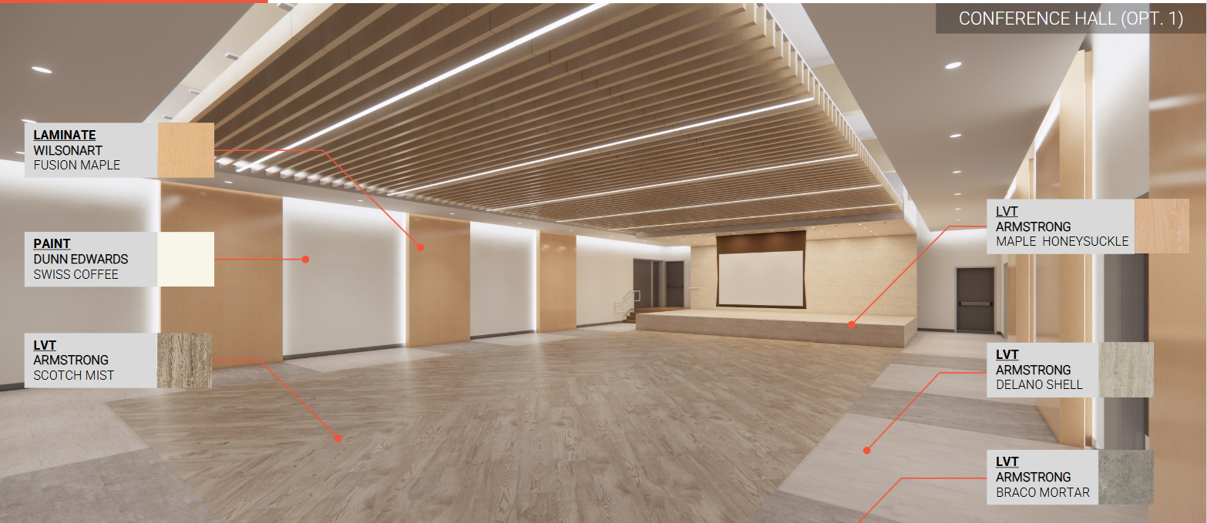
Projects in Progress as of February 27, 2025 Dibble Adult School – Conference Hall Renderings

Slide 18
Projects in Progress as of February 27, 2025
Nutrition Services
Site | Item Description | Architect Plans | DSA Approval | Procurement | Construct | Funding Source | Target Completion Date
Baldwin Elementary School | Kitchen Renovation - Three Compartment Sink Installation | Complete | NA | In Progress | TBD | Food Services | TBD
District Office | Warehouse Freezer | Complete | NA | Complete | Pending | Food Services | TBD
Mesa Robles Middle School | Kitchen Renovation | Complete | Approved | Complete | Pending | Food Services | TBD
Wilson High School | Kitchen Modernization | Pending | Pending | In Progress | TBD | Surplus Property Sales | TBD
Changes And Progress Since Last Report - Blue
Notes:
Kwis Baseball – Will be Re-Bid, uncertified entry was added to scope of work into the project.
Cedarlane Portable – In design phase with PBK architecture. Soils samples being conducted.
Willow Adult School = Two Story Building continues to be under construction. It coming along very well.

Slide 19
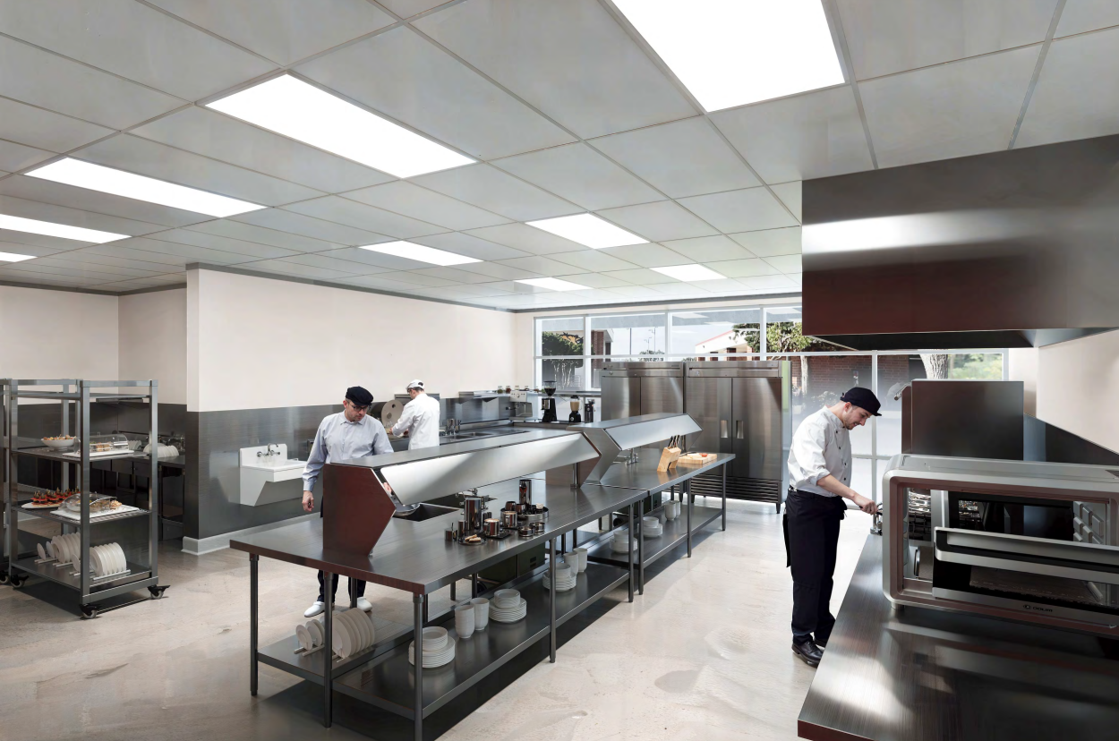
Projects in Progress as of February 27, 2025 Wilson High School – Kitchen Modernization Renderings
Changes And Progress Since Last Report - Blue
Notes:
Kwis Baseball – Will be Re-Bid, uncertified entry was added to scope of work into the project.
Cedarlane Portable – In design phase with PBK architecture. Soils samples being conducted.
Willow Adult School = Two Story Building continues to be under construction. It coming along very well.

Slide 20
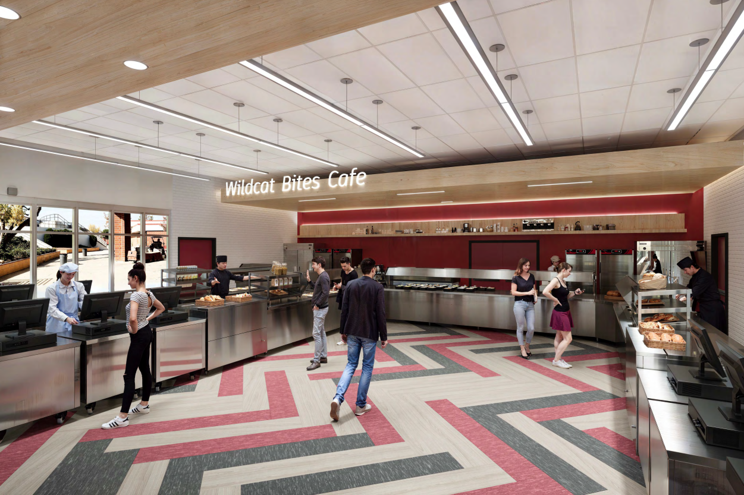
Projects in Progress as of February 27, 2025 Wilson High School – Kitchen Modernization Renderings
Changes And Progress Since Last Report - Blue
Notes:
Kwis Baseball – Will be Re-Bid, uncertified entry was added to scope of work into the project.
Cedarlane Portable – In design phase with PBK architecture. Soils samples being conducted.
Willow Adult School = Two Story Building continues to be under construction. It coming along very well.

Slide 21
Next Report – March 24, 2025

