Slide 1
The Medieval Period
The Middle Ages – Middle English
1066-1485

Slide 2
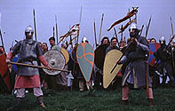
Began in 1066 with the invasion of the Normans, led by William of Normandy. (Battle of Hastings)
The ideologies of the Anglo-Saxons (solid and civilized) merged with the characteristics of the Normans (stylized and older).
Although the Normans ruled England for only 88 years, they brought the English culture closer to the mainstream of the European social, economic and political structure.

Slide 3
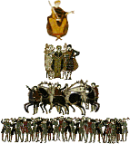
FEUDALISM - system of governing whereby semiautonomous landed nobility have certain well defined responsibilities to the king, lord or baron in return for the use of grants of land (fiefs) exploited with the labor of a semi-free peasantry (serfs).

Slide 4
Language in the Medieval Period changes as a result of the euphonic influences of the French.
In 1154, the royal houses of Plantagenet, Lancaster, and York succeeded the rule of the Normans.

Slide 5
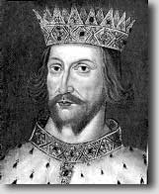
The House of Plantagenet
Henry II
He desired to control the Roman Catholic Church in England.
His oppression led to the murder of Thomas à Becket, the Archbishop of Canterbury.

Slide 6

Richard I
(Henry II’s son)
Known as Richard the Lion-Hearted
Exemplified a true knight
Ruled England for 10 years, but traveled Europe for all of 5 months of his reign
Gave wealth to the poor
Sought holy relics

Slide 7
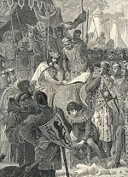
John
(Henry II’s son)
Succeeded his brother Richard I
Perceived as a weak, villainous ruler
Signed the Magna Carta (agreed not to raise taxes without the consent of the baron).

Slide 8
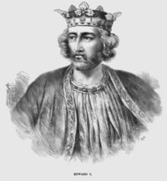
Edward I
popularly known as Longshanks,
achieved historical fame by conquering large parts of Wales and almost succeeding in doing the same to Scotland
Undertook a number of reforms to regain royal control in government and administration

Slide 9
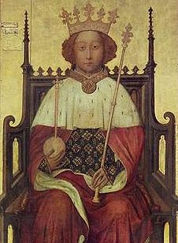
Richard II
Succeeded to the throne at the age of 10
Final King of the Plantagenet House
During first years as king, government was in the hands of a series of councils. The political community preferred this to a regency led by the king's uncle, John of Gaunt, yet Gaunt remained highly influential.
First major challenge of the reign was the Peasants' Revolt in 1381, which the young king handled well, playing a major part in suppressing the rebellion.
In 1387 control of government was taken over by a group of noblemen known as the Lords Appellant

Slide 10
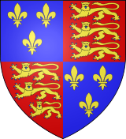
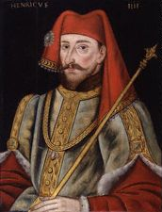
The House of Lancaster
Henry IV
First King of the House of Lancaster
Tries to assume the title King of France as well as King of England

Slide 11
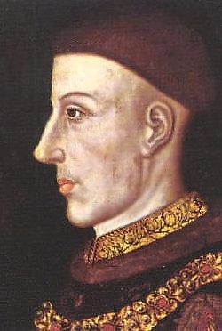
Henry V
(Prince Hal)
Led the British to victory over the French at the battle of Agincourt, a high-point of the Hundred Year’s War with France (1337-1453)

Slide 12
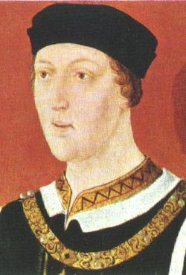
Henry VI
Suffered from Insanity
Relinquished his throne to his uncle, the Duke of York
When he regained his health, Henry attempted to regain control of England.

Slide 13
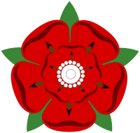
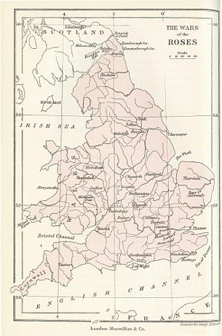
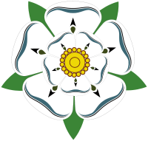
The conflict between Henry VI and his uncle, the Duke of York, initiated the 30 year civil strife know as the War of the Roses – The House of Lancaster (symbolized by a red rose) and The House of York (symbolized by a white rose).

Slide 14
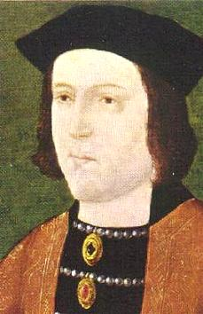
The House of York
Edward IV
Inherited the throne when his father was killed during the War of the Roses
Encouraged William Caxon to set up a printing press with moveable type

Slide 15
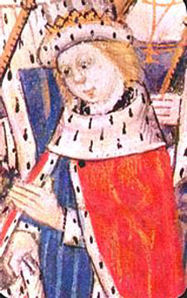
Edward V
Succeeded the throne at the age of 12
Only rules for 3 months until his uncle has he and his brother imprisoned in the Tower of London

Slide 16
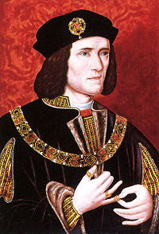
Richard III
Seizes the throne from his 12 year old nephew
Imprisons Edward V and his younger brother in the tower of London, and allegedly has them murdered
Last king of the House of York

Slide 17

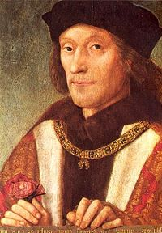
Henry Tudor
Distant relative of the House of Lancaster assumes power
Ushers in the Elizabethan Period

Slide 18
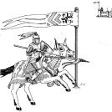
The Chivalric Code: Knighthood, honor and chivalry were important to the Medievalists

Slide 19
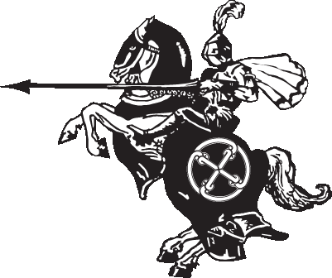
Knighthood flourishes in England
Knights went on quests, especially across the English Channel to fight the French
Knights participated in life-long journeys to the Holy Land (Jerusalem)
Jousting tournaments were a popular pastime

Slide 20
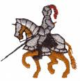
The chivalric code was seen as a romantic philosophy. It stated that all knights must strive to be:
Honorable
Courteous
Generous
Brave
skillful in battle
respectful toward women
helpful to the weak

Slide 21


Religion
The Roman Catholic Church was the powerful institution, in which most people (from kings or serfs) professed their faith.
People believed in both the Church on earth and promise of an afterlife.

Slide 22
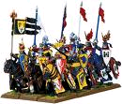
Knights must be willing to die for religious convictions.
They fought in Crusades and Holy Wars to recapture the city of Jerusalem from the Moslems.
They met with little success but with great loss of lives

Slide 23
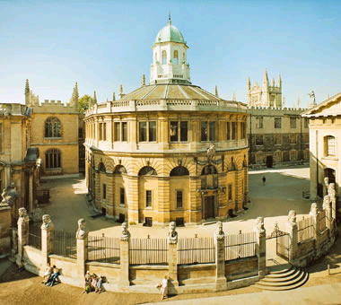
The language of the Church was Latin and was learned by all educated persons in England.
Monasteries, Abbeys, and cathedrals were architectural marvels of the Medieval Period.

Slide 24
Life in Medieval England
In 1348-1349, England was devastated by the Black Death, a form of the bubonic plague that killed about 1/3 of the English population.
In the midst of was and illness, England prospers as people move from castle towns to villages and cities.
Guilds, organizations similar to trade unions developed.

Slide 25
Life in Medieval England continued…
Apprenticeships allowed workers to become skilled before becoming master craftsmen.
Herding replaces farming as a popular livelihood.
Wool manufacturing was a popular industry.
The printing press was developed in 1476 by William Caxton
Chivalry loses its stature in society with the manufacturing of gunpowder.

Slide 26
Literature of the Medieval Period
Romanticism – a blend of Chivalry integrated with love, magic, and marvels
Folk Ballads – poems utilizing dialogue that were written and performed by the common people.
Drama – is performed as a religious ritual. Plays in the Medieval Period are called mystery plays or miracle plays. Plays also began to emerge that were know as morality plays.

Slide 27
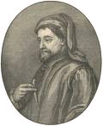
Famous Authors and Tales
Geoffrey Chaucer –
The Canterbury Tales

Slide 28
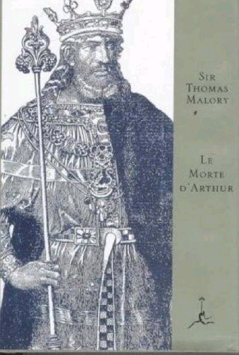
Sir Thomas Malory –
Le Morte D’Arthur
(The Death of King Arthur)

Slide 29
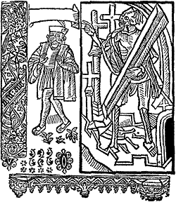
Everyman
(Morality Play)

Slide 30
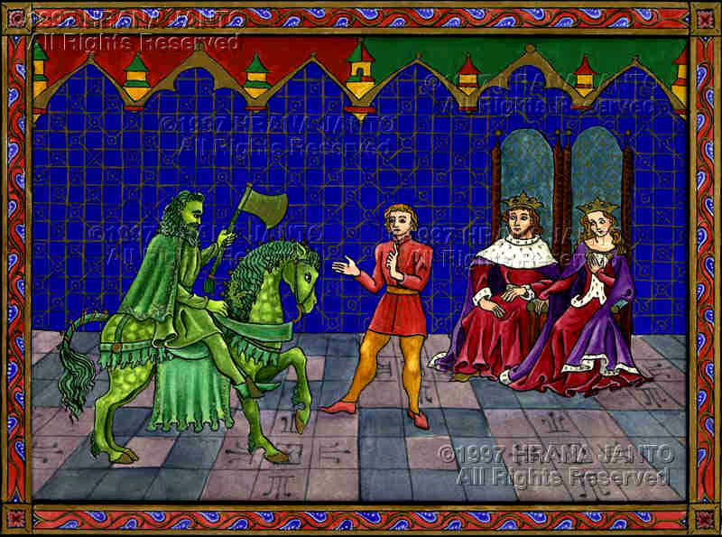
Sir Gawain and the Green Knight

