Slide 1
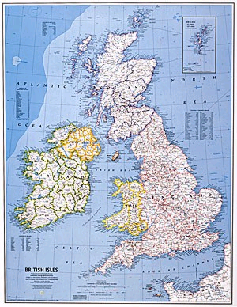
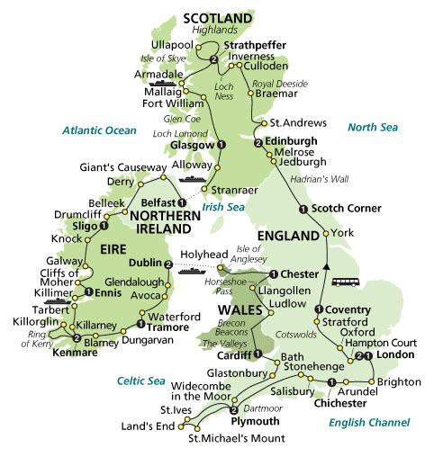
The British Isles:
England
Ireland
Scotland
Wales

Slide 2
England
500BC – 449AD

Slide 3
Early Development in England
In about 500BC England was under the Celts.
The Romans invaded the country in 55BC and 43AD.
The Romans exiled the Celts north into Scotland and west into Wales
The Romans ruled in Albion (their name for England) until they were driven out by the Germans in 449AD

Slide 4
Anglo-Saxon England
449AD – 1066AD

Slide 5
Anglo-Saxon England
Angles \
Saxons Germanic tribes
Jutes /
The Germans referred to England as “Angle Land”
The Germans were warlike tribes. They were also the source of early English Literature.
Originally, the Germans were pagans, but later, they converted to Christianity when the Roman Cleric St. Augustine came to England.
Scop – a minstrel who chanted memorized poetry to a group

Slide 6
Anglo-Saxon England
In 664, England established a church. As a result, conversion and partiality spread.
Once religious unity was established, they established one set language.
Anglo-Saxon (Old English) was influenced by German, Latin, and French. Unfortunately, the language did not spread very far, because there was no printing press.
Values
1) war - brutal; short lives (war casualties)
2) wyrd - fate; destiny (cannot improve life; destiny is controlled)
3) companionship (Comitatus) - warriors were extremely faithful to their tribe.
4) heroism - have courage in times of adversity

Slide 7
Anglo-Saxon England
Qualities of Old English Poetry
1) alliteration - no rhyme; repetition of initial consonant sounds
2) oral formulaic - spoken from memory (repeat to remember)
3) synonyms - many forms for one word (keeps the alliteration)
4) kenning - odd compound words that evoke thought-provoking imagery (i.e. swan-road/ whale-road "sea" or word-hoard "vocabulary")
5) caesura – a deliberate pause or break in a line of poetry, usually ner the middle of the lline
genre - dream vision (popular from the time of the Bible)
date - Vercelli manuscript @ ninth century; but fragments were found in a stone cross (Ruthwell Cross) in Ireland @ the eighth century.
tri-partite structure
1) opening --- words of the dreamer
2) middle ---- the cross id the speaker
3) closure --- the dreamer tells of how he carried out the charge

Slide 8
Beowulf: "Lay of the Lone Survivor's Speech" (ll 2247-2266)
`Heald pu nu, hruse, nu haeleo ne mostan,eorla aehte!
Hwaet, hyt aer on oe
gode begeaton; guodeao fornam,
feorhbealo frecne fyra gehwylcne
leoda minra para oe pis [lif] ofgeaf,
gesawon seledream.Nah, hwa sweord wege
oooe fe(o)r(mie) faeted waege,
dryncfaet deore; dug(uo) ellor s[c]eoc.
Sceal se hearda helm (hyr)stedgolde,
faetum befeallen; feormynd swefao,
pa oe beadogriman bywan sceoldon;
ge swylce seo herepad, sio aet hilde gebad
ofer borda gebraec bite irena,
brosnao aefter beorne. Ne maeg byrnan hring
aefter wigfruman wide feran,
haeleoum be healfe. Naes hearpan wyn,
gomen gleobeames, ne god hafoc
geond sael swingeo, ne se swifta mearh
burhstede beateo. Bealocwealm hafao
fela feorhcynna foro onsended!'

Slide 9
Chaucer: The Canterbury Tales, General Prologue (ll 1-18)
Whan that Aprille with his shoures sote
The droghte of Marche hath perced to the rote,
And bathed every veyne in swich licour,
Of which vertu engendred is the flour;
When Zephirus eek with his swete breeth
Inspired hath in every hot and heeth
The tendre croppes, and the yonge sonne
Hath in the Ram his halfe cours y-roonne,
And smale fowles maken malidye,
That slepen al the night with open ye,
So priketh hem nature in hir corages:
Than longen folk to goon on pilgrimages
And palmers for to seken straunge strandes
To ferne halwes, couthe in sondry landes;
And specially, from every shires ende
Of Engeland, to Caunterbury they wende,
The holy blisful martir for to seke,
That hem hath holpen, whan that they were seke.

Slide 10
Shakespeare: Hamlet, Act II, Scene I (ll 181-190)
Rest, rest, perturbed spirit!
[They swear.]
So, gentleman,
With all my love I do commend me to you:
And what so poor a man as he is
May do, to express his love and friending to you,
God willing, shall not lack. Let us go together;
And still your fingers on your lips, I pray.
The time is out of joint: O cursed spite,
That ever I was born to set it right!
Nay, come, let's go together.
[Exeunt.]

Slide 11
[1] Fæder ure þu þe eart on heofonum,
[2] Si þin nama gehalgod.
[3] To becume þin rice,
[4] gewurþe ðin willa, on eorðan swa swa on heofonum.
[5] Urne gedæghwamlican hlaf syle us todæg,
[6] and forgyf us ure gyltas, swa swa we forgyfað urum gyltendum.]
[7] And ne gelæd þu us on costnunge, ac alys us of yfele.
[8] Soþlice.
[1]Father ours, thou that art in heaven
[2] Be thy name hallowed.
[3]Come thy rich (kingdom),
[4]Worth (manifest) thy will, on earth also as in heaven.
[5] Our daily loaf sell (give) us today,
[6] And forgive us our guilts as also we forgive our guilty
[7]And lead thou us not in temptation, but loose (release) us of evil
[8]Soothly
Click to listen

Slide 12
Oure fadir that art in heuenes, halewid be thi name; thi kyngdoom come to; be thi wille don, in erthe as in heuene.
Yyue to vs this dai oure breed ouer othir substaunce, and foryyue to vs oure dettis, as we foryyuen to oure dettouris; and lede vs not in to temptacioun, but delyuere vs fro yuel.
Amen.

Slide 13

Beowulf

Slide 14
A. Cultural Background
* Anglo-Saxon culture
* Germanic past - fifth and sixth century Scandinavia
- glorified body of literature, but they destroyed parts; therefore they left loose ends on some of the allusions but in that time people would have known about those references
- preservation of the people and culture through literature (the dying past)
B. Literary Structure (very unique and original)
* has balance: talks about a hero in youth and in old age
* speaks about how young men should be/ act
C. Manuscript History
* part of an oral tradition
* probably had more than one author
* probably written @ 1000 A.D.
* probably composed @ 650-850 A.D.
* The original script was burned; therefore some of the sections seem rather confusing (lost in fire).

Slide 15
D. Themes and Issues in Beowulf
1) treasure - highly descriptive; significant part in the plot; part of the Comitatus relationship (lord gives treasure to his retainers); weapons were considered wealth (protection in case of invasion)
Sutton Hoo Ship Burial - Anglo-Saxon treasure that helped understand the symbolism of $ and jewels (not materialistic)
$ - a symbol of loyalty; rewards as gratitude; generous, because treasure should not be kept in the ground by itself -> UNLUCKY
Social standing dealt with the amount of wealth (even with generosity)
2.) revenge - was the primary conflict between the Germanic culture (obligated to pay a wergild <A monetary retribution for killing a member of another's family. This was to curb the useless killing of numerous family members to extract retribution. The money value depended on the individual's social status.>)
3) digressions
- poetry wasn't meant to be linear
- the art was linear and overlapped, the literature did, too (interwoven)

Slide 16
Beowulf is:
- humble and doesn't brag about his strength
- wise, especially for man as young as he insight -> uncanny how Beowulf knows that weapons wouldn't work against Grendel
- boasts to re-assert his strength
- strong man
- acts extremely well with rhetoric
The Comitatus is strong between Beowulf, Hrothgar, and his men.
Socially Beowulf is:
- trusting (when Beowulf arrives in Hrothgar's land)
- hospitable (introduction of self, feasting, the discussion of business)

