Slide 1
Rhyme Scheme

Slide 2
What is rhyme scheme?
The regular pattern of rhyming words in a stanza or a poem

Slide 3
How do you label a rhyme scheme?
To indicate a rhyme scheme, assign a different letter to each final sound in the stanza

Slide 4
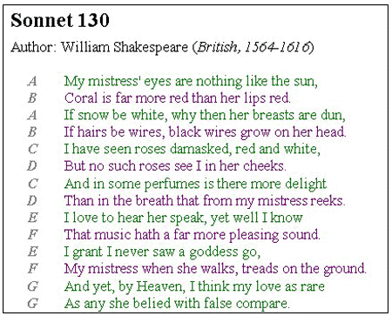
EXAMPLE:

Slide 5
Assignment:
Write a 12 line poem that summarizes the material that you read in class today. Be sure to include the MOST IMPORTANT POINT. And remember poetry is all about word choice. You don’t need sentences, and you can be creative in you arrangement of words and ideas.

Slide 6
Variations of 12 line poems
6 couplets A A B B C C D D E E F F | 3 quatrains A A B B C C D D E E F F | 3 quatrains A B A B C D C D E F E F | 2 sestets A B C A B C D E F D E F
OR

