Slide 1
River Trail Middle School
Rising 6th Grade Information
Spring 2025
Neil Pinnock, Principal
Taylor Kidd, Assistant Principal Guy Crotsley, Assistant Principal
Lori Lahmann-Scullion, Assistant Principal Radhika Godbole, Administrative Assistant
Notes:
Pinnock

Slide 2

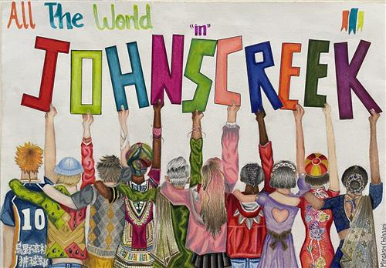
Our Community
Many River Trail students attended one of our local feeder elementary schools:
  Shakerag ES
  Findley Oaks ES
  Wilson Creek ES
  Medlock Bridge ES
Students also come to RTMS from private schools, other FCS schools, other counties, other states, and other countries!
All our students will attend Northview High School upon finishing middle school, unless they move away from our attendance zone or decide to attend another school, such as Innovation Academy.
Notes:
Jacober

Slide 3
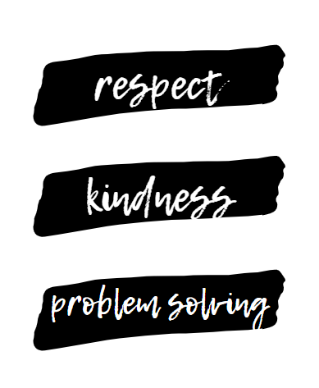

The mission of River Trail Middle School is to advance student creativity, critical thinking and citizenship by engaging students in educational and social opportunities through school and community collaboration.
The vision of River Trail Middle School is to guide all students toward their full potential as productive members of society.
Our Values
Notes:
Pinnock

Slide 4
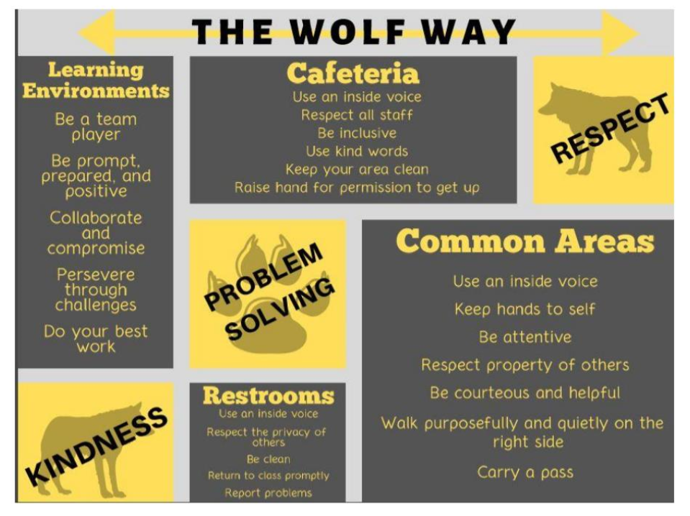
THE
WOLF
WAY
Notes:
Jacober

Slide 5
Daily Procedures
When 6th grade students arrive to school, they report to the cafeteria until released to go down to their 1st period class. 7th and 8th graders go to the Gym.
Students should not arrive before 8:15am.
6th graders have very little interaction with 7th and 8th graders.
Lunch takes place during 4th period for 6th graders.
Money can be placed on a student’s lunch account (same from elementary) by going online.
Visit: www.mypaymentsplus.com/.
Notes:
Palermo

Slide 6
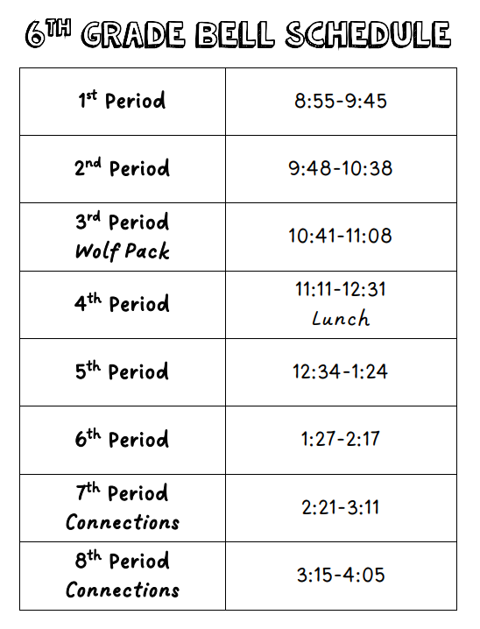
Notes:
Palermo

Slide 7
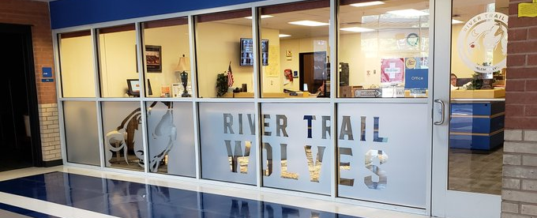
Attendance
When students are absent, their parent/guardian should:
  Write a note stating the child’s name, date of the absence(s), reason for absence, and parent’s signature.
  The student should then give the note to the front office when they return to school.
  OR the parent should email the front office an electronic note/excuse for their child’s absence.
Excuses should be dropped off or emailed within 5 days of returning to school.
It is the student’s responsibility to contact his/her teachers to initiate all make-up work.
Notes:
Palermo

Slide 8

6th Grade Curriculum
safarihub.fultonschools.org/PORTAL/
Core Course Offerings in 6th Grade:
English Language Arts (ELA)
Math
Social Studies
Science
Reading /World Language
Connections Courses
Class Placements
If you have questions about your child’s placement for next year, contact your child’s 5th grade teacher.
Notes:
Endres

Slide 9
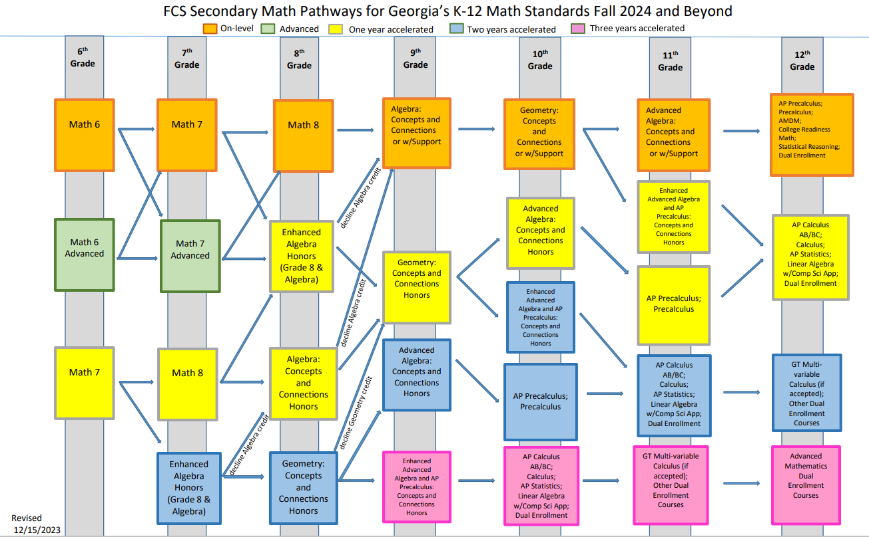
Math Pathways
Notes:
Endres

Slide 10


World Languages & Reading
At RTMS, we offer Reading or World Language classes to students as part of their daily academic schedules. The reading course offered uses a comprehensive literacy program designed to complement skills addressed in the language arts courses while accelerating reading and literacy gains through direct instruction, read-aloud, guided practice, and independent practice on skills such as: comprehension, fluency, phonics, vocabulary, grammar, and spelling.
Initial Placement Guidelines for Reading 6: Students performing below grade level on the Georgia Milestones Reading Indicator for Grade 4 OR at less than the 35th percentile on the Mid-Year i-Ready Reading diagnostic will be placed in Reading 6.
Initial Placement Guidelines for Reading 6 Advanced: If a student performs below grade level on the Georgia Milestones Reading Indicator for Grade 5, they will be placed in Reading. Students performing above the 35th percentile on the Mid-Year iReady Reading Diagnostic, but below the 46th percentile will be placed in Reading 6 Advanced.
Initial Placement Guidelines for WL: At/or above grade level on GMAS Reading indicator for Grade 4/5 AND at or above the 46th percentile on the Mid-Year iReady Reading Diagnostic. Students who meet the placement criteria to take a World Language course will be placed in World Language.
Our World Language course options for 6th grade students who qualify are Chinese, French, and Spanish.
Notes:
Lahmann

Slide 11
Grading
Grades can be viewed in Infinite Campus by students and parents. Usernames and passwords are the same from elementary school.
Grades are cumulative for an entire semester.
  ​Unlike ES, grades do not start over every quarter.
Graded papers are returned to students in class.
  They are not sent home directly to parents as in elementary school.
RTMS follows Fulton County Schools grading policies.
The grading scale is based on Fulton County policy.
The state of Georgia has set 70 as the minimum passing grade.
A = 90 – 100 B = 80 – 89 C = 70 – 79 F = Below 70
Notes:
Reams

Slide 12

Infinite Campus
Infinite Campus Parent is an internet and app-based program that allows parents to get more involved in their child’s day to day education. It gives parents timely information about their child’s progress in school. Using the internet, parents can access their child’s grades, attendance, assignments, and discipline records.
https://www.fultonschools.org/infinitecampus
Notes:
Reams

Slide 13
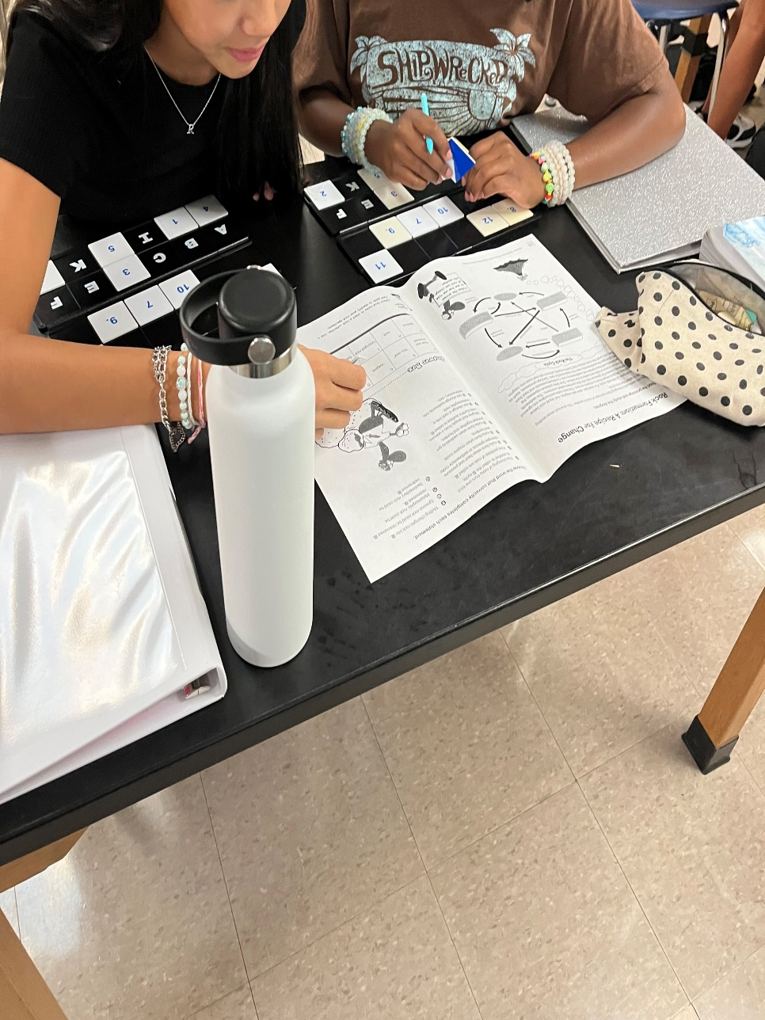
Teams
All 6th grade students are assigned to a team.
A team consists of students that share mostly the same group of teachers and wolf pack teachers.
This year we had 4 teams: A, B, C, & D.
Notes:
Morgan

Slide 14
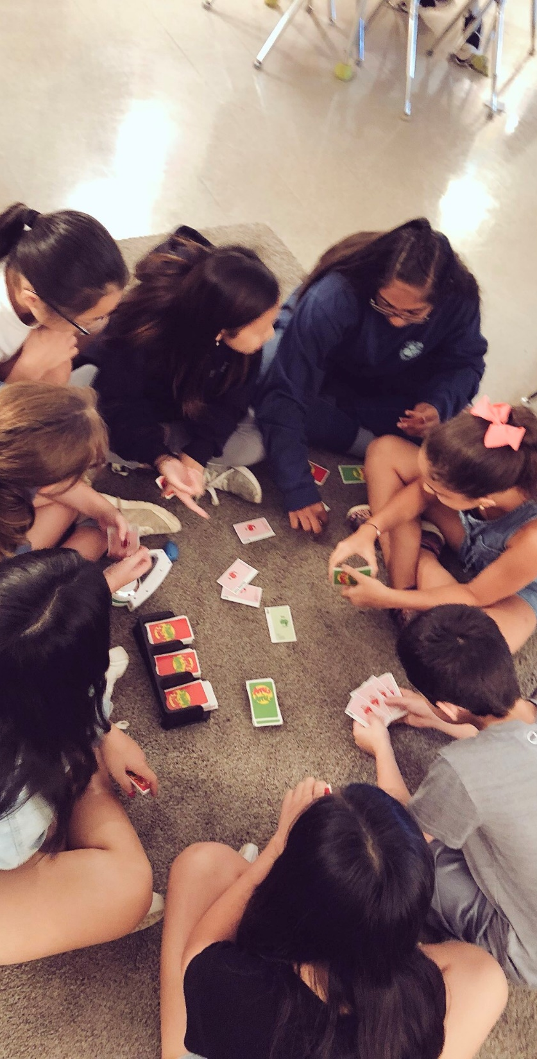
Wolfpack – 3rd Period
Wolfpack is a daily, schoolwide period for students to build relationships with teachers and peers, and to cultivate a sense of school pride and community.
Essentially, it is a homeroom/advisement period.
It is a great time to ask questions and get help too.
The goal of Wolfpack is to foster a sense of belonging and focus on social emotional learning & the needs of students.
In addition, grade levels may use this time to address organizational and academic needs specific to the group.
Notes:
Morgan

Slide 15

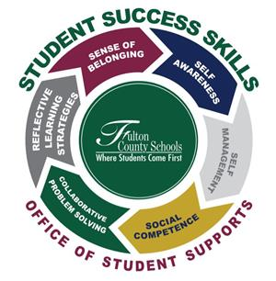


Wolfpack Schedule
Monday | Tuesday | Wednesday | Thursday | Friday
Study Hall /Organization | SSS | Study Hall /Academic Support | SSS | Recess /Academic Support
Notes:
Smith

Slide 16
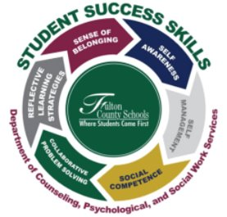

Student Success Skills (SSS)
During Wolfpack time, students learn new skills in… ​
Self-Awareness​
Self-Management​
Collaborative Problem Solving​
Reflective Learning Strategies​
Sense of Belonging​
Social Competence​
These skills are our Student Success Skills
ReThinkEd​
Students learn one lesson, 2 times a week using lessons, videos, and activities in ReThinkEd​.
Students will also have access to lessons, videos, and activities in the Student Center.
Notes:
MOrgan

Slide 17


Organization
Organization is a challenge for many 6th graders. With 5 academic classes and connections classes, this is a big adjustment from elementary school.
With time and patience, students create a system that works for them.
Teachers will help students with organization as they transition to middle school. ​
Some students use:​
  a different binder for every class​
  an accordion folder for all classes​
  one notebook for all their homework.
Organization of one’s time, time management, is also very important in middle school.
  Set alarms and reminders if needed
  Use an agenda or planner to keep track of important dates, assignments, and tests.
Notes:
Brown

Slide 18
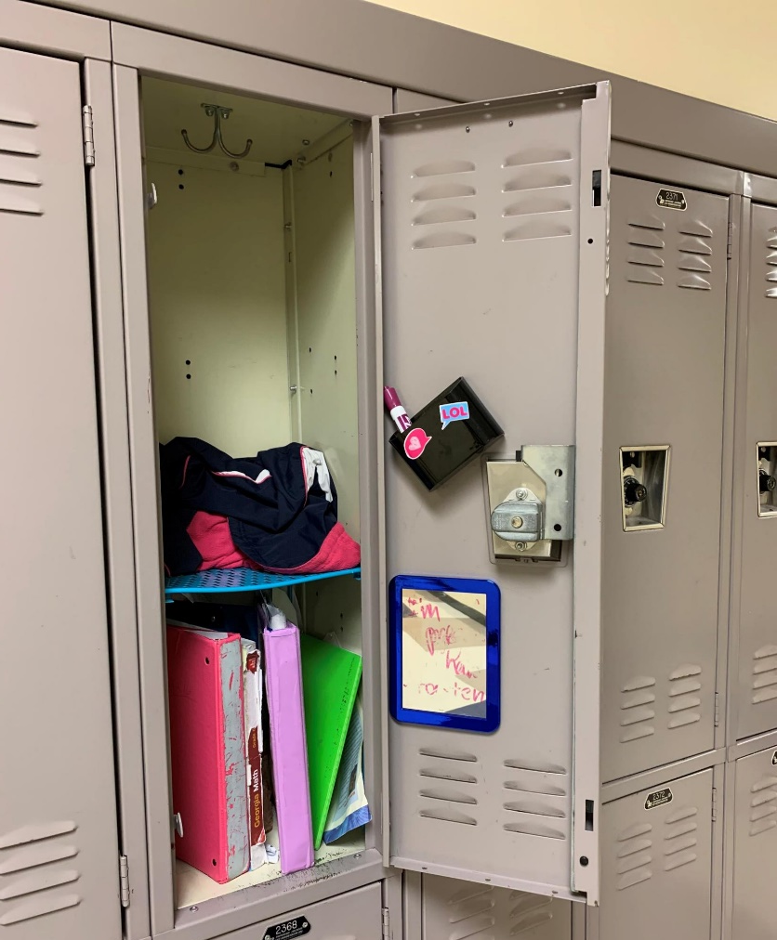
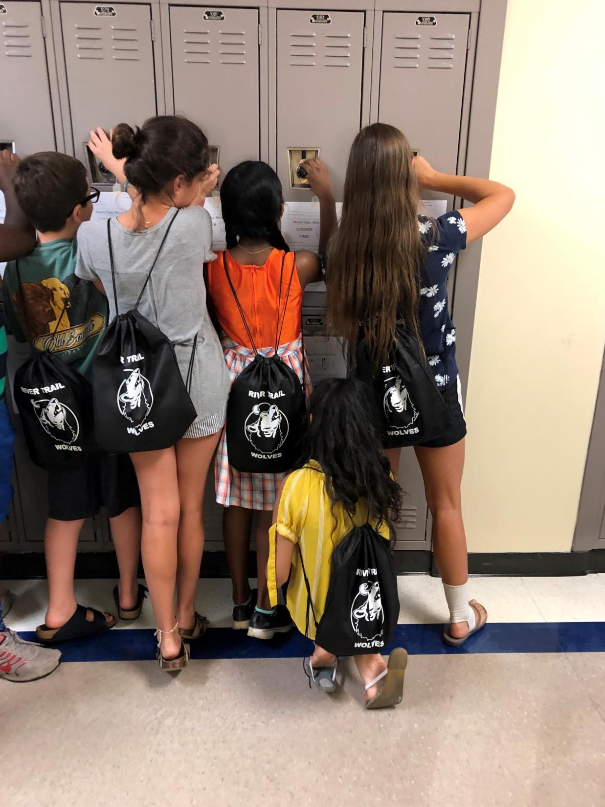
Lockers
Students are assigned lockers at the beginning of the school year. Teachers will attempt to assign a locker relatively close to a student’s classes.
Rolling backpacks will not fit in lockers and are not permitted.
12” Locker shelves work well in lockers- anything smaller is not adequate
Students store their backpacks in their lockers during the day. It is helpful when backpacks can fold into locker.
Cellphones should be kept in locker, turned off.
Please put your child’s name on everything- binders, book bags, pencil cases, jackets, PE uniforms, water bottles, lunch boxes, etc.
Notes:
Brown

Slide 19
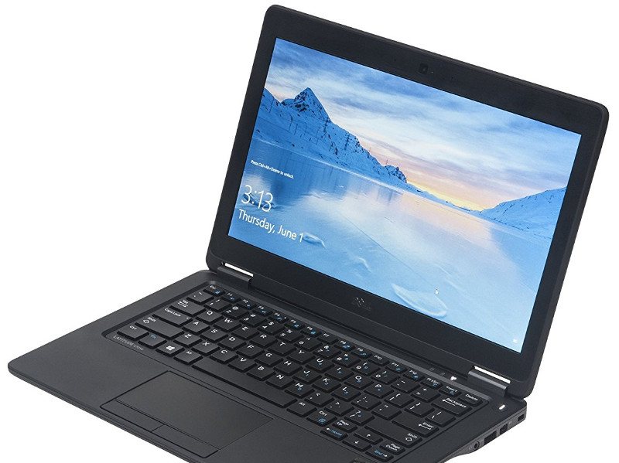

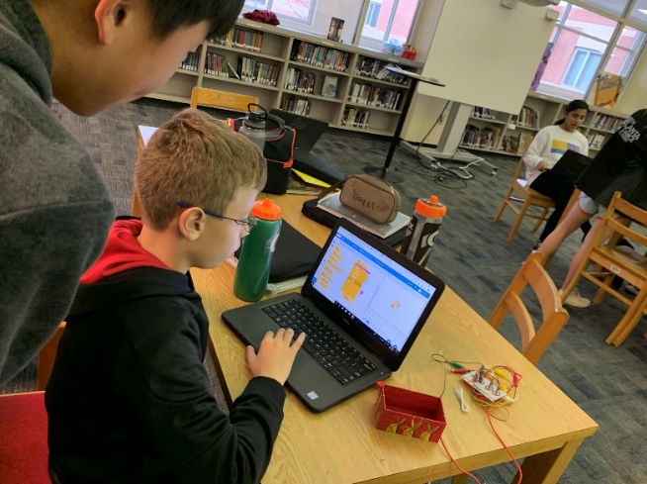
Student Devices
Dell Laptop Computer​
All students are issued a device. ​
Devices go home with students each night.
Only to be used for educational purposes ​
Headphones (with wires) are needed
Notes:
Brown

Slide 20

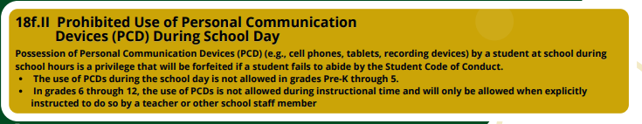
Cellphones
Personal technology devices, such as cellphones and smartwatches, must remain put away during the school day unless requested in class by a teacher.
The school is not responsible for lost or stolen devices.
Cell phones may only be used before and after school outside of the building.
Cell phones are to be turned off when kept in the locker.
Notes:
O’Connor

Slide 21
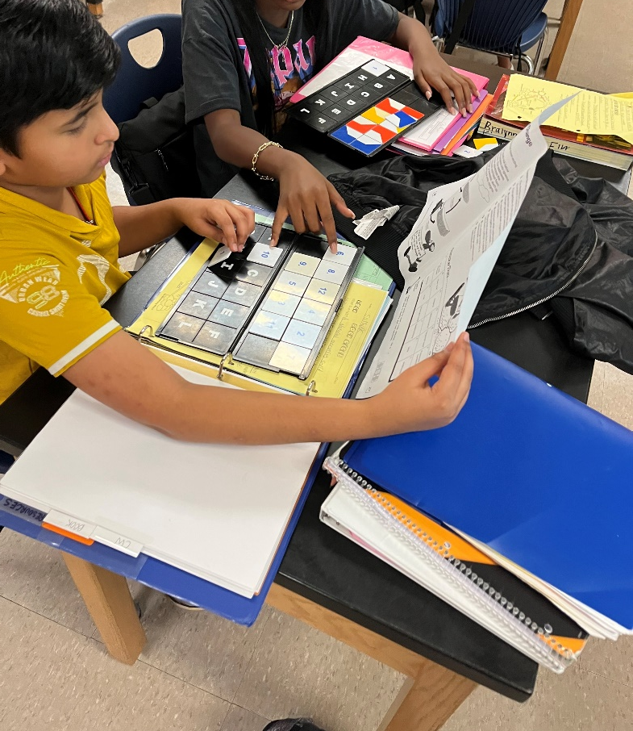
Homework
Homework is given to practice and enhance the skills learned in class.​
Homework may come in many forms such as: reading, studying for a quiz or test, completing assignments, working on projects, collaborating with peers, practicing skills, as well as vocabulary building.
Students should expect homework every night. ​Particularly in Math.
Notes:
O’Connor

Slide 22
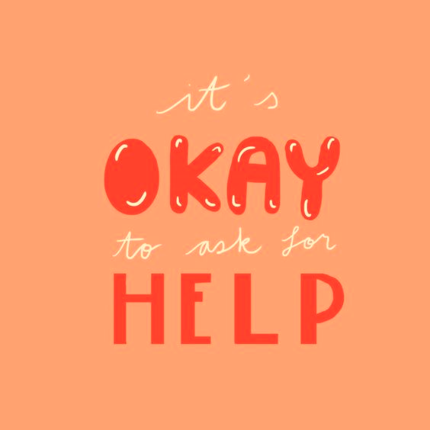
Helpful Homework Resources
Teachers​
Canvas
Teachers’ Help Sessions​
Friends/
classmates​
Parents
1-2-1
Reach Club
Notes:
O’connor

Slide 23

Communication with teachers
Email is the most efficient way to contact teachers.​
Conferences are scheduled by teacher or parent request. ​
Conferences are often conducted with multiple teachers.
  By having multiple teachers in attendance, we can provide various perspectives and better address the needs of the whole child.
  Meetings typically happen before school or during teachers’ planning time.
Students are encouraged to email their teachers.
Notes:
Lahmann

Slide 24
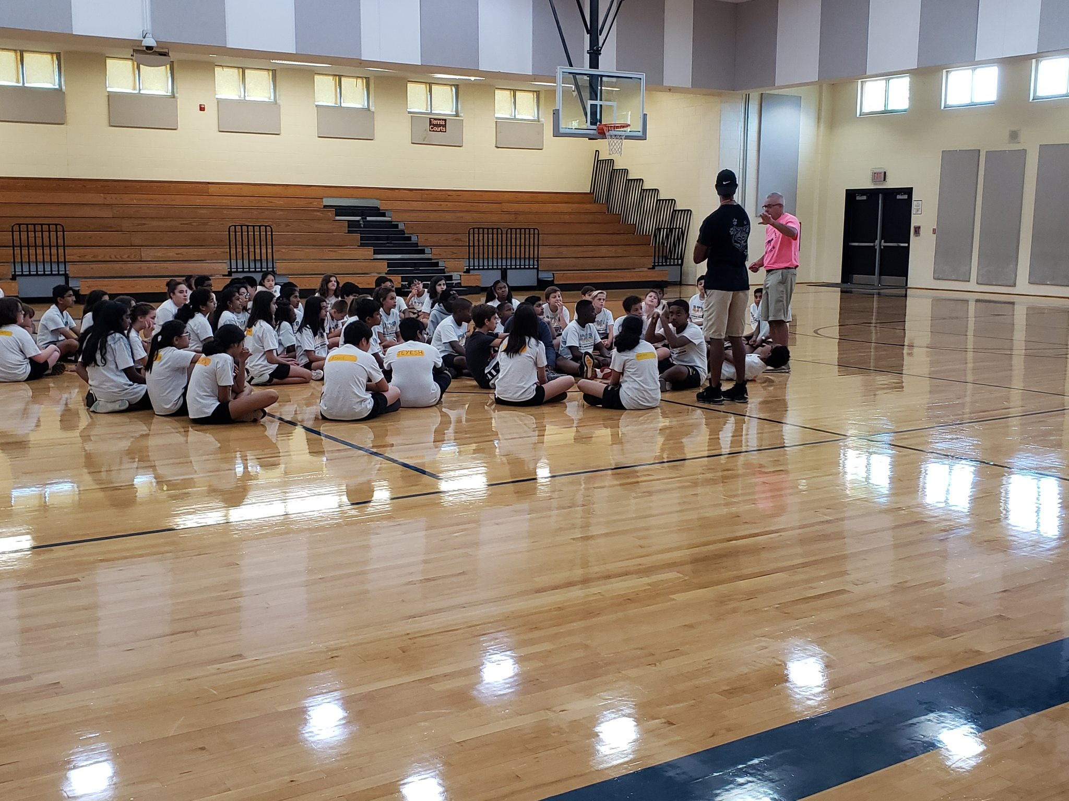
Connections Classes
Like “Specials” in Elementary School, “Connections" classes provide opportunities for students to receive additional exposure to arts, science, career awareness, physical education, etc.
At RTMS, the only courses that students can request to be placed in for connections are our music programs: Band, Orchestra, and Chorus.
All 6th graders must take a 9-week/quarter-long Career Awareness Connections class to explore various career pathways.
6th Graders will be scheduled for Career Awareness, PE, and Health.
Other connections courses beyond these classes are randomly assigned.
6th graders have their connection classes during 7th and 8th period each day.
Notes:
Lahmann

Slide 25
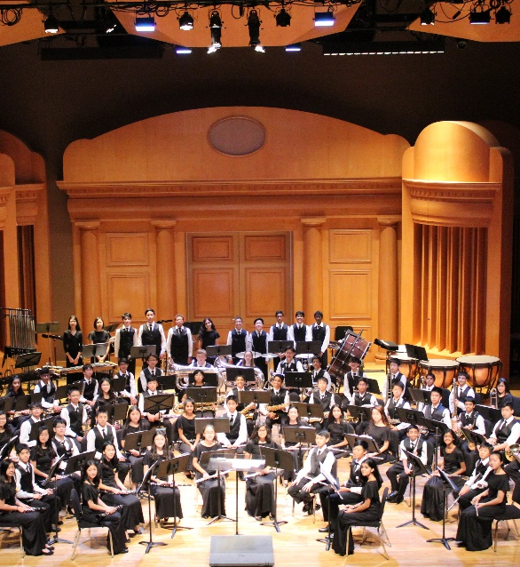
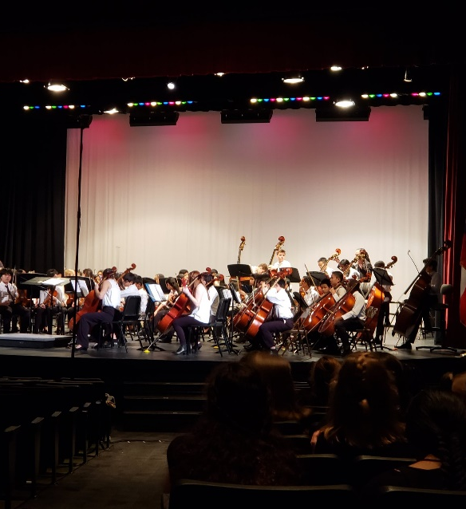
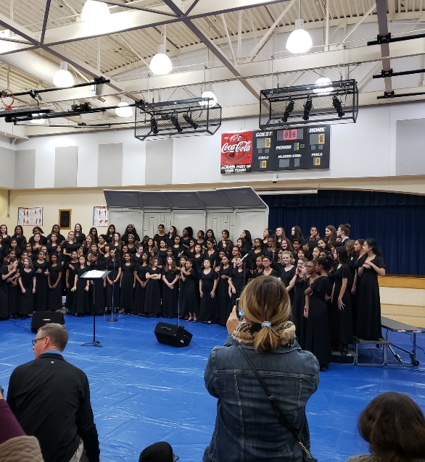
Music Programs
Students may join Band, Chorus, or Orchestra regardless of experience level.
Participation in a music program is a yearlong commitment.
These classes are the first of potentially seven years’ worth of music education. With hard work, students will continue to learn about and enjoy music for the rest of their lives.
Notes:
Lahmann

Slide 26

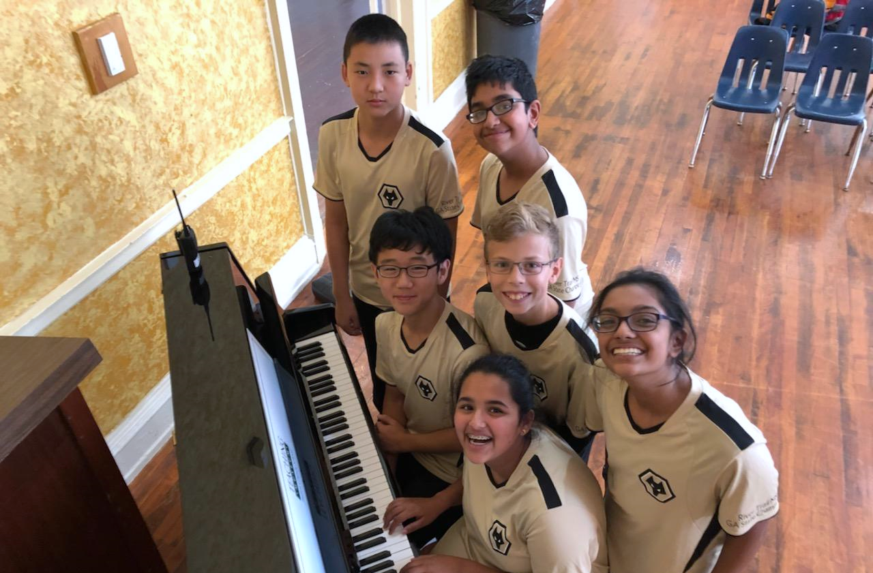
Clubs & Activities
At RTMS, a wide range of clubs and activities are offered for students before and/or after school.
A full listing of these clubs and activities will be available during the fall, and opportunities will be provided for students to enroll in these activities.
See website for current offerings.
Notes:
Endres

Slide 27
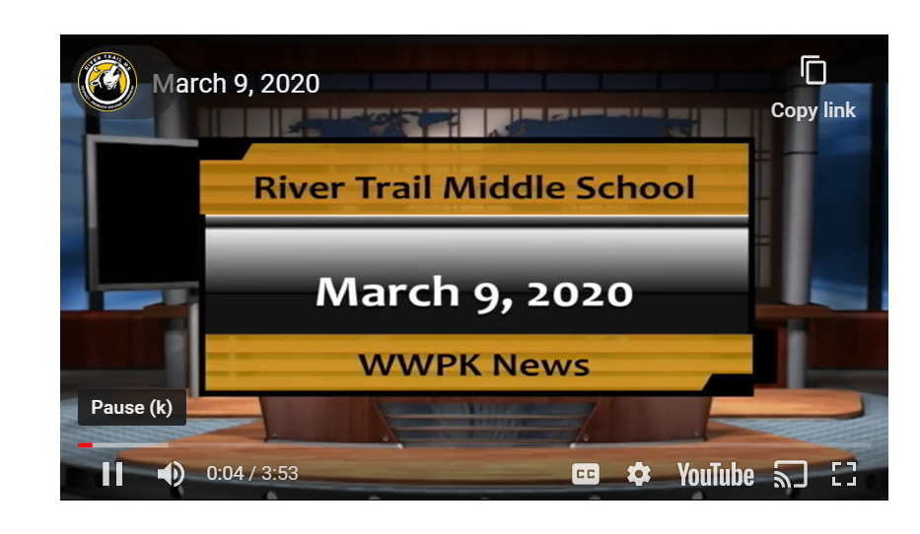
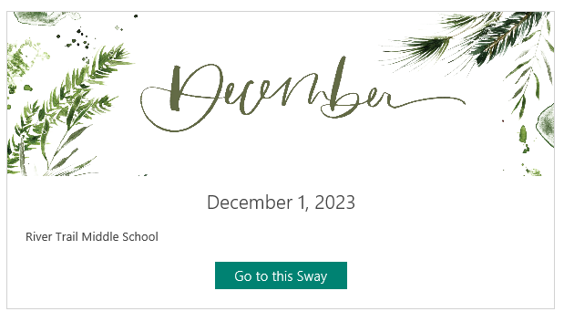
Morning Announcements
School News
Wolf Den News
Weekly Newsletter
WWPK is River Trail’s daily news program that includes important school announcements. WWPK is typically shown in Wolfpack.
The Wolf Den News is our weekly parent communication that includes upcoming events, announcements, and helpful reminders.
Notes:
Endres

Slide 28
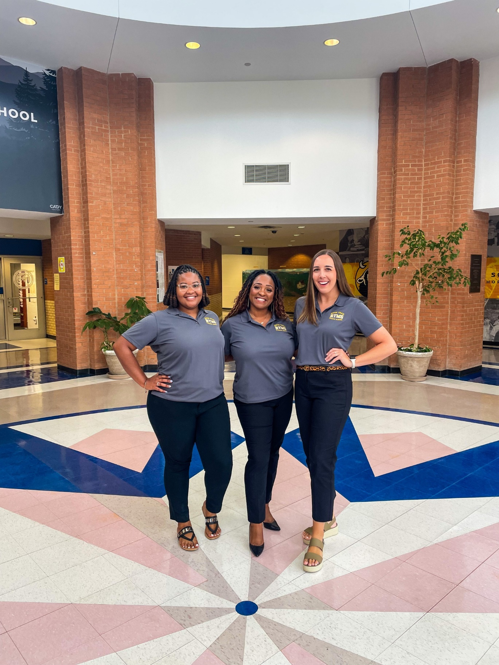

We are here to support you!
At River Trail, we have a wonderful team of student support staff to help RTMS students and families.
3 School Counselors
School Psychologist
School Social Worker
Graduation Coach
Instructional Support Teacher (IST)
Notes:
Dillard

Slide 29
What can Parents do to help?
Help your student stay organized manage the PACING of projects & assignments.
Help foster responsibility and self-advocacy skills. Encourage them to ask questions!​
Help your child take responsibility for their decisions--don’t always “rescue” them!
Help students set academic goals​ & create social/emotional boundaries.
Use positive rewards/incentives to encourage your student.
Help your child study for tests and quizzes​.
Monitor and support (HW, attendance, internet sites, regulate social media usage)​
Talk to your child; stay connected with your child & get involved as much as you can.
  They are growing up, but they still need you. Allow students to experience natural consequences of their actions. ​Set boundaries for your child.
Review student code of conduct & school expectations.
Support teachers and administrators. Support school rules and routines.
Please partner with us!!!
Notes:
Dillard

Slide 30
Immunizations
All children entering sixth grade will need:
2 doses of MMR or each of the following: 2 doses of measles vaccine, 2 doses of mumps vaccine and 1 dose of rubella vaccine.
AND
2 doses of varicella (chicken pox vaccine) or have a year for history of the disease, diagnosis, or serology.
AND
3 Hepatitis B
Vaccines must be on an updated 3231 Immunization Form
Notes:
Dillard

Slide 31

What's involved in volunteering?
We strive to make all our PTO volunteers feel welcomed and appreciated! As part of our vibrant community of parents and educators, you'll join a fun group with a shared goal – making
River Trail Middle School the best it can be.
When you sign up, you can help us continue our commitment to improving the educational experience for our students, teachers, and administrators.
Direct Impact of Your Support
Proceeds from RTMS PTO Membership dues directly benefit all parents, students, teachers, and administration of River Trail Middle School. Your contribution plays a vital role in enhancing the overall educational experience for everyone involved.
Additional donations are gladly accepted.
Notes:
PTO

Slide 32

PTO Membership Benefits
Your contribution directly supports a wide range of school programs and events, including:
• Teacher Mini Grants: Empowering educators with resources.
• Academic Enrichments: Enhancing learning experiences.
• Book Fair and Incentives: Fostering a love for reading.
• Campus Beautification: Creating a welcoming environment.
• Clinic Support: Ensuring health and well-being.
• Communications & Directory: Keeping everyone connected.
• Exceptional Children's Week: Embracing the Unique Talents in Every Child
• Facilities Enhancements: Improving our school facilities.
• Health and Safety: Prioritizing the well-being of all.
• Hospitality: Building a sense of community.
• Media Center: Supporting library resources.
• Red Ribbon Week: Promoting a drug-free lifestyle.
• School Dances & Store: Creating memorable experiences.
• Spirit Wear: Fostering school pride.
• Staff Appreciation: Recognizing our amazing educators.
• S.T.E.M. & SPARKS: Igniting curiosity and innovation.
...And More!
Notes:
PTO

Slide 33
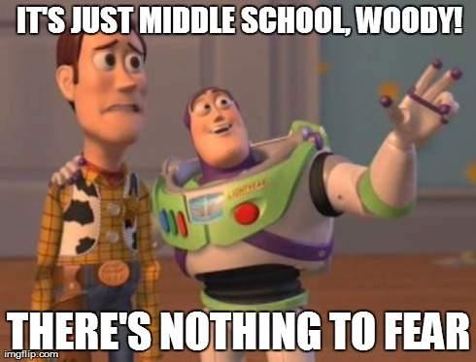
Notes:
Dillard

Slide 34
Who to contact when you have a question…
Class Placements - 5th Grade Teacher​(s)
Assistant Principal – Ms. Lori Lahmann – lahmannl@fultonschools.org
General questions - 6th Grade Counselor (on maternity leave until end of July)
  Ms. Claire Dillard – DillardC3@fultonschools.org
Special Education - Instructional Support Teacher
  Ms. Beatrice Ajorgbor -- ajorgborb@fultonschools.org
TAG - 6th Grade TAG Coordinator for RTMS
  Ms. Kiana Gannaway​ -- gannawayk@fultonschools.org
504 – Graduation Coach/504 Chairperson
  Ms. Sarah Roberson -- robsersons1@fultonschools.org
For general school information, check our website.
All staff email addresses and contact information ​can be found
on the RTMS school website.
Notes:
Dillard

