Slide 1

Welcome to High School
Webutuck Guidance and Counseling Office
So, you are heading to 9th grade… now what?

Slide 2


Middle School versus High School?
Mr. Matthew Pascale
Mr. Robert Knuschke

Slide 3

Credits
Graduation Requirements
* Types of Diplomas
*Community Service
Transcript
Course Weighting – GPA - Rank
Steps for Success – at school – at home
Contact Information
Agenda

Slide 4

CREDITS
Earning Credit:
Credit is earned by mastering the learning outcomes set forth in a
New York State developed or locally developed syllabus for a given high school subject,
after a student has had the opportunity to complete a unit of study in the given subject matter.
CREDIT
Credit is earned for a subject studied within a specified time and counts towards required graduation requirements.
40 weeks X 5 days per week = 1 credit
* 20 weeks X 5 days per week = ½ credit
Year-long courses that run every other day = ½ credit
*A student needs to earn a minimum of 22 credits to graduate from high school.

Slide 5

Graduation Requirements
Distribution of Credits
Local Diploma, Regents Diploma, Regents Diploma with Advanced Designation, (AR)
English | 4
Social Studies Distributed as follows: 2 Credits Global History and Geography 1 Credit U.S. History ½ Credit Participation in Government ½ Credit Economics | 4
Science Distribution as follows: 1 Credit Life Science 1 Credit Physical Science 1 Credit Life Science or Physical Science | 3
Mathematics | 3
Language Other than English (LOTE) | 1* 3 (for AR)
Fine Arts | 1
Physical Education | 2
Health | 1/2
Electives** | 3 1/2
TOTAL | 22
*Students with disabilities may be exempt from the LOTE required credit if so indicated on their IEP
**Elective credits can include additional credits for Math and Science

Slide 6

ASSESSMENT REQUIREMENTS for Graduation with Local or Regents Diploma
PATHWAYS 4 + 1
All students must pass 4 REQUIRED Regents Examinations: One in each discipline
Math, English, Science, Social Studies + 1 Pathway
Pathways:
STEM = An additional Math or Science Exam
Humanities = An additional English or Social Studies Exam
Arts = A NYSED approved exam in the Arts
LOTE = A NYSED approved exam in LOTE
CTE= A NYSED approved CTE examination AFTER the student successfully completes a NYSED approved CTE program
CDOS = The completion of all the components of the CDOS Credential

Slide 7


ASSESSMENT REQUIREMENTS for Graduation with Advanced Regents Diploma (AR)
To earn a Regents with Advanced Designation Diploma, students must pass the following Assessments with a grade of 65 or higher.
English Regents Exam
Global History Regents Exam
U.S. History Regents Exam
3 Math Regents Exams (Algebra, Geometry, Algebra II CC)
2 Science Regents Exams (Biology and one other)
*Students must also complete and earn 3 credits in the same LOTE
OR
earn 5 credits in the Fine Arts or an approved CTE Program.

Slide 8

Types of Diplomas:
Regular Regents: 5 Regents Exams 65+
Advanced Regents: 8 Regents Exams 65+ with 3 credits in same LOTE OR 5 Fine Arts or CTE Credits
Honors: Average of ALL Regents exams required for the diploma type = 90+ (CANNOT ROUND UP!)
Mastery in Science: 3 Science Regents exams with scores of 85+ (Biology and 2 others)
Mastery in Math: ALL 3 Math Regents exams with scores of 85+
Local: Only available to students with an IEP (dependent upon Regents Exam scores)

Slide 9

COMMUNITY SERVICE
**Community Service is a non-paying job performed by one person or a group
of people for the benefit of their community or institutions
Examples:
Volunteering at a hospital, animal shelter, food pantry, church, nursing home, fire department, etc.
Peer-tutoring, translating under supervision on your “free” time
Community or organization fundraising if it does not benefit you individually or your graduating class as a whole
Participation in any community events such as Relay for Life, Race for the Cure or Run to feed the Hungry, etc.
You will be required to complete 40 hours of community service throughout high school.
If you have done community service hours in 8th grade, it can be used towards your graduation requirement.*

Slide 10


There is NO NEED to memorize the
NYS Graduation Requirements!!
PLEASE NOTE:
New York State continually revises graduation requirements.
PLEASE check with your school counselors if you have ANY questions regarding diploma requirements.
There are multiple pathways and options that a student has to earn a NYS high school diploma.

Slide 11

Transcripts
A transcript is an official copy of your educational record. Your high school transcript is what is used to verify your graduation from high school, not your diploma. Your high school transcript consists of the following information:
* Demographic information: Your Name, Date of Birth, Student ID #, Address, Parent/Guardian information
*The year you entered high school
* Your weighted cumulative GPA, weighted rank and class size
*The date you graduated, transferred or withdrew (if applicable)
*Type of diploma
*Every course you have COMPLETED that was worth a high school credit (whether you earned the credit or not)
and the grade level you were in when you took that course
*Course exam grades (mid-term, final, Regents)
*Course final average
*Credit earned for each course with a place for the total number of credits you have earned

Slide 12
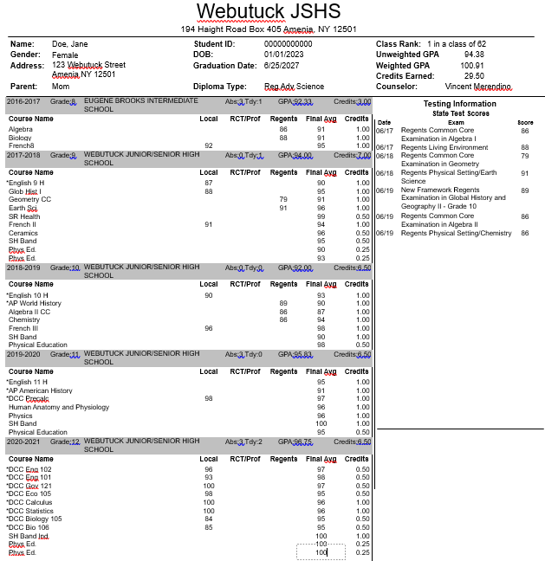
Example of a High School Transcript

Slide 13

Course Weighting….. GPA & RANK
All courses receive a numerical grade and weight (see below). This weight is ONLY used to report GPA and Rank in class.
It is not visible on your report card.
Honors = 10%
Dual Enrollment – 20%
Physical education is NOT included in reported GPA and Rank.

Slide 14

Communicate with your Counselor!!
We are NOT mind readers, but we need to know what you are thinking in order to better serve you!
  Military Academies – process starts in NINTH grade!
  College Scholarships available for certain schools.
  Course selection/requirements for certain majors.
  Want to attend BOCES for a trade? You will need certain courses and exams and good attendance to get there.
  Career/Workforce thoughts.
  We cannot stress enough how important it is to begin planning for high school NOW! Visit colleges, job shadow/internship opportunities will help confirm interests, create a resume, think about where you want to be in 5 years, 10 years, etc.
  Get involved (Clubs, sports, activities, etc.)
  Take the ASVAB (when you are able)
  Take the PSAT
  Attend College fairs and trips
  In case we haven’t made it clear, PLEASE speak with us about anything – we have an open door policy!

Slide 15

STEPS TO A SUCCESSFUL HIGH SCHOOL CAREER
Take challenging courses.
Take world language courses.
Begin volunteer work.
Get involved in extracurricular activities.
Stay organized. – Keep track of activities/honors/awards

Slide 16


Suggestions for Success…
We Encourage You To…
AT SCHOOL…
*Always write your homework down and check Google Classroom regularly
*Keep your locker organized
*Review work – catch careless errors
*Try to participate in class discussions
*ASK FOR HELP… everyone needs it sometimes
*Try to give your attention 100% of the time
*Keep your eyes on your own paper. Never cheat…
*Watch your behavior in class. Cooperation is key

Slide 17

To Support Your Success …
We Encourage You To…
AT HOME…
*Ignore or remove distractions when working.
*Eat a snack; drink some water before working.
*Try to keep to a set study/HW time each day when possible.
*Do your HW sitting up at a desk/table
*Do your hardest HW first to get that done. (“Do the worst first.” ~ Joseph G Pelizza, Motivational Speaker)
*Do ALL HW and remember to turn it in. Do not leave anything for Study Hall as that is risky...
*Practice with a “study buddy” to improve Math facts, spelling and to quiz one another.
*Read for at least 20 minutes per day.
*Look up words in a dictionary when needed.
*Make use of a calendar to plan ahead for quizzes, projects, practices, etc.
*Have a great attitude… remember you can do this!

Slide 18

SUMMARY
All grade levels in high school matter
Courses/Choices matter
Behavior/Attitude matter (letters of recommendation, military/government career investigations)
It’s not too early to begin researching and preparing for what you want to do after high school
  * The more you know what you want to do and what it requires, the better you can prepare yourself.

Slide 19


Contact your School Counselor
Mrs. McLaughlin (Last names A-K)
        Darlene.mclaughlin@webutuck.org
Phone: (845) 373-4100 ext. 3119
Mr. Merendino (Last names L-Z)
        Vincent.merendino@webutuck.org
Phone: (845) 373-4100 ext. 3120
Jamie Betti
Jamie.betti@webutuck.org
Phone: (845) 373-4100
Counselors’ Secretary:
Laura Maston
    Laura.maston@webutuck.org
Phone: (845) 373-4100 ext. 3118

