Slide 1


What You Need to Know About Financial Aid
High School Night

Slide 2

What is FAFSA® and Financial Aid?
Free Application for Federal Student Aid- Standard FREE form that collects information about the student and the parent. You do not pay to submit the FAFSA.
Financial Aid - Funds provided to students to help pay for educational expenses.

Slide 3
What is Cost of Attendance (COA)?
Direct costs (tuition, fees, room & board)
Indirect costs (transportation, personal expenses)
Varies widely from college to college

Slide 4
What is Expected Family Contribution (EFC)?
Measurement of student’s and parent’s ability to pay postsecondary educational expenses
Student contribution
Parent contribution
(for dependent students)

Slide 5
What is Financial Need?
Cost of Attendance
– Expected Family Contribution
= Financial Need

Slide 6
Types of Financial Aid
Scholarships
Grants
Loans
Employment
Gift Aid-Does not have to be paid back
Self-Help Aid-Loans Do have to be paid back. Employment does not come off tuition bill

Slide 7
Sources of Financial Aid
Federal Government
Employers
States
Private Sources
College and Universities

Slide 8
Federal Student Aid Programs
Federal Pell Grant
Teacher Education Assistance for College and Higher Education (TEACH) Grant
Federal Supplemental Educational Opportunity Grant (FSEOG)
Federal Work-Study (FWS)
Subsidized and Unsubsidized Federal Direct Student Loans (Direct Loans)
Federal PLUS Loans

Slide 9
New York State (www.hesc.ny.gov)
Tuition Assistance Program (TAP)/Aid for Part Time Studies (APTS)
Residency requirements apply
Award aid on the basis of both merit and need
Uses information from the FAFSA to determine the award

Slide 10
New York State (www.hesc.ny.gov)
Excelsior Scholarship
Under $125,000 Combined AGI as reported on 2019 Federal Tax Return
Application Deadline usually July/August 2022 for Fall 2022
30 Credit Requirement in One Year
Have to live in New York after completing degree

Slide 11
Private Sources
Foundations, businesses, charitable/civic organizations, churches, high school, web searches
Deadlines and application procedures vary widely
Begin researching private aid sources early
Colleges and Universities- based on merit and financial need. May require institutional application

Slide 12
Free Application for Federal Student Aid (FAFSA)
Information used to calculate the Expected Family Contribution (EFC)
  Measure of 2020 taxable and untaxable income and current assets of both student and parent
  Also based on family size, number in college and other demographic info such as marital status
Colleges use the EFC to determine financial aid eligibility
For the 2022-2023 academic year, the FAFSA may be completed beginning
October 1, 2021
Re-apply every year
The earlier you file, the earlier you may receive your aid offer and the more aid you may be offered
Most colleges set FAFSA filing priority dates
Admissions process vs. Financial Aid process

Slide 13
MULTIPLE WAYS TO COMPLETE FAFSA
FAFSA
FOTW (Desktop)*
Paper
FOTW
(Mobile)*
My Student Aid App*
*IRS DRT Can Be Used

Slide 14
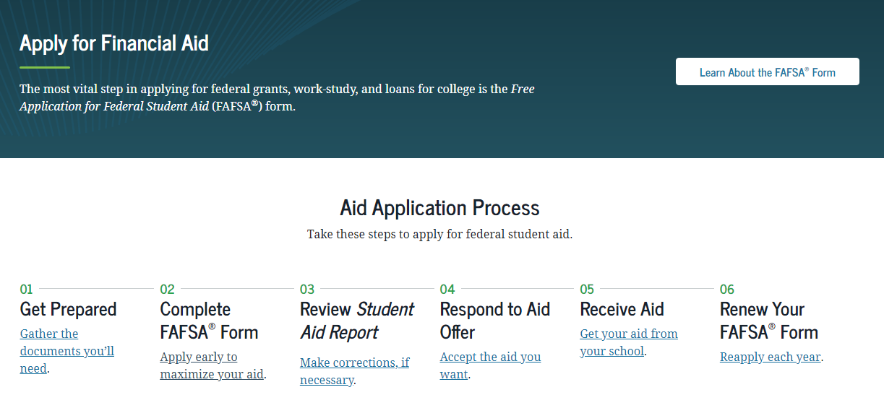
FAFSA
https://studentaid.gov/h/apply-for-aid

Slide 15
FAFSA on the Web (FOTW)
Built-in edits to prevent costly errors
Skip-logic allows student and/or parent to skip unnecessary questions
Option to use Internal Revenue Service (IRS) Data Retrieval Tool to import tax data
More timely submission process
Detailed instructions
Simplified process in future years

Slide 16
FSA ID
https://studentaid.gov/fsa-id/create-account/
The FSA ID is the electronic signature for the FAFSA
Used by students and parents throughout financial aid process, including subsequent school years
  FAFSA Corrections
  FAFSA Renewal
  Student Loan Promissory Note Signatures
Only the owner should create an FSA ID
Each student must have their own FSA ID
One parent must have their own FSA ID

Slide 17
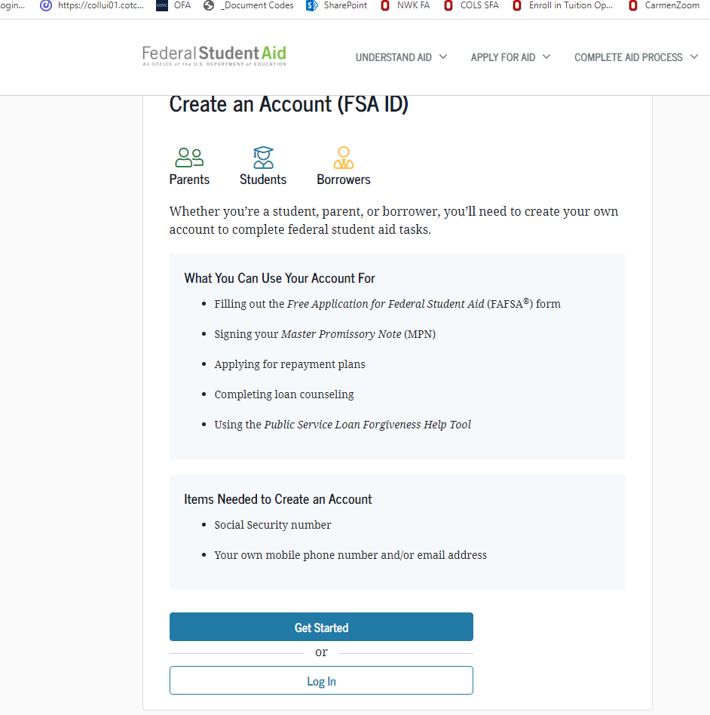
FSA ID
Name
Social Security Number
Date of Birth
Email address
  Not High School Email
  May only use an email one time
Mobile Phone Number
  May only use a mobile number one time

Slide 18
IRS Data Retrieval Tool
Allows for certain tax return information to be transferred from the IRS database
Participation is voluntary and student/parent chooses whether to transfer data to FOTW
IRS will authenticate taxpayer’s identity
If tax record is found, IRS transfers information to populate the FAFSA
Reduces documents requested by financial aid office
Certain tax filers cannot use the DRT

Slide 19
IRS Data Retrieval Tool
Certain tax filers cannot use the
IRS Data Retrieval Tool
Did not indicate on FAFSA a tax return was completed
Marriage date is January 2021, or later
First three digits of the SSN are 666
Filed a non-U.S. tax return
Married and filed as head of household, or filed separate returns
Neither married parent entered a valid SSN
Non-married parent or both married parents entered all zeroes for the SSN

Slide 20
General Student Information
Social Security Number
Citizenship status
Drug convictions
Selective Service registration
Legal Residence

Slide 21
Information About Parents of
Dependent Students
Tax, income, and other financial information
Receipt of means-tested federal benefits
Assets
Untaxed income
Marital Status

Slide 22
WHO is the Parent for the FAFSA?
Biological or Adoptive Parent(s)
  If not married BUT living together report BOTH parents
If parents are divorced:
  Provide information for the parent you lived with most during the last 12 months
  If you did not live with 1 parent more than the other, the parent who provided the most financial support during the last 12 months or most recent year you received support
Include Step-parent information
  Regardless of any ‘agreements’

Slide 23
Information About Student
Tax, income, and other financial information
Receipt of means-tested federal benefits
Assets
Untaxed income

Slide 24

Social Security Numbers
Divorced/widowed/remarried parental information
Income earned by parents/stepparents
Untaxed income
U.S. income taxes paid
Household size
Number of household members in college
Real estate and investment net worth

Slide 25
Net worth of investments (As of ‘today’)
Cash, Savings, and Checking
Investments/Business/Farm Value
  Current/market value minus debt = Net Worth
  Real estate (not home you live in), trust funds, money market and mutual funds, CD’s, stocks, bonds, commodities
  Education benefits/savings accounts (Coverdell, 529, refund value of prepaid tuition plans)
    Asset of the parent not student
    Must include value of ALL accounts owned by parent

Slide 26
Assets NOT included on the FAFSA
Value of your primary residence
Value of Life Insurance
Traditional Retirement Plans
Cash, Savings, Checking already reported
Business or farm with 100 or fewer full-time or full-time equivalent employees
Family Farm you live on and operate

Slide 27
Treatment of Savings in Federal EFC Formula
Assets a factor if parents’ AGI is $50,000 or more
Roughly 5.6 percent of parental net worth OVER the asset protection allowance ends up in the EFC
  Asset protection allowance is around $45,000
•Dependent student net worth assessed at 20%
  No asset protection allowance

Slide 28



FAFSA Processing Results
Institutional Student Information Record (ISIR) sent to colleges listed on FAFSA approximately 10 to 14 days after FAFSA is submitted
CPS
College
Student

Slide 29

Special Circumstances
Loss of Child Support
Unusual uncovered medical/dental expenses
Extraordinary dependent care
Parent or spouse death
Loss of employment
Divorce

Slide 30
Special Circumstances
Conditions exist that cannot be documented with the FAFSA
Send written explanation and documentation to your college’s financial aid office
College will review and request additional information if necessary
Decisions are final and cannot be appealed to U.S. Department of Education

Slide 31
Financial Aid Office reviews FAFSA
May request additional information
  Verification of Income
  Household size/Number in college
Determines Financial Aid Award Offer
  Usually emailed
  Amount of Aid awarded from each program
  How and When aid is disbursed
  Terms and Conditions of student’s award

Slide 32
College Communications with the student
Most colleges/universities use a school portal; an online resource that students can access to register for classes, view financial aid and billing.
Most colleges/universities use a school assigned email account that students are required to activate and check regularly. Schools will begin to communicate with the student primarily through this email account.
Once a student enrolls in college, their college record (academics and finances) become protected under FERPA and students would need to give parent/guardian permission to access this information if they choose.

Slide 33
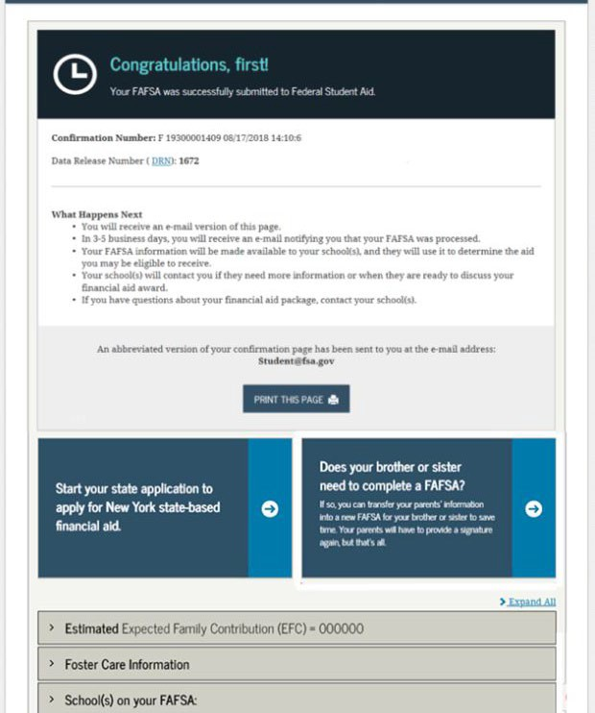
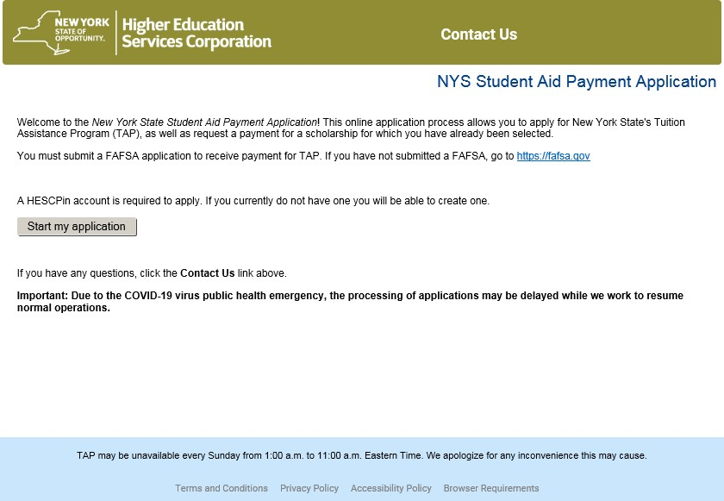
FAFSA Confirmation Page Link

Slide 34

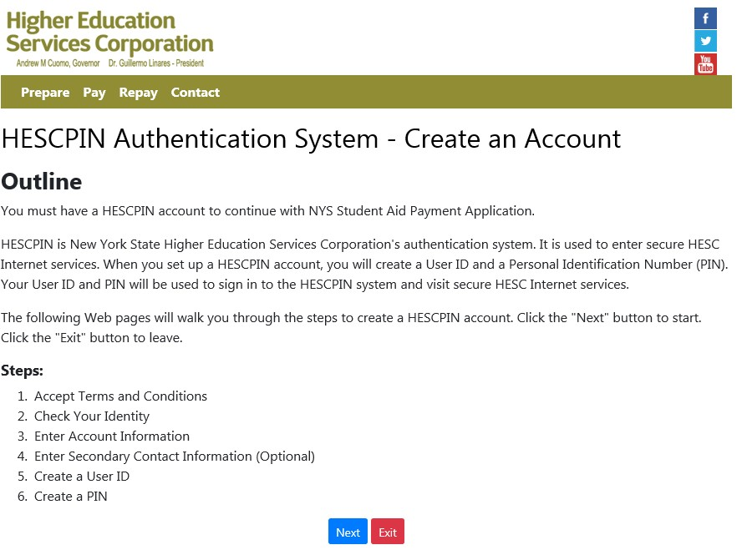
Creating a HESC Account: Outline

Slide 35

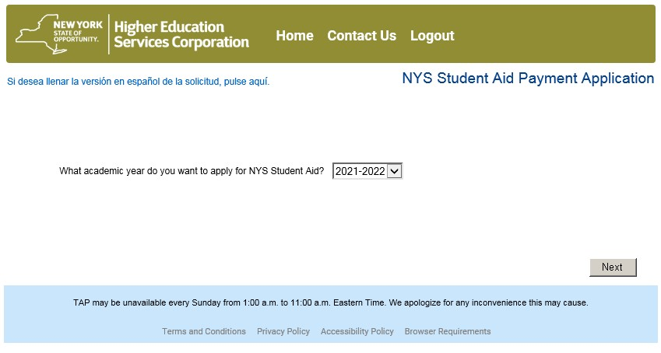
Academic Year Selection Screen

Slide 36

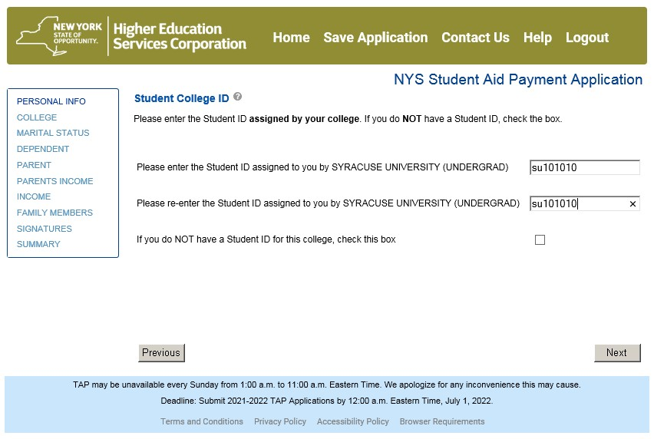
Student’s College ID Number
A student who does not have a college id click next twice

Slide 37
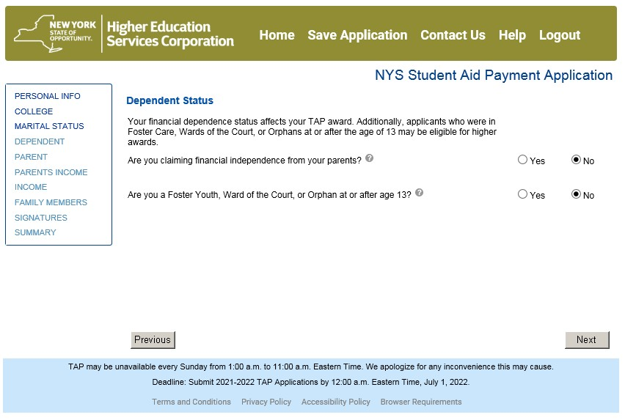
Independent or Dependent?

Slide 38

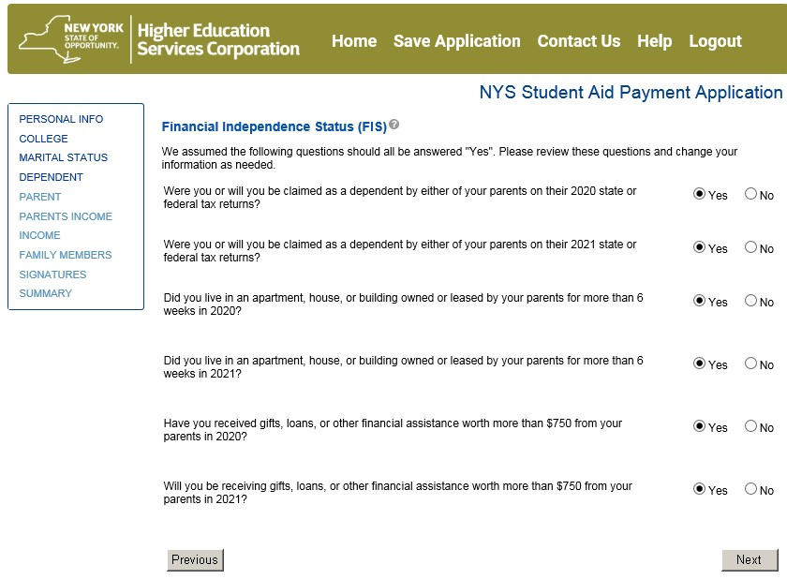
Financial Independent Status Questions

Slide 39

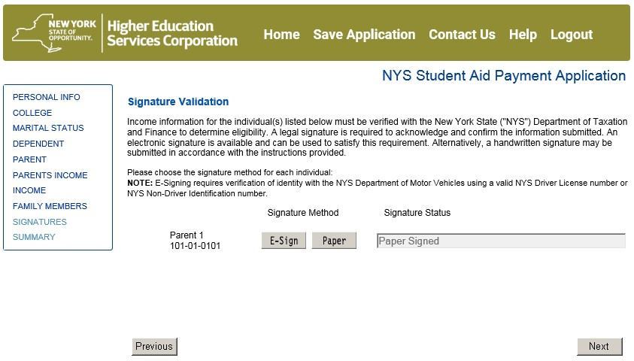
Signature Validation (Parent Signature)
Choose E- Sign or paper signature

Slide 40

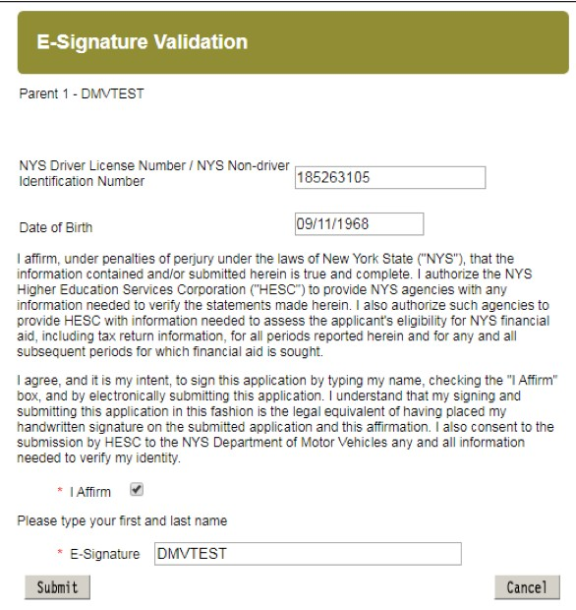

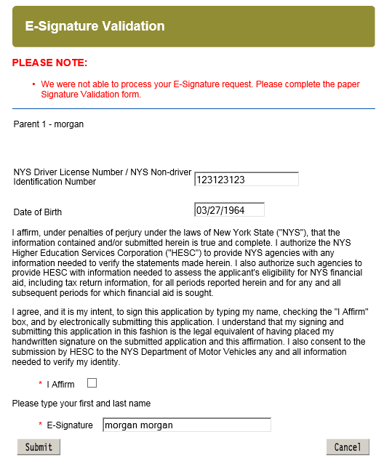
E-Signature: NYS DMV-issued ID
If e-signature does not work, then choose the paper signature option

Slide 41
Points to Remember
Grades do count for financial aid
  Talk to financial aid offices if dropping or failing classes
Financial aid and state requirements may vary with institutions

Slide 42
Thank You
Contact Information
Office of Student Financial Services
Dutchess Community College
53 Pendell Road, Poughkeepsie NY 12601
845-431-8060
Financialservices@sunydutchess.edu
Phone or Zoom Appointment: https://dutchesscommunitycollege5374.setmore.com/

