Slide 1
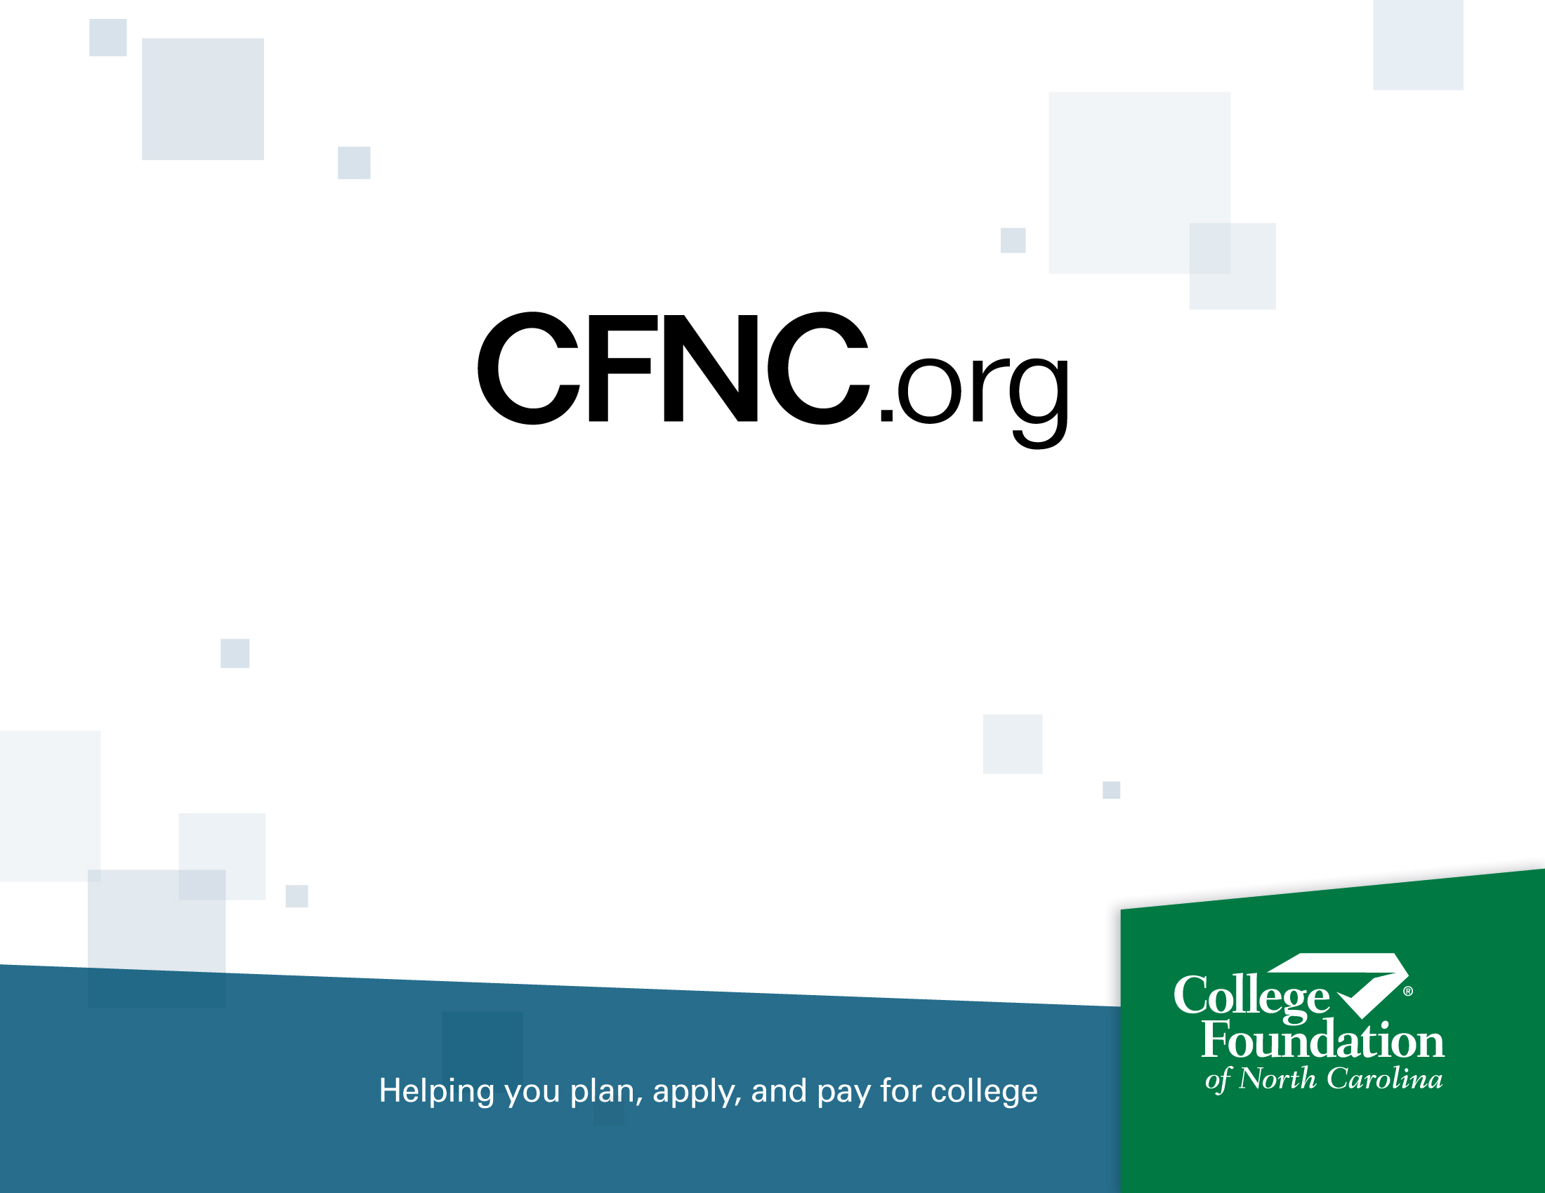
Paying for College in North Carolina: Perspectives on Student Loan Debt and College Affordability
May 2013
Steven Brooks
Executive Director
State Education Assistance Authority

Slide 2

What we constantly hear about college...
College costs too much, delivers too little [Orange County Register]
College Costs Out Of Control [Forbes]
America’s Trillion Dollar Student Loan Train Wreck [Sense on ¢ents]
Student Loan Debt: $1 Trillion and Counting [Forbes]
Student loan debt nearing $1 trillion threatens recovery [NY Daily News]
Notes:
Many recent headlines have suggested that the cost of going to college is too high and that the burden of heavy student loan debt is too great for many college graduates.

Slide 3
Real Questions:
  Are there really lots of students with debts of $75,000?
  Are students borrowing more or are more students borrowing? Or both?
  What are average debt levels and how are they changing?
  What is really happening regarding college costs and financial aid in North Carolina?
Notes:
A review of data on student loan debt nationally and in North Carolina can reveal the real story of college debt and what is happening to the majority of students.
A review of data on the cost of going to college in North Carolina and the availability of financial aid can help us answer questions on affordability in our state.

Slide 4
Student Loan Debt: National Context
  Nationally, of all students who entered college in 2003-04...
  43% have no federal Stafford Loan debt
  25% have debt under $10,000
  16% have debt between $10,000 and $20,000
  16% have debt over $20,000
    8% > $20,000 - $29,999
    8% > $30,000
    2% > $50,000
    1% > $75,000
Notes:
SOURCE: The College Board Trends in Student Aid 2012, Figure 11A.
So, almost half of all students who entered college a decade ago have zero debt.
Two out of three have debt under $10,000. Payments on a debt of $10,000 are about $125 per month for ten years.
Over eight out of ten have debt under $20,000.
Headlines emphasize the 1% or 2% who are outliers. Not to minimize their difficulties, but is this REALLY the place to focus attention?

Slide 5
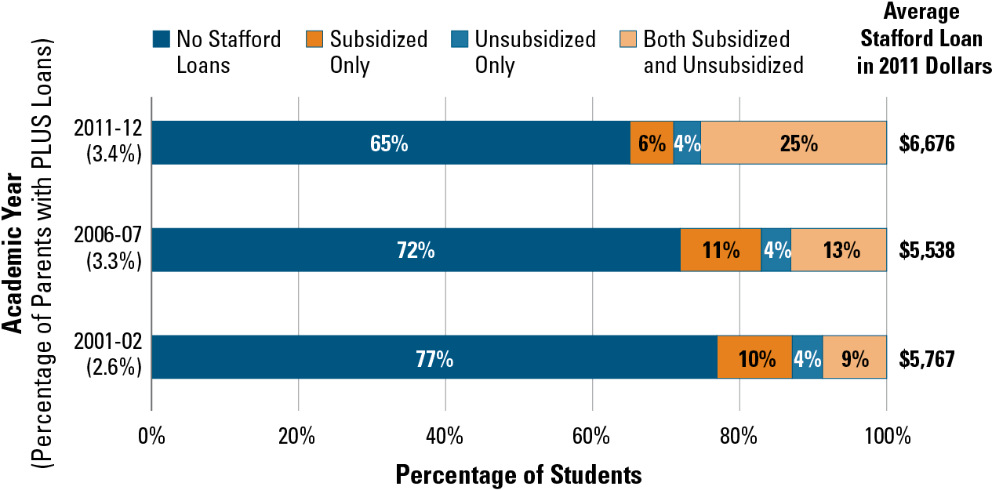
National Percentage of Undergraduate Students
Borrowing Federal Stafford Loans
Notes:
SOURCE: The College Board, Trends in Student Aid 2012, Figure 10A.
This slide shows the changes in ANNUAL borrowing over the past decade, in five year segments. As you can see, more students are borrowing to pay for their education – but still, in 2011-12, only about one out of every three students borrowed at all.
Remember, this is annual borrowing. Not every student borrows every year. But the trend is up – student borrowing has become more of the norm than it was a decade ago, likely because a recessionary economy diminished parental ability to use savings or investments to pay their share.

Slide 6
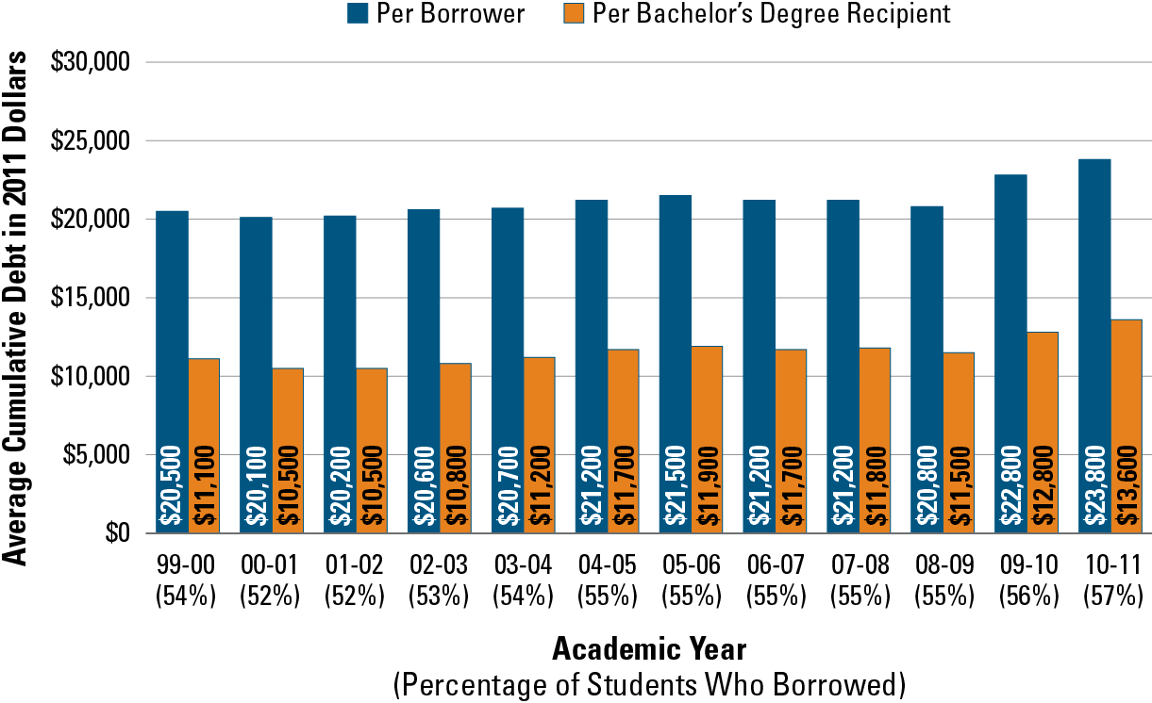
National Average Total Debt Levels
Bachelor’s Degree Recipients
Public Four-Year Colleges and Universities in 2011 Dollars
Notes:
SOURCE: The College Board, Trends in Student Aid 2012, Figure 12A.
Public four year colleges -
Only includes students who began their studies at the institution from which they graduated. Debt figures include both federal loans and loans from nonfederal sources that have been reported to the institutions.
Here we see that the percentage of students who borrowed at any point during their education increased from 54% to 57% during the decade. And, their average indebtedness at graduation increased from $20,500 to $23,800 during the decade, an increase of 16%.
The orange bars account for the large numbers of students who do not borrow at all. When we say the “average” student, the debt at graduation is $13,600. If we say the “average student who borrows” then the debt at graduation is $23,800. Headlines often confuse these two groups.

Slide 7
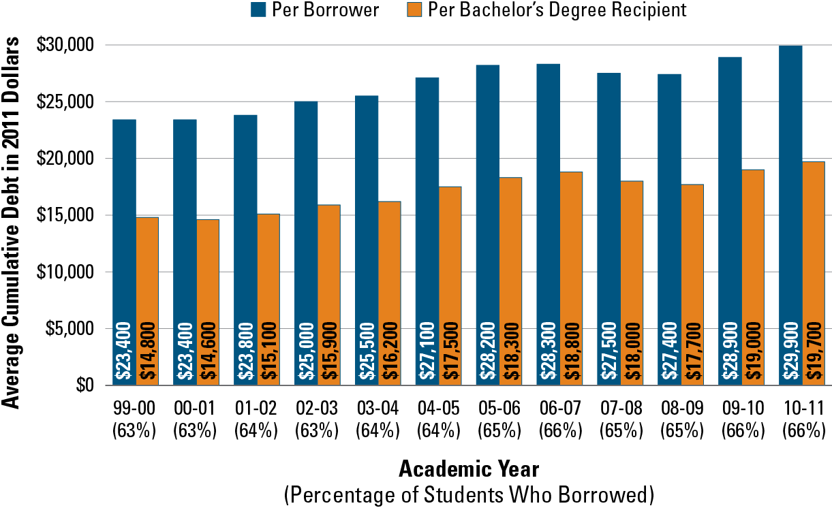
National Average Total Debt Levels
Bachelor’s Degree Recipients
Private Nonprofit Four-Year Colleges and Universities in 2011 Dollars
Notes:
SOURCE: The College Board, Trends in Student Aid 2012, Figure 12B.
Only includes students who began their studies at the institution from which they graduated. Debt figures include both federal loans and loans from nonfederal sources that have been reported to the institutions.
Here we see comparable numbers for students at private four year (non-profit) institutions. About two of every three of them borrow, and the average debt at graduation among those who borrow is $29,900. Considered another way, the “debt cost” of a private education versus a public one is $6,100, or about $1500 for each year of school – less than one might imagine given the differences in tuition and fees.

Slide 8
Student Borrowing: North Carolina
Total Dollars Borrowed for Stafford Loans
+ 186%
Notes:
SOURCE: Statistical Abstract of Higher Education in North Carolina
Now let’s look at borrowing in North Carolina. The data on this slide show the dominant student loan, “Stafford Loans,” combining subsidized and unsubsidized loans.
Total dollars borrowed under this program during the decade rose by 186%, under 2% per year. The steepest increases came during the economic downturn in 2008-10.

Slide 9
Student Borrowing: North Carolina
Total Number of Stafford Loan Borrowers
+139%
Notes:
SOURCE: Statistical Abstract of Higher Education in North Carolina
So, total borrowing in North Carolina did increase during the past decade. But that is not the entire story ... More students than before are actually borrowing to pay for their educations – and, again, the largest portions of increase have come following the economic collapse of late 2008.
The truth is, more students are borrowing AND students on average are borrowing more money than a decade ago.
But the data are not alarming – a rise in borrowing of under 2% per year over a decade is not, arguably, a “student loan train wreck” as portrayed in headlines.

Slide 10
Student Borrowing: North Carolina
Average Debt at Graduation for
Bachelor’s Degree Recipients at
North Carolina Colleges and Universities
Notes:
SOURCE: Project on Student Debt (http://projectonstudentdebt.org/)
Another way to consider student debt in North Carolina comes from the Project on Student Debt. Students graduating from North Carolina colleges and universities actually borrow less, on average, than their counterparts across the nation – 22% less in 2011.
Further, a smaller fraction of graduating North Carolina students actually borrows at all to pay for college – 54% versus the national average of 66% in 2011 – a difference of 12 percentage points!
Finally, it is important to note that the rate of increase in the average amount of debt among students who borrow is rising more slowly in North Carolina than in the rest of the nation, a trend that we hope continues – the rise here is only about half the rate of the national increase.

Slide 11
College Costs: North Carolina
Average Tuition and Fees at North Carolina Institutions
Notes:
SOURCE: Statistical Abstract of Higher Education in North Carolina
And what about college costs? We always read that they are “skyrocketing!”
They have gone up faster than inflation – as this slide shows, costs have increased at both public and private institutions over the last decade in North Carolina, more than doubling in public institutions as state support has diminished.
But does that mean that all students are paying double?

Slide 12
Estimated “Sticker Price” - Entering Fall Semester, 2012
Tuition, fees, room, meals, books, supplies, transportation and personal expenses
How Much Will It Cost?

Slide 13
Financial Assistance: North Carolina
Total Student Financial Aid Awarded
(in millions, rounded)
Notes:
SOURCE: Statistical Abstract of Higher Education in North Carolina
When we look at the growth in state grants, along with the growth in Pell Grants, over the past decade in North Carolina, we see that for many students the net change in costs has actually gone down. Need based grants have far outstripped the increases in tuition and fees in our state. Part of this is due to enrollment growth, but largely it is the story of improved affordability, even as headlines tell the opposite story, for families with incomes at or below the median in North Carolina.
Tying this story of financial aid together is the final set of information on student loans. Subsidized loans are offered on the basis of need. Unsubsidized loans replace the amounts families are expected to pay. As you can see, the unsubsidized loans increased much faster than subsidized during the past decade, indicating that those who do not qualify for need based aid have turned more to borrowing to pay increasing costs. Those who do need help with the costs of education actually have increased borrowing less than their more affluent peers.
Suggest including information about enrollment increase as part of the comment for this slide rather than as a separate slide, along the lines of:
North Carolina’s increased commitment to funding the Need Based State Grants is partly a function of the significantly increased enrollment in North Carolina colleges and universities experienced during this period. Total degree credit headcount enrollment increased 29% between 2001 and 2011… (include sector specific percentages if you think it helpful).

Slide 14
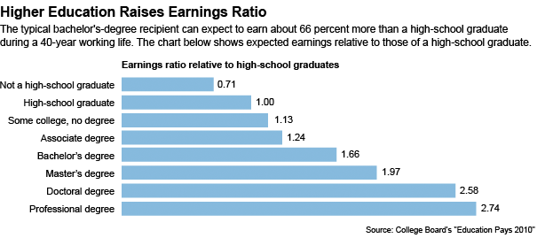
College costs can be daunting … but
Government Gets Back
Its Investment!

Slide 15
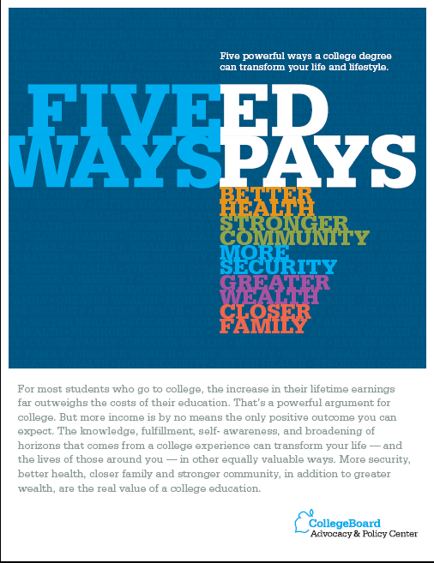
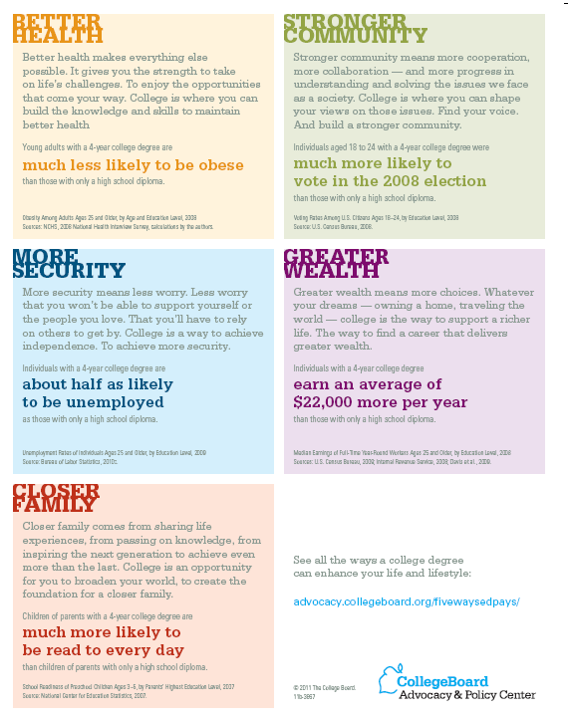
Consider the cost as an investment that pays rich dividends

Slide 16
College costs can be daunting … but
Costs do not have to be paid all at once
There are four ways to pay for this investment
  Saving in advance
  Paying from current income
  Borrowing – pay with future income
  Scholarships and Grants

Slide 17
Observations on the four ways to pay
It is less expensive to save than to borrow
  Those who do not save have to borrow more
  Current income can cut borrowing costs as well
  Some level of sacrifice – at some point – will have to be made (sooner, now, or later)
  Need-based grants and scholarships are designed to provide the amount that the family and student cannot reasonably afford over time
Most families use a combination of all saving, borrowing and
current income to pay their share of college expenses.

Slide 18

So, what should the headlines actually say?
Student loans should be approached cautiously, but for the vast majority they provide access to higher education.
College costs a lot, but it is worth it, and financial aid lowers the cost for those who need help.
College Works! Research shows that college graduates have
  Greater wealth
  More financial security
  Better health
  Stronger community
  Closer family
  For more information please see http://www.cfnc.org/static/pdf/paying/pubs/pdf/pdf/5WaysBro_Eng.pdf

