Slide 1
OVERVIEW OF THE TITLE I PROGRAM AT
RAGSDALE HIGH SCHOOL
School Contact: Hanna Moore
August 20, 2024
Whitney Oakley, ED.D. | SUPERINTENDENT

Slide 2



2
2

Slide 3





About Title I
2
3
Title I is a program created by the US Department of Education that distributes funds to States who, in turn, provide funding to school districts. The districts distribute funds to schools with a high percentage of students from low-income families. The act was funded to emphasize equal access to education and establish high standards and accountability.
Beginning in 1965 as the Elementary and Secondary Education Act (ESEA), the law has had multiple iterations over the years. The most recent reauthorization was in 2015 by then President Barack Obama as “Every Student Succeeds Act (ESSA)”, which provides the current framework and guidelines for the use of funding.
Equal Access
High Standards
5
4
1
Title I
Accountability
Supplement
Funding

Slide 4
GCS by the Numbers
​
Guilford County Schools, in the 2024-2025 school year, has 80 Title I schools:
  46 elementary schools
  12 middle schools
  13 high schools
  3 schools that span multiple grade levels
  4 specialty schools, and 2 alternative schools
Between $12 million - $13 million is distributed to Title I schools
annually.​
3rd

Slide 5

Purpose of Title I

Slide 6




The Purpose of Title I
To ensure that all children have a fair, equal, and significant opportunity to obtain a high-quality education.
Charter School
Growth
Utilities
Liability Insurance
Notes:
SAY: Good evening and welcome to Alderman’s Annual Title I Meeting. We are pleased you have joined us today and hope this presentation will provide you with valuable information regarding our Title I funding and its uses.

Slide 7
Qualifying for Title I Funds
To be served as a Title I school during the 2024-2025 school year, 75% or more of the families in the school must have been identified as low income during the 2023-2024 school year.

Slide 8

What Does Title I Funding Mean for My School?

Slide 9



Title I funds are to be used to:
1
2
3
Supplement the existing instructional programs that are funded with state and local funds
Increase the academic achievement levels of struggling students
Engage Parents
Notes:
Career academies vary across schools and districts, they share three basic components:
Career academies are a leading high school reform designed to engage students and better prepare them for college and the
workplace. They offer small, more personalized learning environments; integrated academic and technical courses organized around
career themes; and work-based learning opportunities.
Career academies, in use for nearly 40 years (Kemple and Willner 2008), are a leading high school reform designed to engage students
and better prepare them for college and the workplace.¹ Initially intended to provide vocational training to students at risk of dropping
out of school, they have since become a comprehensive high school strategy (Stern, Dayton, and Raby 2000), offering small, more
personalized learning environments; integrated academic and technical courses organized around career themes; and work-based
learning opportunities.

Slide 10

Ragsdale- 2024-2025 Title I Funds
Each school receives two types of allocations:
1
2
Non-Restricted Funds:
$268,609.77
Parent and Family Engagement Funds:
$6,725.23

Slide 11




Title I funds can be used for:
Parent and Family Engagement activities
Student supplies and materials
Professional Development activities
Technology Equipment for Students

Slide 12




Title I funds can be used for:
Educational field trips
Literacy
and Math Specialists
Tutoring
Student Support positions

Slide 13

School Improvement Plan and Title I

Slide 14
School-Based Title I Decisions
Decisions about using Title I Funds must:
Include parent and stakeholder input
Be informed by data
  EOG, EOC
  State report card
  DIBELS
  NWEA
  Absentee reports
  Suspension rates
  Retention rates
  Teacher Working Condition surveys, etc.
Title I funds should be linked to support strategies identified from the school’s Comprehensive Needs Assessment and should be outlined in the School Improvement Plan.

Slide 15

Parent and Family Engagement

Slide 16






Title I Parent and Family Engagement Plan
Provide timely information about curriculum, assessments, and achievement levels
Involve parents in an organized, ongoing, and timely way as we plan, review, improve, and develop the school parent and family engagement policy and schoolwide programs
Provide opportunities for regular meetings
Allow a flexible number of meetings for all parents to be able to participate
Convene an Annual Title I Meeting (this meeting)
Include parents’ comments as data in the development of programs
Guarantee
Enlighten
Navigate
Adjust
Give
Examine

Slide 17
Building Capacity
The Title I Program is also a supple to support Parent and Family engagement in the school. Title I Schools provide families with:
Supply materials and training
Give assistance to parents
Educate school personnel
Coordinate and integrate funding sources
Ensure the information is understandable
Provide opportunities for parents with Limited English Proficiency, parents with disabilities, and parents of migratory children
Parent and
Family
Engagement

Slide 18
Parent and Family Engagement
  The school and families work together to develop the School-Parent Compact and Plan that includes:
    Describes school’s responsibility to provide high-quality curriculum and instruction in a supportive and effective learning environment
    Describes ways parents are responsible for supporting learning, volunteering, and decision making (as appropriate)
    Addresses importance of communication between parents and teachers:
      Annual teacher conference for all school levels to discuss compact
      Frequent progress reports to parents
      Reasonable access to staff, opportunities to volunteer, participate, observe child’s classroom
      Ensuring meaningful two-way communication in
      a language parents can understand
Shared Responsibility for High Student Academic Achievement

Slide 19
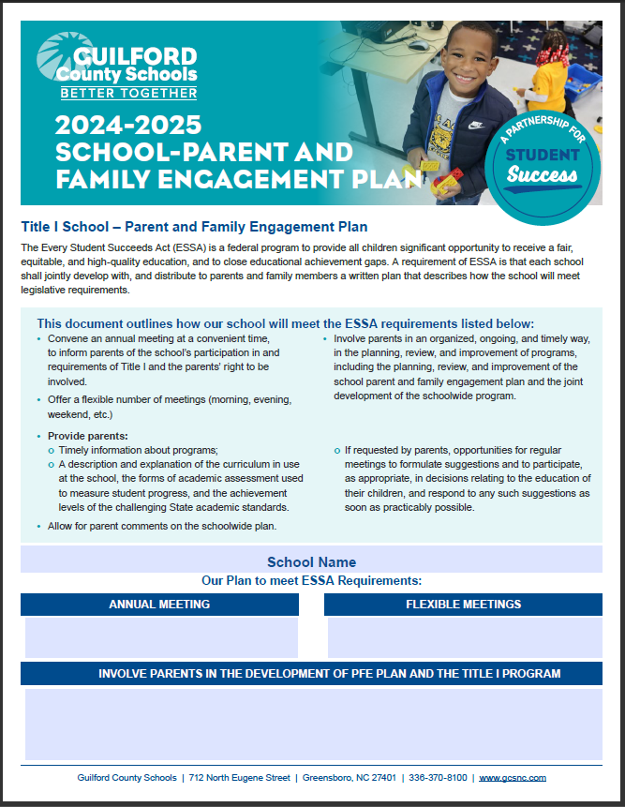
Parent and Family Engagement Plan

Slide 20

Parent and Family Compact

Slide 21

Questions & Dialogue
Questions?

