Slide 1




CLASS OF
2029
NWHS Registration Information

Slide 2
Let's Talk High School
Credits Needed to Graduate
What is a Transcript?
Calculating a GPA

Slide 3
GRADUATION REQUIREMENTS
22 CREDITS TOTAL
4 English Credits
4 Math Credits
4 Social Studies Credits
3 Science Credits
1 Health/PE Credit
Electives
  4 elective credits
(2 Foreign Language Credits)
      Not required for graduation from high school, but required for admission to 4-year colleges/universities
  **You MUST take an ARTS course between grades
  6-12 & pass CPR to graduate

Slide 4
9th Grade Courses
English I (Regular or Honors)
Civic Literacy (Regular or Honors, OR AP Government)
Math I (Honors), Math II (Honors), or Honors Math III (depending on 8th grade math and recommendations)
Earth/Environmental Science (Regular or Honors) OR Honors Biology (Math II and above)
PE/Health
Electives – Information about Options available on NWHS Website & will be presented on Thursday, February 13

Slide 5
Honors versus Regular
It’s more than just doing more work…the expectations are higher.
Key differences:
  1. Pacing – Classes move at a faster pace and incorporate in-depth exploration of the curriculum.
  2. Assignments – Students complete rigorous assignments of greater complexity and length. There can be more essays and open-ended questions.
  3. Classwork – Class time requires more independent work. More time is used to engage in discussions, in-depth labs, and group interactions. There is a heightened homework expectation.

Slide 6
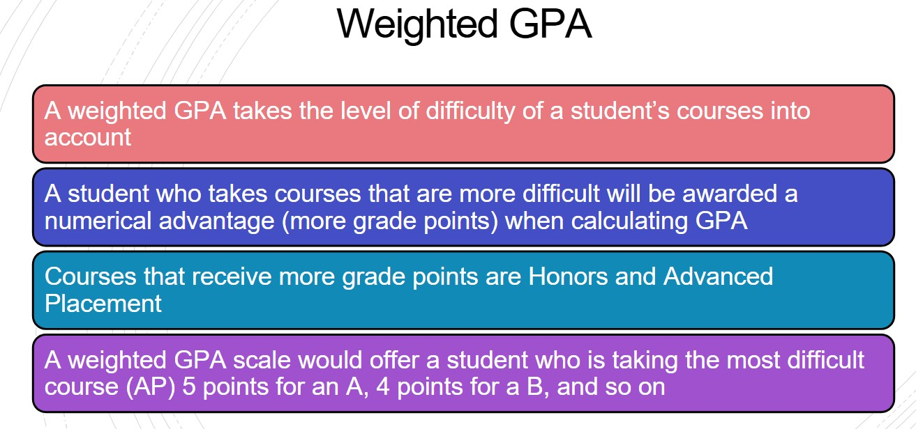
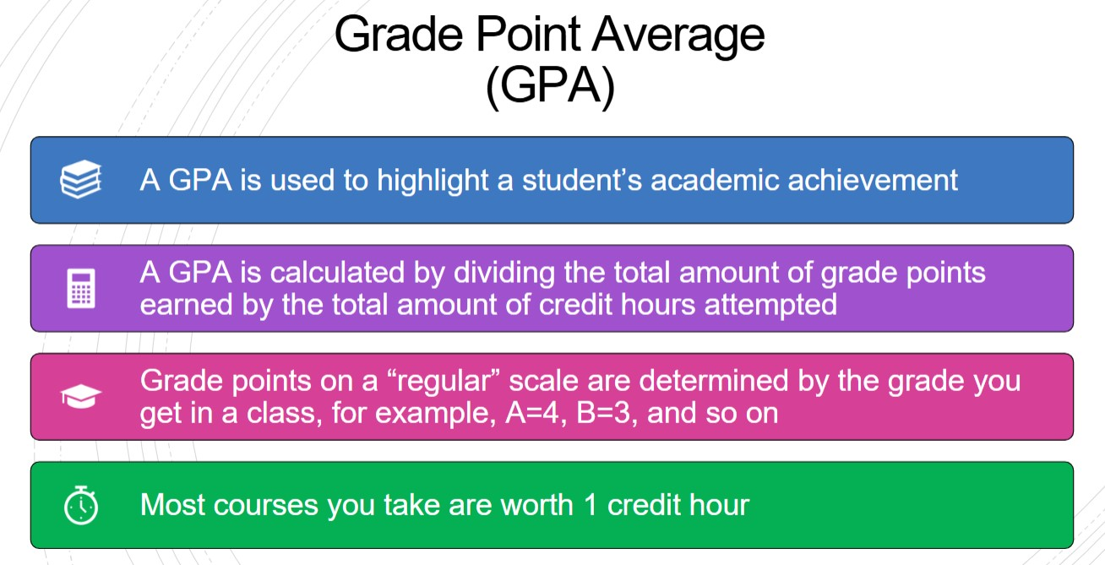
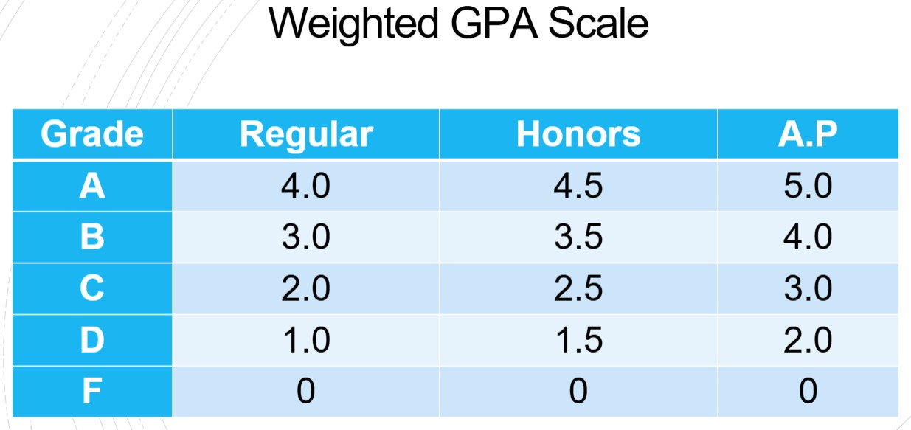
What is a GPA?

Slide 7
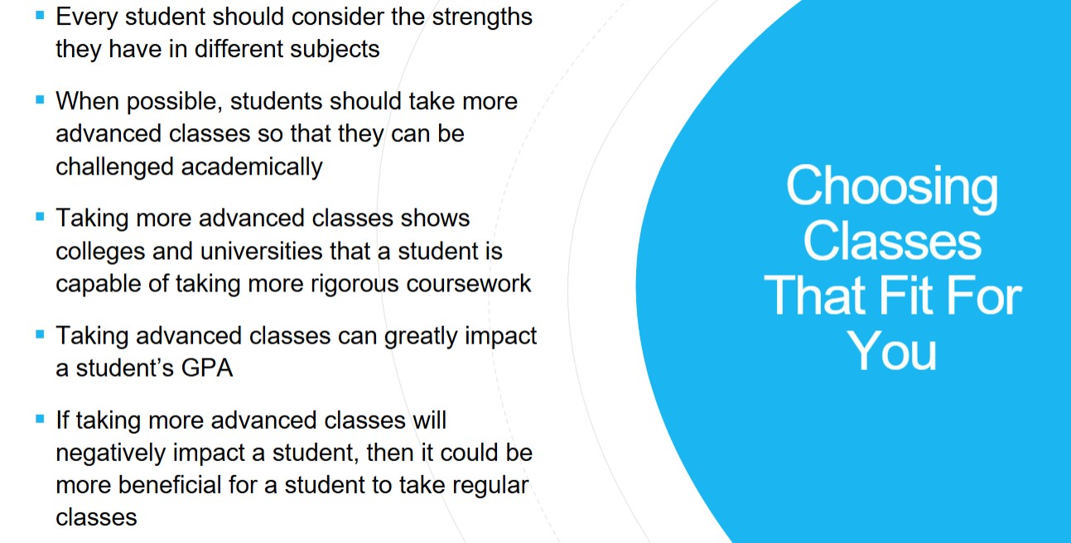

Slide 8
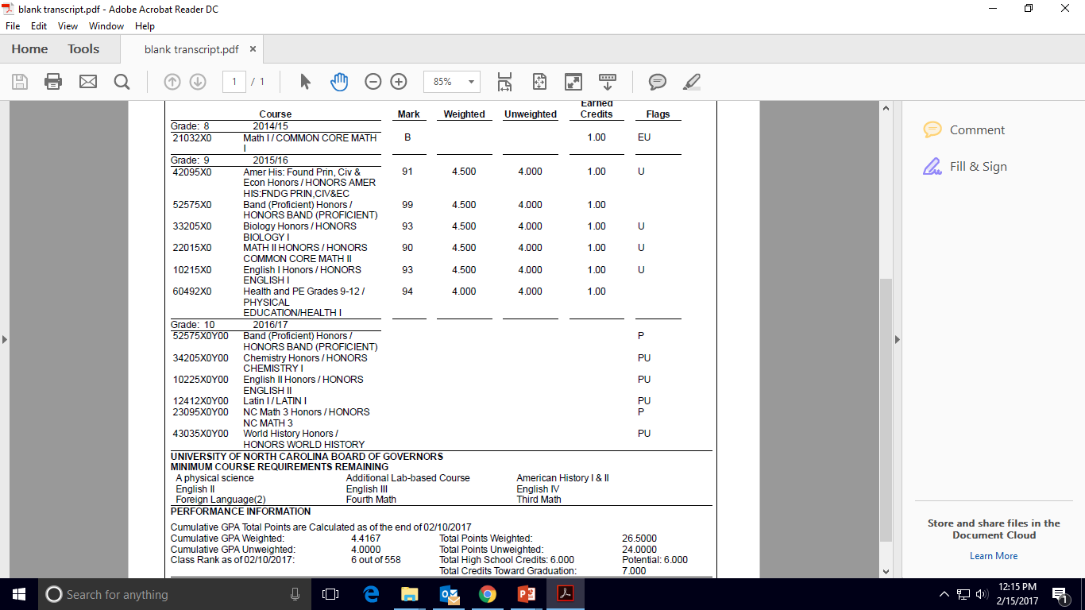
EXAMPLE Transcript

Slide 9
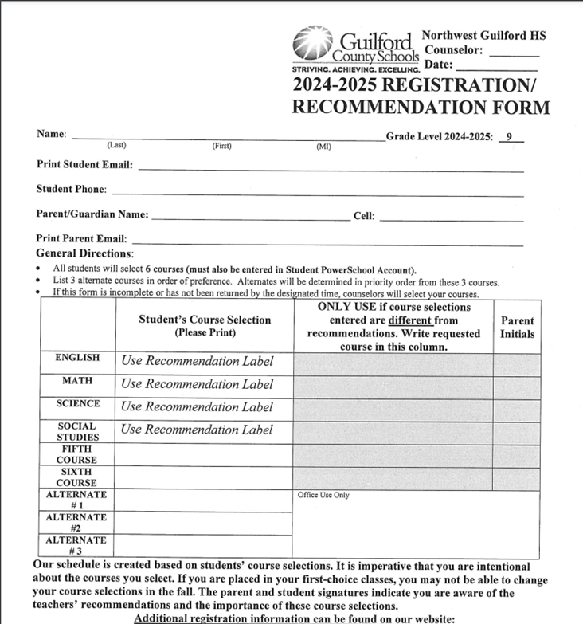
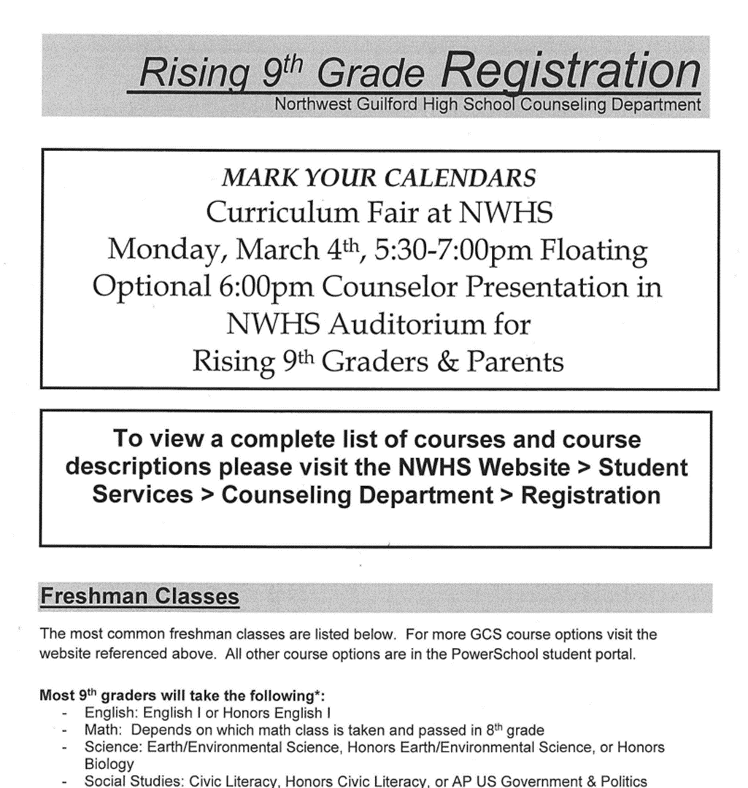
Pink Registration Form: Due February 24th to Homeroom Teacher
Front of Form
Back of Form

Slide 10
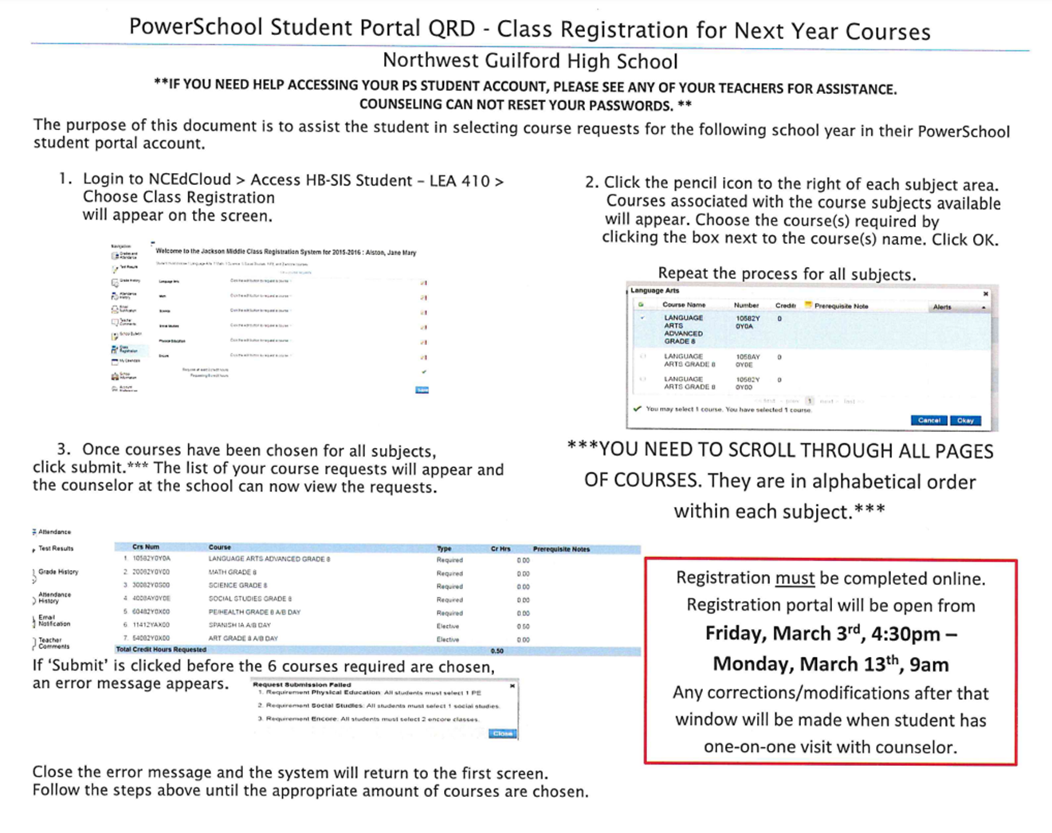
Online Registration – MUST BE COMPLETED
The registration window opens Friday, February 14th at 5:00 pm
The registration window closes on Sunday, February 23rd
Registration NOT FIRST COME FIRST SERVE

Slide 11

Important Items to Remember
Online registration MUST be completed by 2/23/25
Return the pink registration form to your homeroom teacher by 2/24/25
Both online and registration sheet must be completed.
A complete list of courses and course descriptions are on the NWHS website – see instructions on the back of your registration form
High School Counselors will be meeting with 8th grade classes on Thursday, February 13^{th.}
Registration is NOT on a first come first serve basis
Questions??????

