Slide 1
Annual Middle School AG Parent/Guardian Meeting
Northwest Middle School
Heather Lenard (Curriculum Facilitator)
Katie Thompson (6th grade Counselor)
Mac McDowell (7th grade Counselor)
Sharla Martin (8th grade Counselor)
October 25, 2022
Whitney Oakley, ED.D. | SUPERINTENDENT
Notes:
Welcome to our AG Parent Meeting. Each year the district requires that all school’s hold a parent AG meeting to provide an opportunity for parents to understand their child’s AG service, receive the annual plan for classroom differentiation, and have the opportunity to ask any questions they may have.

Slide 2

2022 – 2025 AIG Plan
Notes:
During this meeting, we will provide an overview of the current 2022 -2025 district AIG Plan. We will highlight information from the AIG Plan as it relates to middle school AG service.

Slide 3


Primary Revisions for 2022 -2025 AIG Plan
Increase Availability of Advanced Coursework
Improved efficiency for AG Compliance
Notes:
At the middle grades, revisions for the 2022 – 2025 AIG Plan fell into these two “buckets”. The first area that we will discuss is Increase Availability of Advanced Coursework. The second area we will discuss is Improved Efficiency for AG Compliance.

Slide 4
Increase Availability of Advanced Coursework & Appropriate Instruction
Differentiation Canvas Module provides support to classroom teachers by providing relevant information and sample on differentiation techniques for gifted and advanced learners.
AG PD Series focuses on the characteristics of academically gifted students and highlights best practices for meeting their needs in the classroom.
By the end of 2025, there will be:
Increase access to English I enrollment as an 8th grade option.
Provide an advanced course option for middle school Science and Social Studies.
Notes:
At the middle grades level, AG students are served through appropriate differentiation and enrollment in advanced math and/or reading courses. To help teachers implement effective differentiation strategies, the AG Departments provides a Canvas Course with modules on instructional strategies for advanced learners. All teachers in GCS have access to this course and the resources provided within the course.
The AG Department also provides their AG PD Series, which is two courses that focus on the characteristics of academically gifted students and instructional practices that can best meet their learning needs. As will be highlighted later, the district’s expectation is that all teachers of AG students complete this course or have their AIG licensure.
For the 2022 – 2025, the district hopes to meet the following goals as it relates to increased middle grades opportunity for advanced courses.
Increase access to English I as an eighth-grade course option in more middle schools. Currently, this option is only available at the VS Program and Brown Summit Middle. With more opportunities for English I enrollment, in middle school, the district will also ensure that high school administrative teams have a better understanding the high school course options for students who enter high school already successfully completing English I.
The AG Department hopes to work with middle school and district leaders on the roll-out of advanced courses in Science and Social Studies. The initial focus would be on grade 8.
Other times, the teacher may highlight how they are using district provided resources to provide an opportunity for students to explore content in a way that links their learning to future college and/or career aspirations. The Annual Plan serves as a snapshot that highlights the type of differentiation students and parents can expect throughout the year.
Under the previous AIG Plan, the district was able offer English I, the first high school English course, to eight graders enrolled in the VS Program at the Academy Lincoln as well as 8th graders enrolled at the Brown Summit Center for Advanced Academics. In the current plan, the AG Department will work with the Literacy Department to develop an implementation plan to roll-out the availability of English I at other middle schools.
This slide also addresses how the district is increasing opportunities for appropriate high school course at both the middle school and high school level. The district is currently in Phase 2 of providing English 1 as a course available to 8th grade students. Before full implementation is available at all middle schools, district leaders are ensuring that appropriate pacing and course offerings are available at the high school level. Thus, the reference here to increasing opportunities for Pre-AP high school experiences.

Slide 5
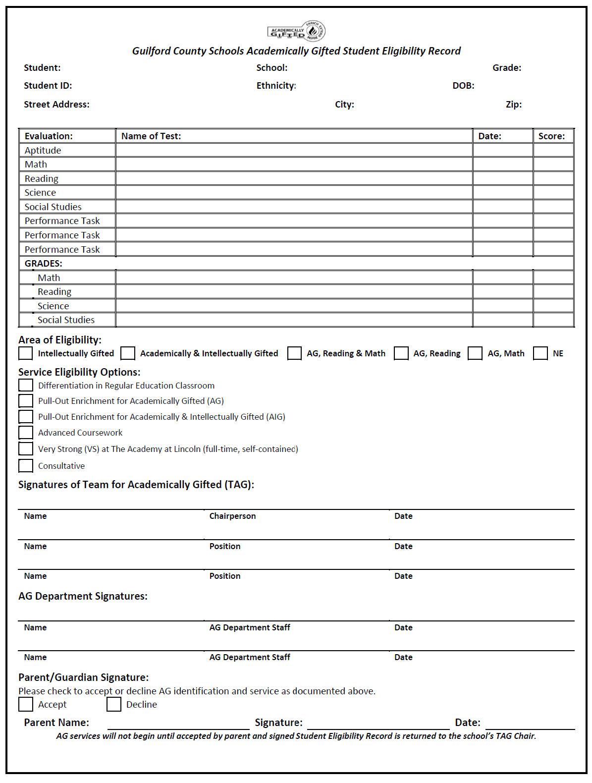
Improved Efficiency for AG Compliance
Revised
Student Eligibility Record (SER)
Data reviewed to make decisions regarding AG eligibility;
Identification and service details; and
Updated to include a place for parent/guardian to accept or decline identification and service.
Notes:
The Student Eligibility Record, often referred to the SER, documents the data that was reviewed to determine if the student met the criteria for AG identification. The SER also details the student eligibility area and the service that is to be provided to the student. At the middle grades level, the service provided to students is enrollment in advanced coursework. The SER has been updated to include a place for the parent/guardian to accept or decline their child’s AG identification and service. Although enrollment in advanced coursework begins from the first day of school, it is important that the SER is returned to document the parent’s/guardian’s acknowledgement of their child’s AG identification. Additionally, at the middle grades level, should the parent decline service, the student would maintain their AG identification and the family would be referred to the counseling department to discuss any possible schedule changes. Declining AG services does not necessarily lead to an immediate schedule change and unenrollment from advanced coursework.

Slide 6
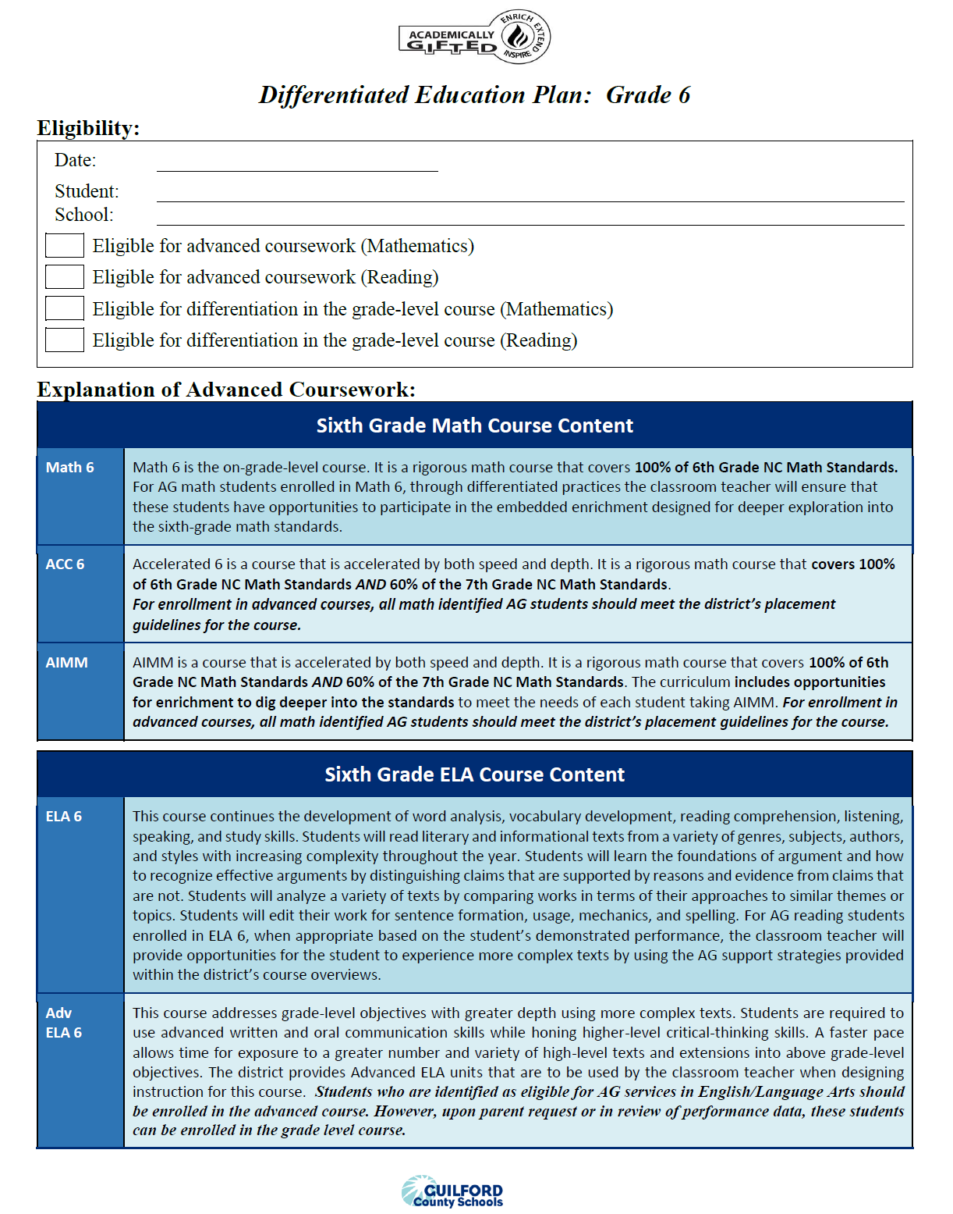
Improved Efficiency for AG Compliance
Revised
Differentiated Education Plan (DEP)
Parent receives DEP annually (updated by grade level)
Provides an explanation of the service that is marked on the SER
For each grade level, describes the differences between the on-grade level course and the advance course options.
For advanced courses, serves as the Group Annual Plan for Differentiation because it details the embedded acceleration and extension provided in these courses.
The Progress Report and Report Card serve as documentation of student performance in AG programming.
Notes:
The Differentiated Education Plan, often referred to the DEP is provided to parents annually at our beginning-of-year parent meeting. The DEP explains the services marked on the SER. For middle grades, the DEP describes the differences between on-grade level course and the advance course options. It serves as the Group Annual Plan as it details the embedded acceleration and extension provided in advanced courses. Parents should use their child’s Progress Report and Report Card as documentation of their child’s performance in AG programming.

Slide 7

Questions regarding the AIG Plan should be directed to the AG Department. The AG Coordinator, Dr. Dee Jordan serves as the middle school AG contact. You can reach her at: 336-370-8322 OR jordand@gcsnc.com
Notes:
The completed AIG Plan is available on the AG Department’s website. You can access the website by going to www.gcsnc.com, click on the “Departments” tab, and select the Academically Gifted Department. Once of the AG Department page, on the left side, click on “AIG Plan 2019- 2022” link. If you have any questions regarding the AIG Plan and middle school AG services, you can contact Dr. Dee Jordan to express your concerns or share your feedback.

Slide 8

Providing Support to AG Students and their Families
Notes:
The next portion of our meeting, we will focus on the how the district and our school can support you and your student.

Slide 9
AG Support
At the School Level:
Classroom Teacher – Responsible for the implementation of the standard course of study and using differentiation to address student need.
Team for Academically Gifted (TAG) – A cross section of school staff who act on behalf of all gifted students in the building
Curriculum Facilitator – Supports all teachers, in the building, with best instructional practices for all students.
School Counselor – Supports students with the development of the social, emotional, and academic skills needed for post-secondary success. Also available to address scheduling questions.
School Administration – Ensures that the school’s vision is implemented in a way that meets the learning needs of all students in the building.
Notes:
Unlike elementary schools, where there is a person in the building who is an AG specialist and who handles all AG matters as well as serves students in a pull-out enrichment program, middle school AG is addressed through a collaboration of multiple people in the building:
the classroom teacher who uses appropriate differentiation to implement the NC standard course of study.
the team for academically gifted which is a cross section of school staff who advocate for the needs of academically gifted students.
the curriculum facilitator who supports all teachers on understanding instructional practices and district mandates regarding teaching and learning.
the school counselor who helps students build the social, emotional, and academic skills and mindsets needed for post-secondary success.
And finally, our school administration team that ensures that the district goals and initiatives are implemented in a way that meets the learning needs of all students in our building.

Slide 10
Team for Academically Gifted (TAG)
What is the function of TAG?
An interdisciplinary team comprised of school staff and a parent representative
Supports and advocates for gifted education in the school
Reviews data to determine student eligibility for AG services
Monitors AG student records and services
Notes:
The role of the Team for Academically Gifted (TAG) is to serve as the decision-making team for gifted services at the school level.
The TAG provides support and advice to AG students, their parents, and their teachers. TAG members serve as advocates for gifted services. Each member shares the responsibility of ensuring that services and documentation within the school comply with the current board-approved AG Plan; doing the work for the grade level they represent.
The TAG Chairperson serves as the lead contact person, in the school, for the AG services and they oversee the function of TAG Team.
TAG meets monthly with face-to-face, virtual, and quick check-in options.

Slide 11
Meet Our School’s TAG Team:
TAG Role: | Team Member: | School Role:
TAG Chair | Heather Lenard Katie Thompson Mac McDowell Sharla Martin | -Curriculum Facilitator -6th grade counselor -7th grade counselor -8th grade counselor
Principal/Principal Designee | Denise Francisco
6th Grade Representative | Carrie Hopkins | Social Studies teacher
7th Grade Representative | Francine Bock | ELA teacher
8th Grade Representative | Monica James | Social Studies teacher
Parent Representative | Francine Bock
Advising Member, EC Teacher | Julie Williams
Advising Member, EL Teacher | Patricia Alen
Advising Member, 504 Coordinator | Sharla Martin
Notes:
This slide summarizes the membership of our school’s current TAG Team.

Slide 12
Our TAG’s Communication Plan
In the school website under “Counseling Center” tab, you will find the Quarterly Newsletters as well as this presentation and any updates that are received throughout the year.
Please check for new information at least quarterly.
Notes:
As parents of AG students, you can expect to hear from our school’s TAG team through quarterly newsletters. We also will provide mass communication to parents on our website.

Slide 13
AG Support
At the District Level:
AG Department– Provides support to schools and families with identification and service of AG students in grades 6-8
Guilford Gifted (formerly known as Guilford PAGE)– A community group comprised of parents and other stakeholders with an interest in gifted programming throughout the district.
Notes:
Our district’s AG Department provides support to schools through appropriate professional development. Additionally, the department provides enrichment experiences, such as the Academic All-Star Camp.
A district wide support is Guilford Gifted, which was formerly known as Guilford PAGE. However, this caused a lot of confusion with Page High School. Therefore, to avoid confusion with Page High School, the organization will now be referred to as Guilford Gifted. The organization remains a non-profit affiliate of the North Carolina Association for Gifted & Talented. Our Guilford Gifted chapter advocates specifically for students in Guilford County.

Slide 14

Guilford Gifted (formerly known as Guilford County Chapter of PAGE)
https://www.guilfordgifted.org/
Notes:
As previously stated, the Guilford Gifted is the community advocacy group for gifted education in Guilford County. With the rebranding from Guilford PAGE, the organization has a new website. We encourage you to visit their website to learn more about their programming and advocacy efforts.

Slide 15

Who are we?
Greg Fleming - President
Alicia Dugas - Vice President
Stephen Adekunle - Treasurer
Kelsey Markovich- Assistant Treasurer
Shannon Pena - Secretary
Carolyn Cheriyan - Webmaster
Angela Olalere - Advocacy and Membership
Kara French - AG Liaison
Becky Lange - Communications
Guilford Gifted Board
Notes:
Currently, the Guilford Gifted is in a rebuilding year operating with a newly established board. This slide list the current board members.

Slide 16

Goals of Gifted Guilford
Increase our membership- and have each school represented
Speaker Series
Start advocating and recruiting for a TAG member associated with Guilford Gifted in each school
Support our AG teachers
Offer resources to families
Promote resources aimed at MS/HS students
Notes:
This slide highlights 6 goals of the organization. Those that are related to the needs of academically gifted middle school students include:
Having a membership in which all GCS schools are represented;
Once the membership includes representation of all schools, Guilford Gifted will be better prepared to assist our TAG teams with securing parent representation.
Another middle school related goal is to ensure that families have access to resources that specifically address the needs of middle school students.

Slide 17
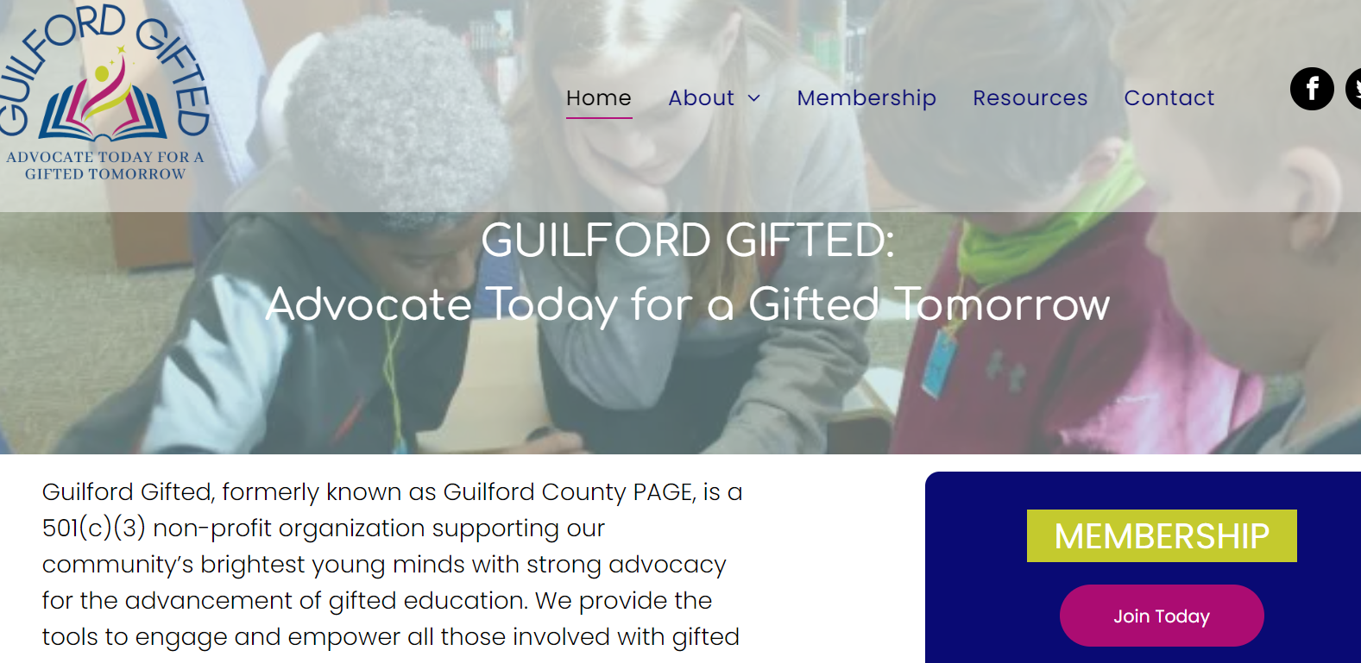
Become A Member
Free Membership for all Teachers
Find us at www.guilfordgifted.org
Email us at guilfordgifted@gmail.com
Notes:
During this period of rebuilding and rebranding, membership to Guilford Gifted is FREE! To assist with programming, the organization is accepting donations.

Slide 18
Become A Member & Stay Informed!
Join Guilford Gifted!
Bookmark the new website
Follow Gifted Guilford on Facebook (https://www.facebook.com/GuilfordCoPAGE)
Follow Gifted Guilford on Twitter (https://twitter.com/GuilfordCoPAGE)
You’re the experts, provide the organization with your feedback and any ideas of how they can best assist your family. (https://www.guilfordgifted.org/contact)

Slide 19
Overview of Middle School AG Services

Slide 20
Middle School Service Model
The entirety of the academically gifted student’s day is spent in a general education setting, therefore, the responsibility for differentiation is with the classroom teacher.
The middle school AG service model does not include pull-out enrichment services.
Advanced Courses:
ELA: Advanced ELA at all grade levels and English 1 available, at grade 8, at select schools.
Math:
Grade 6: Accelerated Math, AIMM
Grade 7: Accelerated Math, NC Math 1
Grade 8: NC Math 1, NC Math 2
Notes:
The middle school service model does not include a pull-out enrichment model like the elementary school service model. At the middle grades level, AG students receive their service through enrollment in advanced coursework. As previously stated, the students DEP details the curriculum expectations of the advance course.
For ELA, at grades 6, 7, and 8, there is an English 1 option for 8th grade at select schools. The current AG plan states that students identified in reading should be placed in advanced ELA.
For Math, the district guidelines determine math class placement. On the slide, we have listed the math options. It is important to know that all of these courses meet AIG plan requirements as appropriate advanced courses.

Slide 21
Differentiation in the Classroom
Schools are given guidance for grouping AG students in classes.
Teacher Qualification: AG students will be assigned to a teacher with AIG licensure or who has met minimum LEA requirements.
AG PD Course
AG Scholarship
Clustering Grouping: Students are grouped with similarly achieving peers in the fewest grade level classrooms possible and placed in the appropriate course according to their area of AG identification and district placement criteria.
Number of AG Students: | # of Teachers with AIG Licensure | # of Teachers Meeting the Local Requirement
444 | 3 | 12
Notes:
In order to facilitate appropriate classroom differentiation and meet the academic needs of gifted and advanced learners, classroom teachers of AG students should hold their AIG licensure or, at a minimum, meet the district’s minimum requirement. To assist teachers in meeting the district’s minimum requirement, the AG Department offers the AG PD Series several times throughout the year. For teachers who want to gain a deeper understanding of AG students, the AG Department offers scholarships for teachers to participate in four graduate courses from a partnering university to complete the requirements for AG licensure.
The use of clustering grouping is the intentional grouping of academically gifted and advanced learners. The AIG Plan recommends that academically gifted and advanced learners are group in groups of 6 – 10 in the least amount of grade level classrooms as possible.
Finally, this slide provides a chart that summarizes the number of teachers, on our staff, who have met the district’s requirement for teaching AG identified students.

Slide 22
Required AG Documents
Newly Identified
Updated Identification
Students new to GCS with previous AG identification (in-state transfer)
Previously Identified Students
Student Eligibility Record (SER) – must be signed by parent and returned to the school. Copy in AG folder and copy to parent/guardian.
Grade level Differentiated Education Plan (DEP) –copy provided to parent/guardian.
Grade level Differentiated Education Plan (DEP) –copy provided to parent/guardian.
Notes:
As a parent, you can expect to receive the following documents. If your child is newly identified, has had a change in their AG identification, or was previously identified in another NC district and meets the GCS criteria you will get a copy of the SER and the DEP. If your child was previously identified and does not have a change in their AG identification, you will get the appropriate grade level DEP.

Slide 23

Enrichment Opportunities

Slide 24
Academic All-Star Camp
FREE opportunity for high-achieving rising ninth-grade students
The camp provides students with a unique experience that exposes them to subject-related interests, ACT/SAT preparation, an overview of advance placement (AP) opportunities, and leadership skills.
Selection:
Eighth-grade students from each middle school are selected to participate based on their 7th grade end-of-grade scores. Top 10% from each middle school
Two hundred (200) seats are available.
Held at two GCS high schools. Last year was held at Western High and Ragsdale High.
Transportation may be available
All students who accept the invitation must be able to attend the duration of camp (3 weeks)
Notification and registration begins late January.
Notes:
The AG Department offers a summer enrichment opportunity to rising 9th grade students. The top 10% of 8th graders from each of the district’s middle schools are selected based on their previous year’s EOG performance. The camp has 200 slots, 100 slots at two high schools. Last year the camp was held at Western High and Ragsdale High. The AG Department anticipates that limited transportation will be provided based on the proximity of the student’s address to one of the camp locations. Notification and registration will begin in January.

Slide 25
Talent Identification Programs (TIP)
Unfortunately, during the global pandemic, the Duke TIP program underwent transitions and was dissolved. Duke University now focuses on it’s Pre-College Program, with some programming available to middle school students. Visit their website to learn more.
Duke Pre-College Programming:
https://learnmore.duke.edu/about/duke-pre-college-middle-school-program
Notes:
Duke TIP use to be one of the premier opportunities for gifted students. However, due to the global pandemic, the university made the decision to discontinue to the talent search program and focus on the university’s youth programming. You can visit the website listed her (or Google Duke University Pre-College programming) to learn more about the university’s enrichment opportunities.

Slide 26
Talent Identification Programs (TIP)
Although Duke TIP has discontinued its talent search services, there are three talent identification programs in the country. The programs listed below may have virtual opportunities for your child:
Johns Hopkins University Center for Talented Youth
Accepts NC EOG Data as evidence of eligibility.
Northwestern University Center for Talent Development
University of Denver – Rocky Mountain Talent Center for Bright Kids
Notes:
Although Duke TIP’s talent search program has been discontinued, families of academically gifted students can contact the nation’s three other talent identification programs to determine their programming availability.

Slide 27
Talent Identification Programs (TIP)
The links below provide information on additional talent search opportunities:
Davidson Institute: Talent Search Opportunities for Gifted Students
Hoagies’ Gifted Education Page: Talent Search Programs
Notes:
Our TAG will share a document with you that will includes all the links to enrichment opportunities mentioned in this presentation. This slide highlights two websites that have links to other talent search opportunities that may be of interest to your child. Also, in previous years the Guilford Gifted (formerly Guilford PAGE) has been able to provide additional enrichment opportunities.

Slide 28
Extracurricular Opportunities
Student Council
Student Ambassadors
Academics/Arts Clubs
Socially Responsive Student Life
Spotlight Character Education recognition
You can see a complete list of opportunities on the Activities page of our school website. Or click this link…. https://www.gcsnc.com/domain/2764

Slide 29
If you have a question or concern:
Talk with your child
Contact the classroom teacher
Contact the principal/TAG Chair
Contact the AG Department at 336-370-8361
Dibrelle Tourret, Director
Dee Jordan, AG Coordinator
Barry McDougald, Lead Teacher
Kelly Woody, Lead Teacher
Notes:
If you have a concern regarding your child’s AG service, after talking to your child about the situation, you should speak to the appropriate teacher. After speaking with the classroom teacher, if you still have concerns, at that time, you can share your concerns with the school principal or the TAG Chair. Since the TAG chair does serve in a supervising role over any classroom teachers, they may find it necessary to consult with the principal to address your expressed concern. If you feel that your concern has not been addressed at the school level, you may contact the AG Department. On our slide, Dibrelle Tourret and Dee Jordan are in bold font because they primary address middle school services.

Slide 30

Please click here to verify your attendance: AG Parent Meeting Attendance Verification
Our school’s TAG looks forward to the opportunity to serve your child.

