Slide 1
The WHY, WHERE, & HOW of Your PSAT Scores

Slide 2

Why do I need to take the PSAT?
It shows you how the SAT is structured
It connects you to millions of $$$ in scholarships
You can earn eligibility to the National Merit Scholarship program (more free $$$)
It measures your academic standing and shows you areas that need improvement

Slide 3
So where are your scores and how do you access them?
A code was sent to the email you provided when you took your test
If you didn’t provide an email (or can’t remember) you can create a college board account (collegeboard.org)
NC students’ scores are ready as of Monday, Dec. 6th

Slide 4
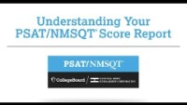
HOW?

Slide 5
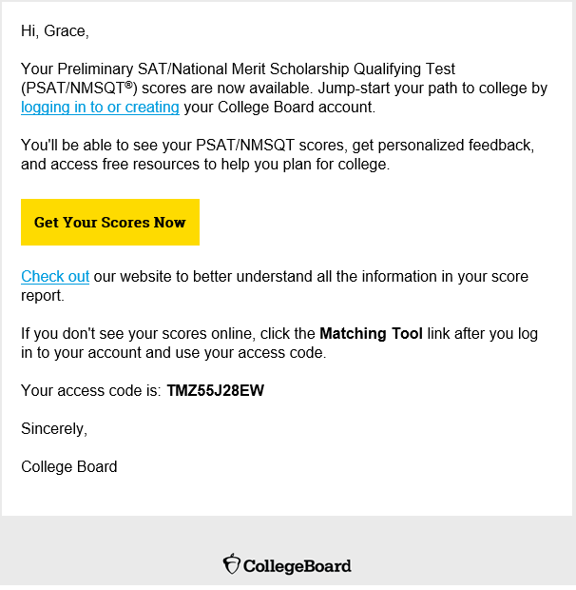
Log in to view score and link to Khan Academy
www.collegeboard.org

Slide 6
Remember . . .
You are not defined by a test!
Standardized tests are just one measure colleges use to determine your readiness
Tests do not define who you are as a person or student
Colleges want well-rounded students, not just great “test takers”
Use the PSAT to help you determine which areas you can study/improve for the SAT

Slide 7






DON’T FORGET:
Counselors are here to help you!
Ms. Garner
Last Names A-B
garners@gcsnc.com
Mrs. Lucas
Last Names C-Ge
lucase@gcsnc.com
Mrs. Gross
Last Names Gi-Ki
grosse@gcsnc.com
Mr. Kaplan
Last Names KL-N
kaplanm@gcsnc.com
Mr. Devonmille
Last Names O-Sm
devonmj@gcsnc.com
Mr. Murphy
Last Names SN-Z
murphya@gcsnc.com

