Slide 1
NGMS Registration 2025-26
MRs. Hunter, School counselor (6th and 7th )
Mrs. Johnson, School counselor (6th and 8th)

Slide 2
NGMS School counseling program
Individual student concerns/sessions
Small group counseling
Classroom counseling
Career exploration
Social/Emotional Support
Parent/Student/Teacher conferences
504 questions
Mental health referral information
Food and school supply assistance
AND MORE…

Slide 3
Ngms counseling department website
NGMS Counseling Department Website

Slide 4
Parent/student registration february 14-23
During this time frame you and your student are able to go in and select your classes for next school year
You are choosing a language arts level and math level
You are selecting encore choices
The portal will close at 5pm on February 23rd

Slide 5
Arts requirement
Beginning in Fall 2022, students entering Grade 6 and subsequently entering Grade 9 for the first time in 2025-26 shall have at least one arts education course in grades 6-12 to meet graduation requirements.

Slide 6
Side note:
Switching Levels
If your student is switching levels (elementary to middle OR middle to high) and you do not live in our district you will have to reapply for reassignment. The reassignment window opens on May 1st at 8am and runs through May 31st at 5pm. If this applies to you, your school counselor will have your student fill out their registration requests on paper.

Slide 7
ELA Levels choose one
Advanced ELA-Level 4 or higher
ELA

Slide 8
Math levels
6th | 7th | 8th
Math 6 Accelerated Math 6 AIMM | Math 7 Accelerated Math 7 Math 1 | Math 8 Math 1 Math II

Slide 9
Where to find more math info:
https://www.gcsnc.com/Page/28021

Slide 10
Online registration Handbook
https://www.gcsnc.com/Page/28797

Slide 11
Encore choices-6th, 7th, and 8th
*All students need 4 points total
^{*Everyone must take PE}
6th 1 Point | 7th 1 Point | 8th 1 Point | All Grades 2 Points
PE Intro to Spanish Art Exploration Exploring Technology Computer Sci Disc I Computer Skills and Appl. | Spanish 1A (HS Credit) PE Art 7 Exploring Eng. And Design Computer Sci Disc II Intro to Office Product | Spanish 1B (HS Credit) PE Art 8 Computer Sci Disc III Exp Business and Entrepr. Exploring Aviation | Chorus Band Orchestra PE Sports Education General Music (Musical Theater)

Slide 12
Counselor/student registration
February 24-March 28
During this time counselors will meet one on one with students to guide them through the registration process and ensure that they have selected the right classes

Slide 13
Course registration timeline
6th | 7th | 8th | Absence Students
February 24th Week | March 3rd Week | March 10th Week | Week of March 17th

Slide 14
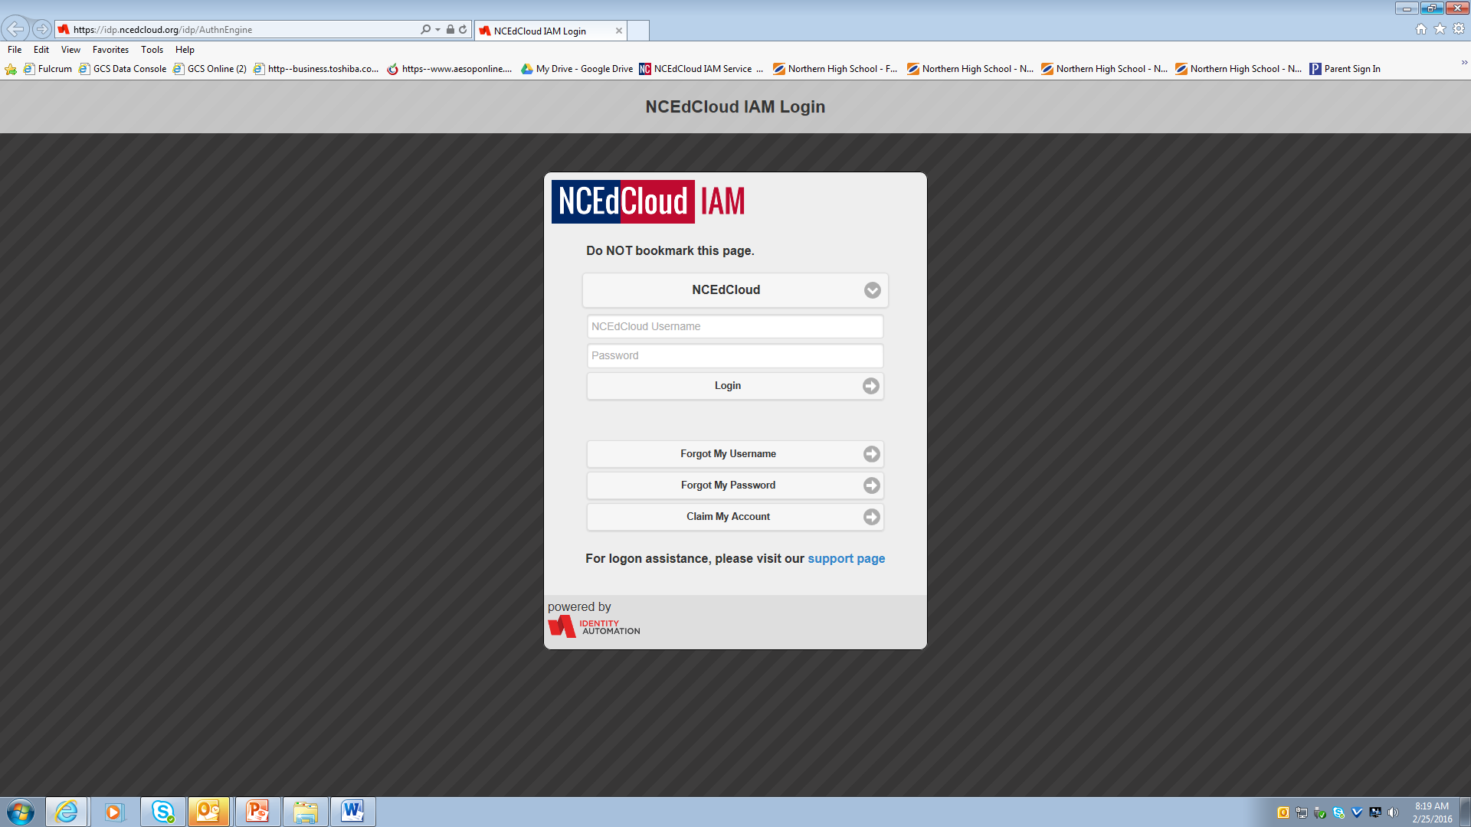
1. Go to my.ncedcloud.org
2. Enter Username & Password
Enter your student ID (lunch #)
Enter your password.

Slide 15
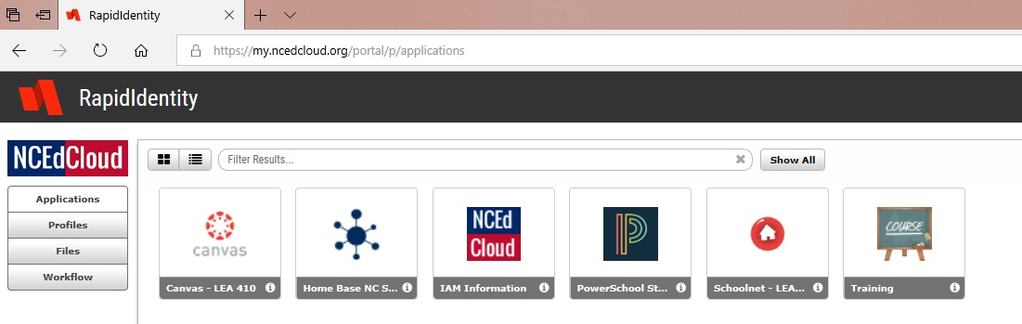
3. Select PowerSchool Student
Click here

Slide 16
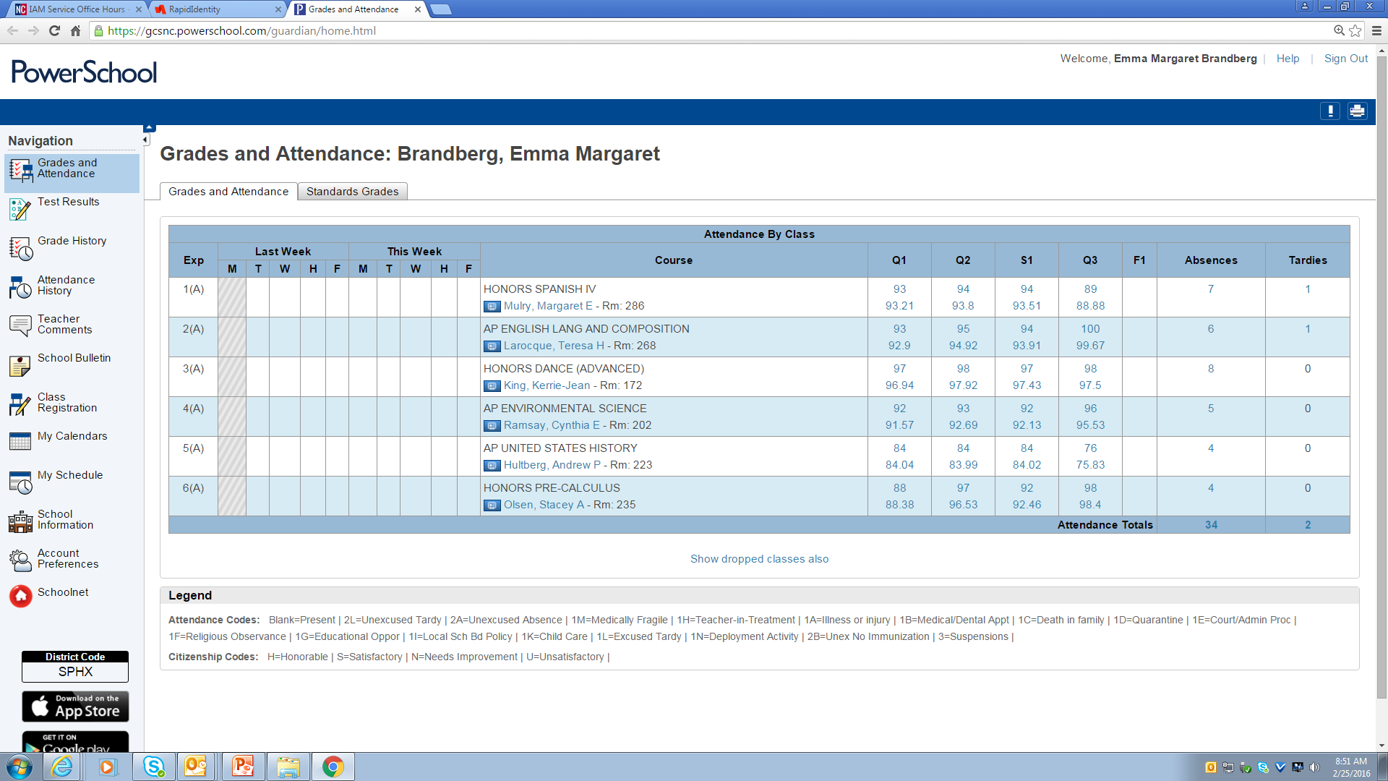
4. Select Class Registration
Select Class Registration

Slide 17
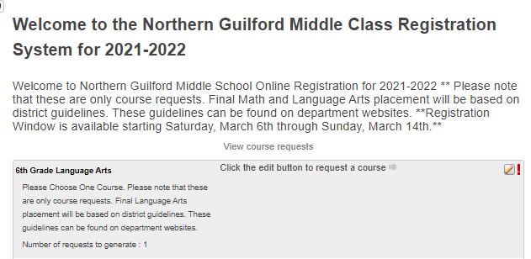
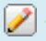
5. Read Instructions at Top of Screen
6. Register for Classes
Click on the pencil
to make your selections.

Slide 18
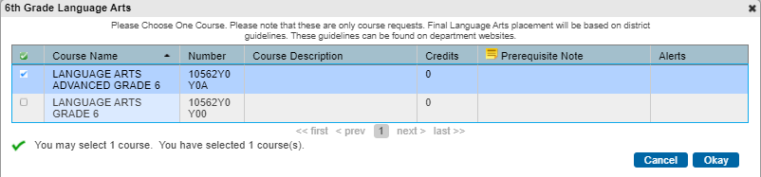
7. Selecting Courses
Select 1 course in each area and click “Okay”.
Each grade level will have choices specific to their grade level.
Some categories will allow for multiple selections.
Please consider your teacher recommendations.

Slide 19
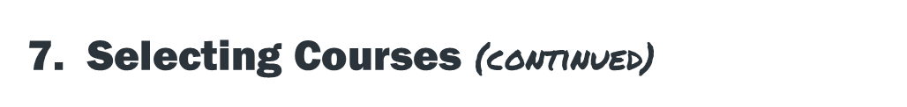
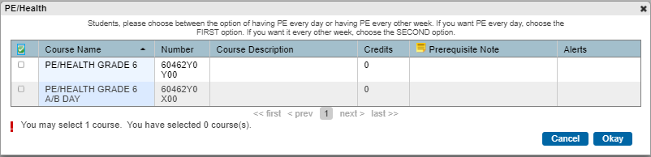
Encore options are spread over three sections. Be sure to read and follow instructions for each course selection.

Slide 20
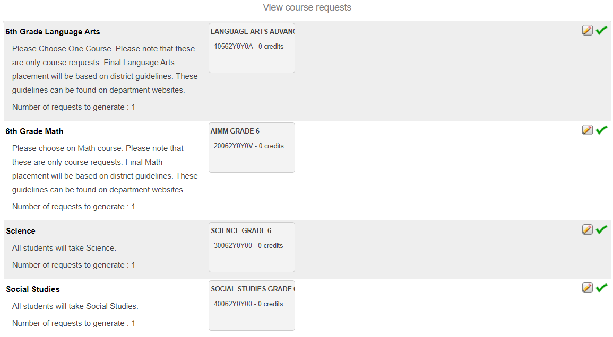
8. Select 4 Core Classes
9. Select 4 points worth of Encores
As you make selections, boxes will appear with the course names.
Make sure you have no !’s on the right hand side.

Slide 21
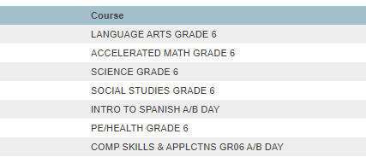
10. Double Check Your Selections
ELA
Math
Science
Social Studies
4 Points Total
When you select “Submit” the above screen will appear.
Double check your work.
  Do you have 4 Core Classes?
  Do you have 4 TOTAL points worth of encore classes? (Refer to the 6th Grade Encore Course Information Sheet)
You may edit these selections until the online registration window closes on Sunday, February 23rd at 5pm.

Slide 22


