Slide 1


Service-Learning in Guilford County Schools Northeast High School Service Learning Coach: Mrs. Hawkins hawkinl2@gcsnc.com

Slide 2

How does service-learning connect to the GCS Strategic Direction?
Prepare Students for the World:
Build 21st-century schools that prepare students to compete in a global economy​
Invest in programs that provide students with the tools to perform 21st-century jobs​
Service-learning is an essential strategy in providing a rigorous and relevant curriculum which will prepare students to succeed in the 21st century. 21st Century Skills and the Connection to Service-Learning, https://dpi.wi.gov/sites/default/files/imce/service-learning/pdf/21cent-intro.pdf
Using the skills and knowledge gained from the core curriculum in carrying out service-learning projects joins the vision for 21st century learning by calling upon students to look deeper, reach higher, and grow as individuals and contributing. 21st Century Skills and the Connection to Service-Learning, https://dpi.wi.gov/sites/default/files/imce/service-learning/pdf/21cent-intro.pdf

Slide 3
Service-Learning Standards for Quality Practice
Meaningful Service
Link to Curriculum
Reflection
Diversity
Youth Voice
Partnerships
Progress Monitoring
Duration & Intensity

Slide 4

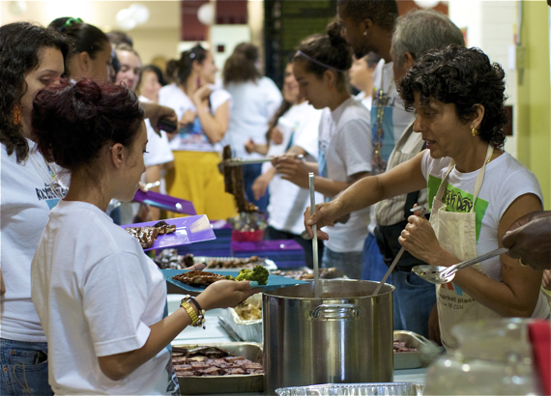



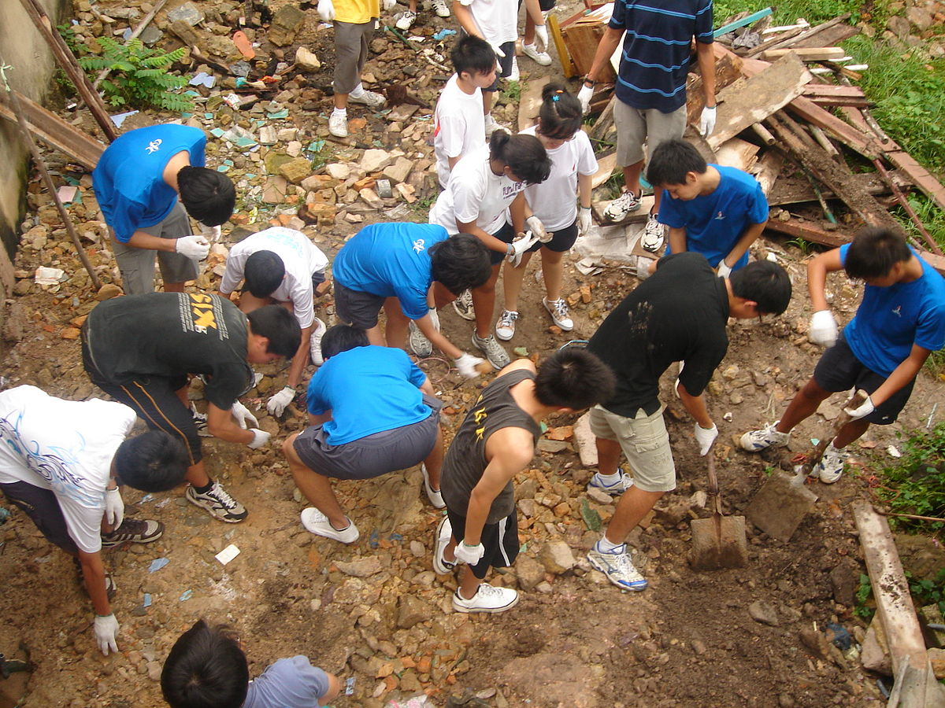
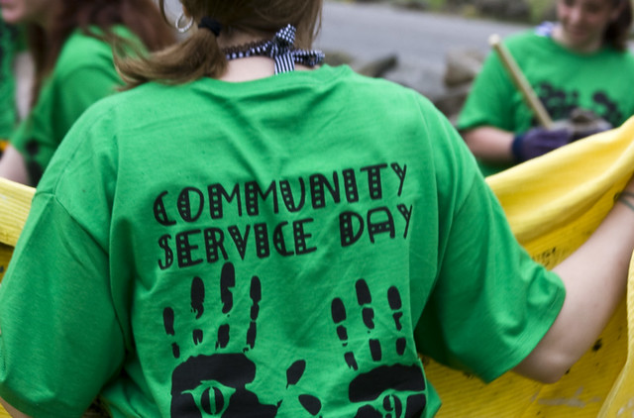
Service-Learning (SL) is a way of teaching and learning that connects the classroom with meaningful community and civic engagement.

Slide 5
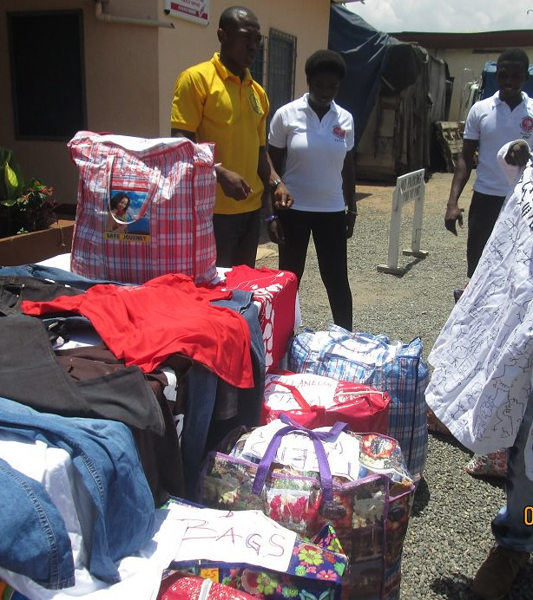
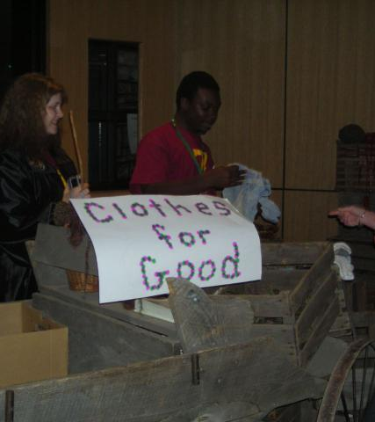
Student Roles for Successful Service-Learning
Investigation
Planning/ Preparation
Action
Reflection
Demonstration

Slide 6
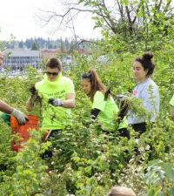
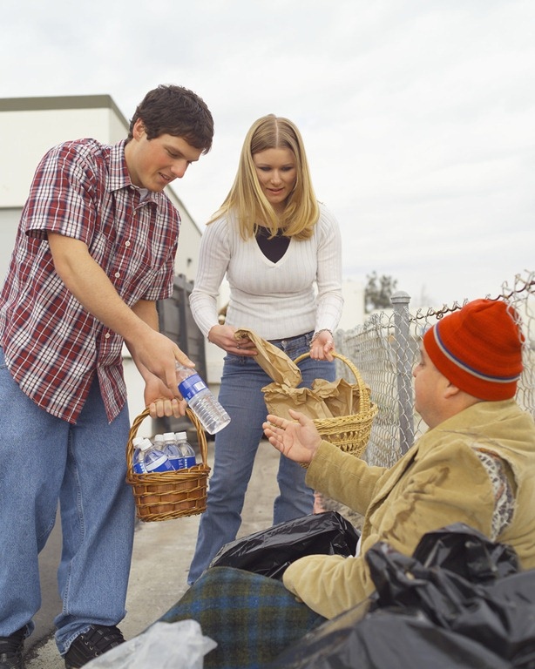

Examples of Types of Service Experiences
Teach
Others
Product
or
Performance
Problem
Solving
Apprentice
Public
Policy
Could the youth teach what he/she is learning to benefit others?
Could the youth craft a product or performance to benefit others?
Could the youth’s learning be applied to solve a real concern in the community?
Could the youth apprentice / volunteer in a local non-profit?
Could the youth research a public policy issue and make recommendations to public officials?
Compass Institute

Slide 7
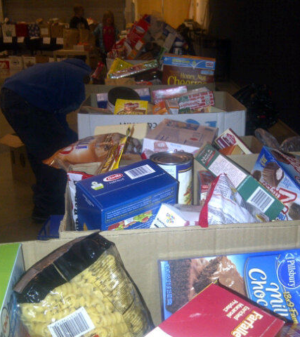
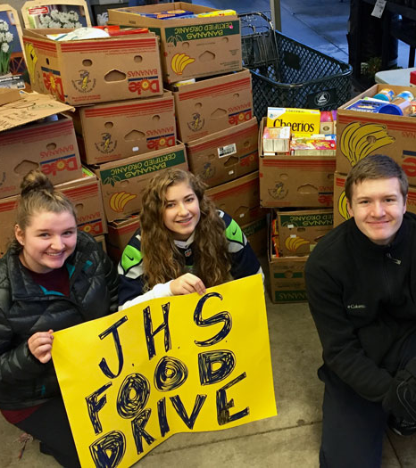
What are the benefits of Service-Learning for Students?
Prepare for a Changing World
Learn the Importance of Collaboration & Teamwork
Develop Critical Thinking Skills and Innovative Ideas
Become Creative Problem Solvers
Develop Global Awareness
Connect with people while developing skills
CHARACTER DEVELOPMENT

Slide 8
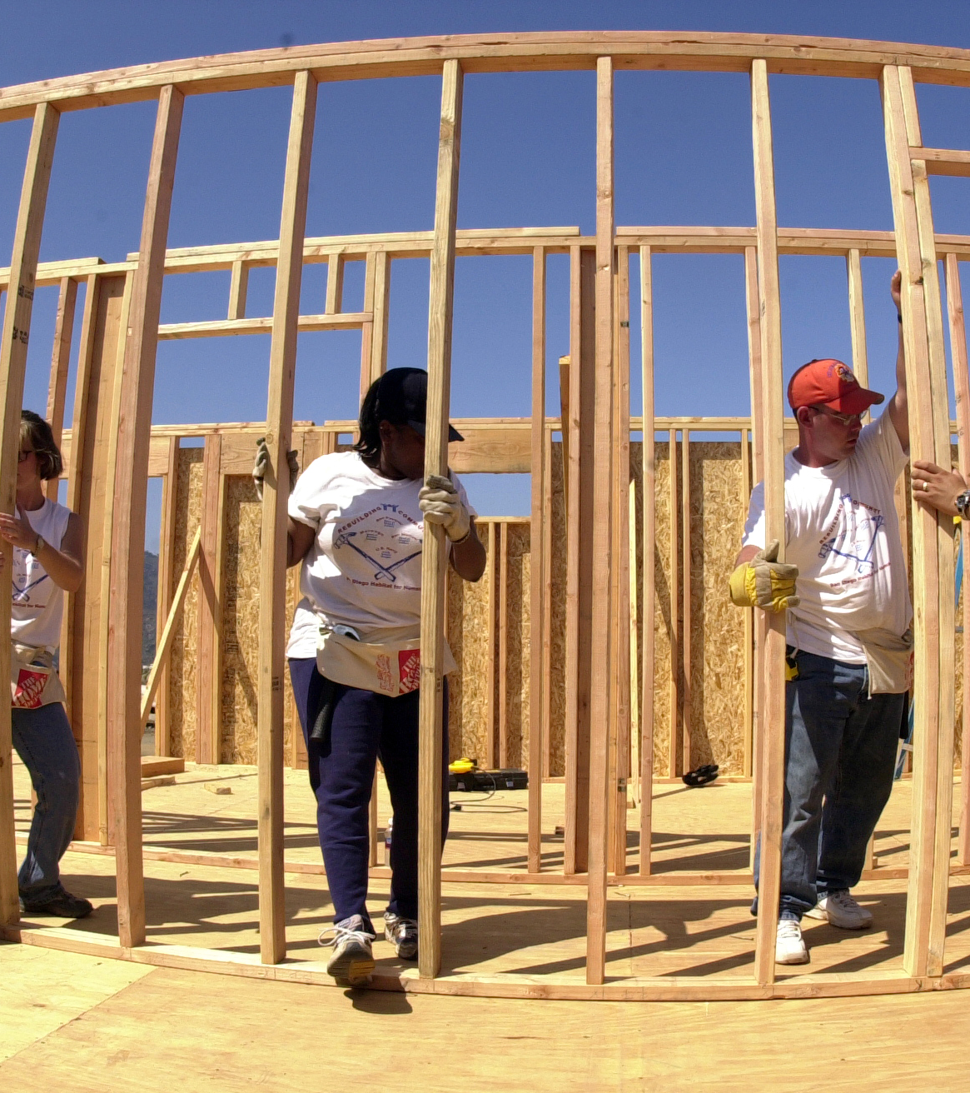
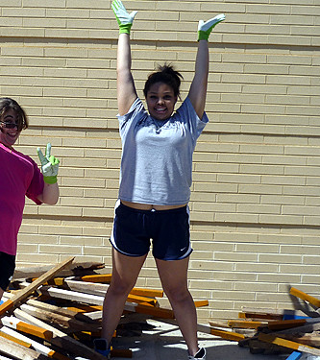
Service-Learning 4-Year Plan
9th Grade | 10th Grade | 11th Grade | 12th Grade
Investigation Year (Learn about SL) | Action Year (Earn Hours) | Action Year (Earn Hours) | Reflection Year (Complete project as determined by the school SL Coach)
*These guidelines do not apply to
OCS/Adaptive Students

Slide 9
Service-Learning Recognitions
Hours needed for SL Honors | Hours needed for SL Exemplary Award | Hours needed for SL Diploma
70-99 | 100-199 | 200+
*These guidelines do not apply to OCS/Adaptive Students

Slide 10
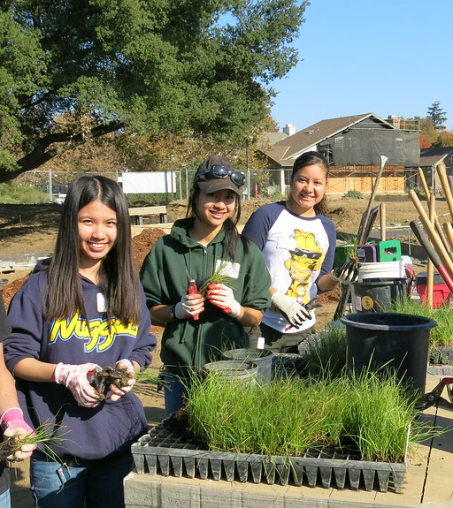
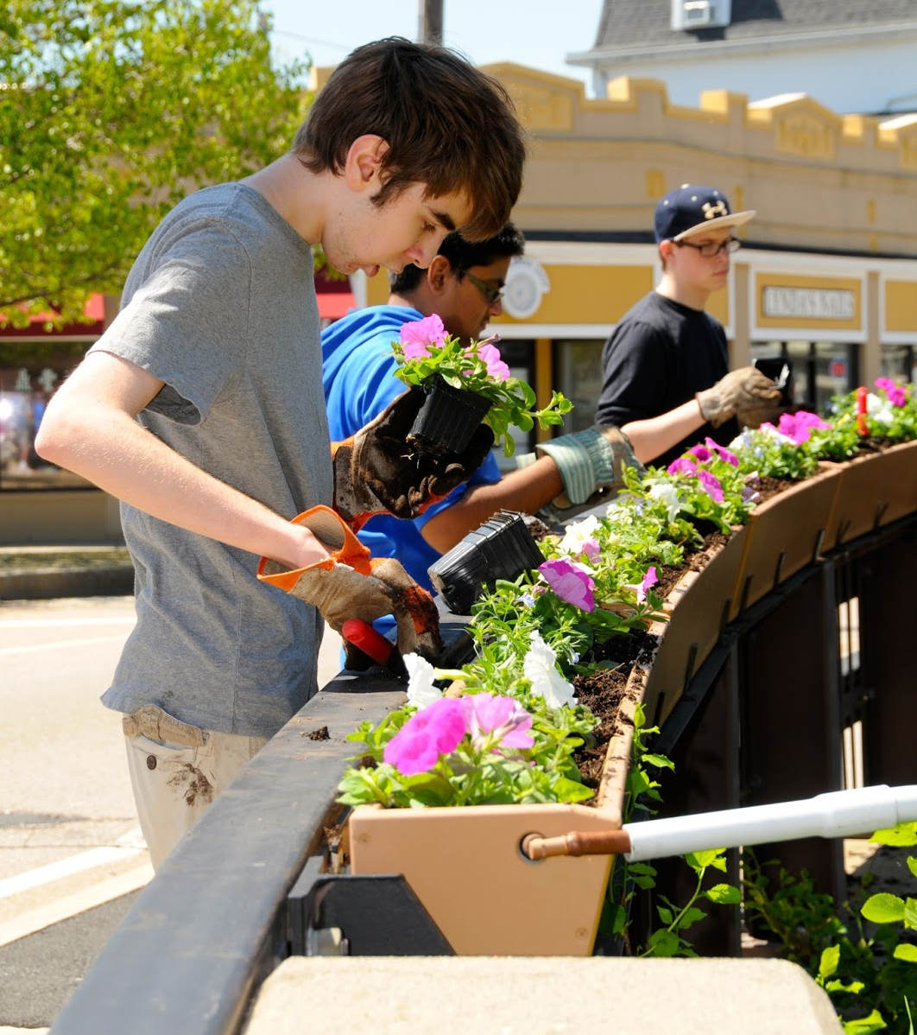
2 Paths…
NEHS based with NEHS teachers
Classes
Clubs
School-wide projects
Documentation – x2vol – Any hours completed through ROTC must be logged into x2vol to count towards an award
Independent Partnerships with Non-Profit Agencies
Planning with Community Partners
Documentation – SL Approval Form & x2vol

Slide 11
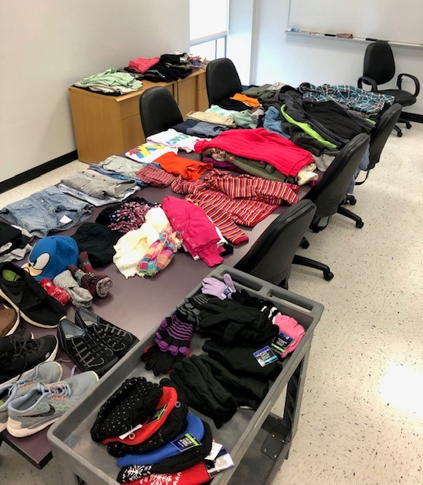
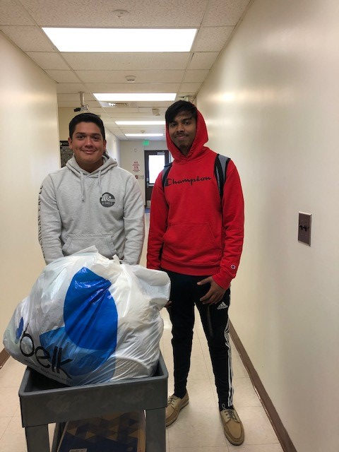
Checklist for an Independent Project with a Non-Profit Agency
Complete the Service-Learning Approval form online
Link can be found on Northeast High School website front page – Quick Links
Receive confirmation of approval of the project
Enter hours in x2vol.com
Service Learning Approval Form: https://forms.office.com/r/NeMZW30tx6

Slide 12
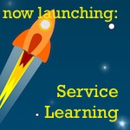
Important Details…
Hours must be submitted within the semester that they are completed. Hours completed from June-December must be entered into x2vol by end of December. Hours completed from January-May must be entered by the end of May.
SL Approval Forms must be submitted within the semester that service is started with the organization and should be submitted prior to beginning service.
Speak with Mrs. Hawkins before completing the SL Approval Form

Slide 13
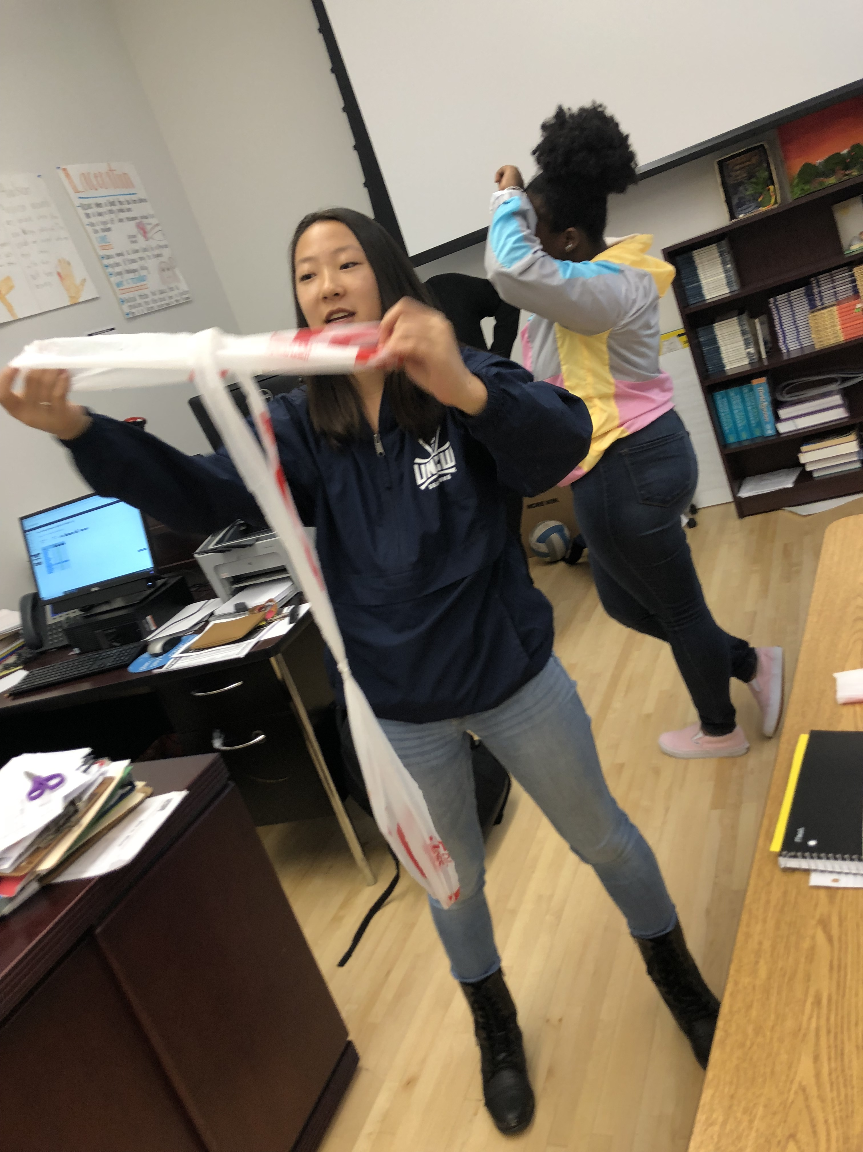
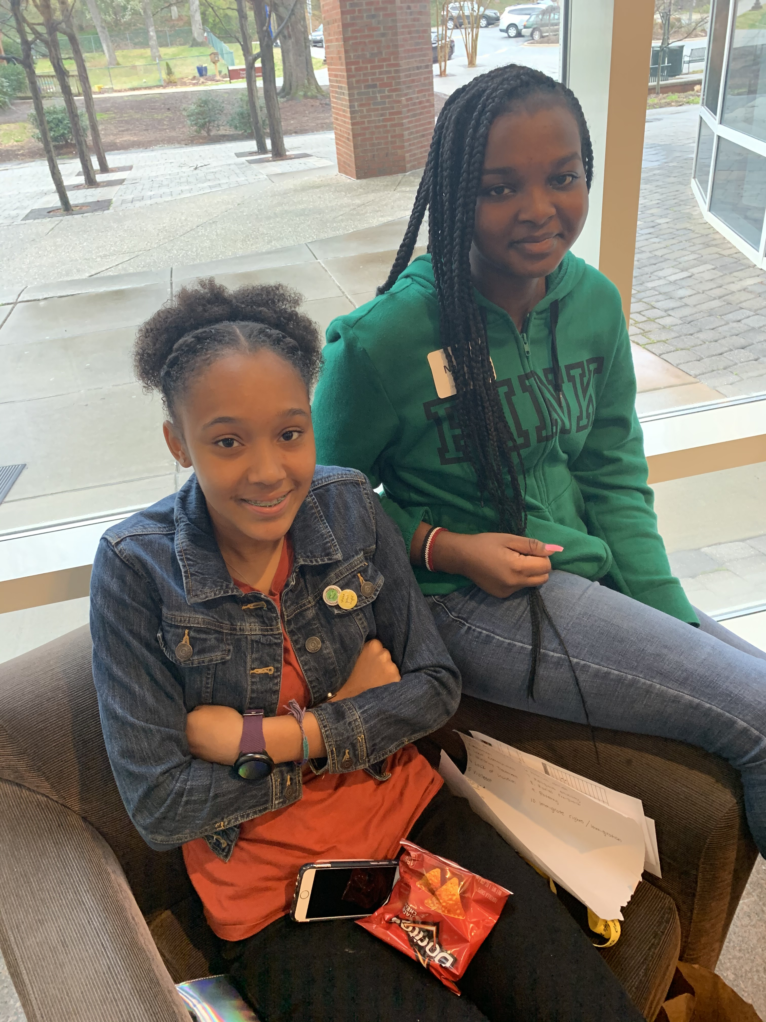
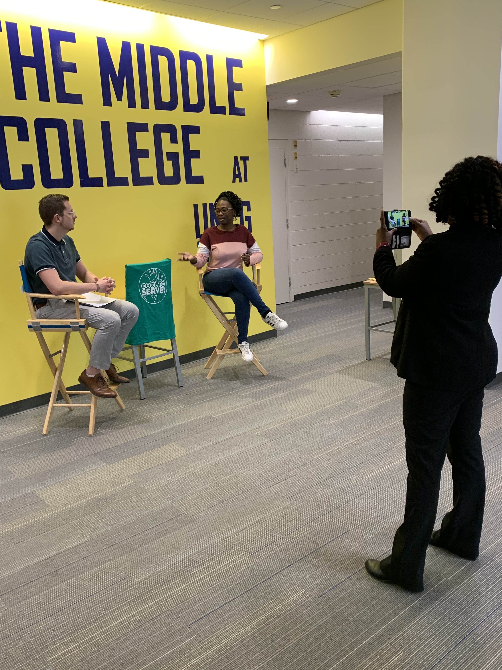
Service-Learning Youth Council

Slide 14
Thank you!!

