Slide 1

Choice Schools –
High School Options
Kiser Middle School
Mrs. Ingram – 8th grade Counselor
Mr. Barnard – Grimsley IB Coordinator
SFC (R) Robinson, D.L. – Grimsley ROTC
October 1, 2024

Slide 2
JROTC at Grimsley
What is JROTC?
What we offer to our students:
JROTC is a military funded program capable of providing you leadership opportunities, life skills, and the team you will grow to love as you navigate through your high school career. Upon completion, you will be well equipped to succeed in your career path of choice.
Academics
Athletics
Drill Team
Color Guard
Marksmanship Team
Raider Team
Leadership Academy
Community Service

Slide 3
JROTC at Grimsley
Why JROTC?
Contact Information & Sign Up:
We are not a recruiting tool for the Armed Forces!!!!
JROTC will be a great addition to your college resume
JROTC will help you get the summer job of your dreams
JROTC will provide the life skills and discipline you’ll need to tackle tough challenges
If the military is in your future, JROTC is for you
If the military is NOT in your future, JROTC is still for you
If living a happy life is in your future, JROTC is really for you
Army Instructor SFC (R) Robinson - robinsd2@gcsnc.com
Students districted to go to Grimsley next year may sign up for JROTC during regular high school enrollment
Students districted to go to a different GCS High School may apply for the program during the Choice School application window

Slide 4


Grimsley High School IB Program

Slide 5
What is IB?
-Founded in 1968 in Geneva, Switzerland
-Over 4000 IB schools worldwide
Mission Statement:
“...to develop inquiring, knowledgeable and caring young people who help to create a better and more peaceful world through intercultural understanding and respect…to encourage students across the world to become active, compassionate and lifelong learners who understand that other people, with their differences, can also be right.”

Slide 6

IB Diploma Program requirements
Six Academic Areas
-Students must take one course from each of the six subject areas (students can choose to forgo the arts and take two courses in another subject area)
-Three courses (no more than four) must be taken at the Higher Level (HL)
-The other courses must be taken at the Standard Level (SL)

Slide 7
IB Diploma Program requirements
Three Core Areas-required for all candidates
-Theory of Knowledge (TOK): A course on the nature of knowledge, to reflect on the process of learning in all their subjects, and to see and understand the connections between them
-Extended Essay: A substantial piece of academic writing of up to 4,000 words, enables students to investigate a topic of special interest that they have chosen themselves
-Creativity, Activity, and Service (CAS): A range of enjoyable and significant student-selected experiences that encourages students to grow both personally and socially, developing skills such as cooperation, problem-solving, conflict resolution and creative and critical thinking,
as well as developing their own identities

Slide 8
What does it look like at Grimsley?
Ninth Grade Year
1 | Honors English I
2 | Math: (Honors) Math II, (Honors) Math III
3 | Honors Civics and Economics, AP US Government & Politics
4 | Honors Biology
5 | World Language: Spanish, French, Latin, ASL (Level 1, 2, or 3 based on placement)
6 | Health and PE
Tenth Grade Year
1 | Honors English II
2 | Math: (Honors) Math III, (Honors) Pre-Calculus, or (Honors) AFM
3 | Honors Economics & Personal Finance*, AP European History
4 | Honors Chemistry
5 | World Language: Spanish, French, Latin, ASL (2, 3, or 4 based on placement)
6 | AP Music Theory (if Music HL track) AP Government AP Human Geography or Honors Elective
7 | Elective: Fine Arts or Honors Environmental Science*
Online Possibilities
Honors Environmental Science
Honors Math (based on student math progression)
*Honors Economics & Personal Finance – summer before/after 10th grade year

Slide 9
Ib courses currently offered at Grimsley
Group 1: Studies in Language and Literature | Group 2: Language Acquisition | Group 3: Individuals and Societies | Group 4: Sciences | Group 5: Mathematics | Group 6: The Arts**
IB English HL (jr. and sr. years) | -IB Spanish SL/HL -IB French SL -IB Latin SL | IB History of Americas SL/HL (jr. and sr. years) -IB Philosophy SL/HL -IB Psychology SL/HL -IB Environmental Systems & Societies SL* | -IB Biology SL/HL -IB Chemistry SL/HL -IB Environmental Systems & Societies SL* | -IB Math Applications SL -IB Mathematics HL | -IB Visual Art SL/HL
**Arts: May be omitted for a second science, language acquisition, or individuals and society
* Interdisciplinary-counts for one

Slide 10
Grimsley IB Students
-Diverse
-World Travelers—many study abroad
-Attend universities in North Carolina, out of state (including Ivy League universities), and out of the country
-Some of the current colleges: Duke, Brown, Yale, NYU, UVA, Emory University, Lehigh University, NC A&T, UNC-CH, NC State, Wake Forest, Davidson College, Temple University
-Have received the Morehead Scholarship, the Robertson Scholarship, the BN Duke Scholarship, the Park Scholarship, the Jefferson Scholarship, and many others
-Are involved in their communities and campuses
-Are varsity, junior varsity, and club athletes
-Participate in the visual and performing arts on their campuses
-Participate in student government
-Receive global internships

Slide 11

2024 IB Diploma CEremony
Is not just a Diploma Ceremony.
It is a chance to hear where our class of 2024 went to school and what they are doing.
It is a chance to celebrate all the hard work that our current IB Diploma Candidates have undertaken and all that they have accomplished.
IB Seniors will receive their IB Honor Cords for graduation.
IB Juniors will receive their IB Pins as official IB Diploma Candidates.
Monday, December 16, 2024 6-7:30 PM

Slide 12
2024 Tuesday Tours
Oct. 22nd 11 AM & 2:30 PM
Oct. 29th 11 AM & 2:30 PM
Nov. 12th 11 AM & 2:30 PM
Please email Mr. Barnard to reserve a spot – barnarr@gcsnc.com

Slide 13
IB Open House
Thursday, October 24th in the Grimsley Media Center
6-7 PM

Slide 14
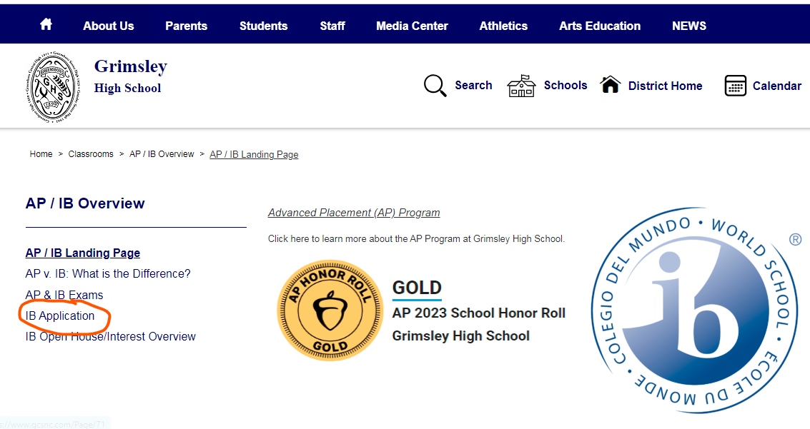

Application

Slide 15
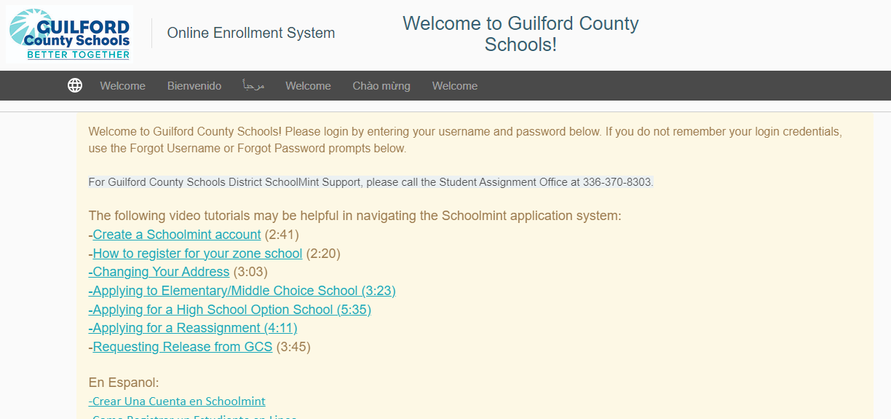
School mint

Slide 16
Questions? BARNArR@gcsnc.com southes2@gcsnc.com
Thanks for your time!

Slide 17

Important Dates
Application Period: October 9 – November 22
Choice Schools Showcase: October 16 at Coliseum
Tuesday Tours: Oct. 22 & 29, Nov. 12
Grimsley IB Open House: Oct. 24 from 6-7pm
Interviews/Auditions (select schools): TBA
Acceptance notification: January 31 (by email or text)
Parent/Student Accept or Decline: February 7
^{Future Events:}
TBA – Rising 9th Grade Parent Night
^{TBA – Career Development Plans}
^{TBA – Grimsley Tours}

Slide 18
Information Needed for Application
Mobile/cell phone number and/or email address
Home address
GCS Student ID number (same as student’s lunch number)
PowerSchool Student ID number if student is currently enrolled in a charter school
Current school name
School assignment by attendance zone for next school year (use the School Assignment Locator if unsure)
For some schools/programs:
  Recommendations from teachers – students will need the name and email address for 2/3 teachers
  Emails will be sent directly to teachers/recommendation will link directly back to the student’s application
  Parent/guardian education level and household income may be needed
Students not currently enrolled in GCS may be asked to provide additional documentation.

Slide 19
Application Process
Step 1
visit https://gcsnc.schoolmint.net/
Step 2
Create a ONE family account for all children
Step 3
Choose up to 5 programs based on your attendance zone
Step 4
Complete background information, add recommender name/email, answer questions/essays
Step 5
Submit Applications (changes can’t be made after submission)

Slide 20
Frequently Asked Questions
Why do I need to rank my choices?
  You should rank up to 5 choices from 1st choice/preference to last. Rank order does not impact your chances of getting an offer but it does impact whether you remain on a waitlist. If you accept an offer, you will remain on the waitlist for any school ranked higher than the school where you accepted the offer, but you will be removed from the waitlist for any school ranked lower.
Can I apply to any school?
  For IB, JROTC, Performing Arts programs – based on address/feeder pattern
  For Middle & Early Colleges & Specialty Academies – all Guilford County residents may apply
Do parents pay tuition for High School Options programs?
  No, tuition is charged for parents who live in Guilford County
Is transportation provided?
  GCS will make a reasonable effort to provide transportation for high school option students who are county residents and within proper feeder zones.

Slide 21
High School Option Programs
Early College at Guilford & STEM Early College at A&T – require at least Math 1 in 8th grade
Middle College at UNCG (focus on Health Careers)
Middle College at GTCC (Jamestown, Greensboro, High Point)
Middle College at A&T (all male)
Weaver Academy (Greensboro) & Penn Griffin (High Point) – Performing Arts
Advanced Placement Academy at Western Guilford
IB Program (Grimsley, Page, Smith, High Point Central)
JROTC (Grimsley, Page, Smith, High Point Central, Northeast, Southeast, Ragsdale, Dudley, Smith)

Slide 22
High School Option Programs
Greensboro College Middle College (11th & 12th grade only)
Aviation Academy at Andrews High School
Southern High Academy of Education and Advanced Sciences
Dudley Academy of Engineering, Education and Health Sciences
Smith High Academy of Advanced Manufacturing and Engineering
The Academy at Smith Academy of Biomedical Technology and Specialized Health Sciences
Western High Academy of Transportation, Distribution and Logistics
Northeast High Academy of Computer and Information Science
The Andrews Early College Academy of Health Science

Slide 23

Weaver Academy Performing/Visual Arts
Dance
Theater
Visual Arts
Guitar
Piano
Strings
Vocal Music
Recording Engineering (Music Production)
*Apply during the application period, Weaver will contact students for auditions/portfolios, etc.

Slide 24

Weaver Academy – CTE
  Adobe Academy & Media Production
  Apparel Production & Fashion Merchandising
  Architecture & Computer-Aided Design and Drafting (CADD)
  Automotive Services
  Collision Repair
  Construction Technology
  Culinary Arts and Hospitality
  Diesel Technology
  Electronics
  Health Sciences
  Heating, Ventilation, and Air Conditioning (HVAC)
  Information Technology
  Metals Manufacturing
  Project Management
  *Students will enroll in these courses during traditional high school registration not during application period.
This Photo by Unknown Author is licensed under CC BY-NC-ND

Slide 25
For More Information
Magnet and Choice Schools / Applying to a School/Program (gcsnc.com)
Magnet and Choice Schools / GCS Magnet/Choice Schools by Theme (gcsnc.com)

Slide 26

Join the 8th Grade Remind App
Send a text to: 81010
Cantrell’s Team Text: @bhdkc3
Whiteheart’s Team Text: @a674b29
Myers’s Team Text: @727ga26
Zegarra’s Team (Spanish Imm.) Text: @h9gg64
*Receive important updates for: high school registration, parent meetings, course selection, tours, career development plans & end of the year celebrations

Slide 27

Any questions please email 8th grade counselor Mrs. Ingram at ingramk2@gcsnc.com

