Slide 1
Kiser Middle School
Rising 6th Grade Parent Night
Presenters:
Mrs. Conaway & Ms. Holmes - Principal/Asst. Principal
Ms. Russell – 6th grade Math
Mr. Edd-Wyckoff – 6th grade ELA
Mr. Perry/Mr.Sandeen – 6th grade Science
Mr. Henzler – 6th grade SS
Ms. White – Band
Ms. Greene-Stimpson – Orchestra
Ms. Ingram – 8th Grade Counselor
Ms. Moore – American Sign Language
Mr. Alvarez – Spanish Immersion
(available after presentation for questions)

Slide 2
Kiser Updates
Kiser students will be transitioning to the new building in 2025 (date to be announced)!

Slide 3
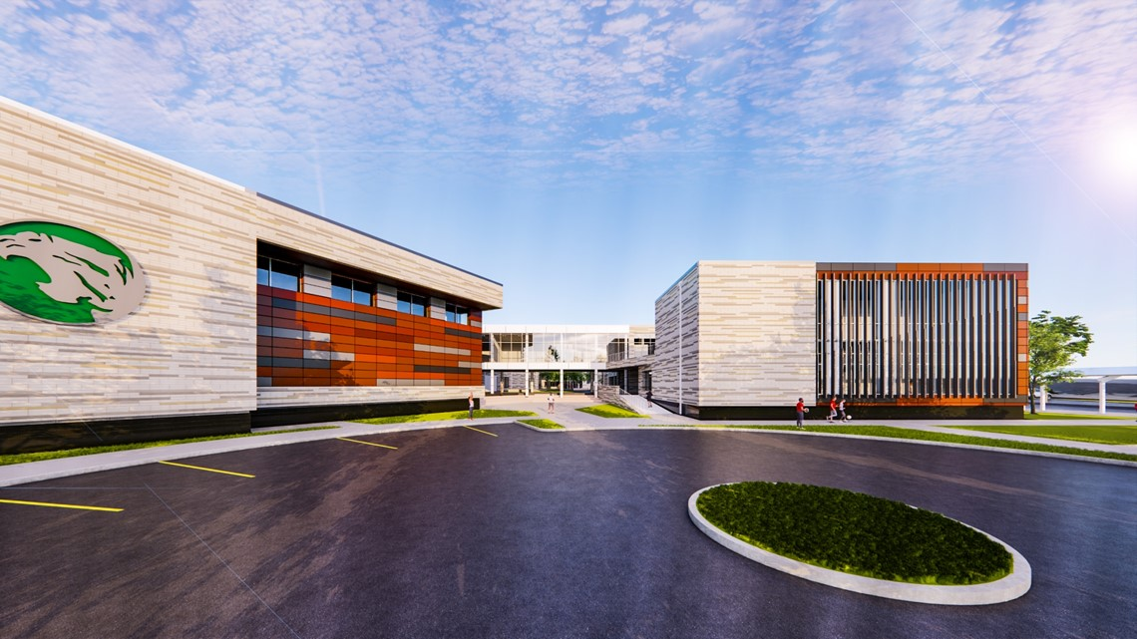

Slide 4
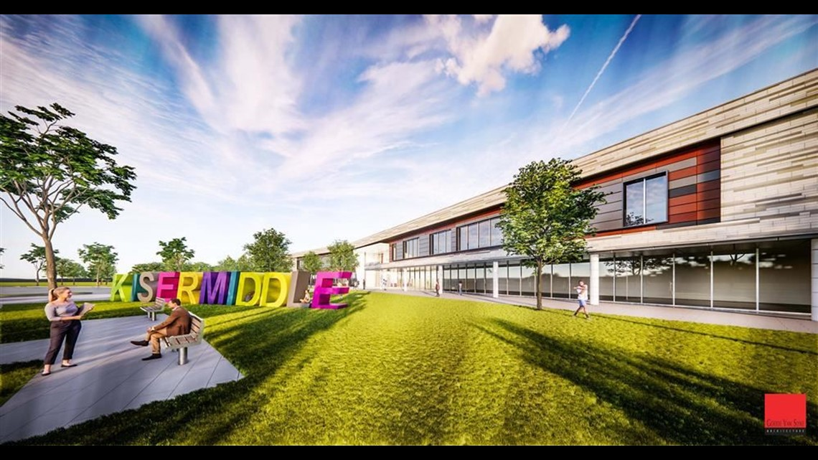

Slide 5
Planning for Success in Middle School Math
Be organized
Use a planner and write down your assignments
Establish a homework routine
Complete and turn in assignments on time
Check PowerSchool and Canvas daily
Work on fluency with times tables

Slide 6


Mathematics
  Ratio and proportional reasoning
  Division of fractions
  Number sense including rational and negative numbers
  Writing, interpreting, and evaluating expressions and equations
  Developing an understanding of statistical thinking
  Measuring geometrical shapes by finding area, surface area, and volume

Slide 7

English Language Arts
(ELA)
  Unit 1: Literacy Launch – Goal: to get excited about reading and learn the different types of genres
  Unit 2: Informational – Goal: focus on non-fiction text structures, connotation and denotation of words all while focusing on space
  Unit 3: Adventure – Goal: read a novel as a class and dive into the elements of plot and how they progress a story forward
  Unit 4: Argumentative – Goal: learn the difference between statements and claims; use that knowledge to debate in class
  *All year focus on the etymology of words by
  looking at Greek and Latin word parts

Slide 8

Science
Unit 1: PS.6.1 Matter & Its Interactions
Unit 2: PS.6.2 Energy
Unit 3: PS.6.3 Waves & Their Interactions
Unit 4: ESS.6.2 Earth’s Systems
Unit 5: ESS.6.1 Earth’s Place in the Universe
Unit 6: LS.6.1 Structures & Processes
Unit 7: LS.6.2 Ecosystems
Unit 8: ESS.6.3 Earth & Human Activity
PS = Physical Science
ESS = Earth and Space Science
LS = Life Science

Slide 9

Social Studies
Unit 1: Early Humans
Unit 2 : Mesopotamia
Unit 3: Ancient Egypt
Unit 4: Ancient India
Unit 5: Ancient China
Unit 6: Ancient Greece & Rome
Unit 7: Islam & Islamic Empires
Unit 8: Middle Ages (Europe & Japan)
Unit 9: Mesoamerica (Maya, Aztec & Inca)

Slide 10

General Information
Hours: Arrival 8:00am – Dismissal 3:20pm
Laptops will be distributed to all students
Cell phones may be brought to school but must be kept off and put away
*Information is subject to change

Slide 11
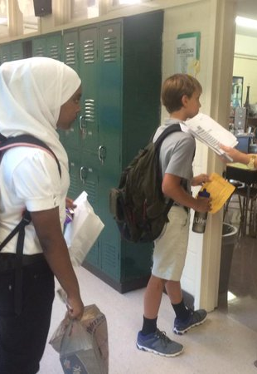
Daily Schedule
4 cores
  English
  Math
  Science
  Social Studies
2 Encores
*Spanish Immersion students will take an additional Language class – this is not considered an encore

Slide 12

Core Classes
4 core subjects each day
  3 Math levels
    Math 6
    Accelerated Math 6
    Accelerated Integrated Middle Math (AIMM)
  2 ELA levels
    Language Arts
    Advanced Language Arts
Social Studies & Science classes are not leveled

Slide 13
Important Dates
February 11, 12, 13 – Counselors will visit (during school day) – Jones, Gillespie, Sternberger, Lindley, Morehead, General Greene
February 14-23 – Online Registration Window

Slide 14

Registration Window February 14-23
Parent letters, Registration Directions & a list of Encore Classes will be sent home by your student’s Elementary Counselors the week of February 3rd
Students will make their Class Requests online through their PowerSchool Account
Students will select Math and ELA classes as well as Encore (“specials”)
Final Math and ELA placement will be determined over the summer based on available data and county recommendations
Please note that Encore Requests are NOT guaranteed, they are based on enrollment and capacity.

Slide 15
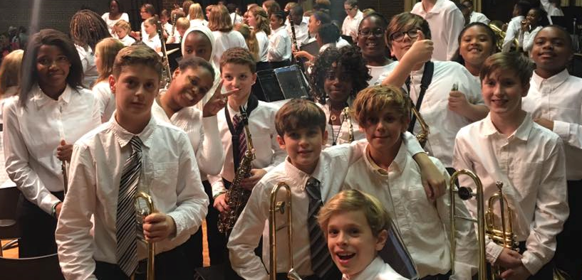
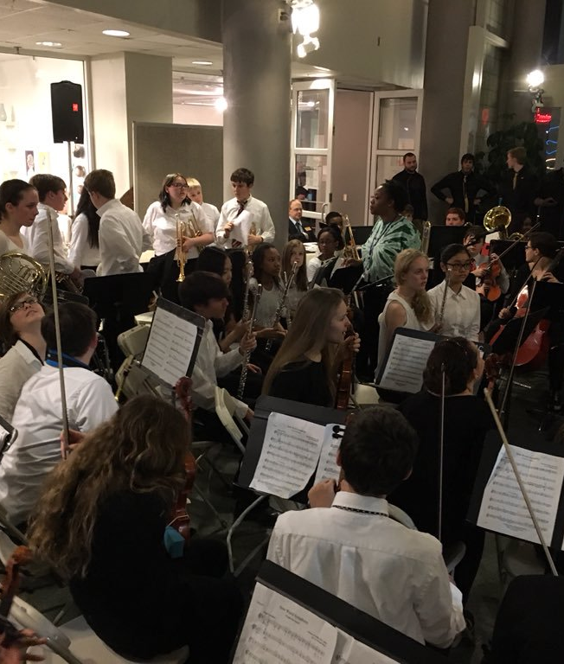
Band or Orchestra
(Everyday)
Students with strong interest
Must start in
6th grade
No prior experience required
Instruction on fundamentals
Group and individualized instruction
Performances throughout the year
Parents are encouraged to secure instruments

Slide 16



A/B Encores
Arts
  Traditional Art
  Digital Art
  Theater
  Chorus
Career Technical
  Computer Science 1
  Computer Skills
  Exploring Nutrition & Wellness
  Exploring Technology
  Exploring Careers & Employment
World Language
  Intro to American Sign Language

Slide 17




New Arts Graduation Requirement
Beginning in fall 2022, students entering Grade 6 shall have arts education course in grades 6-12 – students must pass the course
(includes Art, Digital Art, Theater, Chorus, Band, Orchestra)
*Arts course needs to be completed through standard course of study - after school activities or partial courses do not fulfill this graduation requirement.
* Total number of credits required to graduate is not changing.

Slide 18
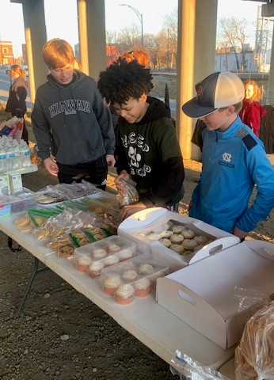
Sports & Clubs
Sports Offered:
Basketball, Track, Wrestling, Soccer, Volleyball, Softball, Baseball, Football
Physical forms - prior to tryouts
Grades/attendance from previous quarter are considered
Clubs offered:
Chess, Yearbook, Eco Wise, SGA, BOB, Kiser Kingdom, Tigers Undivided, Girls Who Game, Creative Writing, American Sign Language, KMS Robotigers, Sewing
*Please note: Students can not try out for football until summer before 7th grade.

Slide 19

Communication
Join PTA!
Sign Up for Powerschool Parent Portal
  See grades, missing assignments, etc.
Follow us on Social Media
  Facebook & Instagram
Weekly Parent E-mail/Voicemails
  General Updates on schedules, events, clubs, sports, etc.

Slide 20

Reminders
Available this summer
  Medical Release forms – nurse will send at EOY
  Students are encouraged to get their sports physicals done in the summer – all sports forms must be uploaded and completed on Dragonfly prior to try-outs
  Bus requests
    Must fill out one every year
    Due by July 1st to ensure bus for first day of school

Slide 21
Important Contacts
Principal Mrs. Conaway - conawam@gcsnc.com
6th gr. Asst. Principal - holmess@gcsnc.com
6th gr. Counselor – Ms. Stewart - stewars5@gcsnc.com
504 Coordinator – Ms. Drew - drewa@gcsnc.com
AG Coordinator – Ms. Ingram - ingramk2@gcsnc.com
Data Manager – Ms. Milian - miliann@gcsnc.com

Slide 22


